Slide 1
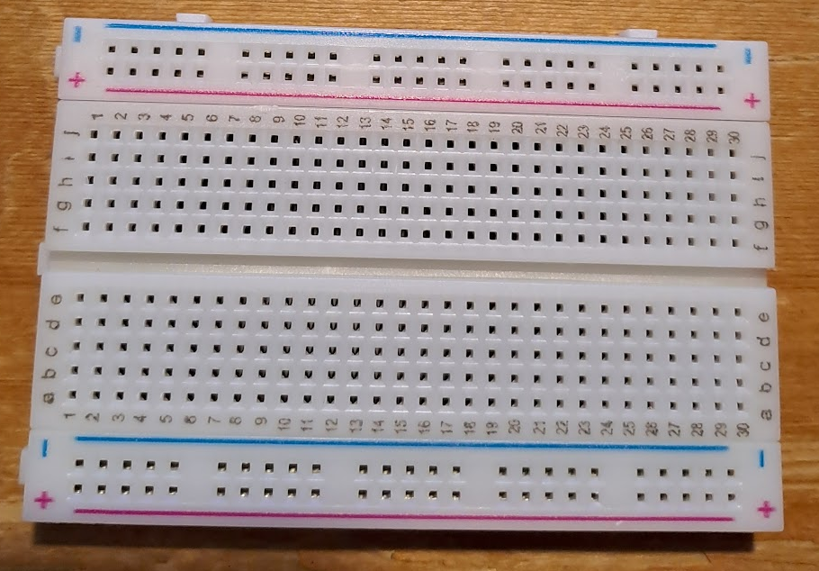
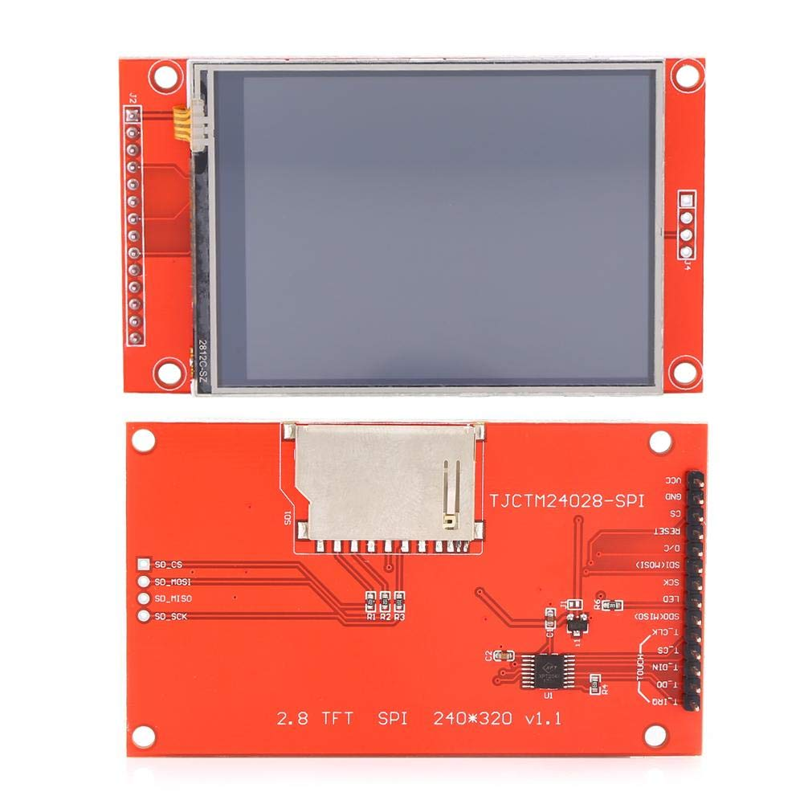
P10
P9
P8
P7
P6
P5
P4
P3
P2
P1
14
13
12
11
10
9
8
7
6
5
4
3
2
1
P10 GPIO17 | P9 GPIO7 | P8 GPIO9 | P7 GPIO11 | P6 GPIO10 | P5 GPIO25 | P4 GPIO24 | P3 GPIO8 | P2 GND | P1 3.3V
14 T_IRQ | 13 T_DO (MISO) | 12 T_DIN (MOSI) | 11 T_CS | 10 T_CLK | 9 SDO (MISO) | 8 LED | 7 SCK | 6 SDI (MOSI) | 5 D/C | 4 RESET | 3 CS | 2 GND | 1 VCC

