Slide 1

Prediction of Bitcoin Bull and Bear Markets
Corbin Sparks

Slide 2
Context
In the early 2010’s cryptocurrencies were essentially non-existent in the public eye. By 2021, 13% of Americans have traded crypto within the last 12 months in comparison to the 24% of Americans who have invested in stocks. It is one of the fastest growing markets worldwide.
The goal of this project is to try to predict bitcoin markets using public source trend data and proprietary data, property of Coindera.
Success of the project will be determined by whether the predictive model will be able to make more money than if one was just to buy Bitcoin and then hold.

Slide 3
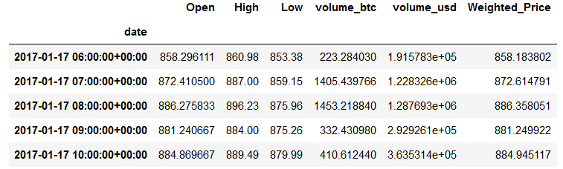
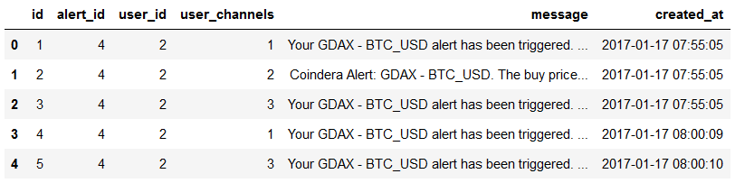
Raw Data
Bitcoin Market data
Messaging data

Slide 4
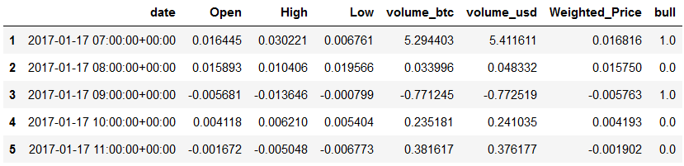
Bitcoin Market Data Wrangling
The data was normalized by changing it to percentage increase or decrease from previous unit of time.
An identifier of upcoming market trend was added (see bull column).

Slide 5
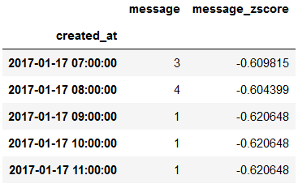
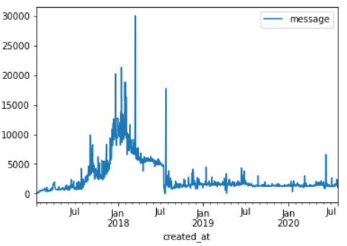
Message Data Wrangling
Notes were counted per unit of time (in the example on the right, per hour) and then the Z score for each unit was calculated in order to normalize.

Slide 6
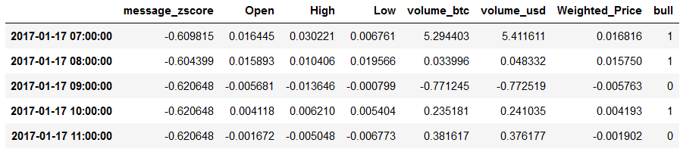
Model Features
We built 4 simple models: The models were divided on hourly market analysis vs daily market analysis and simple model vs base model. The base model did not have the Z score feature, while the simple model did.

Slide 7
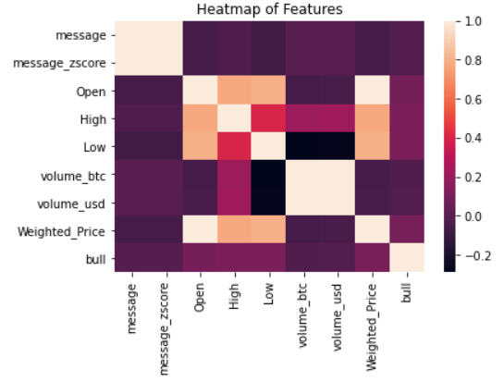
Heatmap
Unfortunately, there does not seem to be a strong correlation between any one feature and a predicted bull market.

Slide 8
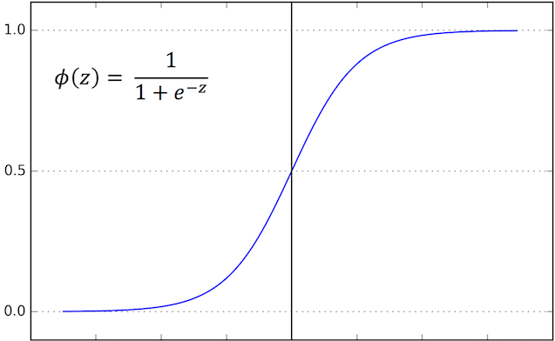
Logistic Regression
This model was chosen purely for its simplicity in analysis and reading. In the future, we can use neural networks and the DART package of Python.

Slide 9
Metrics
Accuracy:
Base model hourly: 0.5585 Simple model hourly: 0.5555
Base model daily: 0.5752 Simple model daily: 0.5868
Specificity:
Base model hourly: 0.2188 Simple model hourly: 0.1983
Base model daily: 0.2362 Simple model daily: 0.2519
Sensitivity:
Base model hourly: 0.8595 Simple model hourly: 0.8849
Base model daily: 0.9015 Simple model daily: 0.9090

Slide 10
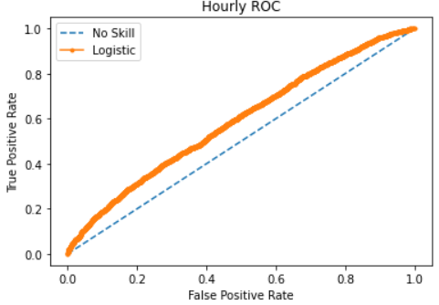
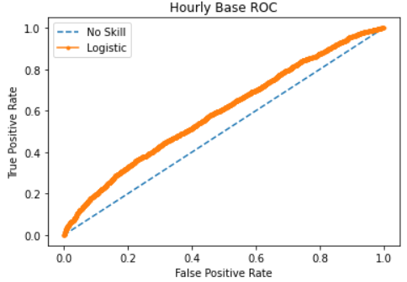
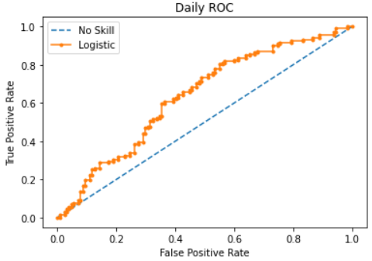
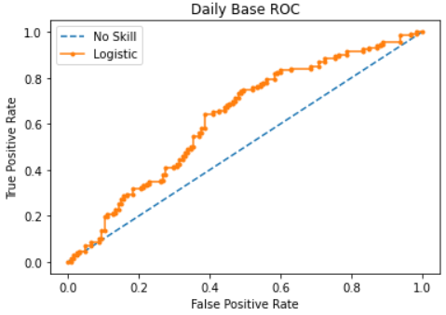
Receiver Operating Characteristic
The area under the curve: 0.591, 0.593, 0.637, 0.629 (from top left to bottom right)

Slide 11

Outcome
Simple messaging data cannot be used to meaningfully predict Bitcoin markets using logistic regression without significant feature enhancement.

Slide 12

Future Directions
Use different predictive model.
Add Bollinger bands as possible feature.
Explore note content for possible feature expansion.
Increase sample size to increase accuracy.

