Slide 1
CJL_citibike1
File created on: 3/23/2019 11:58:15 PM

Slide 2
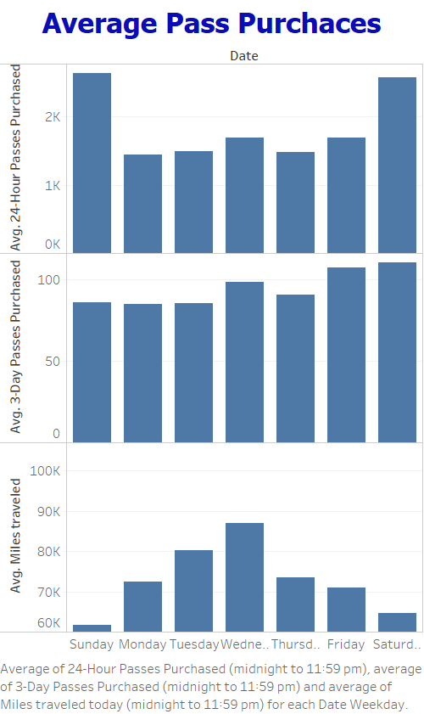

Slide 3
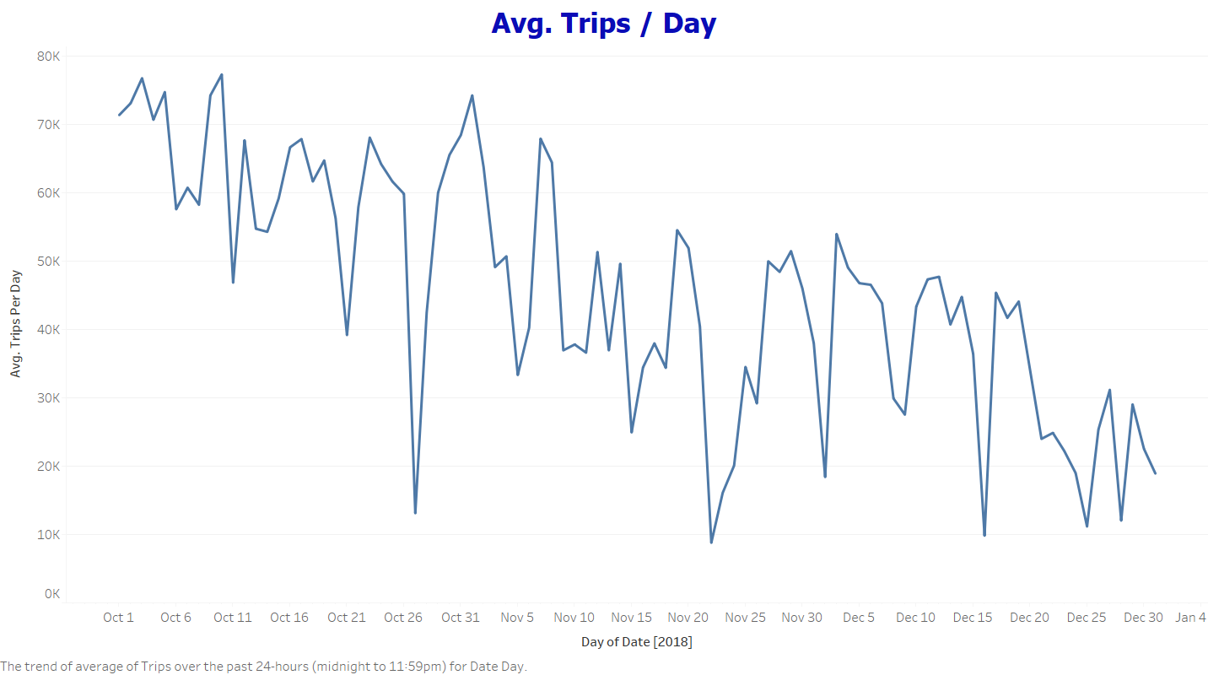

Slide 4
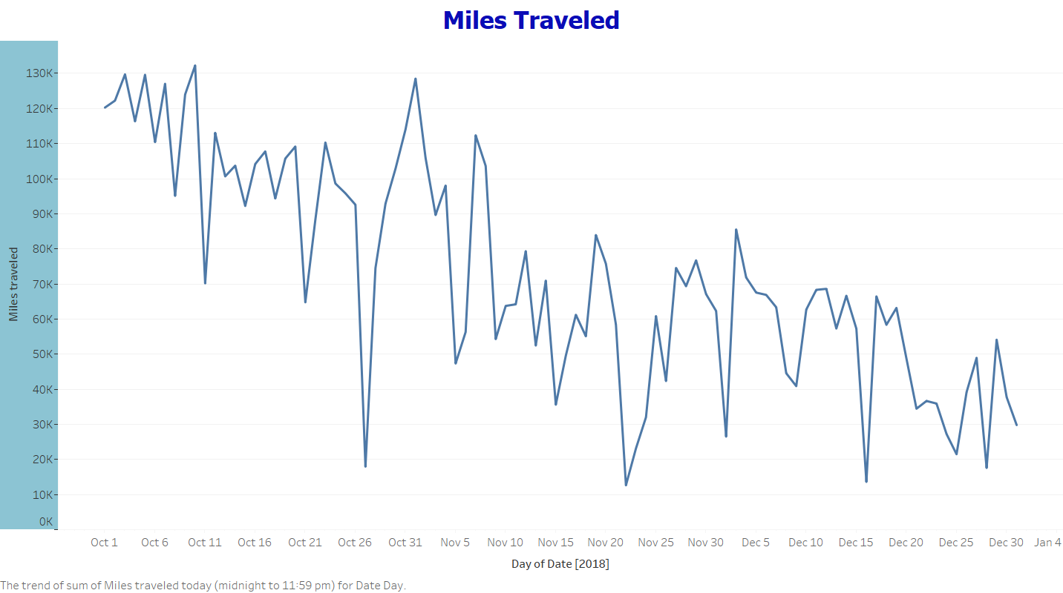

Slide 5
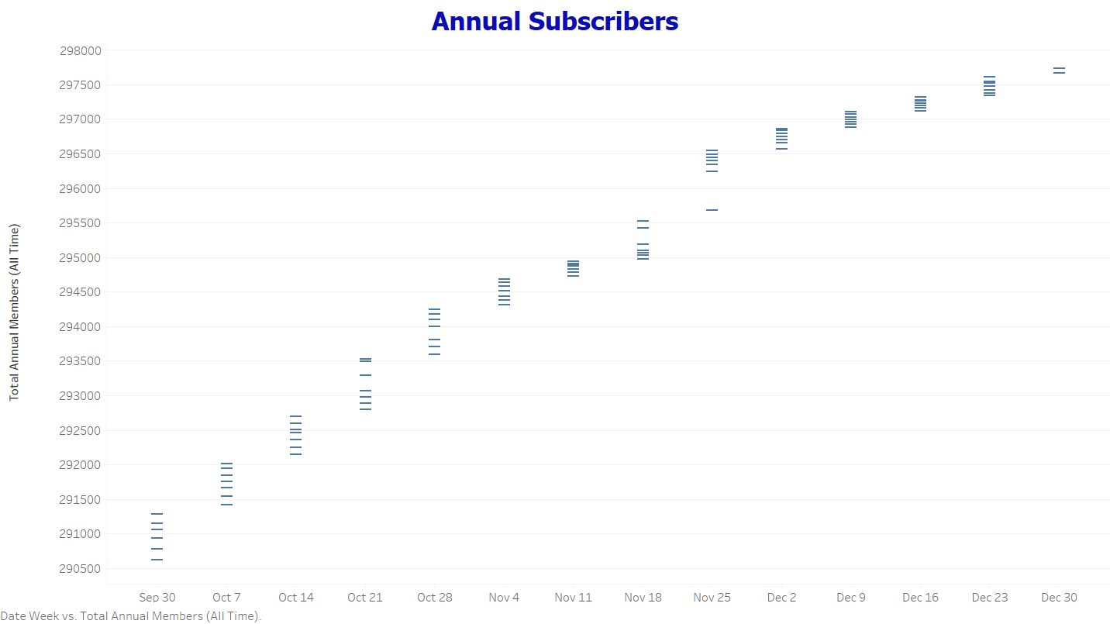

Slide 6
