Slide 1
Book1
File created on: 4/8/19 8:26:16 PM EDT

Slide 2
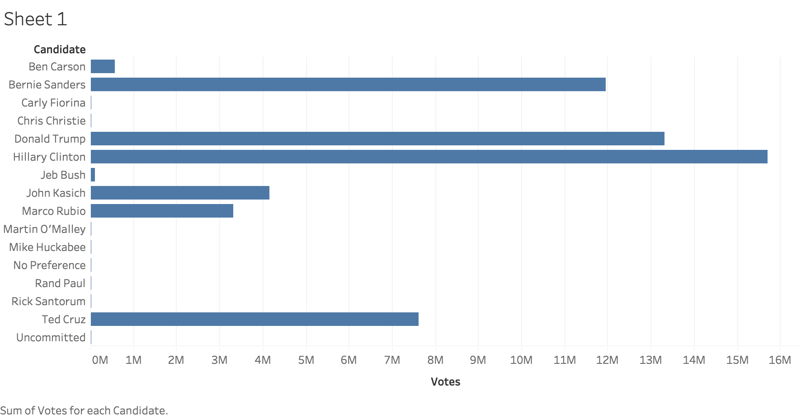

Slide 3
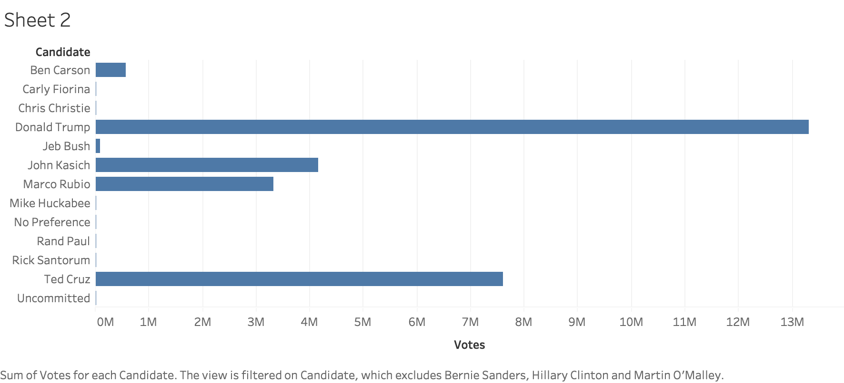

Slide 4
