Slide 1
Trajectory of Information Entropy During peptide folding. Case study: lk14
David Corbo
Mentor: Sid Rath, tatum hennig
dcorbo3@uw.edu
1/30/20
PI: M. Sarikaya

Slide 2
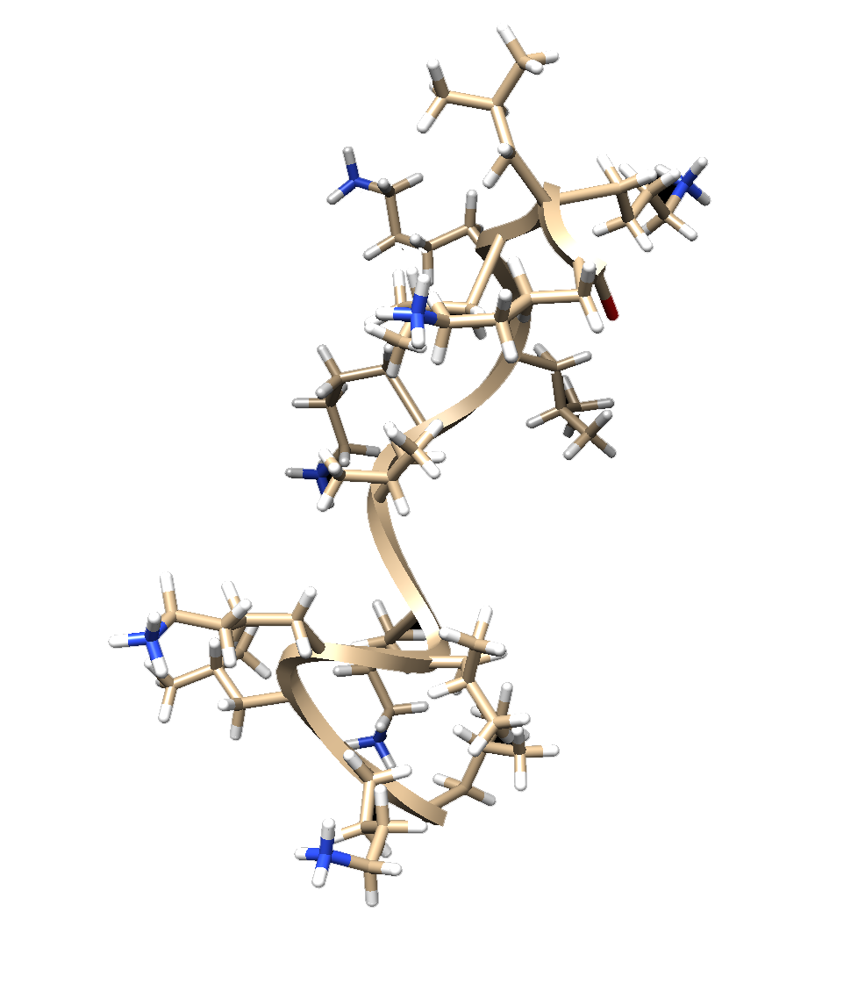
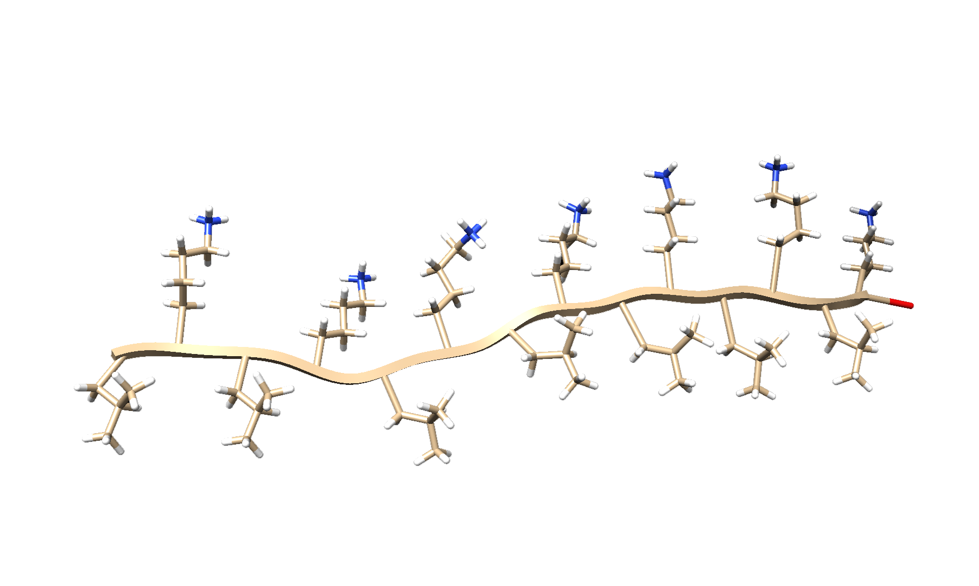
Goal
Prove that uncertainty in electron energy values increases upon formation of stable secondary structures

Slide 3
Literature
Learning how to run MD simulations in Schrodinger
Learning the SciPy ecosystem (Numpy and similar libraries)
Learning about information entropy and energy

Slide 4
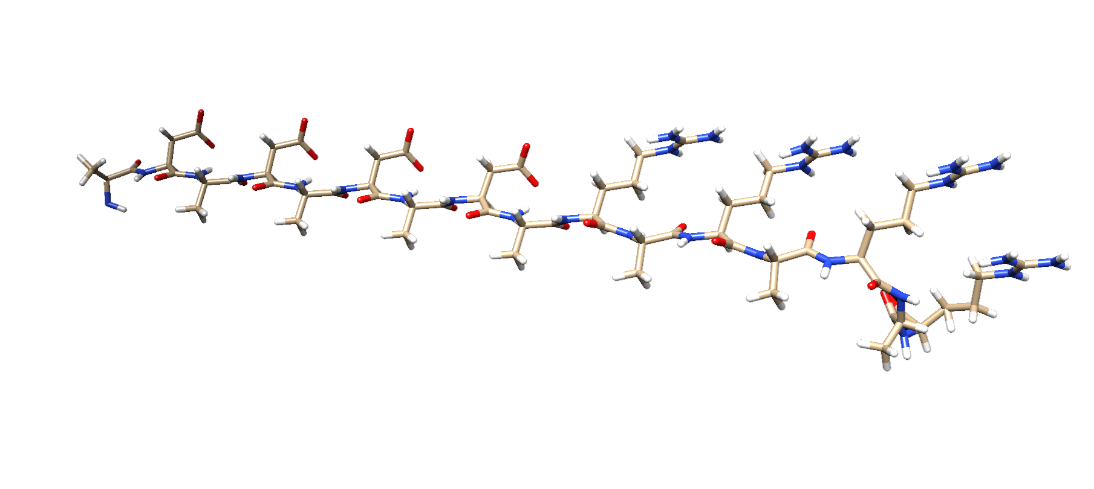

MD simulations
Got acquainted with Schrodinger
Ran simulation for evolution of LK14
Running simulations for evolution of DAR16-IV (second case study α to β transition)

Slide 5
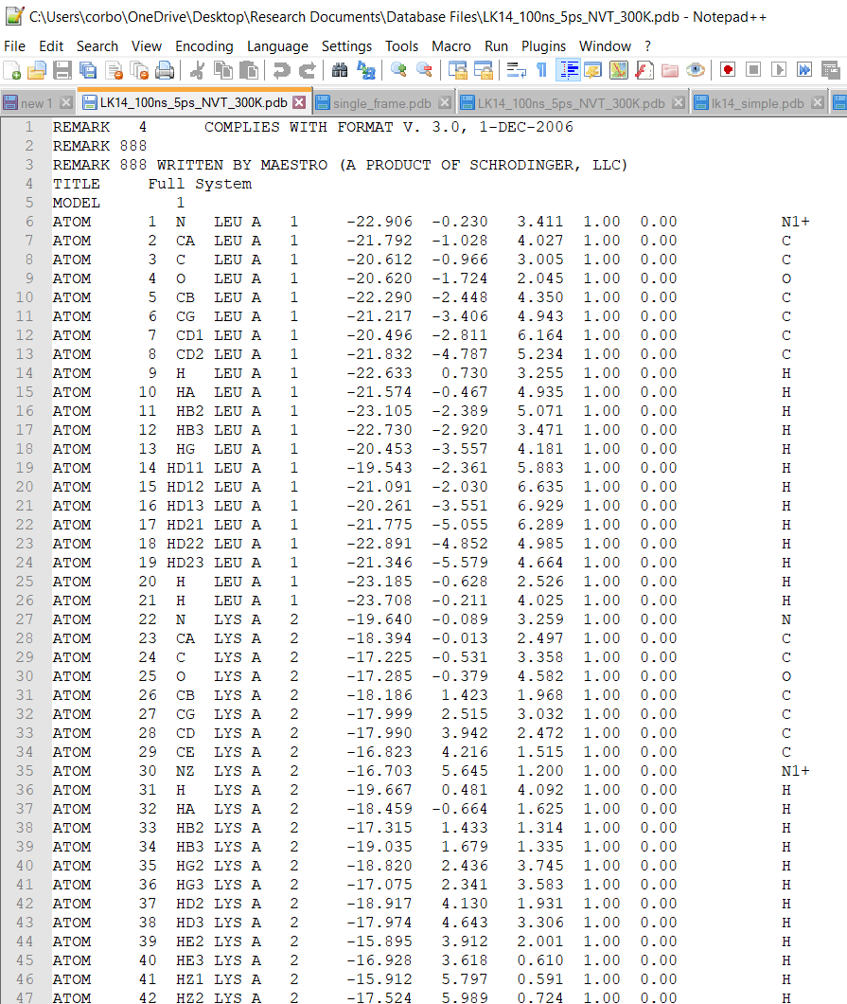
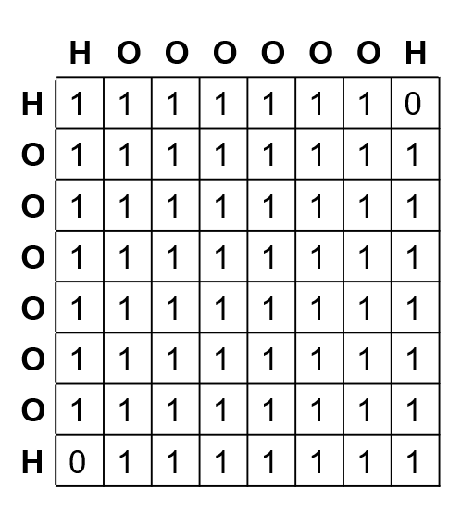
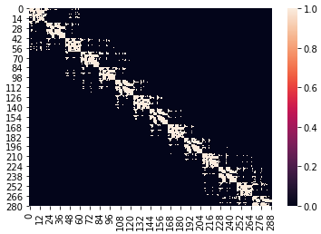
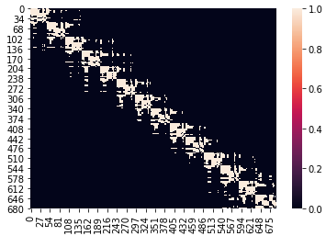
Analysis of data
 | H | O | H
H | 1 | 1 | 0
O | 1 | 1 | 1
H | 0 | 1 | 1
Extraction of PDB
Creation of Atom Adjacency Matrices
Creation of Valence Electron Adjacency Matrices
Analysis of Dynamics of Electron Adjacency Matrices

Slide 6
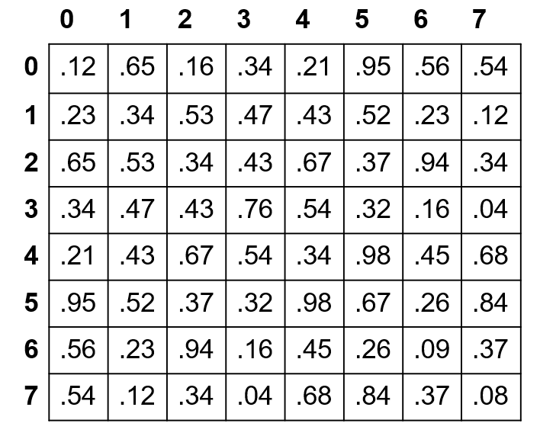
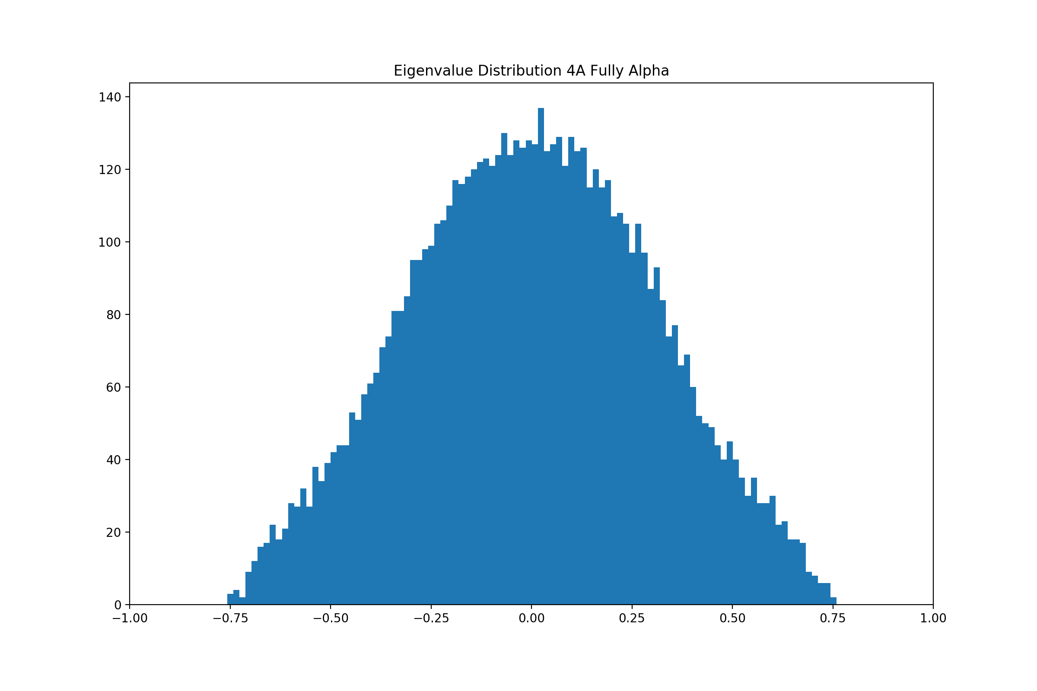

Analysis of data
Symmetric normal matrix imposed on adjacency matrix
Calculation of eigenvalues
Analysis of eigenvalues

Slide 7
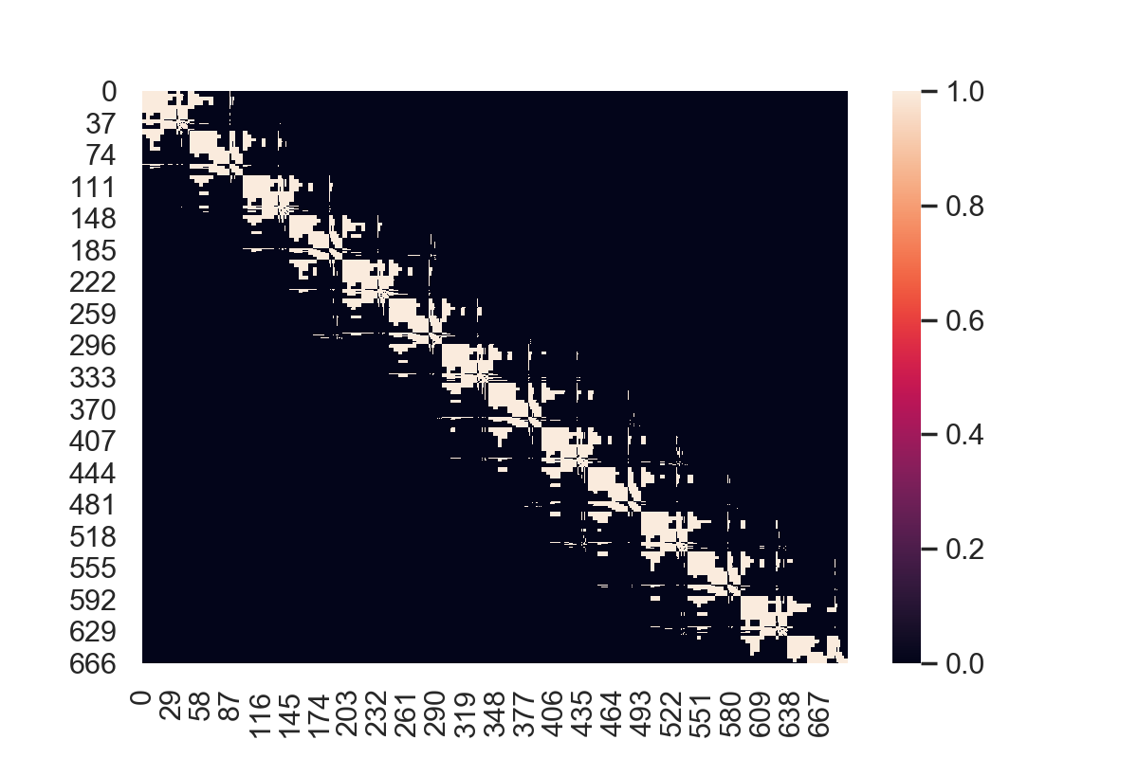
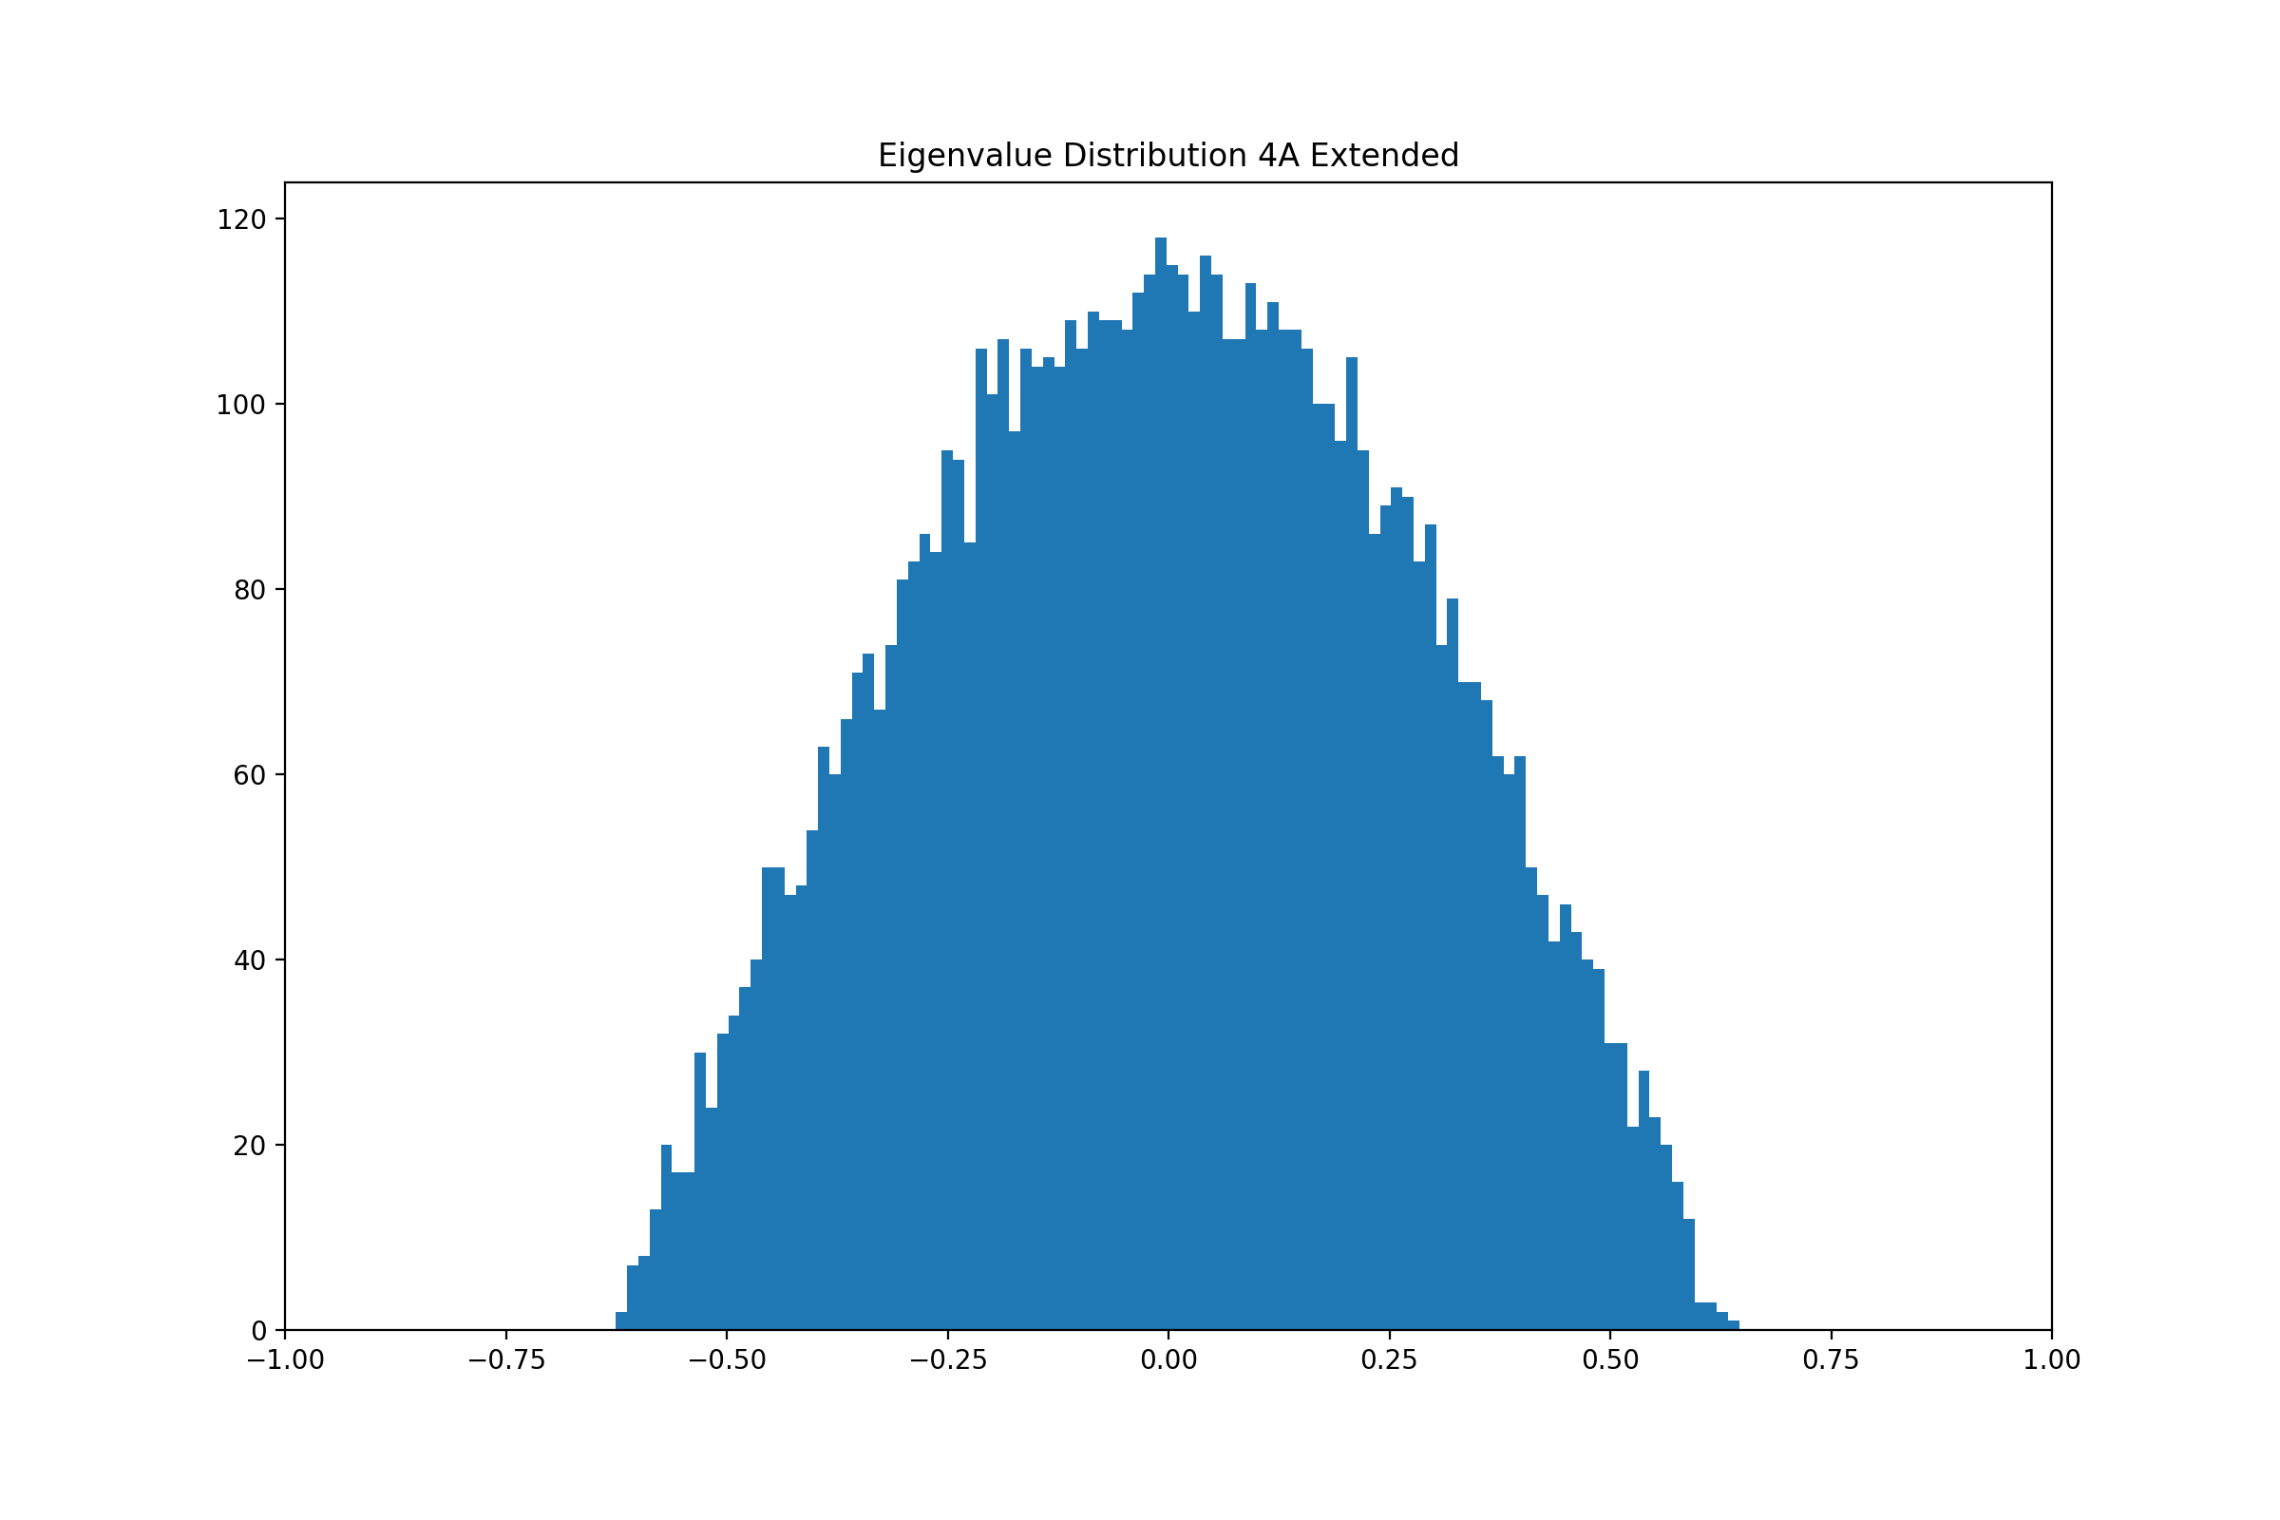
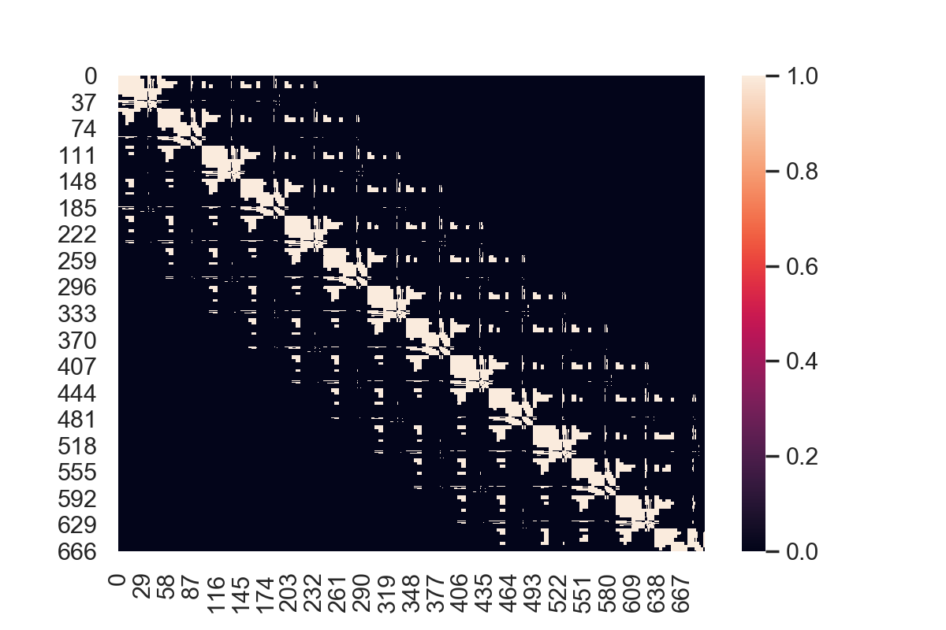
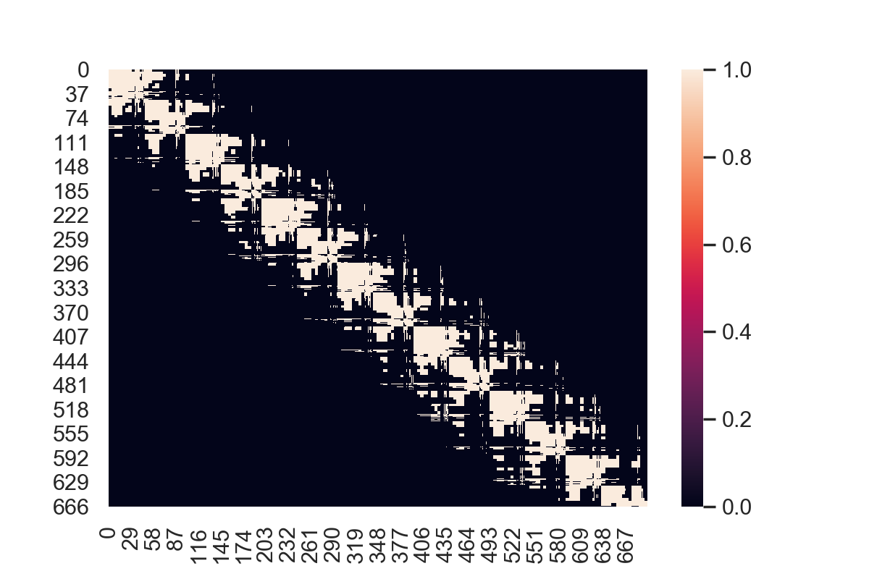
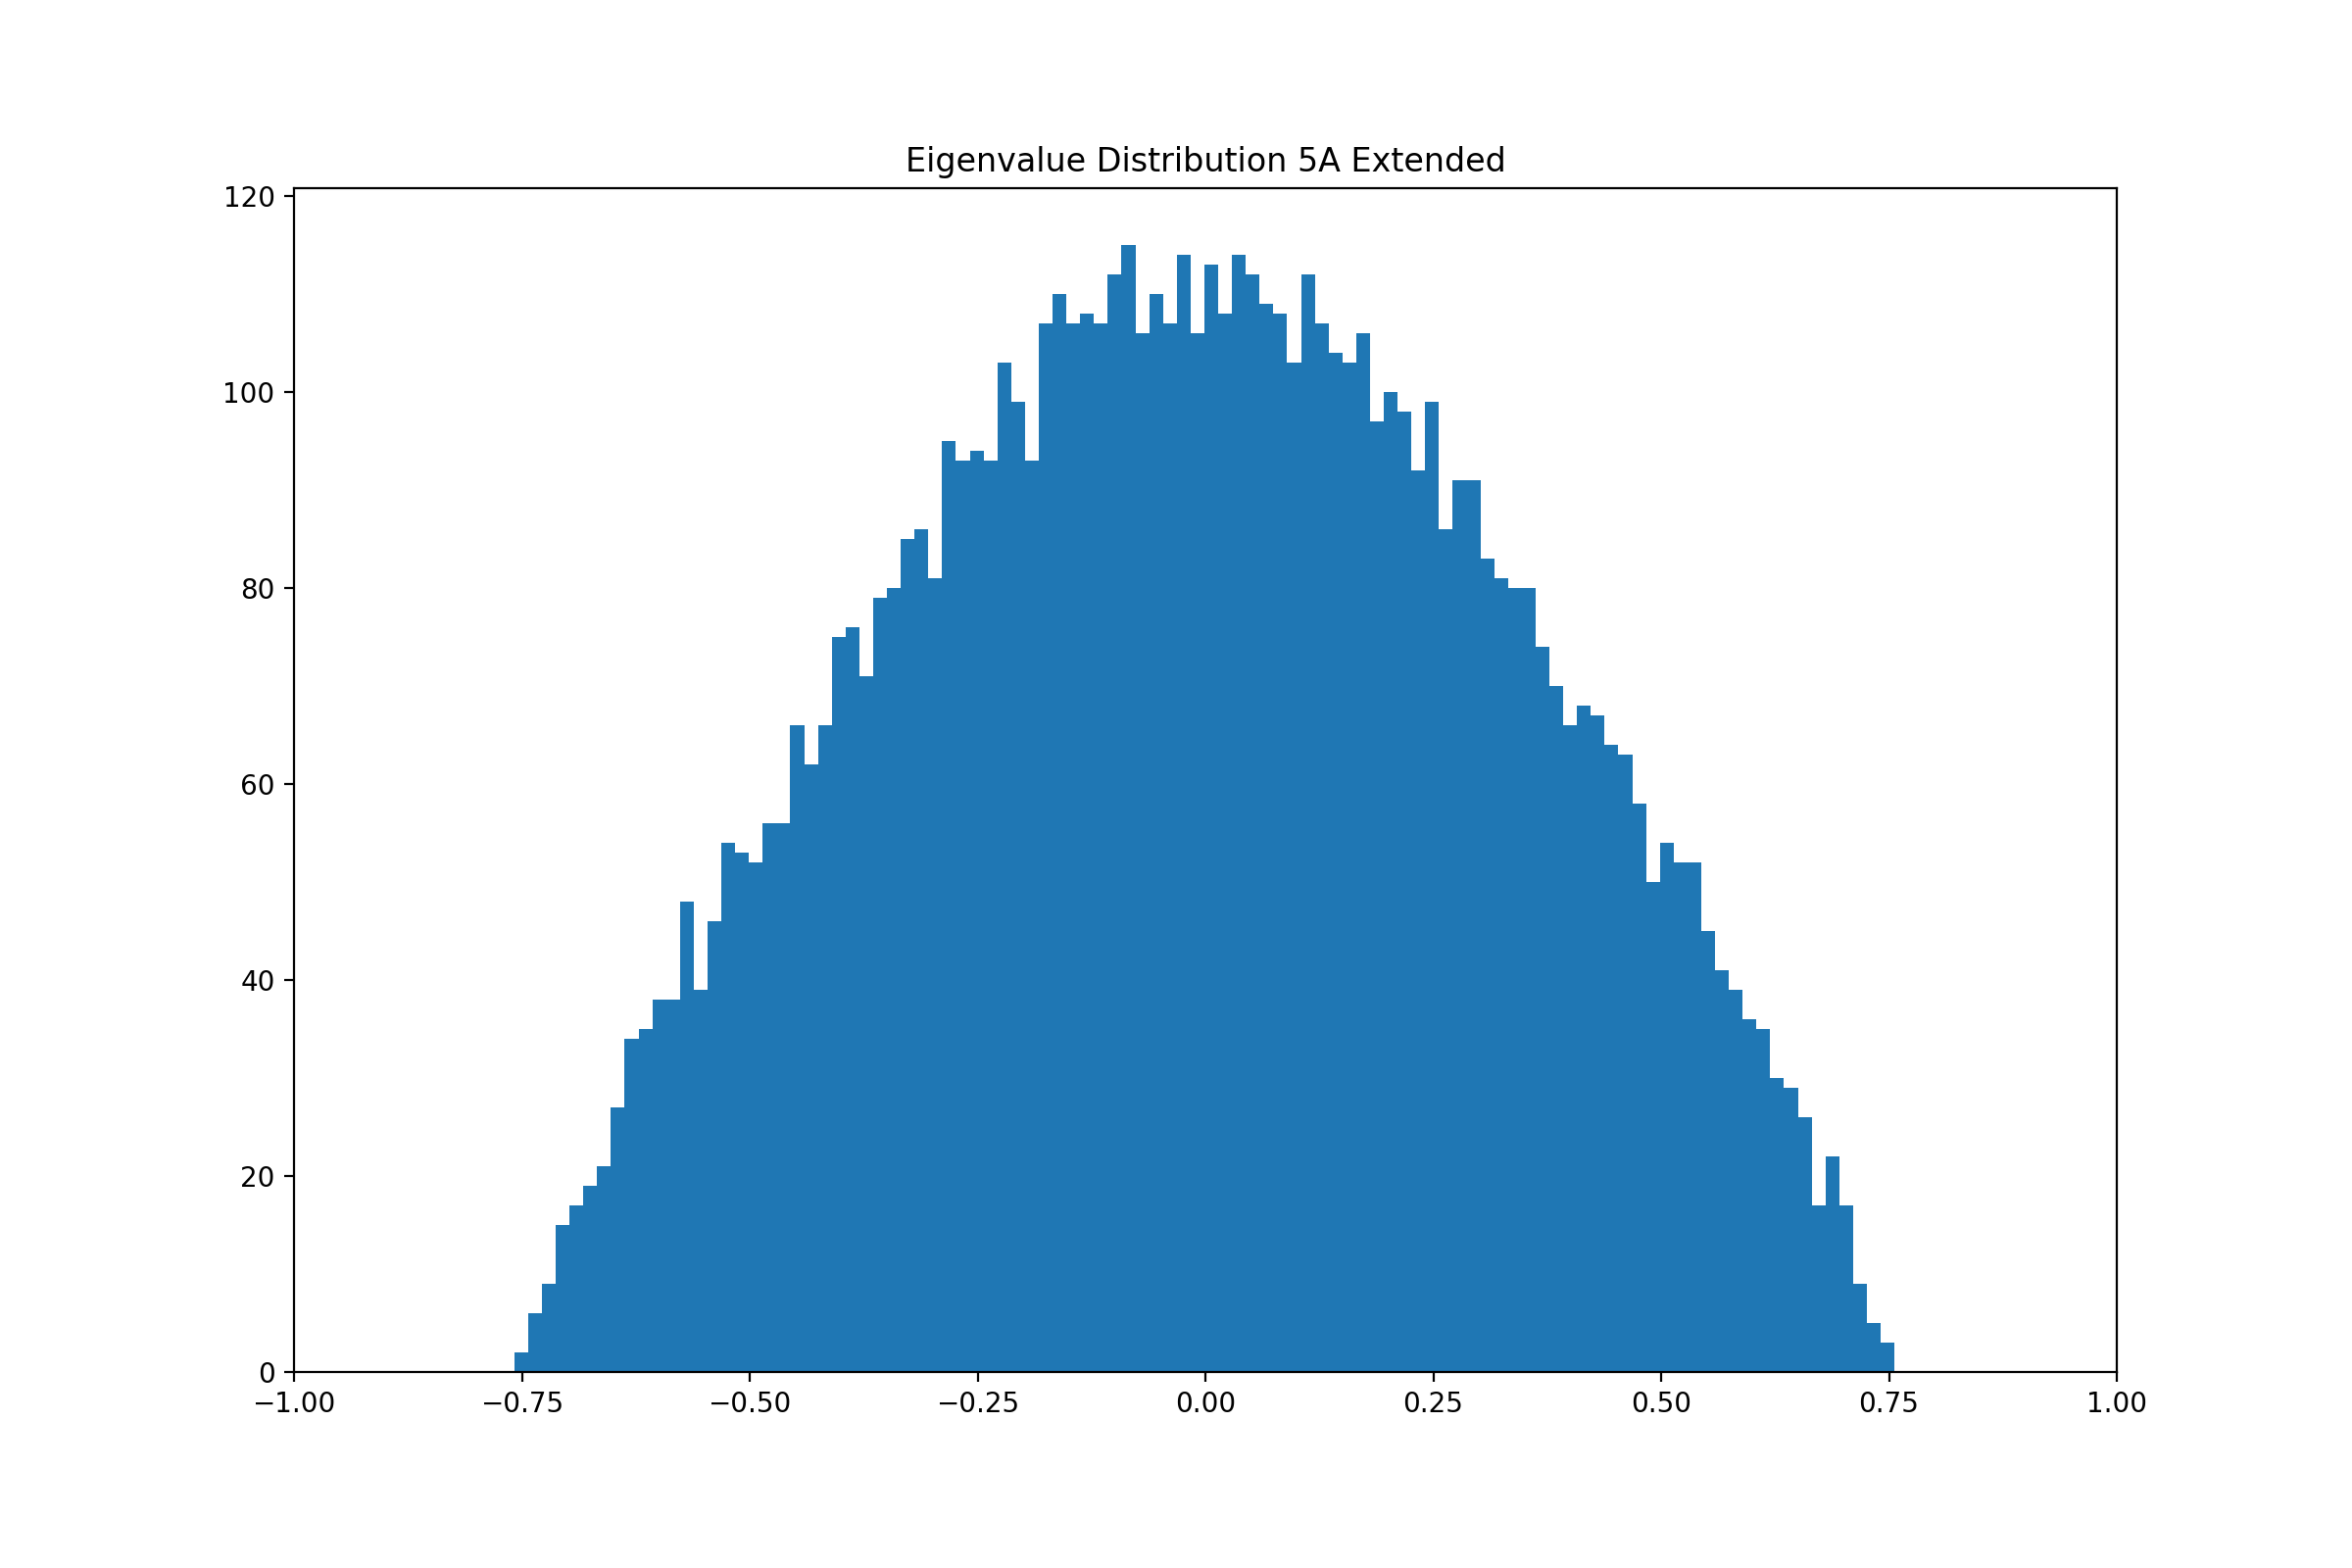
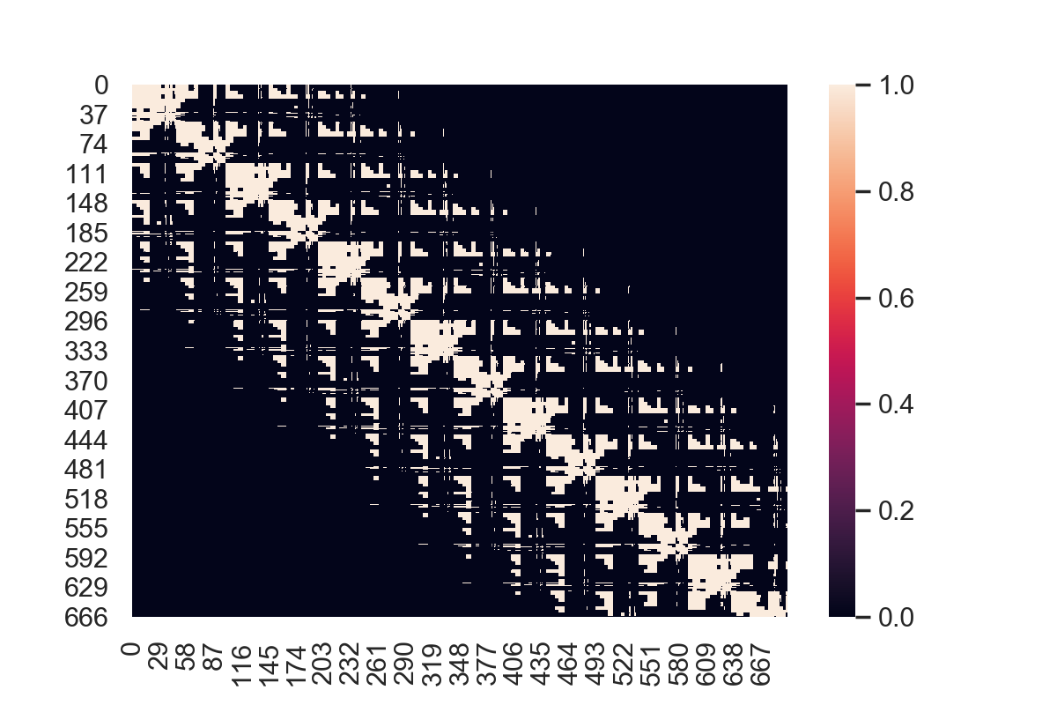
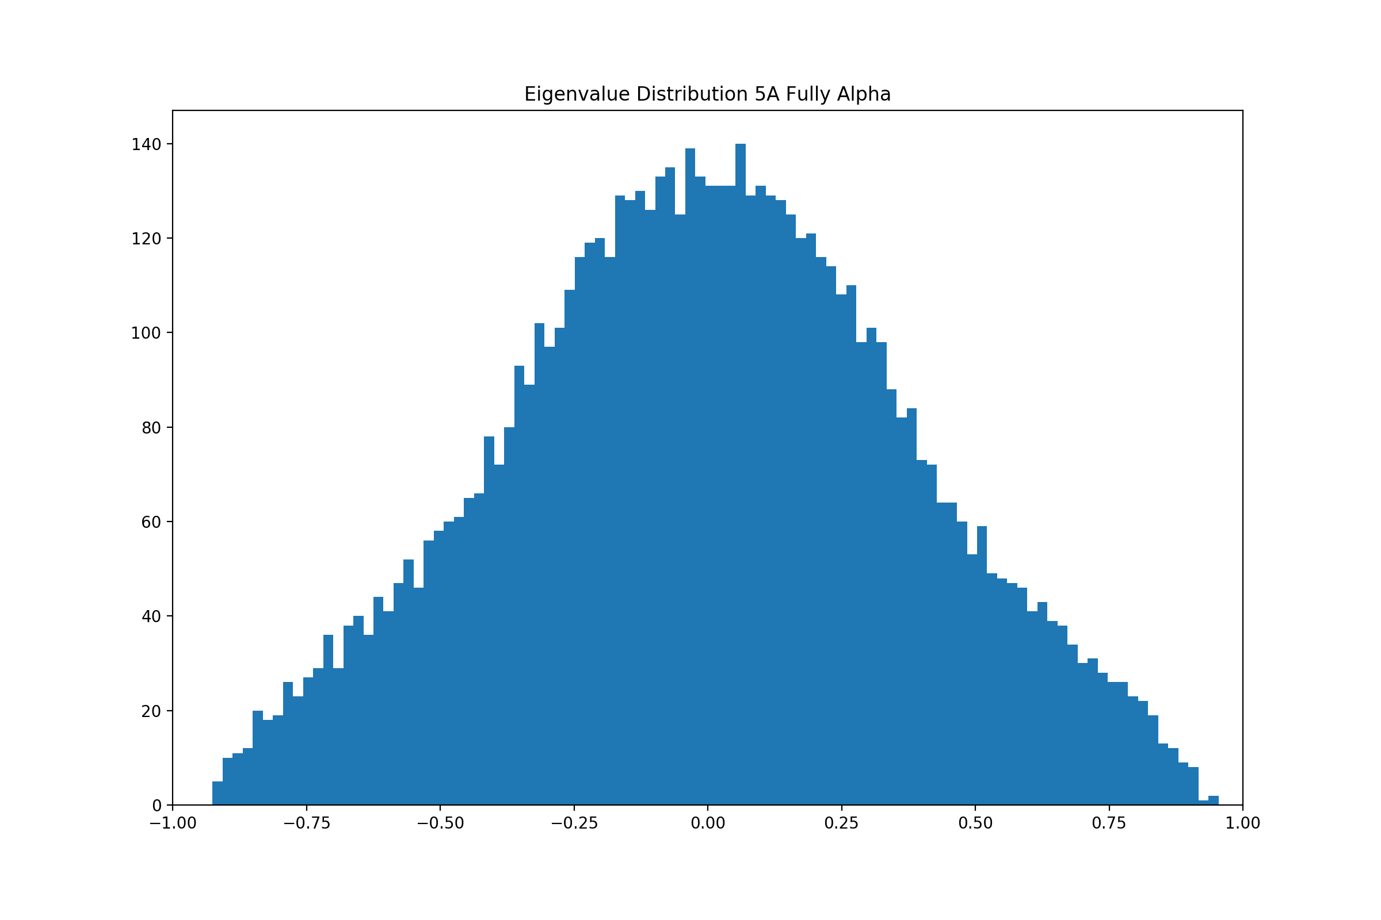
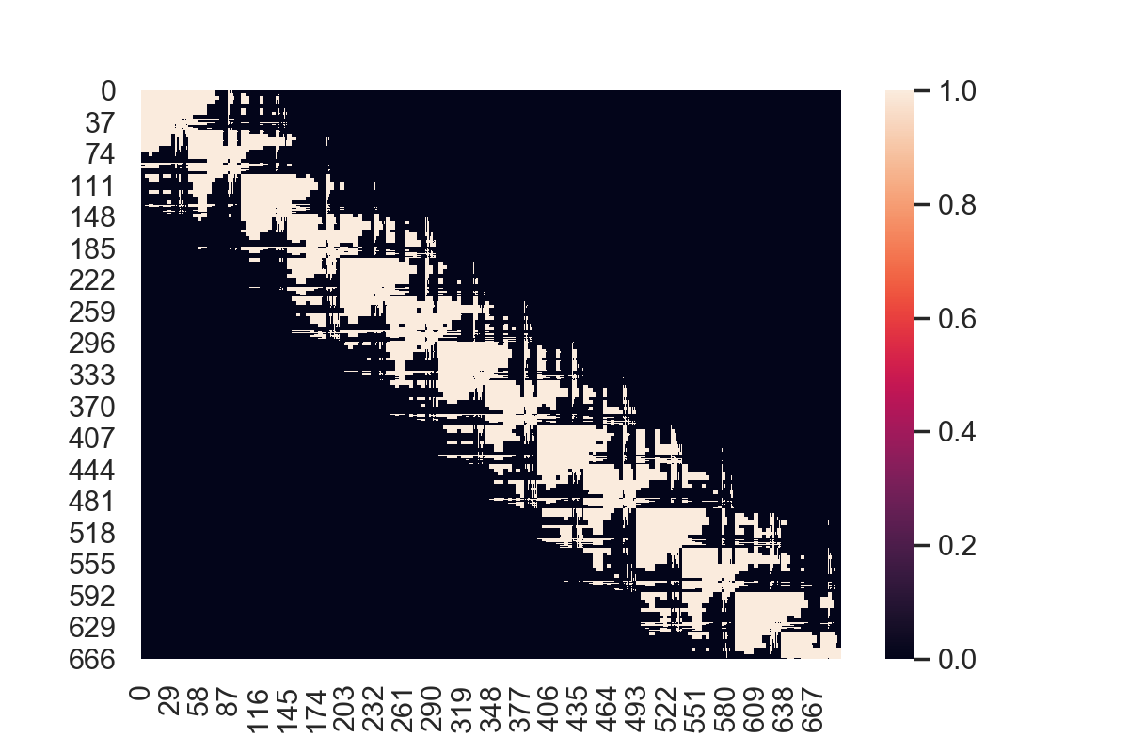
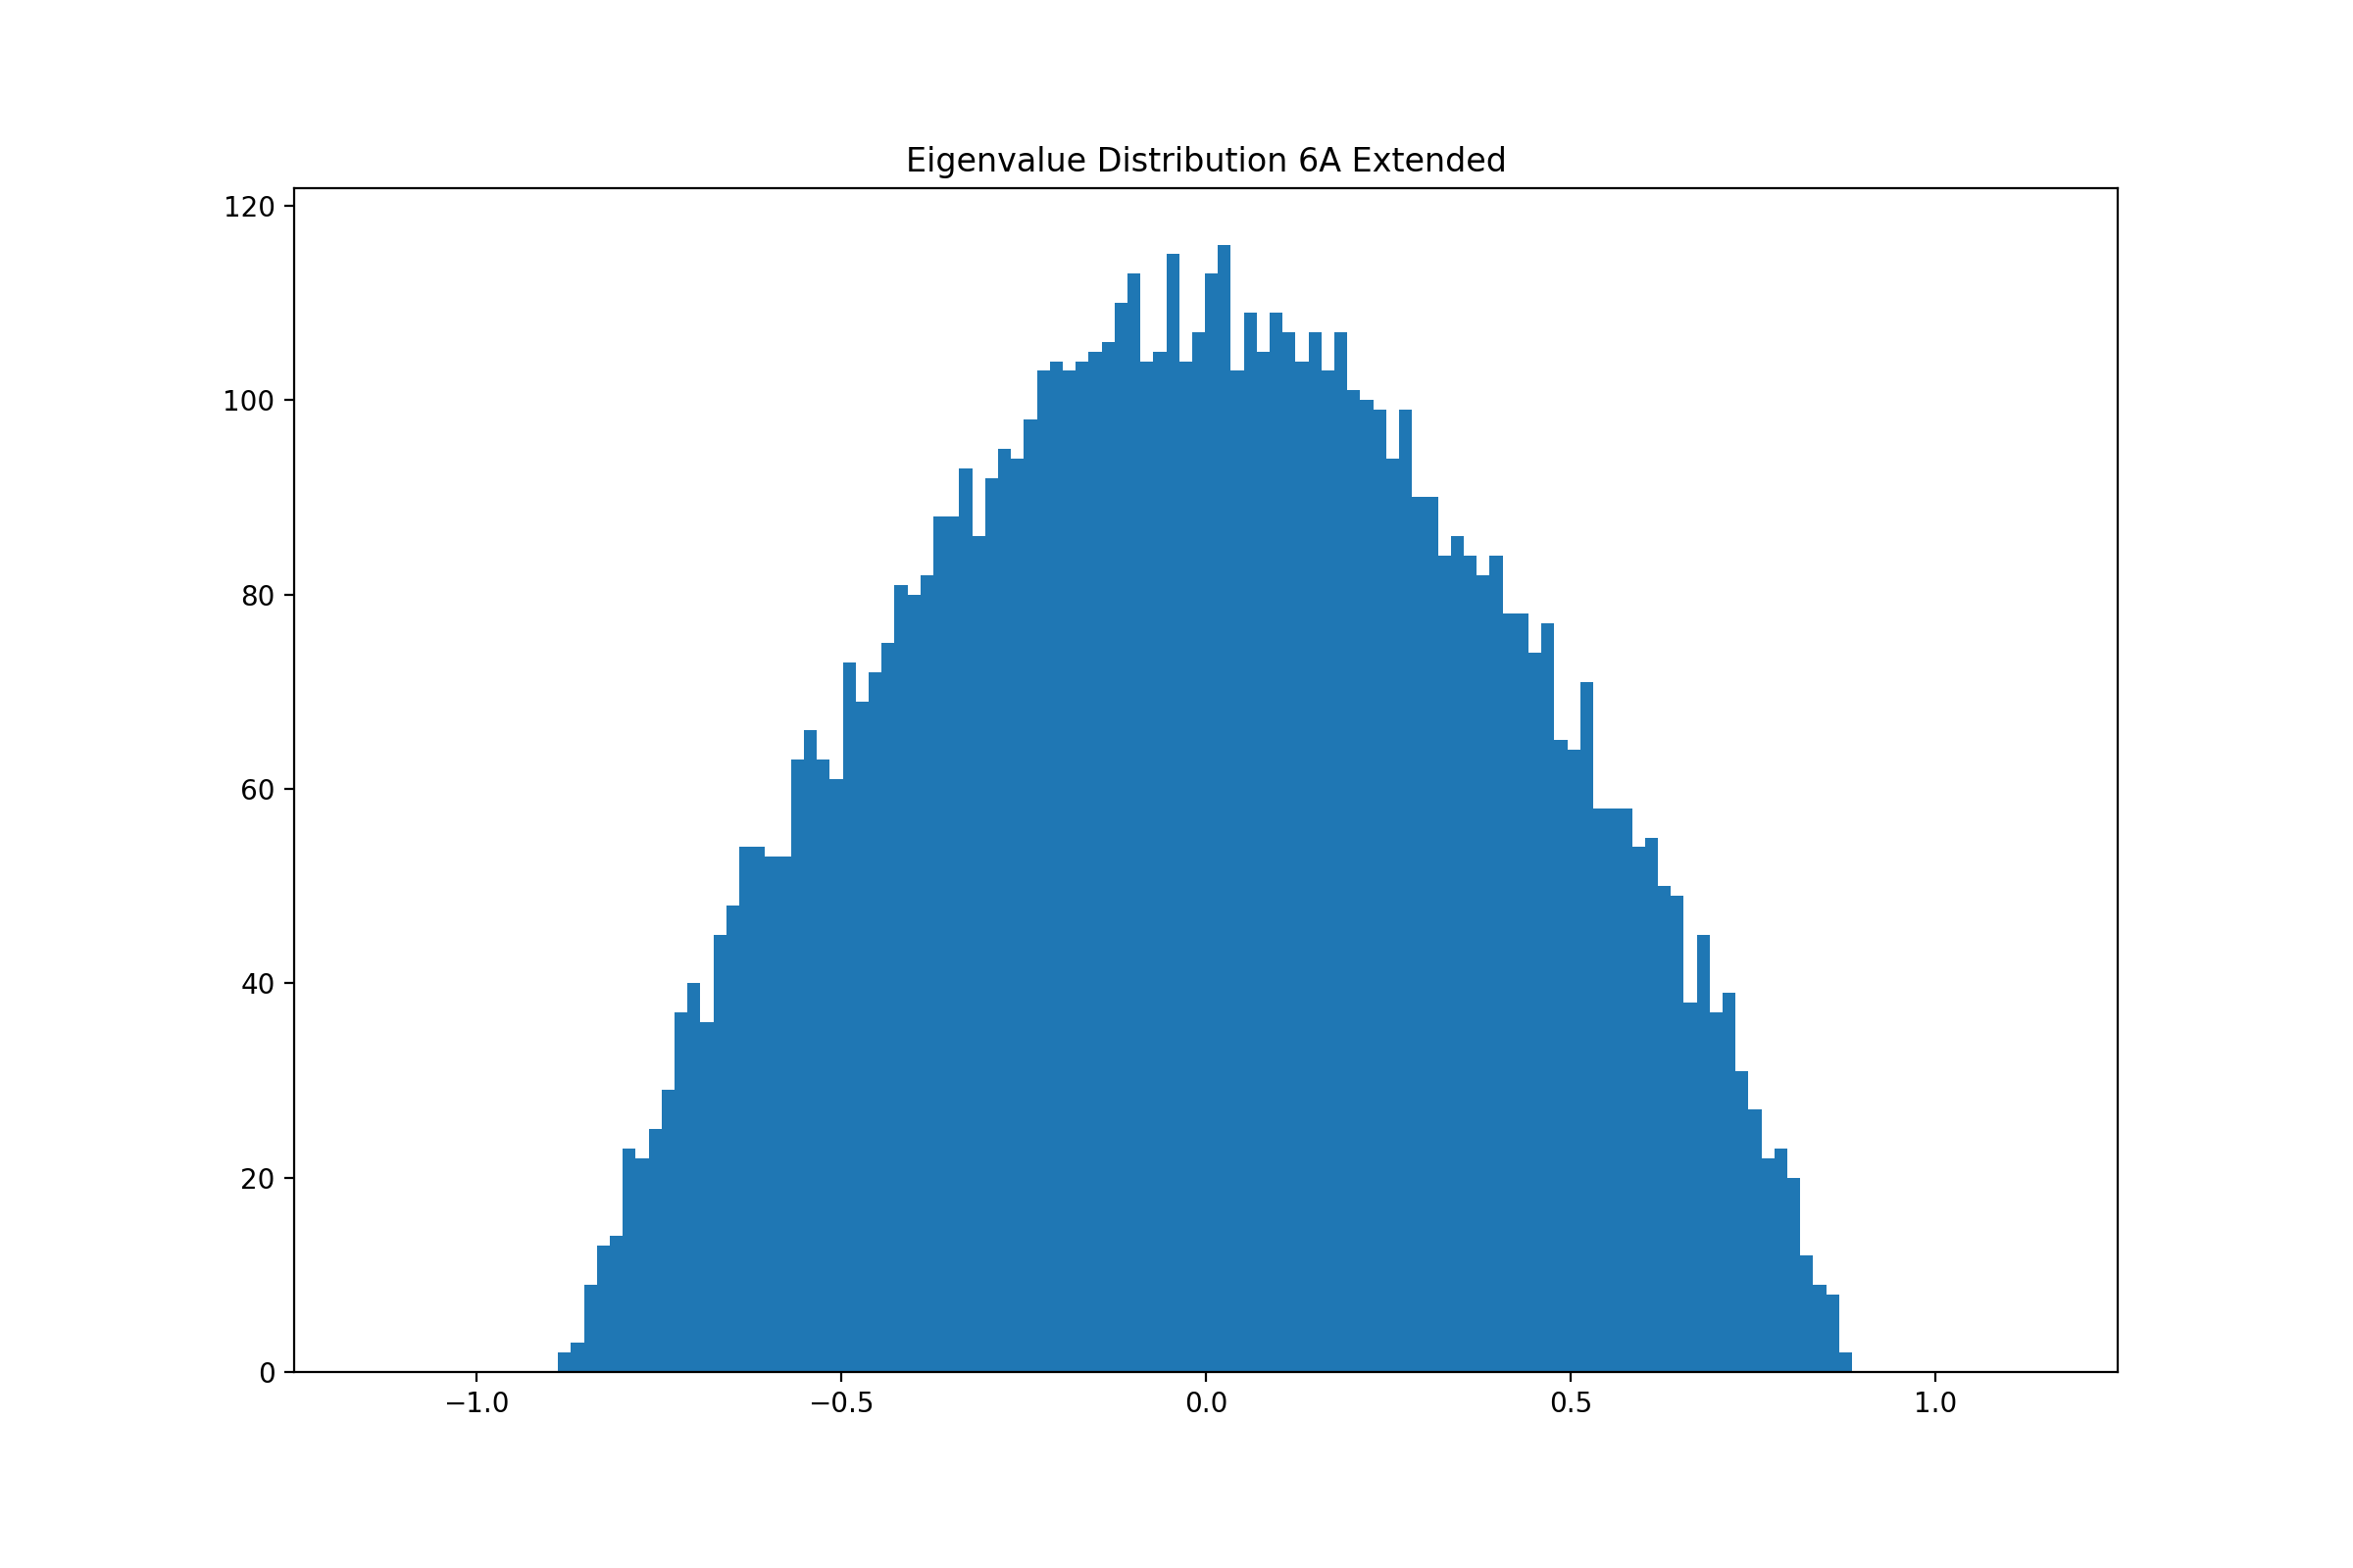
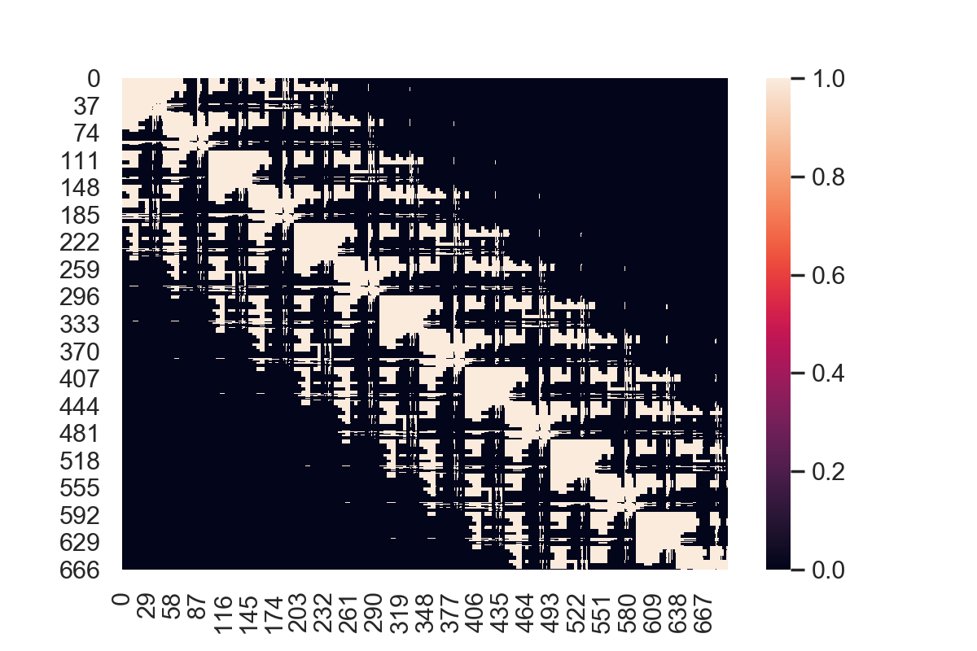
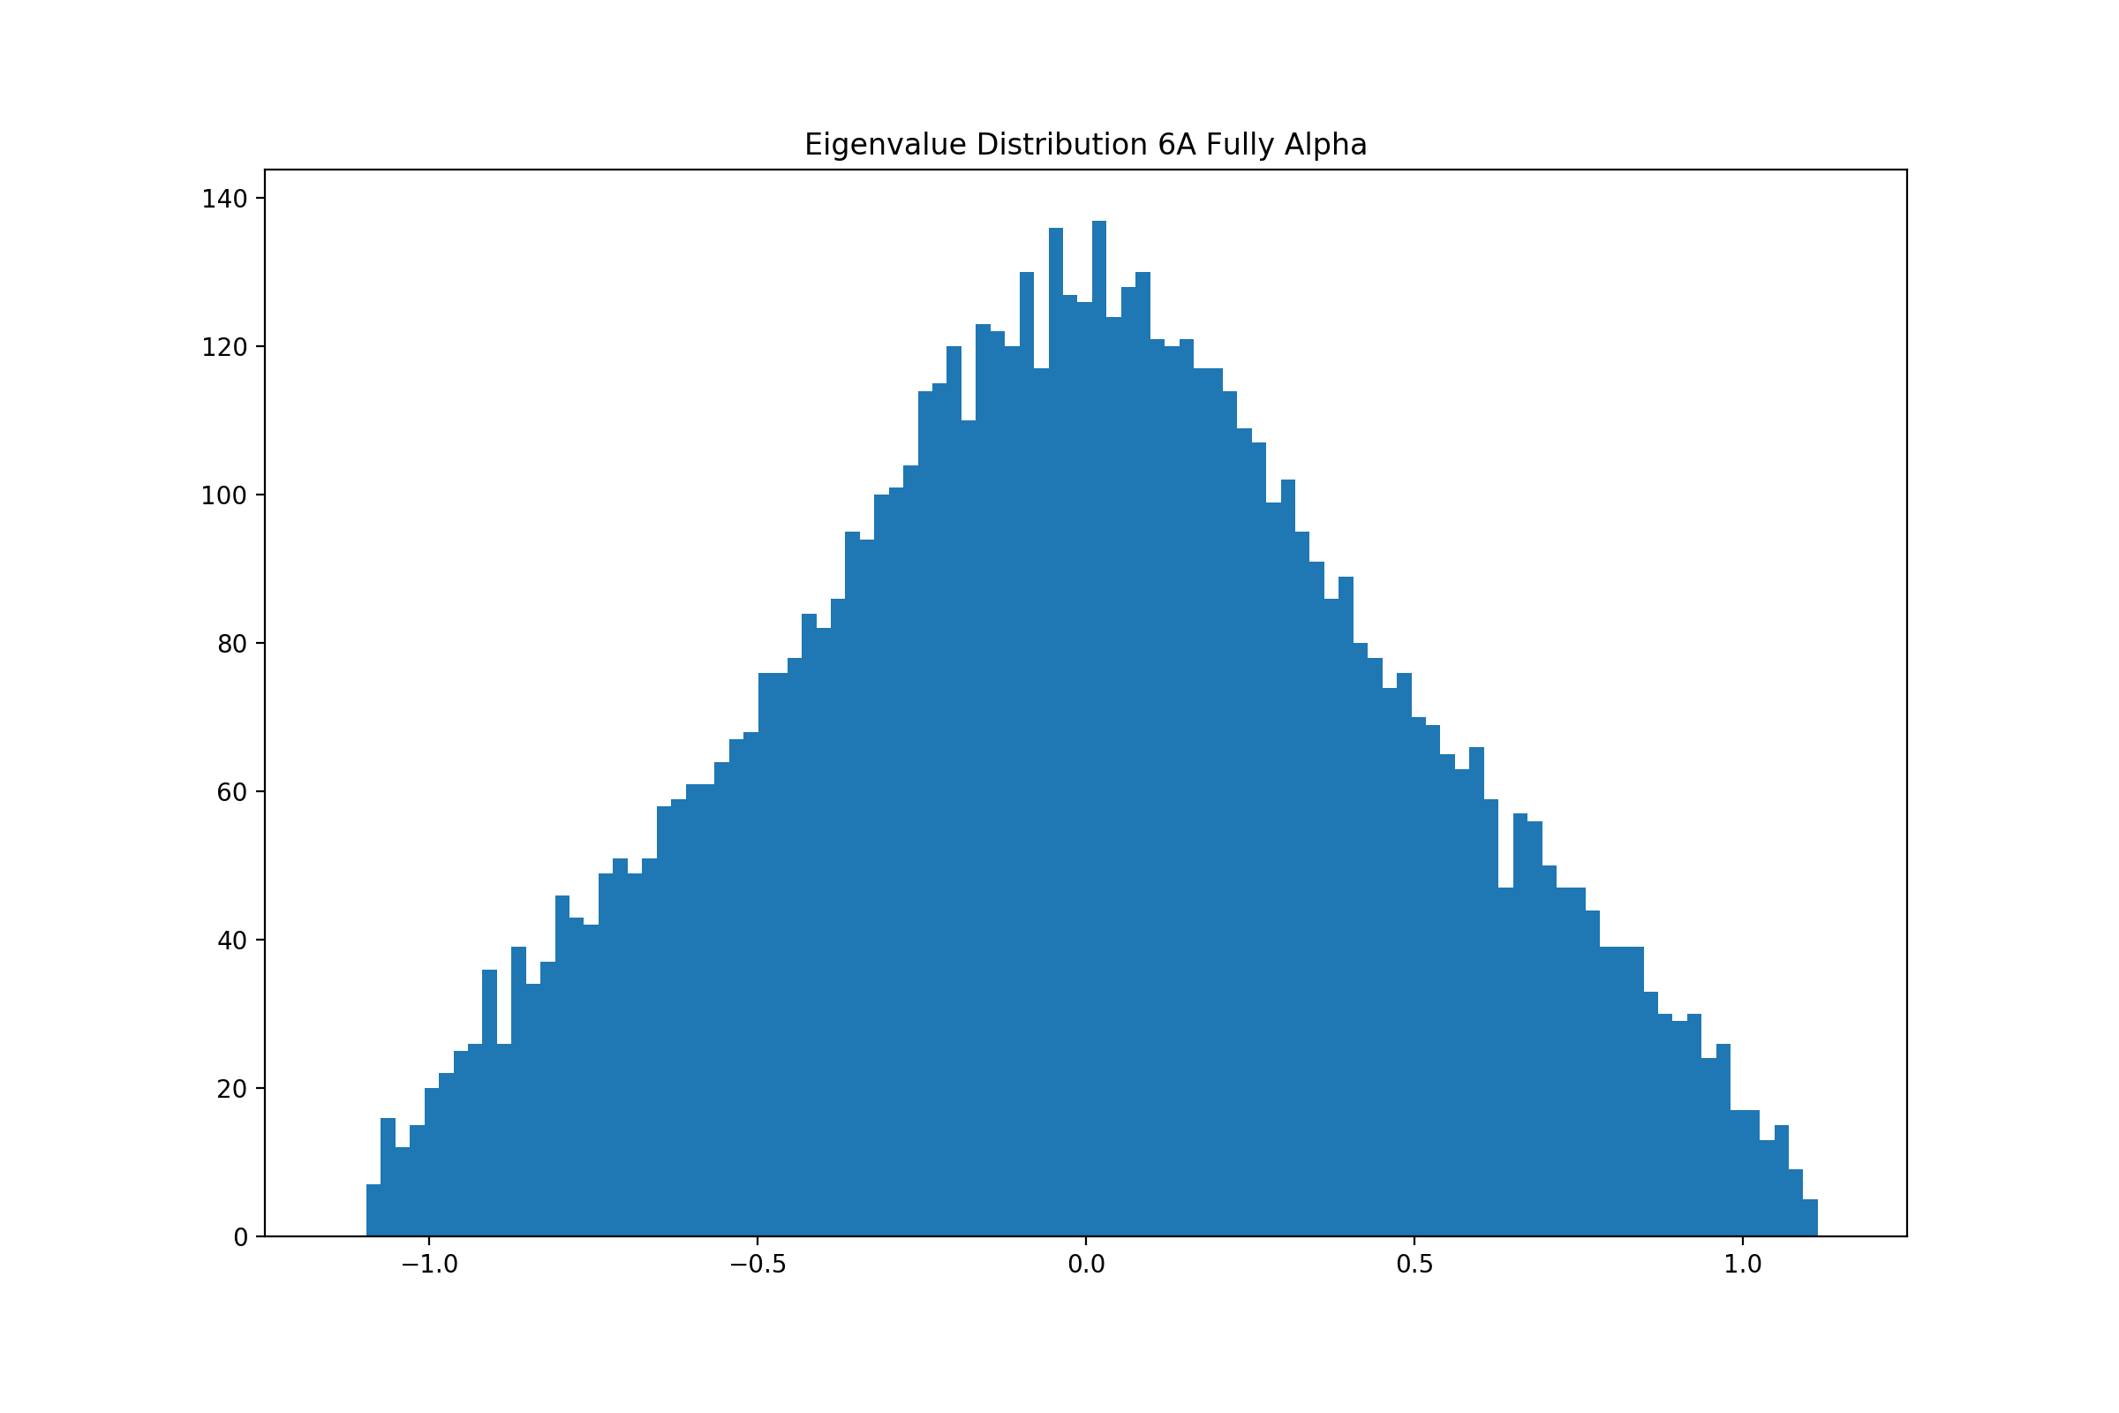
Analysis of Data
4Å
5Å
6Å

Slide 8
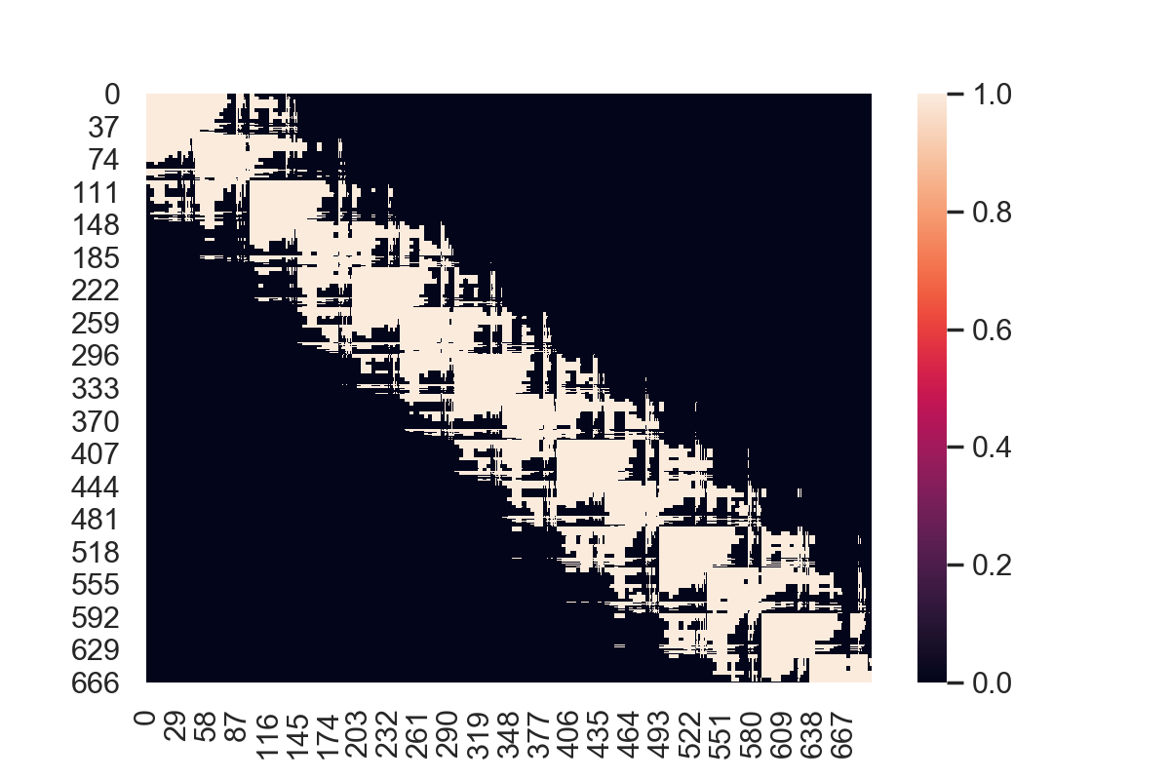
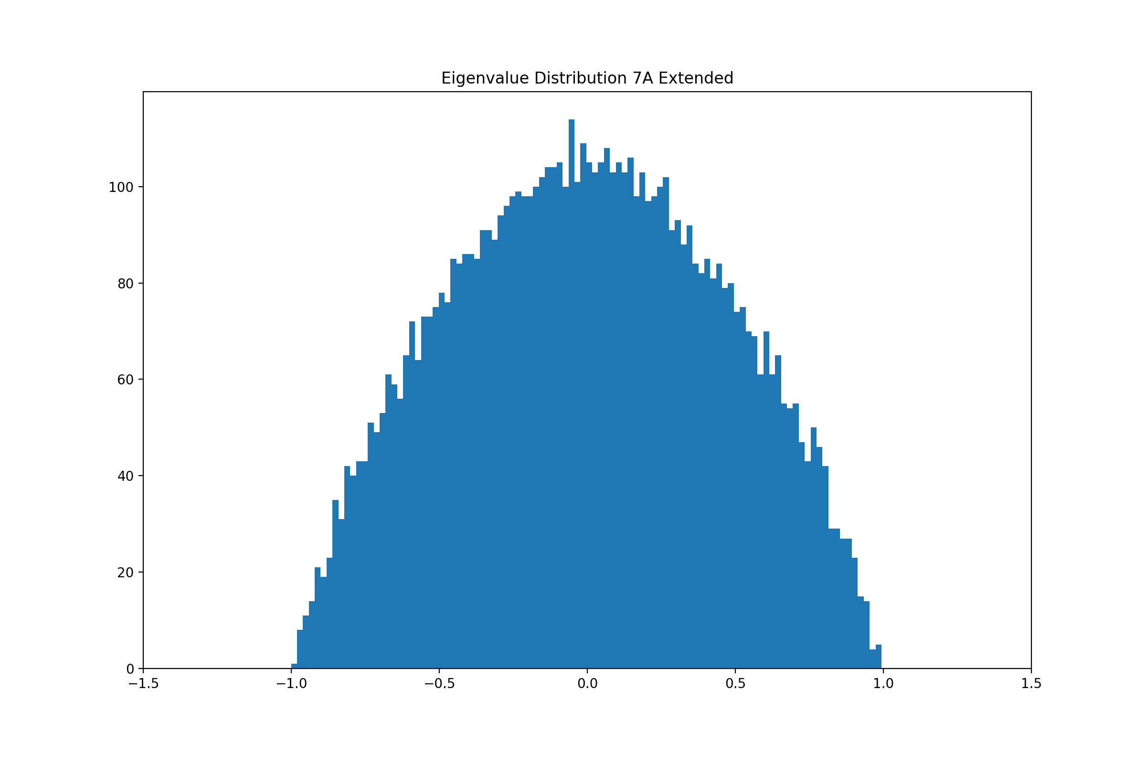
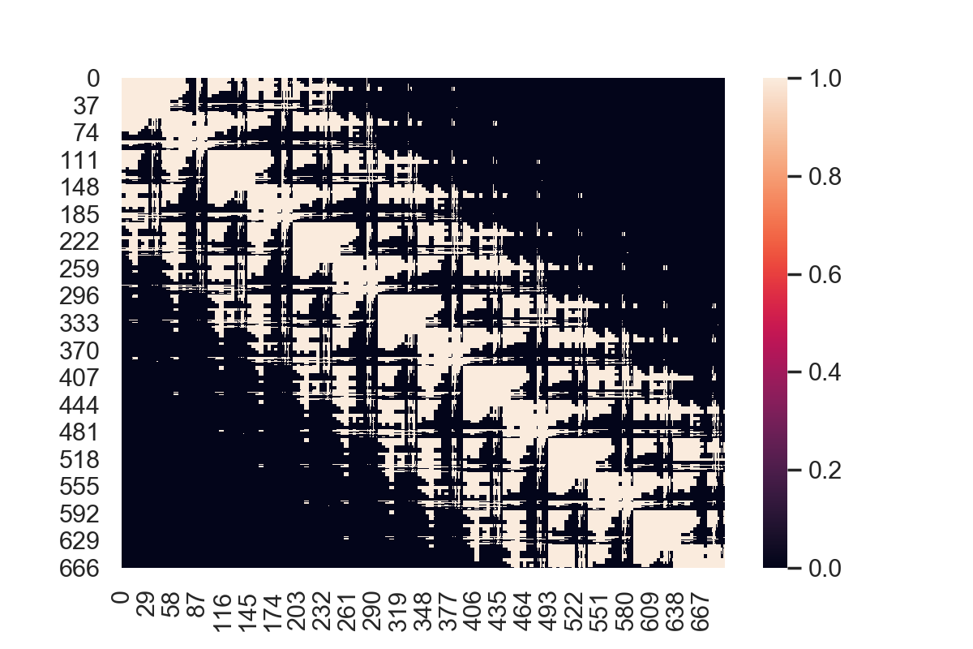
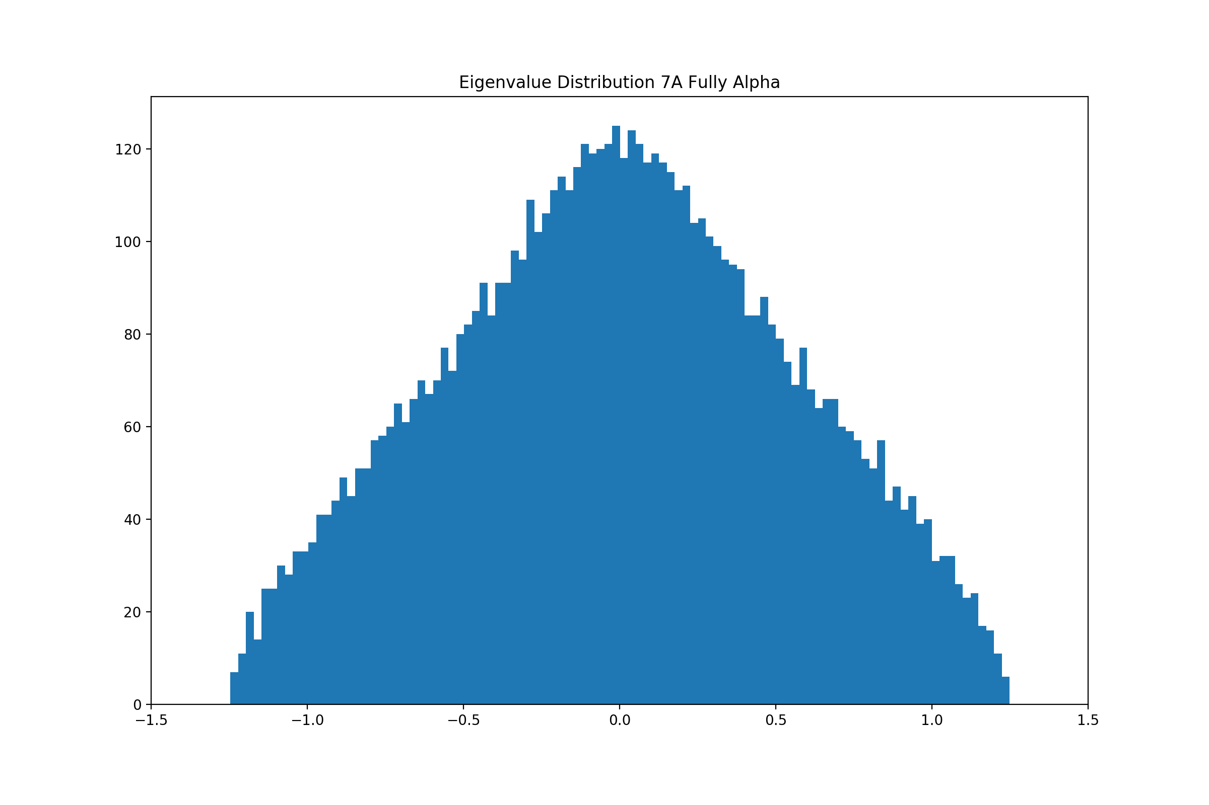
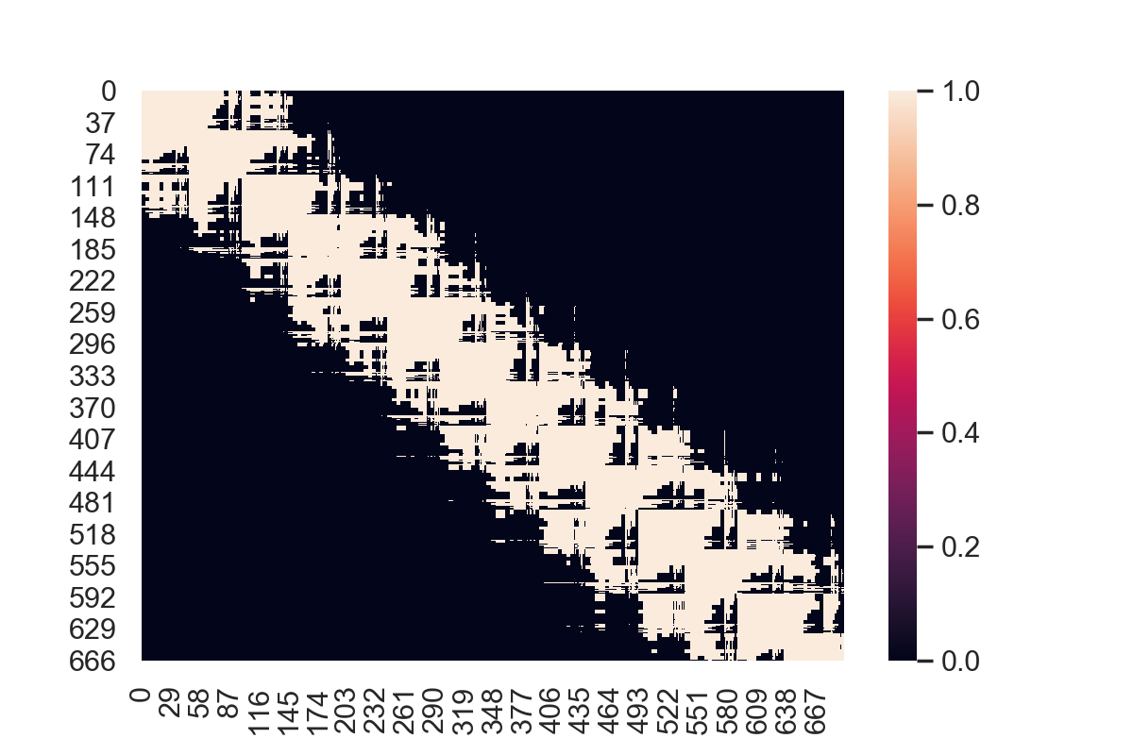
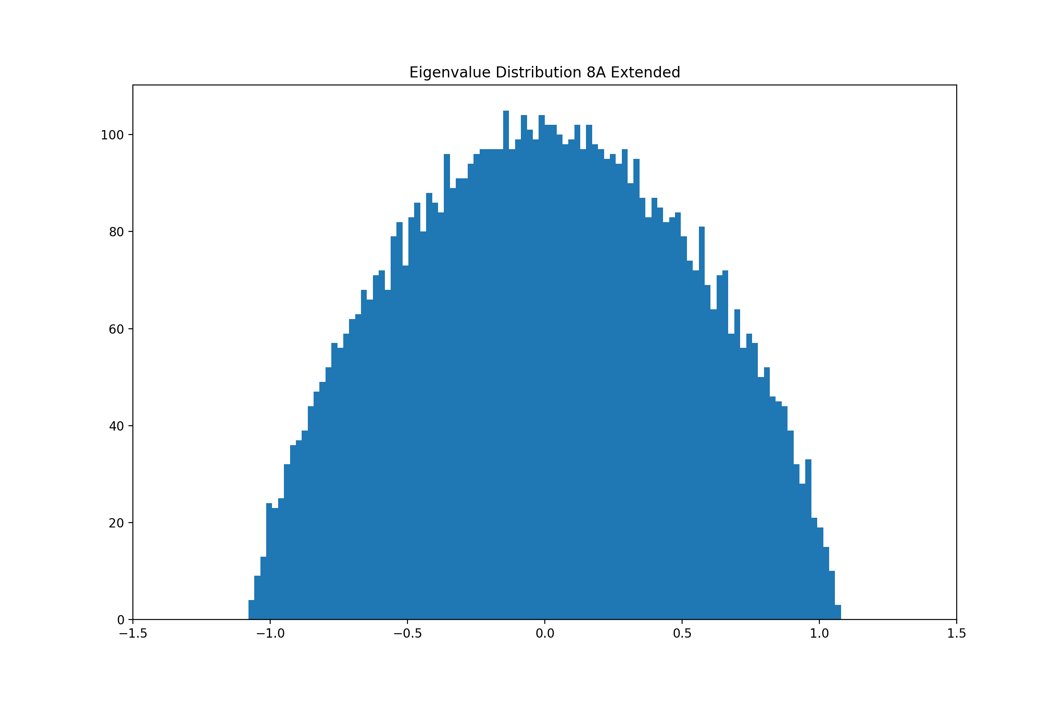
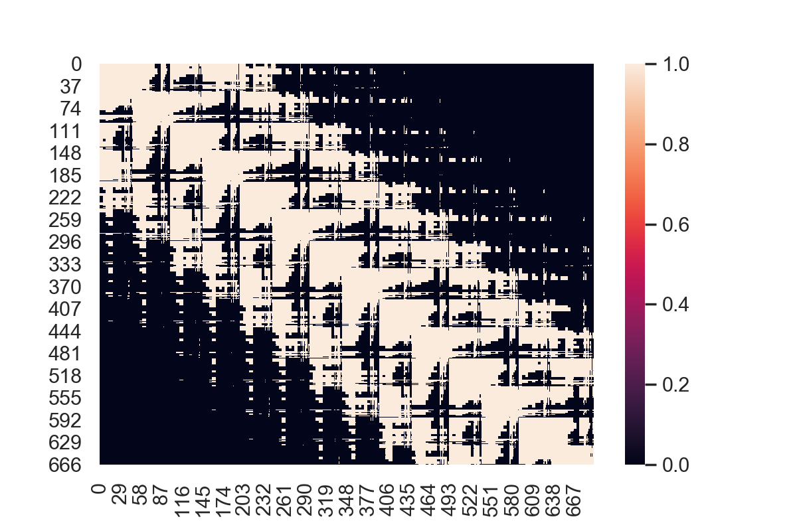
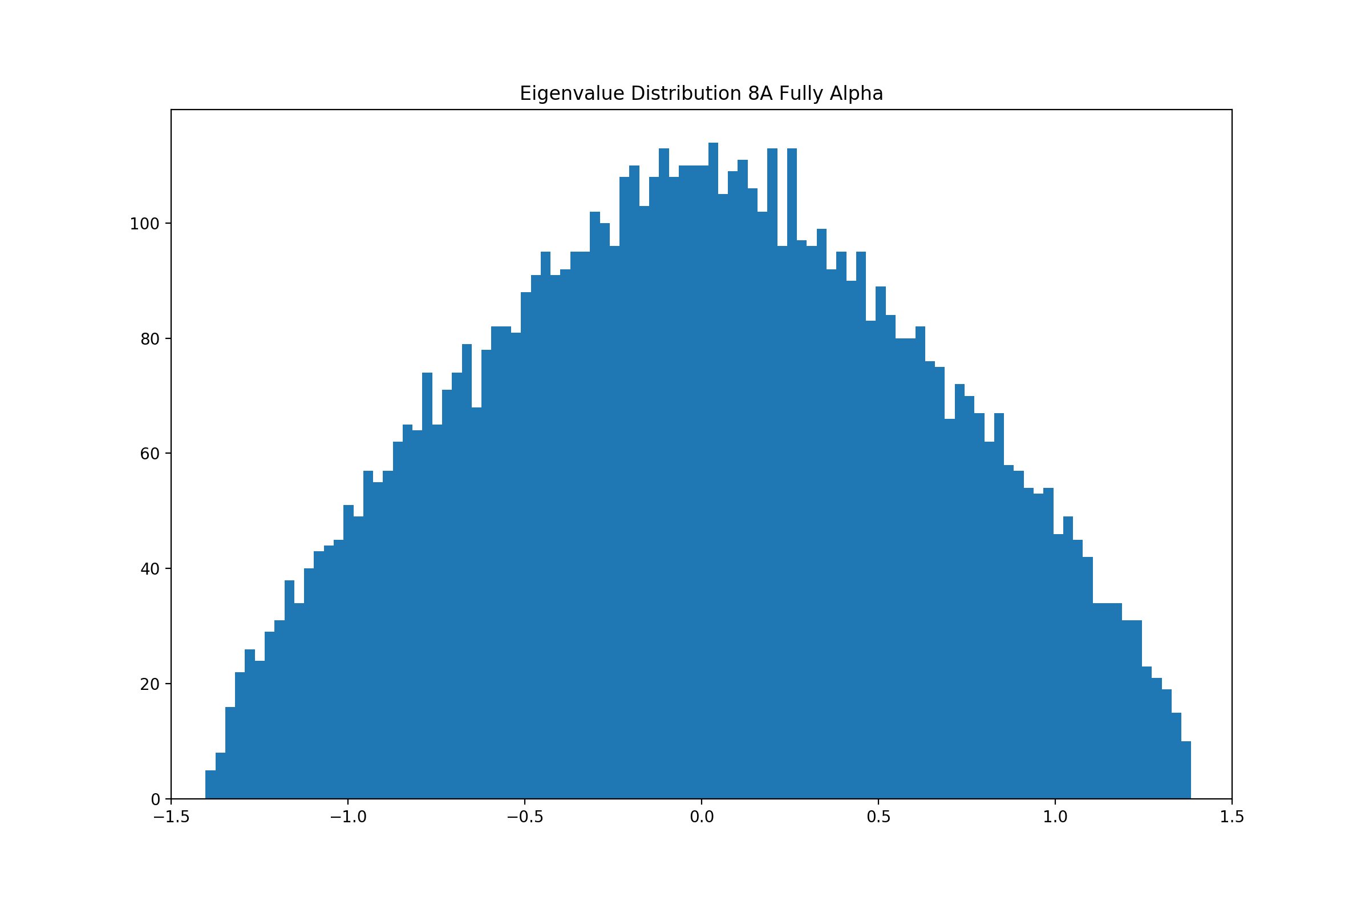
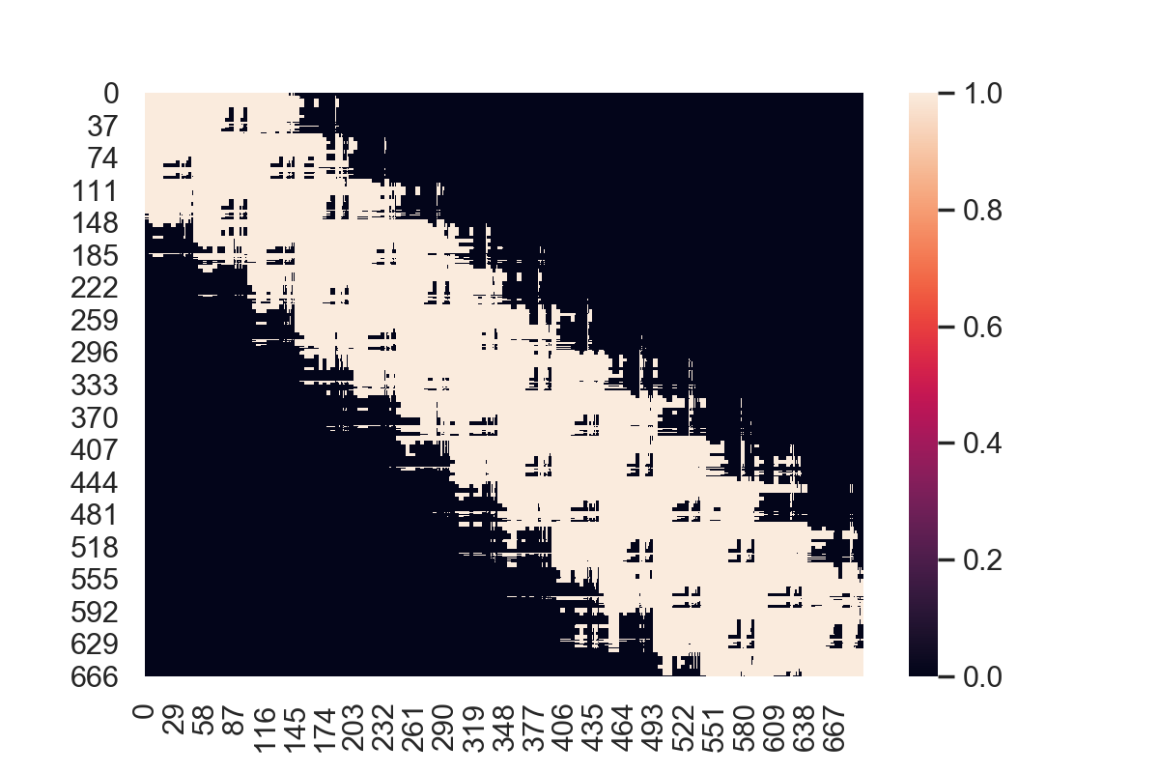
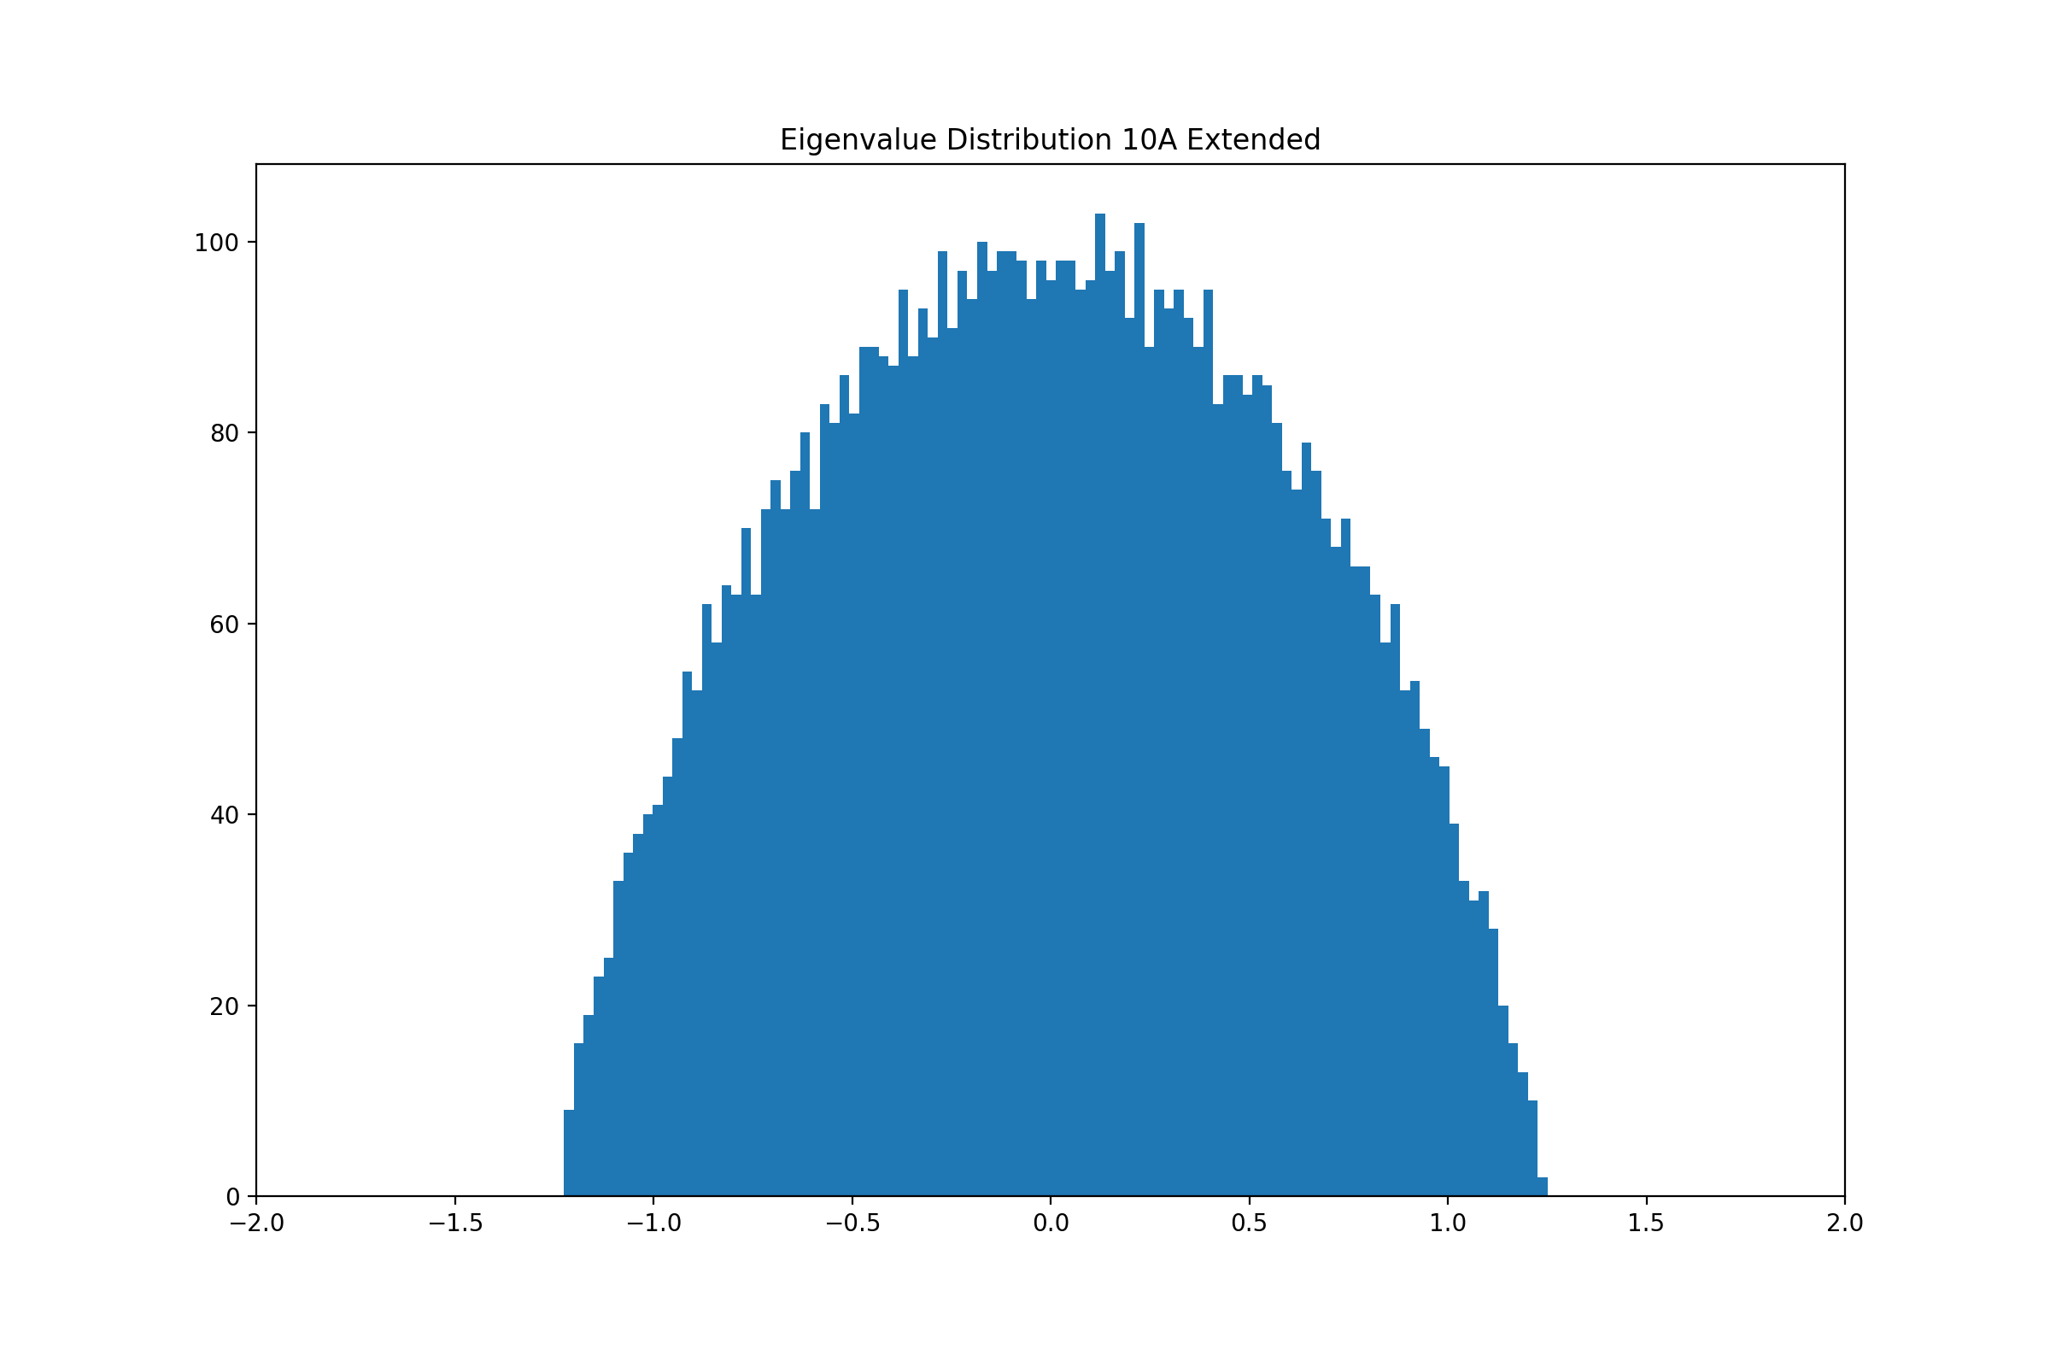
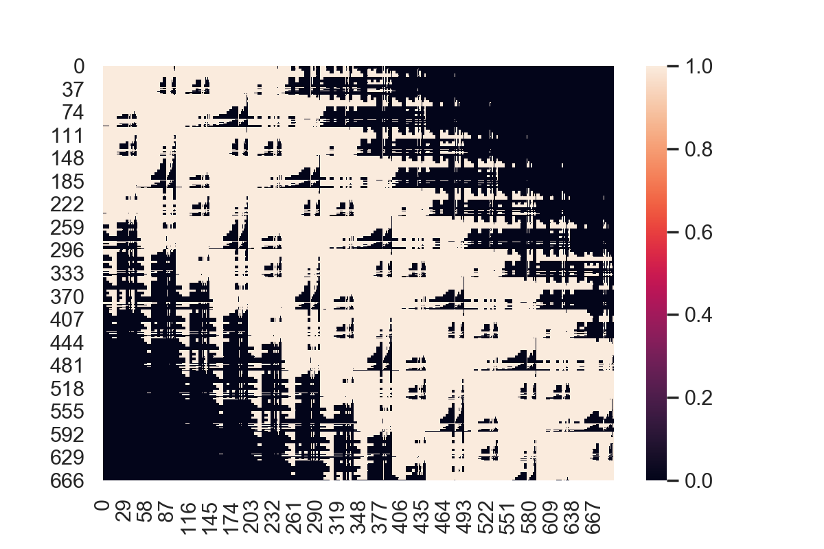
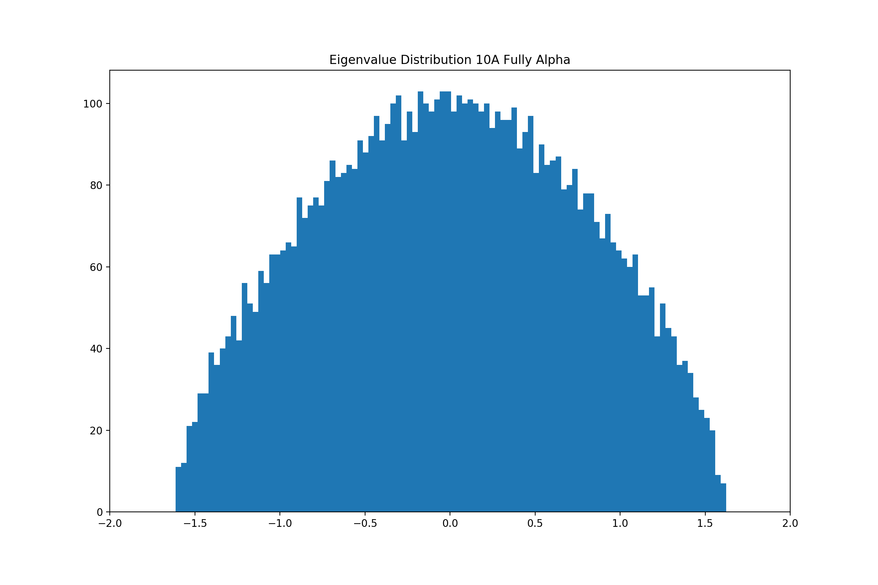
Analysis of Data
7Å
8Å
10Å

Slide 9
Next steps
Understanding the math behind random graph matrices and calculating entropy and energy
Include water in adjacency matrices, make algorithm for optimizing water atom validation

