Slide 1

Debugger
Banana Development Team

Slide 2
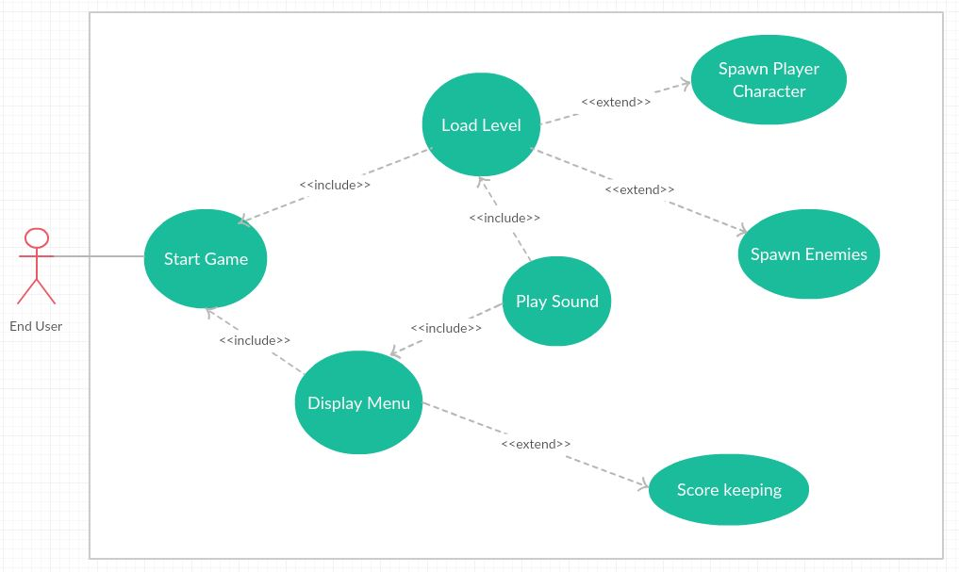
Global Use Case

Slide 3
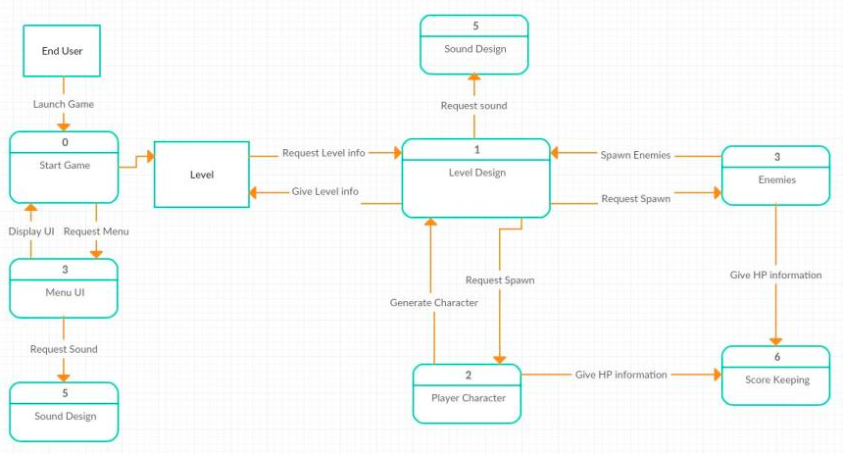
Diagram 0

Slide 4
Luis Lopez – Player Character
Coordinate Rigid body with character movement
Create projectile to destroy enemies
Communicate with scorekeeper to keep track of score and health
Create character motions such as walk, jump , run and shoot
Priority level: 2
Complexity: Moderate

Slide 5
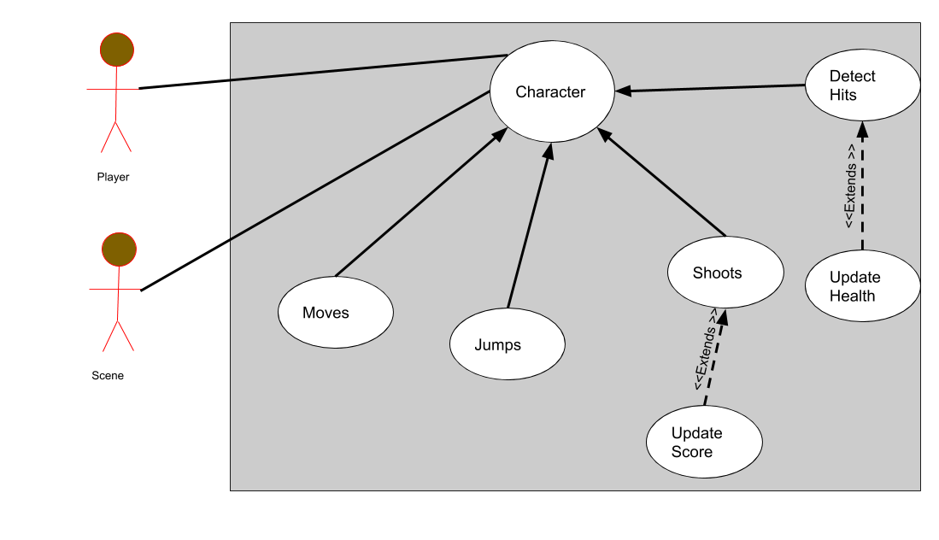
Player Character – Use Case Diagram

Slide 6
Josh – Level Design
Creating graphics of stage and objects
Coordinate with Luis for player character
Coordinate with Ben for enemy spawn
Ensuring all objects interact as intended
Priority level: 1
Complexity: Moderate

Slide 7
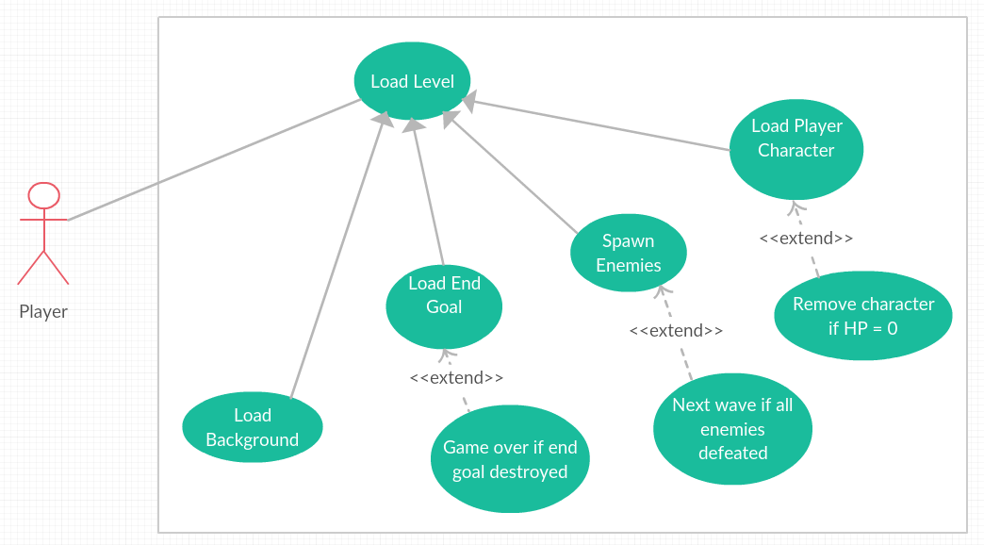
Level Design – Use Case Diagram

Slide 8
Ben – Enemies
Creating Enemies and releasing them into the playing field
Coordinating with Josh on when to spawn enemies
Making sure enemies advance and attack automatically
Making sure enemies can navigate around obstacles
Coordinating with Luis on interactions between enemies and the player character
Priority level: 3
Complexity: Moderate

Slide 9
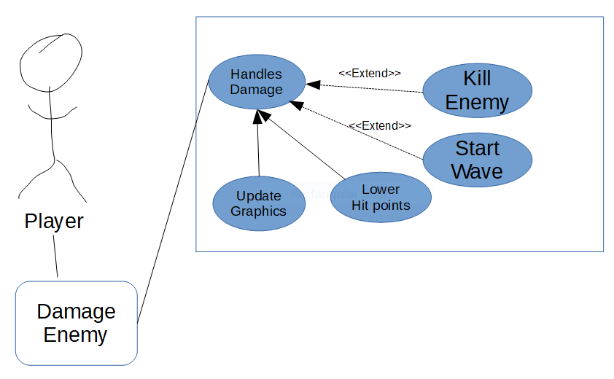
Use case – Damaging enemies

Slide 10
Blakely – Sound
Creating Sounds for levels and sound effects
Coordinate with Luis on player sound effects
Coordinate with Ben on enemy sound effects
Provide seamless timing between character trigger and sound effect
Priority level: 3
Complexity: Moderate

Slide 11
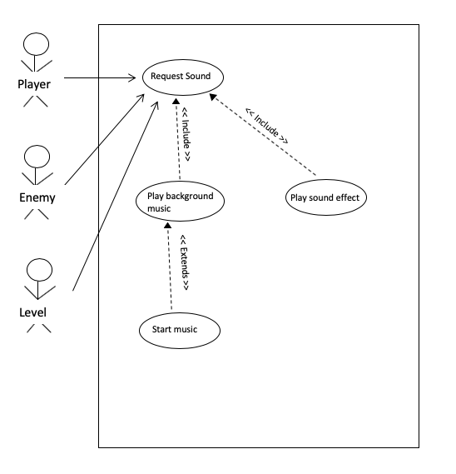
Sound Design – Use Case Diagram

Slide 12
Joel – Game Menus
Creating game menus that include a Start Menu and a Pause Menu.
Coordinate with Luis and Josh to determine most useful functionalities for the gamer and add them as options to the appropriate menu.
Coordinate with Josh to determine a design that flows with the in game graphics.
Coordinate with Luis to determine how the gamer can access the appropriate menu.
Priority level: 2
Complexity: Moderate

Slide 13
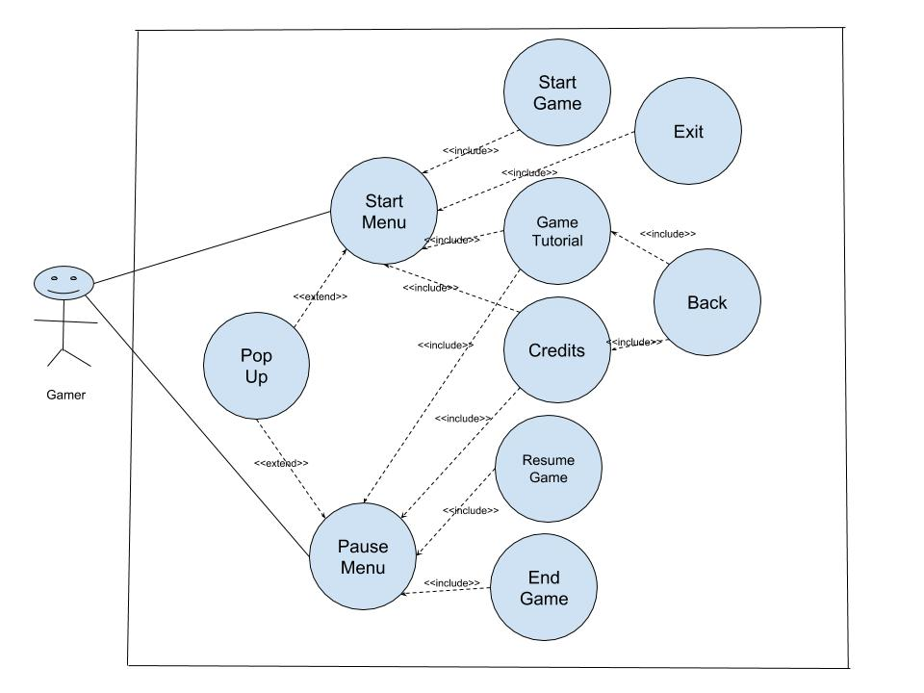
Display Menu – Use Case Diagram

Slide 14
Nate – Score Keeping
Generating a value based on performance of the player
Coordinating with Luis to determine player stats
Coordinating with Ben to determine enemy stats
Coordinating with Joel to display performance value
Priority level: 3
Complexity: Light

Slide 15
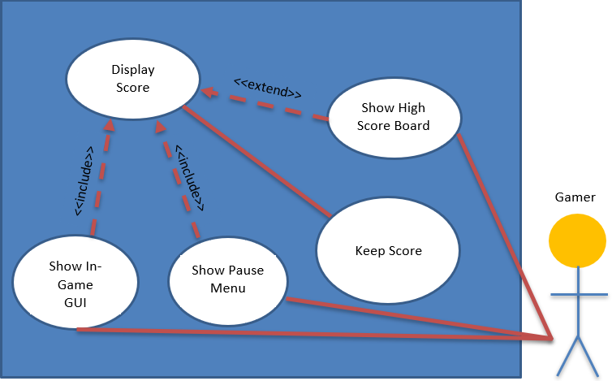
Display Score – Use Case Diagram
Player

