Slide 1

Debugger
Banana Development Team

Slide 4
Josh – Level Design
Creating graphics of stage and objects
Coordinate with Luis for player character
Coordinate with Ben for enemy spawn
Ensuring all objects interact as intended
Priority level: 1
Complexity: Moderate

Slide 5
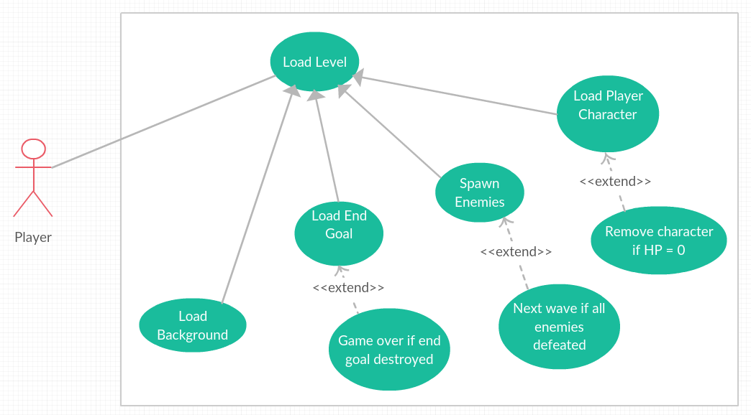
Level Design – Use Case Diagram

Slide 8
Ben – Enemies
Creating Enemies and releasing them into the playing field
Coordinating with Josh on when to spawn enemies
Making sure enemies advance and attack automatically
Making sure enemies can navigate around obstacles
Coordinating with Luis on interactions between enemies and the player character
Priority level: 3
Complexity: Moderate

