Slide 1







Debugger
Ben
Luis
Team Banana
Josh
Joel
Blakely
Nate

Slide 2
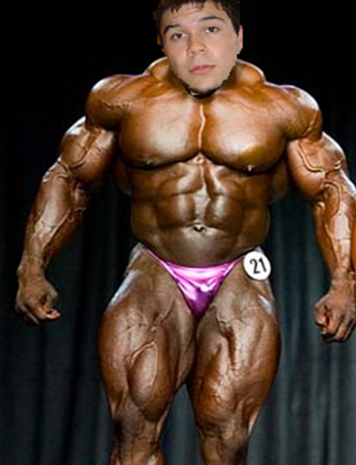
Banana Profile
Joel
Team Lead 4
Project Manager
Game Menus

Slide 3
Team Banana
IT Manager – Ben: enemies
Software Architect – Luis: player character
Quality Assurance Manager – Josh: level design
Project Manager – Joel: menus
Software Architect – Blakely: sound
Documentation Specialist – Nate: score keeping

Slide 4

This Week
Enemy spawning
Gameplay music
Main menu functionality

Slide 5
Remaining Task
Enemy interactions
Player functionality
Game menus (pause menu, end menu)
Sound effects
Score keeping
Game cosmetics

