Slide 1

Debugger
Banana Development Team

Slide 4
Josh – Level Design
Creating graphics of stage and objects
Coordinate with Luis for player character
Coordinate with Ben for enemy spawn
Ensuring all objects interact as intended
Priority level: 1
Complexity: Moderate

Slide 5
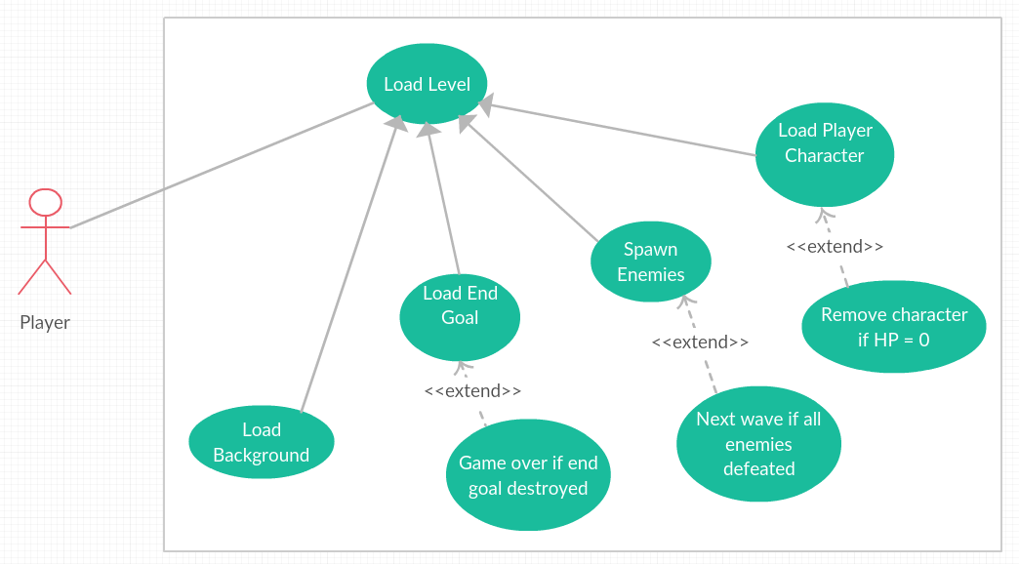
Level Design – Use Case Diagram

