Slide 1
RAILGUN
By Corbyn Becker and Ethan Vorkink

Slide 2
History
Pros
Cons
Implementations
Summary
References

Slide 3
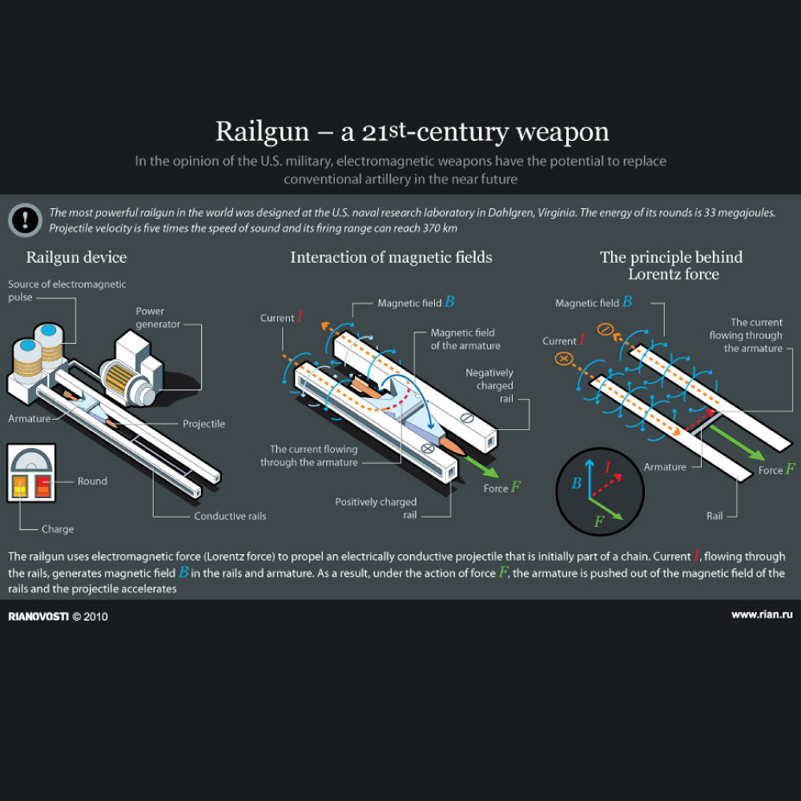
Summary
The railgun, invented in 1918, is a weapon that uses electrical power to shoot projectiles at hypersonic speeds, it uses electromagnetic forces to shoot the projectiles. It is made of 2 parallel conductors and a sliding armature is sped up with the electromagnetic force it goes down one rail, into the armature, and back up the other rail. The projectile is placed in the armature, in doing so, it completes the circuit. The projectile is just a projectile, nothing more. They contain absolutely 0 explosive aspect, and depend on the kinetic energy of the projectile to obliterate anything in its path. It travels upwards of 7 times the speed of sound.
Notes:
Rail guns use electrical power instead of chemical power to propel projectiles over long distances at hypersonic speeds. A linear motor device, this weapon typically uses electromagnetic force to launch its projectiles.
Such weapons will usually consist of two parallel conductors (rails) along which a sliding armature is sped up by the electromagnetic effects of a current that flows down one rail, into the armature, and then back along the other rail. A projectile is loaded in the armature, completing a circuit between the rails. It works on the same kind of ideas as the homopolar motor.
However, unlike present-day artillery shells, railgun projectiles are just that – projectiles.
They contain no explosives, relying on the kinetic energy imparted by the projectile, traveling seven or so times the speed of sound, which can rip through steel or concrete, destroying anything in its path.

Slide 4
History
The railgun was first thought of in 1918 by French inventor Louis Octave Fauchon-Villeple.
The first working railgun was made in Germany 1944
They were going to be mass produced as electric anti-aircraft weapons, but the power needed to run them would have to be equivalent to half of Chicago.
During 1950, an Australian physicist named Sir Mark Oliphant, started making the world's largest homopolar generator. It worked from 1962 and was used to power a large railgun that was a scientific experiment.
Notes:
In 1918, French inventor Louis Octave Fauchon-Villeplee invented an electric cannon which is an early form of railgun. He filed for a US patent on 1 April 1919, which was issued in July 1922 as patent no. 1,421,435 "Electric Apparatus for Propelling Projectiles".^{[5]} In his device, two parallel busbars are connected by the wings of a projectile, and the whole apparatus surrounded by a magnetic field. By passing current through busbars and projectile, a force is induced which propels the projectile along the bus-bars and into flight.^{[6]}
In 1944, during World War II, Joachim Hänsler of Germany's Ordnance Office built the first working railgun, and an electric anti-aircraft gun was proposed. By late 1944 enough theory had been worked out to allow the Luftwaffe's Flak Command to issue a specification, which demanded a muzzle velocity of 2,000 m/s (6,600 ft/s) and a projectile containing 0.5 kg (1.1 lb) of explosive. The guns were to be mounted in batteries of six firing twelve rounds per minute, and it was to fit existing 12.8 cm FlaK 40 mounts. It was never built. When details were discovered after the war it aroused much interest and a more detailed study was done, culminating with a 1947 report which concluded that it was theoretically feasible, but that each gun would need enough power to illuminate half of Chicago.^{[6]}
During 1950, Sir Mark Oliphant, an Australian physicist and first director of the Research School of Physical Sciences at the new Australian National University, initiated the design and construction of the world's largest (500 megajoule) homopolar generator.^{[7]} This machine was operational from 1962 and was later used to power a large-scale railgun that was used as a scientific experiment.^{[8]}

Slide 5
More History
During World War II, Joachim Hänsler of Nazi Germany developed a railgun concept, launching projectiles at a speed of 2000 m/s
As of yesterday(3/5/23), the U.S navy plans on using the rail gun they have been developing, for the primary use of shooting down stealth aircraft and hypersonic missiles.
Notes:
During World War II, Joachim Hänsler of Nazi Germany’s Ordnance Office also developed a concept for a railgun that that was supposed to launch projectiles at a speed of two thousand meters per second.

Slide 6
Pros
Some of the advantages of the rail gun are…
The railgun has a lot higher velocity then a normal gun so it is more accurate and it has a longer range.
The railgun does not have any cartridge cases so it makes the gun smaller
The railgun has smaller projectiles and an open breech so it has a fast fire rate
In the eyes of the government the railgun projectile is relatively cheap

Slide 7
Cons
Some cons of the railgun include…
Very power hungry
Unbelievably strong
High upkeep cost
They break very fast, so they are usually one use only, or just wear down, so high maintenance.
Notes:
Given the fact that the weapons are so accurate and deadly but not widely adopted must mean there are issues—and there are actually plenty. The first is the aforementioned power supply. Even today the amount of energy to power the weapons is simply not feasible, which is why railguns would likely be confined to a warship or other platform that could in fact supply that demand for power.
Then there is the issue of resistive heat, which can damage the surface of the rails. Heat has been a problem with machine guns since their invention and an early solution was to water cool the barrel, while later the best option was to swap out the barrel and maintain fire discipline. Cooling options are being explored, but a weapon that can’t be repeatedly fired without damaging the system isn’t something any military is likely to adopt.
The final problem is that because the currents can also create serious wear and tear—meaning many prototypes will break after just a few uses.

Slide 8
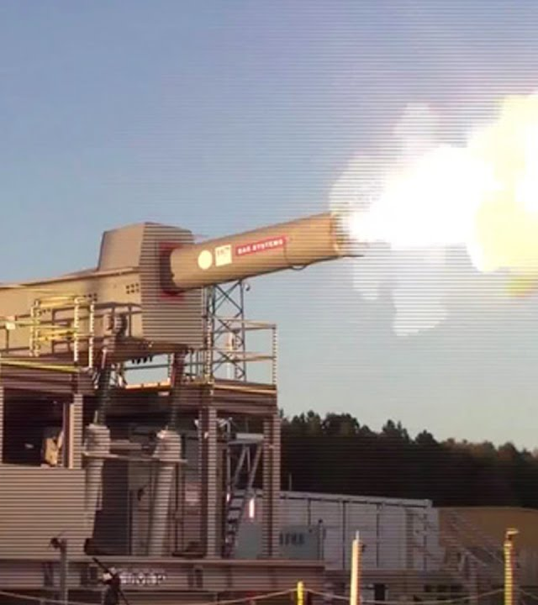
Implementations
As of March 5, 2023 the Railgun will be used on warships and trucks to shoot down stealth aircraft, hypersonic missiles and satellites.

Slide 9
Excel Spreadsheet

Slide 10
Refrences
https://military-history.fandom.com/wiki/Railgun#History
https://cove.army.gov.au/article/future-battlefield-what-impact-will-railguns-have
https://science.howstuffworks.com/rail-gun2.htm#:~:text=Because%20the%20currents%20in%20a,can%20only%20be%20used%20once.
https://prezi.com/stbqhmhmyjen/rail-guns-moral-pros-and-cons/

