Slide 1

AUTOMATIC EVOLVING A ROBOCODE TANK BASED ON GENETIC PROGRAMMING
戴宗明
張筠婕
連俊豪

Slide 2

INTRODUCTION

Slide 3
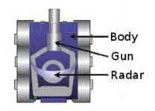
Tank can move forward and backward
There are three components
    Radar: Scan the enemy
    Gun: Fire bullets
    Body: Moving direction
Once the energy is empty, any additional damage will destroy the tank
You can ram or fire to cause damage

Slide 4
Result scores
    Total Score - This is everything else added up, and determines each robot's rank in this battle.
    Survival Score - Each robot that's still alive scores 50 points every time another robot dies. Last
    Survivor Bonus - The last robot alive scores 10 additional points for each robot that died before it.
    Bullet Damage - Robots score 1 point for each point of damage they do to enemies.
    Bullet Damage Bonus - additional 20% of all the damage it did to that enemy when killed enemy.
    Ram Damage - Robots score 2 points for each point of damage they cause by ramming enemies.
    Ram Damage Bonus - additional 30% of all the damage it did to enemy when killed enemy.

Slide 5
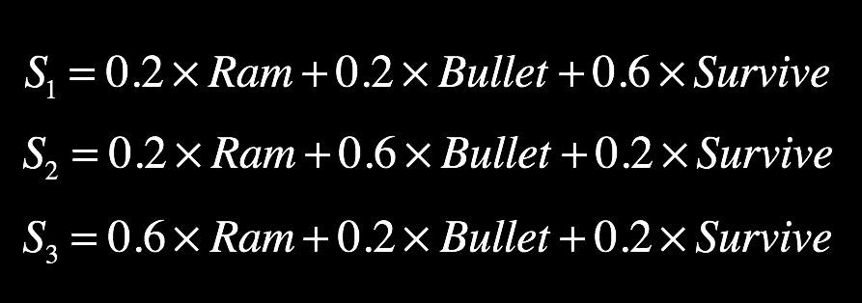
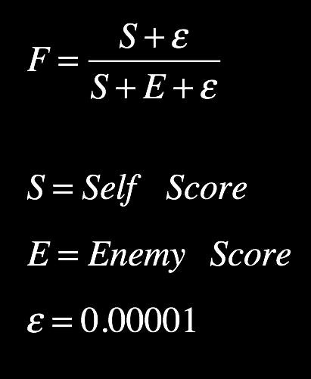
GOAL (FITNESS)
Automatically generating tanks that try to get higher score
3 Population groups
Different goal in each population group

Slide 6
GENETIC PROGRAMMING

Slide 7
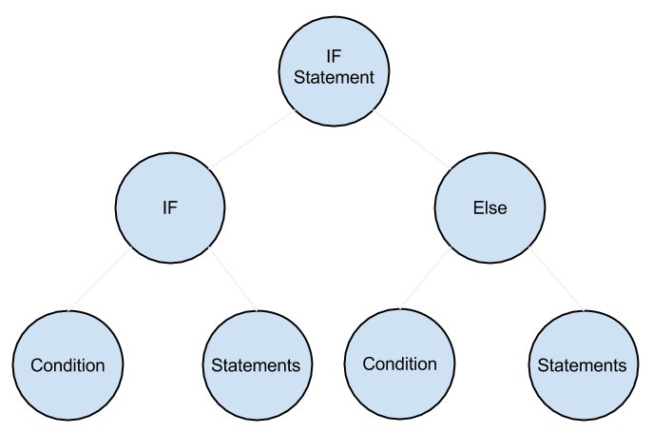
ENCODE
An individual contains multiple trees
Tree are ruled by a syntax table

Slide 8
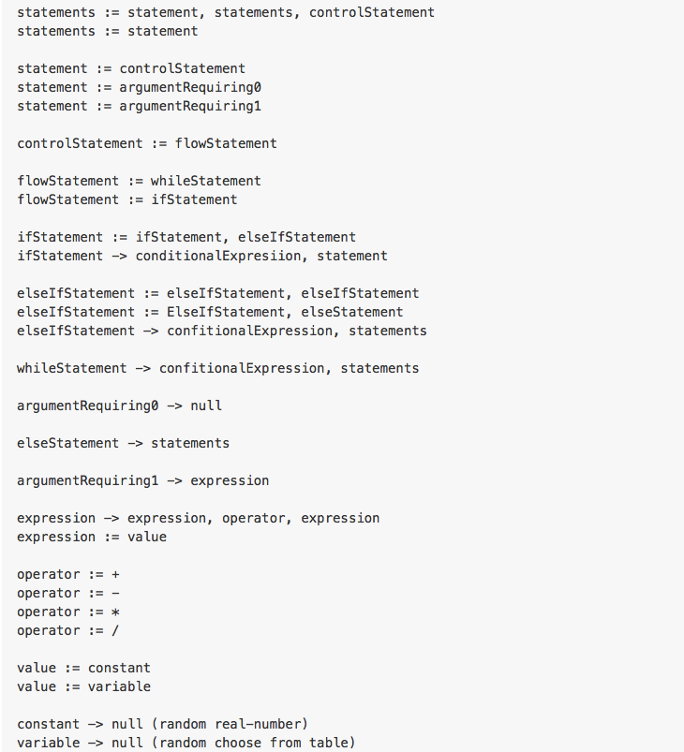
https://github.com/CorcovadoMing/GeneticProgrammingRobocode

Slide 9
DECODE
If ( Condition ) {
Statements
}
Else ( Condition ) {
Statements
}

Slide 10
ABOUT POPULATIONS
Three Population group ( Survival, Bullet, Ram )
In each population group, there are 10 individuals ( Population size)
In each individuals, there are 3 tress (Evolving 3 functions, Fire, Move, onHitWall)

Slide 11
INITIALIZE
Random initiaization
If level less than 5, use both growth ruleset and terminal ruleset
if level more than 5, use terminal ruleset only

Slide 12
MATING SELECTION
2 - Tournament

Slide 13
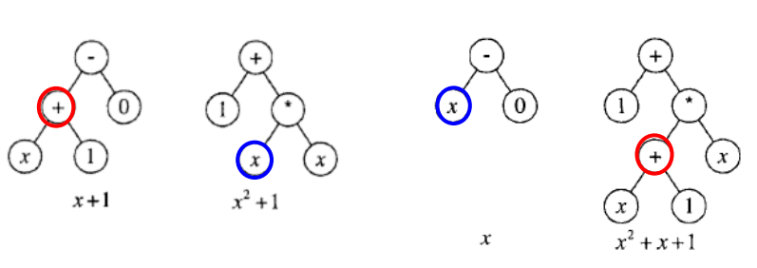
CROSSOVER
Swap two sub-tree
Crossover rate: 1

Slide 14
MUTATION
For each individual, if U(0, 1) less than mutation rate, choose a random function tree ( 1 of the 3 ), then choose a random node in the tree, delete and re-generate
Mutation rate 0.5

Slide 15
ENVIRONMENT SELECTION
Steady-state, ( top half of N+N )
Elitism

Slide 16
INTEGRATION

Slide 17
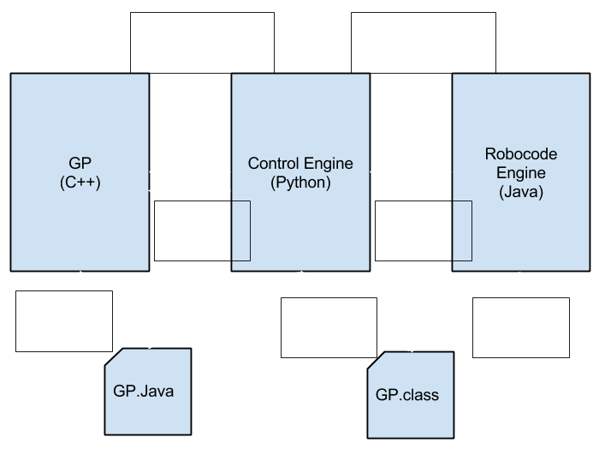
ARCHITECTURE

Slide 18
RESULT

Slide 19
EXPERIMENTS
Simulate times: 10 (Sum up the results)
Crossover rate 1,
Mutation rate 0.5
Population size: 10
Experiment 1:
    Benchmark robots: 5-Built-in (RamFire, Crazy, SpinBot, TrackFire, Fire)
Experiment 2:
    Benchmark robots: Handmade (By me), cslib.SnipperBot (Internet)

Slide 20
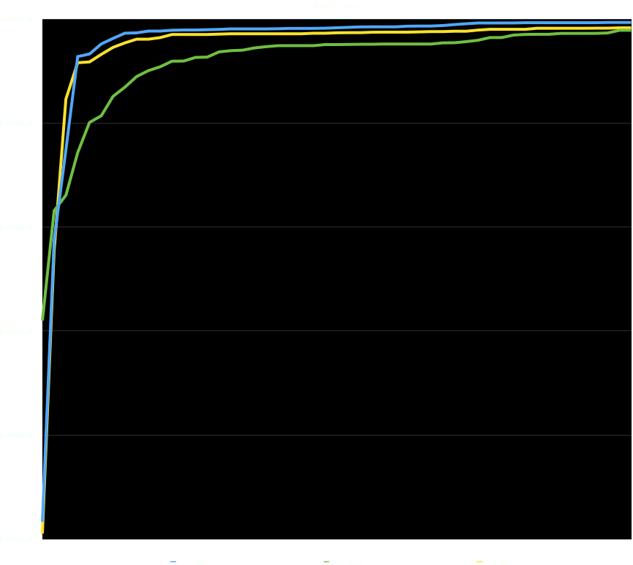
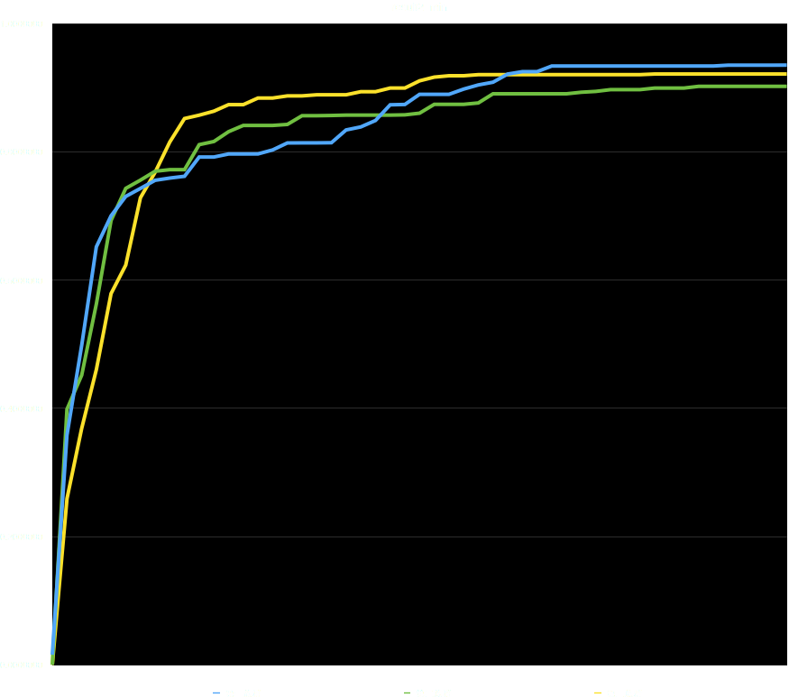
RESULT MIN ( EXP1, EXP2 )

Slide 21
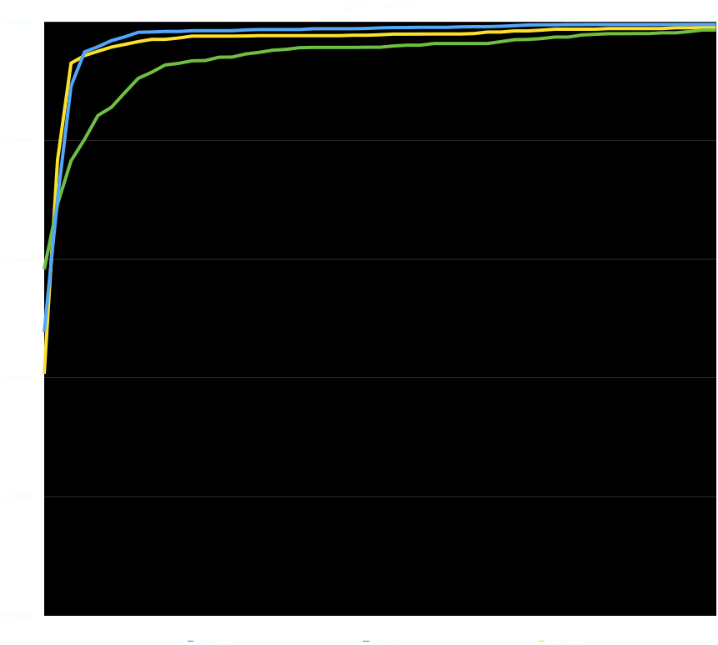
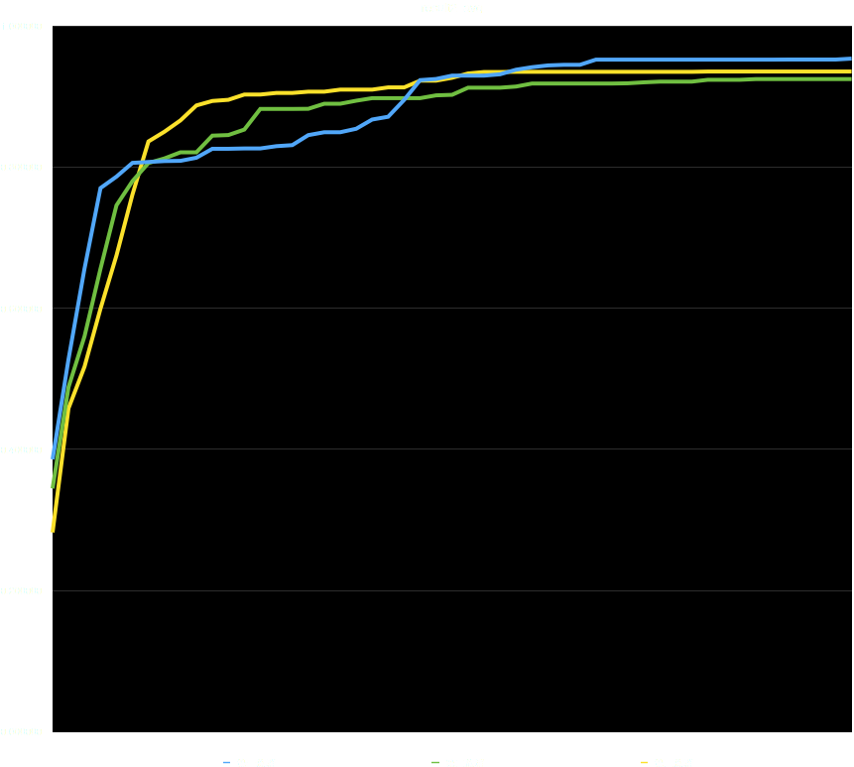
RESULT AVG ( EXP1, EXP2 )

Slide 22
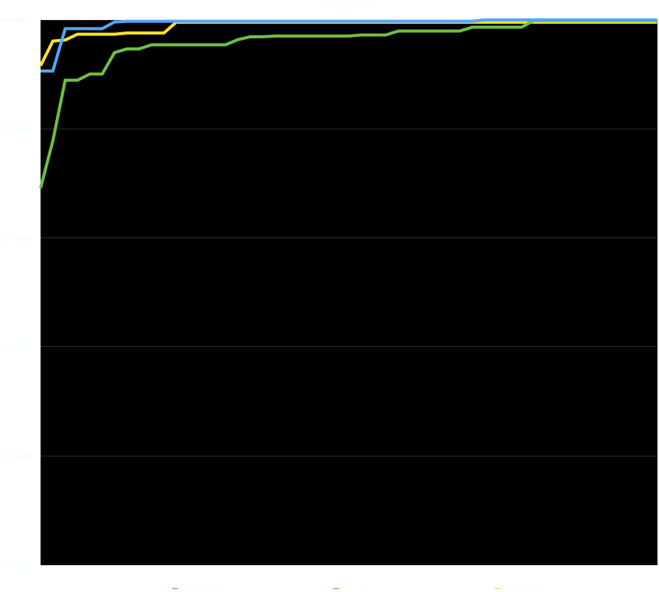
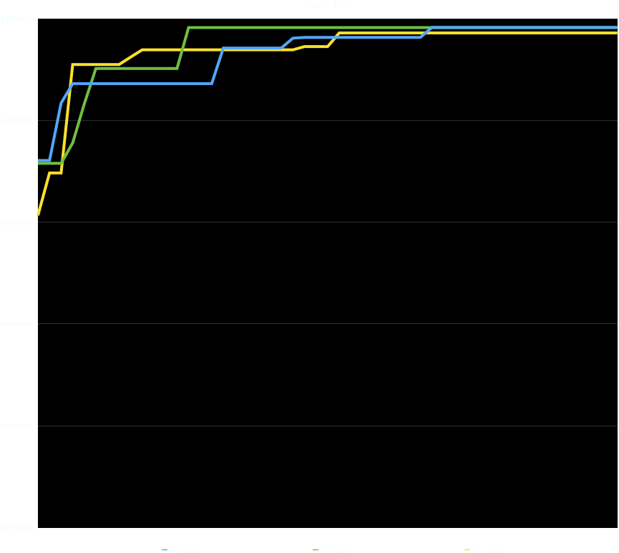
RESULT BEST ( EXP1, EXP2 )

Slide 23
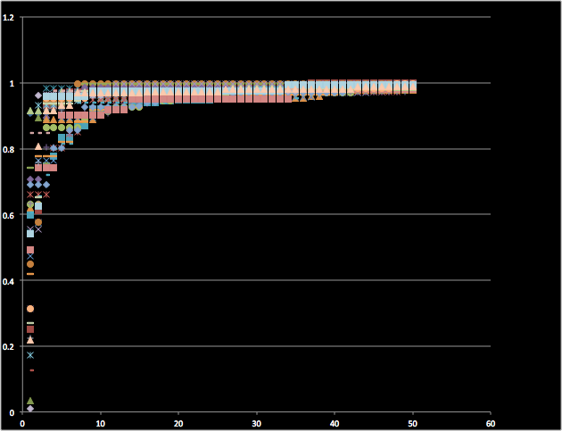
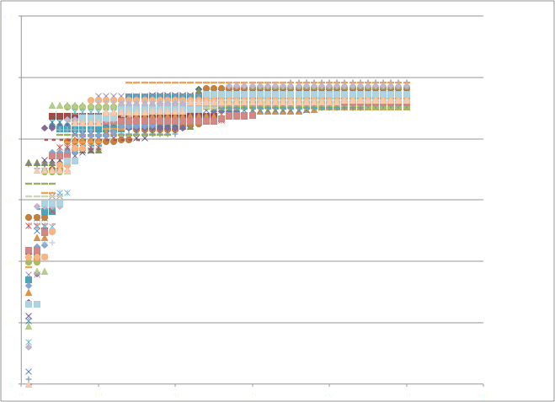
RESULT CONVERGE ( EXP1, EXP2 )

Slide 24
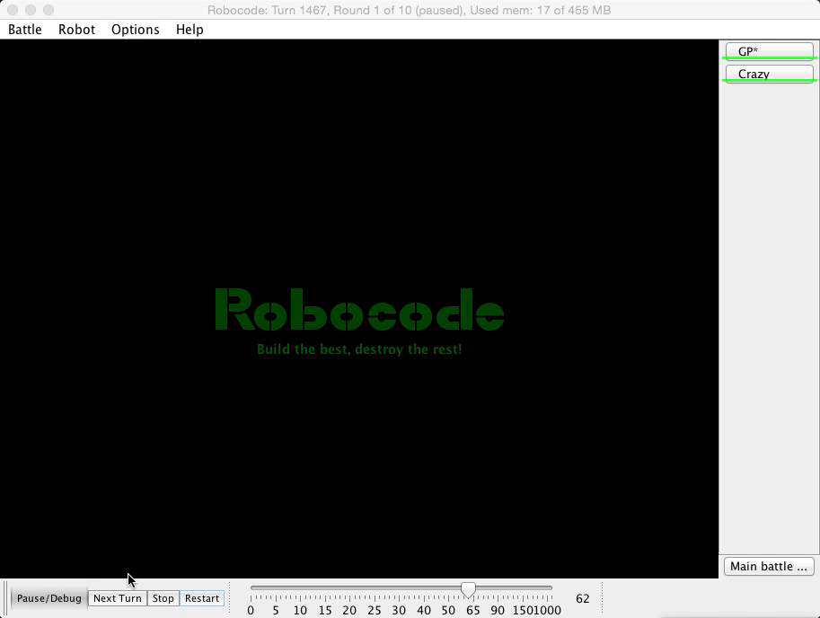
VIDEO-INITIAL ( GENERATION 0 )

Slide 25
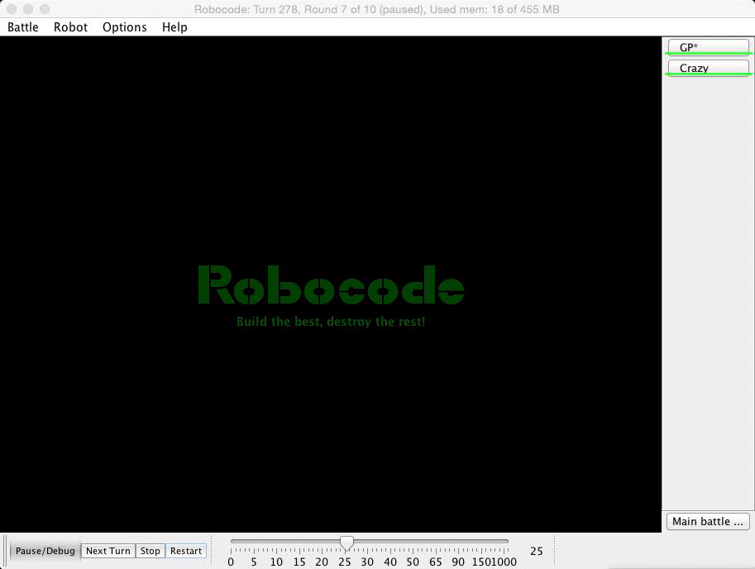
VIDEO-FINAL-EXP1 ( GENERATION 50 )

Slide 26
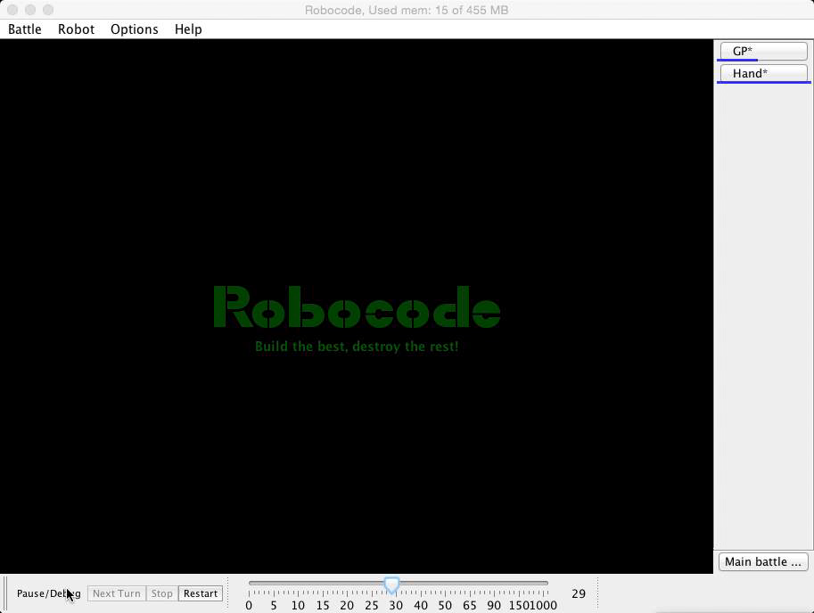
VIDEO-FINAL-EXP2 ( GENERATION 50 )

Slide 27
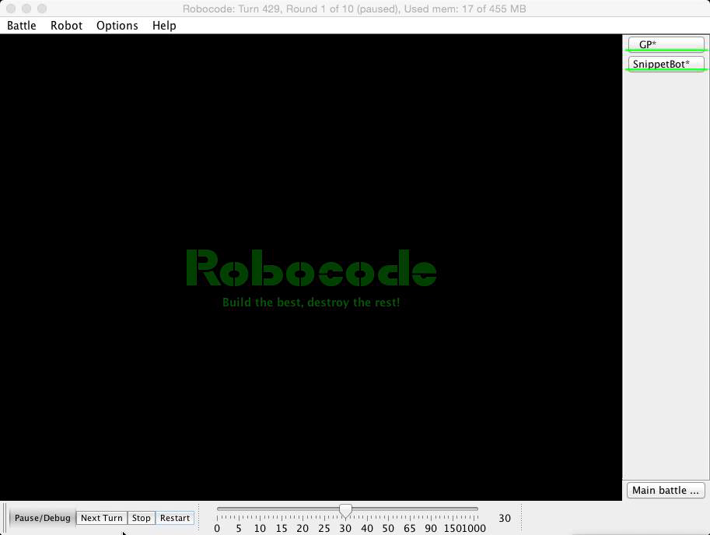
VIDEO-FINAL-EXP2 ( GENERATION 50 )
It became Wall?

Slide 28
DISCUSS
3 Population group are the same
    Fitness function is important ( need to consider more )
    Bullet score dominate
Benchmark target is also important
    Exp 1, lead to a “more general tank”
    Exp 2, A “Wall-like” take

Slide 29
FUTURE WORK
More benchmark robots from internet to evolve
Local search
Refine and refactor the code
We put the whole project in docker containers and on the github, welcome to contribute or provide any advises!

Slide 30
Questions?

