Slide 1

Spectre, the juicy parts
Ofek, Jan 2018

Slide 2
Organization
Process Isolation
Process Isolation loopholes:
Flush & Reload
Branch Poisoning
Gadgets
Tying it together (==Spectre)
Optional:
Potential Mitigations
Impact

Slide 3
Process Isolation
The CPU & OS present to each process a worldview wherein it is the only one in the world.
notepad.exe
“Memory at” 0x12345678
0xbaadf00d
calc.exe
“Memory at” 0x12345678
0x1ee71ee7

Slide 4
Process Isolation
The CPU & OS present to each process a worldview wherein it is the only one in the world.
notepad.exe
Virtual address 0x12345678
Memory manager
Physical address 0x12312312ab
0xbaadf00d
calc.exe
Virtual address 0x12345678
Physical address 0xabcabcab12
0x1ee71ee7

Slide 5


A. Flush + Reload Attack
Yuval Yarom, Katrina Falkner, 2014 https://www.usenix.org/system/files/conference/usenixsecurity14/sec14-paper-yarom.pdf
Extends on ‘Prime & Probe’ 2010 paper, and ‘Cache Games’ from 2011.

Slide 6
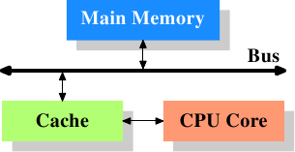
Process Isolation Loophole 1: Caches
Memory hierarchy
L1 i/d ~0.5 ns
L2 per core ~7 ns
L3 common ~25 ns
RAM ~100ns
Shared Pages
Common DLLs are loaded at memory once, used by multiple processes.
Tagged at the cache level too.

Slide 7
Flush & Reload
Attacker Process
Basic attacker course of action:
Load the victim DLL of interest
For any particular address within the DLL:
Make sure it is out of the cache
Access it, measure the time.
Less than 80 ns? Just used by the victim.
Victim Process
DLL
Notes:
A round of attack consists of three phases. During the first phase, the monitored memory line is flushed from the cache hierarchy. The spy, then, waits to allow the victim time to access the memory line before the third phase. In the third phase, the spy reloads the memory line, measuring the time to load it. If during the wait phase the victim accesses the memory line, the line will be available in the cache and the reload operation will take a short time.

Slide 8
Flush & Reload
Original attack traced code execution in GPG (Gnu PrivacyGuard), an open source RSA implementation.
“…Each occurrence of Square-Reduce-Multiply-Reduce within the sequence corresponds to a bit whose value is 1.
Occurrences of Square-Reduce that are not followed by a Multiply correspond to bits whose values are 0. …”

Slide 9
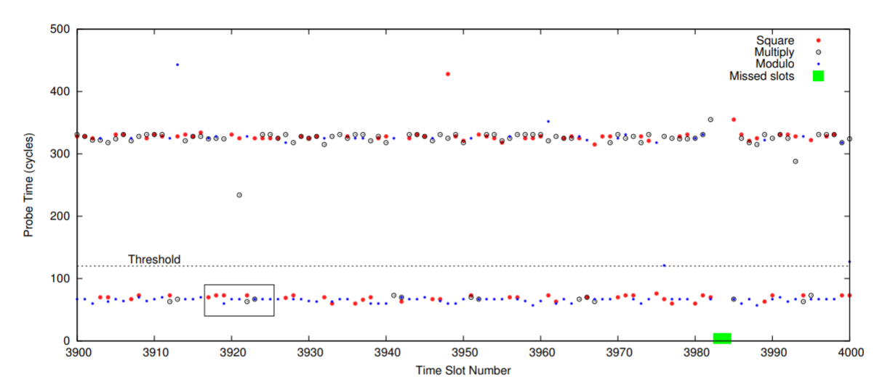
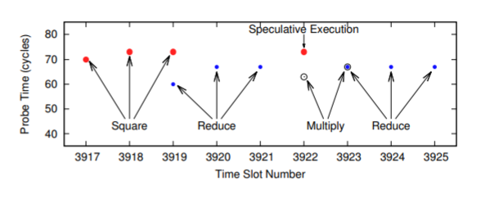
Flush & Reload
On some systems, this attack had 99% success in obtaining RSA keys

Slide 10
Flush + Reload
2017 Novelty: leak values in memory, not just address usage!
y = array2[array1[x] * 256];
The value in x dictates the memory chunk accessed.

Slide 11










B. Branch Poisoning (Spectre!) yamba ppl

Slide 12
Process Isolation Loophole 2: Speculative Execution
CPUs can’t wait, and execute ahead of time (Out Of Order).
Naïve execution induces many such waits.
…
cmp [var], 0
jne SomeFunc
…
…
call [eax]
…

Slide 13
Process Isolation Loophole 2: Speculative Execution
Several mechanisms are in place for ‘informed guesses’ on branch destinations.
Mostly, this branch will be true:
Virtual function calls ( call [eax] ) in a succession from the same address, mostly direct to the same destination.
for (int i=0; i<1000; ++i)

Slide 14
Process Isolation Loophole 2: Speculative Execution
CPUs maintains ‘history caches’ to predict branch destinations and perform speculative execution. When the branch is retired, speculative results based on wrong guesses are dumped.
The loopholes:
Branch prediction is per-processor, not per process. A process can train a branch, and thereby direct speculative execution on a different process.
Speculative execution can go where regular code can’t. (Meltdown)
Notes:
Undocumented details
Haswell seems to have multiple branch prediction mechanisms that work very differently:
A generic branch predictor that can only store one target per source address; used for all kinds of jumps, like absolute jumps, relative jumps and so on.
A specialized indirect call predictor that can store multiple targets per source address; used for indirect calls.
(There is also a specialized return predictor, according to Intel's optimization manual, but we haven't analyzed that in detail yet. If this predictor could be used to reliably dump out some of the call stack through which a VM was entered, that would be very interesting.)

Slide 15
Spectre I
Suppose:
this victim process has a code snippet similar to:
The attacker can control x - via file, external parameter etc.
if (x < array1_size) y = array2[array1[x] * 256];

Slide 16
Spectre I
Then the attacker process:
Trains the branch x < array1_size to be true,
Flushes x out of the cache.
Sniffs x via flush & reload.
if (x < array1_size) y = array2[array1[x] * 256];
A CPU delay is incurred at the branch.
The statement array2[array1[x]*256] is executed speculatively - without bounds restrictions!

Slide 17

C. Gadgets
Return Oriented Programming
Hovav Shacham 2007 https://cseweb.ucsd.edu/~hovav/dist/geometry.pdf

Slide 18
Process Isolation Loophole 3: Existing code is rich enough to do anything
In a large enough piece of machine code, you can find anything you want.
The SW equivalent of a million monkeys typing for a million years.
In particular for x86/x64 architectures: dense code.
Notes:
Attach to calc

Slide 19
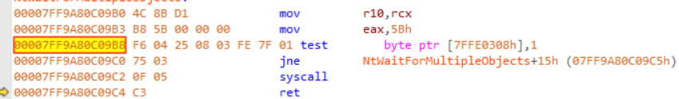
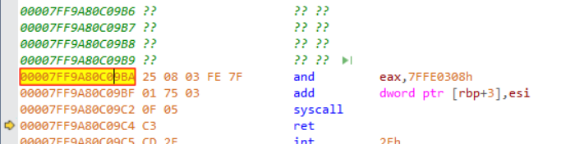
Gadgets
Notes:
Search examples

Slide 20
Context: Return Oriented Programming
NX
Buffer overflow
History:
Stack-smashing
DEP
Malicious code
Malicious return
Return address
Local variables

Slide 21
Context: Return Oriented Programming
NX
Buffer overflow
Gadget
History:
Stack-smashing
DEP
RoP
More or less turing-complete machine from gadget building blocks.
Code Execution exploit, of buffer overrun vulnerability
Gadget
Malicious return
Malicious return
Malicious return
Return address
Gadget
Local variables

Slide 22




D. Tying it all together – Spectre II

Slide 23
Abilities thus far
Process Isolation
Process Isolation loopholes:
Flush & Reload
Branch Poisoning
Gadgets
Tying it together (==Spectre)
Optional:
Potential Mitigations
Impact
3. Sniff memory value at address accessed by the victim
2. Direct speculative execution at victim process to the gadget
1. Find gadgets to direct execution to.
Notes:
Each requires intimate knowledge of different processor internals

Slide 24
Spectre II - Toy Example Attack
At the victim process, locate this gadget:
At joint attacker/victim process, locate this frequently-executed branch:
Suppose at the branch location ebx is some unused external function argument.
Control ebx to point to a memory location of interest.
At the attacker process, train the jump to reach the gadget. It is now executed speculatively.
At the attacker process, use Flush and Reload to sniff which address was read.
mov eax [ebx]
add 1 [eax]
jmp [0x00123456]

Slide 25
Spectre II – PoC
The victim gadget: the sequence of bytes 13 BC 13 BD 13 BE 13 12 17 found in ntdll.dll:
The victim branch:
At a point where ebx and edi contain file data and are ignored by Sleep()
adc edi,dword ptr [ebx+edx+13BE13BDh]
adc dl,byte ptr [edi]
Sleep(0) :
jmp dword ptr ds:[76AE0078h]

Slide 26
Spectre II - General
At the victim process, find a gadget that accesses memory via the attacker controlled registers.
At the victim process, find a frequently executed indirect jump:
at a site where the attacker can control some registers.
At the attacker process, train the jump to reach the gadget.
At the attacker process, use Flush and Reload to sniff the speculative execution results.
Jmp / call
eax / [eax] / [0x12345678]

Slide 27
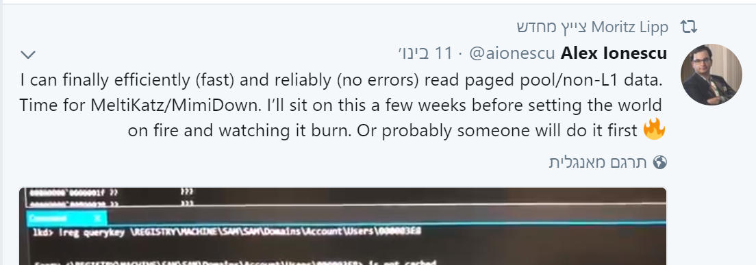
Impact
https://spectreattack.com/

Slide 28
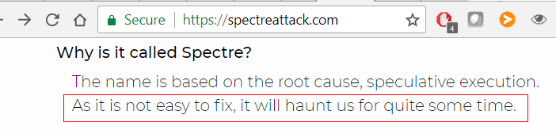
Mitigations
Timer resolution
Speculation Barrier (https://github.com/ARM-software/speculation-barrier)
Hard on performance (image)
Retpoline (http://lists.llvm.org/pipermail/llvm-commits/Week-of-Mon-20180101/513630.html)
Not really.

Slide 29

Q?

