Slide 1
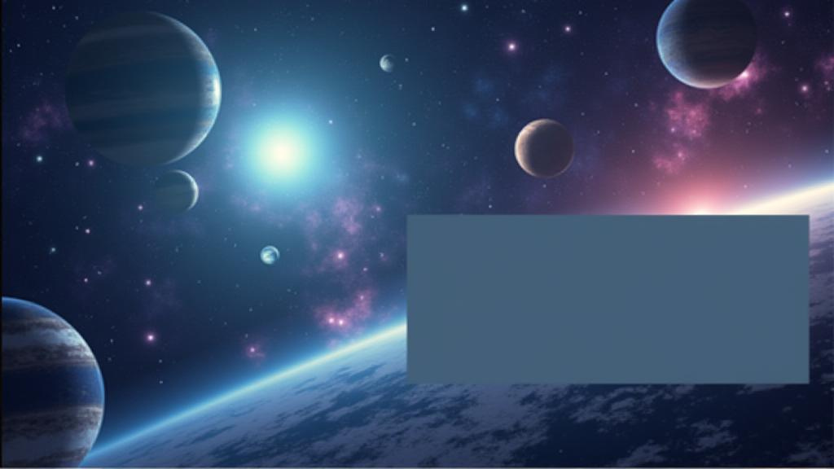
Welcome to NASA

Slide 2
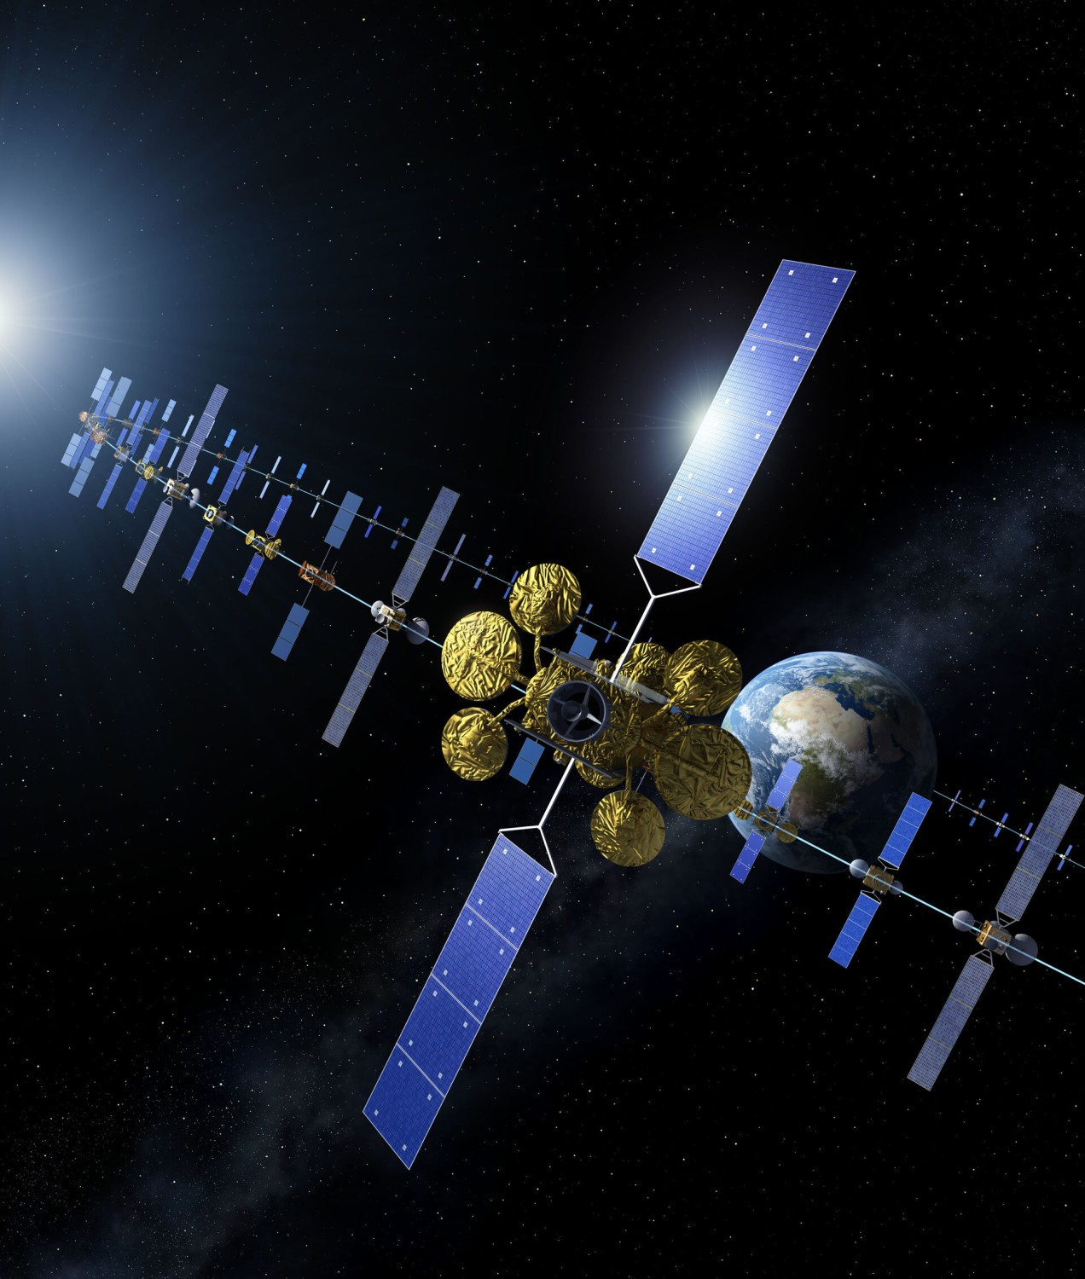



Introduction to Satellite Tracking
Discover Purpose and Missions
This website serves as a comprehensive platform for tracking satellites in real-time. You can learn about significant satellites like the ISS, Hubble, and Sentinel, along with their missions. The user-friendly interface allows you to navigate through various features including real-time travel updates and distance metrics, enhancing your understanding of space technology.

Slide 3



Overview of Key Satellites
International Space Station (ISS)
The ISS is a unique laboratory orbiting Earth, enabling research in microgravity and international collaboration for scientific advancements.
Hubble Space Telescope
Learn about important satellites and their missions
The Hubble Space Telescope has provided breathtaking images of space, revolutionizing our understanding of the universe through its detailed observations of distant galaxies.
Terra Satellite
The Terra satellite monitors Earth's climate and environment, providing critical data on land, oceans, and atmosphere to support global sustainability efforts.
Sentinel Satellites
The Sentinel satellites are part of the Copernicus program, dedicated to monitoring and understanding changes in our planet's land and water resources.

Slide 4
Accessing the Live Server
Instructions for Viewing the Website
Well to access the or visit the visit all you gotta do it in given link click and you get zip file then all you do it just go ahead with the index.html just open with [MICROSOFT EDGE]You got everything.. Then you can easily freely access all over the page and visit whichever information you need to know

Slide 5



Exploring Satellite Data: Real-time Insights
Discover the fascinating world of satellites, their missions, and how to track them in real-time for educational and research purposes.

Slide 6
Purpose of the Website
Track Satellites and Access Information
This website serves as a comprehensive resource for tracking satellites. It provides detailed information about their purpose and missions, ensuring that users can easily access real-time data. With a user-friendly interface, visitors can explore various satellites, including the ISS, Hubble, and more, fostering a deeper understanding of our orbiting companions and their contributions to science.

Slide 7





Click here to Explore about our project
CoreFour-1/CoreFour: Something you want to know about Satellites
Team Members -Farhad Ahmed
-Abdel Rehman
-Hamid Mehmood
-Mohammed Saiyam

