Slide 1
Enterprise JavaScript with Jangaroo
Using ActionScript 3 for JavaScript ”Programming in the Large”
Andreas Gawecki Frank Wienberg
Software Architects & Jangaroo Evangelists

Slide 2
Need
Applications are supposed to run on many platforms. The browser is becoming the ubiquitous client platform, so everybody is doing JavaScript today.
Notes:
Andere RIA-Technologien haben sich nicht durchgesetzt
Für viele ein notwendiges Übel: “Muss man ja leider benutzen”
“Möglichst viel auf dem Server implementieren, da gibt es wenigstens vernünftige Infrastruktur”  Web 2.0

Slide 3
Problem
The target platform Web / browser only understands JavaScript, but:
JavaScript was not made for programming in the large
Notes:
Andere RIA-Technologien haben sich nicht durchgesetzt
Für viele ein notwendiges Übel: “Muss man ja leider benutzen”
“Möglichst viel auf dem Server implementieren, da gibt es wenigstens vernünftige Infrastruktur”  Web 2.0

Slide 4
What Brendan says
"The over-minimized design of JS [...] imposed a long-term complexity tax on JS programmers and libraries. Everyone invents an OOP framework, some standard packaging discipline, and a latent type system. Why should not the core language address these obvious requirements?"
Brendan Eich, creator of JavaScript
Notes:
But: the standardization process is going on for years, it seems that eventually Microsoft is retreating or even sabotaging the progress. If Microsoft does not support JS2, then IE won't, and it will only run via plugin...
What makes our approach different? We put the OOP framework into the language, not (only) into a runtime extension.

Slide 5
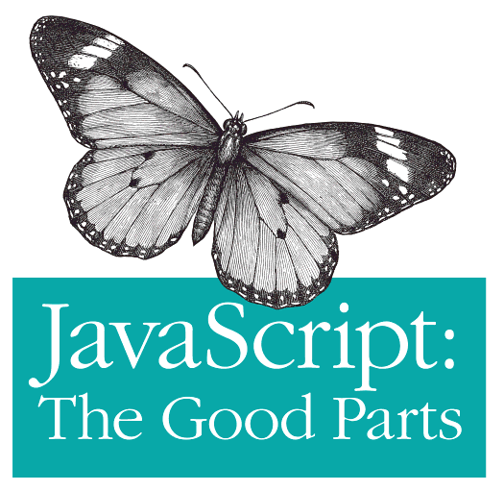
JavaScript for Enterprise – The Bad Parts
No packages / namespaces, classes, modules
No explicit interfaces / APIs
No static typing
Libraries and build process not standardized
Enterprise
Bad

Slide 6
Jangaroo Answer:
To target JavaScript, use a language similar to JavaScript, overcoming these Bad Parts:
ActionScript 3
Notes:
Andere RIA-Technologien haben sich nicht durchgesetzt
Für viele ein notwendiges Übel: “Muss man ja leider benutzen”
“Möglichst viel auf dem Server implementieren, da gibt es wenigstens vernünftige Infrastruktur”  Web 2.0

Slide 7
But ActionScript already runs in the browser?!

Slide 8
Yes, but only through a browser plugin!

Slide 9
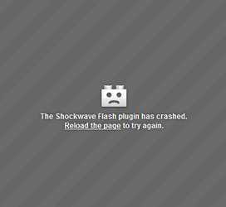
FlashPlayer Browser Plugin Downsides
Some platforms not Flash-enabled (iOS)
FlashPlayer has to rely on quirky old Browser plugin API
Does not integrate seamlessly with (D)HTML
Up-to-date plugin version not installed everywhere

Slide 10
How to execute another programming language in the browser?

Slide 11
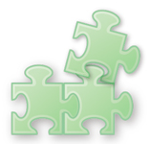


How to execute another programming language in the browser?
by plugin
Translate to JavaScript
Interpret in JavaScript

Slide 12
Which programming language?

Slide 13



Which programming language?
Java
(Oracle)
C#
(Microsoft)
ActionScript 3
(Adobe)

Slide 14








Available Technologies
 | by plugin | translate to JavaScript | Interpret in JavaScript
Java | Java Applet | GWT | Orto
C# | Silverlight | Script | - / -
ActionScript | Flash Player | Jangaroo (AS3) | Swiffy (AS2)

Slide 15
ActionScript 3 from a JavaScript developer’s point of view
ActionScript adds programming-in-the-large features missing in JavaScript
ActionScript and JavaScript are quite similar
Advantages of JavaScript are kept
Enhanced tool support
Notes:
ActionScript bietet die in JavaScript fehlenden programming-in-the-large-Features
Pakete, Klassen, Module, Schnittstellen, Sichtbarkeit
Statische Typisierung
ActionScript und JavaScript gut aufeinander abbildbar
Generierter Code und Quellcode sehr ähnlich
Einfacher für Entwickler (und für den Compiler)
Statische Typisierung optional => iterative Migration
Stärken von JavaScript bleiben erhalten
Closures
Dynamische Sprach-Aspekte
JavaScript-Bibliotheken können direkt verwendet werden
Tool-Unterstützung
In den letzten Monten dank Flex professionelles Niveau erreicht.
Diverse IDEs
Build-Prozess (Flex-Maven-Plug-Ins)
…

Slide 16
Jangaroo Approach
Compile ActionScript 3 to JavaScript that (through a small runtime library) a) runs in any browser and
b) looks very similar to the AS3 source code.

Slide 17
Jangaroo = Enterprise JavaScript ⊂ ActionScript 3

Slide 18
Jangaroo Source Code
package joo.util {
public class Offset {
public static const HOME : joo.util.Offset = new Offset(0, 0);
public function Offset(left : Number , top : Number ) {
this.left = left;
this.top = top;
}
public function clone() : joo.util.Offset {
return new Offset(this.left, this.top);
}
public function getDistance() : Number {
return Math.sqrt(this.left*this.left + this.top*this.top);
}
public function scale(factor : Number) : joo.util.Offset {
return new Offset(this.left * factor, this.top * factor);
}
public function isHome() : Boolean {
return this.left==0 && this.top==0;
}
public var left : Number;
public var top : Number;
}}

Slide 19
Jangaroo Compiled Code (JavaScript)
joo.classLoader.prepare(
"package joo.util",
"public class Offset",function($$l,$$private){var is=joo.is,assert=joo.assert,…;return[
"public static",{/*const*/ HOME/*: joo.util.Offset*/: function(){return new Offset(0, 0);}},
"public",function Offset(left/*: Number*/, top/*: Number*/) {
this.left = left;
this.top = top;
},
"public",function clone()/*: joo.util.Offset*/{
return new Offset(this.left, this.top);
},
"public",function getDistance()/*: Number*/{
return Math.sqrt(this.left*this.left + this.top*this.top);
},
"public",function scale(factor/*: Number*/)/*: joo.util.Offset*/{
return new Offset(this.left * factor, this.top * factor);
},
"public",function isHome()/*: Boolean*/{
return this.left==0 && this.top==0;
},
"public",{/*var*/ left /*: Number*/: undefined},
"public",{/*var*/ top /*: Number*/: undefined}
]});

Slide 20
Jangaroo’s ActionScript 3
Supported Features
package
class
private members
static members
inheritance (extends)
Import
interface (implements)
helper classes (same file)
optional semicolons
annotation ([…])
Only supported syntactically
visibility modifiers (protected, internal)
namespace
typing (no type conversion / coercion)
Not (yet) supported
E4X (XML literals and -API)
Not supported in IE < 9
Property accessor functions (get / set)

Slide 21
Jangaroo is More Than a Compiler

Slide 22
Jangaroo Features
Automatic loading of dependant classes
On-demand class initialization (static code)
Simple boot strap from HTML / JavaScript
Simple to use Jangaroo libraries from JavaScript code
Modular build process through Apache Maven
Versioned modules
Collection of transitive dependencies
Generate debug and optimized code in one go
IDE support through being AS3 compatible
Minor overhead in generated code
Jangaroo tools: ~13 k SLoC

Slide 23
Jangaroo Libraries
JavaScript libraries can be used as-is or through “fake” AS3 API
Available Jangaroo modules with AS3 API wrappers:
Browser DOM and BOM API
Ext Core
Ext JS 3
Sencha Touch (alpha)
soundmanager 2
Open Source ActionScript libraries can simply be recompiled:
FlexUnit
Box2D
Flixel
Flash standard libraries are not Open Source and thus have to be re-implemented for Jangaroo (work in progress on github)

Slide 24
Jangaroo: Project History
2004: Start as internal project „JSC“
Using it in CoreMedia CMS
07/2008: Open Source „Jangaroo“
09/2010: github
10/2011: current version: 0.8.7
6/2009: From ECMAScript 4 to ActionScript 3
http://blog.jangaroo.net/2008/07/former-life-and-birth-of-jangaroo.html

Slide 25
Software Lifecycle with Jangaroo
Jangaroo supports the whole lifecycle of professional software development of enterprise JavaScript applications

Slide 26
Software Lifecycle with Jangaroo
IDE
Build Process
Unit Test Framework
Automatic UI Tests
Continuous Integration
HTML Documentation
Source-Level Debugging

Slide 27
IDE Support
IntelliJ IDEA
Flash Develop
Powerflasher FDT
Flash Builder

Slide 28

Build Process
Command Line
Ant
IDEA (incremental)
Maven

Slide 29

Test Tools
UI Tests: Selenium
Unit Tests: JooUnit = FlexUnit 0.9 ⇨ Jangaroo
Continuous Integration: Hudson / Jenkins

Slide 30


Documentation and Debugging
Documentation: ASDoc
Debugging: Firebug & Co

Slide 31
Jangaroo: Resources
User Group
http://groups.google.com/group/jangaroo-users/
Source Code
http://github.com/CoreMedia/jangaroo-tools
http://github.com/CoreMedia/jangaroo-libs
Demos
Flash Demos: http://www.jangaroo.net/files/examples/flash/lines/ http://www.jangaroo.net/files/examples/flash/box2d/
Browser Game: http://www.jangaron.net
www.jangaroo.net

Slide 32
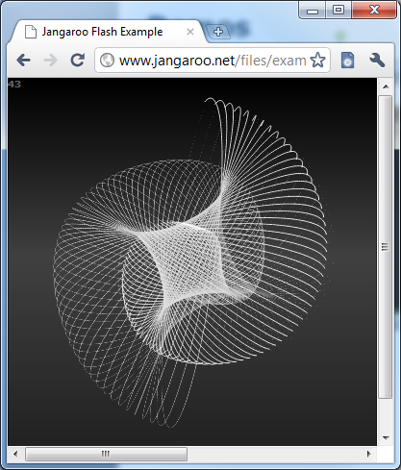
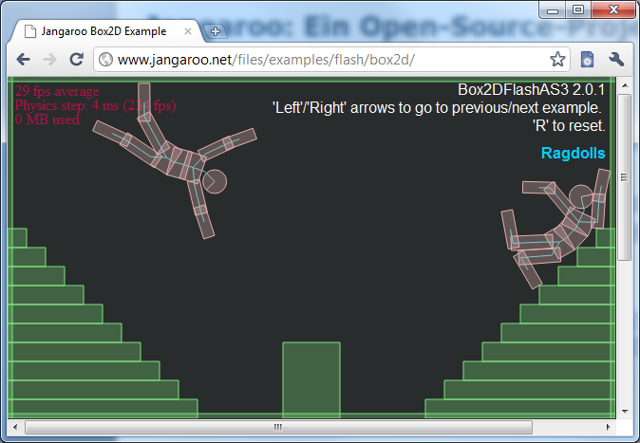
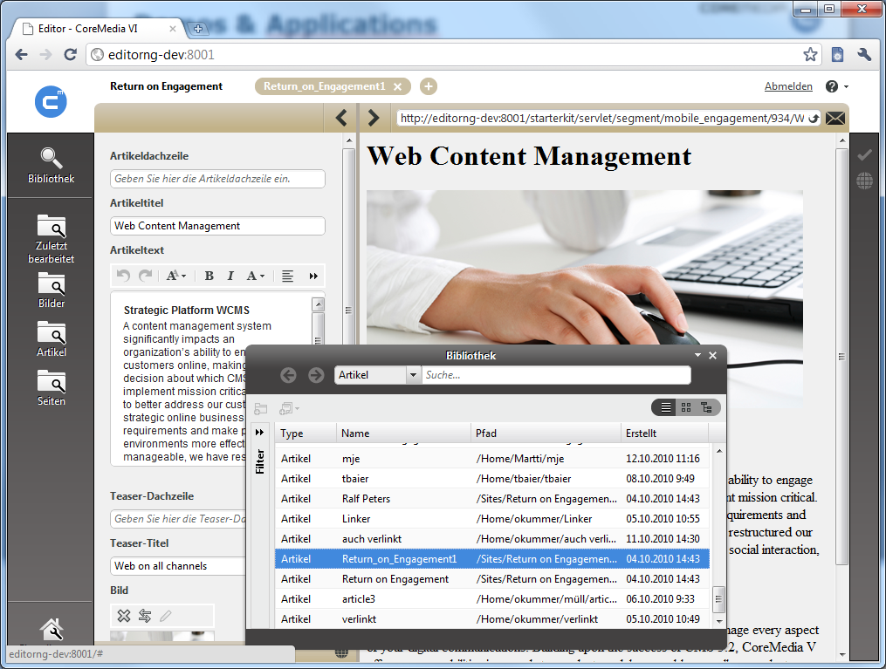
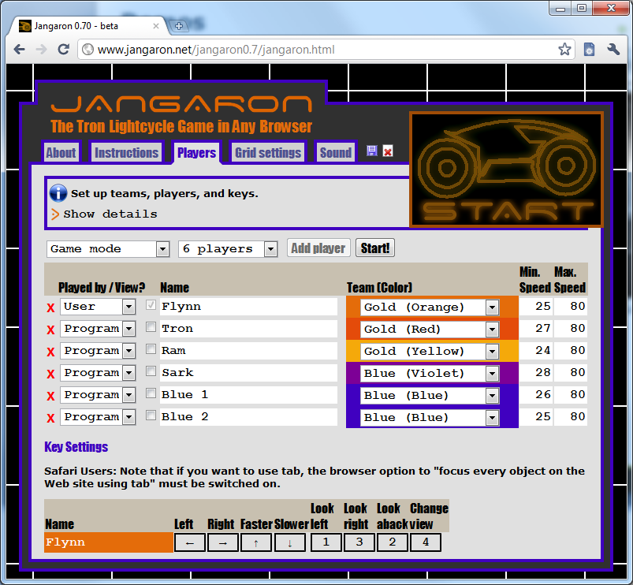
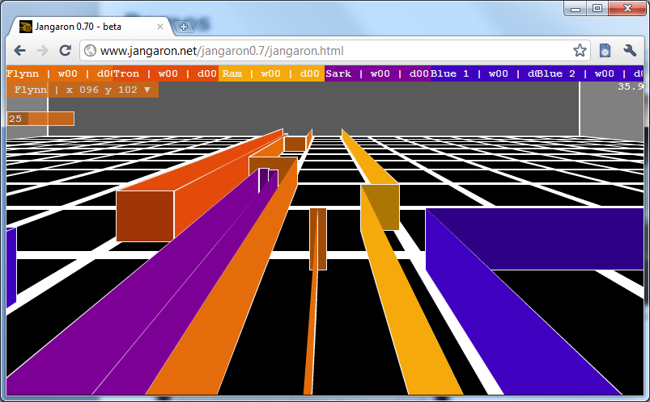
Demos & Applications

