Slide 1
Jangaroo - AS3 w/o FlashPlayer
Running Flash Apps in HTML5-enabled browsers
Andreas Gawecki Frank Wienberg
Software Architects & Jangaroo Evangelists

Slide 2
Problem 1
Flash / Flex can do awesome things, but not without FlashPlayer browser plugin.
Ppl do amazing things with HTML 5, CSS 3 and JavaScript – is Flash dead?
Notes:
Andere RIA-Technologien haben sich nicht durchgesetzt
Für viele ein notwendiges Übel: “Muss man ja leider benutzen”
“Möglichst viel auf dem Server implementieren, da gibt es wenigstens vernünftige Infrastruktur”  Web 2.0

Slide 3
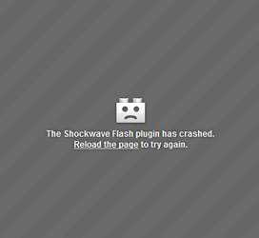
FlashPlayer Browser Plugin Downsides
Some platforms not Flash-enabled (iOS)
FlashPlayer has to rely on quirky old Browser plugin API
Does not integrate seamlessly with (D)HTML
Up-to-date plugin version not installed everywhere

Slide 4
Problem 2
The target platform Web / browser only understands JavaScript, but:
JavaScript was not made for programming in the large
Notes:
Andere RIA-Technologien haben sich nicht durchgesetzt
Für viele ein notwendiges Übel: “Muss man ja leider benutzen”
“Möglichst viel auf dem Server implementieren, da gibt es wenigstens vernünftige Infrastruktur”  Web 2.0

Slide 5
What Brendan says
"The over-minimized design of JS [...] imposed a long-term complexity tax on JS programmers and libraries. Everyone invents an OOP framework, some standard packaging discipline, and a latent type system. Why should not the core language address these obvious requirements?"
Brendan Eich, creator of JavaScript
Notes:
But: the standardization process is going on for years, it seems that eventually Microsoft is retreating or even sabotaging the progress. If Microsoft does not support JS2, then IE won't, and it will only run via plugin...
What makes our approach different? We put the OOP framework into the language, not (only) into a runtime extension.

Slide 6
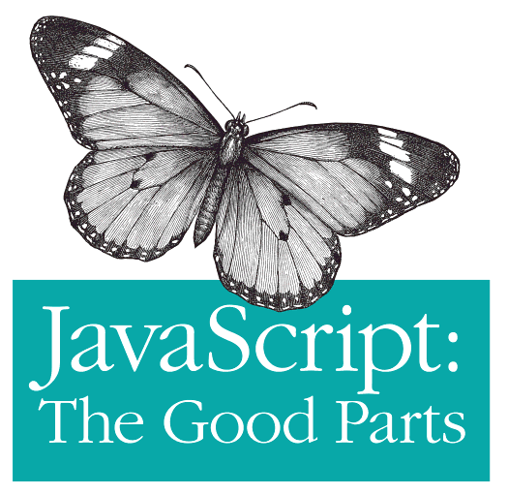
JavaScript for Enterprise – The Bad Parts
No packages / namespaces, classes, modules
No explicit interfaces / APIs
No static typing
Libraries and build process not standardized
Enterprise
Bad

Slide 7
Jangaroo Answers:
Keep on coding ActionScript 3!
Keep on using Flash APIs!
Target the Web through FlashPlayer and HTML 5!
Notes:
Andere RIA-Technologien haben sich nicht durchgesetzt
Für viele ein notwendiges Übel: “Muss man ja leider benutzen”
“Möglichst viel auf dem Server implementieren, da gibt es wenigstens vernünftige Infrastruktur”  Web 2.0

Slide 8
How to execute another programming language in the browser?

Slide 9
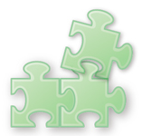

How to execute another programming language in the browser?
by plugin
translate to JavaScript

Slide 10
Which programming language?

Slide 11



Which programming language?
Java
(Oracle)
C#
(Microsoft)
ActionScript 3
(Adobe)

Slide 12






Available Technologies
 | by plugin | translate to JavaScript
Java | Java Applet | GWT
C# | Silverlight | Script# JSC
ActionScript | Flash Player | Jangaroo

Slide 13
ActionScript 3 from a JavaScript developer’s point of view
ActionScript adds programming-in-the-large features missing in JavaScript
ActionScript and JavaScript are quite similar
Advantages of JavaScript are kept
Enhanced tool support
Notes:
ActionScript bietet die in JavaScript fehlenden programming-in-the-large-Features
Pakete, Klassen, Module, Schnittstellen, Sichtbarkeit
Statische Typisierung
ActionScript und JavaScript gut aufeinander abbildbar
Generierter Code und Quellcode sehr ähnlich
Einfacher für Entwickler (und für den Compiler)
Statische Typisierung optional => iterative Migration
Stärken von JavaScript bleiben erhalten
Closures
Dynamische Sprach-Aspekte
JavaScript-Bibliotheken können direkt verwendet werden
Tool-Unterstützung
In den letzten Monten dank Flex professionelles Niveau erreicht.
Diverse IDEs
Build-Prozess (Flex-Maven-Plug-Ins)
…

Slide 14
Jangaroo Approach
Compile ActionScript 3 to JavaScript that (through a small runtime library) a) runs in any browser and
b) looks very similar to the AS3 source code.

Slide 15
Jangaroo = Enterprise JavaScript ⊂ ActionScript 3

Slide 16
Jangaroo Source Code
package joo.util {
public class Offset {
public static const HOME : joo.util.Offset = new Offset(0, 0);
public function Offset(left : Number , top : Number ) {
this.left = left;
this.top = top;
}
public function clone() : joo.util.Offset {
return new Offset(this.left, this.top);
}
public function getDistance() : Number {
return Math.sqrt(this.left*this.left + this.top*this.top);
}
public function scale(factor : Number) : joo.util.Offset {
return new Offset(this.left * factor, this.top * factor);
}
public function isHome() : Boolean {
return this.left==0 && this.top==0;
}
public var left : Number;
public var top : Number;
}}

Slide 17
Jangaroo Compiled Code (JavaScript)
joo.classLoader.prepare(
"package joo.util",
"public class Offset",function($$l,$$private){var is=joo.is,assert=joo.assert,…;return[
"public static",{/*const*/ HOME/*: joo.util.Offset*/: function(){return new Offset(0, 0);}},
"public",function Offset(left/*: Number*/, top/*: Number*/) {
this.left = left;
this.top = top;
},
"public",function clone()/*: joo.util.Offset*/{
return new Offset(this.left, this.top);
},
"public",function getDistance()/*: Number*/{
return Math.sqrt(this.left*this.left + this.top*this.top);
},
"public",function scale(factor/*: Number*/)/*: joo.util.Offset*/{
return new Offset(this.left * factor, this.top * factor);
},
"public",function isHome()/*: Boolean*/{
return this.left==0 && this.top==0;
},
"public",{/*var*/ left /*: Number*/: undefined},
"public",{/*var*/ top /*: Number*/: undefined}
]});

Slide 18
Jangaroos ActionScript 3
Supported Features
package
class
private members
static members
inheritance (extends)
Import
interface (implements)
helper classes (same file)
optional semicolons
Only supported syntactically
visibility modifiers (protected, internal)
namespace
annotation ([…])
typing (no type conversion / coercion)
Not (yet) supported
E4X (XML literals and -API)
Not supported in IE < 9
Property accessor functions (get / set)

Slide 19
Jangaroo is More Than a Compiler

Slide 20
Jangaroo Features
Automatic loading of dependent classes
On-demand class initialization (static code)
Simple boot strap from HTML / JavaScript
Simple to use Jangaroo libraries from JavaScript code
Modular build process through Apache Maven
Versioned modules
Collection of transitive dependencies
Generate debug and optimized code in one go
IDE support through being AS3 compatible
Minor overhead in generated code
Jangaroo tools: ~13 k SLoC

Slide 21
Jangaroo Libraries
JavaScript libraries can be used as-is or through “fake” AS3 API
Available Jangaroo modules with AS3 API wrappers:
Browser DOM and BOM API
Ext Core
Ext JS
soundmanager 2
Open Source ActionScript libraries can simply be recompiled:
FlexUnit
Box2D
Flash standard libraries are not Open Source and thus have to be reimplemented for Jangaroo (work in progress on github)

Slide 22
Jangaroo: Project History
2004: Start as internal project „JSC“
Using it in CoreMedia CMS
07/2008: Open Source „Jangaroo“
09/2010: github
11/2010: current version: 0.7.9
6/2009: From ECMAScript 4 to ActionScript 3
http://blog.jangaroo.net/2008/07/former-life-and-birth-of-jangaroo.html

Slide 23
Software Lifecycle with Jangaroo
Jangaroo supports the whole lifecycle of professional software development of enterprise JavaScript applications

Slide 24
Software Lifecycle with Jangaroo
IDE
Build Process
Unit Test Framework
Automatic UI Tests
Continuous Integration
HTML Documentation
Source-Level Debugging

Slide 25
IDE Support
IntelliJ IDEA
Flash Develop
Powerflasher FDT
Flash Builder

Slide 26

Build Process
Command Line
Ant
IDEA (incremental)
Maven

Slide 27

Test Tools
UI Tests: Selenium
Unit Tests: JooUnit = FlexUnit 0.9 ⇨ Jangaroo
Continuous Integration: Hudson

Slide 28


Documentation and Debugging
Documentation: ASDoc
Debugging: Firebug & Co

Slide 29
Jangaroo: Resources
User Group
http://groups.google.com/group/jangaroo-users/
Source Code
http://github.com/CoreMedia/jangaroo-tools
http://github.com/CoreMedia/jangaroo-libs
Demos
Flash Demos: http://www.jangaroo.net/files/examples/flash/lines/ http://www.jangaroo.net/files/examples/flash/box2d/
Browser Game: http://www.jangaron.net
www.jangaroo.net

Slide 30
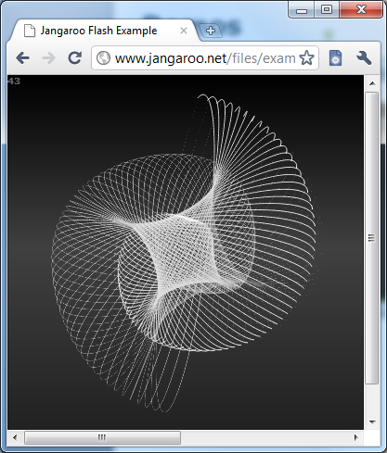
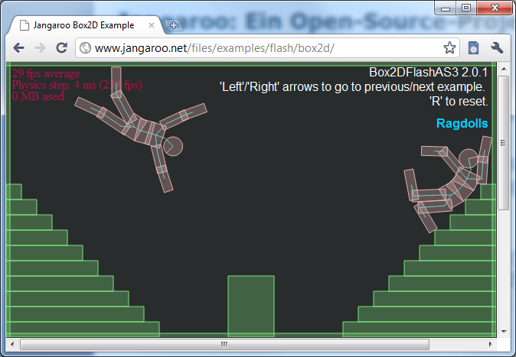
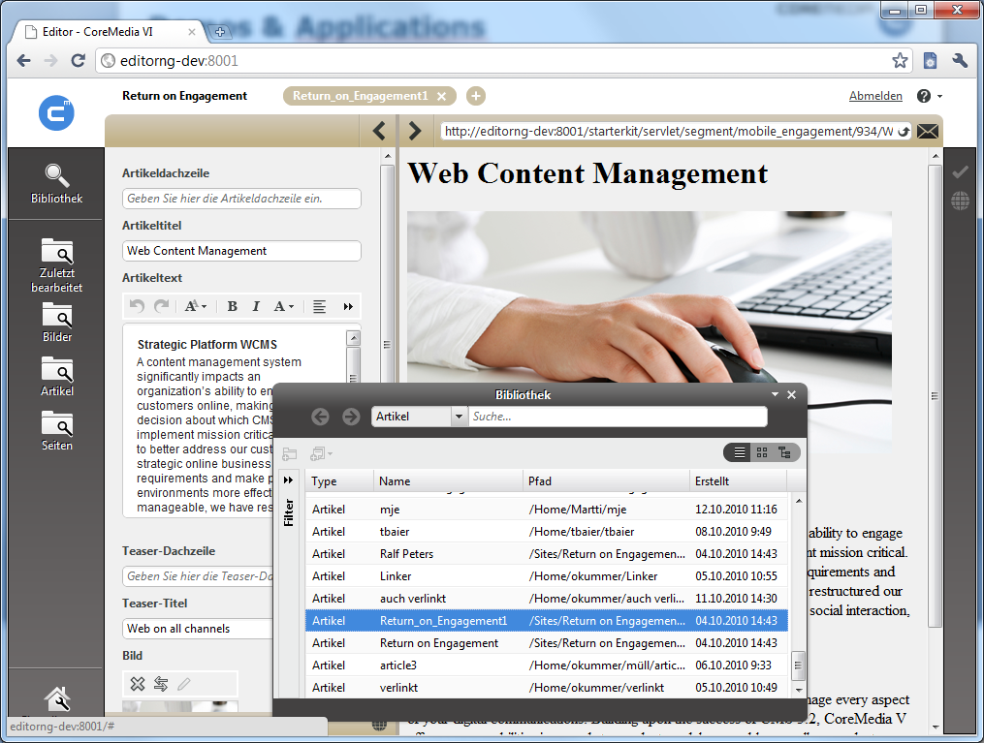
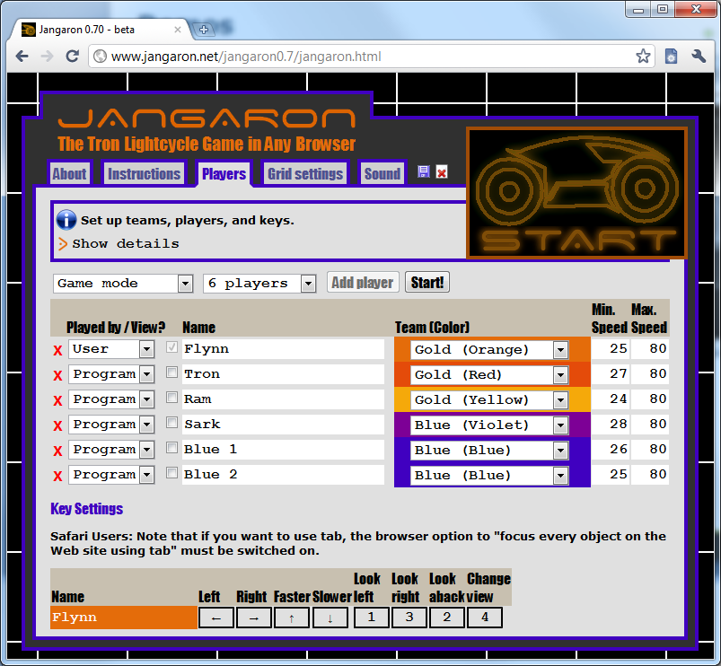
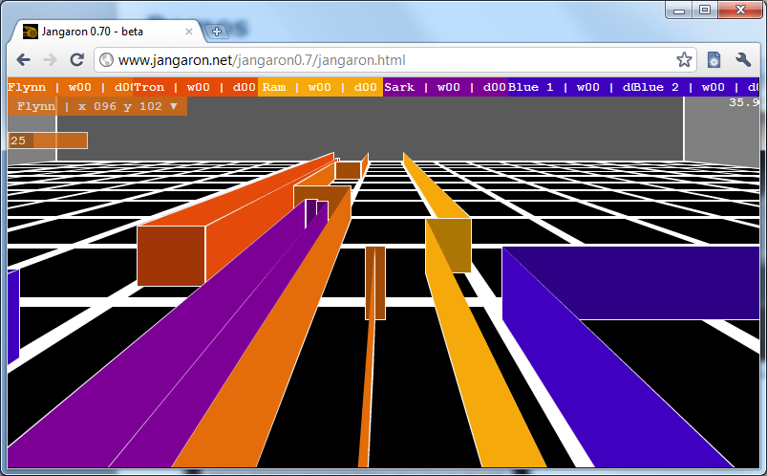
Demos & Applications

