Slide 1
predicting the outcome of a competitive game
Cristopher Orellana Jara

Slide 2
Counter Strike : GO
Counter-Strike: Global Offensive Es un juego multijugador de disparos desarrollado por Hidden Path Entertainment y Valve.
$76,833,604.48 ( en Dolares ) a lo largo de los torneos que se han realizado.
En 2016 eSports Industry Awards calificó a CSGO como "eSports Game of the Year” (deporte electronico del año).

Slide 3
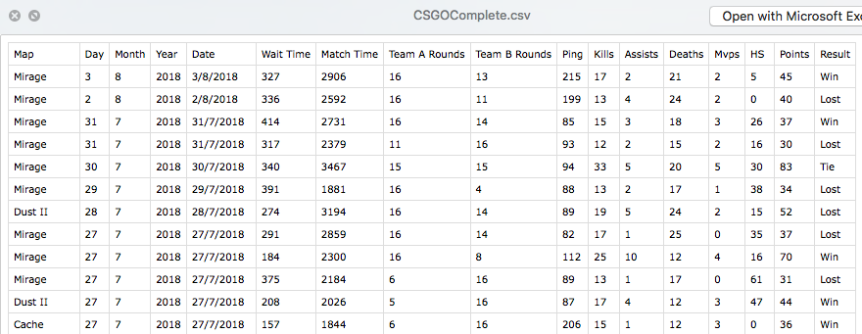
DATASET
Win : 1
Lost : 2
Tie : 3
Clase

Slide 4
Análisis de atributos
Team A & B rounds
No SMOTE

Slide 5
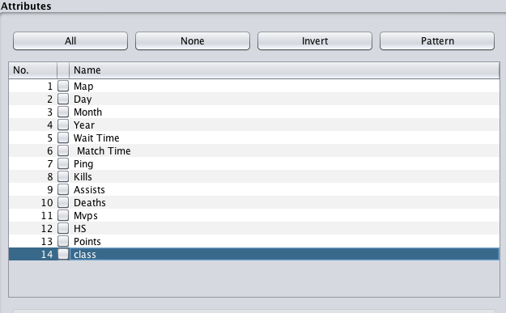
Modelos de clasificación
RandomForest
Time taken to build model: 0.35 seconds
73.8747 %
=== Confusion Matrix ===
a b c <-- classified as
355 128 5 | a = 1
74 464 22 | b = 2
15 52 18 | c = 3

Slide 6
Modelos de clasificación
NaiveBayes. 65.4016 %
ZeroR.
49.4263 %
Time taken to build model: 0 seconds
Time taken to build model: 0 seconds
=== Confusion Matrix ===
a b c <-- classified as
276 155 57 | a = 1
75 412 73 | b = 2
9 23 53 | c = 3
=== Confusion Matrix ===
a b c <-- classified as
0 488 0 | a = 1
0 560 0 | b = 2
0 85 0 | c = 3

Slide 7
?Por Qué?
NaiveBayes
RandomForest
65%
ZeroR
50%
74%

Slide 8



Conclusión

