Slide 1
MINI PROJECT
CS5234
Xu Kai A0198855E
Wang Yue A0194946L
Notes:
Hello, I’m kai, my teammate is wangyue. Today we are going to talk about some dimension reduction techniques, as our mini project representation. We will cover Johnson Lindenstrauss Lemma and Principle Components Analysis.

Slide 2
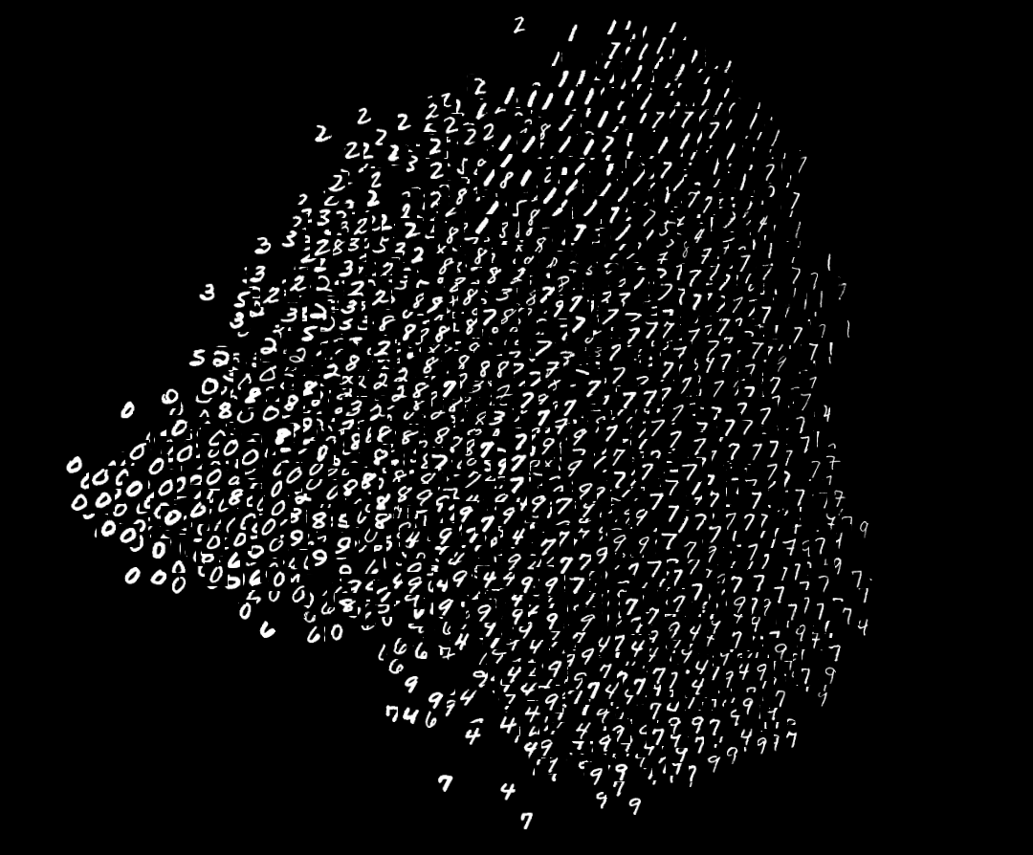
Dimension Reduction
Notes:
Let’s first ask why you need dimension reduction. In fact, dimension reduction allows you to find the latent features in your data, with these features, you can apply your algorithm with less time and computation. Or you can reduce your data into 2 dimension, so that you can visualise your data with scatter plot. for example, MNIST dataset, I’m sure most of you familiar of this, they are handwrite digits, which has 784 dimensions if we unfold it by 28 times 28 pixels. But think a minute, do we really need so many dimensions to describe these digits? No, we can represent these data only using two dimension with lots of information preserved. As you can see in the graph, we can

Slide 3
Johnson-Lindenstrauss Lemma
Notes:
Is it possible to condense high-dimensional data into smaller dimensions and retain the important geometric properties of the data?

Slide 4
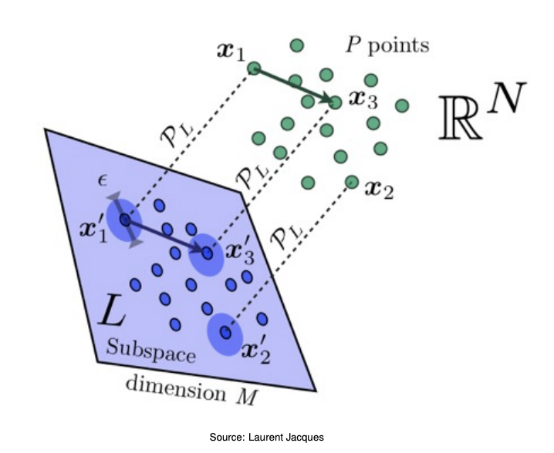
Pairwise Distance
Think about we want to computer all pairwise distance to run nearest neighbour search on n data, each data has d dimensions.
The running time: $O(n^{2}d)$
Time via JL: $O(\frac{dnlogn}{ϵ^{2}}+\frac{n^{2}logn}{ϵ^{2}})$
N
d
Compute Pairwise Distance:$O(n^{2}k)$
Find what the low dimensional representation are.
$k=O(ϵ^{-2}logn)$: reduced dimension.
O(dkn) :Matrix Multiplication

Slide 5
Johnson-Lindenstrauss Lemma
To proving dimension reduction is possible.
Notes:
the key technique is to take a random linear subspace of a certain dimension, and project every data point onto that subspace. No searching required. The fact that this works is called the Johnson-Lindenstrauss Lemma.

Slide 6
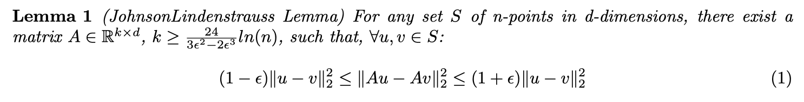
Johnson-Lindenstrauss Lemma
(JL Lemma, 1984) : Every set of N points in Euclidean space can be embedded into $O(ϵ^{-2}logN)$-dimensional Euclidean space s.t. all pairwise distance are preserved up to a $1±ϵ$ factor.
Original Dimension: d
Reduced Dimension: $k=O(ϵ^{-2}logN)$
Why does n show up instead of d?
:WLOG , d<<n
Notes:
ku − vk 2 2 is the pairwise euclidean distance for all points in S, i.e. ku − vk 2 2 = (u i − v i ) 2 , therefore i=1 Theorem 1 states that one can preserve distance geometry of a set of points approximately using low dimensional representation Ax, where A is a mapping matrix.

Slide 7
But how we could find such embedding matrix A?
[Indyk-Motwani, 1998]: Random matrix with independent Gaussian entires:
A = numpy.random.normal(mean=0, variance=1, size=(subspaceDimension, originalDimension))
A = A / math.sqrt(subspaceDimension)
[Achlioptas, 2001]: Random matrix with independent $±1$ entries.
[Matousek, 2008]: Independent entries with mean=0, variance=1/k, and subGaussian tails.
But we still need O(n*k*d) time to do full matrix multiplication.

Slide 8
Use sparse matrix.
[Achlioptas, 2003]: The entires of A are chosen as :
$$R_{ij}=\sqrt{3}\{\begin{matrix}+1 & & w.p.1/6 \\ 0 & & w.p.2/3 \\ -1 & & w.p.1/6\end{matrix}$$
$$A=\frac{1}{\sqrt{k}}R$$
[Kane, Nelson 2014]: The are distributions on $A∈R^{k×d}$, with $k=O(\frac{logn}{ϵ^{2}})$, and with $S=O(\frac{logn}{ϵ})$ non-zero entries per column, have the JL-Property.

Slide 9

How we implement JL Transform?
Generate your embedding matrix A.
Multiply it on your data! 😀
Data_reduced = A.dot(data.T).T

Slide 10
Matrix Factorization

Slide 11
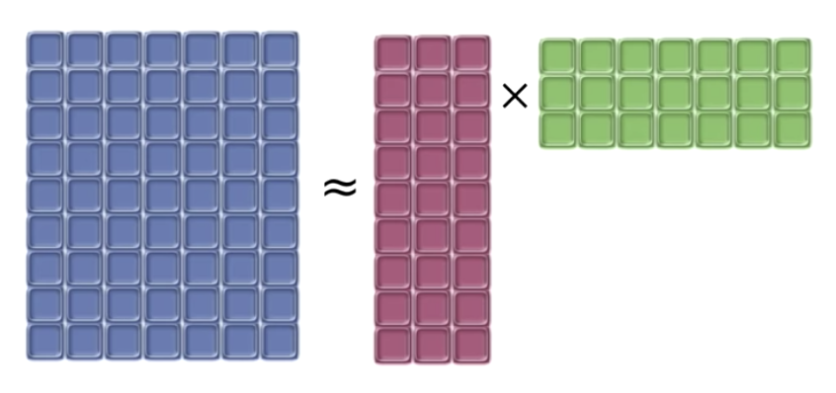
Matrix Factorization
Slide from Leland McInnes
Notes:
Pictorially, the goal of the goal of matrix factorization is to express a matrix as approximately product of two smaller matrices.

Slide 12
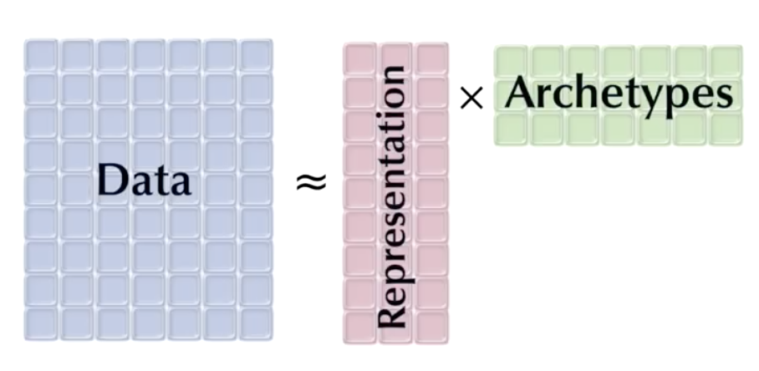
Matrix Factorization
Slide from Leland McInnes
Notes:
Blue matrix is our data. Each row is a sample, each column is a feature. We want to factor that into a representation multiply some archetypes.
You can think of representation as your representation of your high dimensional data, the archetypes are basic exemplars that we are going to use to reconstruct the data.

Slide 13
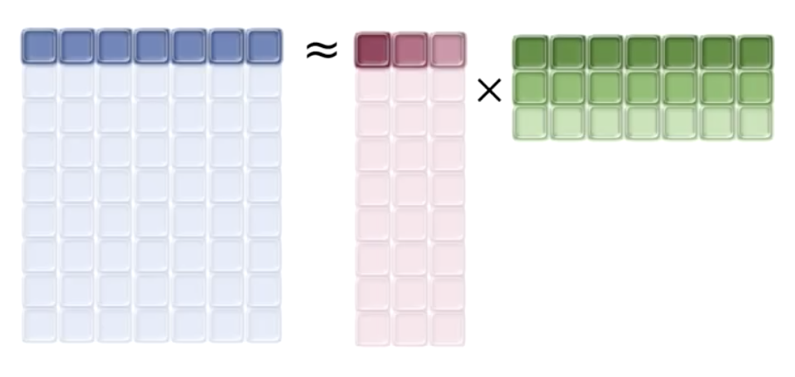
Matrix Factorization
Slide from Leland McInnes
Notes:
The intuition is, looking at the single row, one data sample, as being represented one row of the low-dimensional representation multiply the archetypes.

Slide 14
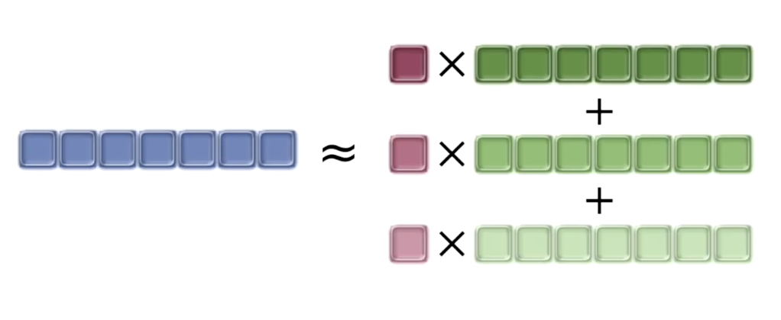
Matrix Factorization
Slide from Leland McInnes
Notes:
That is the single row, your single sample is the linear combination of the archetypes.

Slide 15
Matrix Factorization
Find
$$X≈UV$$
Principle Component Analysis:
Minimizing:
$${∥X-UV∥}_{2}$$
Notes:
How do we find approximately equal representation of X? We can turn this into the optimisation problem. We can defined loss as the L2 distance of two matrices, the mean square error without any constrain. Which give us a classical dimension reduction method called Principle Component Analysis.

Slide 16
Principle Component Analysis
1. Remove mean from each feature
2. Singular Value Decomposition (SVD)
$$X=UΣV^{T}$$
$$X∈R^{m×d}$$
Data, m samples, d dimensions
$$U∈R^{m×m}$$
Orthonormal matrix
$$Σ∈R^{m×d}$$
Diagonal matrix, singular values listed in descending order
$$V∈R^{d×d}$$
Orthonormal matrix, columns are principle axes
3. Select first k principle components
$$U_{k}Σ_{k}=XV_{k}$$
$$U_{k}∈R^{m×k}$$
$$Σ_{k}∈R^{k×k}$$
$$V_{k}∈R^{k×d}$$
Notes:
The first step of PCA is to center the data, meaning we need to remove the mean value from each feature.
The second step is to perform SVD on the data matrix.
Decomposed into 3 matrices.
Sigma is a diagonal matrix. The diagonal values are called singular values and sorted in descending order. U and V are orthonormal matrices. The columns of V are principle axes. We are going to project the data matrix on these new axis to get the principle components we want. The third step is to select the first k principle components so that we can do dimension reduction. I’m going to illustrate the steps through a simple example.

Slide 17
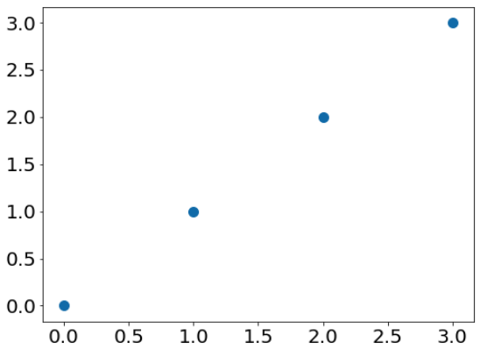
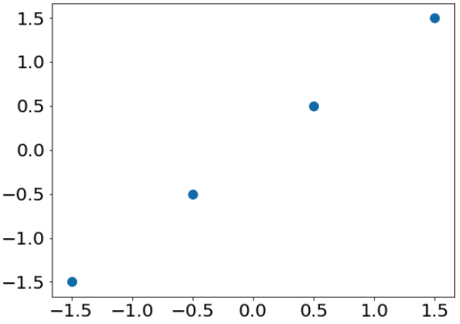
Principle Component Analysis
1. Remove mean from each feature
0 | 0
1 | 1
2 | 2
3 | 3
-1.5 | -1.5
-0.5 | -0.5
0.5 | 0.5
1.5 | 1.5
$$X$$
$$X$$
Notes:
In this example we have 4 sample points (0,0), (1,1)… After removing the mean of each column, the points are centered to origin.

Slide 18
Principle Component Analysis
2. Singular Value Decomposition (SVD)
$$X=UΣV^{T}$$
V: principle axes
Highest variance on first principle axis
$$X$$
$$U$$
$$Σ$$
$$V^{T}$$
-1.5 | -1.5
-0.5 | -0.5
0.5 | 0.5
1.5 | 1.5
-0.67 | 0.71 | 0 | 0.43
-0.22 | 0 | 0.71 | -0.64
0.22 | 0 | 0.71 | 0.64
0.67 | 0.71 | 0 | 0
3.16 | 0
0 | 0
0 | 0
0 | 0
0.71 | 0.71
-0.71 | 0.71
$$=$$
$$\overset{·}{}$$
$$\overset{·}{}$$
Notes:
Then we perform SVD on X. We can see that the first diagonal entry of sigma is 3.16 and the second diagonal entry is zero. The columns of V, rows of VT, are the principle axes.
The rationale behind is that larger singular values are associated with higher variance. If we project our data on the first principle axis, we have larger variance. If we project data on the second axis, variance is 0.

Slide 19
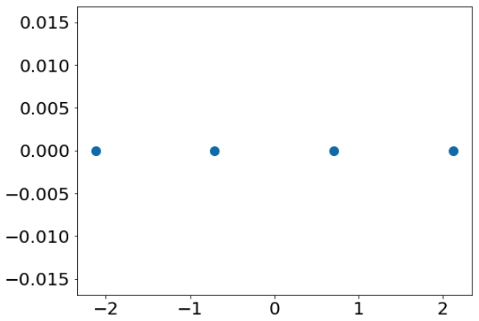
Principle Component Analysis
2. Singular Value Decomposition (SVD)
$$UΣ=XV$$
Project X on new axes
$$X$$
$$V$$
-1.5 | -1.5
-0.5 | -0.5
0.5 | 0.5
1.5 | 1.5
0.71 | 0.71
-0.71 | 0.71
-2.1 | 0
-0.7 | 0
0.7 | 0
2.1 | 0
$$\overset{·}{}$$
$$=$$
Notes:
Then we calculate the dot product of X and V, which means we project the data on the new axes. The projected data becomes one dimensional. That is good because we have confidence to keep the first axis only without losing any information.

Slide 20
Principle Component Analysis
3. Select first k principle components
$$X_{k}=U_{k}Σ_{k}=XV_{k}$$
k = 1, keep the first principle component only
$$X$$
$$V_{k}$$
$$X_{k}$$
-1.5 | -1.5
-0.5 | -0.5
0.5 | 0.5
1.5 | 1.5
0.71
0.71
-2.1
-0.7
0.7
2.1
$$\overset{·}{}$$
$$=$$
Notes:
The next step is to select the first k principle components. In this example, we select k = 1 and keep the first principle component. We multiple X with the first column of V to get the reduced data Xk. Now we have reduced our data to half its original size.

Slide 21
Principle Component Analysis
Reconstruction
$$\overset{̂}{X}=X_{k}V_{k}^{T}$$
$$X_{k}$$
$$V_{k}^{T}$$
$$\overset{̂}{X}$$
-2.1
-0.7
0.7
2.1
0.71 | 0.71
-1.5 | -1.5
-0.5 | -0.5
0.5 | 0.5
1.5 | 1.5
In this case,
same as original X (mean removed).
$$\overset{·}{}$$
$$=$$
Notes:
Now assume we have the reduced data and want to reconstruct the original data. We multiply Xk with the transpose of Vk. In this case, the reconstructed matrix X hat is the same as the original matrix with mean removed. This is because the second singular value is 0.
In more general case, we will have non-zero reconstruction error if there are non-zero singular values being dropped. But because we sort singular values in descending order, we know that the reconstruction error can be minimised with PCA.

Slide 22
Thanks for your attention!

