Slide 1
Algorithms at Scale
(Week 13)
Dimensionality Reduction
Notes:
Alright... Let's get started! How's everyone doinggg? I hope you had the chance to rest the past week, 'cause
Today we are going to talk about Dimensionality Reduction! YEAH.

Slide 2
Sample slide
The goal of these presentations is to teach us something, so focus
in your talk on teaching the class something about an algorithm, how to use an algorithm to solve
a class of problems, how a certain class of algorithms works in practice, etc. (The presentation is
not supposed to be a summary of the work you have done. It is supposed to be something you
think the entire class would be benet from learning related to your topic.)

Slide 3
Summary
Motivation
Approaches
Johnson-Lindenstrauss Transforms
Fast JL Transform (+ Proof)
Experiments’ Design
Results
Notes:
Here’s the plan. We’re going to explain why it’s useful, common approaches to it,
and then we are going to dig deeper into a special kind of reduction technique called Fast Johnson-Lindenstrauss Transform.
Next, we’ll talk about our projects and result.

Slide 4
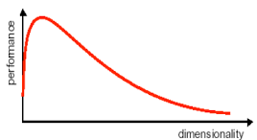
Dimensionality Reduction - Why?
d
0.3 | 0.9 | ... | 0.343
0.9 | 0.2 | ... | 0.43
... | ... | ... | ...
0.6 | 0.0 | ... | 1.0
n
Reduces cpu workload and storage needed;
Alleviates curse of dimensionality;
Allows noise/redundancies removal.
potential
performance
improvement
Source: https://blog.knoldus.com/machinex-when-data-is-a-curse-to-learning/amp/
Notes:
So, consider a set of n datapoints in R^d.
When d, number of variables is very large, several problems arise when operating on the dataset.
Of course, more cpu workload and memory storage are required.
Moreover, other obstacles for algorithms are caused by the ``curse of dimensionality'', namely, the fact that higher dimensional spaces carry geometric unexpected and counterintuitive behaviors.
To overcome these issues, research has been done on ``dimensionality reduction'' techniques, namely, methods to reduce the number of dimensions on which the data ``spans across''.
Besides reducing the space and time needed, dimensionality reduction has a number of benefits, including the possibility of removing noise/redundancies and, well, alleviating the effects of the course of dimensionality.
In particular, the effects of the curse of dimensionality are often an impediment to the algorithms processing the dataset, so for some algorithms there are ways of reducing the dimensionality and factually improving the performances.
However, in general, representing data with less storage leads to part of the information being lost, therefore a major concern with dim. reductions is to avoid destroying the inner structure of the data.

Slide 5
Common approaches
Drop useless variables
  Variables with low variance may not tell anything useful;
  When variables are highly correlated, one of them is unnecessary;
Derive a new set of variables
  Factor Analysis;
  Principal Component Analysis;
  Linear Discriminant Analysis;
  ...
  Randomized Projections
d
0.3 | 0.9 | ... | 0.343
0.9 | 0.2 | ... | 0.43
... | ... | ... | ...
0.6 | 0.0 | ... | 1.0
n
Notes:
With this regard, research has given birth to many different technique that do not harm too much.
Perhaps, the simplest approach to dim. reduction is to drop some useless variables. As a first example, one might want to drop variables which variance is too low. This approach is called ``Low Variance Filter'', and it leverages the fact that for a variable to effectively contribute to datapoints overall information within the dataset, it is expected for the variable to yield different values for different datapoints. A second criteria to select drop variables to drop is correlation: we could have many variables that are correlated with each other, i.e within some error, one can always deduce one of them from the others, therefore one of them can be dropped. Unfortunately, the cost of checking every possible correlation set is exponential in the number of dimensions, so different approaches arise for approximating this search.
...
Different linear approaches to dim. reduction involve independently projecting the single data entries, say, from a space $R^d$ to a space $R^k, k\ll d$, and proving that some ``non-destruction'' property applies.
Today we are going to focus on randomized linear projections, namely randomized ways of constructing these projections in the form of an $k by d$ matrix.

Slide 6

What do we want?
A function that reduces dimensionality:
Notes:
[transition TBD]

Slide 7
What do we want?
A function that reduces dimensionality:
Without losing information:
Notes:
We don’t want this function to lose any information about the input data. We want points which are far from each other to STAY far from each other. Therefore the distance of the OUTPUT data, should be an espilon approximation of the distance of the INPUT data.
This is are pieces from the report:
This property states that the pairwise L2 distances in the original data are not perturbed too much during the reduction. …
A well-known result which goes by the name of ``Johnson-Lindenstrauss lemma'' states that, for $k$ large enough, for any input set of datapoints, a function with this property exists [1], % cite properly...
and such reductions are called Johnson-Lindenstrauss transforms.

Slide 8
What do we want?
A function that reduces dimensionality:
Without losing information:
Johnson-Lindenstrauss Lemma:
Such a function exists.
[1] W.B. Johnson, J. Lindenstrauss, Extensions of Lipschitz mappings into a Hilbert space, Conference in modern analysis and probability, New Haven, CI, 1982, Amer. Math. Soc., Providence, RI, 1984, pp. 189-206
Notes:
And here comes the Johnson-Lindenstrauss lemma...

Slide 9
Can we build a JL Transform?
We call Johnson-Lindenstrauss transform any function that satisfies these two properties.
Recall that in the lemma f has to satisfy:
Notes:
Do you see anything wrong with that property ?

Slide 10
Can we build a JL Transform?
We call Johnson-Lindenstrauss transform any function that satisfies the JL lemma.
Recall that in the lemma f has to satisfy:
⮕Our data is too big, we can’t go through the whole input data to define f...
f depends on X !
Notes:
X is set in this property, so f actually depends on X !
This is a huge problem for us

Slide 11
Let’s tweak our definition to make it easier.

Slide 12
What do we want?
A function that reduces dimensionality:
Without losing information with probability at least ⅔:
Johnson-Lindenstrauss Lemma:
Such a function exists.
[1] W.B. Johnson, J. Lindenstrauss, Extensions of Lipschitz mappings into a Hilbert space, Conference in modern analysis and probability, New Haven, CI, 1982, Amer. Math. Soc., Providence, RI, 1984, pp. 189-206

Slide 13
What’s the simplest way of making new dimensions you can think of?

Slide 14
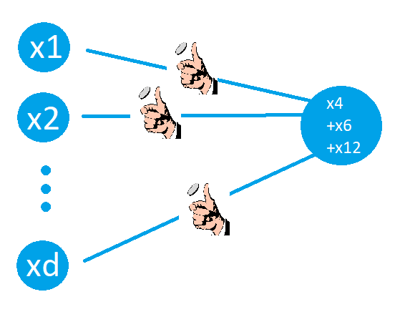

Binary coins
Just take random linear combinations of the original dimensions.
Very simple to implement:
buildTransform():
P is a matrix
pick P[i][j] in {-1,0,1}
return P
transform(vector):
return P*vector
[2] D. Achlioptas. Database-friendly random projections: Johnson-Lindenstrauss with binary coins. J. Comput. Syst. Sci., 66(4):671-687, 2003.
Notes:
Easiest way to generate as many new dimensions as we want

Slide 15
Binary coins
Just take random linear combinations of the original dimensions.
Very simple to implement:
buildTransform():
P is a matrix
pick P[i][j] in {-1,0,1}
return P
transform(vector):
return P*vector
⮕What’s the problem with this?
[2] D. Achlioptas. Database-friendly random projections: Johnson-Lindenstrauss with binary coins. J. Comput. Syst. Sci., 66(4):671-687, 2003.

Slide 16
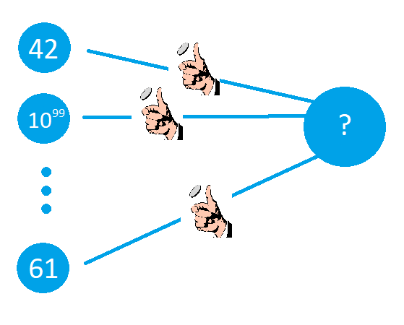
A problem
What happens if we aggregate a big value with small ones ?
Notes:
If you have one value which is significantly larger than the rest, you’re losing information when you aggregate it with the other.

Slide 17
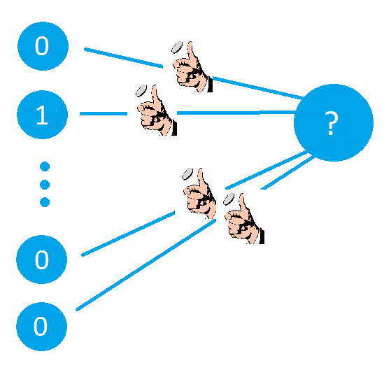
Another problem
What if we miss the 1 in all of our new dimensions ?
Notes:
Now let’s consider another vector : a vector where only one value is not zero. When you generate your transform, you have a non-neglectable chance of simply missing the value. And if you do, your output will be only zeroes, so again you’re losing information.

Slide 18
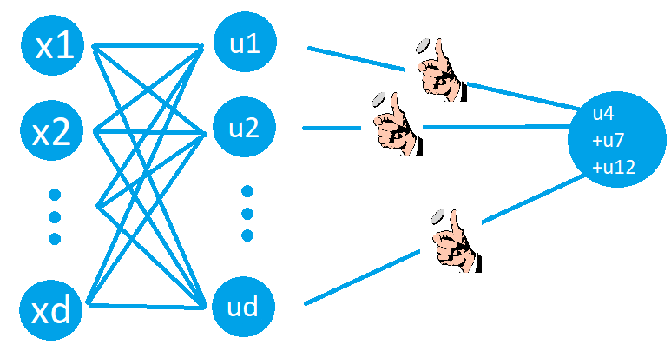

Fast JL Transform (FJLT)
We want to pre-process the data to avoid the previous problems (with high probability).
New transform:
}
u = H D x is the pre-processed vector
How do we design H and D?
[3] Ailon, N., Chazelle, B.: The fast Johnson-Lindenstrauss transform and approximate nearest neighbors. SIAM J. Comput. 39(1), 302-322 (2009)
Notes:
That’s why different authors have come up with the idea of pre-processing the data. We would like to find two new matrices that do not actually reduce the dimension, but we hope that they can make it extremely unlikely that we encounter one of the previous cases. So now our transform will be the product of three matrices.

Slide 19
FJLT:
P is the same coin-flip matrix
Notes:
First, P.

Slide 20

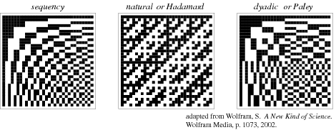
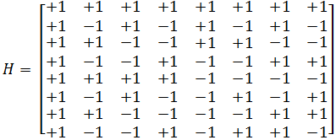

FJLT:
(H is a Walsh-Hadamard matrix. More formally, H is a square matrix of size d and: )
P is the same coin-flip matrix
d
Notes:
Then H. We will use Walsh Hadamard matrix. It’s a tool commonly in signal processing. To make it simple, it’s filled with + ones and - ones such that you’re pretty much encoding the information on every new dimension. For a position i,j , the sign is defined by the binary dot-product of i and j. So we’re converting the indices into binary and doing a simple dot product.

Slide 21
FJLT:
(H is a Walsh-Hadamard matrix. More formally, H is a square matrix of size d and: )
P is the same coin-flip matrix
d
⮕This will solve one of our problems
Notes:
And we hope that this will solve one of our problems. The problem was that we had a good chance of missing information. But thanks to H, this information is present everywhere on the processed data and we can’t miss it.

Slide 22
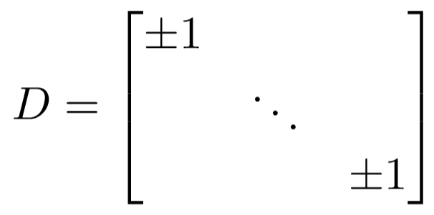
FJLT:
P is the same coin-flip matrix
d
⮕Randomly switching signs of variables: we hope the values will cancel out in the aggregation
Notes:
And finally D...

Slide 23
FJLT:
P is the same coin-flip matrix
d
⮕ Problem : H may actually produce much larger values
⮕ I claim that it’s not too bad.
Notes:
But now you should be thinking : that H matrix is full of ones, will this not actually lead to much larger values ? In some way yes but I claim that it’s not too bad and I’m going to prove it.

Slide 24

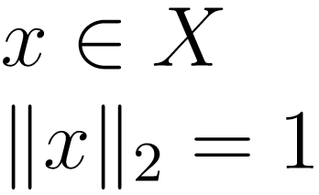
Claim:
That way we won’t make the values much bigger than they were
Notes:
.. We’re only considering elements with a norm of one here without loss of generality, we may still have big values, but we’ll show that the pre-processed data won’t be larger than the input data by a factor bigger than this order.

Slide 25
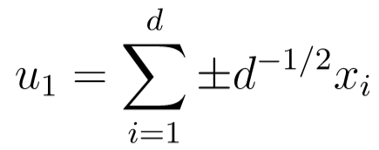



Claim:
By construction:
Must-remember box
Notes:
Let’s call our preprocessed data u. We have...
… where the sign in front of D is determined by the coefficients in the H and the D matrix. Thanks to D, it has a 1 in 2 chance of being positive.

Slide 26
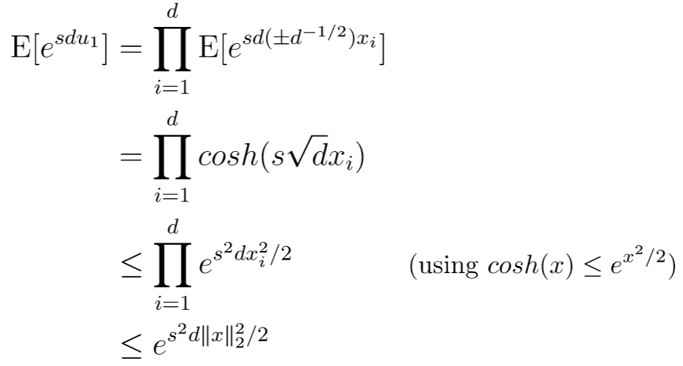
Claim:
By construction:
← Moment generating function
Must-remember box
Notes:
To prove our claim, we’re going to use the..

Slide 27

Claim:
By construction:
Must-remember box
Notes:
With what we have said we can rewrite the moment generating function like THIS. Since the sign in front of the d has a 1 in 2 chance of being positive, we can write the expectancy like this, and you’ll notice that this actually is the cosh function

Slide 28
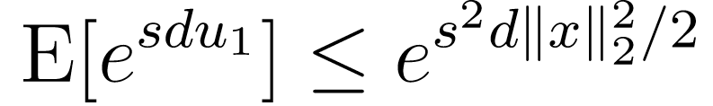
Claim:
By construction:
Must-remember box
Notes:
So we can rewrite with cosh and use the classic upper bound of cosh to get this upper bound for the moment generating function. I’m going to write it down in the must-remember box.

Slide 29
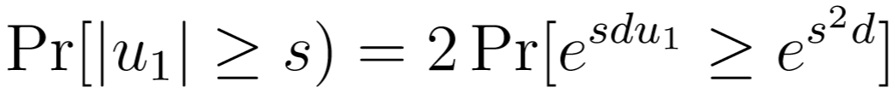
Claim:
By symmetry:
Must-remember box
Notes:
Now we need to find a link between u1 and the MGF. First note that we can rewrite the probability [] with exponentials like this.

Slide 30
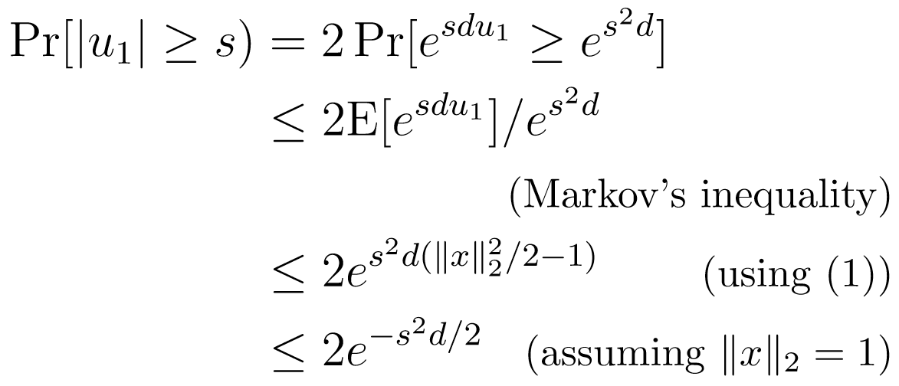
Claim:
By symmetry:
Must-remember box
Notes:
Let’s use Markov’s inequality and there we have it : the mgf.

Slide 31
Claim:
By symmetry:
Must-remember box
Notes:
So we can use the bound in the must remember box.

Slide 32
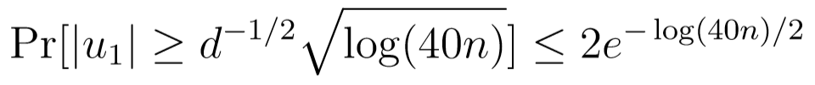
Claim:
By symmetry:
Must-remember box
Notes:
and using the assumption that the norm of x is one, we get the following, and all we have to do now is set s to the right value so we’ll set it to...

Slide 33
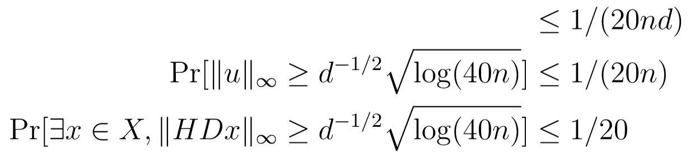
Claim:
Must-remember box
Notes:
Therefore u1 is bigger than this value with probability lesser than 1 over 20 nd
The probability that any value in u is too big is lesser than 1 over 20n
and the probability that any input vector gives values which are too big is lesser than 1 over 20 because we have n elements.
Here is our proof : we have shown that the values of the pre-processed data are not too big with a high probability.

Slide 34

FJLT properties
Unbiased property:
where is a constant factor.
Notes:
Now that we have shown this, let’s mention some other properties that our transform has.
First, it’s almost unbiased. The expectancy of the output value (after pre-processing AND flipping coins) is an epsilon approximation of the input vector, multiplied by a constant by a constant factor alpha. But that’s not a problem because we know alpha.

Slide 35
FJLT properties
Unbiased property:
where is a constant factor.
Sharp concentration around the mean property:
Notes:
Second, it satisfies … meaning that the norm of the output is within an epsilon factor range of its expectancy with high probability.

Slide 36
Experiments’ Design
We assessed the goodness of some dim. reduction methods
Dataset
Reduction
Method
Metric
Score
Reduced
Dataset
Test problem
Notes:
Ok, now let’s get to our miniproject.
Our question is: how well do these methods work in practice?
In order to assess that, we have a few players in the game.
First of all we have to choose a dataset, preferably with many variables;
Secondly, we pick a dimensionality reduction method, and we derive the reduced dataset
Then we consider a test problem and run it on the original dataset and the reduce one;
Finally, we use a metric to compare the two results.
In our case, we choose clustering algorithms as a test problems, so we had to find a metric to compare how similar the original clustering and the reduced one are.

Slide 37
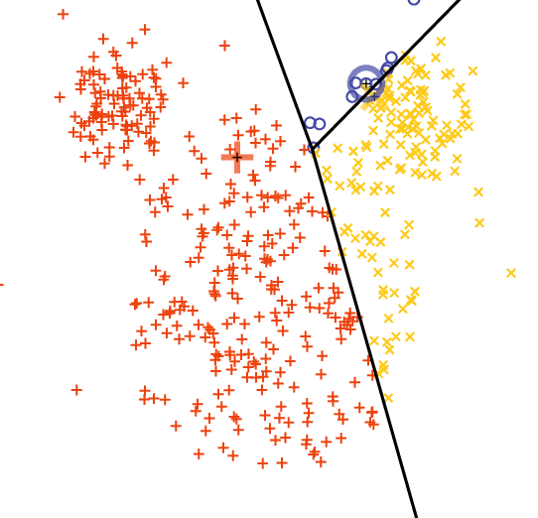
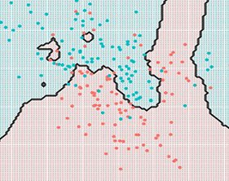
Test problems
K-means Clustering
  Elliptical clusters
KNN Clustering
  Complex shaped clusters
Notes:
Now, as I said we wanted to inspect the level of degradation of the data through clustering; in particular, we chose K-means clustering, and K-Nearest Neighbors. Both algorithm allow to set the number of cluster required, but have different ways of segmenting the space.

Slide 38
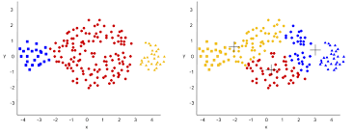
Metric
v-measure
  Measure of clustering similarity
≅
?
[4] Andrew Rosenberg, Julia Hirschberg, V-Measure: A Conditional Entropy-Based External Cluster Evaluation Measure, Proceedings of the 2007 Joint Conference on Empirical Methods in Natural Language Processing and Computational Natural Language Learning (EMNLP-CoNLL), 2007, pp. 410–420
Notes:
And because we need then a way of comparing the clusterings in the original and reduced space, we turned to this commonly used metric called ‘v-measure’ which was proposed in 2007.

Slide 39
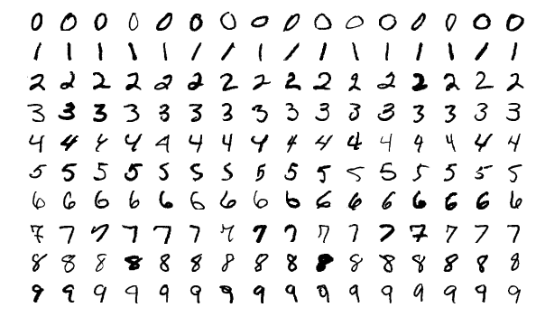
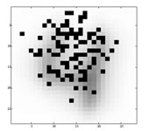
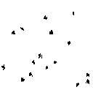
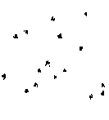
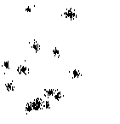
Datasets
MNIST
  d = 28*28 = 784
  N = 10’000
  # clusters = 10
GISETTE
  d = 5’000
  N = 7’000
  # clusters = 2
Synthetic high-dimensional data
  d = …, 256, 512, 1024
  N = 1024
  # clusters = 16
Notes:
As for the datasets.
We initially used the MNIST dataset of handwritten digits, with a dimensionality of 784 and 10 clusters.
Then, we found this GISETTE dataset, with a much higher dimensionality of 5’000, and only two clusters. Actually, this dataset is derived from MNIST by only considering the two clusters of 9s and 4s, and adding many dummy variables.
Finally, we compared the results with synthetic high-dimensional data consisting of 16 non-intersecting clusters spanning across up to 1024 dimensions.

Slide 40
Methods
Low variance filter
  Select the k most variant variables
Sampling variables
  Random sample k variables
Coin Flip method
  Linear project on a random k-hyperplane
Fast JL Transform
  Random projection with improved bounds
Notes:
Here we are going to show the results for these methods: we have the very simple low variance filter, simple random sampling of variables, the random linear projection, and the FJLT method.

Slide 41
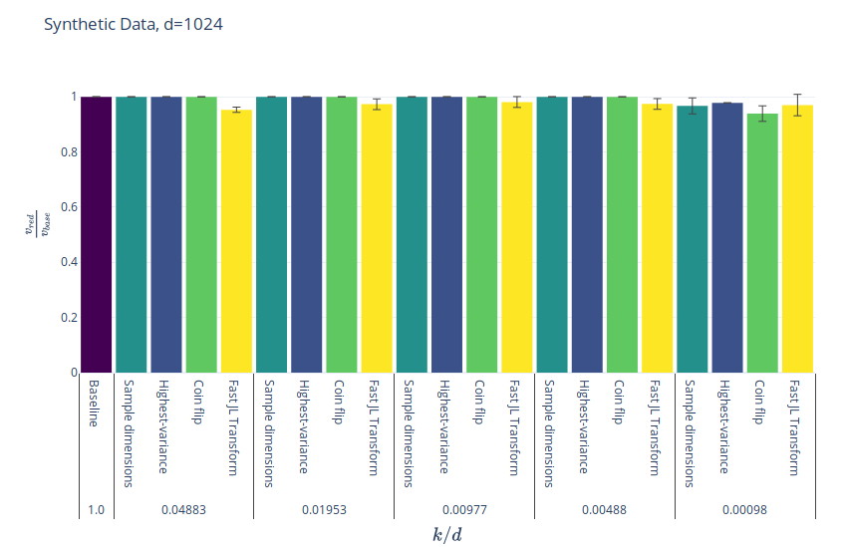
Result
Notes:
Starting from the less interesting result,
with the sinthetic galaxy-like clusters, remember we had up to 1024 dimensions and we found that we can replicate basically the same clustering when data is reduced to just one dimension with virtually every method we have tried. Here you see that FJLT actually is doing slightly worse than the others.

Slide 42
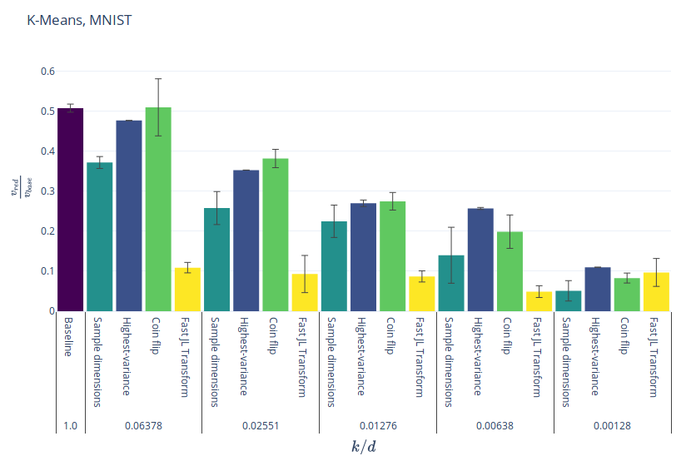
Result
Notes:
Indeed it turns out that it does pretty worse than the others until the reduction factor is 0.1%. That’s where it actually seems to start doing better.
This is K-means over MNIST, and here we see that when the 784 dimensions are reduced to 1, it starts showing its benefits.

Slide 43
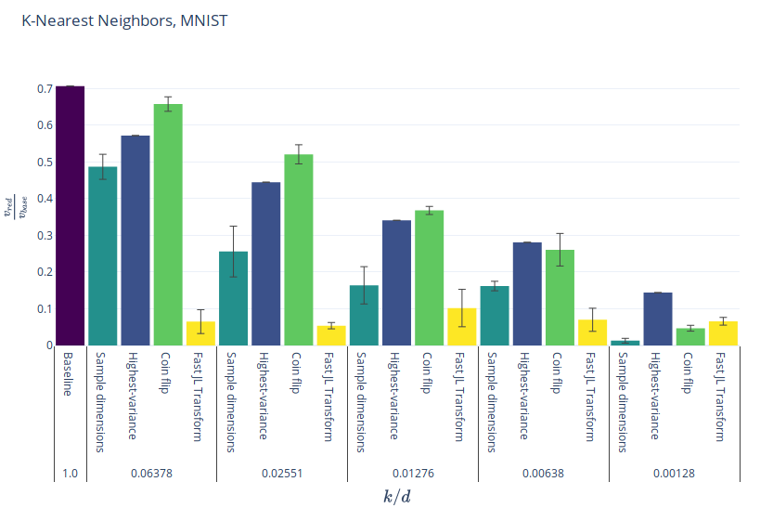
Result
Notes:
This is with KNN clustering, very similar patterns. You can see, for some reason the high variance filter is not that bad.

Slide 44
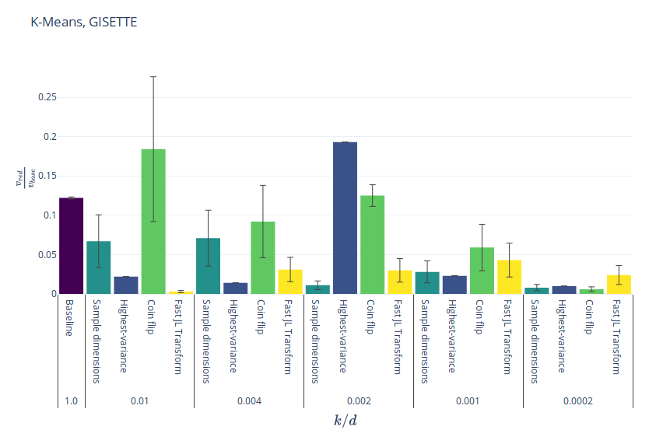
Result
Notes:
But finally, this is the result with the highest-dimensional dataset we worked with. 5000 variables, and you see that when shrinked to 1, FJLT really seems to hint that for more and more important reductions it does better than the others.

Slide 45
Bibliography
[1] W.B. Johnson, J. Lindenstrauss, Extensions of Lipschitz mappings into a Hilbert space, Conference in modern analysis and probability, New Haven, CI, 1982, Amer. Math. Soc., Providence, RI, 1984, pp. 189-206
[2] D. Achlioptas. Database-friendly random projections: Johnson-Lindenstrauss with binary coins. J. Comput. Syst. Sci., 66(4):671-687, 2003
[3] Ailon, N., Chazelle, B.: The fast Johnson-Lindenstrauss transform and approximate nearest neighbors. SIAM J. Comput. 39(1), 302-322 (2009)
[4] Andrew Rosenberg, Julia Hirschberg, V-Measure: A Conditional Entropy-Based External Cluster Evaluation Measure, Proceedings of the 2007 Joint Conference on Empirical Methods in Natural Language Processing and Computational Natural Language Learning (EMNLP-CoNLL), 2007, pp. 410–420

