Slide 1
Warsaw Reader

Slide 2
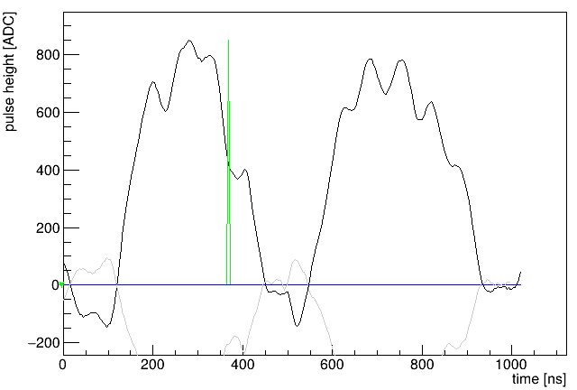
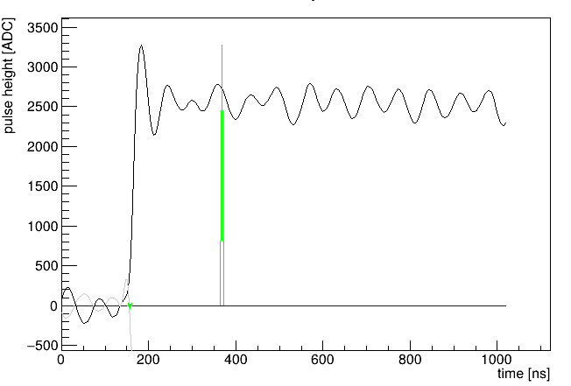
Coulex data
First 1000 SiPM traces of first file
Next traces

Slide 3
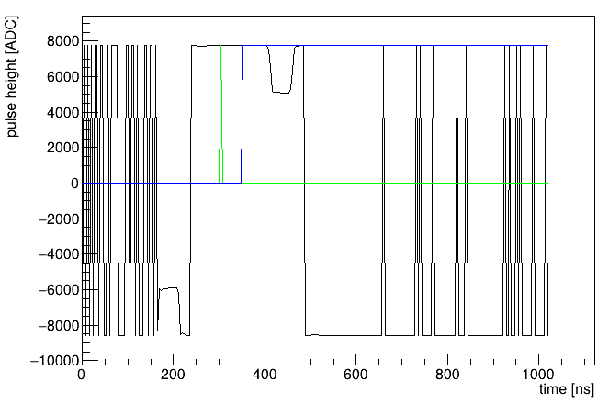
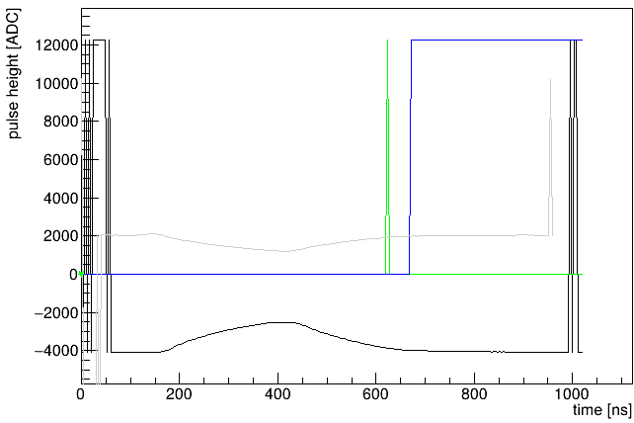
Coulex data
BGO traces
Ge traces
Wrong registers settings …

Slide 4
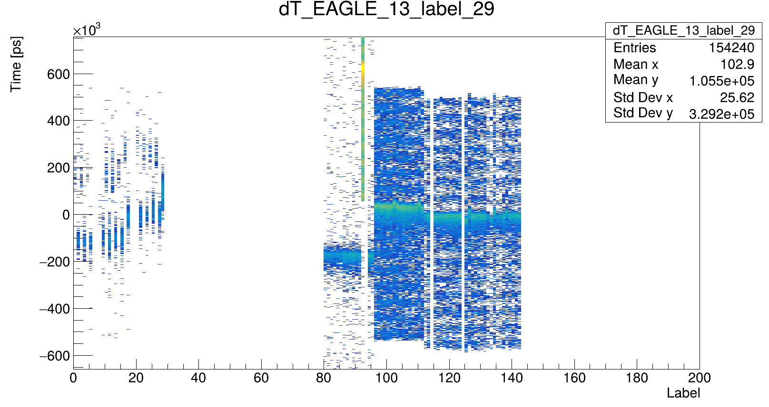
Coulex data
T(OTHER) - T(EAGLE_13) VS Label(OTHER)

Slide 5
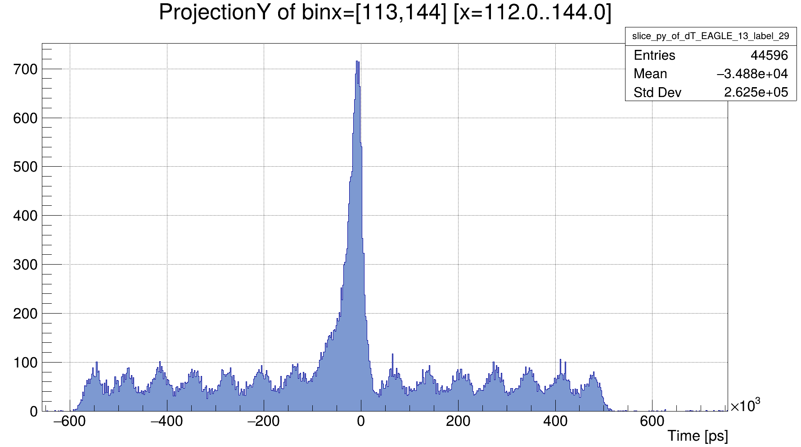
Coulex data
All sectors

Slide 6
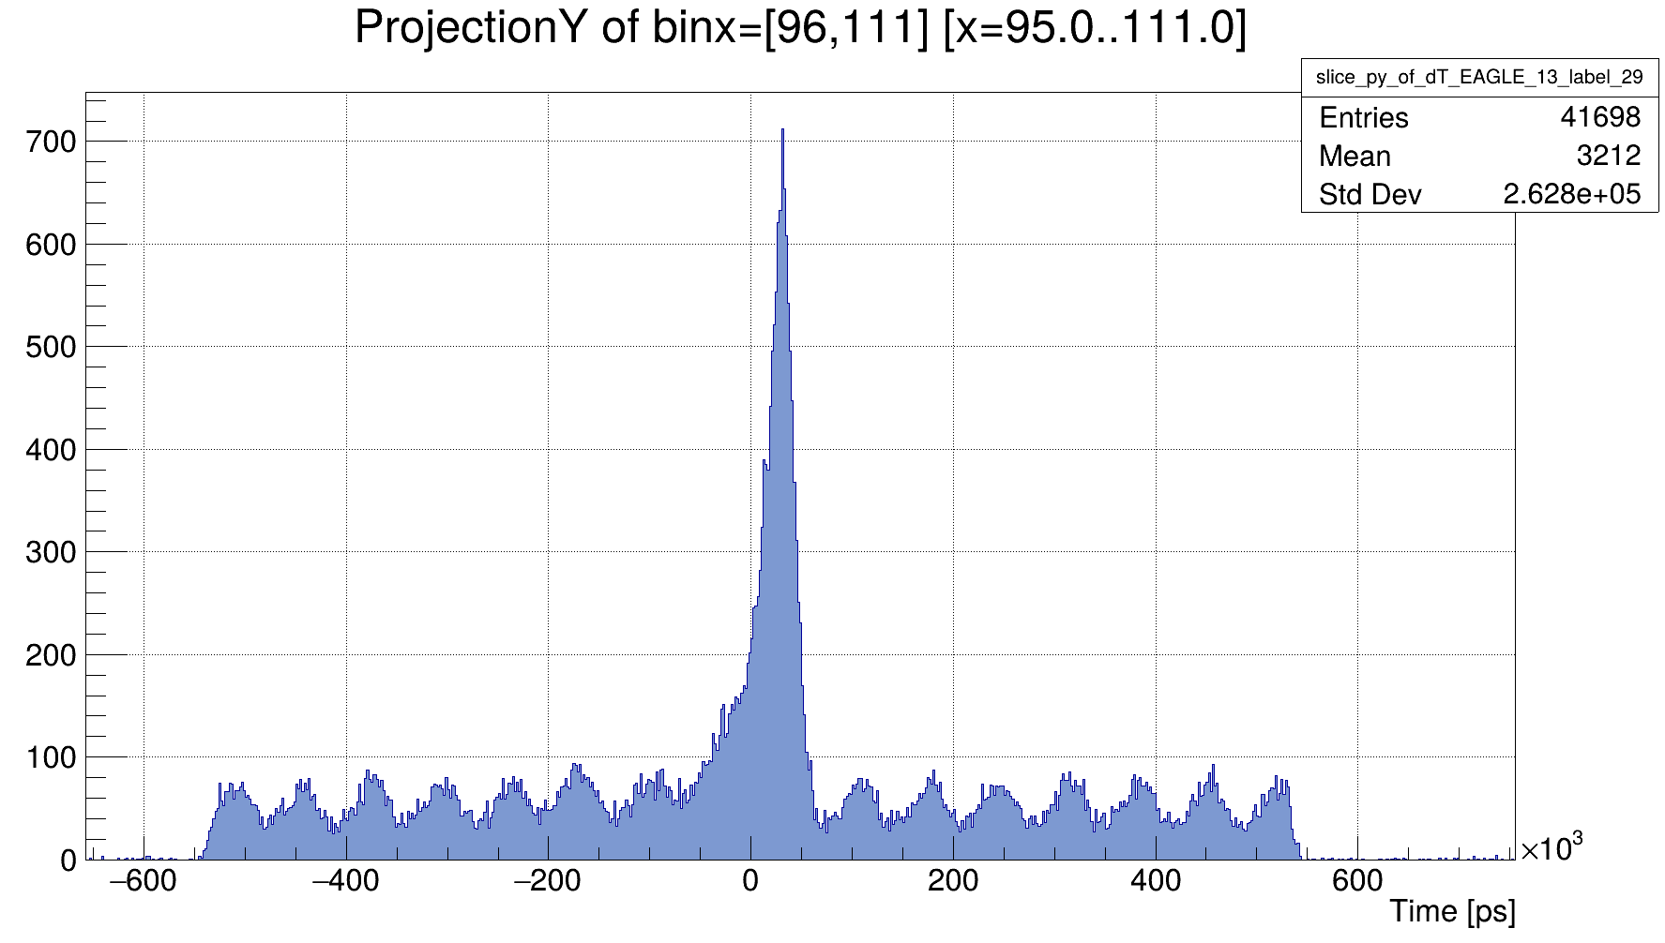
Coulex data
All rings

Slide 7
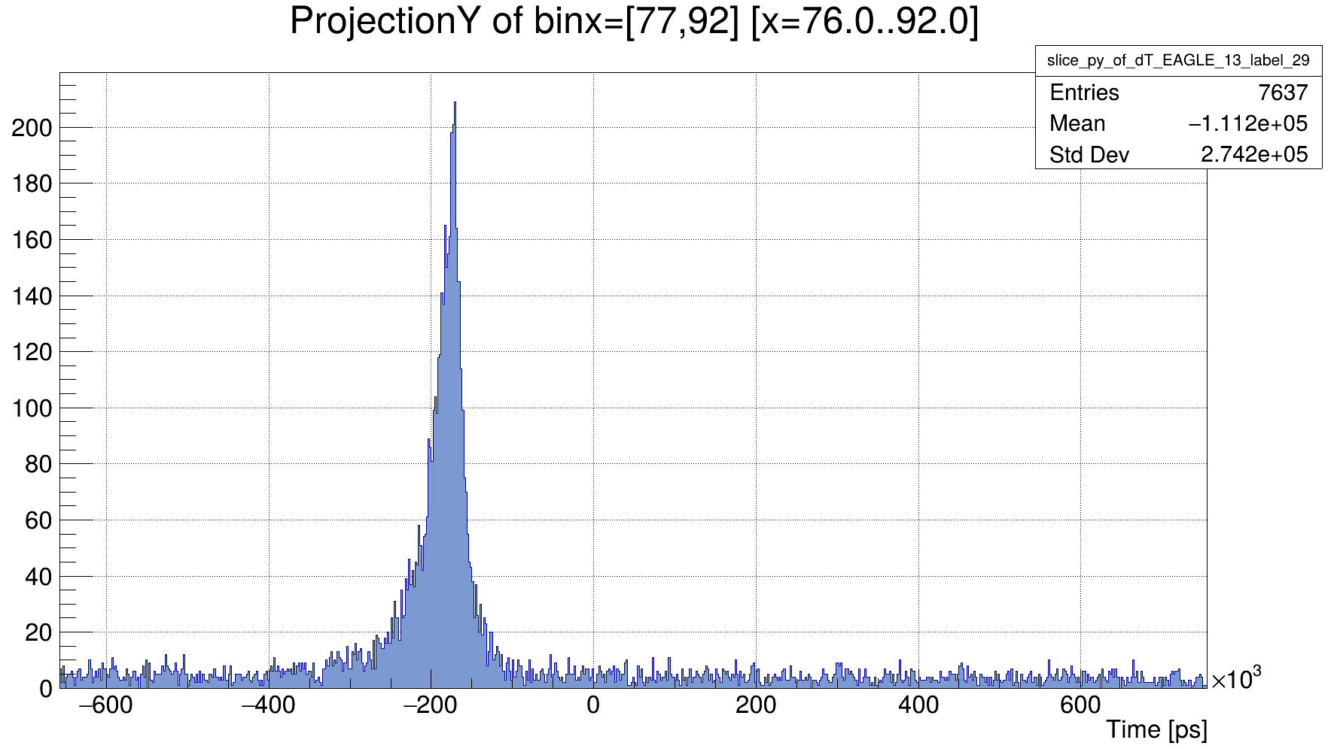
Coulex data
NEDA

Slide 8
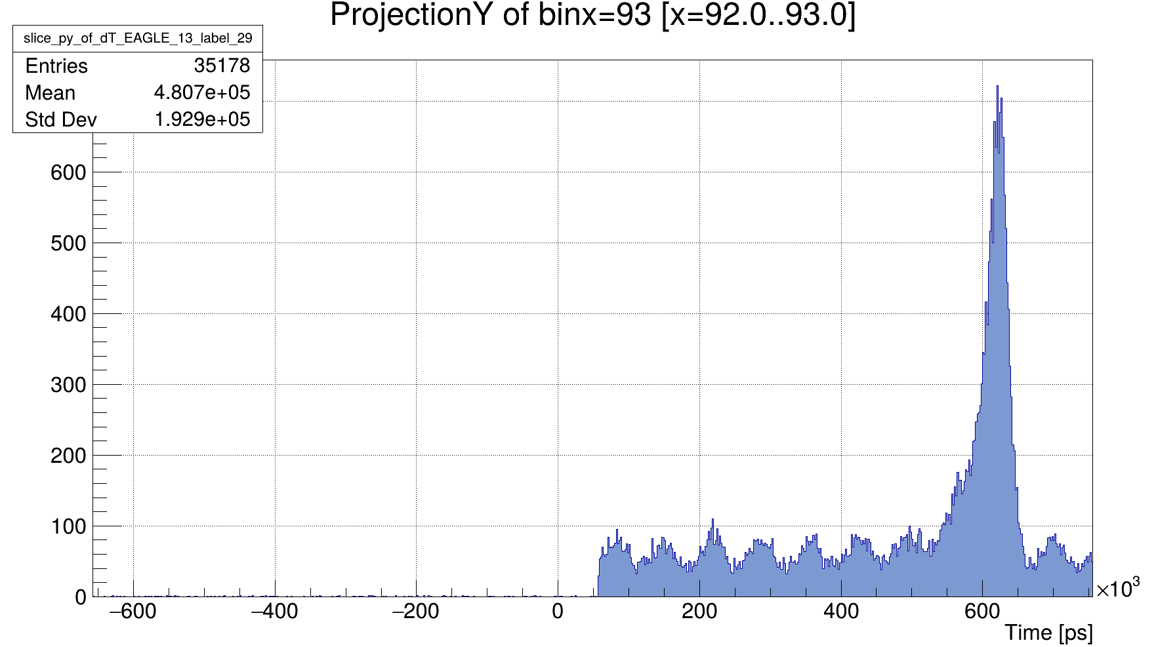
Coulex data
‘’NEDA’’

Slide 9
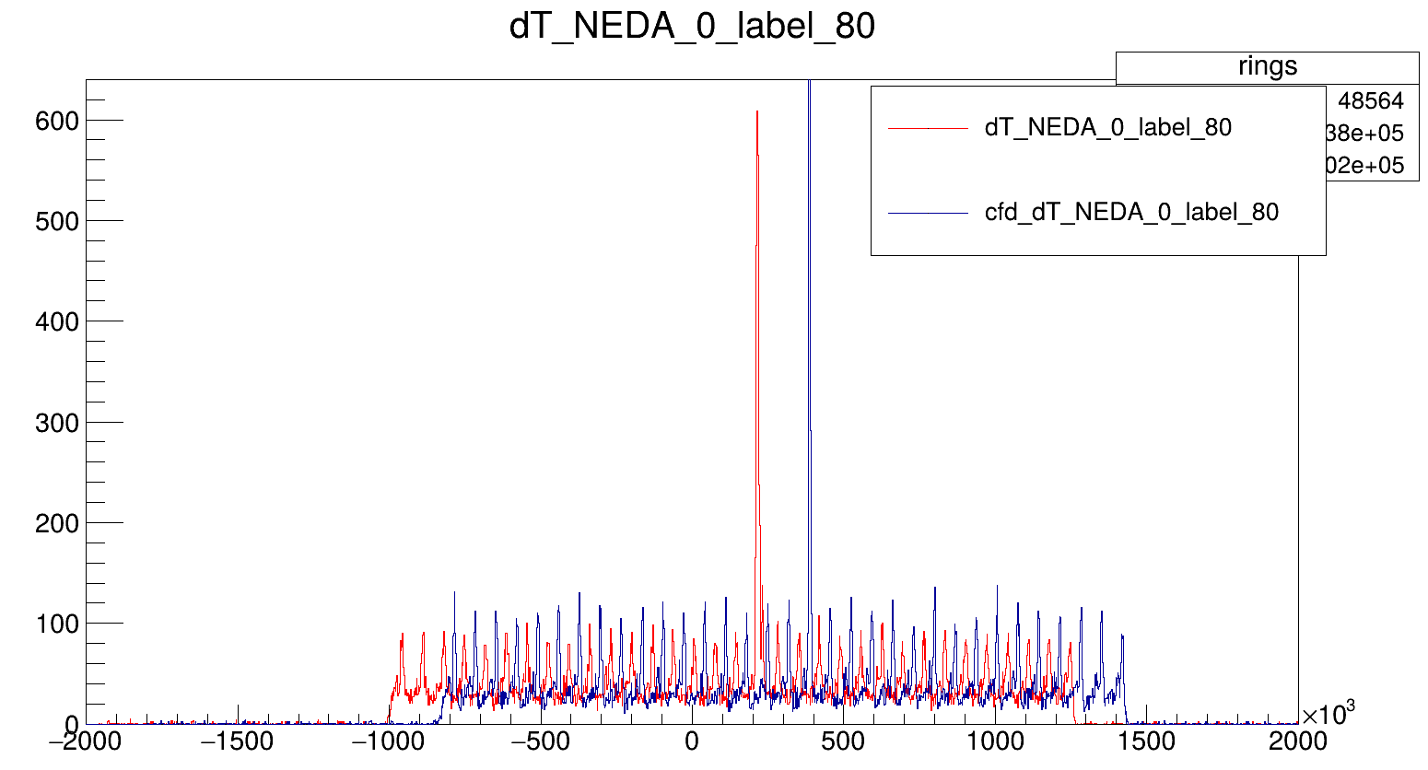
Coulex data

Slide 10
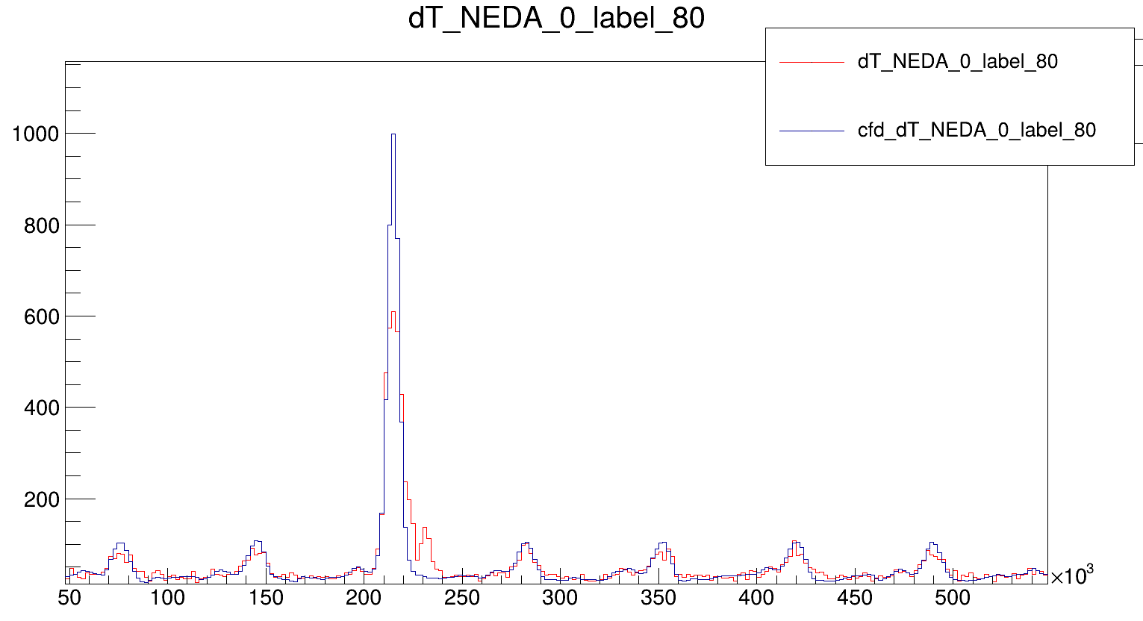
-172,5 ns
Come froms my CFD implementation, easy fix if needed
Coulex data
Realign of misaligned detectors through CFD only !!
→CRRC2 has systematic error for some detetors

Slide 11
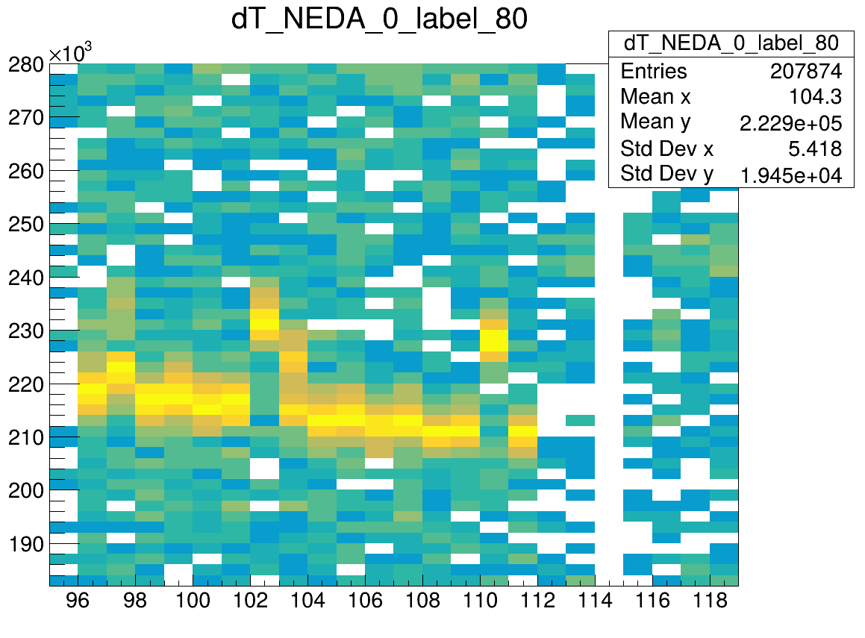
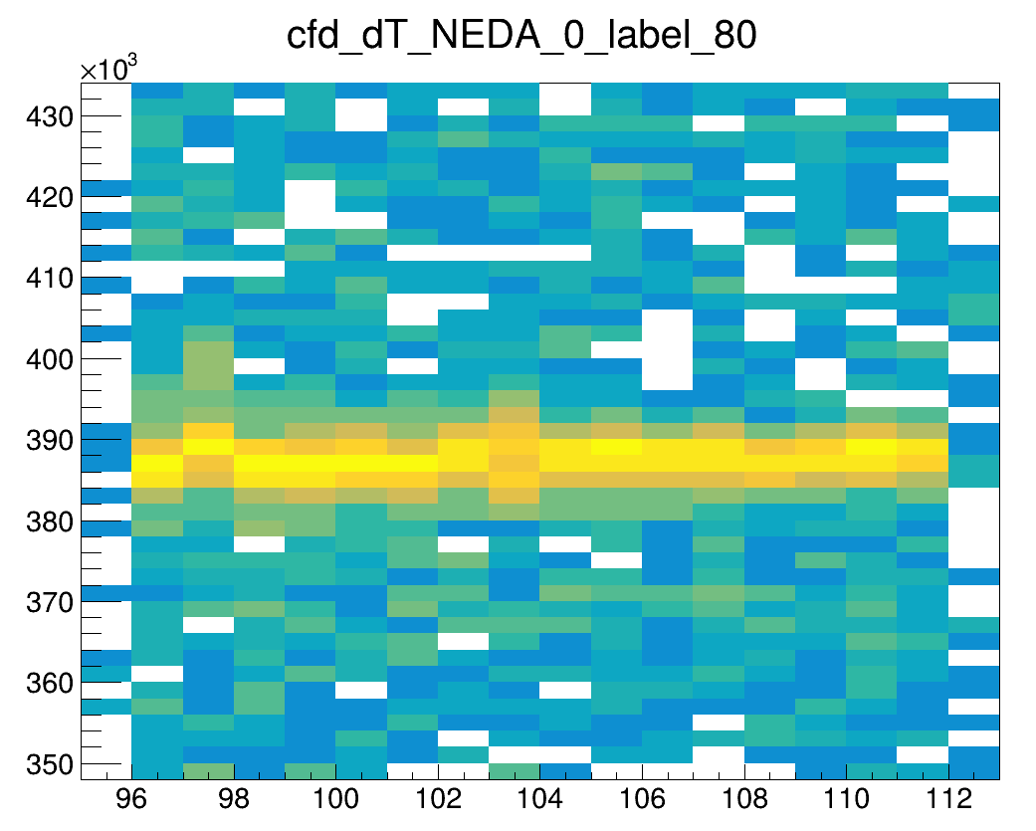
Coulex data
Realign of misaligned detectors through CFD only !!
→CRRC2 has systematic error for some detetors

Slide 12
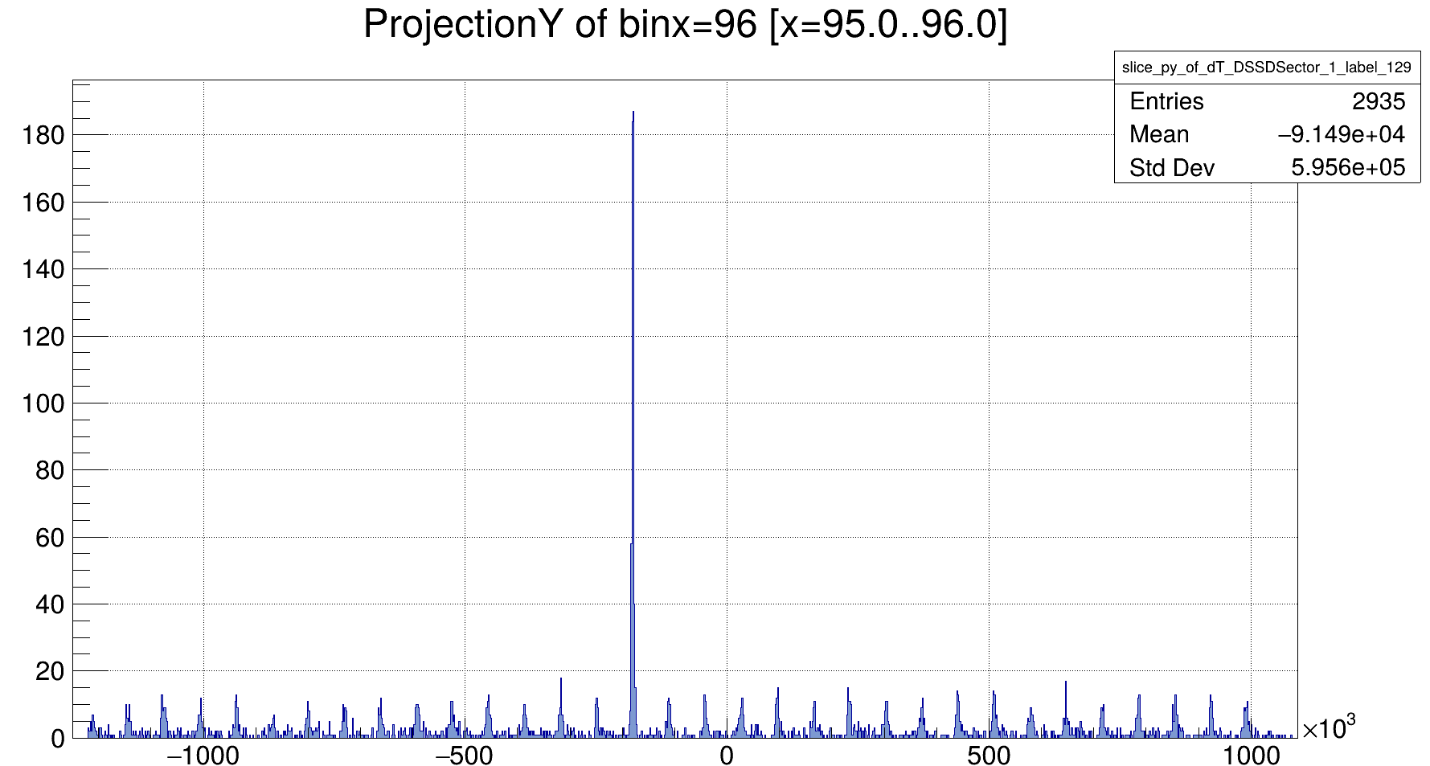
Coulex data
1 NEDA VS 1 Sector

Slide 13
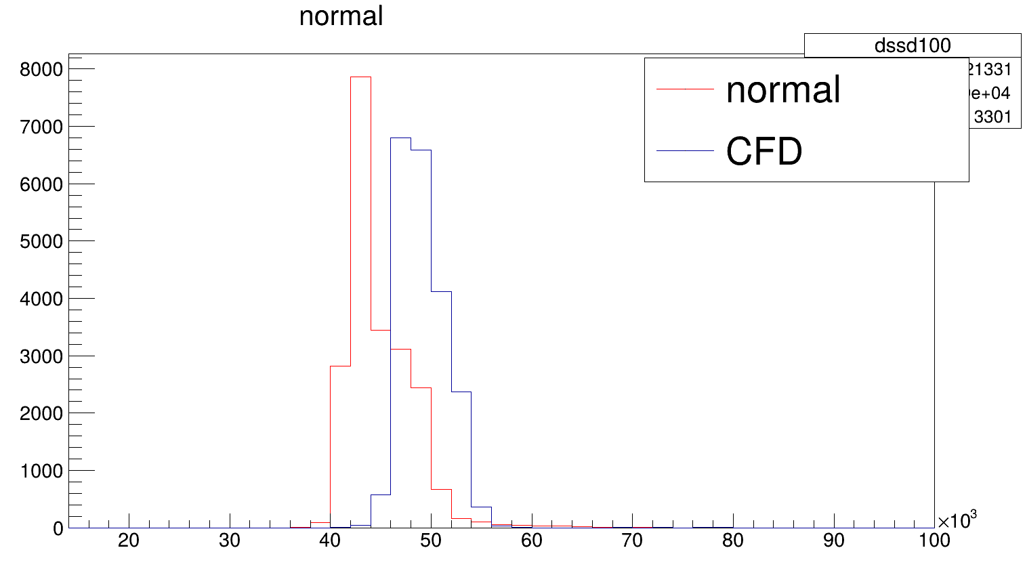
Coulex data
Sector VS ring timing (no shift)

Slide 14
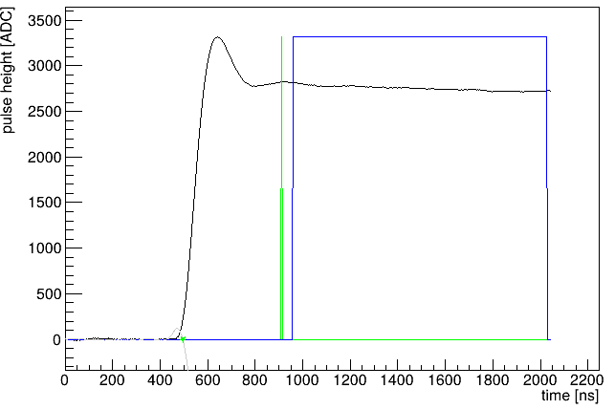

Slide 15
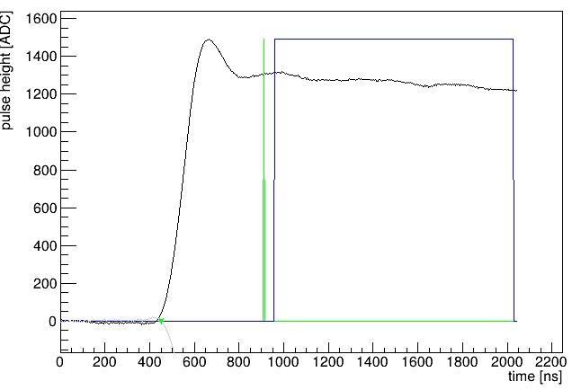

Slide 16
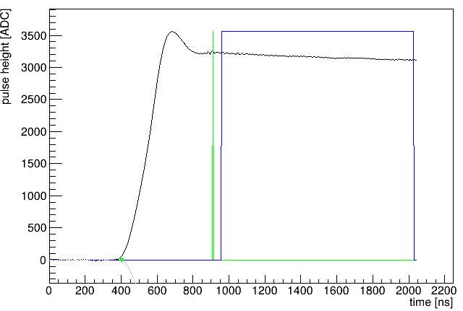

Slide 17
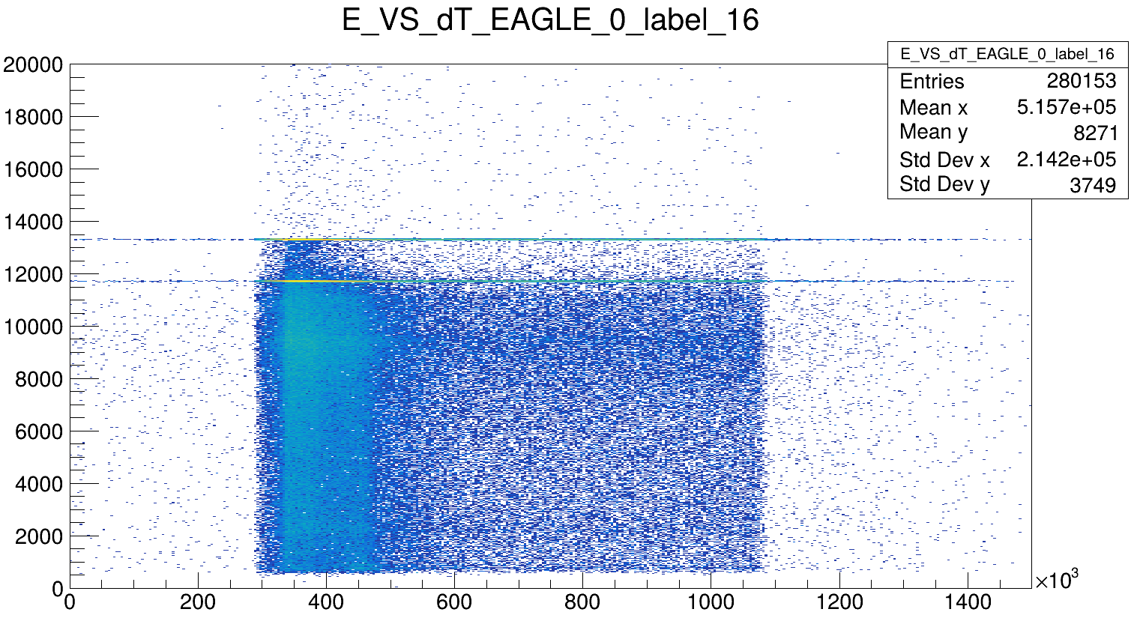

Slide 18
