Slide 1
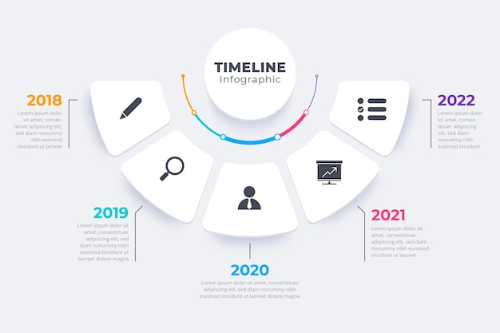


U-REACH
Synthesize and
disseminate

Slide 2

U-REACH
Synthesize and
disseminate
U-REACH
Synthesize and
disseminate

