Slide 1
Game-Playing Agents in Connect Four
Corey Lang and Jenna Mauch

Slide 2
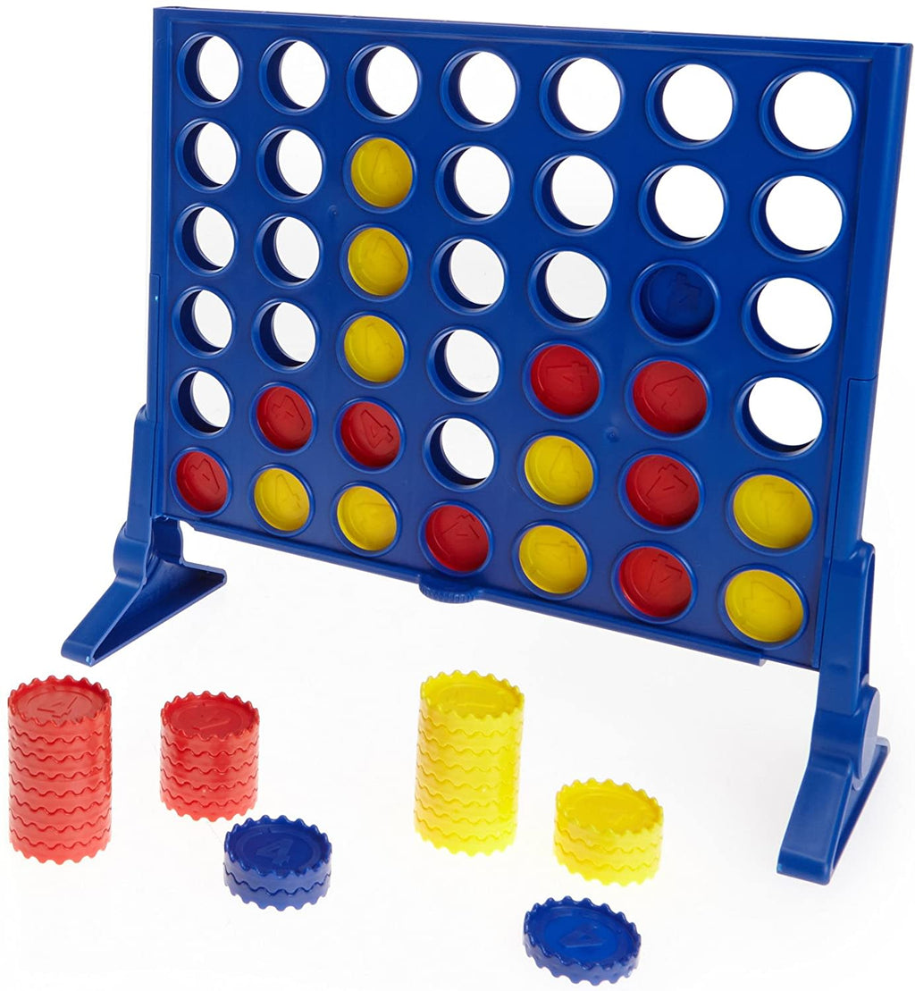
Our problem:
What’s the best algorithm to use for connect 4?
“Best” as in, what will have the highest win rate?
Bot vs Bot, Bot vs Human
Notes:
Jenna

Slide 3
PEAS
Performance Measure: Winning, Connecting pieces
Environment: Connect 4 board game made from a matrix, typically 6x7 Game pieces on the board. 1’s and 2’s
Deterministic, competitive, multi-agent
Actuators: Drop a game piece in a column
Sensors: Fully Observable game board allows the AI bots to see what pieces are in play at each state
Notes:
Jenna

Slide 4
The Bot Algorithms
Breadth First Bot (Uninformed)
Greedy Bot (Informed)
Minimax Bot (Widely used in 2 player turn-based games)
Notes:
Corey

Slide 5
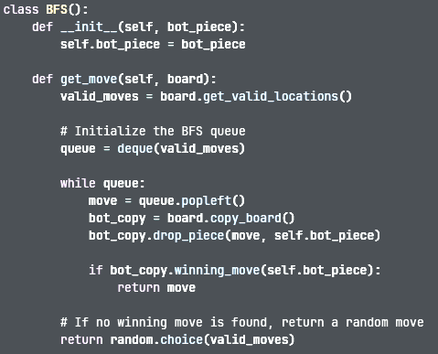
Breadth First Bot
Checks for immediate winning move from a queue containing valid moves, returns move if found
When no move directly leads to a win, random move from the queue of valid moves is returned.
Each turn restarts to queue completely independent of that last move
Notes:
Corey

Slide 6

Queue = [ 1, 2, 3, 4, 5, 6, 7 ]
*checks for a winning move popping elements out the queue as it goes
1 2 3 4 5 6 7
If no valid move resulting in a goal state, a random move is returned
Notes:
Corey

Slide 7
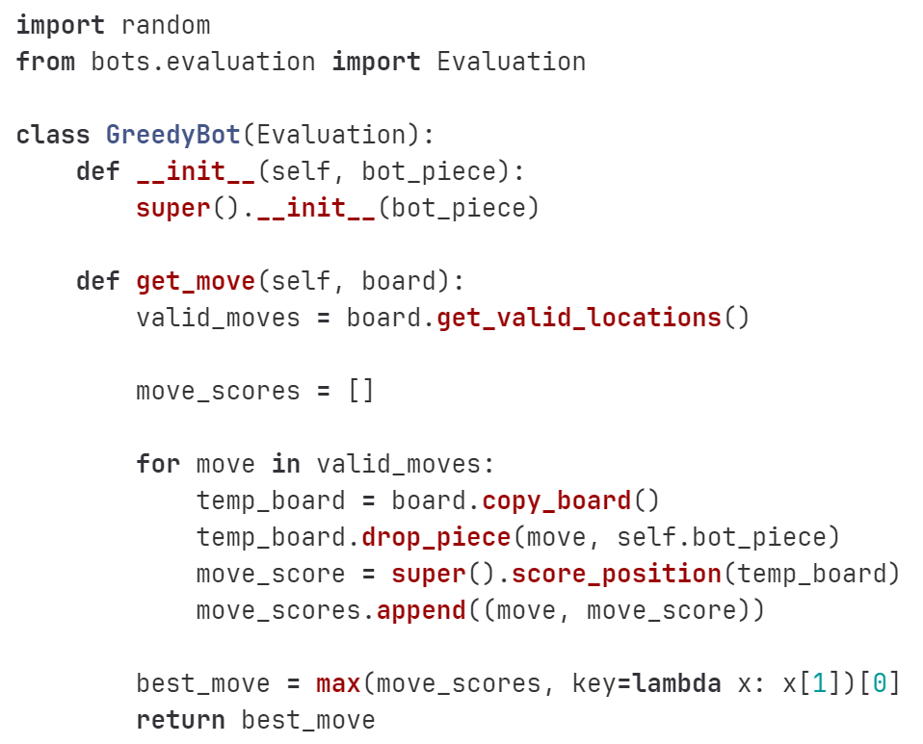
Greedy Bot
Checks valid locations and simulates dropping a piece, scoring that position
The move that gives the max score is the move that is chosen
If two moves have the same max score, the leftmost column is chosen (Should do this)
Evaluation function also factored in
Notes:
Jenna

Slide 8
move_scores = [ 2, 4, 6, 100, 11, 2, 1]
*checks the score of the move, inserting them into an array
1 2 3
4 5 6 7
Chooses the max score in the array, with positions being the column
Notes:
Jenna

Slide 9
Minimax Bot
Utilizes an evaluation function to assign rewards/penalties for various moves
Can evaluate thousands of potential board states in seconds
Depth first search process
Assumes opponent will make logical choice
Notes:
Corey

Slide 10
MAX
7
*initial board state
Board game tree will have 7 possible child states not 2
Depth is 5 for our algorithm
MIN
7
6
MAX
7
100
6
9
4
7
-4
100
6
6
9
-8
Notes:
Corey

Slide 11
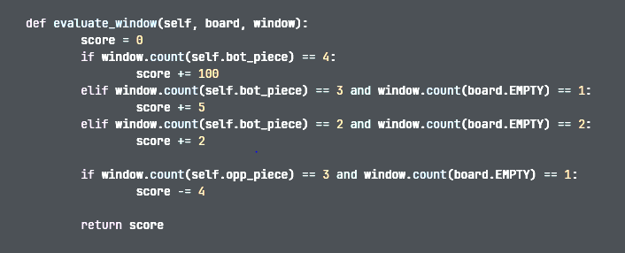

Minimax Bot (Evaluation)
Scoring
center column
Two pieces connected
Three pieces connected
Four pieces connected (win)
Three opponent pieces connected
Notes:
Corey

Slide 12


Slide 13
Initial Findings
Minimax > Greedy > Breadth-FIrst
Bot playing against the same bot will provide identical states everytime
Breadth-first search algorithm updated
Breadth-first > Greedy in the first iteration
Moves are placed in real time, GUI sometimes cannot keep up
Also shows the length of decision making process
Notes:
Jenna - first two
Corey - last two

Slide 14
Final Report
Larger sample space
Time per moves comparison
Different size boards
Bot testing against human players
Maybe code in turn taking for easier testing
Reinforcement learning
Notes:
Corey - First 3
Jenna - Last 3

Slide 15
Thank you
Any questions?

