Slide 1

Executive Summary and Project Goals
Goal
Develop a machine learning model to inform stock trading by predicting buy/sell/hold actions at close. Aim for actionable and reliable signals for practical application.
Performance Target
Achieve higher than 50% classification accuracy despite market volatility challenges. An additional model was tested to predict the 200-day moving average for contextual insights.
Process Highlights:
Large-scale data cleaning, advanced feature engineering, and model tuning to overcome data complexity and optimize predictive performance.

Slide 2

Choosing a Large Dataset
More historical data allows for better trend analysis.
Identify patterns, price movement, and seasonality.
Enhanced Statistical Significance.
Confidence in your findings.
Allows for regression analysis, moving averages, and ML algorithms to future forecast returns.

Slide 3

Reaching Our Goals
Team Coordination and Task Assignment
Outlined objectives, assigned roles based on strengths, set deadlines, and held regular check-ins to stay aligned.
Data Collection and Preprocessing
Feature Engineering and Model Development
Validation and Cross-Checking
Results Analysis and Insights
Presentation
Worked together to create this presentation, summarizing our approach, findings, and insights.

Slide 4
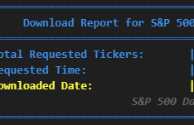
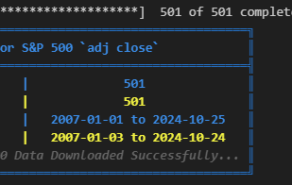

Data Collections, Cleaning, and Exploration
Identified dataset from Yahoo! finance that provided `Adjusted Close`, `Date`, and `Ticker` data for requested time frame.
Calculated values and created new features individually such as: `Returns`, `RSI`, `Volatility`, `SMA's`, `Next Day's Price`, `Buy/Sell Actions`, etc...
Accounted for look ahead bias.
Removed all rows where `Adjusted Close` is `0` which meant stock did not start or exists for ticker at that time.
Used Feature Selection techniques to clean dataset further.

Slide 5
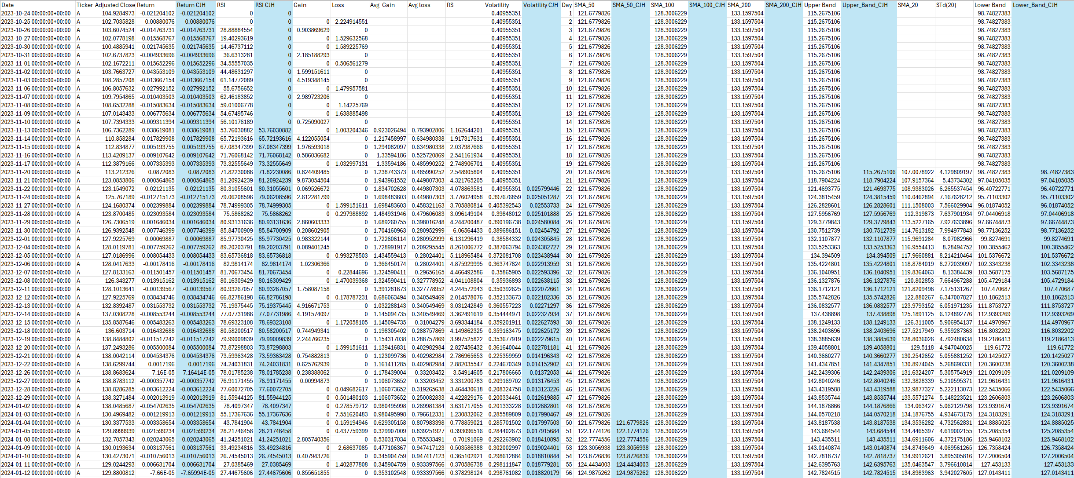
Data Preparation Continued...
Cleaning and Validation performed in Excel and Jupyter Notebook
After performing calculations in our notebook, we exported the data to validate accuracy and confirm that no values were shifted. We cross-checked the exported results against our Excel database to ensure alignment with expected values.

Slide 6
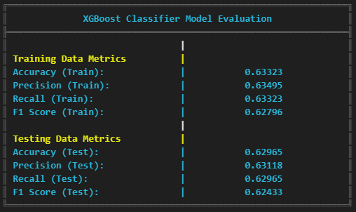
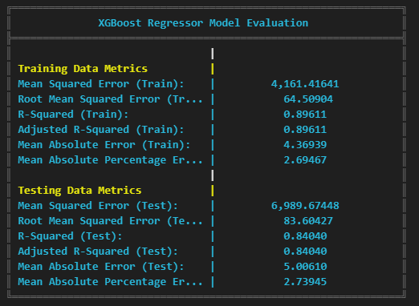
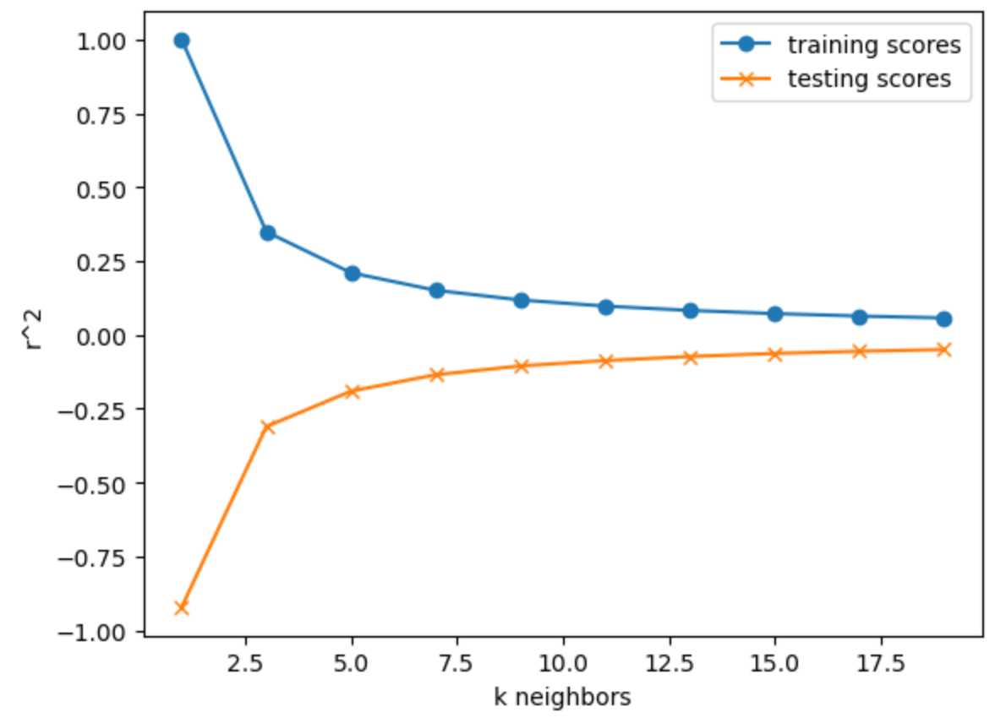
The Switch from Regression to Classifier
Regression Models | Classifier Models
Limited predictive accuracy on unseen data. | Reasonable accuracy for binary classification
Model overfits and performs poorly on new data. | Balances sensitivity and specificity
Struggles with continuous value prediction due to market volatility. | Better for general trend (up/down) detection due to categorical target.
Ineffective due to market complexity and sensitivity to point errors. | Effective for binary classification task, more resilient to noise
Notes:
Regression Limitations
Initially, we used XGBoost Regressor to predict exact stock prices. Despite high training scores (R² of 0.89), testing data showed an R² of 0.84, and errors increased significantly, indicating overfitting and poor generalization due to market volatility.
Why Classification was Better
Switching to classification shifted our goal to trend detection, focusing on whether the stock would go up or down. This approach was more resilient to noise and better aligned with our goal of actionable insights.
XGBoost Classifier Results
With classification, we achieved stable cross-validation scores around 62-63%, making this approach more effective for reliable trend predictions.

Slide 7
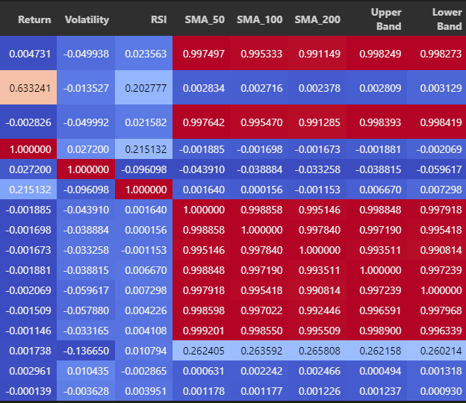
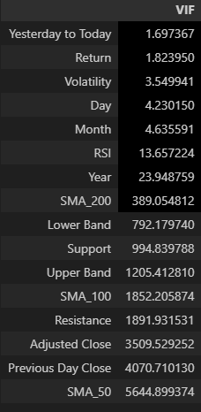
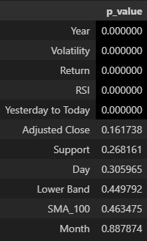
Feature Selection
Corr Matrix and VIF: Recommend to remove `["Previous Day Close", "Resistance", "Upper Band", "SMA_50", "SMA_200"]` after inspection...
Instead of removing all of them, using domain knowledge, removed features that had relationship with other features: `Resistance` vs. `Support` etc...
Compared to before, it dramatically improved `p_value`
Notes:
Initial Feature Reduction
We used Correlation Matrix and VIF to identify features with high multicollinearity, recommending removal of features like "Previous Day Close" and "SMA_200".
Applying Domain Knowledge
Instead of removing all flagged features, we selectively removed only a few, like "Resistance" over "Support", to retain more relevant financial indicators.
Results
This selective reduction improved p-values significantly and lowered VIF values. Key features now have VIFs mostly under 5, with p-values close to zero, indicating improved model robustness.

Slide 8
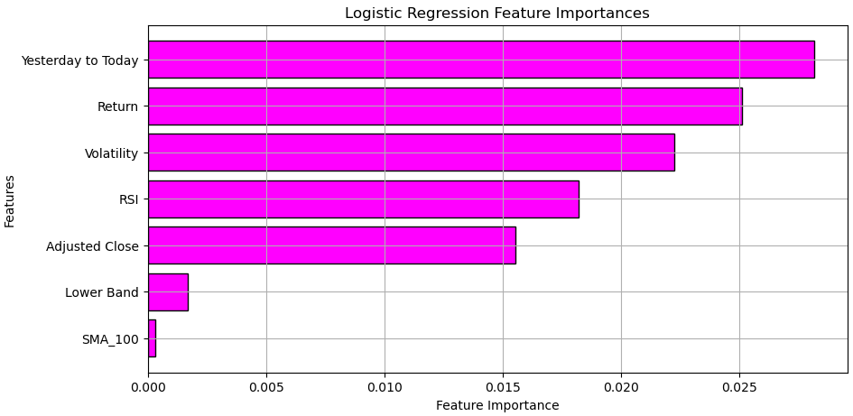
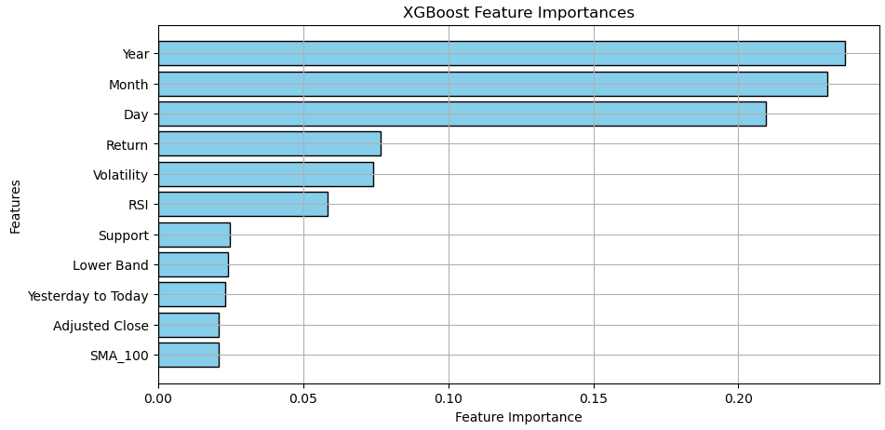
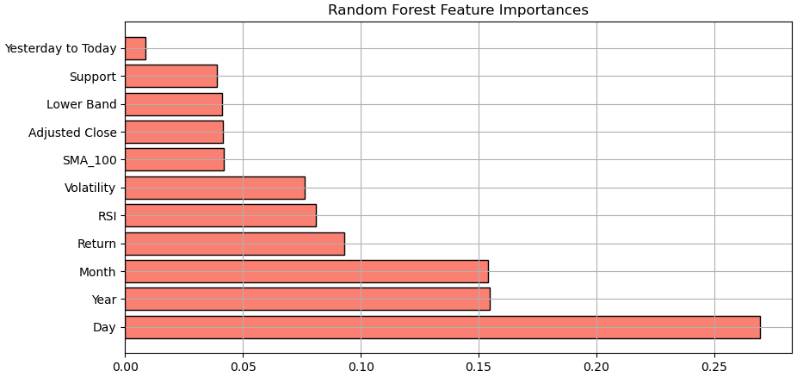
Feature Importance
Date, Returns, RSI, Volatility, Adjusted Close

Slide 9
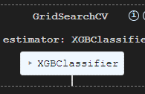
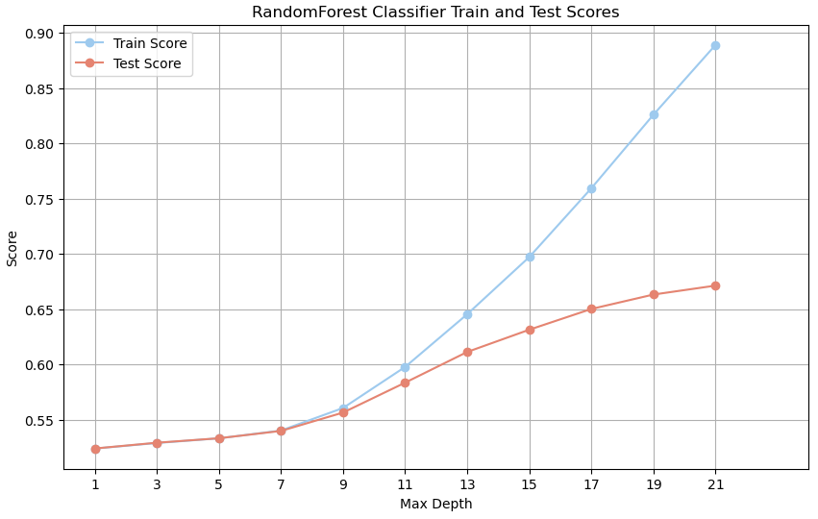
Model Hyperparameter Tuning
k-Nearest Neighbors (k-NN)
Plotted training vs. testing accuracy across `k` values to identify optimal `k`.
Balanced accuracy to prevent overfitting (low k) or underfitting (high k).
Random Forest Classifier
Tuned `max_depth` to improve model generalization.
Examined accuracy at varying depths to avoid excessive model complexity.
GridSearchCV for Optimal Parameters
Applied to multiple models to systematically select the best parameters.
Chose configurations maximizing accuracy for robust predictions.
Example Best Parameters
{
"colsample_bytree": 1.0,
"gamma": 0,
"learning_rate": 0.15,
"max_depth": 5,
"n_estimators": 300,
"subsample": 1.0
}
Notes:
k-Nearest Neighbors (k-NN) Optimization
We plotted training and testing accuracy across k values, allowing us to find the optimal balance between overfitting (too low k) and underfitting (too high k). This approach led to a more stable model.
Random Forest Classifier Tuning
Adjusted max_depth for improved generalization, ensuring the model wasn’t overly complex. This maintained a strong accuracy-performance balance while preventing over-complexity.
Automated Tuning with GridSearchCV
We used GridSearchCV across models to find the best parameter configurations for accuracy. This systematic approach maximized our models' predictive robustness, ultimately enhancing overall performance.

Slide 10
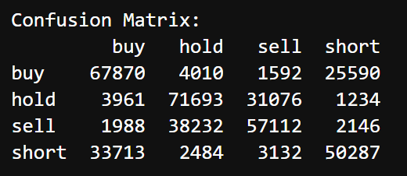
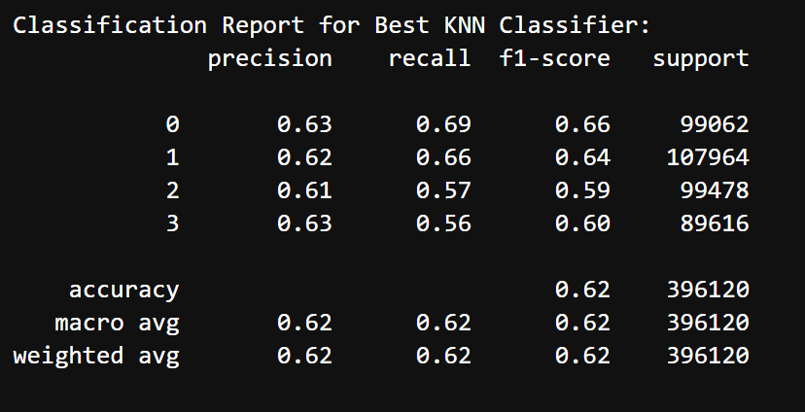
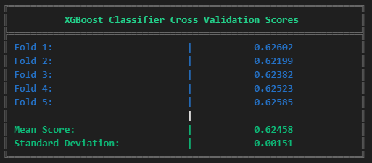
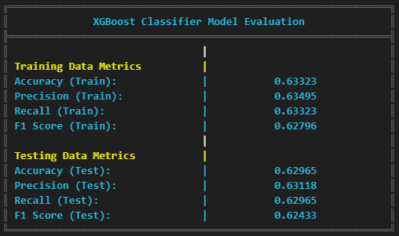
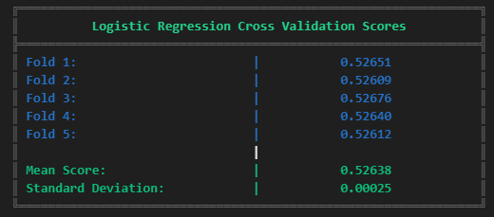
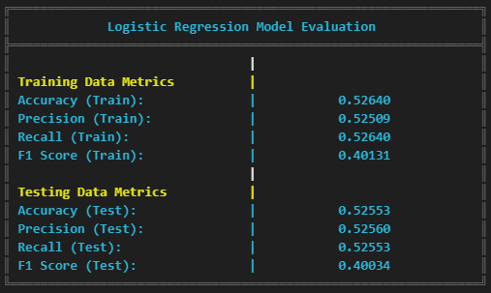
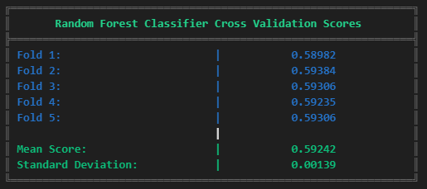
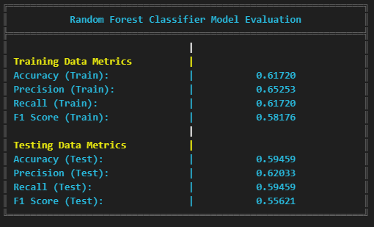
Cross-Validation and Model Evaluation
Consistent Model Evaluation with Cross-Validation
Used multiple data folds to train and test models, ensuring reliable performance across different data splits.
Reduced risk of overfitting, as each model was tested on unseen data.
Model Comparison through Metrics
Compared models on accuracy across cross-validation folds to find the most stable performer.
Used classification reports to assess precision, recall, and F1-scores, providing a complete view of model accuracy for each class.
Detailed Error Analysis
Confusion matrices allowed us to visualize true vs. predicted classifications, revealing common misclassifications and areas for improvement.
Helped identify where models struggled, supporting adjustments in feature engineering and hyperparameter tuning.
Notes:
Cross-Validation for Consistent Performance
We used multiple data folds to validate our models, testing on different splits. This helped ensure reliable performance and reduced overfitting by exposing models to various data distributions.
Comparative Metrics and Classification Reports
By evaluating models on accuracy across folds, we identified the most stable models. Classification reports added depth, with metrics like precision, recall, and F1-scores, which highlighted how well each class was being classified.
Detailed Error Analysis with Confusion Matrices
Confusion matrices offered insight into true vs. predicted classifications, pinpointing common misclassifications. This informed feature engineering tweaks and adjustments in hyperparameter tuning.
For example, in the XGBoost Classifier, training accuracy was 63.3% with similar precision and recall scores, and testing accuracy remained stable at 62.9%, showing balanced performance without overfitting.

Slide 11
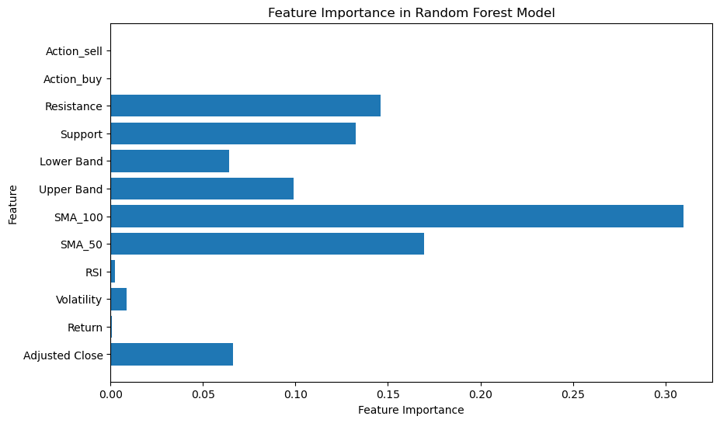
200 Day Moving Average with Random Forest Classifier
Grid Search CV ​took 12 hours to find optimal parameter.
Best parameters: {'max_depth': None, 'min_samples_leaf': 1, 'min_samples_split': 2, 'n_estimators': 300}
Predicting at 0.999997474*** Accuracy
Notes:
Predicting the 200 day average as a sanity check for the model accuracy.

Slide 12
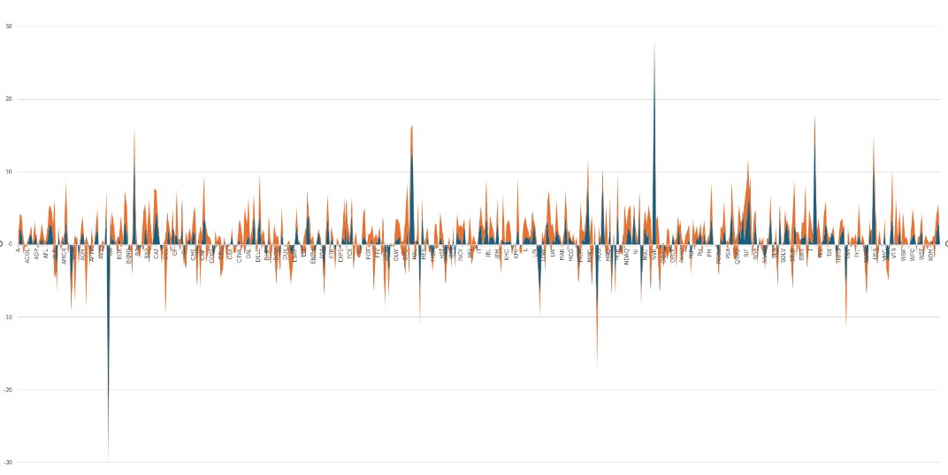
Results
Budget $109k
One Day Realized gains/loss 10/25/2024-10/28/2024
X axis = tickers
Y axis = $ USD
Logistical Regression
Market Returns
Notes:
Buying 1 share of every stock required a large budget and it allowed us to understand how successful our models are at beating the market.
In our testing, Logistic Regression outperformed the market on a one day trade at 115%
Random Forest 10%
Logistic Regression 215%

Slide 13
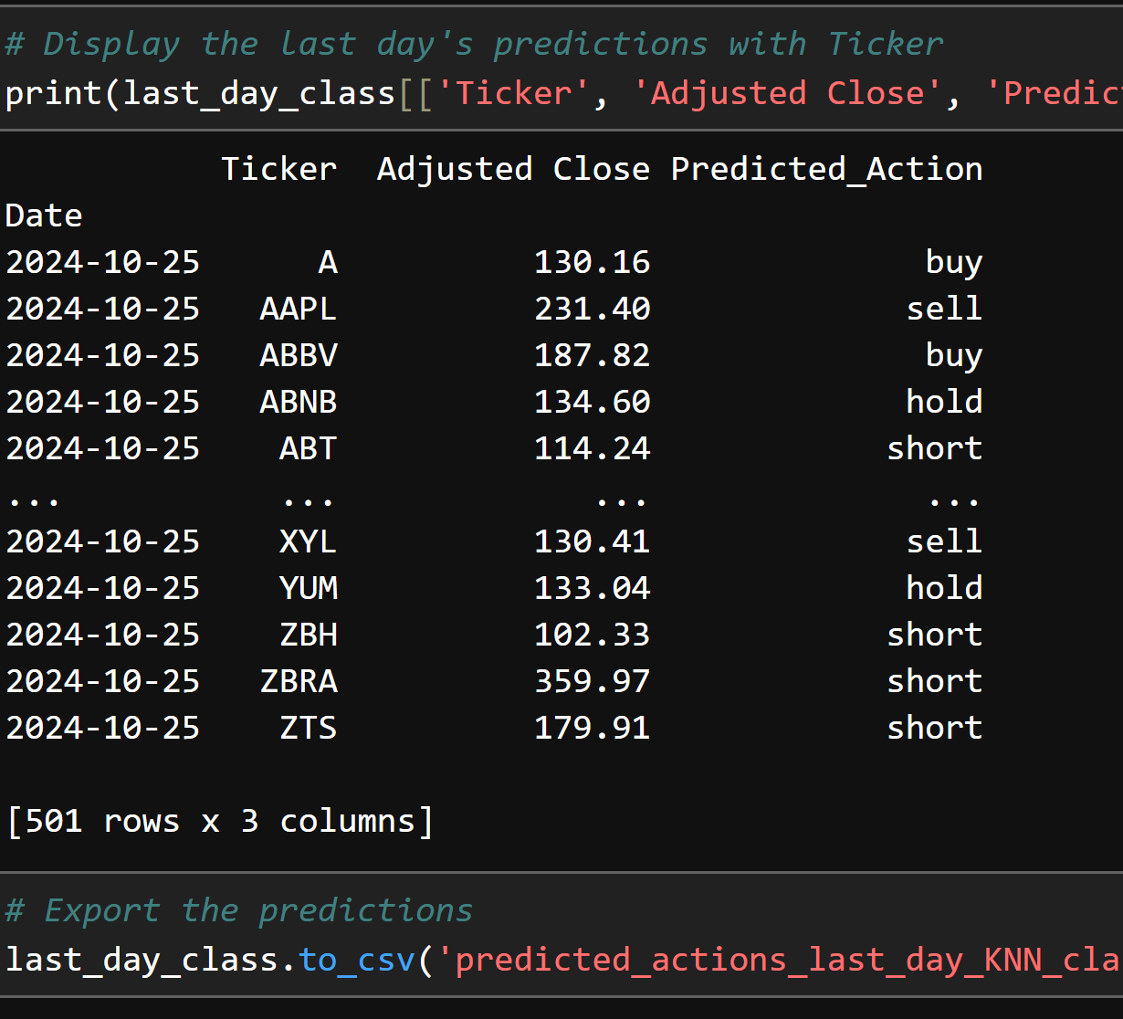
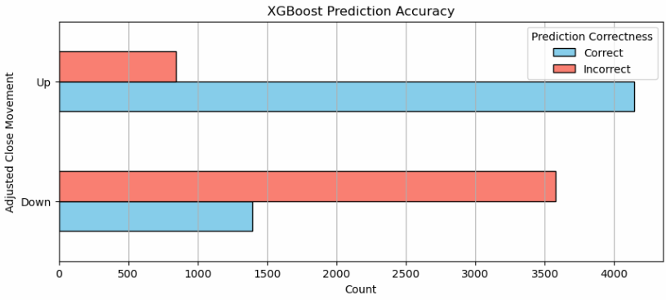
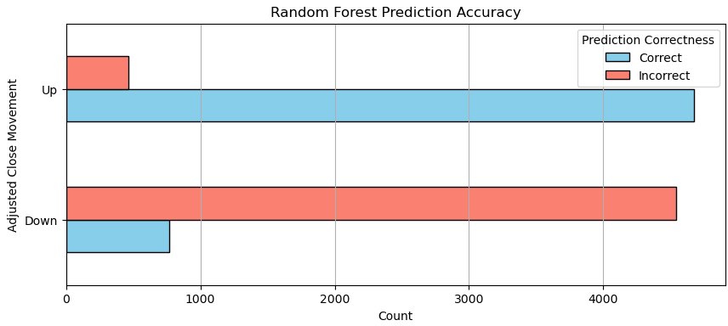
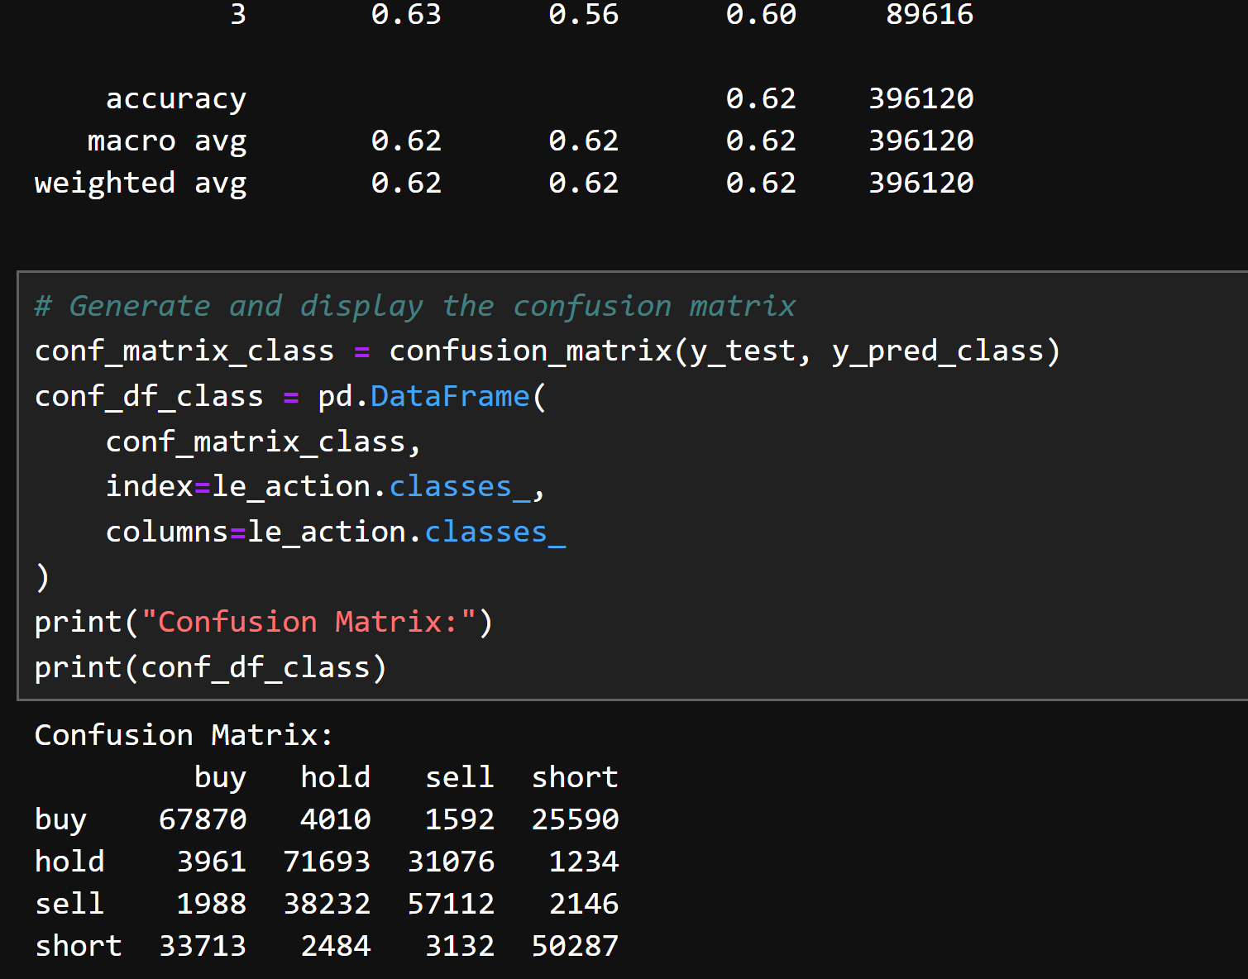
Model Predictions
October 2024
844 (17%)
4143 (83%)
3,579 (72%)
1,393 (28%)
One Month Outlook
October 2024
462 (9%)
4,673 (91%)
4,539 (86%)
767 (14%)
Notes:
Model Prediction results are strong with 63% precision and provided high hopes that we will beat the market.
The weakest 1day prediction model proved the strongest predictions at a 1 month outlook.

Slide 14
Challenges
Learning Curve in Finance Features
New finance indicators required team adaptation and domain learning.
Pivoting Prediction Goals
Started with regression (exact values), switched to direction-based indicators (Returns), and finalized with Classification (Today vs. Tomorrow).
Flexibility Through Trial and Error
Iterative testing taught us to adapt based on model performance; Classification proved most effective.
Demanding Resouces to Train Model
Large dataset requires large training times.
Uploading very large dataset to repo
Difficulty is high. Hard to get good results.
Notes:
Making sure, team understand financial indicators. Pivoting was frustruation but a good learning experience

Slide 15
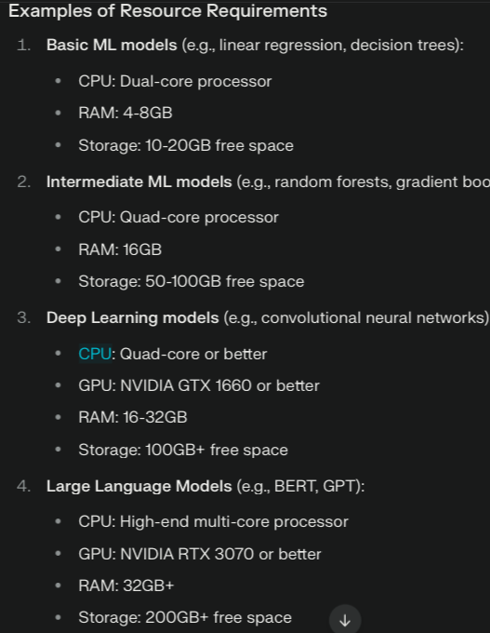
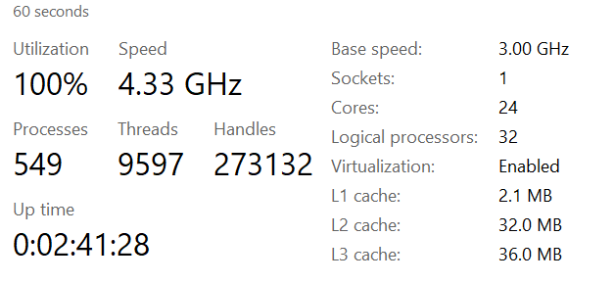
Demanding Resources for Machine Learning Model
Machine Learning Models place an exhaustive load on machines to find the optimal parameters.
SVR – Running for 2 day on full system resources on 10% of sample data.
Notes:
Since we had so many rows of data ~2million. It took some of our models day(s) to run.

Slide 16

Future Development
Hourly Prediction Analysis
Shift from daily to hourly predictions for finer trading insights, enabling quicker response to market movements.
Advanced Modeling Techniques
Explore Long Short-Term Memory (LSTM) models to capture sequential patterns and improve accuracy for time-dependent data.
Enhanced Data Splitting Methods
Implement date-aware data splits to maintain sequence integrity, ensuring realistic model evaluation with forward-looking data.
Refine Time Frame Selection
Investigate optimal prediction time frames (daily, weekly, monthly) to align model outputs with specific trading strategies.
Feature Expansion
Integrate additional economic indicators such as exploring additional indicators or sentiment analysis from news to enrich model inputs and capture broader market influences.

