Slide 1
Requirements
Data Model Implementation (25 points)
There is a Jupyter notebook that thoroughly describes the data extraction, cleaning, and transformation process, and the cleaned data is exported as CSV files for the machine learning model. (10 points)
A Python script initializes, trains, and evaluates a model or loads a pretrained model. (10 points)
The model demonstrates meaningful predictive power, at least 75% classification accuracy or 0.80 R-squared. (5 points)

Slide 2
Data Model Optimization (25 points)
The model optimization and evaluation process showing iterative changes made to the model and the resulting changes in model performance is documented in either a CSV/Excel table or in the Python script itself. (15 points)
Overall model performance is printed or displayed at the end of the script. (10 points)

Slide 3
GitHub Documentation (25 points)
GitHub repository is free of unnecessary files and folders and has an appropriate .gitignore in use. (10 points)
The README is customized as a polished presentation of the content of the project. (15 points)

Slide 4
Presentation Requirements (25 points)
Your presentation should cover the following:
An executive summary or overview of the project and project goals. (5 points)
An overview of the data collection, cleanup, and exploration processes. (5 points)
The approach that your group took in achieving the project goals. (5 points)
Any additional questions that surfaced, what your group might research next if more time was available, or share a plan for future development. (3 points)
The results and conclusions of the application or analysis. (3 points)
Slides effectively demonstrate the project. (2 points)
Slides are visually clean and professional. (2 points)
This project will be evaluated against the requirements and assigned a grade according to the following table:

Slide 5
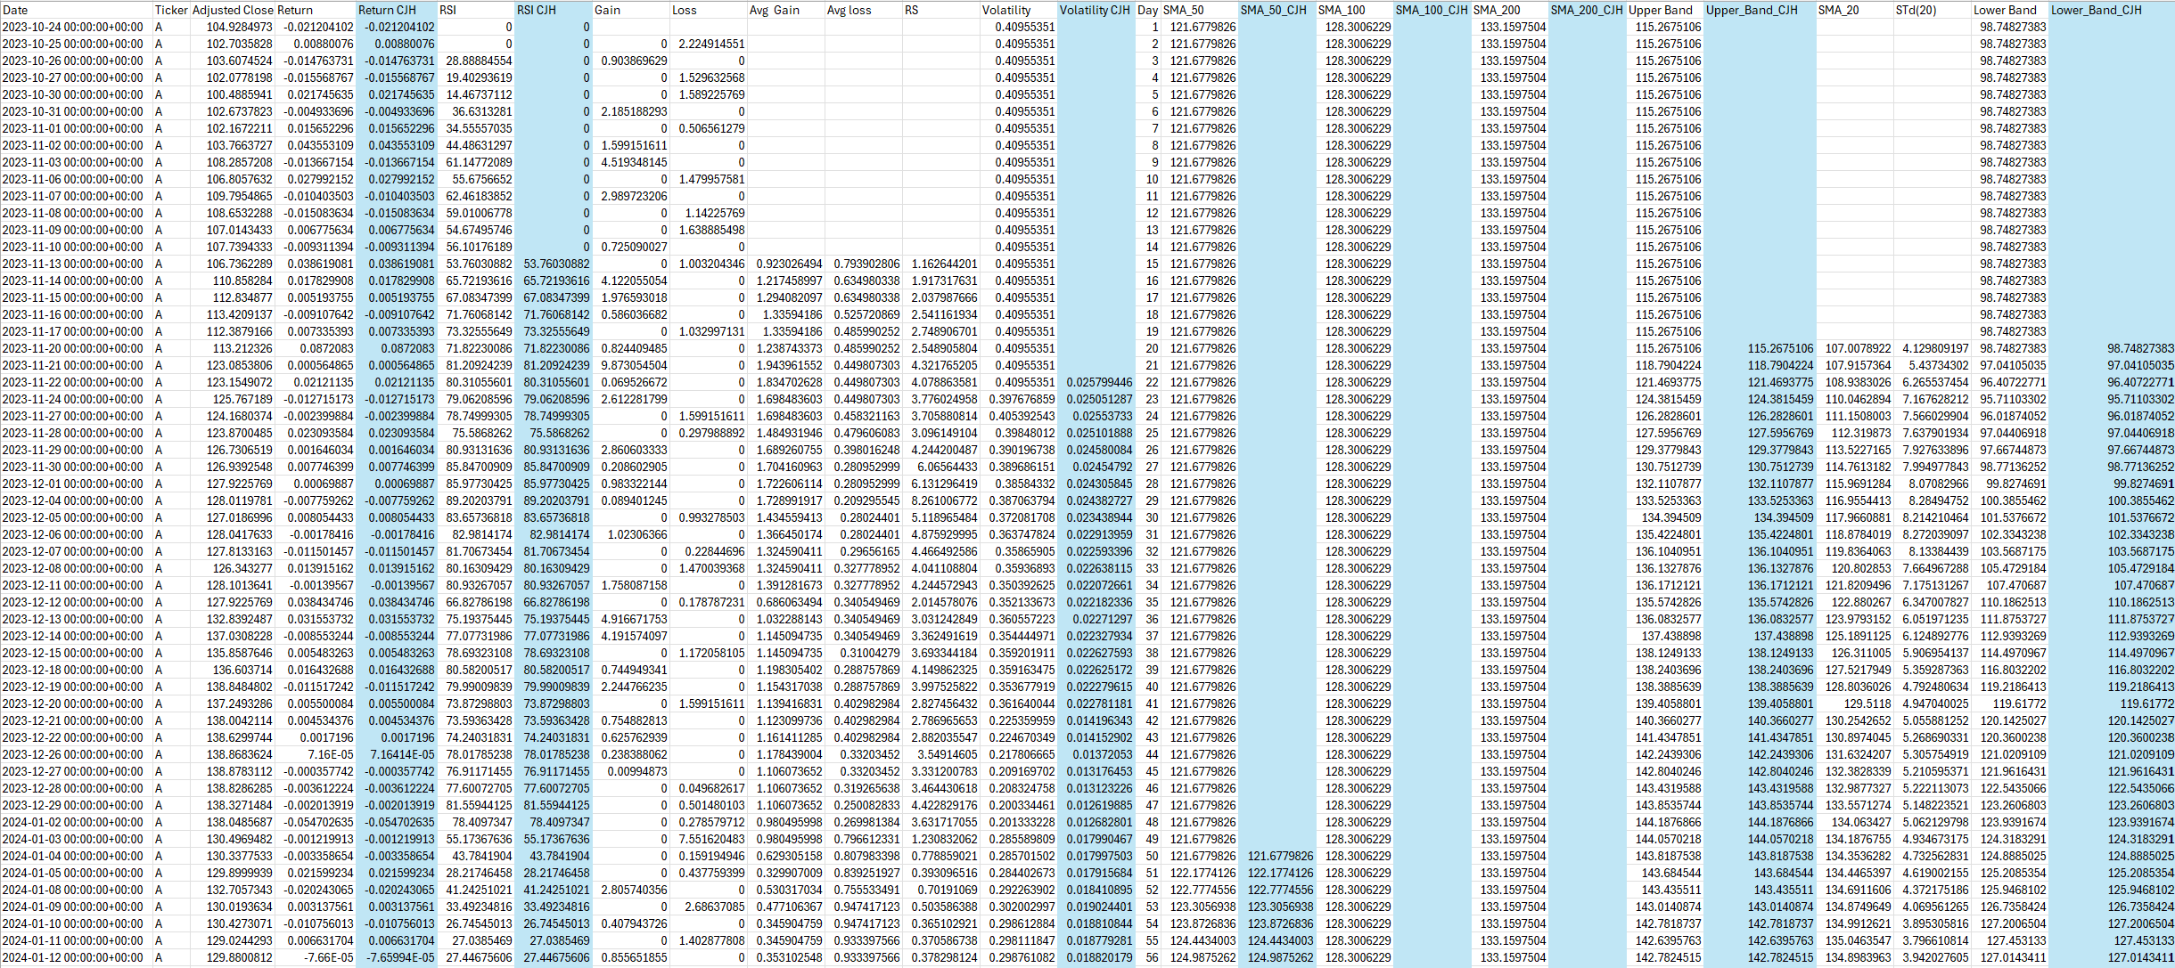
Data cleaning and DB checking

Slide 6
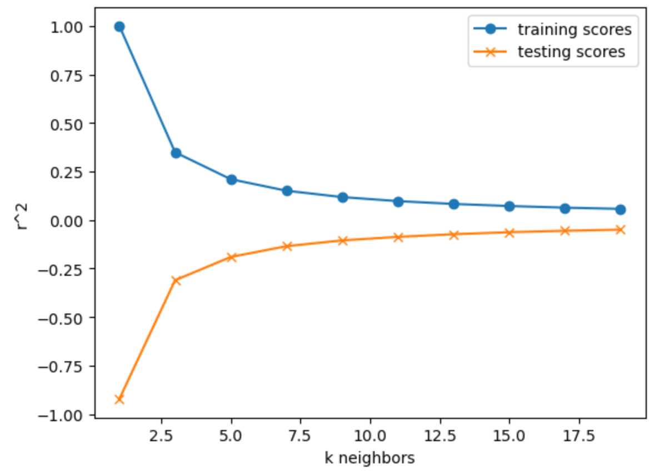
KNN Regression 1st attempt

Slide 7
Advantage of Large Dataset
More historical data allows for better trend analysis.
Identify patterns, price movement, and seasonality.
Enhanced Statistical Significance
Confidence in your findings
Allows for regression analysis, moving averages, and ML algorithms to future forecast returns.

