Slide 1
Intro
Build two Azure-based implementations of the same expense approval workflow and compare their architecture, complexity, cost, and usability.

Slide 2
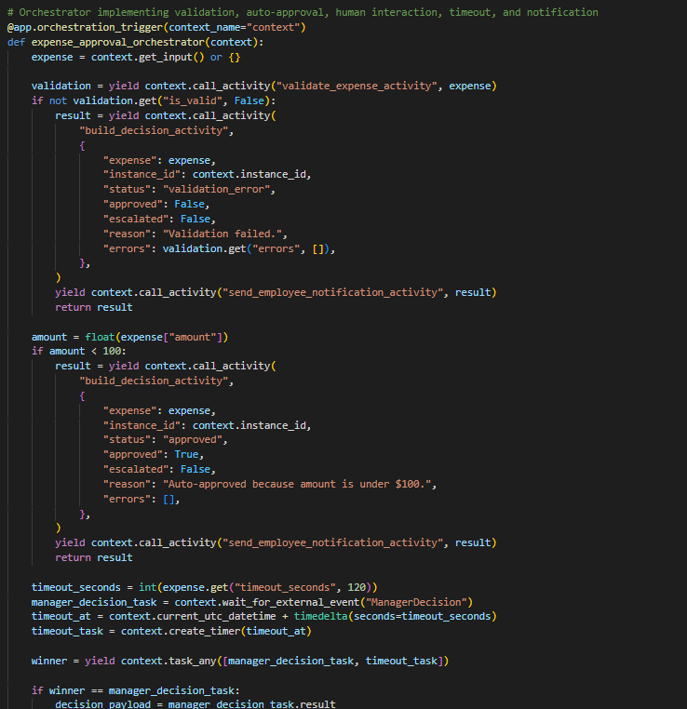
Version A

Slide 3
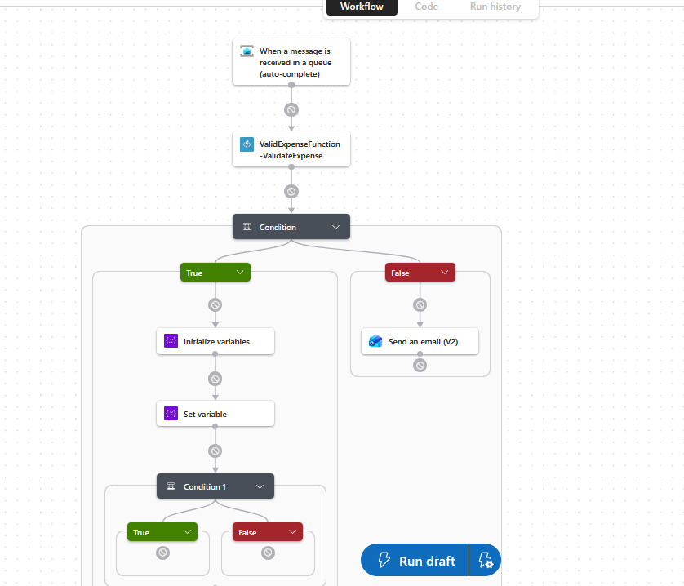
Version B

Slide 4
Comparison

Slide 5
Recommended

Slide 6
Lessons

