Slide 1

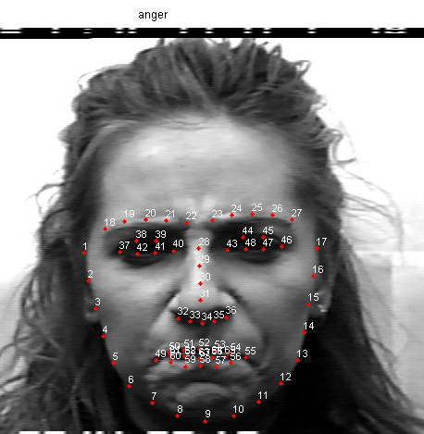
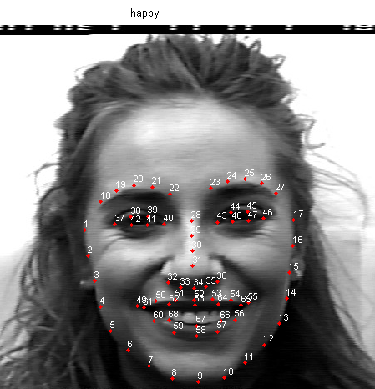
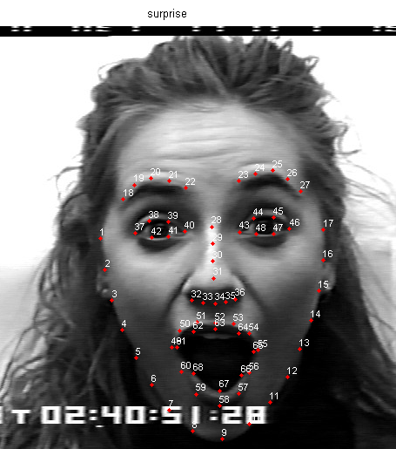
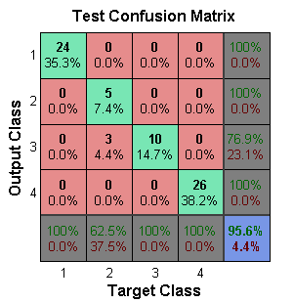
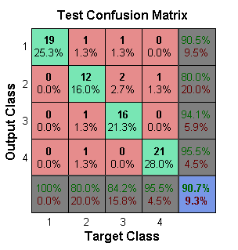
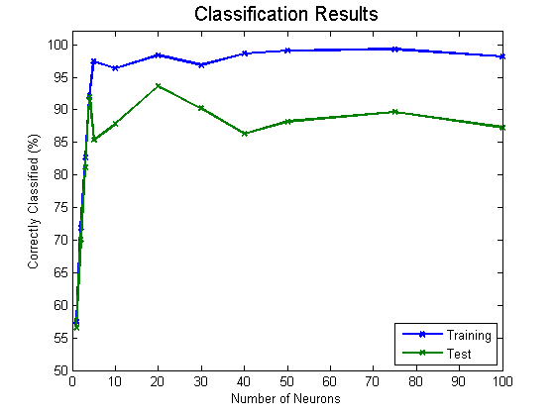
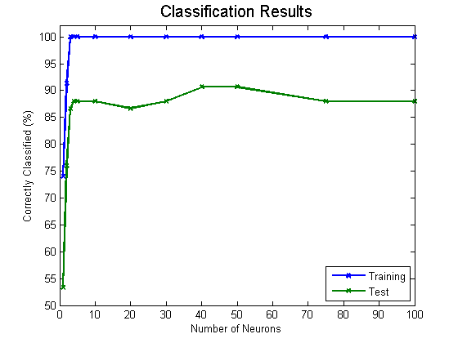
Winter 2015 – ECE457B Computational Intelligence
ECE Dept, University of Waterloo
Instructor: Fakhri Karray
Facial Expression Recognition System
Group 10: Corey Kirschbaum, Jason Ku, Caleb Yu
Abstract and Overview:
The goal of this project is to explore and evaluate facial expression detection for the purposes of improving human-machine interfacing through enabling artificial intelligence to perceive non-verbal cues. Since the desired application involves analyzing human faces while they are speaking, the detection and tracking of metrics regarding the mouth may not be precise. This project will explore whether a reliable facial expression classification system can be created without the use of mouth metrics.
Text Size: 32
Problem Formulation:
Tools, Algorithms:
Evaluation Metrics
The application should be able to classify four facial expressions using facial data and metrics. The four emotions are happiness, sadness, surprise, and anger. The source of facial data is not within the scope of this project, however the source should be able to provide a large set of data for training and testing. The classification should be accurate, correctly identifying 70% of the emotions. The research should also attempt to maximise the accuracy where possible.
Classification Accuracy vs Neurons, Layers, Input Size
Database: Cohn-Kanade AU-Coded Expression
Method 1: Matlab Neural Network Library (nnstart)
Method 2: Code Implemented of Back Propagation Neural Network with
Offline Learning (Cumulative Error)
Momentum
Batch Learning
(Updating Weights)
Analysis
Best Result
Matlab – 20 Neurons (95.6%)
Our Solution – 50 Neurons (90.7%)
Effect of Number of Neurons
Text Size: 32
Our Solution
Proposed Solution:
Matlab
The proposed solution is to use facial landmark data provided by the Cohn-Kanade (CK and CK+) database. Some of the data will then be used to train a neural network which will be implemented in MATLAB. The remaining unused data will then be used to validate the accuracy of the implementation. In order to improve the accuracy of the system, the code will be run with varying parameters in order to determine an optimal range of parameters.
Effect of Number of Hidden Layers
Experiments, Analysis:
Neurons per layer Number of Hidden Layers | 5 Neurons |  | 20 Neurons |  | 50 Neurons
 | Train | Test | Train | Test | Train | Test
1 | 100 % | 88 % | 100 % | 87 % | 100 % | 91 %
2 | 91 % | 76 % | 100 % | 89 % | 100 % | 88 %
3 | 91 % | 75 % | 100 % | 83 % | 100 % | 87 %
Experiment Setup
Input: Face Landmarks (136: x₁, …, x₆₈, y₁, …, y₆₈)
Output: 4 Classes of Emotions
Happy, Surprise, Anger and Sadness
Exemplars: 225
Training: 65% of Exemplars
Testing: 30% of Exemplars
Effect of Size of Input
 | !( ) | !(Jaw) | !(Eye Brows) | !(Eyes) | !(Nose) | !(Mouth)
Training | 100 | 100 | 100 | 100 | 100 | 97.9
Testing | 88.6 | 91.1 | 89.9 | 89.9 | 86.1 | 70.9
 | !(Jaw, Eye Brows) | !(Jaw, Eye Brows, Eyes) | !(Jaw, Eye Brows, Eyes, Nose)
Training | 100 | 100 | 100
Testing | 91.1 | 92.4 | 93.7
 | Jaw | Mouth | Eye Brows | Eyes | Nose
Training | 96.6 | 100 | 97.3 | 87.7 | 76.7
Testing | 50.6 | 93.7 | 43 | 59.5 | 43
Conclusion:
The team was able to achieve a fairly high overall classification rate of over 90% for the 4 emotions. A single hidden layer with 50 neurons provided the best classification results.
Facial landmarks that most reduces classification accuracy are situated on the mouth. Using only the mouth as input actually happens to provide the best classification accuracy of 93.7 %. Over fitting occurs with reduced landmarks.

