Slide 1
Methods and goals
METHODS:
Sampling of 240 1year old shoots (120 from own-rooted plant; and 120 from grafted ones)
2020
Biometric measures at shoot level (diameter, length, number of nodes) of 1 year old shoots (parent);
Qualitative measures at node level (type of bud/sylleptic (M= mixed, C=catkin, V=vegetative, B=blind) of the same 1 year old shoots
2021
Biometric measures at shoot level (diameter, length, number of nodes) of 1 year old shoots (child) born from the parerent;
Qualitative measures at node level (type of bud/sylleptic (M= mixed, C=catkin, V=vegetative, B=blind) of the same child shoots
GOALS:
The model of my dreams should answer those questions:
How 1 yeard old shoot is composed?
There are some zones of the same type of bud?
There are difference in composition according to the length of the shoot?
How is the behavior of lateral shoots?
How many of them developed?
Where?
From which bud? (vegetative or mixed?)
how can we deal with multiple buds and multiple lateral shoots per node?
This problems cold be solved analysing the data:
From different point of views
Shoot scale
Metamer scale
Bud scale
With different tecniques:
exploratory analysis
Glms/marcovian
WE WILL FOCUS JUST ON ON ROOTED PLANTSOWN-ROOTED

Slide 2
GLMs
Markovian models
They are used to understand if a predictor describes a variable
Poisson if the variable is quantitative;
Binomial if the variable is categorical
Es. Is Vegetative bud burst (Y) depending on (~) length, rank node, sibling M, sibling V, tot buds at that rank?
They are used to understand if the variables (buds) can be grouped into homogeneus zones.
HAZELNUT ISSUES:
Dependencies between rank nodes;
Dependencies between buds at the same rank

Slide 3
DATASET_ARCHITECTURE HAZELNUT
Process
OWN-ROOTED e INNE
 | Starter DF | Ending DF | What was done | Scripts | Scale
1 | 2020DFAUTO.csv | 2020shoot_level.csv | Count number of buds per each shoot; Adding the plant ID to each shoot; | create_shootlevel.R | shoot
2 | 2020shoot_level.csv | 2020metamer_level.csv | Creating the dataframe at the metamer level | create_metamer_level.R | Metamer
3 | 2020metamer_level.csv | 2020metamer_level.csv | Information of how many shoots developed next year | modify_metlevel.R | Metamer
4 | 2020shoot_level.csv | 2020shoot_level_DEVELOPED.csv | CREATE A NEW DATASET WITH THE SHOOT OF 2020 THAT WERE FOUND IN 2021 | modify_shootlevel.R | Shoot
5 | 2020metamer_level.csv | 2020metamer_level_DEVELOPED.csv | CREATE A NEW DATASET WITH THE SHOOT OF 2020 THAT WERE FOUND IN 2021 | modify_metlevel.R | Metamer
6 | 2020metamer_level_DEVELOPED.csv | bud_level_develop.csv | Duplicate the rows for the number of buds of each metamer | create_bude_level | Bud
7 | bud_level_develop.csv | bud_level_FINAL.csv | Position of the bud (lateral/apical) Fate of each bud Number of sibling buds (in multiple buds Numberof new shoots Info regarding the new shoot developed Substrating to the sibling value the fate of that bud | create_budlevelFINAL.R | Bud

Slide 4
DATASET_ARCHITECTURE HAZELNUT
Process
OWN-ROOTED
 | Starter DF | Ending DF | What was done | Scripts | Scale
8 | bud_level_FINAL.csv | bud_level_LATERALS.csv | Filter just for lateral buds | modify_budscale.R | Buds
9 | bud_level_FINAL.csv | bud_level_APICALS.csv | Filter just for apical buds | modify_budscale.R | Buds
10 | 2020metamer_level_DEVELOPED.csv | met_level_develop_lateralbuds.csv | Modifying the count of buds per each node, removing the apical bud!!! | modify_metlevel.R | Metamer
11 | 2020shoot_level_DEVELOPED.csv | 2020shoot_level_DEVELOPED_fin.csv | Adding the info of how many lateral and apical buds and the fate of apicals | modify_shootlevel.R | Shoot
12 | 2020shoot_level_DEVELOPED_fin.csv | shoot_level_develop_lateralbuds.csv | Modifying the count of buds per each node, removing the apical bud!!! | modify_shootlevel.R | Shoot

Slide 5

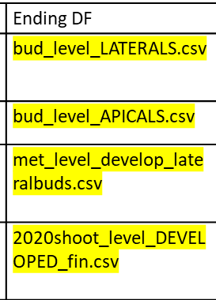


What will we use
Bud scale
Metamer scale
Shoot scale

Slide 6
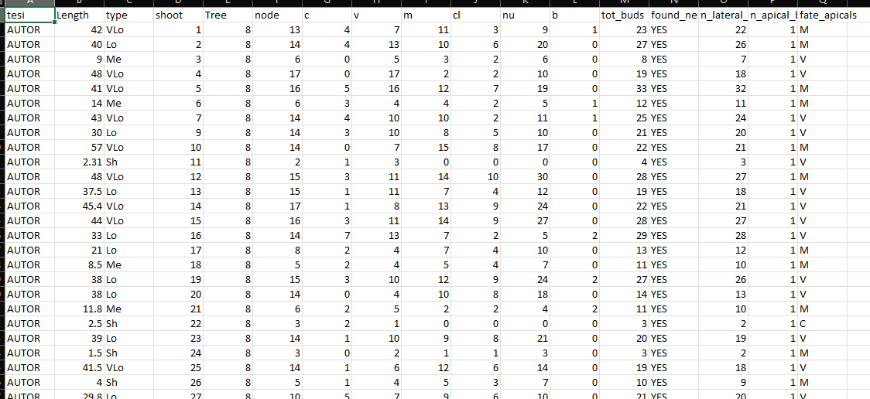
Shoot scale
Description of each shoot composition in terms of:
row ID
Not grafted
Plant ID mother of the shoot
Length(cm);
Length(class);
Number of nodes;
Number of buds per type (C,V,M,B);
Number of clusters;
Number of nuts;

Slide 7
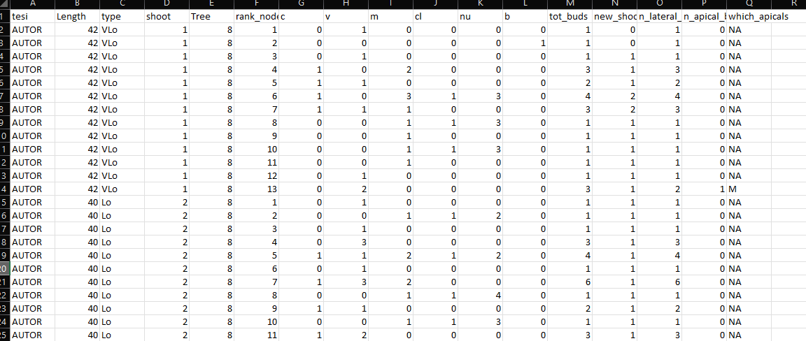
Metamer scale
Description of each metamer composition in terms of:
Year of sampling
Not grafted
Shoot length(class);
Shoot ID
Shoot length(cm);
Metamer ID
Number of LATERAL buds per eac rank (C,V,M,B);
Total buds per rank;
Shoots developed at that rank;
NUMBER LATERAL BUDS
NUMBER APICAL BUDS
FATE OF APICAL BUDS

Slide 8
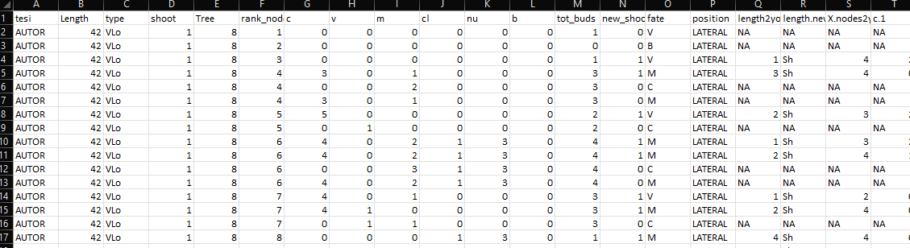
Bud scale
Description of each bud composition in terms of:
New shoot ID
Year of parent sampling
Shoot ID
Shoot length(cm);
Metamer ID
Number of sibling buds at the same node(C,V,M,B);
Total buds per node;
Number of Shoots developed at that rank;
Fate of bud (one per each row)
Position of the bud (apical/lateral)
Length of new shoot(cm)
Length of new shoot(class)
Information regarding each new shoot composition

Slide 9
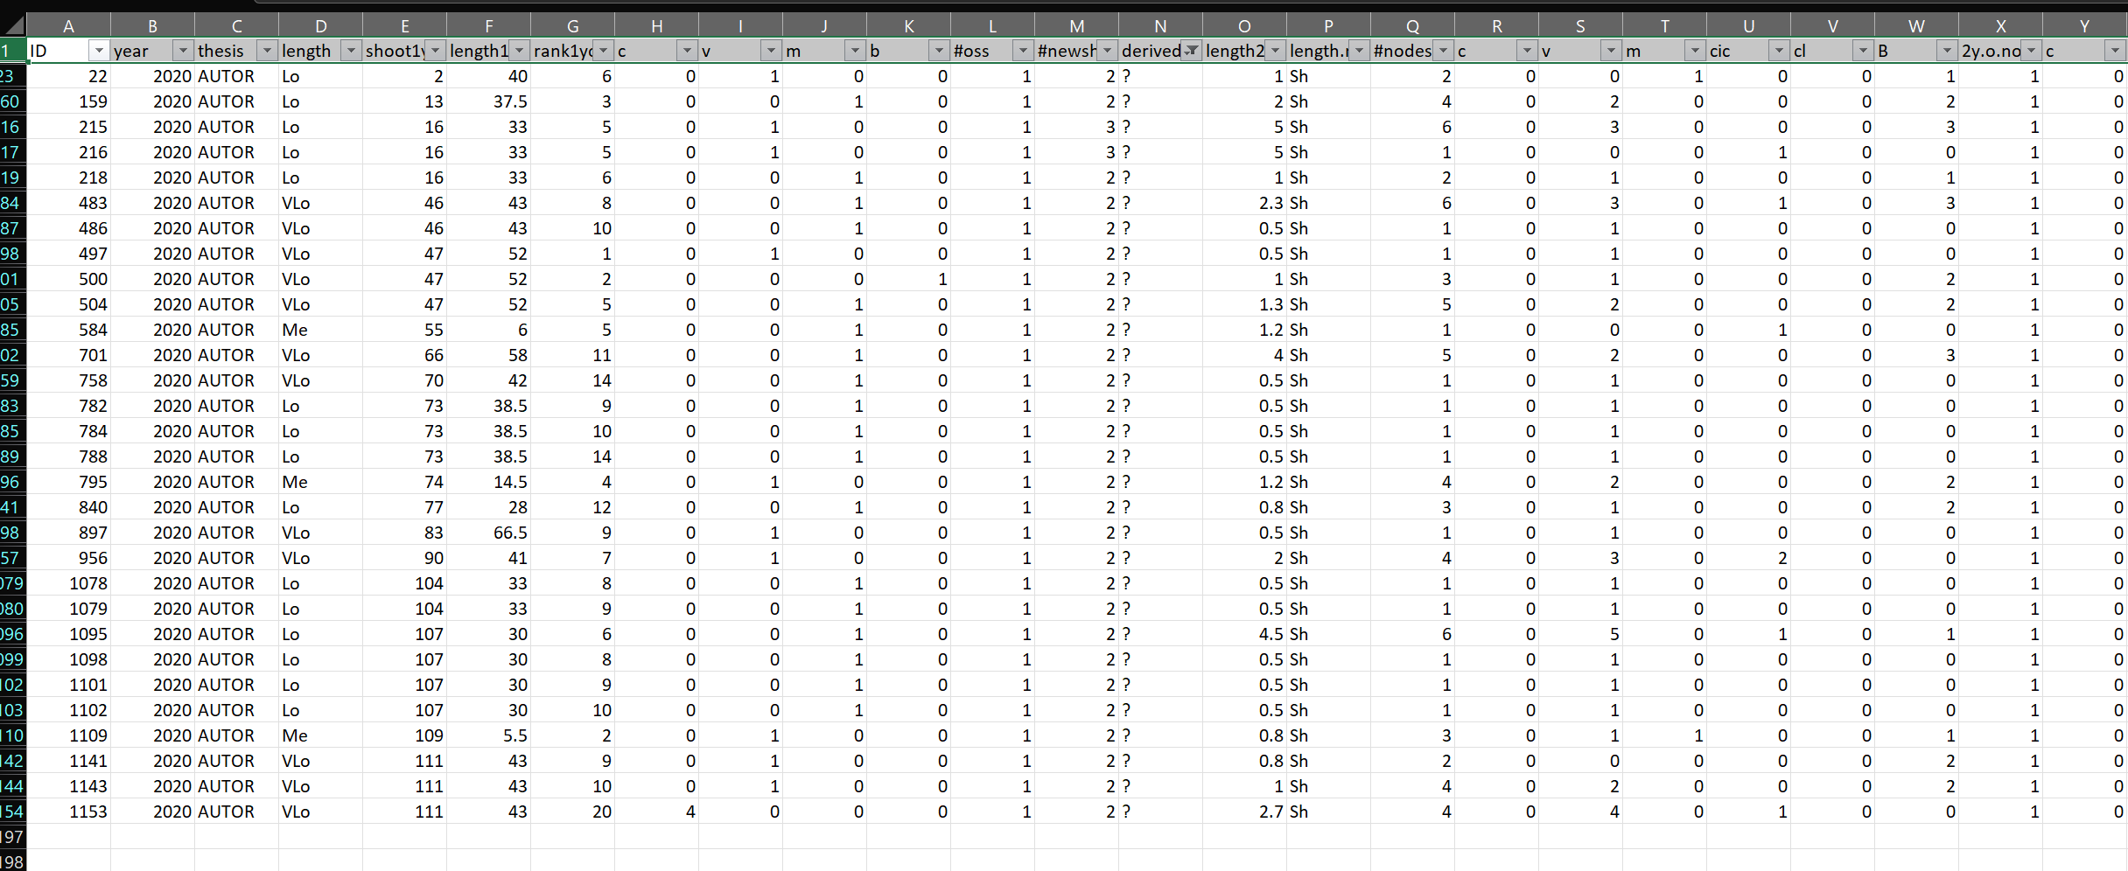
The original «new_shoots» file has the same information of the bud fate scale(in terms of new shoots details) plus it contains some the errors.
Errors= new shoots that i can’t explain from where they came from. Assigned as «?»
These errors impact less than 3% on the totals, so i guess we can ignore them and use the bud_scale file also for new shoots. What do you thing?

Slide 10
GLMs
glm(Y~F1+F2+F3+F4+F5+F6+F7, family=«binomial»)
PREDICTORS
Two GLMs:
For fate=V
For fate=M
F1
F2
F3
F4
F5
F6
F7
Y
How to Interpret glm Output in R (With Example) - Statology

Slide 11
Problems & solutions
Several predictors mask their effects (ES. NA values)
Run different GLMs avoid each time a predictor:
Y~tot_buds+length+rank
Y~M+V+C+length+rank
p. Value are significant because we have many data. Is real significance?
Permutation models + difference in AIC

Slide 12
Permutation models
GLMS(Y~A+B+C, data=DF)
Shows that A is really significant (***)
Permutation
We shuffle the variable A: DF$A=sample(DF$A)
We run again the glms GLMS(Y~A+B+C, data=DF)
If the significance was true, now A should be not significant any more
AIC difference
GLMS(Y~A+B+C, data=DF)
Shows that AIC is 800
AIC difference
We run a null model GLMS(Y~1, data=DF)
We make the difference between AIC real (800) and AIC null
Now we make permutation of a variable and we run again the model.
AICpermutation-AICnull should be GREATER than AICreal-AICnull!!!

Slide 13
First approach to modelling
Glm metamer scale
Box1: in that rank buds are in sylleptic shoots?
NO
YES
Box2: how many buds?
Box2: how many buds?
2 different glms (V,M)
Box2: V, M or B?
Box2: V or M?
No new shoots
V
M
V
M
B
Box3: do you burst?
Box3: do you burst?
Box3: do you burst?
Box3: do you burst?
2 different glms

Slide 14
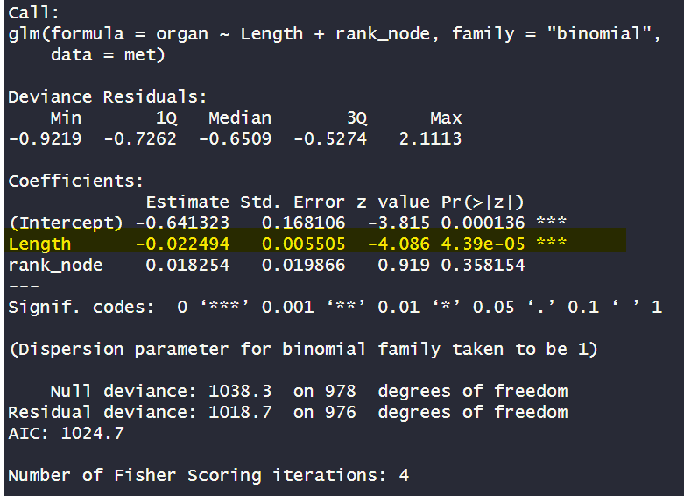
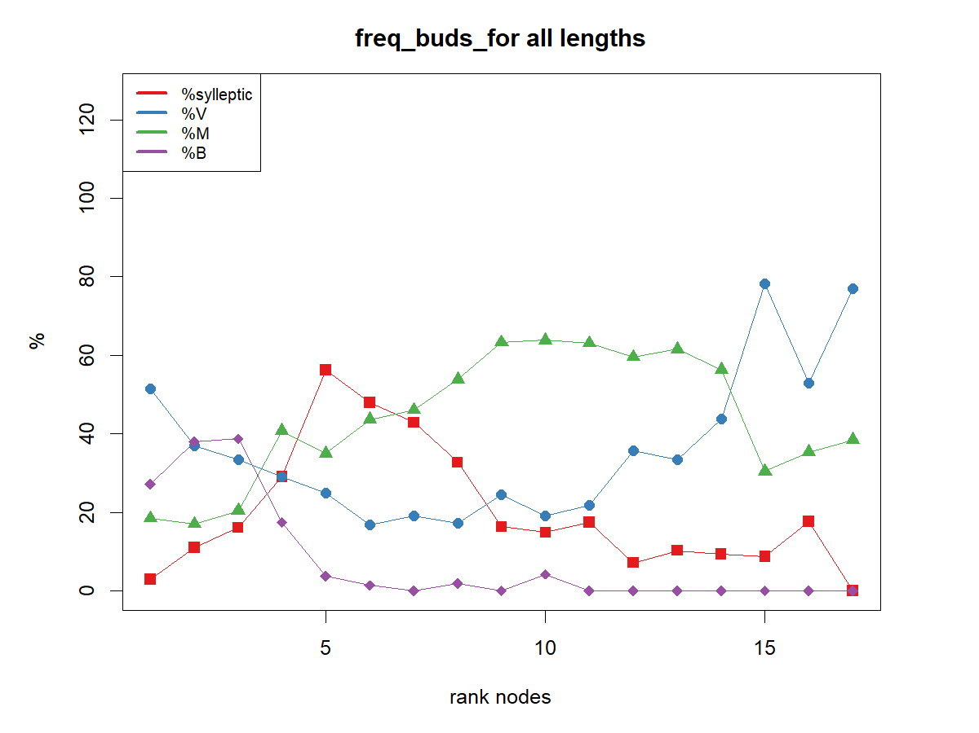
Box1: rank is sylleptic?
Metamer level
Glm that relate if the bud is IN SYLLEPTIC shoot (1= YES, 0=NO) with length and rank node of parental
Conc:
Length is significative (***). Coef -0.01
This could confirm what we saw in exploratory: maximum sylleptic in short and medium. Not long and very long

Slide 15
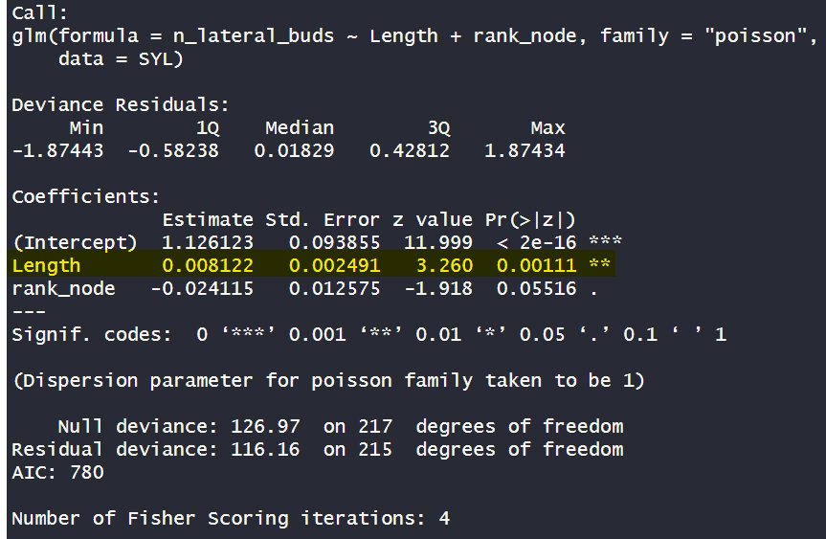
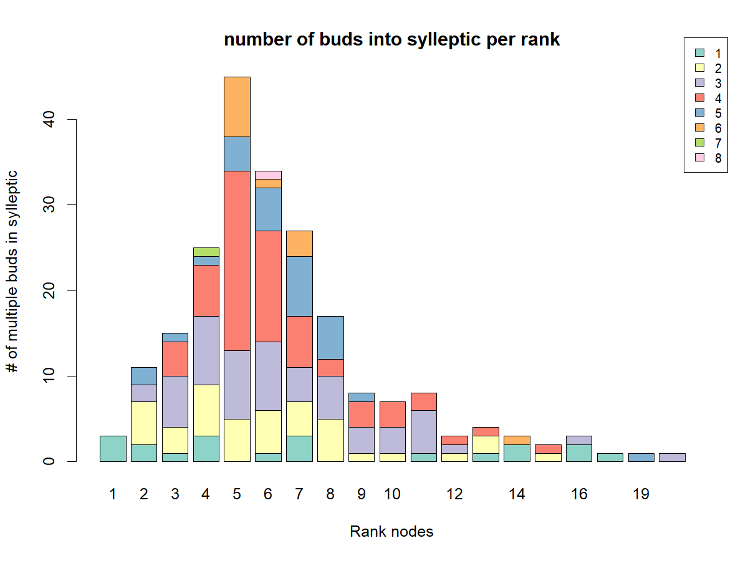
Box2: how many buds?
Metamer level
Glm that relate number of buds in IN SYLLEPTIC shoot with length and rank node of parental
Conc:
Length is significative (**). Coef +0.008
This could confirm what we saw in exploratory: maximum variability in medium and long

Slide 16
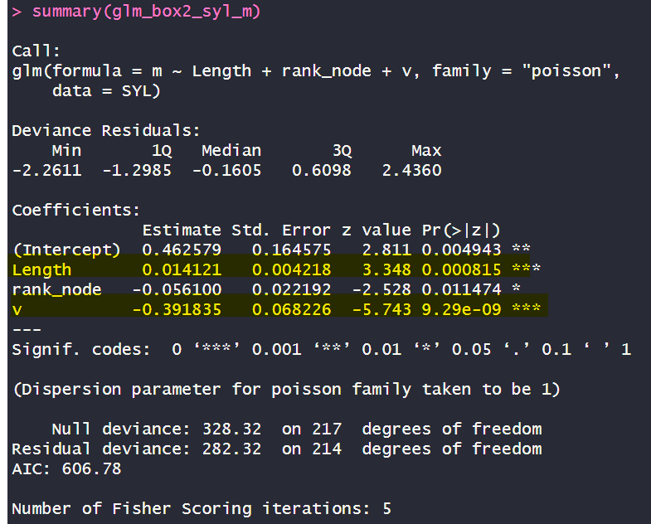
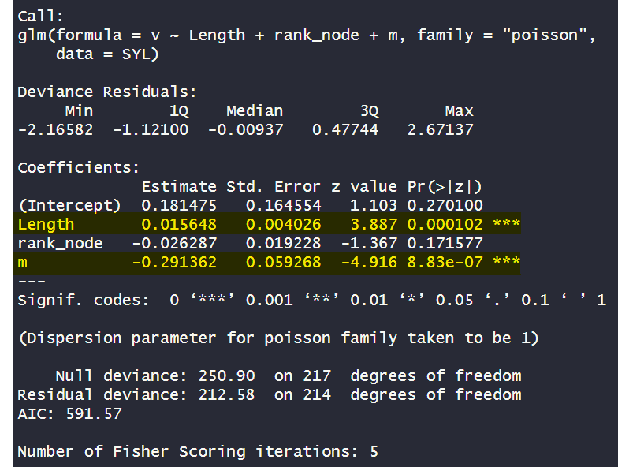
Box2: V or M?
Metamer level
Is the number of «m» at that rank related to length, rank node and number of v at that rank?
Is the number of «m» at that rank related to length, rank node and number of m at that rank?
What we can deduct by that?
Conc:
Length is significative (***). Coef 0.01
Rank is significative (*). Coef -0.05
V is significative(***). Coef -0.39
Conc:
Length is significative (***). Coef 0.01
M is significative(***). Coef -0.29

Slide 17
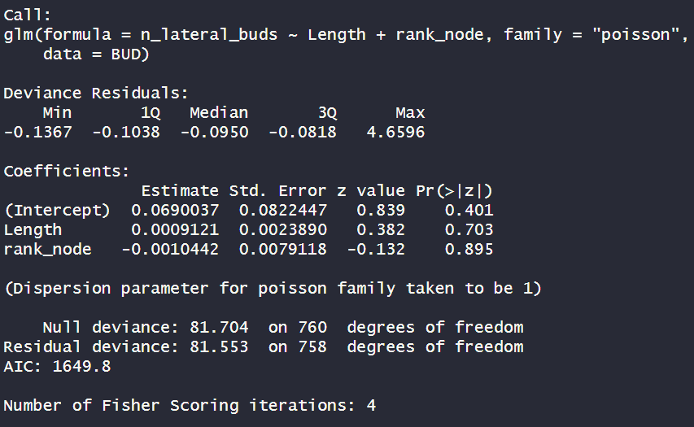
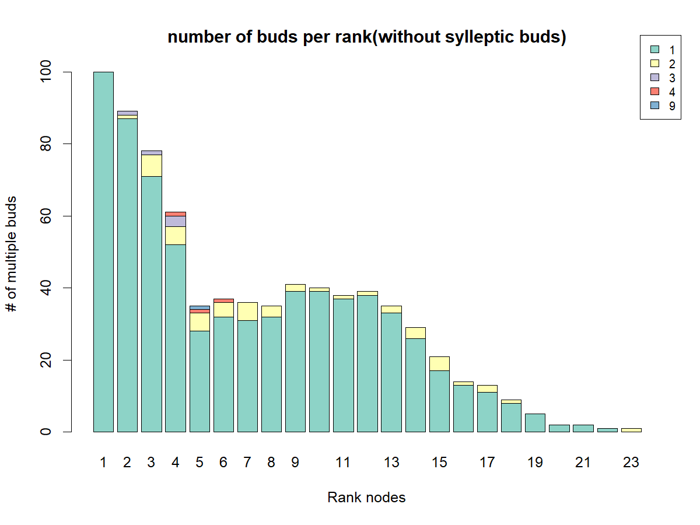
Metamer level.
IF AT THAT RANK THERE IS NO SYLLEPTIC.
HOW MANY BUDS?
Box2: how many buds?
Glm that relate number of buds NOT in IN SYLLEPTIC shoot with length and rank node of parental
Conc:
No significance
This could confirm what we saw in exploratory: the majority is «1» bud

Slide 18
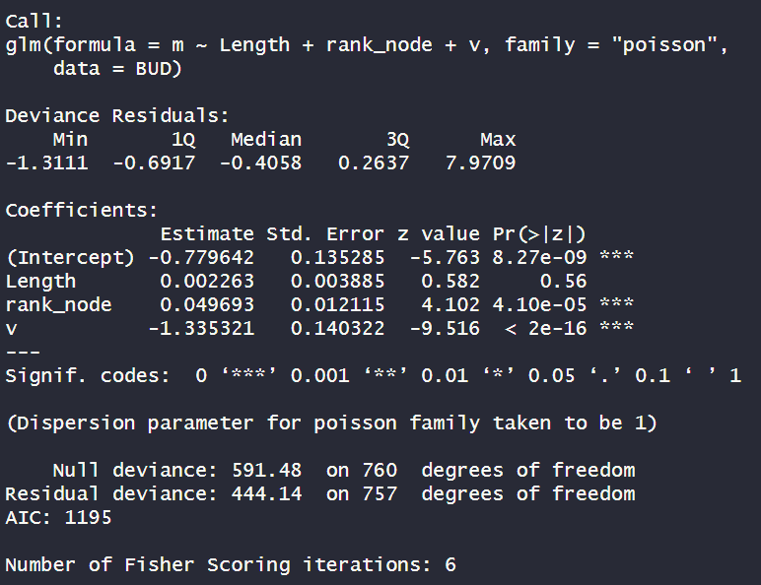
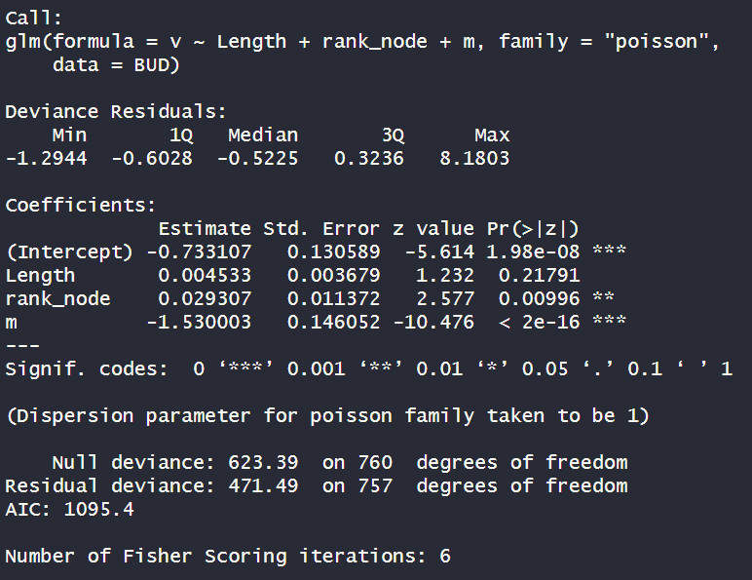
Box2: V, M or B?
Metamer level
Is the number of «m» at that rank related to length, rank node and number of v at that rank?
Is the number of «m» at that rank related to length, rank node and number of m at that rank?
Conc:
Rank is significative (***). Coef +0.04
V is significative(***). Coef -1.33
Conc:
Rank is significative (**). Coef +0.02
M is significative(***). Coef -1.53

Slide 19
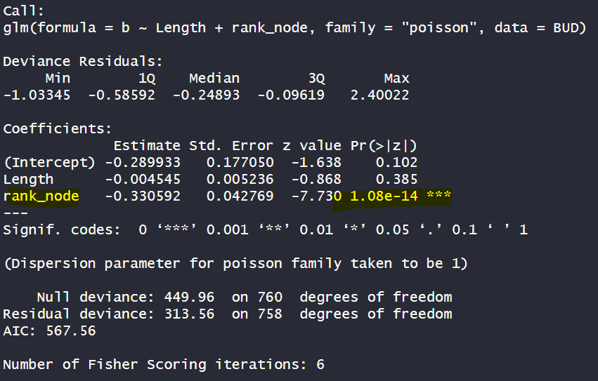
Box2: V, M or B?
Metamer level
Is the number of «b» at that rank related to length, rank node at that rank?
Conc:
Rank is significative (**). Coef -0.33

Slide 20
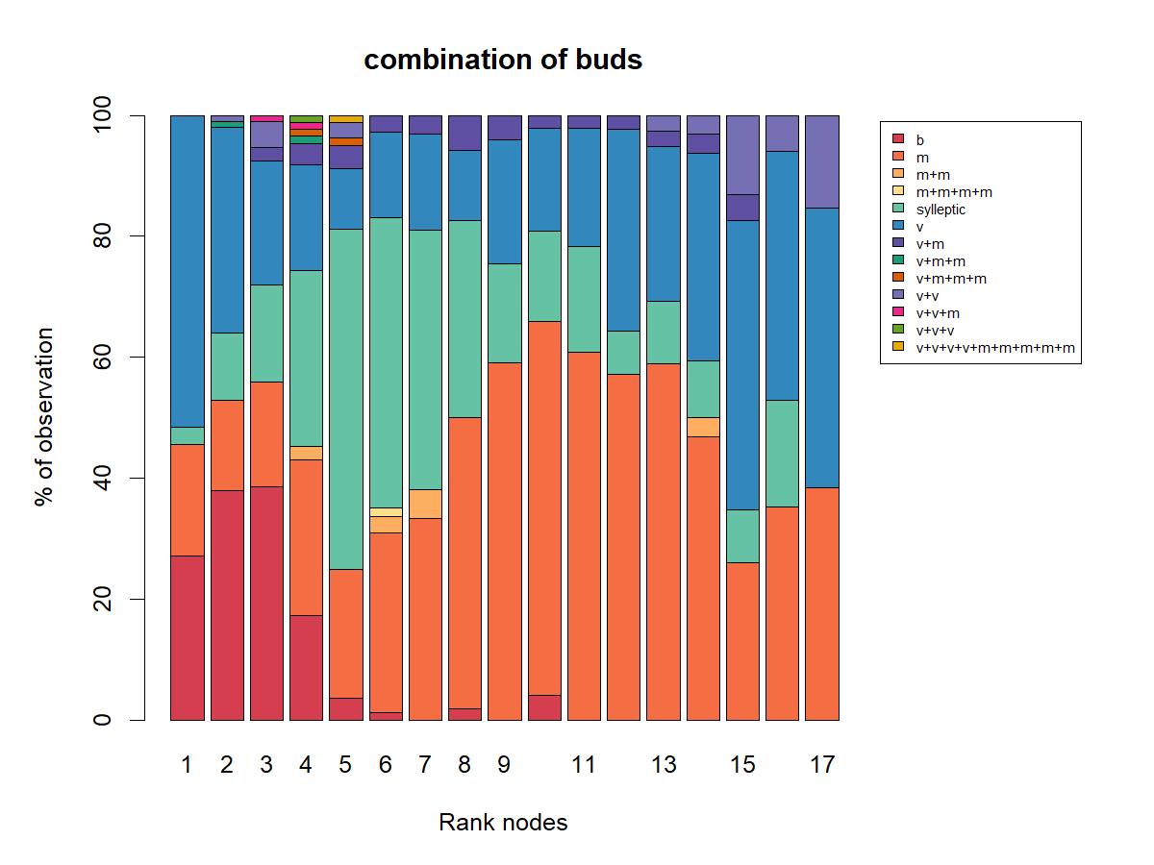
Box2: V, M or B?
Metamer level

Slide 21
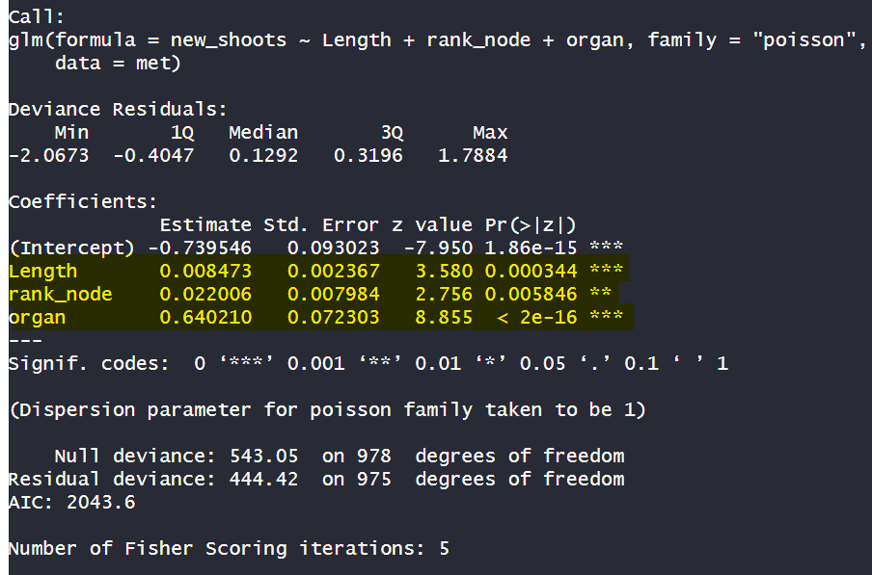
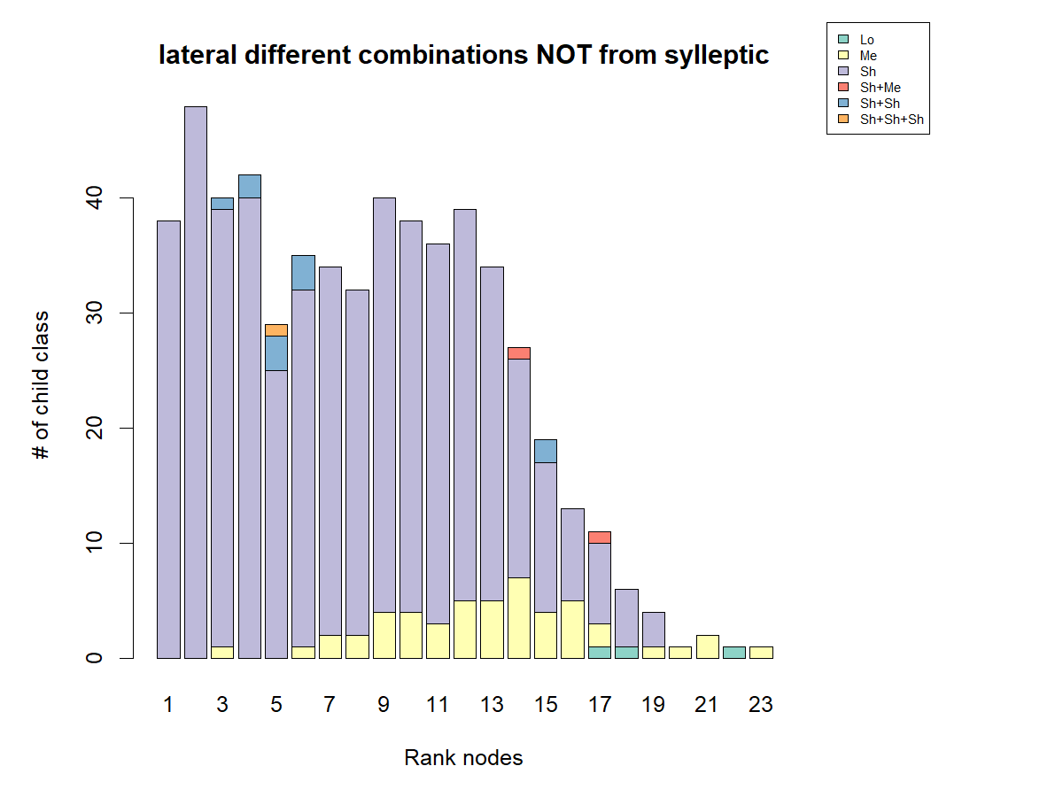
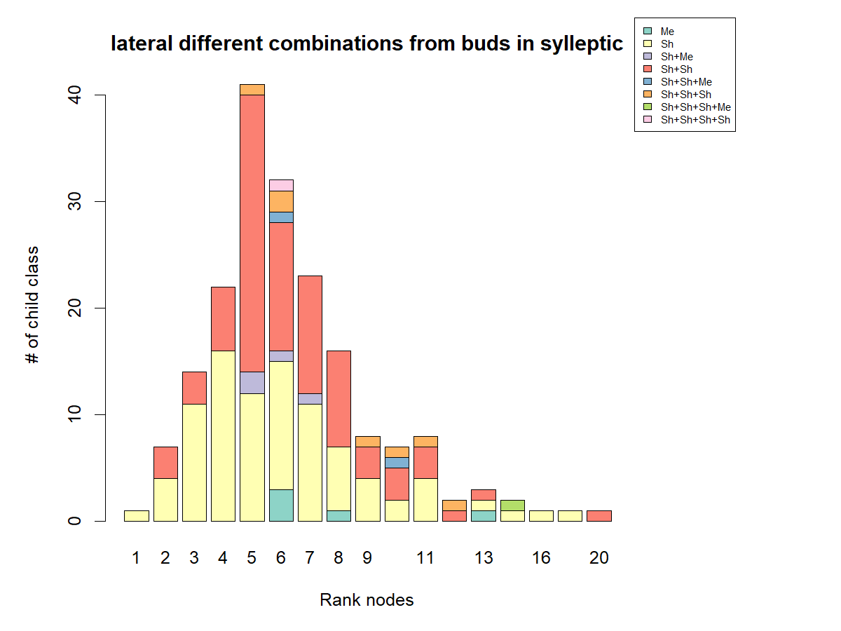
Question1: are the NUMBER of new shoots related to length,
rank and position(bud in sylleptic or bud in parental) ?
Metamer level
Conc:
Length significative (***). Coef: 0.008;
Rank_node significative(**). Coef:0.022
Organ(bud in sylleptic or bud not in sylleptic) significative (***). Coef: 0.64

Slide 22
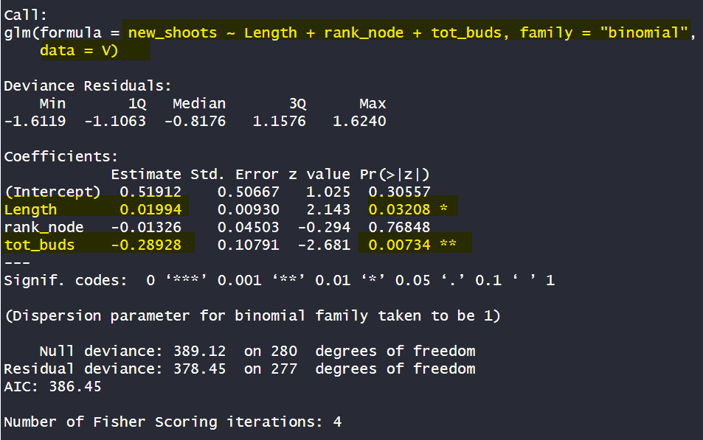
From V
Box3: do you burst?
New shoots (1=present, 0=absent), in V buds, related to length, rank node and total buds at that rank
PERMUTATION BOX
Permuting «tot_buds» it is not more significant;
Permuting «length» it is not more significant;
Conc:
Length significative (*). Coef: 0.02;
Tot buds is significative(**). Coef: -0.28

Slide 23
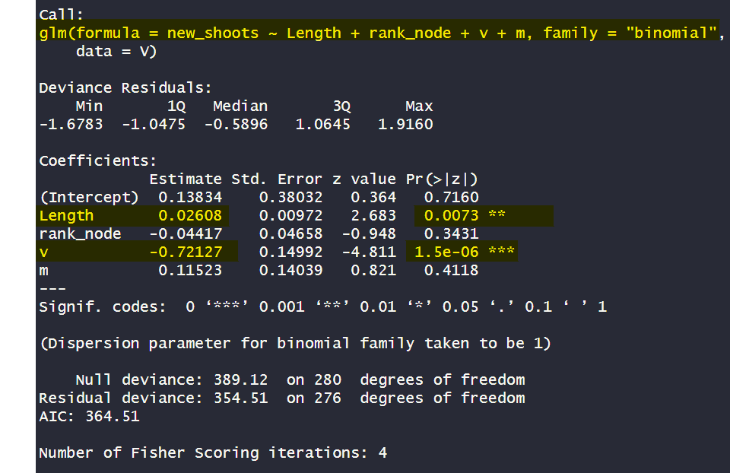
From V
Box3: do you burst?
New shoots (1=present, 0=absent), in V buds, related to length, rank node and v+m at that rank
PERMUTATION BOX
Permuting «v» it is not more significant; but M starts being significative(*) coef=0.28. DOES IT MEANS THAT V MASK M?
Permuting «length» it is not more significant;
Conc:
Length significative (**). Coef: 0.02;
V is significative(***). Coef: -0.71

Slide 24
Conclusion “V”
BUD V burst is explained by:
Shoot length (+);
Tot buds (-):
Vegetative (-) and mixed (+): VEGETATIVE MASK MIXED

Slide 25
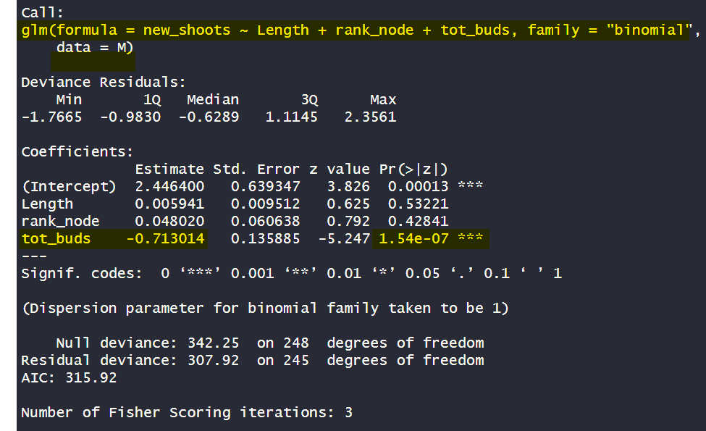
From M
Box3: do you burst?
New shoots (1=present, 0=absent), in M buds, related to length, rank node and total buds at that rank
PERMUTATION BOX
Permuting «tot_buds» it is not more significant;
Conc:
Length NOT significative ;
Tot buds is significative(***). Coef: -0.71

Slide 26
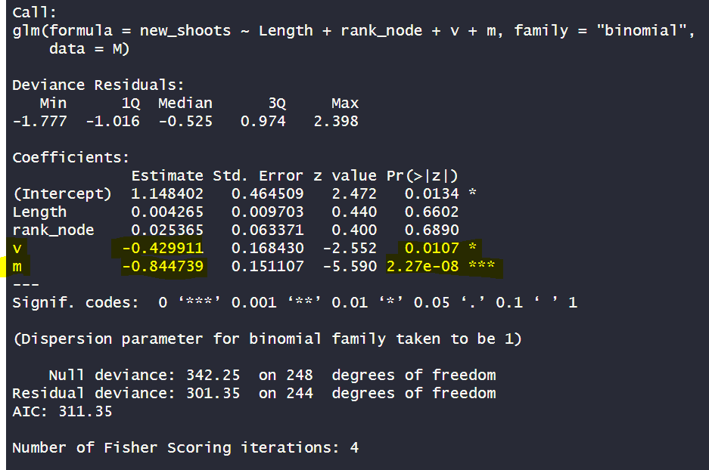
From M
Box3: do you burst?
New shoots (1=present, 0=absent), in M buds, related to length, rank node and v+m at that rank
PERMUTATION BOX
Permuting «V» it is not more significant;
Permuting «M» it is not more significant AND ALSO V IS NO MORE SIGNIFICAND.
Does it mean that M and V are related?
Conc:
V significative (*). Coef: -0.43;
M is significative(***). Coef: -0.84

Slide 27
Conclusion “M”
BUD M burst is explained by:
Shoot rank (+);
Tot buds (-):
Vegetative (-) & mixed(-): VEGETATIVE and MIXED are related?

Slide 28
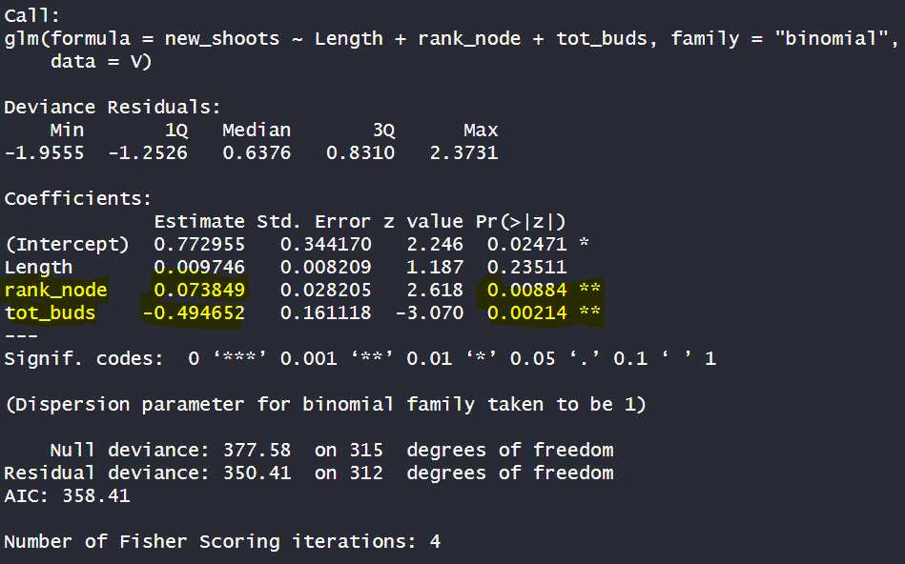
From V
Box3: do you burst?
New shoots (1=present, 0=absent), in V buds, related to length, rank node and total buds at that rank
PERMUTATION BOX
Permuting «tot_buds» it is not more significant;
Permuting «rank» it is not more significant; but starts to be significative the length (**) coef=0.02
Conc:
RANK significative (**). Coef: 0.07;
Tot buds is significative(**). Coef: -0.49

Slide 29
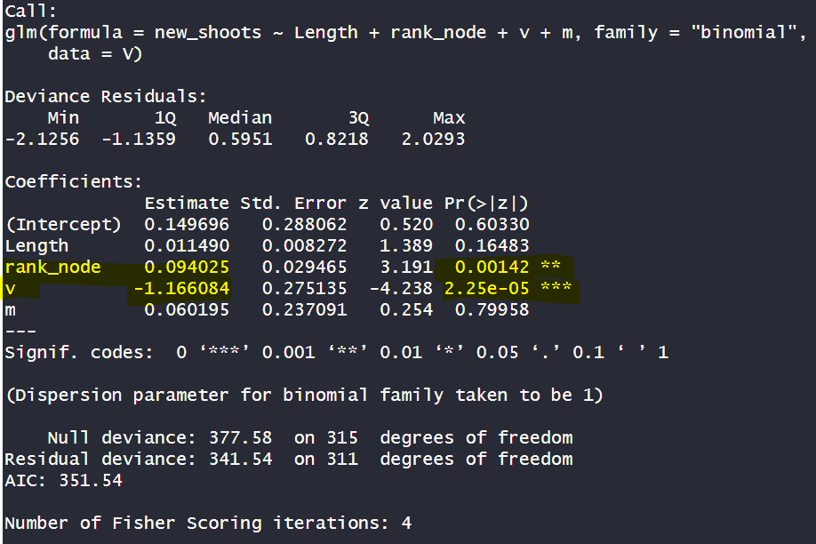
From V
Box3: do you burst?
New shoots (1=present, 0=absent), in V buds, related to length, rank node and v+m at that rank
PERMUTATION BOX
Permuting «v» it is not more significant; but M starts being significative(*) coef=-0.35. DOES IT MEANS THAT V MASK M?
Permuting «rank» it is not more significant; but length starts to be significant (***) coef:0.02
Conc:
rank significative (**). Coef: 0.09;
V is significative(***). Coef: -1.16

Slide 30
Conclusion “V”
BUD V burst is explained by:
Shoot length (+);
Tot buds (-):
Vegetative (-) and mixed (+): VEGETATIVE MASK MIXED

Slide 31
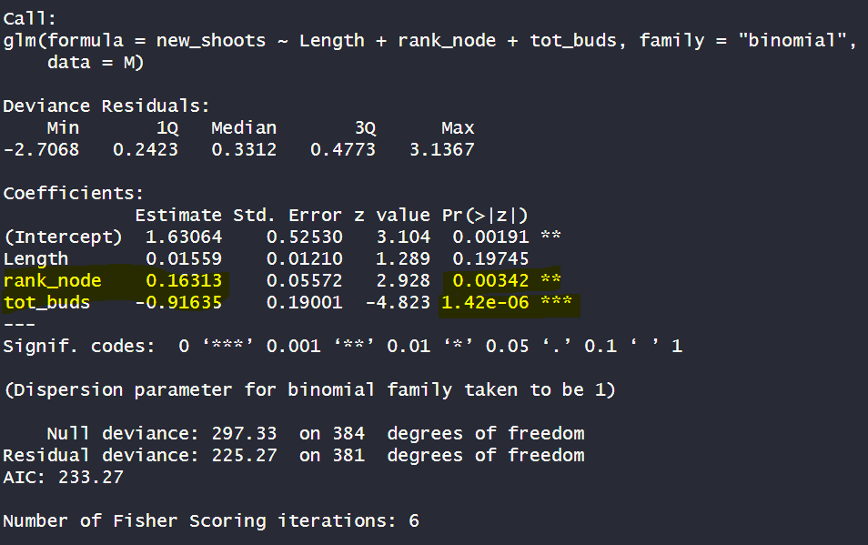
From M
Box3: do you burst?
New shoots (1=present, 0=absent), in M buds, related to length, rank node and total buds at that rank
PERMUTATION BOX
Permuting «tot_buds» it is not more significant;
Permuting «rank_node» it is not significant any more. But length starts being significant (**) coef:0.03
Conc:
Rank is significative(**). Coef:0.16 ;
Tot buds is significative(***). Coef: -0.91

Slide 32
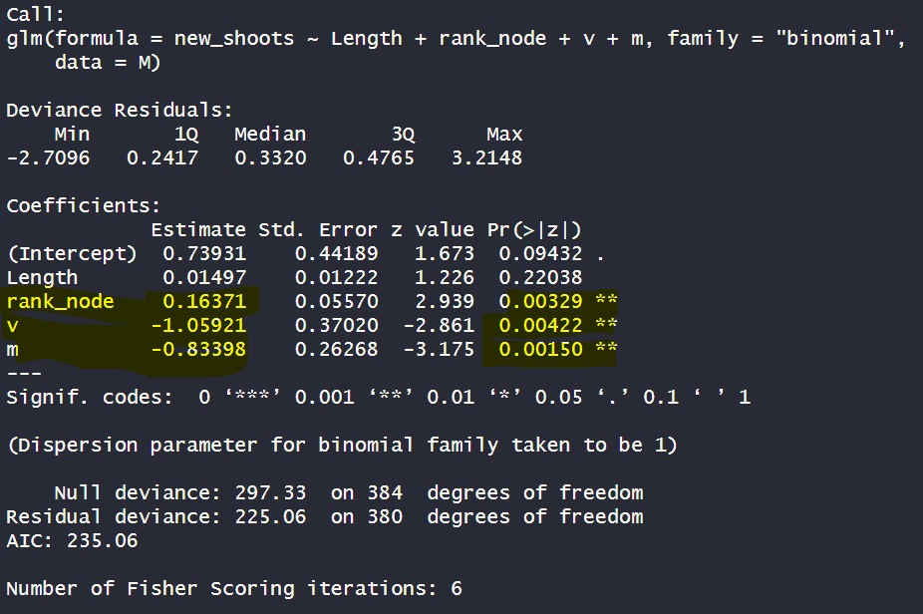
From M
Box3: do you burst?
New shoots (1=present, 0=absent), in M buds, related to length, rank node and v+m at that rank
PERMUTATION BOX
Permuting «V» it is not more significant;
Permuting «M» it is not more significant
Permuting «rank node» it is not significant any more but length starts being significant (**). Coef: 0.03
Conc:
Rank is significant(**). Coef=0.16
V significative (**). Coef: -1.05;
M is significative(**). Coef: -0.83

Slide 33
Conclusion “M”
BUD M burst is explained by:
Shoot rank (+);
Tot buds (-):
Vegetative (-) & mixed(-): VEGETATIVE and MIXED are related?

