Slide 1
Methods and goals
METHODS:
Sampling of 240 1year old shoots (120 from own-rooted plant; and 120 from grafted ones)
2020
Biometric measures at shoot level (diameter, length, number of nodes) of 1 year old shoots (parent);
Qualitative measures at node level (type of bud/sylleptic (M= mixed, C=catkin, V=vegetative, B=blind) of the same 1 year old shoots
2021
Biometric measures at shoot level (diameter, length, number of nodes) of 1 year old shoots (child) born from the parerent;
Qualitative measures at node level (type of bud/sylleptic (M= mixed, C=catkin, V=vegetative, B=blind) of the same child shoots
GOALS:
The model of my dreams should answer those questions:
How 1 yeard old shoot is composed?
There are some zones of the same type of bud?
There are difference in composition according to the length of the shoot?
How is the behavior of lateral shoots?
How many of them developed?
Where?
From which bud? (vegetative or mixed?)
how can we deal with multiple buds and multiple lateral shoots per node?
This problems cold be solved analysing the data:
From different point of views
Shoot scale
Metamer scale
Bud scale
With different tecniques:
exploratory analysis
Glms/marcovian
WE WILL FOCUS JUST ON ON ROOTED PLANTSOWN-ROOTED

Slide 2
DATASET_ARCHITECTURE HAZELNUT
Process
OWN-ROOTED
 | Starter DF | Ending DF | What was done | Scripts | Scale
1 | 2020DFAUTO.csv | 2020shoot_level.csv | Count number of buds per each shoot; Adding the plant ID to each shoot; | create_shootlevel.R | shoot
2 | 2020shoot_level.csv | 2020metamer_level.csv | Creating the dataframe at the metamer level | create_metamer_level.R | Metamer
3 | 2020metamer_level.csv | 2020metamer_level.csv | Information of how many shoots developed next year | modify_metlevel.R | Metamer
4 | 2020shoot_level.csv | 2020shoot_level_DEVELOPED.csv | CREATE A NEW DATASET WITH THE SHOOT OF 2020 THAT WERE FOUND IN 2021 | modify_shootlevel.R | Shoot
5 | 2020metamer_level.csv | 2020metamer_level_DEVELOPED.csv | CREATE A NEW DATASET WITH THE SHOOT OF 2020 THAT WERE FOUND IN 2021 | modify_metlevel.R | Metamer
6 | 2020metamer_level_DEVELOPED.csv | bud_level_develop.csv | Duplicate the rows for the number of buds of each metamer | create_bude_level | Bud
7 | bud_level_develop.csv | bud_level_FINAL.csv | Position of the bud (lateral/apical) Fate of each bud Number of sibling buds (in multiple buds Numberof new shoots Info regarding the new shoot developed Substrating to the sibling value the fate of that bud | create_budlevelFINAL.R | Bud

Slide 3
DATASET_ARCHITECTURE HAZELNUT
Process
OWN-ROOTED
 | Starter DF | Ending DF | What was done | Scripts | Scale
8 | bud_level_FINAL.csv | bud_level_LATERALS.csv | Filter just for lateral buds | modify_budscale.R | Buds
9 | bud_level_FINAL.csv | bud_level_APICALS.csv | Filter just for apical buds | modify_budscale.R | Buds
10 | 2020metamer_level_DEVELOPED.csv | met_level_develop_lateralbuds.csv | Modifying the count of buds per each node, removing the apical bud!!! | modify_metlevel.R | Metamer
11 | 2020shoot_level_DEVELOPED.csv | 2020shoot_level_DEVELOPED_fin.csv | Adding the info of how many lateral and apical buds and the fate of apicals | modify_shootlevel.R | Shoot
12 | 2020shoot_level_DEVELOPED_fin.csv | shoot_level_develop_lateralbuds.csv | Modifying the count of buds per each node, removing the apical bud!!! | modify_shootlevel.R | Shoot

Slide 4
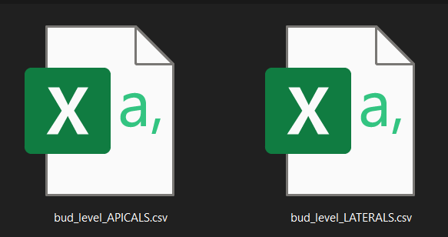
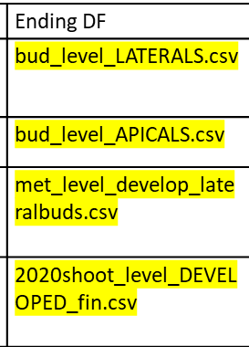

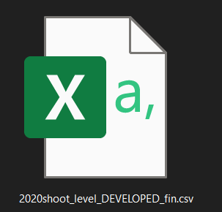
What will we use
Bud scale
Metamer scale
Shoot scale

Slide 5
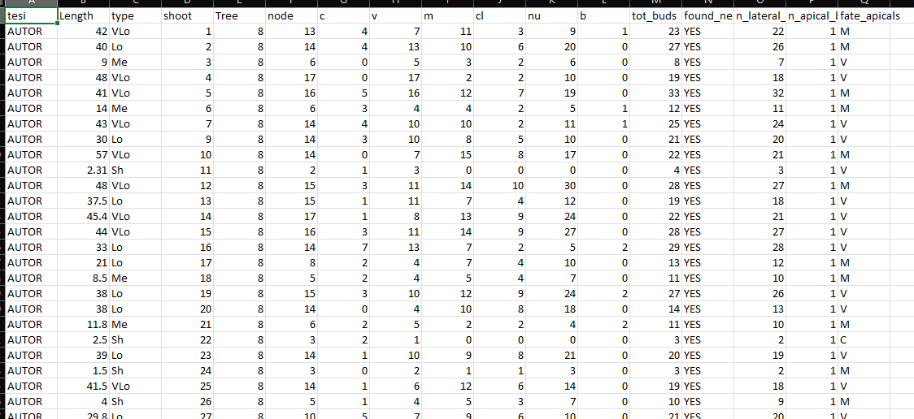
Shoot scale
Description of each shoot composition in terms of:
row ID
Not grafted
Plant ID mother of the shoot
Length(cm);
Length(class);
Number of nodes;
Number of buds per type (C,V,M,B);
Number of clusters;
Number of nuts;

Slide 6
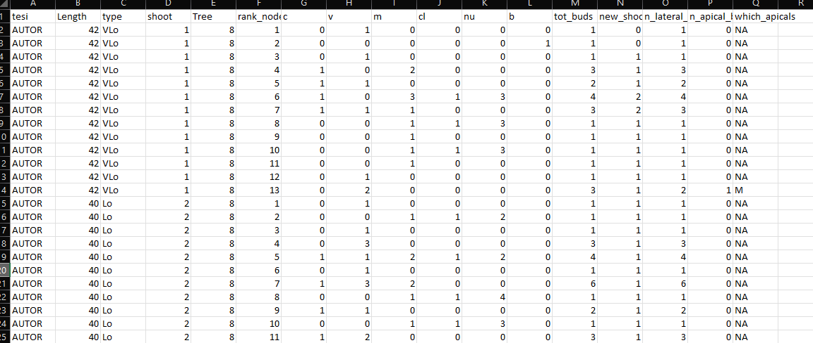
Metamer scale
Description of each metamer composition in terms of:
Year of sampling
Not grafted
Shoot length(class);
Shoot ID
Shoot length(cm);
Metamer ID
Number of LATERAL buds per eac rank (C,V,M,B);
Total buds per rank;
Shoots developed at that rank;
NUMBER LATERAL BUDS
NUMBER APICAL BUDS
FATE OF APICAL BUDS

Slide 7
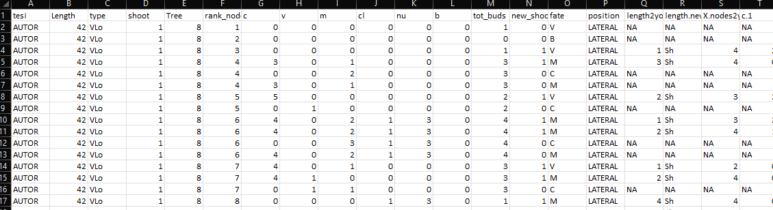
Bud scale
Description of each bud composition in terms of:
New shoot ID
Year of parent sampling
Shoot ID
Shoot length(cm);
Metamer ID
Number of sibling buds at the same node(C,V,M,B);
Total buds per node;
Number of Shoots developed at that rank;
Fate of bud (one per each row)
Position of the bud (apical/lateral)
Length of new shoot(cm)
Length of new shoot(class)
Information regarding each new shoot composition

Slide 8
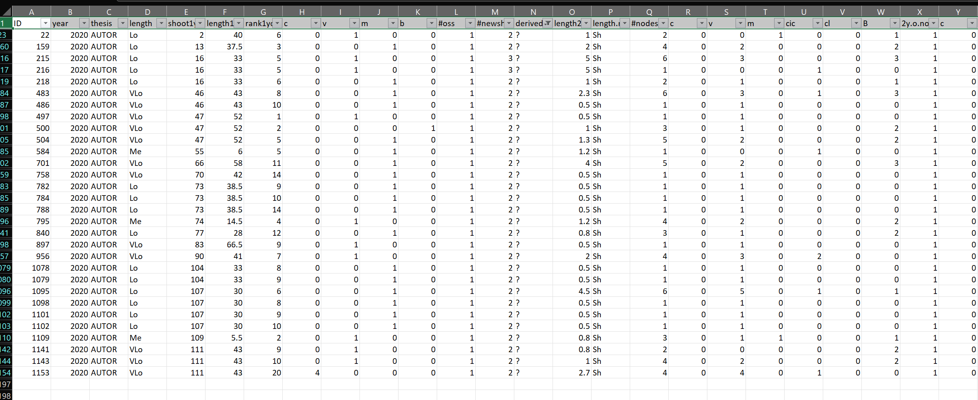
The original «new_shoots» file has the same information of the bud fate scale(in terms of new shoots details) plus it contains some the errors.
Errors= new shoots that i can’t explain from where they came from. Assigned as «?»
These errors impact less than 3% on the totals, so i guess we can ignore them and use the bud_scale file also for new shoots. What do you thing?

Slide 9
GLMs
glm(Y~F1+F2+F3+F4+F5+F6+F7)
PREDICTORS
Two GLMs:
For fate=V
For fate=M
F1
F2
F3
F4
F5
F6
F7
Y

