Slide 1
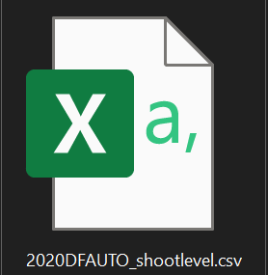
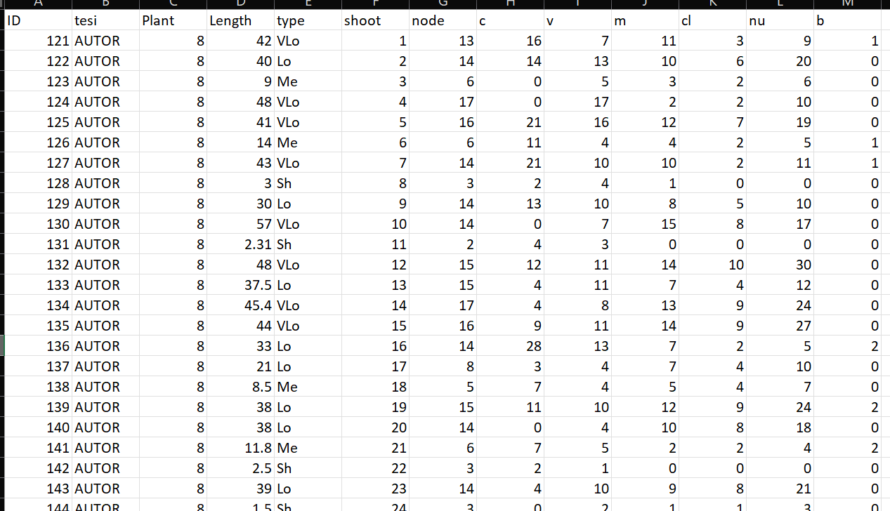
Shoot level
Description of each shoot composition in terms of:
row ID
Not grafted
Plant ID mother of the shoot
Length(cm);
Length(class);
Shoot ID (all the shoots sampled in 2021)
Number of nodes;
Number of buds per eac type (C,V,M,B);
Number of clusters;
Number of nuts;

Slide 2

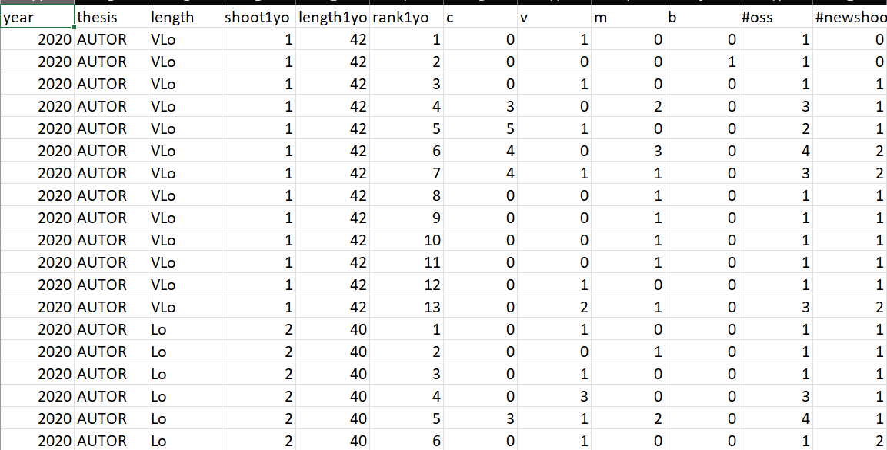
Metamer level
Description of each metamer composition in terms of:
Year of sampling
Not grafted
Shoot length(class);
Shoot ID (JUST SHOOTS THAT WERE FOUND IN 2021)
Shoot length(cm);
Metamer ID
Number of buds per eac rank (C,V,M,B);
Total buds per rank;
Shoots developed at that rank;

Slide 3

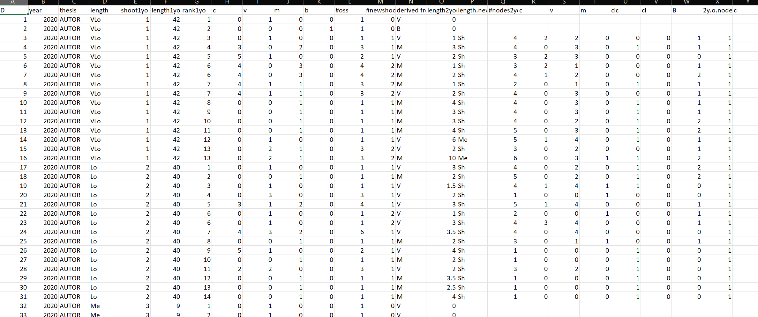
New shoots level
Description of each metamer composition in terms of:
New shoot ID
Not grafted
Year of parent sampling
Shoot length(class);
Shoot ID
Shoot length(cm);
Metamer ID
Number of parents buds per eac rank (C,V,M,B);
Total buds per parental rank;
Shoots developed at that rank;
Type of bud that burst in case of multiple buds
Length of new shoot(cm)
Length of new shoot(class)
Total node of new shoots
Information regarding buds composition of each shoot

