Slide 1
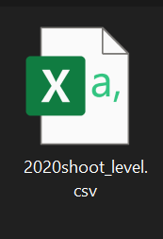
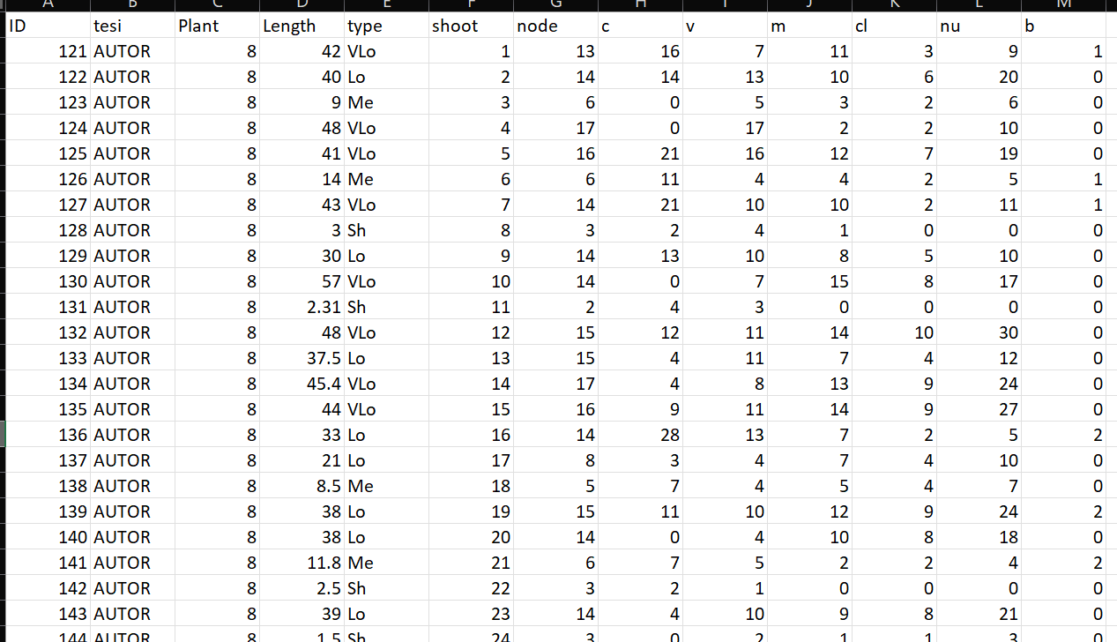
Shoot level
Description of each shoot composition in terms of:
row ID
Not grafted
Plant ID mother of the shoot
Length(cm);
Length(class);
Number of nodes;
Number of buds per eac type (C,V,M,B);
Number of clusters;
Number of nuts;

Slide 2
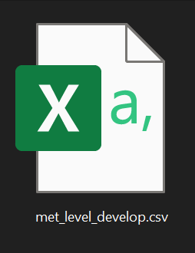
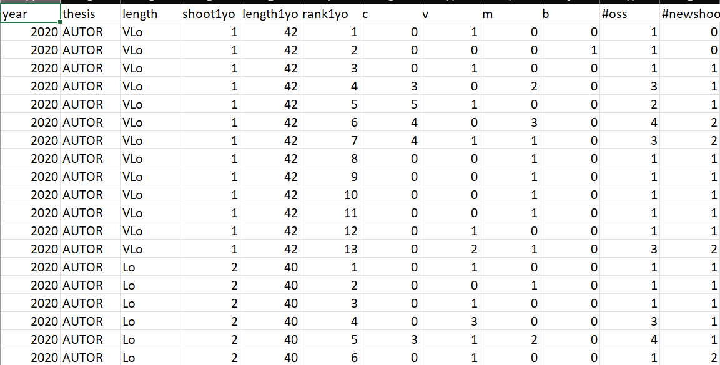
Metamer level
Description of each metamer composition in terms of:
Year of sampling
Not grafted
Shoot length(class);
Shoot ID
Shoot length(cm);
Metamer ID
Number of buds per eac rank (C,V,M,B);
Total buds per rank;
Shoots developed at that rank;

Slide 3
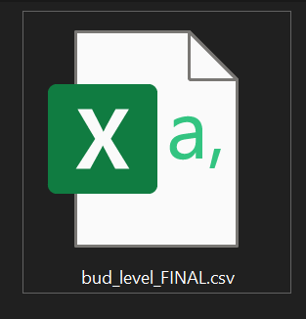
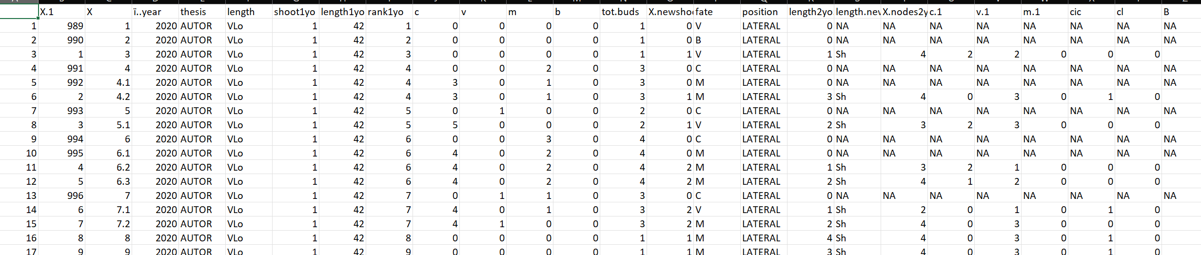
Buds level
Description of each bud composition in terms of:
New shoot ID
Year of parent sampling
Not grafted
Shoot ID
Shoot length(cm);
Metamer ID
Number of other buds at the same node(C,V,M,B);
Total buds per node;
Number of Shoots developed at that rank;
Fate of bud (one per each row)
Position of the bud (apical/lateral)
Length of new shoot(cm)
Length of new shoot(class)
Information regarding each new shoot composition

Slide 4

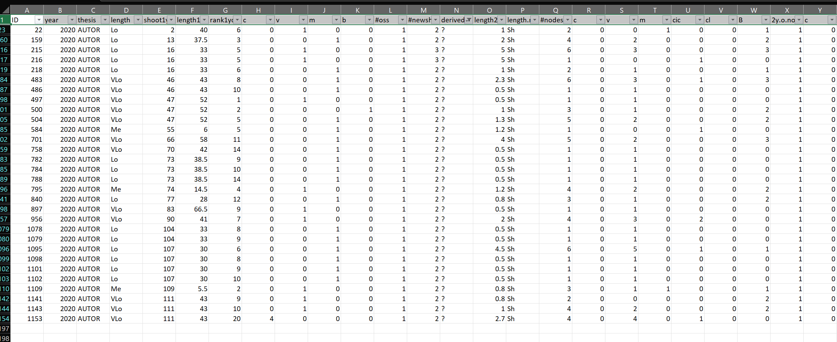
New shoots level
This file has the same information of the previous (in terms of new shoots details) but it contains also the errors.
Errors= new shoots that i can’t explain from where they came from. Assigned as «?»

