Slide 1
Methods and goals
METHODS:
Sampling of 240 1year old shoots (120 from own-rooted plant; and 120 from grafted ones)
2020
Biometric measures at shoot level (diameter, length, number of nodes) of 1 year old shoots (parent);
Qualitative measures at node level (type of bud/sylleptic (M= mixed, C=catkin, V=vegetative, B=blind) of the same 1 year old shoots
2021
Biometric measures at shoot level (diameter, length, number of nodes) of 1 year old shoots (child) born from the parerent;
Qualitative measures at node level (type of bud/sylleptic (M= mixed, C=catkin, V=vegetative, B=blind) of the same child shoots
GOALS:
The model of my dreams should answer those questions:
How 1 yeard old shoot is composed?
There are some zones of the same type of bud?
There are difference in composition according to the length of the shoot?
How is the behavior of lateral shoots?
How many of them developed?
Where?
From which bud? (vegetative or mixed?)
how can we deal with multiple buds and multiple lateral shoots per node?
This problems cold be solved analysing the data:
From different point of views
Shoot scale
Metamer scale
Bud scale
With different tecniques:
exploratory analysis
Glms/marcovian
WE WILL FOCUS JUST ON ON ROOTED PLANTSOWN-ROOTED

Slide 2
GLMs
Markovian models
They are used to understand if a predictor describes a variable
Poisson if the variable is quantitative;
Binomial if the variable is categorical
Es. Is Vegetative bud burst (Y) depending on (~) length, rank node, sibling M, sibling V, tot buds at that rank?
They are used to understand if the variables (buds) can be grouped into homogeneus zones.
HAZELNUT ISSUES:
Dependencies between rank nodes;
Dependencies between buds at the same rank

Slide 3
DATASET_ARCHITECTURE HAZELNUT
Process
OWN-ROOTED e INNE
 | Starter DF | Ending DF | What was done | Scripts | Scale
1 | 2020DFAUTO.csv | 2020shoot_level.csv | Count number of buds per each shoot; Adding the plant ID to each shoot; | create_shootlevel.R | shoot
2 | 2020shoot_level.csv | 2020metamer_level.csv | Creating the dataframe at the metamer level | create_metamer_level.R | Metamer
3 | 2020metamer_level.csv | 2020metamer_level.csv | Information of how many shoots developed next year | modify_metlevel.R | Metamer
4 | 2020shoot_level.csv | 2020shoot_level_DEVELOPED.csv | CREATE A NEW DATASET WITH THE SHOOT OF 2020 THAT WERE FOUND IN 2021 | modify_shootlevel.R | Shoot
5 | 2020metamer_level.csv | 2020metamer_level_DEVELOPED.csv | CREATE A NEW DATASET WITH THE SHOOT OF 2020 THAT WERE FOUND IN 2021 | modify_metlevel.R | Metamer
6 | 2020metamer_level_DEVELOPED.csv | bud_level_develop.csv | Duplicate the rows for the number of buds of each metamer | create_bude_level | Bud
7 | bud_level_develop.csv | bud_level_FINAL.csv | Position of the bud (lateral/apical) Fate of each bud Number of sibling buds (in multiple buds Numberof new shoots Info regarding the new shoot developed Substrating to the sibling value the fate of that bud | create_budlevelFINAL.R | Bud

Slide 4
DATASET_ARCHITECTURE HAZELNUT
Process
OWN-ROOTED
 | Starter DF | Ending DF | What was done | Scripts | Scale
8 | bud_level_FINAL.csv | bud_level_LATERALS.csv | Filter just for lateral buds | modify_budscale.R | Buds
9 | bud_level_FINAL.csv | bud_level_APICALS.csv | Filter just for apical buds | modify_budscale.R | Buds
10 | 2020metamer_level_DEVELOPED.csv | met_level_develop_lateralbuds.csv | Modifying the count of buds per each node, removing the apical bud!!! | modify_metlevel.R | Metamer
11 | 2020shoot_level_DEVELOPED.csv | 2020shoot_level_DEVELOPED_fin.csv | Adding the info of how many lateral and apical buds and the fate of apicals | modify_shootlevel.R | Shoot
12 | 2020shoot_level_DEVELOPED_fin.csv | shoot_level_develop_lateralbuds.csv | Modifying the count of buds per each node, removing the apical bud!!! | modify_shootlevel.R | Shoot

Slide 5

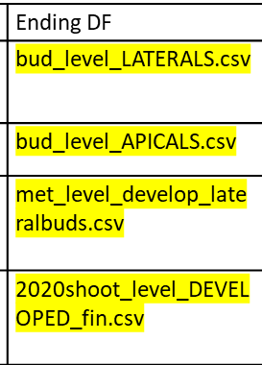


What will we use
Bud scale
Metamer scale
Shoot scale

Slide 6
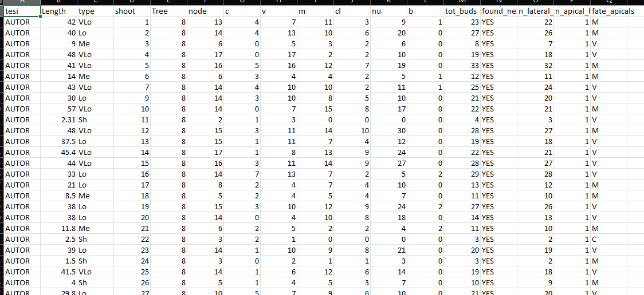
Shoot scale
Description of each shoot composition in terms of:
row ID
Not grafted
Plant ID mother of the shoot
Length(cm);
Length(class);
Number of nodes;
Number of buds per type (C,V,M,B);
Number of clusters;
Number of nuts;

Slide 7
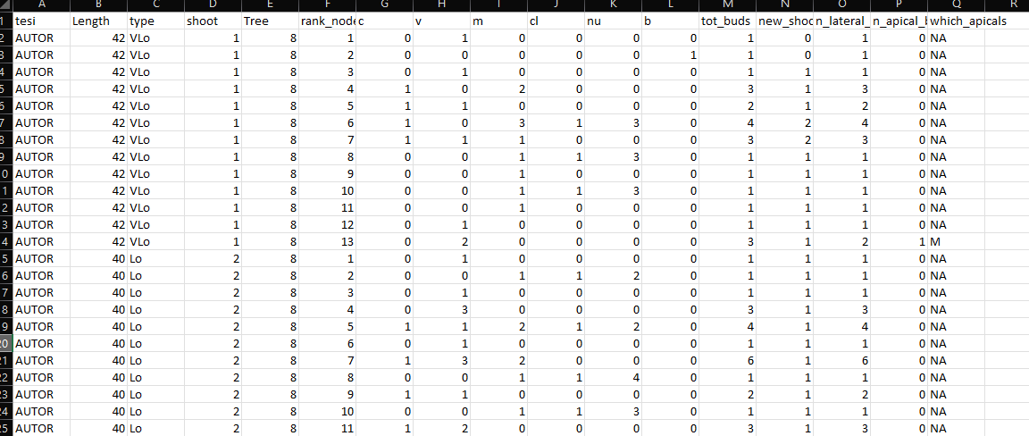
Metamer scale
Description of each metamer composition in terms of:
Year of sampling
Not grafted
Shoot length(class);
Shoot ID
Shoot length(cm);
Metamer ID
Number of LATERAL buds per eac rank (C,V,M,B);
Total buds per rank;
Shoots developed at that rank;
NUMBER LATERAL BUDS
NUMBER APICAL BUDS
FATE OF APICAL BUDS

Slide 8
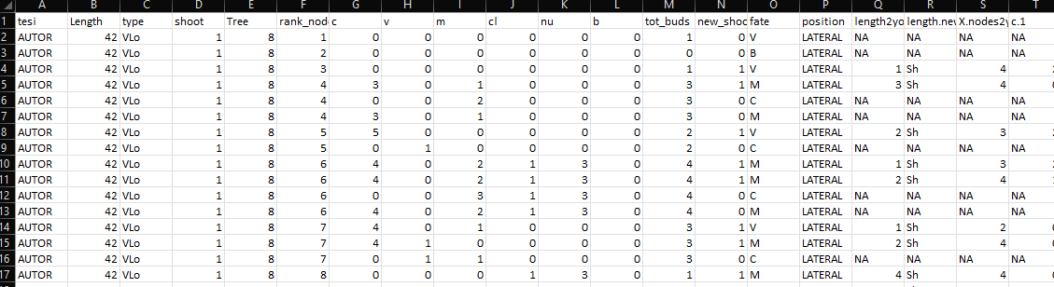
Bud scale
Description of each bud composition in terms of:
New shoot ID
Year of parent sampling
Shoot ID
Shoot length(cm);
Metamer ID
Number of sibling buds at the same node(C,V,M,B);
Total buds per node;
Number of Shoots developed at that rank;
Fate of bud (one per each row)
Position of the bud (apical/lateral)
Length of new shoot(cm)
Length of new shoot(class)
Information regarding each new shoot composition

Slide 9
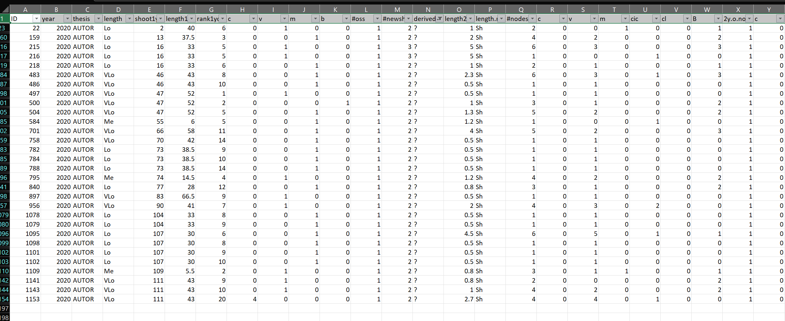
The original «new_shoots» file has the same information of the bud fate scale(in terms of new shoots details) plus it contains some the errors.
Errors= new shoots that i can’t explain from where they came from. Assigned as «?»
These errors impact less than 3% on the totals, so i guess we can ignore them and use the bud_scale file also for new shoots. What do you thing?

Slide 10
GLMs
glm(Y~F1+F2+F3+F4+F5+F6+F7, family=«binomial»)
PREDICTORS
Two GLMs:
For fate=V
For fate=M
F1
F2
F3
F4
F5
F6
F7
Y
How to Interpret glm Output in R (With Example) - Statology

Slide 11
Problems & solutions
Several predictors mask their effects (ES. NA values)
Run different GLMs avoid each time a predictor:
Y~tot_buds+length+rank
Y~M+V+C+length+rank
p. Value are significant because we have many data. Is real significance?
Permutation models + difference in AIC

Slide 12
Permutation models
GLMS(Y~A+B+C, data=DF)
Shows that A is really significant (***)
Permutation
We shuffle the variable A: DF$A=sample(DF$A)
We run again the glms GLMS(Y~A+B+C, data=DF)
If the significance was true, now A should be not significant any more
AIC difference
GLMS(Y~A+B+C, data=DF)
Shows that AIC is 800
AIC difference
We run a null model GLMS(Y~1, data=DF)
We make the difference between AIC real (800) and AIC null
Now we make permutation of a variable and we run again the model.
AICpermutation-AICnull should be GREATER than AICreal-AICnull!!!

Slide 13
To do
Dependencies between the number of siblings and shoot length and rank (poisson glms)
Redo glms V and M avoiding each time a predictor to see the p_value
Permutation models and difference in AIC

Slide 14
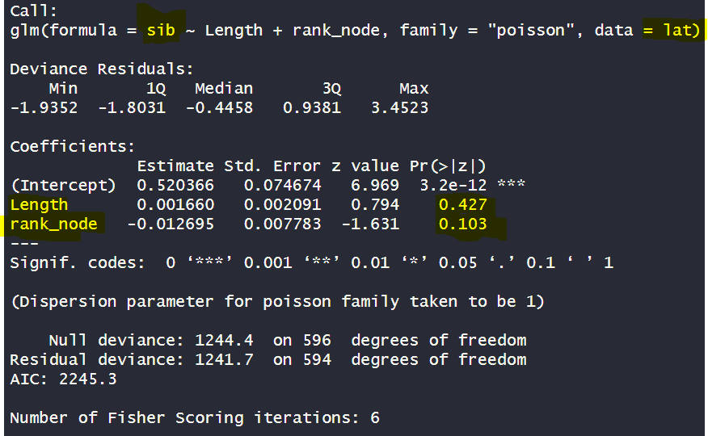
BUD LEVEL_ #sibling buds~lengt, rank
The number of sibling buds is NOT positively related both to length and rank node

Slide 15
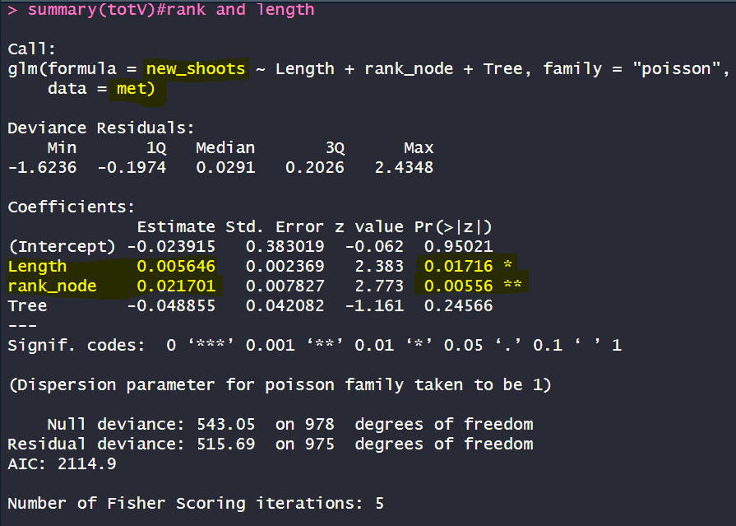
METAMER LEVEL_ #new shoots~lengt, rank
The number of new shoots is positively related both to length and rank node

Slide 16
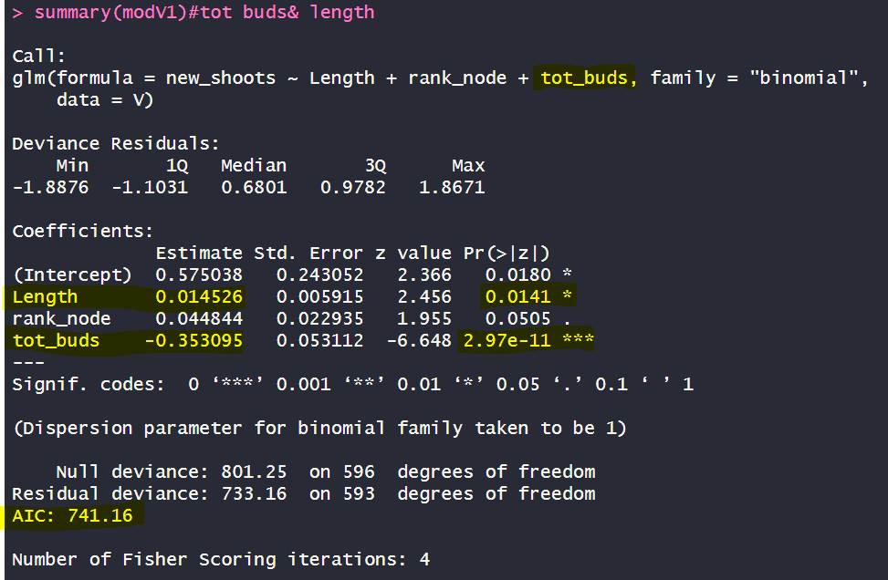
Fate=“V”_tot buds_modV1

Slide 17
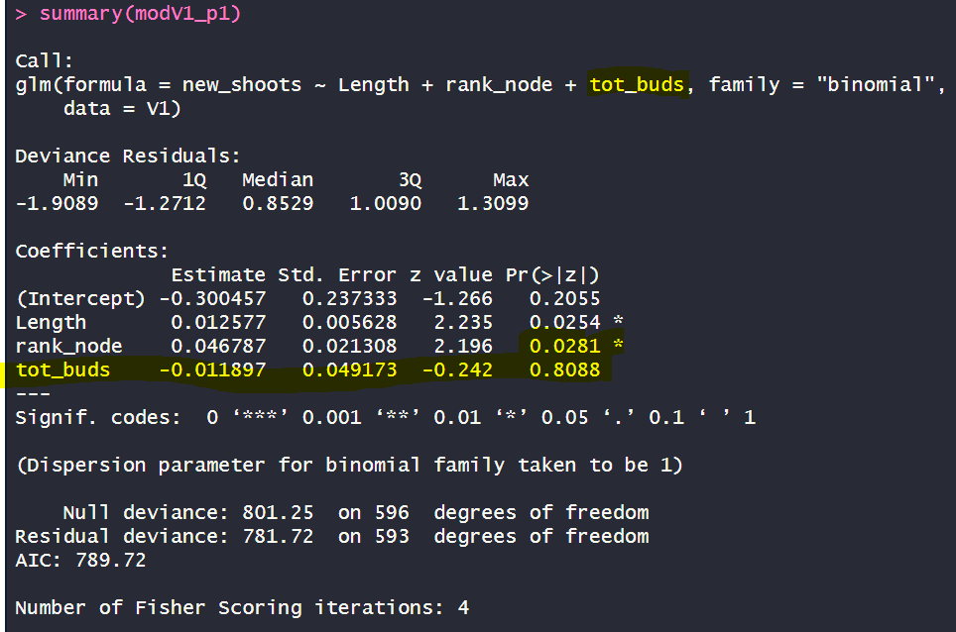
Fate=“V”_permutation
Shuffle TOT BUDS
Shuffling tot_buds, p value is not significant any more!
But Rank node starts beeing significant (?) why?

Slide 18
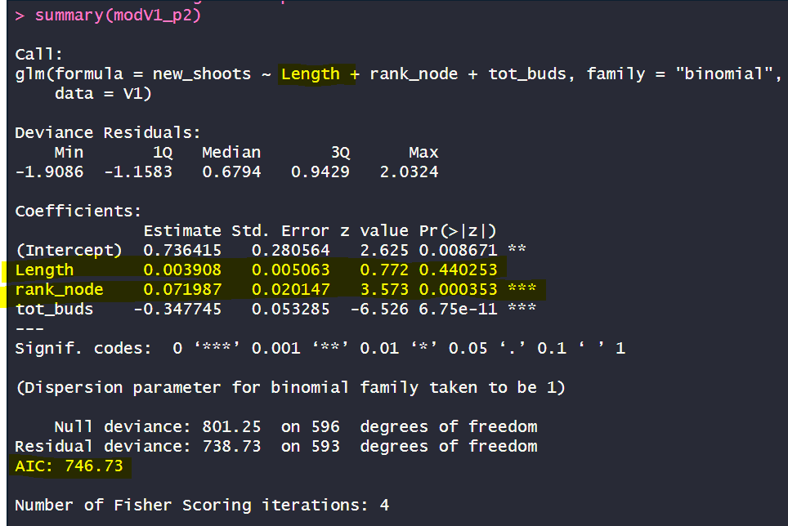
Fate=“V”_permutation
Shuffle LENGTH
Shuffling length, p value is not significant any more!
But Rank node starts beeing significant. Is it because length and rank are correlated?

Slide 19
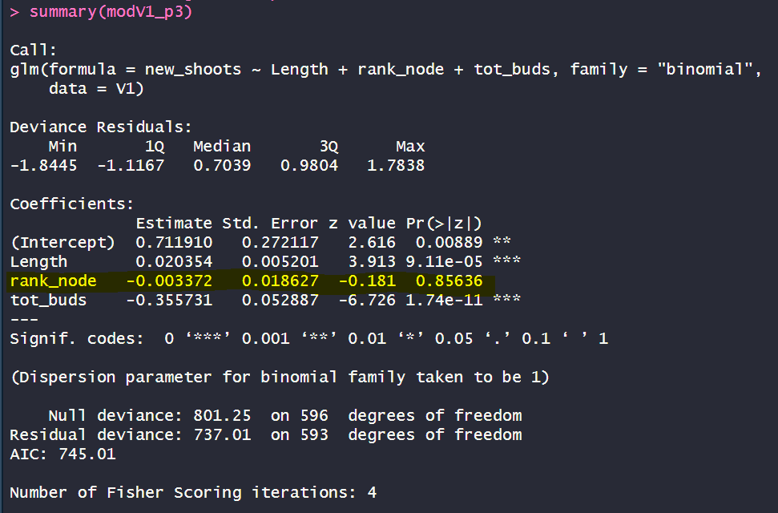
Fate=“V”_permutation
Shuffle RANK NODE
Shuffling rank node, p value remains not sig

Slide 20
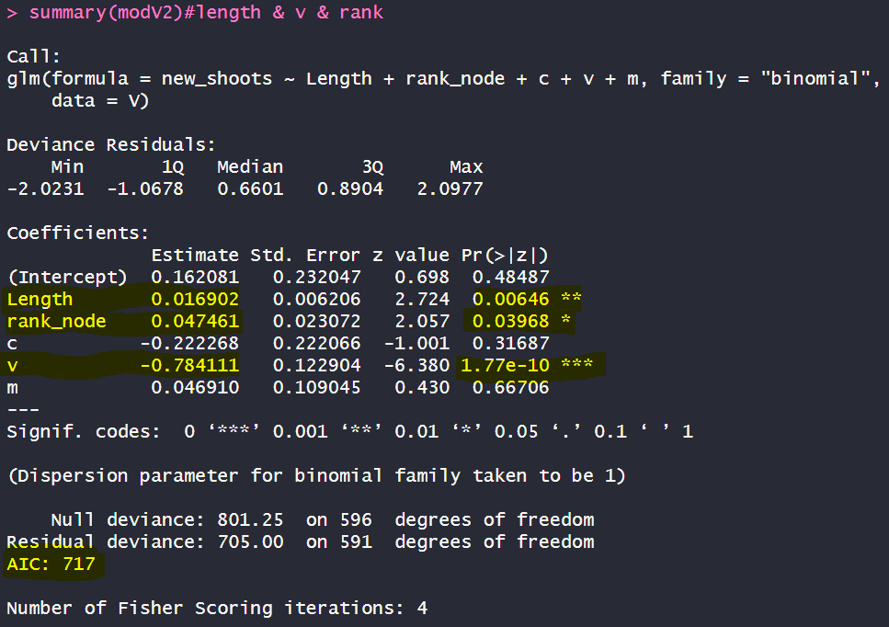
Fate=“V”_v+m+c_modV2
When i decompose tot_buds into (v+c+m or v+m) rank nodes is significative! Does it means that v/c/m difference accordin to rank node thus they make it significative?

Slide 21
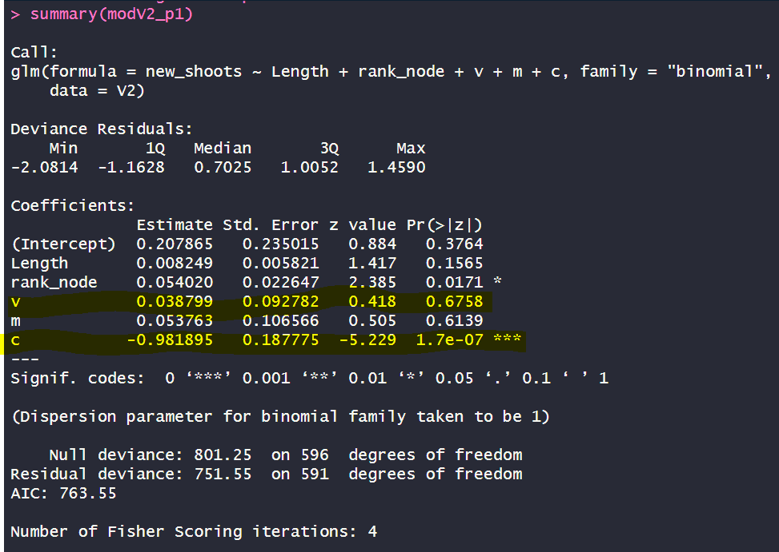
Fate=“V”_permutation
Shuffle_V
Shuffling V, p value is not significant any more BUT catkins are higly significant!!! DOES IT MEAN THAT V MASK C?

Slide 22
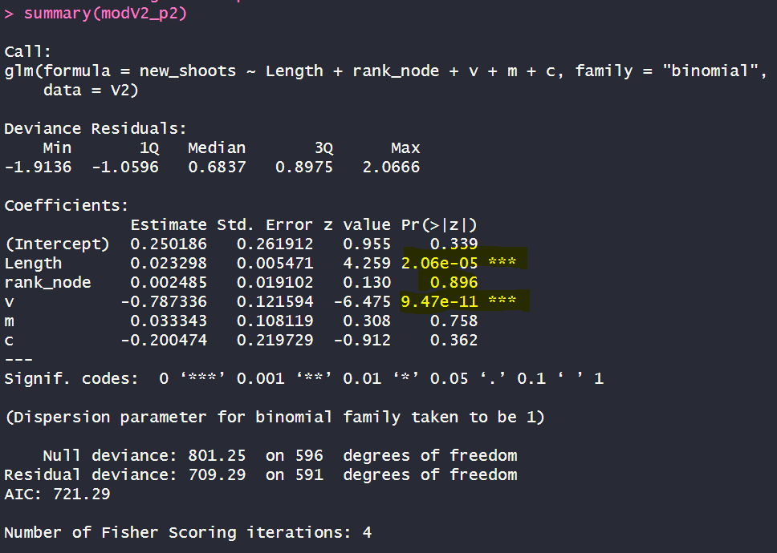
Fate=“V”_permutation
Shuffle_rank
Shuffling rank, p value is not significant any more

Slide 23
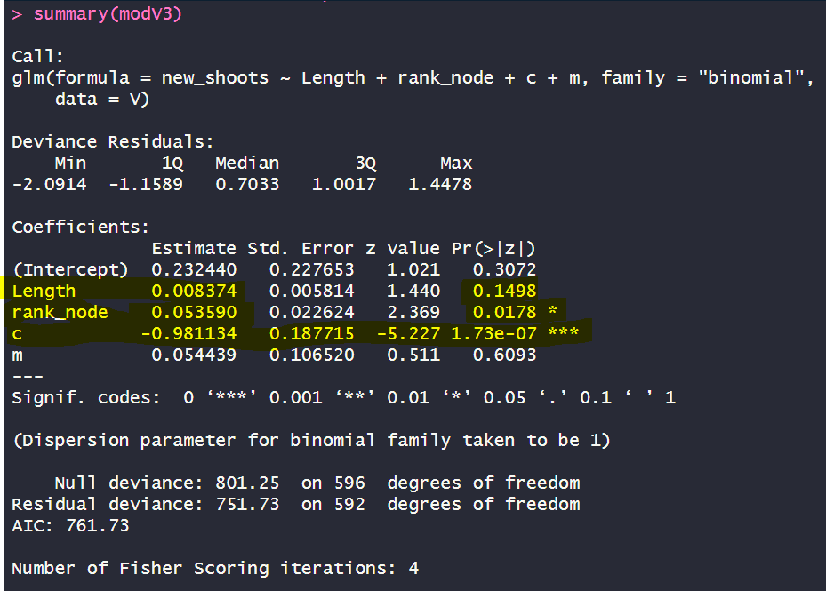
Fate=“V”_m+c_modV3
Because in slide 19, permutating V, catkins become positive, i tried to delate V from the predictors. Now C p_value is significant. V MASK C

Slide 24
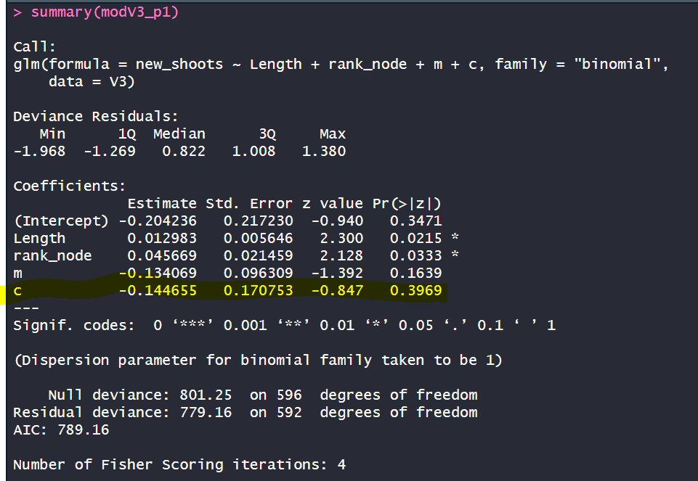
Fate=“V”_permutation
Shuffle_c
Shuffling c, p value is not significant any more

Slide 25
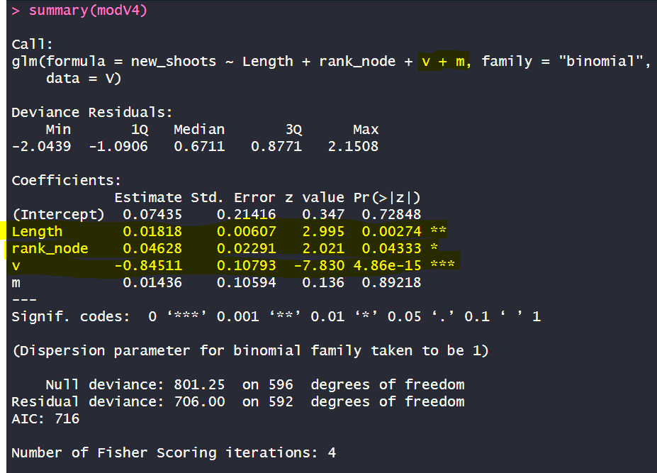
Fate=“V”_m+v_modV4

Slide 26
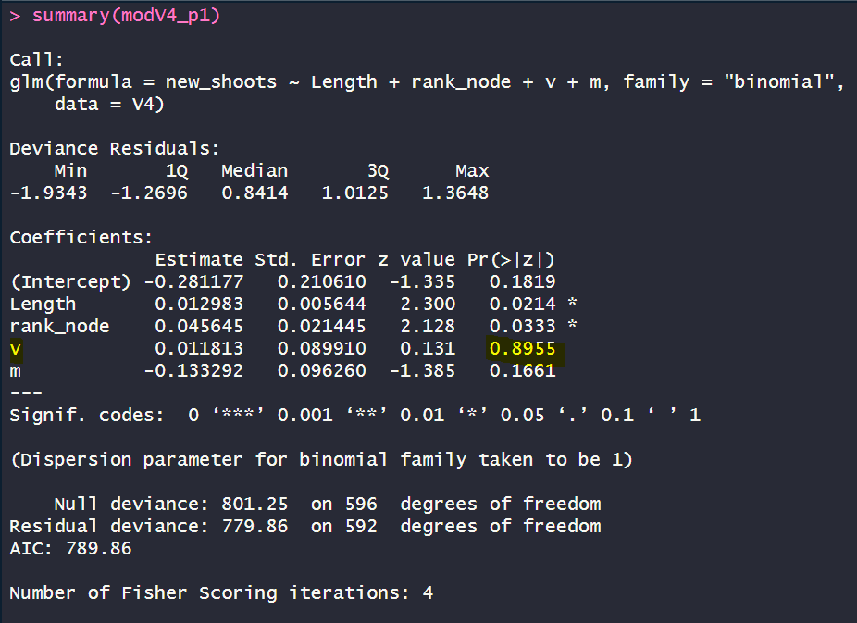
Fate=“V”_permutation
Shuffle_v
Shuffling c, p value is not significant any more

Slide 27
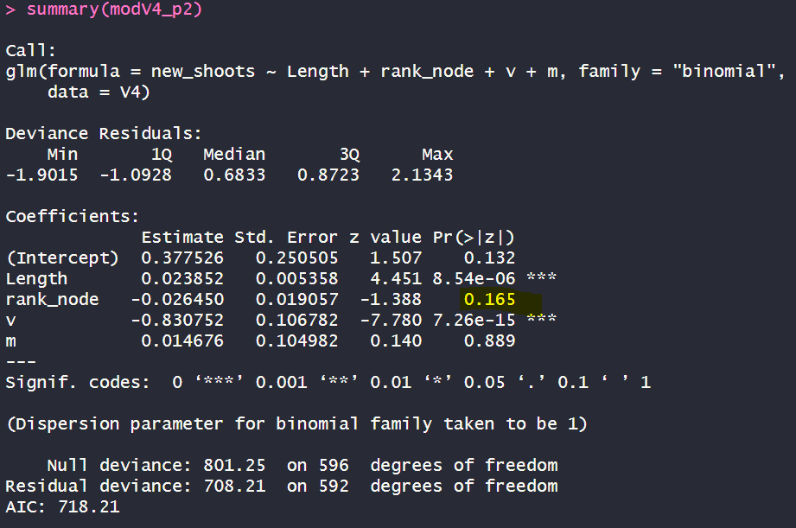
Fate=“V”_permutation
Shuffle_rank
Shuffling c, p value is not significant any more

Slide 28
Conclusion “V”
BUD V burst is explained by:
Shoot length (+);
Tot buds (-):
Vegetative (-) and catkins (-): VEGETATIVE MASK CATKINS

Slide 29
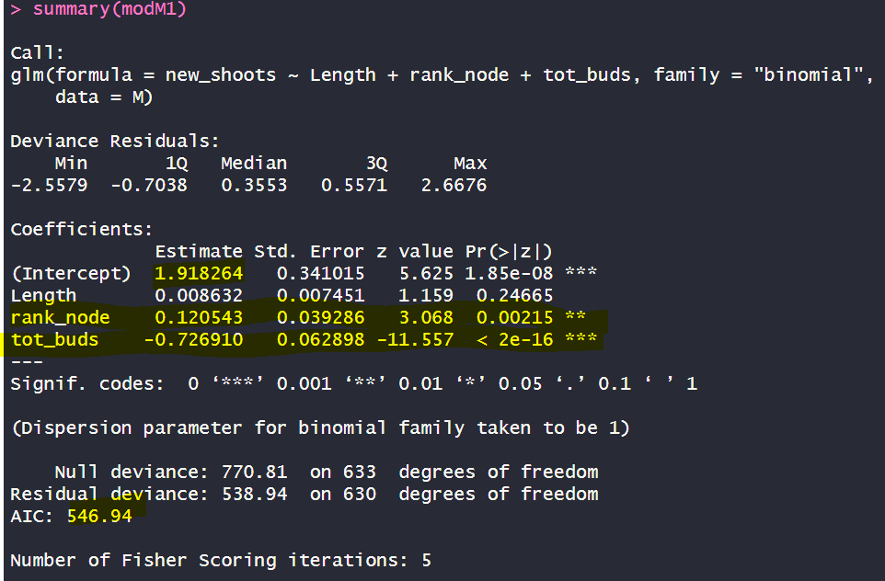
Fate=“M”_tot buds_modM1

Slide 30
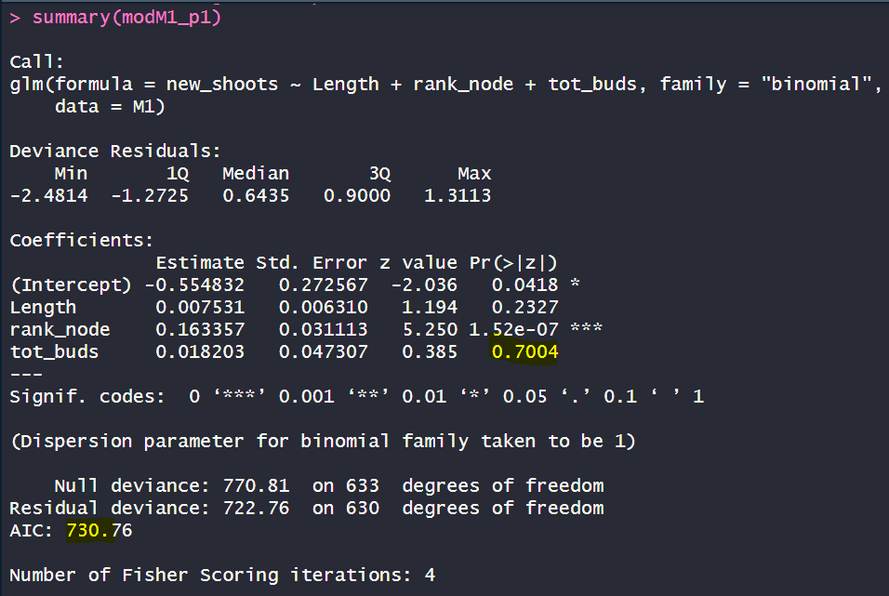
Fate=“M”_permutation
Shuffle TOT BUDS
Shuffling tot_buds, p value is not significant any more!

Slide 31
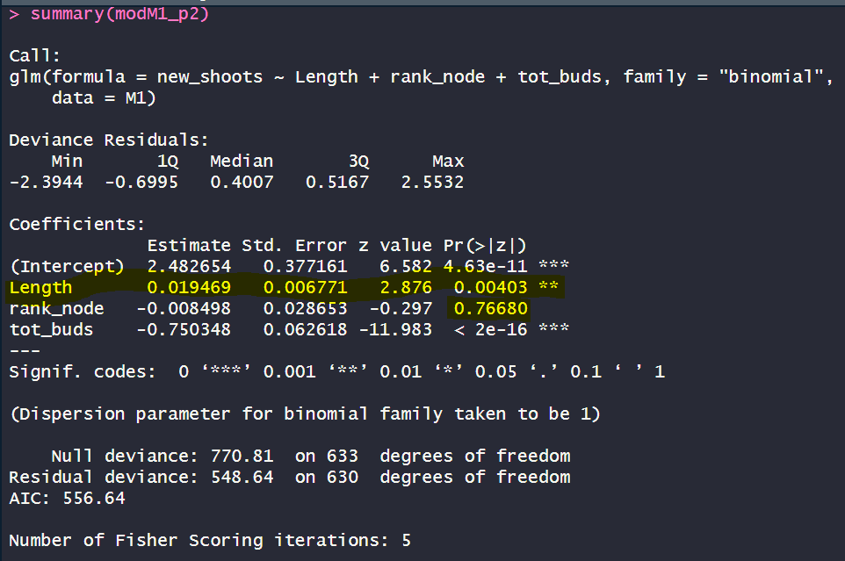
Fate=“M”_permutation
Shuffle RANK
Shuffling rank, p value is not significant any more!
But length e starts beeing significant. Is it because length and rank are correlated?

Slide 32
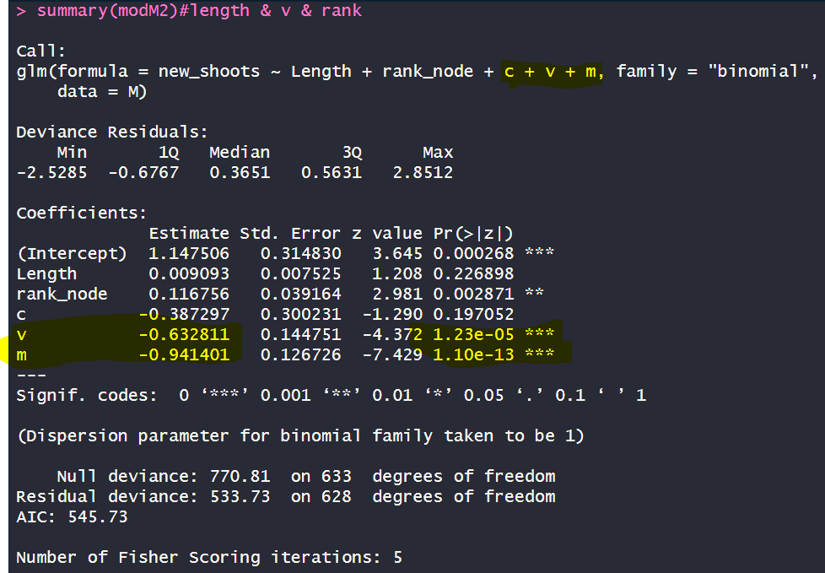
Fate=“M”_v+m+c_modM2

Slide 33
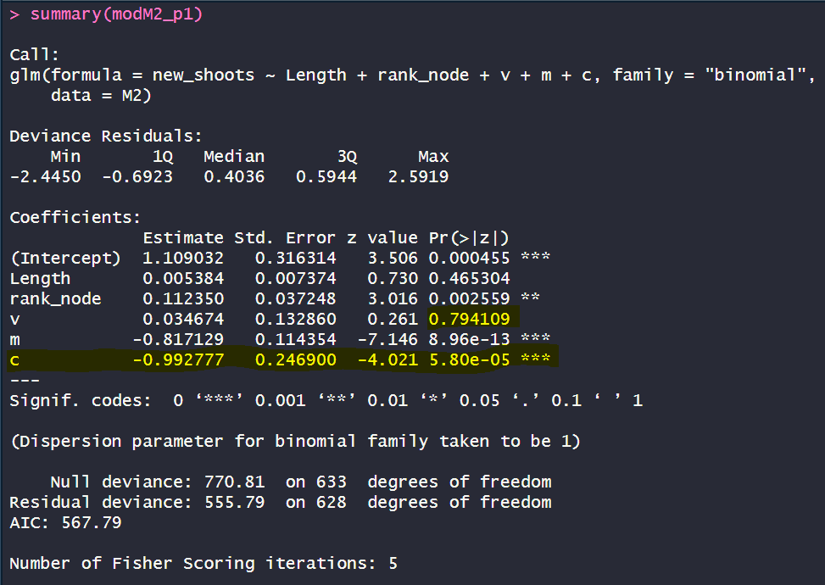
Fate=“M”_permutation
Shuffle_V
Shuffling V, p value is not significant any more BUT catkins are higly significant!!! DOES IT MEAN THAT V MASK C?

Slide 34
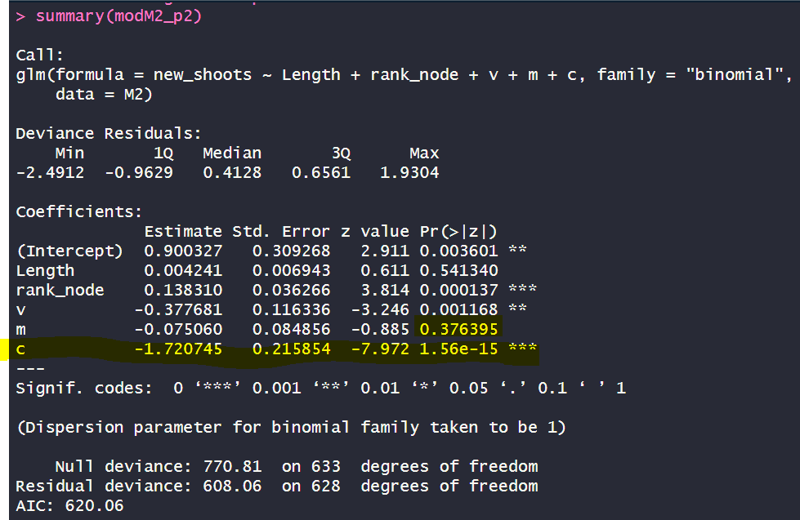
Fate=“M”_permutation
Shuffle_M
Shuffling V, p value is not significant any more BUT catkins are higly significant!!! DOES IT MEAN THAT V MASK C?

Slide 35
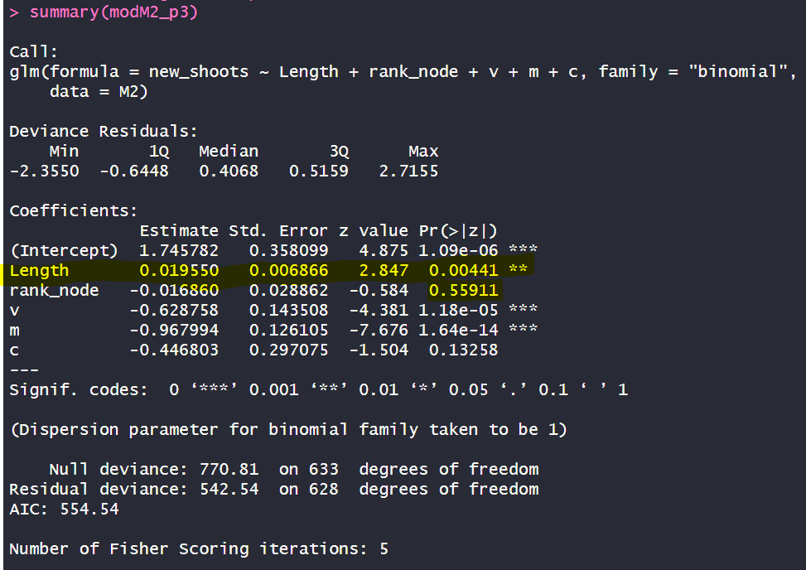
Fate=“M”_permutation
Shuffle_Rank
Shuffling V, p value is not significant any more BUT length is higly significant!!! Rank and length are correlated?=

Slide 36
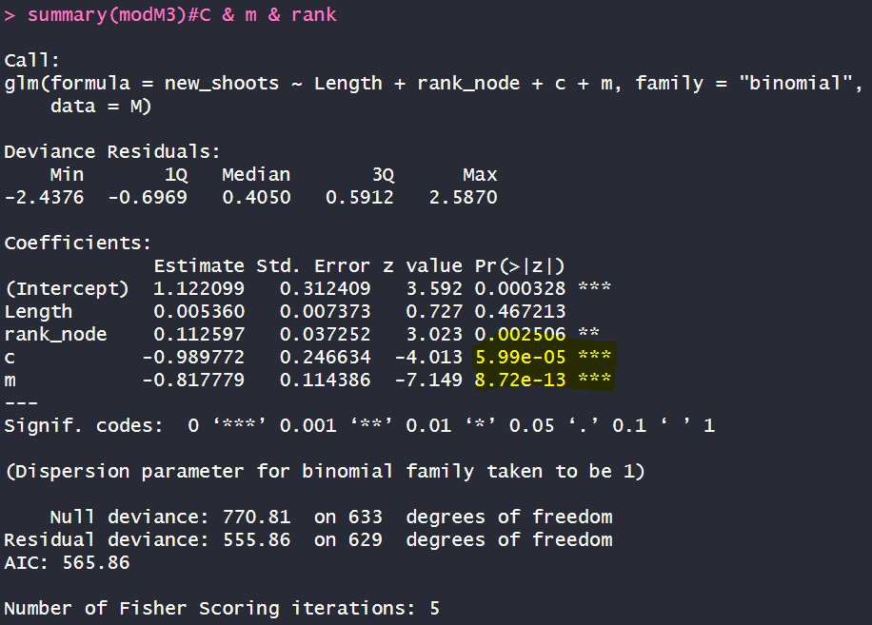
Fate=“M”_m+c_modM3

Slide 37
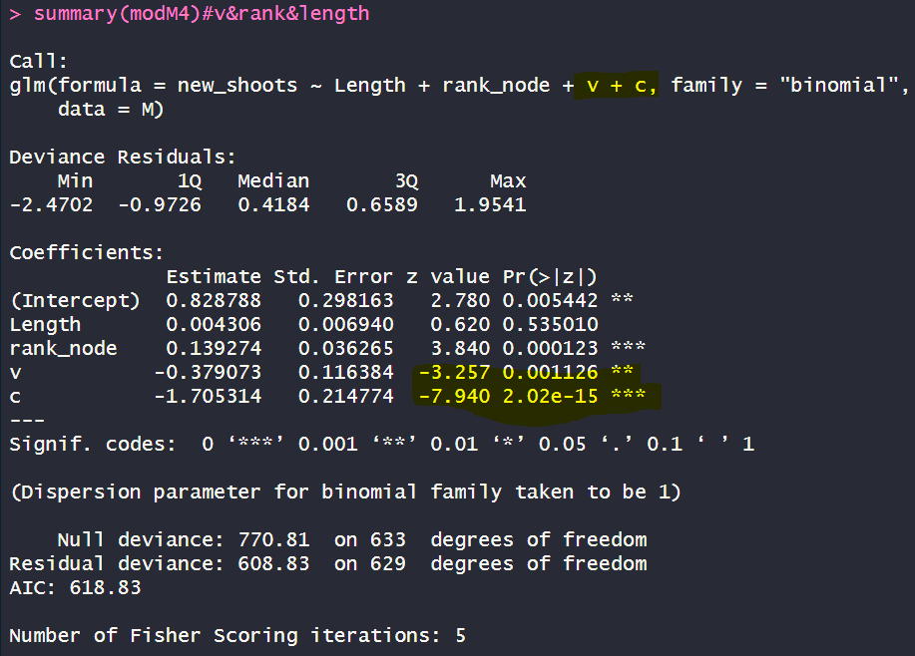
Fate=“M”_v+c_modM4

Slide 38
Conclusion “M”
BUD V burst is explained by:
Shoot rank (+);
Tot buds (-):
Vegetative (-) & mixed(-) and catkins: VEGETATIVE and MIXED MASK CATKINS

