Slide 1
Modelling health impacts of transport-related physical activity
James Woodcock
Lambed Tatah
Corin Staves
Ali Abbas

Slide 2

Housekeeping
Time: 90 minutes
Work in groups of 3-5 persons
At least one laptop per group
Access Rstudio cloud:
https://rstudio.cloud/content/4794988

Slide 3
Learning objectives
By the end of this workshop participants will be able to:
Describe the relationship between physical activity and health
Estimate physical activity volume from travel behaviour data
Calculate health impacts from changes in travel physical activity

Slide 4
Physical activity and health
Physical activity reduces incidence and mortality of many health outcomes:
All-cause mortality
Cardiovascular diseases (stroke, heart disease, heart failure)
Cancers (lung, breast, colon, endometrial, etc.)
Diabetes
Dementia
Depression
Notes:
This slide has been left blank intentionally for you to add your own content.

Slide 5
To model physical activity health outcomes, we need to be able to:
Quantify physical activity
Link physical activity to risk of outcome
Link risk reduction to reduction in burden of disease

Slide 6


Quantifying physical activity
Self-reported surveys are used to capture population’s physical activity
Intensity x Duration x Frequency = Volume

Slide 7
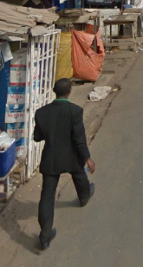

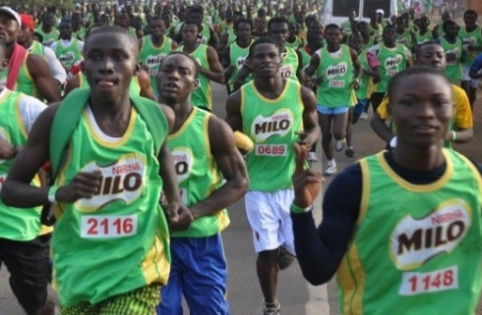
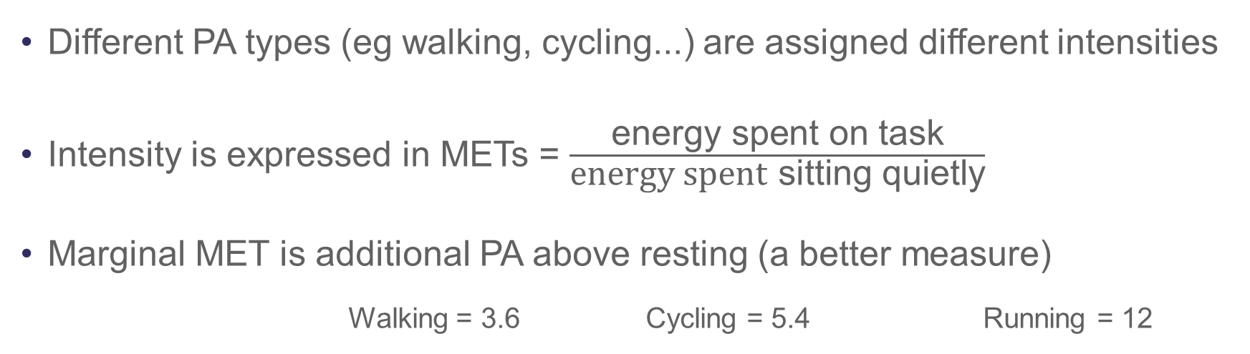
Different PA types (eg walking, cycling...) are assigned different intensities
Intensity is expressed in METs = $\frac{\text{energy} \text{spent} \text{on} \text{task}}{\text{energy} \text{spent} \text{sitting} \text{quietly}}$
Marginal MET is additional PA above resting (a better measure)
Walking = 3.6 Cycling = 5.4 Running = 12
METs from PA compendium

Slide 8
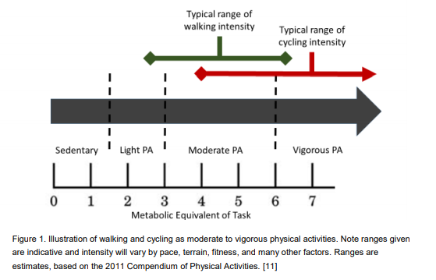

Slide 9

Physical activity volume = $Intensity ∗Frequency ∗Duration$
For example, If one cycles for 1 hour every day, one’s weekly PA volume due to cycling will be:
1 hour * 7 days * 5 mMET
= 35 mMET-hours/week

Slide 10
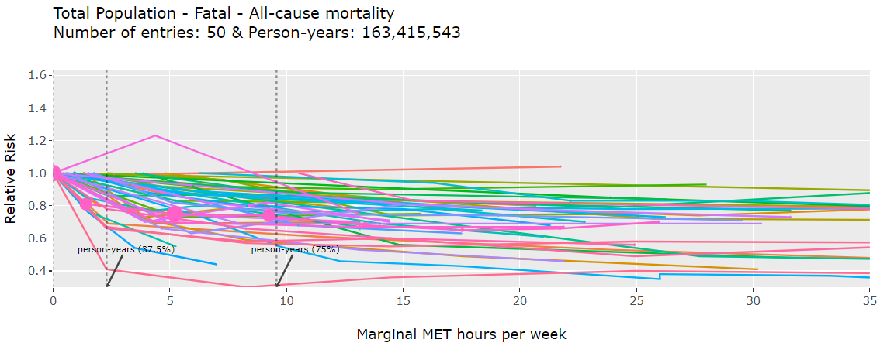
Linking PA and health outcomes: non-linear relationship
Non-occupational physical activity and risk of cardiovascular diseases, cancer, and mortality outcomes: a dose-response meta-analysis of large prospective studies. Garcia et al. https://shiny.mrc-epid.cam.ac.uk/meta-analyses-physical-activity/

Slide 11
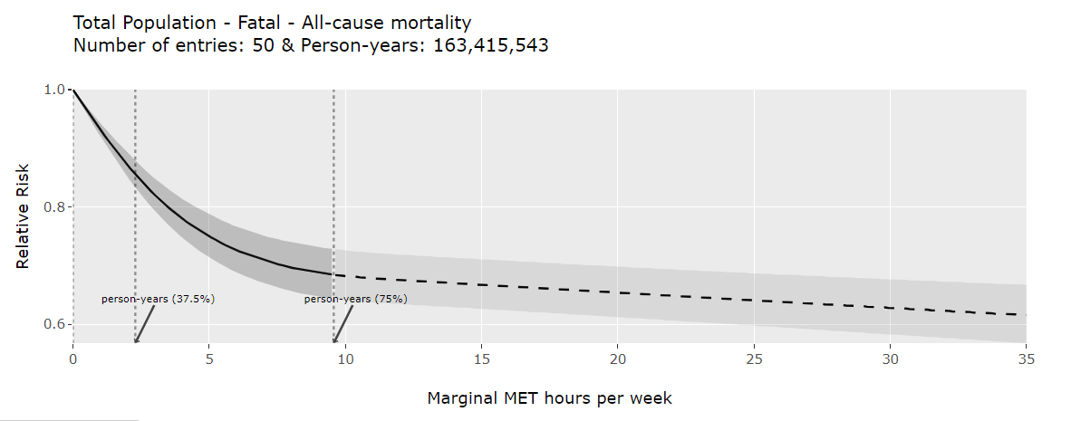
Non-linearity implies different gains for individuals based on starting point
2 hrs of cycling per week
1 hr of cycling per week

Slide 12
Because of the non-linear relationship
Risk reduction from additional PA depends on previous PA levels
Health gains from a single PA source are better captured if we understand the other sources.

Slide 13
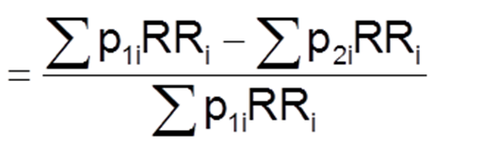
Relative risk reductions allow calculation of PIFs
PIF * Disease burden = Burden of disease reduction

Slide 14
Relative risk reductions allow calculation of PIFs
PIF * Disease burden = Burden of disease reduction

Slide 15
To know by how much physical activity reduces the risks and burdens of health outcomes, we need to be able to:
Quantify physical activity
Link physical activity to risk of outcome
Link risk reduction to reduction in burden of disease
So with population PA data we can now estimate health effects changes in population levels of PA

Slide 16
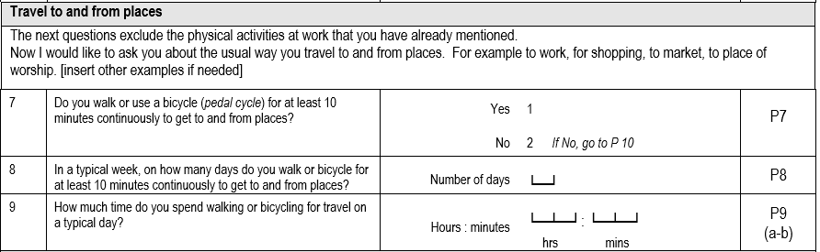
Getting PA Volumes for modelling transport PA:
PA surveys poorly capture transport PA
Capture aggregated walking and cycling but don’t tell us more about trips.
Makes it difficult to create realistic scenarios

Slide 17
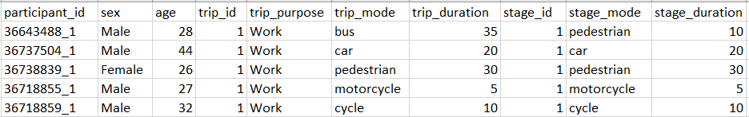
Travel/time-use surveys capture more trip details
They do not capture other types of PA
We know that other sources of PA are needed to estimate transport physical activity health impact

Slide 18
Non-linearity implies different gains for individuals based on starting point
2 hrs of cycling per week
1 hr of cycling per week

Slide 19
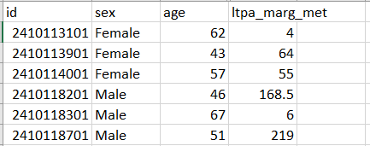
We probabilistically combine travel behaviour and PA data from different surveys of the same population to get a synthetic population
Travel survey data
+
PA from surveys such SAGE. STEPs

Slide 20
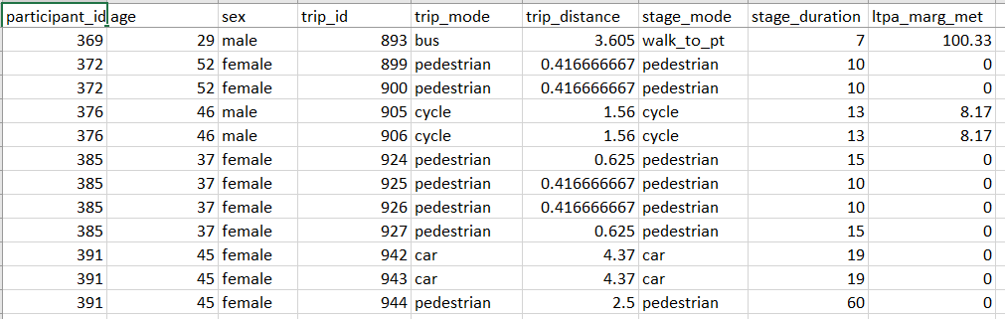
Synthetic population
Other uses of synthetic pop

Slide 21
Demo of the physical activity dose-response function
https://shiny.mrc-epid.cam.ac.uk/meta-analyses-physical-activity/

Slide 22
The physical activity dose-response function
if (!require("drpa",character.only = TRUE)) {
print('Installing "drpa" package...')
remotes::install_github("meta-analyses/drpa")
library(drpa)
print("")
}
drpa::dose_response(cause = "all-cause-mortality", outcome_type = "fatal", dose = 5)

Slide 23
Exercise on dose-response functions applications
How do the shapes of the curves for CVD (fatality vs non-fatality) differ
For depression, how do ‘combined fatality and non-fatality’ relative risks differ for 5 and 10 mMET/wk (hovering the mouse over the curve)
For neurological diseases, how do mortality relative risks differ for 5 and 10 mMET/wk (using downloaded data)
Using the r package function, determine cancer mortality rr for people accumulating 5, 12 and 18 mMETs/week

Slide 24
Exercise on micro-simulation of Health impact
Introduction to PA data

Slide 25
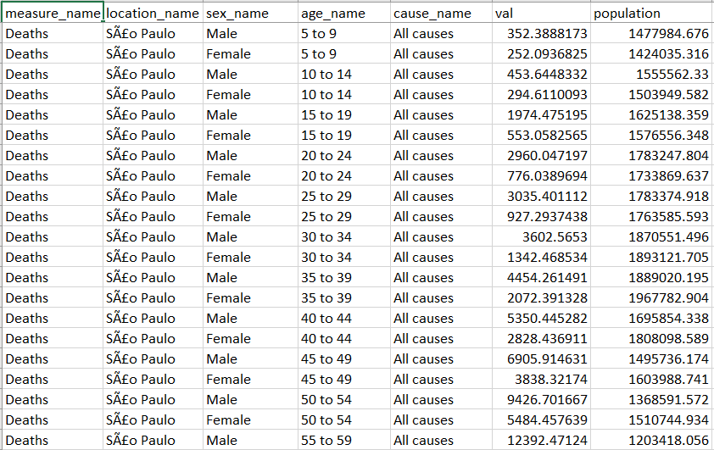
Introduction to GBD data

Slide 26
Exercise
***Further details are provided in the markdown document
Explore how PA changes when we half transport PA
How does the change translate to the risk of all-cause mortality
What is the corresponding change in all-cause mortality?
How does the PIF change for men and women?
Bonus
1. How do rr estimates change when using the linear function based like in HEAT

Slide 27
Acknowledgements
ITHIM-Global Team: Leandro Garcia,
Physical activity group MRC Epidemiology Unit: Soren, Matt, Tessa

Slide 28

Thank you
MRC Epidemiology Unit
@MRC_EPID
mrc-epid.cam.ac.uk

