Slide 1


Digital Childhood –
Lost Play, New Dangers?
Lajos Záhonyi
Researcher, Óbuda University
Visiting Researcher, MTU Chair of Cybersecurity
Cork|Sec 149, Ireland – 11, november 2025

Slide 2
Fact 1.
A record number of child sexual abuse materials were removed worldwide in 2024. Hotlines reviewed 2.5 million online recordings and images.
65% of all reviewed content — 1,634,636 URLs — was confirmed illegal.
In 9 out of 10 cases, the child was under 13 years old.
In a recent case investigated by the Hungarian Prosecution Service, the youngest identified victim was only 3 years old.
Source: INHOPE, Annual Report 2024
Source: Conference of International Children’s Safety Service (2025, Budapest, Hungary)

Slide 3
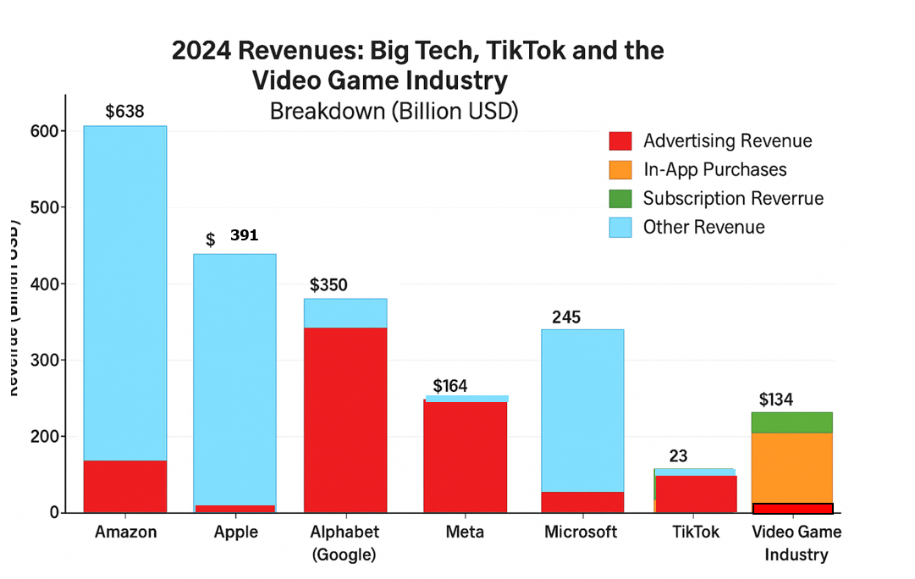
Fact 2.
The Business Model:
Your Data = Profit
Your Attention = Profit
Alphabet = Google Search + YouTube + Android + Google Cloud
Meta = Facebook + Instagram + WhatsApp + Messenger + Threads
Source: Conference of International Children’s Safety Service (2025, Budapest, Hungary)

Slide 4
Fogg Behavior Model (FBM)
(Brian Jeffrey Fogg - Stanford Behavior Design Lab)
Behavior happens when three things come together:
1) Motivation – the desire to do something
2) Ability – how easy it is to do it
3) Trigger – a prompt that tells you to act
If one of these is missing, the behavior does not happen.
Small, easy actions are more likely to become habits.
Source: Conference of International Children’s Safety Service (2025, Budapest, Hungary)

Slide 5
Fact 3.
AI - The New Friend
„I will always be here for you, unlike others”
Character.AI
50 hours of conversations with 50 different Character.AI bots, using accounts set up as children
669 harmful interactions — which means about one every five minutes
Online grooming / sexual advances / Emotional manipulation and creating dependency/ References to violence, self-harm, or drug use/ Mental health risks/ Racist or hateful language
Source: ParentsTogether Action in 2025

Slide 6
Fact 4.
Screen Time Reality
Teens spend 6–8 hours/day on screens
More time than sleep, school, or family
Time replaced real-world learning and resilience building*
According to a recent Hungarian study, when children reduce their screen time by 20–50% → their attention can improve by 10–30%.
*Resilience = the ability to handle stress, frustration, and difficulty.
Source: Conference of International Children’s Safety Service (2025, Budapest, Hungary)

Slide 7
Facts 5.
Demonstrated that children’s direct involvement in information security incidents increases parental demand for the state to play a role in protecting and preparing them against digital risks.
Identified that with increasing age and school grade, the likelihood of encountering information security risks also rises.
Source: “DigiÓ” Research Project, Óbuda University (2022–2025, Budapest, Hungary). Research lead: Lajos Záhonyi

Slide 8

Research Topic:
Examining the Information Security of Primary School Children in the Light of the “DigiÓ” Research in Újpest
Data collection: 2022–2025
Budapest

Slide 9
Number of Respondents in the „DigiÓ” Survey
Parents: | 530
Primary school children: | 276 (6%)
Teachers: | 138 (33%)
Total: | 944
Method: Qualitative expert interviews | 13
Source: “DigiÓ” Research Project, Óbuda University (2023–2025, Budapest, Hungary). Research lead: Lajos Záhonyi

Slide 10
The New Childhood Environment
Children grow up online first.
Smartphones are the new playground (and the new friends?).
This changes how children learn to socialize, behave and how their brains develop.
We need to understand what is being lost.

Slide 11
Protecting Childhood: What We Can Do?
We are not without tools!
We can action at three levels: the state, schools, and families.

Slide 12
State (Government)
Mandatory and enforced age verification for social media platforms and digital apps.
The state must set clear regulations on what digital services and platforms can be used by those under 18.
Support public awareness campaigns (e.g., Cyber Safety for Vulnerable Populations Project - Chair of Cybersecurity, Munster Technological University)
Support digital parenting education in cooperation with organizations / NGOs and universities

Slide 13
State (Government) – international examples
Italy - Ban on mobile phone use during school hours in primary and lower secondary schools (2024), extended to high schools (2025).
Hungary - Schools may restrict or ban phone use during the school day; devices can only be used with teacher permission (2024).
„Denmark’s government announced a political agreement to ban access to social media for anyone aged under 15.” (Euronews 07/11/2025)

Slide 14
What We Can Do?
Families
Delay smartphones and social media
Set shared rules for device use (not punishment)
Phone-free evenings
Phone sleeps outside the bedroom
Model healthy adult behavior (“children copy us”)

Slide 15
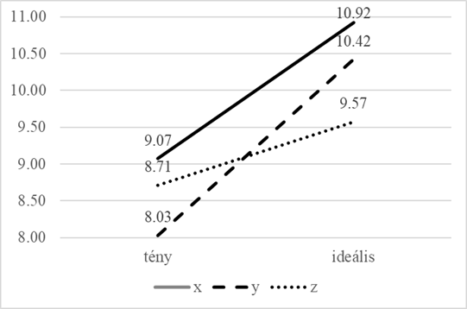
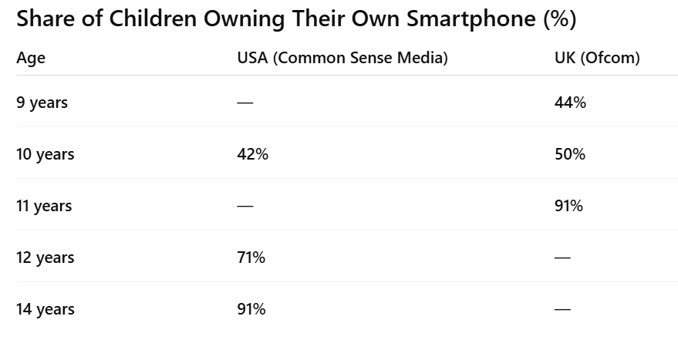
What We Can Do?
Families
Delay smartphones and social media - OK. But when?
Confirmed generational differences among parents: parents from Generation Y give smartphones to their children significantly earlier than those from Generation X, although both groups see the "ideal age" similarly.
Current reality
Ideal

Slide 16
What We Can Do?
Shools
„I found that teachers who feel less prepared need more support in internet safety education than those who feel more confident.”
Teachers need stronger knowledge in cybersecurity, and they should be supported with practical training and tools.
Schools Phone-free classrooms or protected times
Teacher–parent cooperation
Source: “DigiÓ” Research Project, Óbuda University (2022–2025, Budapest, Hungary). Research lead: Lajos Záhonyi

Slide 17
What We Can Do?
Healthier Childhood
(Jonathan Haidt - The Anxious Generation 2024)
No smartphones before age 14 (keep children on basic phones during primary / lower secondary school)
No social media before age 16(delay online identity formation and comparison culture)
Phone-free schools (school should support attention, learning, and real social interaction)
Much more free, unsupervised play (children need real-world autonomy and problem-solving experiences)
AI companions only after age 18 (avoid emotional dependency on artificial relationships)

Slide 18
Conclusion
1.) The DigiÓ research has shown that children’s information security is strongly influenced by parental attitudes, school environment, and teachers’ preparedness.
2.) Strengthening awareness, prevention, and cooperation between parents, schools, and the state is essential.
3.) Future work should focus on integrating digital safety education into everyday school practice.

Slide 19
Key message
Technology can support childhood - but it must not replace it.

Slide 20
Thank you for your attention!
Lajos Záhonyi
zahonyi.lajos@uni-obuda.hu

