Slide 1


<Cork|Sec 152>
GENERATIVE AI DEEPFAKES:
REAL-WORLD THREATS TO FACIAL BIOMETRIC AUTHENTICATION
Daniel Fitzmaurice MSc in Cybersecurity | MTU
| 10 February 2026
Notes:
Good evening, my name is Daniel Fitzmaurice, and today I’ll be presenting my MSc research: Generative AI Deepfakes – Real-World Threats to Facial Biometric Authentication.
This research was carried out under the supervision of Dr Oonagh O’Brien, with Dr Naumann Qureshi as second reader.
What I’m going to do today is walk you through why I chose this topic, the research questions and objectives, the methods I used to test deepfake attacks, the results I found, and finally the implications — both for cybersecurity practice and for policy.
By the end, I hope to show you that deepfakes are not just a curiosity or a social media gimmick, but a real, technical threat to the biometric systems we use to protect both personal and enterprise accounts.

Slide 2

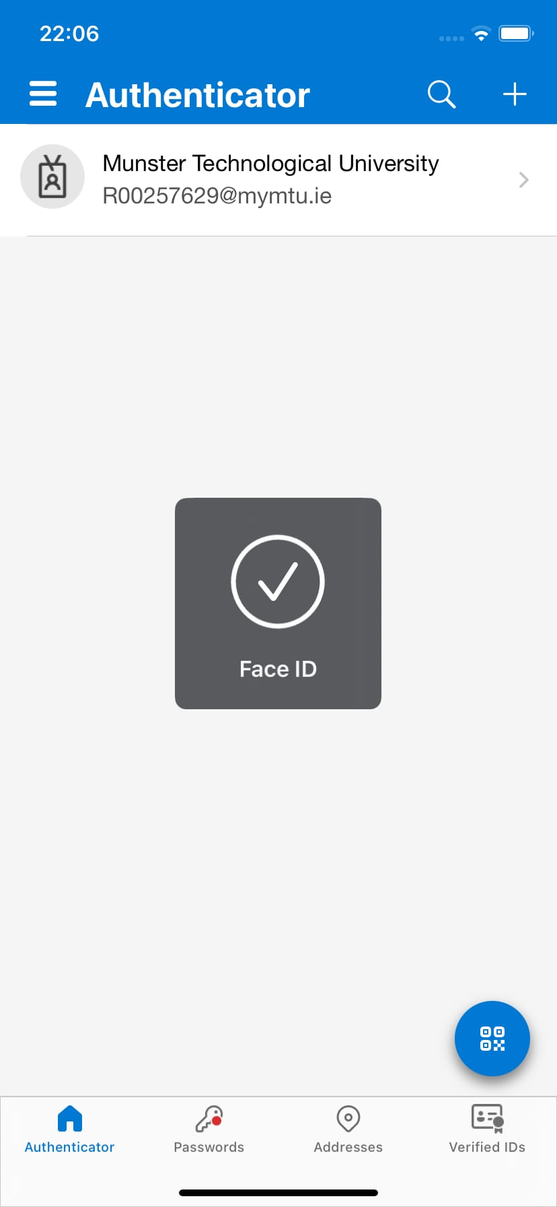
Motivation & Research Problem
Fraud cases - $25m Hong Kong scam, Irish deepfake
Biometric risk - Face ID, Face Unlock, Windows Hello, Authenticator
Research gap - CPU-only attacker realism
Notes:
The motivation for this project came from two directions: real-world fraud cases, and gaps in the academic literature.
On the fraud side, one case really stood out — in Hong Kong in 2023, a finance worker was tricked into transferring the equivalent of 25 million US dollars after attending a video call with what looked like their CFO and other colleagues. In reality, everyone on that call was a deepfake. It’s one of the largest corporate losses to deepfake technology ever reported, and it highlights how attackers are now weaponising generative AI for high-value crime.
Closer to home, here in Ireland we’ve also seen manipulated media — for example, deepfakes of political figures being circulated online and AI-generated voices used in scam calls. These may not all be as sophisticated as the Hong Kong case, but they show the direction of travel: this technology is spreading fast and becoming more accessible.
Now, why is that relevant to biometrics? Because we increasingly rely on facial recognition — whether it’s Face ID on an iPhone, Windows Hello on a laptop, or even Microsoft Authenticator, which enterprises use to protect access to Azure accounts. The problem is, if a deepfake can bypass these systems, then the ‘trusted’ biometric factor in multi-factor authentication is undermined.
And when I looked at the research, I found a gap. Most academic studies on deepfakes assume the attacker has access to powerful GPUs and cloud resources. That’s not very realistic. Not every attacker is a state actor. Many are ordinary criminals working with limited means. So the question I asked was: what if we put ourselves in the shoes of a CPU only attacker — no GPUs, just the kind of resources most people already have? Could they still generate deepfakes capable of bypassing real biometric systems?

Slide 3
Research Questions
• RQ1: How accurate are deepfakes generated with common open-source tools across OS and hardware conditions?
• RQ2: Can deepfakes bypass Apple Face ID to unlock Microsoft Authenticator and gain enterprise access?
Notes:
To tackle that problem, I broke it into two research questions.
The first was more technical: How accurate are deepfakes generated with open-source tools across different operating systems and hardware conditions? What I mean by that is: if you take the same source data and run it through DeepFaceLab, FaceSwap, or FaceFusion — across different devices and OS platforms — how do the results differ? Are the deepfakes realistic enough to potentially fool a biometric system?
The second question was security-driven: Can deepfakes actually bypass Apple Face ID to unlock Microsoft Authenticator, and by extension, compromise access to Azure enterprise accounts? This is the critical scenario — because if an attacker can get through Face ID on an iPhone, they can potentially get into the linked Authenticator app, and from there into enterprise logins. That turns what looks like a personal device attack into an enterprise security breach.
So, in short: the first question was about the quality and performance of deepfakes in practice, and the second was about whether they could be weaponised to break real-world security systems.

Slide 4
Research Objectives
Assess the ability of deepfakes to bypass facial biometric systems
Evaluate state-of-the-art detection tools
Identify weaknesses in current defences
Propose recommendations for resilience
Notes:
To answer those two research questions, I set myself four key objectives.
The first was to evaluate whether deepfakes could bypass live biometric systems in practice. Not just in theory, not just on benchmark datasets, but actually testing against devices like iPhones, Samsung phones, and Windows Hello laptops.
The second was to test the effectiveness of state-of-the-art detection tools — specifically Attestiv and Deepware AI. These tools are often marketed as solutions for enterprises who are worried about deepfakes, but there’s very little independent research on how reliable they really are when faced with realistic attacks.
The third objective was to identify where the weaknesses are. Is it the deepfake tools themselves that make the difference? Is it the device hardware, or the environmental conditions like lighting or playback quality? Understanding that helps us know where defences should be focused.
Finally, I wanted to make practical recommendations — for both technology and policy. If deepfakes are already able to bypass biometrics in certain scenarios, then how do we make authentication systems more resilient? And what kind of policy or regulatory support is needed to keep up with these emerging threats?

Slide 5
Literature Review (Background)
Generative AI methods - GANs, diffusion models
Deepfake attack types - face swaps, lip-syncing, identity synthesis
Defences - detection models, multi-factor approaches
Gap - studies often lab-based, not real-world deployment
Notes:
Before running my own experiments, I looked at what the literature already said about deepfakes and biometric security.
On the generation side, deepfakes are usually produced using generative adversarial networks, or GANs, and more recently diffusion models. These techniques have massively improved realism — we’ve gone from blurry, uncanny outputs a few years ago to near photorealistic faces today.
In terms of attack methods, the literature identifies a range of approaches — face swaps, lip syncing, identity transfer, and even fully synthetic characters. Some of these are more convincing than others, but all present challenges for detection.
On the defensive side, there are a lot of proposed detection methods: analysing spatial artefacts in the image, looking for temporal inconsistencies across frames, or using frequency analysis to spot subtle anomalies. More recently, biometric-based detectors that analyse eye movements or micro-expressions have also been tested.
But here’s the gap: most of these studies are lab-based, trained on datasets like FaceForensics, and they rarely test against actual deployed systems like iPhone Face ID or Microsoft Authenticator. That means they don’t necessarily reflect what happens in the real world when a deepfake is played back to a biometric sensor. That’s where my research comes in — moving from lab datasets to real-world systems.

Slide 6
Contributions
First CPU-only, cross-tool, cross-OS benchmark (DeepFaceLab, FaceSwap, FaceFusion)
Private biometric dataset (ethical, GDPR-compliant)
First MFA bypass demonstration: iPhone Face ID → Microsoft Authenticator → Azure
Policy-relevant insights: regulatory + enterprise security gaps
Notes:
My research makes four main contributions.
First, I carried out a cross-tool, cross-environment analysis using three open-source deepfake generators: DeepFaceLab, FaceSwap, and FaceFusion. Each of these tools has different strengths and weaknesses, and by testing them across devices and operating systems, I was able to compare their effectiveness in practice.
Second, I built and used a private biometric dataset — in other words, I only used my own facial data to train the models. That kept the research ethical and GDPR-compliant, while still producing realistic results.
Third, and probably the most significant, I demonstrated an end-to-end MFA bypass scenario. That means using a deepfake to spoof Apple Face ID, which then unlocked the Microsoft Authenticator app, and in turn provided access to Azure enterprise accounts. This shows how a personal biometric weakness can cascade into an enterprise-level compromise.
And finally, I modelled the attack under CPU-only conditions. This is important because most research assumes the attacker has powerful GPUs. I wanted to test a more realistic attacker — someone using just the resources available on a standard PC or laptop. And as I’ll show later, even under those constraints, deepfakes were still able to bypass biometrics in some scenarios.

Slide 7
Threat Model
• Adversary goal: unauthorised access using synthetic media
• Attack vector: video injection, replay, or pre-generated deepfakes
• Target: systems relying on single-factor facial authentication
Attacker
Deepfake Tool
Target device (Face ID)
Azure
Notes:
To make the research clear and reproducible, I defined a simple threat model.
The attacker’s goal is straightforward: unauthorised access to a device or account using synthetic media.
The main attack vector I considered was video injection or replay attacks — in other words, playing back a pre-generated deepfake clip to the target device’s camera.
And the targets were systems that rely on single-factor facial authentication — iPhone Face ID, Android Face Unlock, and Windows Hello. These are widely used both by individuals and in enterprise contexts.
Visually, you can think of the chain as: Attacker → Deepfake Tool → Target Device → Authenticator which is Azure. If the attacker succeeds at the Face ID stage, they potentially gain access to everything linked to that authenticator app.
This threat model kept the research focused and realistic, and it also illustrates why this problem matters beyond just one device. The risk cascades from a single bypass into enterprise-level compromise.

Slide 8
Methodology / Design
Data collection (own biometrics)
Tool selection (DFL, FaceSwap, FaceFusion)
Deepfake generation & training
Spoof attempts (iPhone, Samsung, Windows Hello)
Evaluation (detection tools + manual review)
Notes:
My methodology followed a fairly structured process.
First, I started with data collection. Since I wanted to stay ethical and GDPR-compliant, I only used my own facial biometrics. That meant capturing video samples of my face in controlled conditions — different lighting and angles — so that I could train the deepfake models.
Second, I selected three open-source deepfake tools: DeepFaceLab, FaceSwap, and FaceFusion. These were chosen because they’re accessible to the average attacker, each has active developer communities, and each represents a different balance of usability, realism, and performance.
Third, I trained and generated deepfake clips. A key design choice here was to keep everything CPU-only — no GPUs, no cloud servers. The idea was to replicate what a determined but resource-limited attacker could actually do at home.
Fourth, I tested these clips against live biometric systems. I used an iPhone 11 with Face ID, several Samsung models with Android Face Unlock, and Windows Hello on a laptop. For the enterprise chain, I linked the iPhone’s Face ID to Microsoft Authenticator and Azure.
Finally, I evaluated the results in three ways: whether the spoof attempt succeeded, whether detection tools like Attestiv and Deepware flagged it, and my own qualitative review of artefacts and realism.

Slide 9
Implementation
Generated 10s clips simulating logins
CPU-only training for realism (no GPUs, attacker realism)
Artefacts: blending, scaling issues, frame instability
Data stored locally + encrypted (GDPR compliant)
Notes:
Once the design was set, I moved on to the implementation.
I generated 10-second video clips simulating login attempts. These were long enough to trigger Face ID or Face Unlock, but short enough to train efficiently on a CPU.
All training was carried out on a CPU-only machine. This was deliberately restrictive, but it allowed me to answer the question: can an attacker with just a normal laptop produce a convincing deepfake?
As I generated clips, I noticed several artefacts — things like poor blending at the edges of the face, mismatched scaling where the fake face didn’t perfectly align, or frame instability that caused flickering. These artefacts varied by tool. DeepFaceLab, for example, produced higher fidelity but with long training times, while FaceFusion produced rougher visuals but much faster.
Finally, I made sure all data handling was ethical. Everything was stored locally, encrypted, and never uploaded to the cloud. This was important not just for compliance, but also because attackers in the wild may prefer local methods to avoid detection.

Slide 10
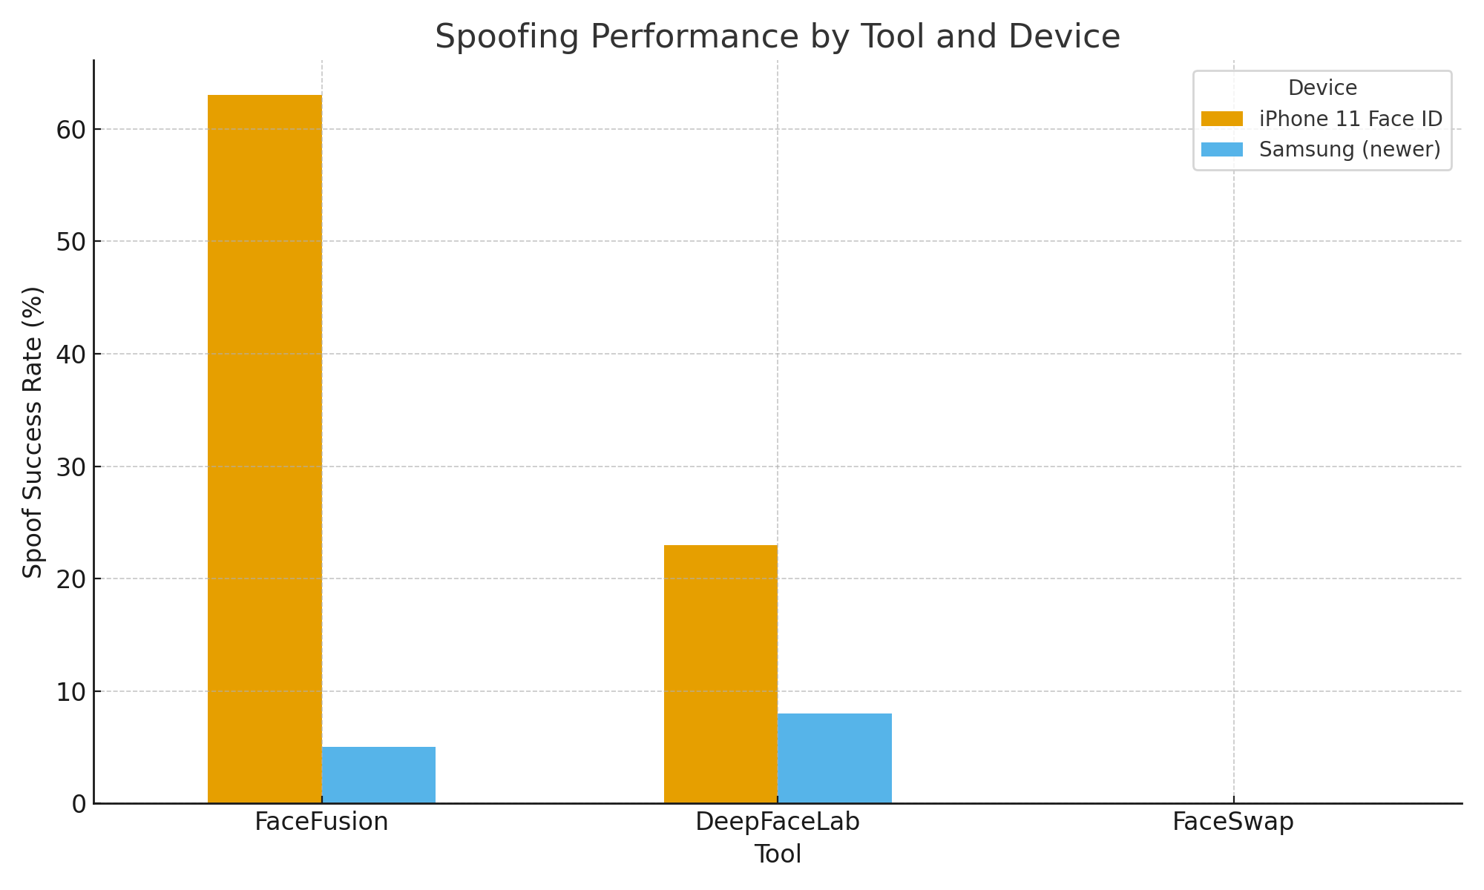
Results: Spoofing Performance
• FaceFusion: 63% success (iPhone 11 Face ID)
• DeepFaceLab: 23% success, weaker on newer Samsung devices
• FaceSwap: 0% spoof success
• Newer devices resisted >95% of attempts
Notes:
The most striking finding was that FaceFusion, even though it produced the least polished visuals, had the highest spoof success rate — up to 63% on iPhone 11 Face ID.
DeepFaceLab was slower to train but moderately successful, with around 23% success on the same device.
FaceSwap was the surprise — it actually produced some of the cleanest visuals but achieved 0% spoof success across all tests.
This shows that what looks good to the human eye doesn’t necessarily fool biometric systems, and vice versa.
I also tested on newer Samsung devices like the S21 FE and S23 Ultra, and here success rates dropped to near zero. These newer devices integrate multi-sensor hardware and liveness detection, which made them much more resilient.
The key takeaway is that older devices remain vulnerable, while newer devices are far more resistant.

Slide 11
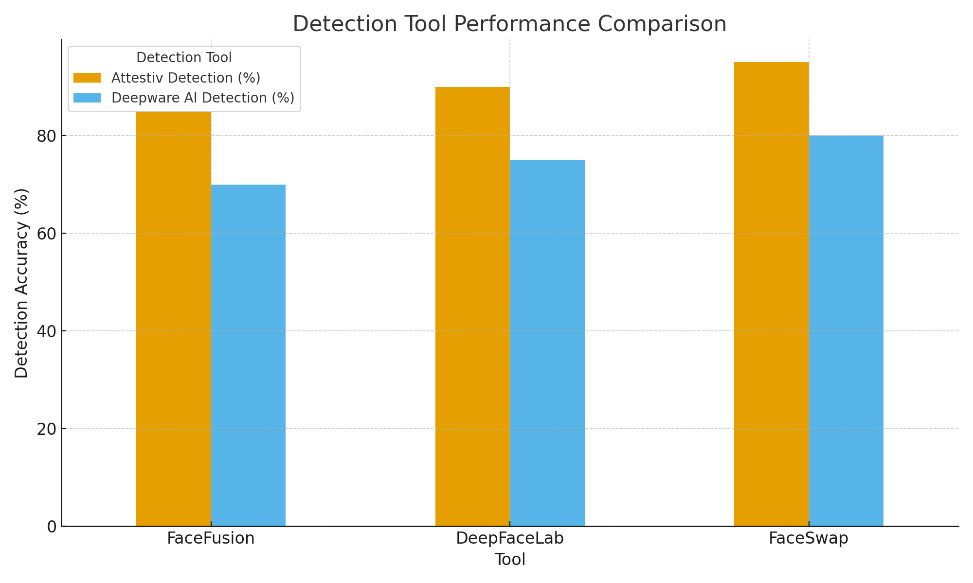
Results: Detection & Analysis
• Detection tools gave inconsistent results
• Realism ≠ guaranteed bypass (environmental factors)
• Same deepfake fooled iPhone but failed on Samsung
Notes:
I also tested detection tools.
The main finding was that detection is inconsistent. Sometimes Attestiv or Deepware AI caught the deepfakes, but other times they let them through.
Interestingly, visual realism didn’t always equal success. Some very polished fakes were still blocked, while some poor-quality ones slipped through. This suggests biometric systems and detectors are sensitive to different signals.
Device differences also mattered. The exact same deepfake clip could spoof an iPhone but fail against a Samsung device. That underlines how much hardware variation affects outcomes.
The bottom line is: detection tools alone are unreliable. They miss cases, they produce false negatives, and they’re not consistent enough to serve as the only line of defence.

Slide 12
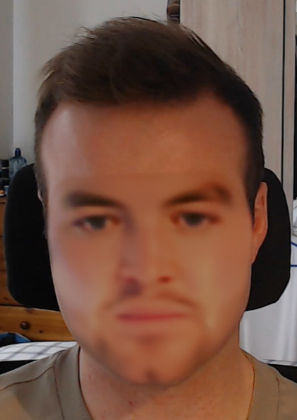
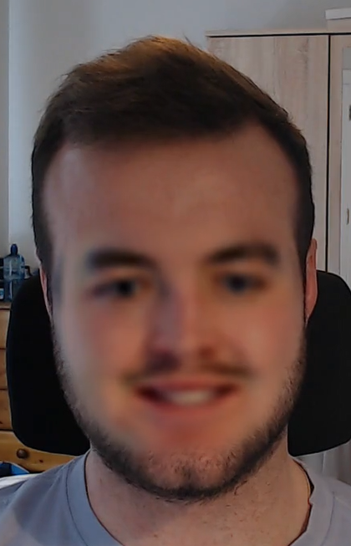

Results: Example Deepfakes
• Generated outputs tested against real devices
• Some fooled facial biometrics, others failed
DeepFaceLab
FaceSwap
FaceFusion
Notes:
Here are some examples of the deepfakes I generated.
On the left you can see a DeepFaceLab output — fairly realistic, but with blending artefacts around the jawline.
In the middle, FaceSwap looks clean visually, but again, remember this had zero spoof success in practice.
On the right, FaceFusion looks less polished, with some distortion, but ironically it was the most successful at spoofing Face ID.
This illustrates the important point that aesthetic realism doesn’t always predict security risk. What fools us as humans isn’t necessarily what fools an algorithm, and vice versa.

Slide 13
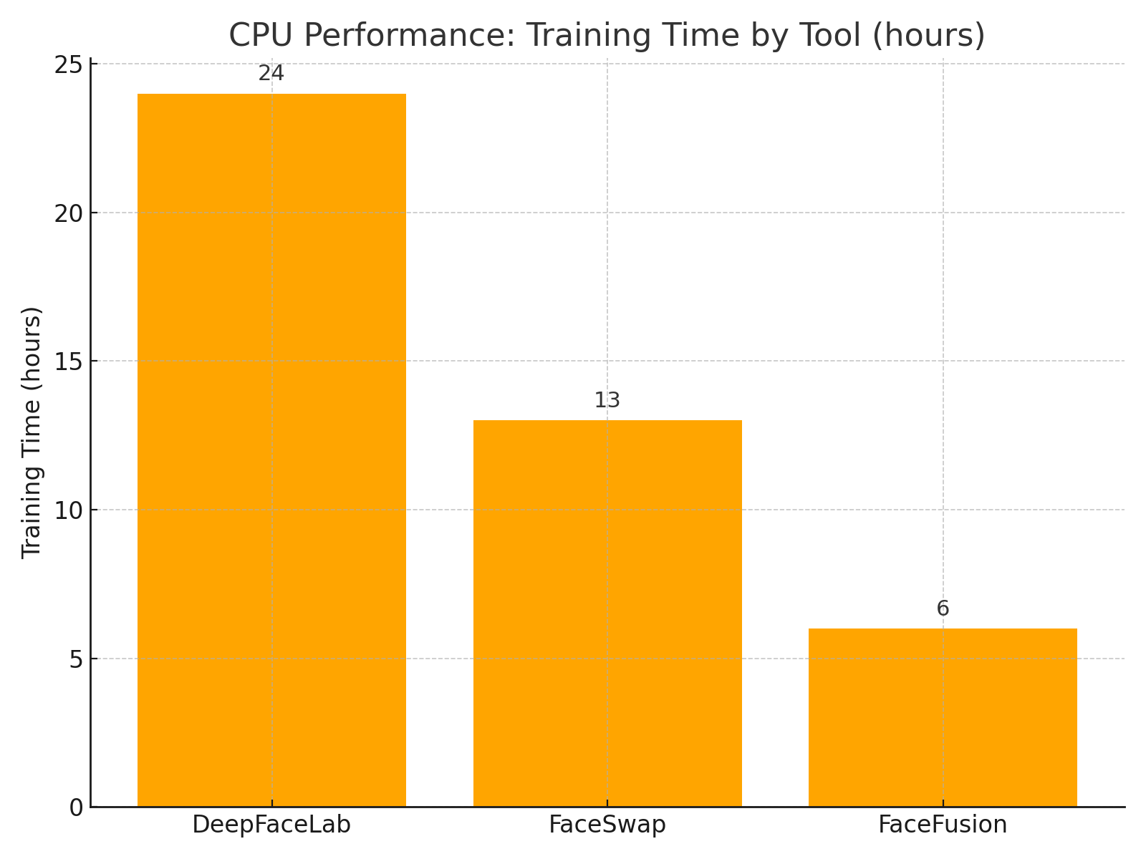
Results: CPU Performance
• CPU-only attacker simulation → realistic constraint
• FaceFusion fastest; DeepFaceLab slowest
Notes:
Another key finding was performance under CPU-only conditions.
FaceFusion was by far the fastest, producing usable deepfakes in around 6 hours of training.
FaceSwap was in the middle range.
DeepFaceLab was the slowest, often taking over 24 hours to produce one model. So there’s a trade-off: DeepFaceLab gives higher visual fidelity but at a heavy time cost, while FaceFusion is faster and actually more effective in spoofing.
The key takeaway is that CPU-only attackers are still viable. Even without a GPU, an attacker could realistically train deepfakes that bypass certain biometric systems.

Slide 14
Discussion & Implications
• CPU-only attacks feasible under certain conditions
• Enterprise MFA chains vulnerable → adaptive defences needed
• Detection tools inconsistent → multi-engine + context-aware required
• Policy gap: EU/Irish regulation lags behind tech risk
Notes:
So, what does all this mean in practice?
First, we’ve shown that CPU-only attacks are feasible under certain conditions. That challenges the assumption that deepfake attacks always require high-end GPUs or cloud infrastructure.
Second, we’ve demonstrated that enterprise MFA chains can be vulnerable. If Face ID can be spoofed, that doesn’t just give access to one phone. It can unlock Authenticator apps, and from there, enterprise logins like Azure. That means the risk cascades from the individual level into the enterprise level.
Third, we’ve seen that detection tools are not reliable enough. Neither Attestiv nor Deepware AI consistently caught the fakes. That means detection alone is not a sufficient safeguard.
Finally, there’s a clear policy gap. The pace of generative AI is far ahead of EU and Irish regulation. The European AI Act is moving in the right direction, but it hasn’t yet addressed the practical risks of biometric spoofing with deepfakes. That leaves enterprises and individuals exposed.
The broader implication is that security has to evolve beyond single-factor biometrics. We need layered defences: multi-factor authentication that doesn’t just rely on a face scan, detection tools combined with hardware checks, and stronger policy frameworks to guide deployment.

Slide 15
Conclusion & Future Work
• Contributions: empirical, ethical CPU-only attack study
• Findings: vulnerabilities exist; outcomes vary by environment + device
• Implications: security must move beyond single-factor biometrics
• Future work:
Larger more diverse datasets
Include GPU & commercial tools
Test next-gen variants (chimeric, impossible faces)
Notes:
To wrap up, my research makes four main contributions.
First, it provides one of the first empirical, ethical studies of deepfake attacks under CPU only conditions, showing what’s realistically possible for a low-resource attacker.
Second, the findings confirm that vulnerabilities exist, but the outcomes vary by device and environment. Older devices like the iPhone 11 are much more at risk, while newer devices with multi-sensor security are far more resilient.
Third, the implications are clear: single-factor biometrics are not enough. If deepfakes can bypass Face ID even occasionally, that means additional layers of security are necessary.
And finally, I’ve identified several directions for future work:
Expanding the dataset to include more faces and demographics, since my study focused only on my own biometrics.
Benchmarking GPU-based and commercial deepfake tools, to see how much stronger they are compared to open-source, CPU-only methods.
And testing next-generation deepfakes, like chimeric faces or “impossible faces” that don’t exist in reality, which may pose even greater challenges to biometrics.
So, in short, my work shows that deepfakes are a genuine, emerging threat to biometric systems, but it also points to the steps we need to take to strengthen security.

Slide 16

THANK YOU / Q&A
GENERATIVE AI DEEPFAKES: REAL-WORLD THREATS TO FACIAL BIOMETRIC AUTHENTICATION
Notes:
Key takeaway: Deepfakes pose a realistic but inconsistent threat to biometrics; layered security is essential
And that brings me to the end of my presentation.
Thank you very much for your attention and for the opportunity to share this work.
I’d now be happy to take any questions you may have.

