Slide 1

Thesis Proposal:
Anti-Piracy measures on Android, a defense in depth approach to combat app piracy.
Gerard Morris
January 07, 2013
Notes:
Introduce myself here.
Gerard Morris. Associate Software Engineer for McAfee. MSc in Networking and Security in CIT. Masters in Games Development from Abertay University Dundee. BSc Hons in Software Engineering in Carlow IT.

Slide 2

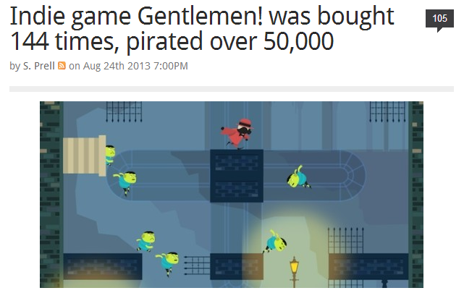
Gentlemen!
“Ok! I think I’ll call time on this. Official Android sales numbers for Gentlemen! after three days: 8 copies sold. 2,462 copies pirated.”
— Lucky Frame (@lucky_frame)
http://www.vg247.com/2013/08/22/gentlemen-pirated-about-50000-times-on-android/
http://www.joystiq.com/2013/08/24/indie-game-gentlemen-was-bought-144-times-pirated-over-50-000/
http://www.gamasutra.com/blogs/YannSeznec/20130820/198453/Gentlemen_Or_how_our_most_successful_game_is_also_our_least_profitable.php
Notes:
Introduce Gentlemen! One of my numerous case studies.

Slide 3
Agenda
To be done once I have everything filled out ..
Get involved
Notes:
Talk about the Agenda. Encourage people to email me if they think of interesting papers, want to volunteer for an interview as I will need candidates, or if they even think of good case studies or ways to combat APK reversal and what not.

Slide 4
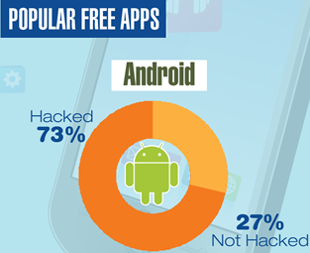
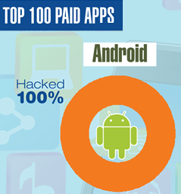
Piracy Rates on Android
Based upon Arxan 2013 report.
In most cases, there are free pirated versions available now on torrent sites.
Notes:
Based upon Arxan reports.

Slide 5
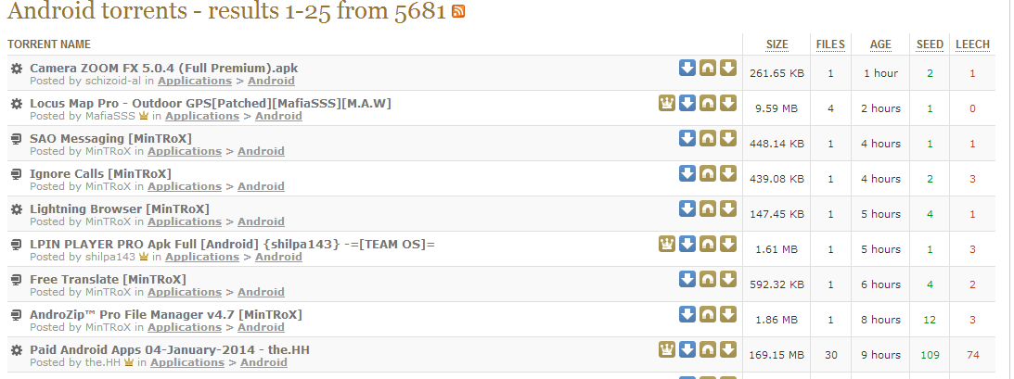
Piracy Search Results
Piratebay will not show more than 100 pages of results and has no exact number of results size.

Slide 6
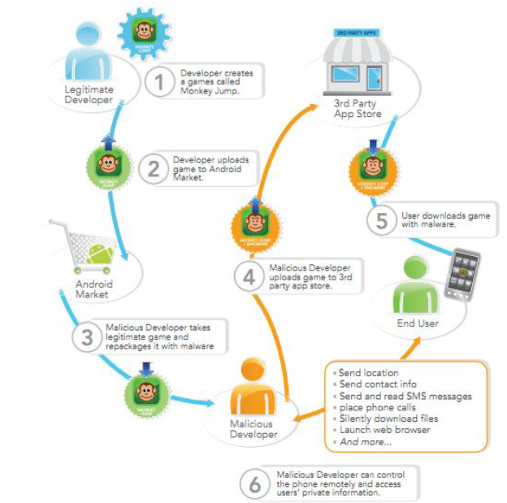
Problem Description
Notes:
Talk through the steps in the image ..
My work is meant to take place at step 3.

Slide 7
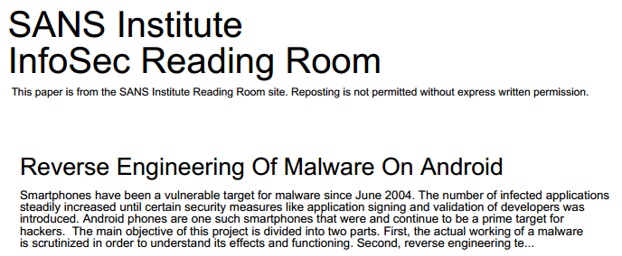

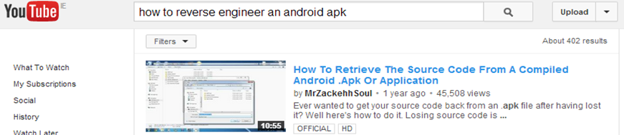
Reverse Engineering an APK
Notes:
Learning about it will use a mixture of these and some of the references found on the printed IEEE rough introduction draft. If you know any yourself, then do please share.

Slide 8
Thesis Areas
Some of the areas of this thesis include:
Piracy across various medium.
Reverse Engineering of Android APKs.
Securing Android apps.
Code obfuscation.
Digital Signatures.
Signature Verification.
Proper Licencing.
Etc.
Notes:
These are some of the areas this thesis aims to go over. Explore other mediums to see what can be learned from them.

Slide 9
Background Research
Geinimi
DroidDream
First Android malware to display botnet like behaviour.
Ability to receive commands from a remote server and allow remote control by the server owner.
Repackaged with versions of legitimate applications, primarily games such as Monkey Jump 2.
Distributed in third-party Chinese Android app markets.
Found in more than 50 applications available in the official Android Market
Lead to:
Removal of all the known malicious applications
Ban the developer accounts
Creation of the Android Market Security Tool to remove malicious application
Symantec reported the discovery of a maliciously repacked version of this tool just a few days later.
Still present to this day on some third party app stores.
Notes:
All the information is on the slide

Slide 10
Sample Trojaned Android Games
Greemlins Holydays
Road of the Pharaoh
Greemlins Holydays for Android by Tolenica Games has been found to contain the BadNews malware. The BadNews family of malware is designed to look like a standard advertising network SDK and can be found in a variety of applications. Once installed into an application, it has the ability to spoof news messages, prompt users to install arbitrary applications, send sensitive information to a remote server, or push additional malware to the device. In this case, the software was using AlphaSMS malware to send premium-rate SMS messages.
The Road of the Pharaoh Application for Android has trojaned copies available for download on some app markets. These trojans will allow an attacker to send premium SMS messages
Notes:
All the information is on the slide

Slide 11
Sample Trojaned Android Apps
Walk and Text
The Holy F***ing Bible
The version 1.3.6 of Walk and Text allows the user to type in the device while walking. However, the malicious version of Walk and Text (1.3.7) is the first mobile phone threat discovered in the wild that attempts to discipline users who download files illegally from unauthorized sites. It does so by sending SMS to all contacts on the list. That SMS reads “Hey, just downloaded a pirated App off the Internet, Walk and Text for Android. Im stupid and cheap, it costed only 1 buck. Don’t steal like I did!”. The application also gathers personal information from the device like the phone number and IMEI, and it will send that data to a remote server.
A pirated version of the application was discovered by Symantec with the main purpose of sending “the end of the world” style spam to all the contacts stored in the device when the date in the device was May 21 2011. The messages were like:
• Cannot talk right now, the world is about to end
• Jebus is way over due for a come back
• Is the Raptures, praise Jesus
• Prepare to meet thy maker, make sure to hedge your bet juss in case the Muslims were right
• Just saw the four horsemen of the apocalypse and man did they have the worst case of road rage
Notes:
All the information is on the slide

Slide 12
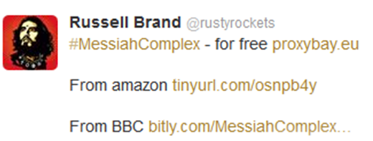
Alternate Options – Encourage Piracy
Minecraft
“Just pirate it. If you still like it when you can afford it in the future, buy it then. Also don't forget to feel bad. ;)”
Russell Brand
As can be seen from the Tweet below, Brand not only linked to The Pirate Bay but also to a proxy site. This link enabled UK Internet users to bypass the blocks put in place by their ISPs following High Court action by the music and movie industries against The Pirate Bay.
Notes:
All the information is on the slide

Slide 13
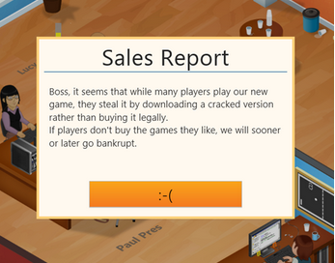
Alternate Options – Pre-empt piracy
Game Dev Tycoon
Pre-empting the game's eventual appearance on file-sharing sites, Patrick and Daniel Klug uploaded their own cracked copy of the full game. But within the code lay a few extra lines. Anyone playing a cracked copy would unwittingly fail due to piracy.

Slide 14
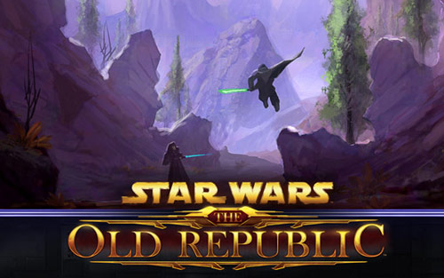



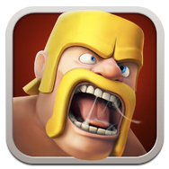
Alternate Options - Freemium
Freemium
The typical freemium or free-to-play app is a free download that uses in-app purchases or advertising to produce revenue rather than charging a flat fee for the app. The freemium model has become very popular over the past few years, especially on mobile devices and massively multiplayer online games (MMOs) like Star Wars: The Old Republic, which have both switched to a freemium model.

Slide 15
App Market Places
Google Android Market | AppsLib | NetDragon
Amazon Appstore | Handango | Appoke
SlideMe | Mikandi | AppstoreHQ
GetJar | Motorola | BlapkMarket
Soc.io | GoApk | Camangi
AndroidGear | Me and My Droid | Hyper Market
1 Mobile | Androidblip | Indiroid
Appbrain | AndroidPit | Insyde Market
Applanet | mymarket.cc | F-Droid
Appstoreconnect | Handster | Aptoide
AndroLib | Noverca | Phoload
Mobihand | Apps.ie | android.ie
ggggggg
Notes:
Some of many marketsplaces.

Slide 16
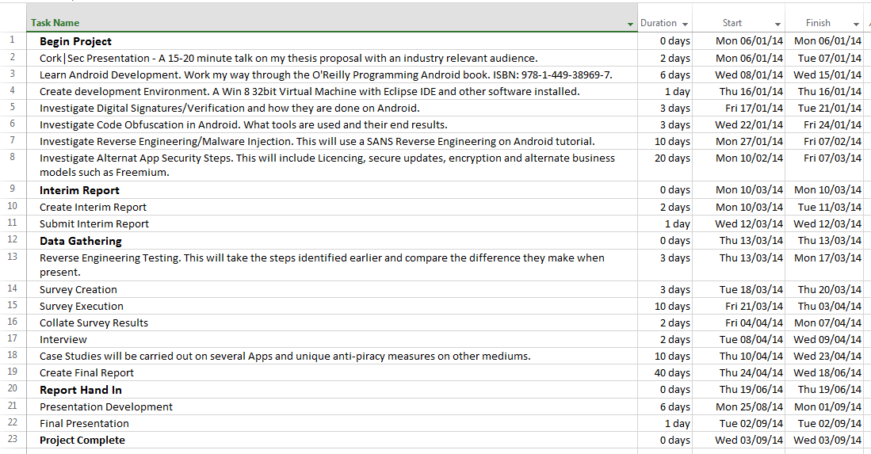
Draft Project Plan
Notes:
Not sure if this is needed, but sure why not.

Slide 17
Thesis Goals
Protect your app from piracy
Protect your legitimate app users
Notes:
In the end, there is 2 goals that this security checklist wants to do. Protect your app and your apps users.

Slide 18
Questions?

