Slide 1

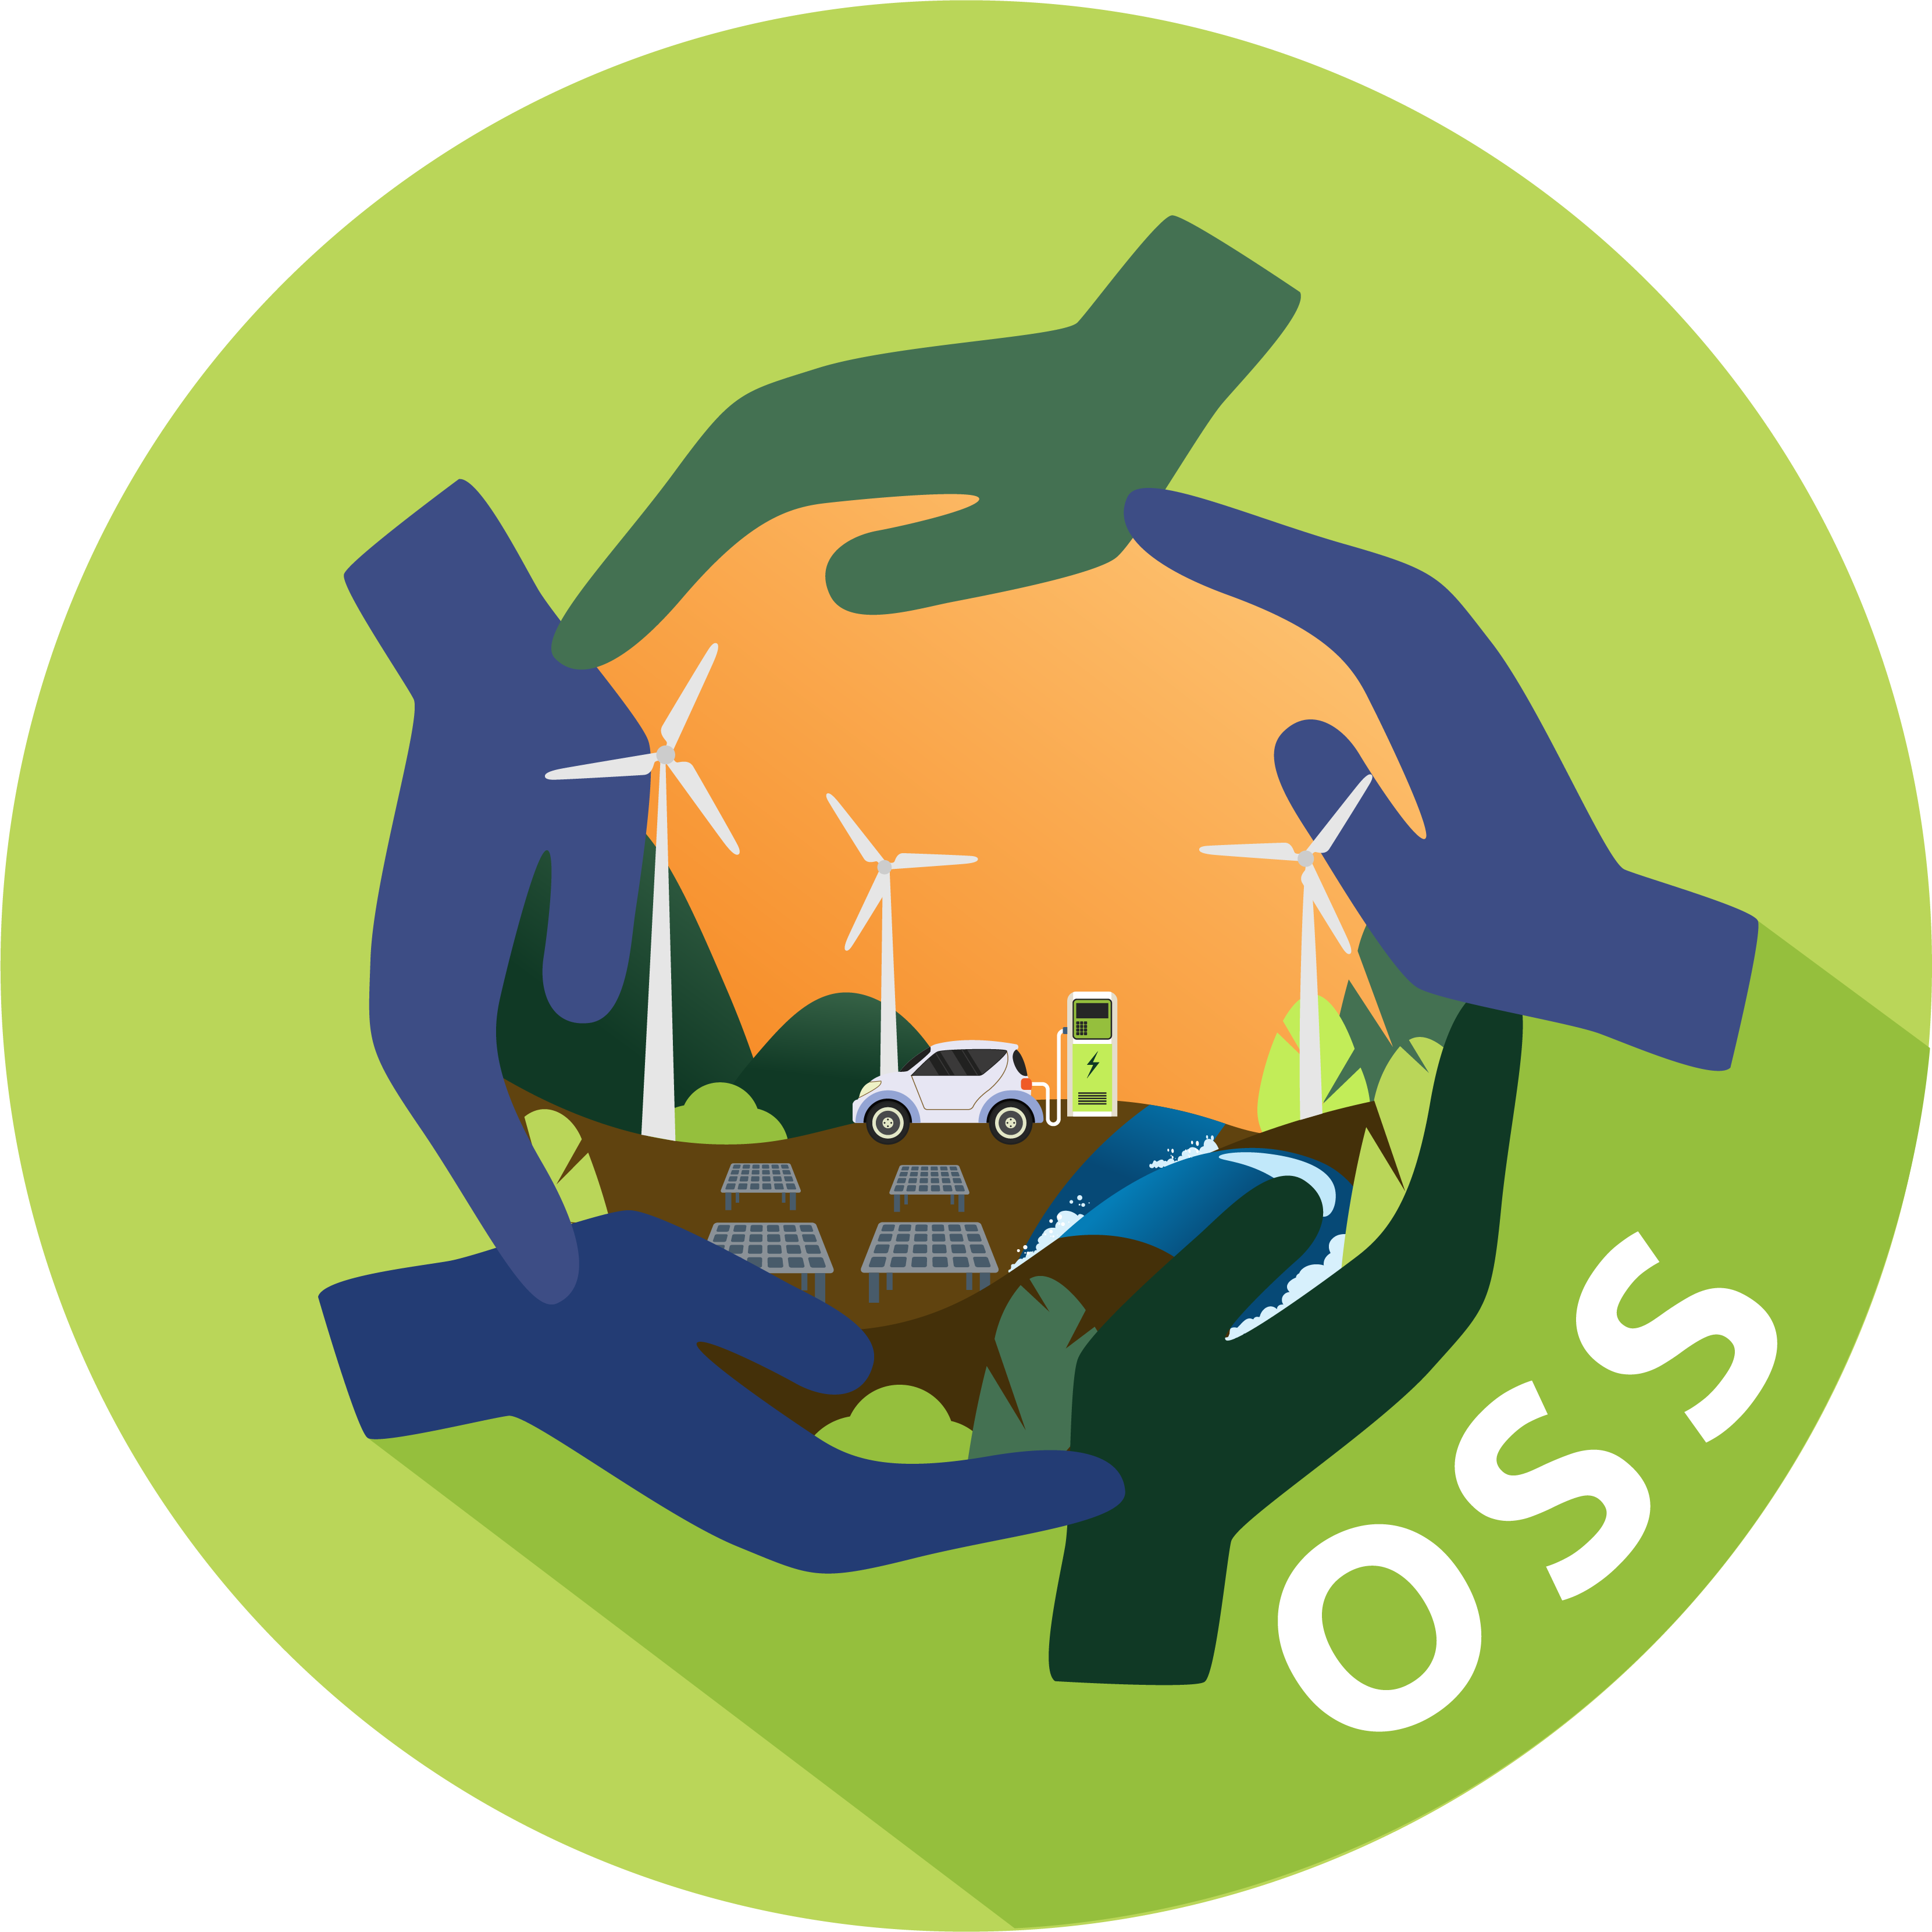
The Trials and tribulations of securing a CMS
The ins and outs of the development, testing and securing of a social media Content Management System

Slide 2
whoami
Dean Brennan
ITM Y3 Student
Chairperson of Cyber Security society
“Independent security researcher”
I like to mess with stuff

Slide 3
The story
In late March I got an email from the now head of CompSci
It was for an web/app development internship for students
It was to develop a One Stop Shop for the ECCO project
Caught my attention so I looked into it further

Slide 4
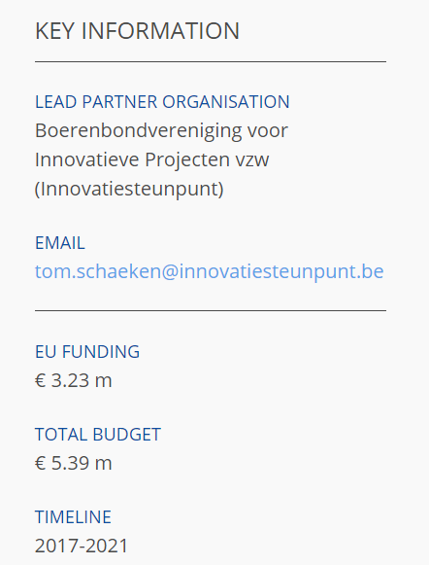
ECCO
What is the ECCO?:
Energy Community Co-Operatives
“Policymakers want to unlock Renewable Energy (RE) to meet their GHG reduction targets. Currently, they can only turn to the establishment of energy producers to realise their objectives. These traditional actors are slowly becoming interested in RE but are very reticent to share socio-economic benefits with the local communities concerned. The result is a growing public resentment (NIMBY) and a failing market for RE.”
In short, it’s a project to influence policymakers to think differently and pro-actively about community energy (renewable energy)
As a small time student… the budget was terrifying

Slide 5
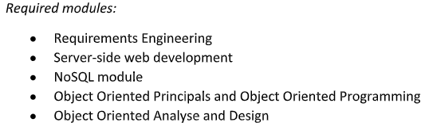

The Job Spec One Stop Shop?
What did they want?
“The One Stop Shop aims to provide all the necessary resources and information for communities who are interested in becoming an ECCO“
Seems interesting. A complete stack of server side, web and app development, security for servers
Great for a CV and a to stretch my legs as a developer… only one problem

Slide 6
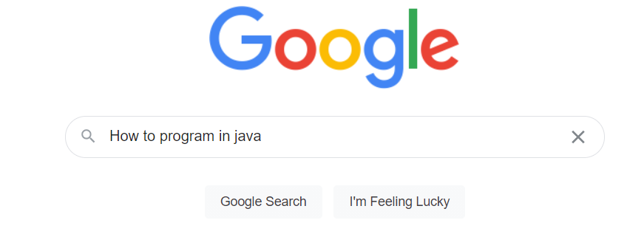

Slide 7
Story cont.
After a few months of waiting
(and attempting to learn Java)
I got an interview!
Morning of the interview I felt sick
I couldn’t change the date so I powered through
Interview went great… or so I thought
That night I was hospitalized with appendicitis and sent to the ER

Slide 8


Slide 9
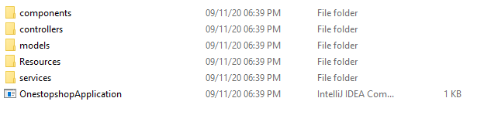
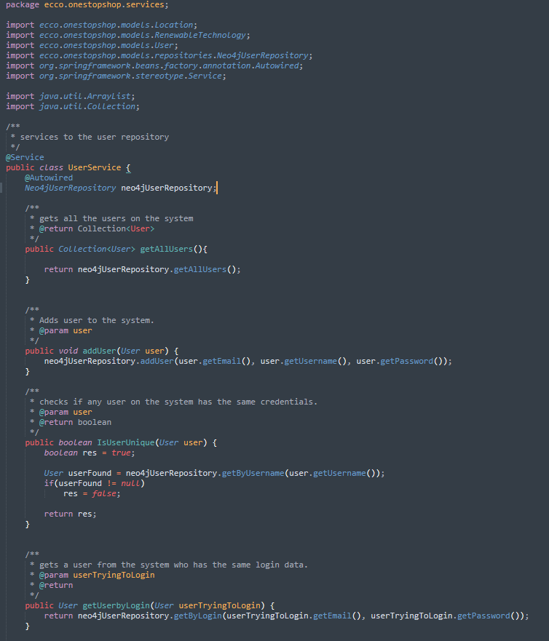
Back to the Tech
Few days out of the hospital I started with ECCO
The issue… The prototype website was written in spring
Spring is Node, but more complicated and difficult
I got permission to redo the whole site
After some extensive research over a week I decided to use a CMS

Slide 10
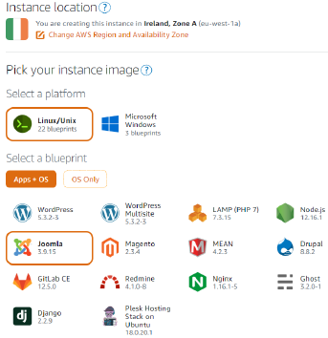
Why CMS?
Speed up development of the site
With 3rd party plugins and apps massive jumps in development can be made
Depending on the CMS, security is usually pretty decent
Depending on admin set-up and settings
There was also the option to have it run on AWS easily
This meant that security and back end would be even more secure
And with some IAM magic some issues can be negated
I have some basic experience in it. But something I wanted to know

Slide 11
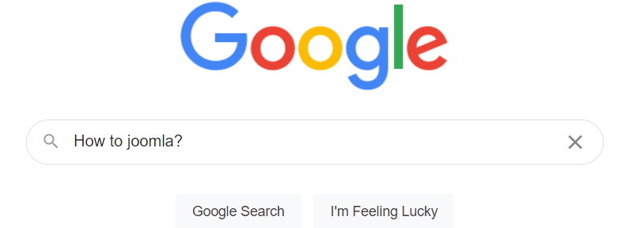
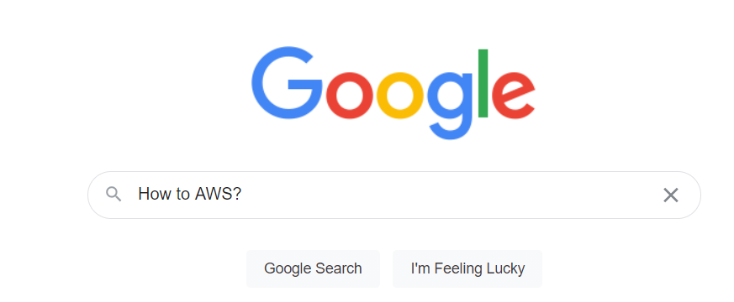
The plan
After another weeks worth of research
We came up with the plan to use Joomla! as CMS and AWS as a host
That meant only two things left to research…

Slide 12
Securing the OSS
With the new website battle plan in action, it was time to start setting up the AWS infrastructure, the OSS website and social media and secure it simultaneously
This was secured on 3 main fronts on AWS
LightSail – Platform where the CMS is hosted
IAM – Identity Access Management
Route53 – AWS DNS service
Joomla CMS was secured by part in 2 main areas
User account management, migration and configuring
URL redirection to prevent PHP injection and scraping

Slide 13
LightSail
AWS LightSail offers a virtual server platform to launch applications quickly
This meant the installation of Joomla was done, but I still had to manually configure it with security in mind
AWS being AWS it was already fairly secure with some DOS protection
The file system could only be accessed from either an internal shell using a private IP
Or through SSH with an account/IAM specific token

Slide 14

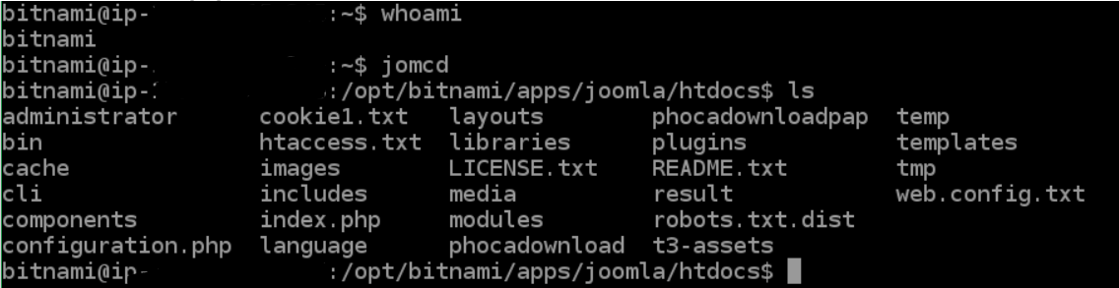
LightSail in OSS
The SSH to the client used one account (a bitnami default), since there was multiple developers at once, the idea of one account accessed through the web browser was worrying
A sudoer account was made with access to the Joomla FS, a private key was then attached for this account to an IAM group for the developers, as a sub-admin account of sorts
This meant all devs had root like access and can connect to the session easily, but the admin account still held absolute resolve over the instance
Snapshots of the instance were set to be made regularly and were manually made before big updates or big releases
These snapshots were kept for a quick launch resort in case of a system failure

Slide 15
LightSail – Not implemented
Although never fully implemented there is also the availability of locking SSH/RDP access down to a specific IP address.
Using IAM this could be locked down to a specific user group
Another feature would be using a separate database using AWS S3. This would mean that the Joomla DB and FS could be accessed, through IAM, from multiple AWS services and from any location, securely. Fully implemented the CIA triad for the database
These were set up with the availability to be implemented, but never was as it interfered with testing and development , and was slightly complex for the timeframe

Slide 16
IAM
IAM or Identity Access Management
“Is the discipline that enables the right individuals to access the right resources at the right times for the right reasons”
It is a great mix between authorization and authentication

Slide 17
IAM in AWS
There is 4 main IAM resources in AWS
Users – Tied to one account
Groups – Collection of users
Roles – Way to grant permissions to entities
Policies – Collection of permissions in JSON format

Slide 18
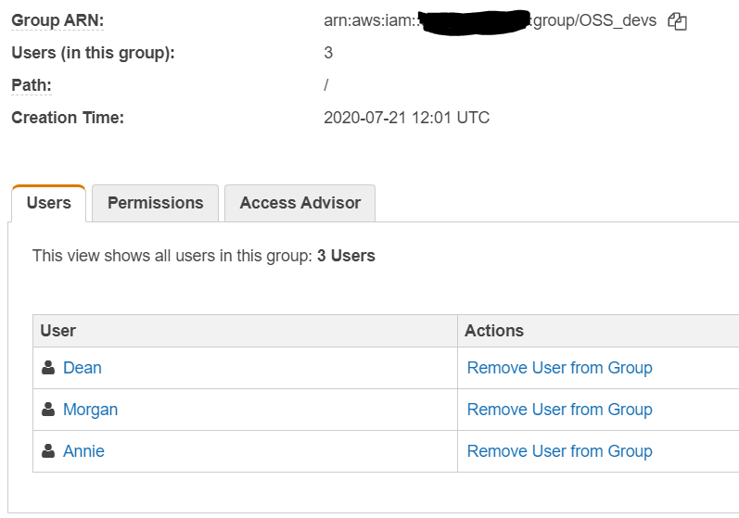
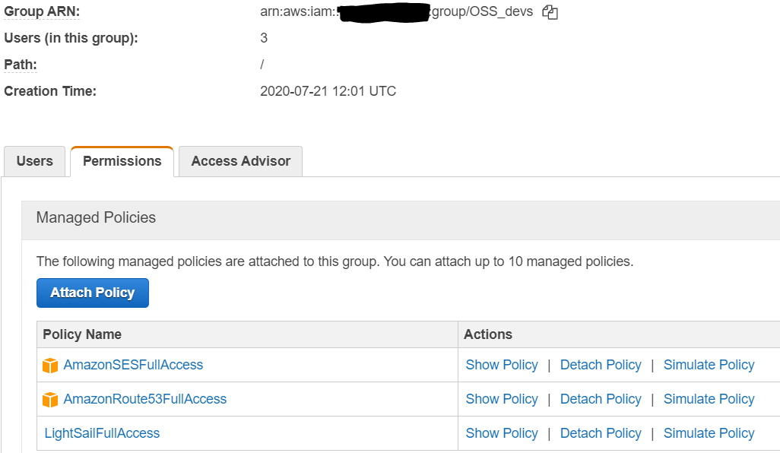
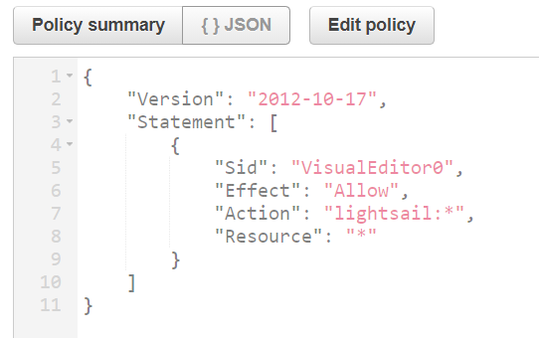
IAM in OSS
For the OSS a group was made for the OSS developers
This group then had 2 AWS managed and one customer managed policy attached
This meant all devs had access to all the necessary resources and nothing more
Here is an example of a custom policy

Slide 19
Route53
Route53 is AWS’ DNS service
Offers high-availability and scalability directly to AWS services such as LightSail
This allowed us to set up DNS for the server directly
It also allowed for some site verification and redirection

Slide 20
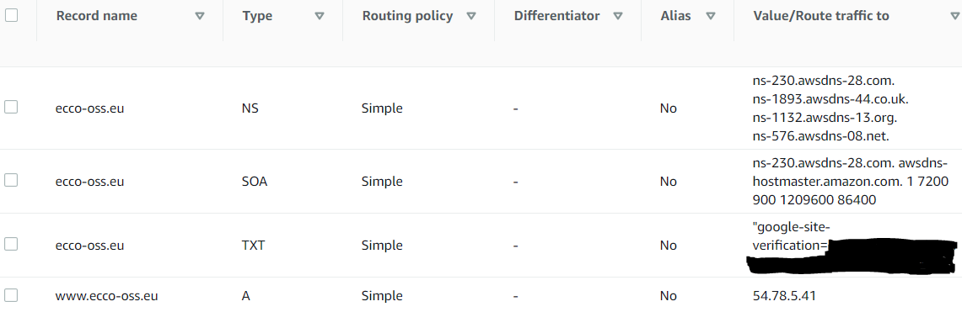
Route53 in OSS
For the OSS the routing was relatively simple
The subdomain www links statically to the website.
There is a backup version of this for ecco-oss.com
This was to both to have both roots and for high availability
With the load balancer in LightSail Route53 can be used to redirect in the case of a failure

Slide 21
Joomla – Quick development overview
The OSS was split into 3 main sections
Tools
Resources
Social Network
LinkedIn Style, connect and meet social media
Forum board

Slide 22
Joomla Security
Securing the tools and resources was going to be relatively simple.
Mainly sanitizing and escaping user input to prevent XXS
A bug was found with how Joomla deals with loading plugins via URL
When selecting a custom plugin, joomla leaks a small portion of the file structure
Someone versed in Joomla development could mess with this to force a load on a blank view/script without needing credentials
This could in theory force an injection or a RCE

Slide 23
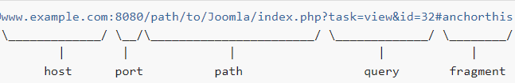
Joomla Security
To prevent this
We modified a small portion of the source code for our plugins and joomla and made it so links would redirect to /samletext
This meant that all URLs would direct to plaintext rather than an FS
Using this we also hid where the Admin portal could be accessed from

Slide 24
OSS user accounts
Since we wanted 2 social network aspects (forum and media)
This mean, along with Joomla, there was 3 user account databases linked to an account
In order to make sure it was secure from all aspects, this meant migrating, managing and configuring all 3 databases to act and access the same way
This lead to extensive rulings, and configurations in order to make sure no user data was leaked from any social endpoint

Slide 25

I went a bit crazy

Slide 26
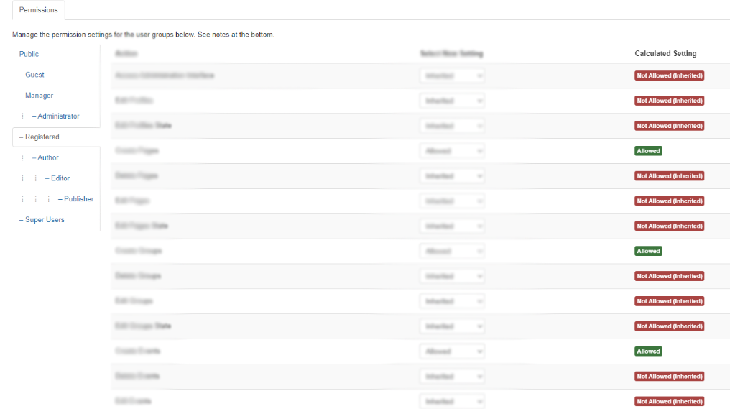
How did we fix it?
To fix it we ended up merging all the accounts, to link to the social media aspect of the site
This meant that the forum board and its account would link back to their media page
And the Joomla account, used for the projects made with the tools, also linked back to the social media
This turned the social media into the root of the accounts, and then simple privacy and security settings throughout carried across the site

Slide 27
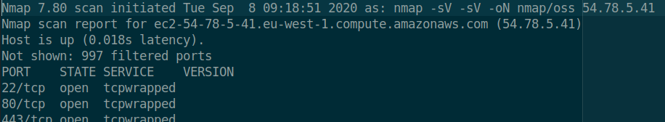
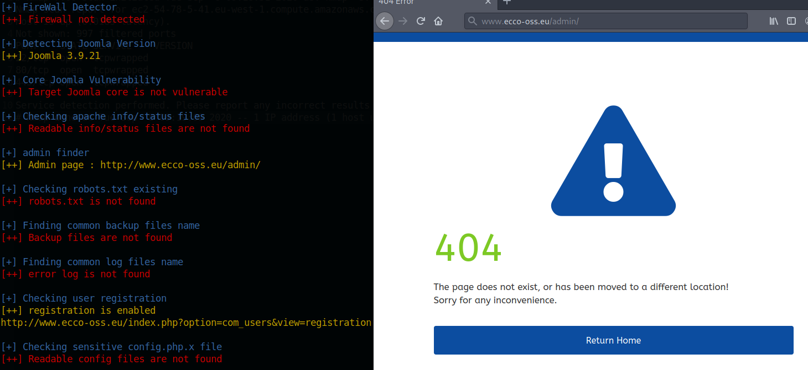
How did it stack up?
It “passed” nmap – Not giving much away
Joomscan also didn’t give much information away
Users emails and private info is hidden

Slide 28
Thanks!

