Slide 1
Adding security into the Container delivery pipeline
Matija Topfer | CorkSec, December 2020

Slide 2


Me
Matija [aka Mat]
DevOps / xOps
Multi Cloud: AWS, Azure, GCP
Cloud automation (X as a code) and CI/CD
Containers, Security, Cloud Native
Unofficial Tourism Ambassador of Croatia

Slide 3
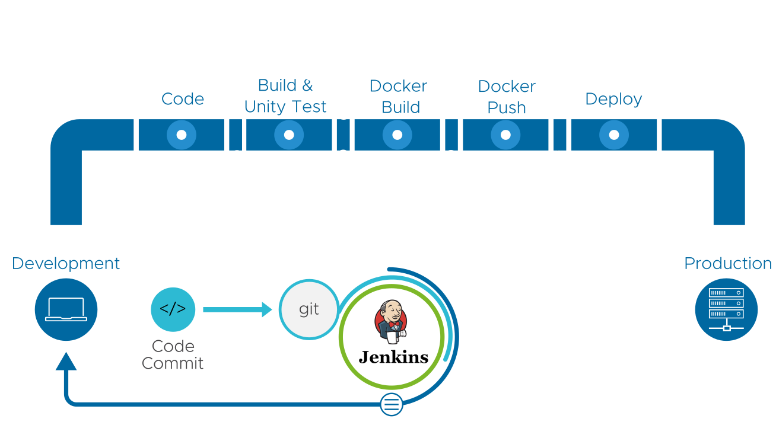
Starting Point: Container Delivery Pipeline

Slide 4
Plan: Make it secure
Research (Where to start? Requirements?)
Defining Requirements
Installing Security Testing Tools (and Infrastructure)
Embedded security into existing delivery pipeline
Note: Not a comprehensive guide into Container security or DevSecOps (more of a practical start)

Slide 5
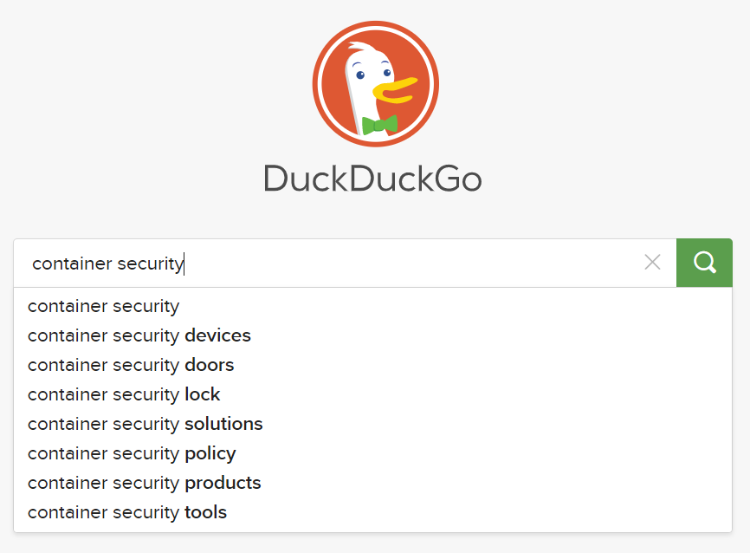
Research: Death by Information Overload

Slide 6
Market
The global container security market size is expected to grow from USD 568 million in 2019 to USD 2,178 million by 2024, at a Compound Annual Growth Rate (CAGR) of 30.9% during the forecast period [1]
[1] MarketsAndMarkets research company https://www.marketsandmarkets.com/Market-Reports/container-security-market-156059467.html#:~:text=The%20global%20container%20security%20market,30.9%25%20during%20the%20forecast%20period.
Notes:
[1] MarketsAndMarkets research company https://www.marketsandmarkets.com/Market-Reports/container-security-market-156059467.html#:~:text=The%20global%20container%20security%20market,30.9%25%20during%20the%20forecast%20period.

Slide 7
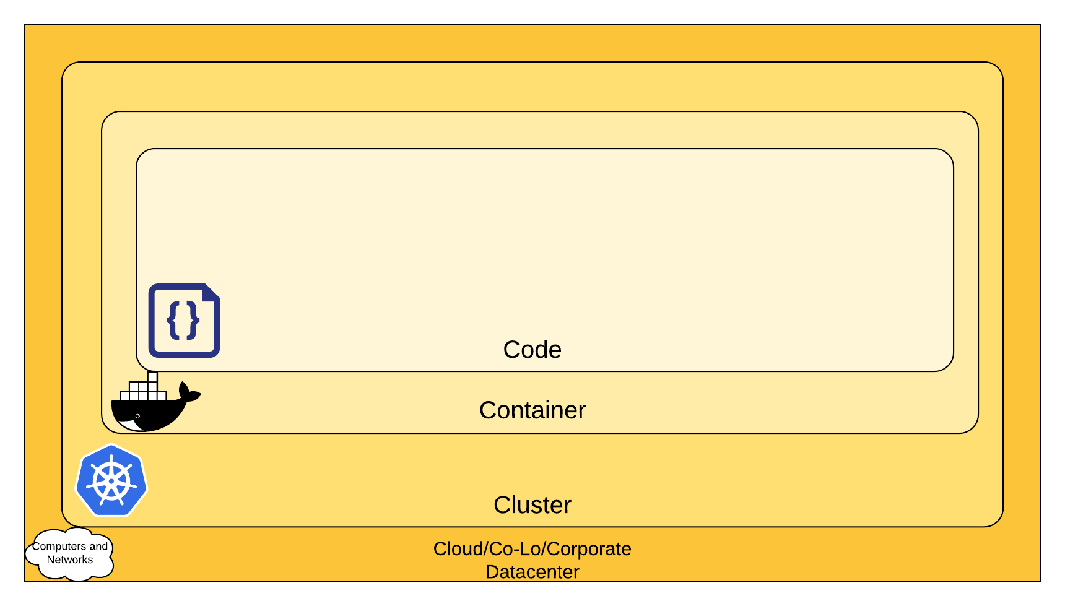
Important find: 4 C’s of Container Security
DELIVERY= CODE + IMAGE BUILD + FIRST RUN
RUNTIME = RUN, STOP, RM, RUN (MONITOR, DIAGNOSE)
Source: https://kubernetes.io/docs/concepts/security/overview/

Slide 8
Focus on the code

Slide 9
Developing secure software
Security vulnerabilities in software arise from several development
factors, generally traced to:
poor software development practices,
new modes of attacks,
misconfigurations,
and unsecured links between operations
Source: D. P. Gilliam, J. D. Powell, J. C. Kelly, and M. Bishop, “Reducing software security risk through an integrated approach," in Proceedings 26th Annual NASA Goddard Software Engineering Workshop, 2001, pp. 36-42

Slide 10
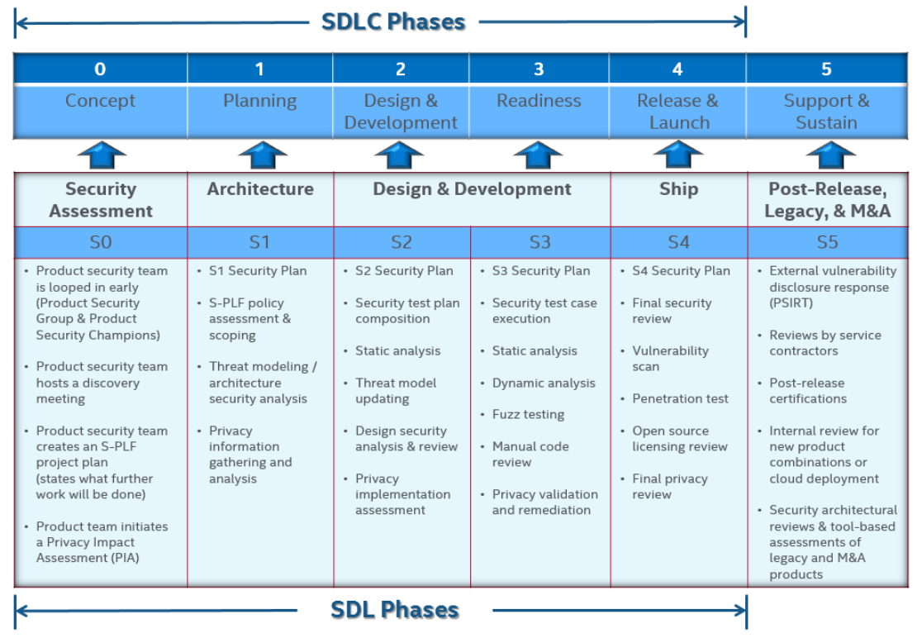
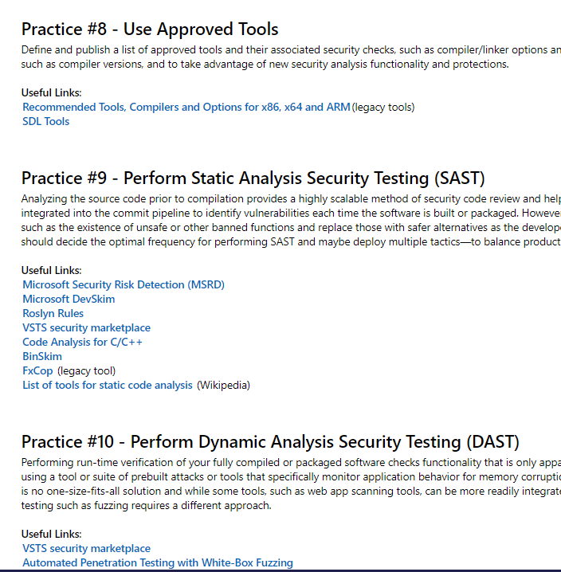
Secure Code? SDL: Secure Development Lifecycle
McAfee SDL
Microsoft SDL
Sources: - https://www.mcafee.com/enterprise/en-us/assets/misc/ms-product-software-security-practices.pdf - https://www.microsoft.com/en-us/securityengineering/sdl/practices

Slide 11
SAST TOOLS - SOURCE CODE ANALYZER
Static Application Security Testing
Detects vulnerabilities in the code
Some of the SAST tools are specific to a programming language, Some support multiple programing languages:
List of the SAST Tools: https://owasp.org/www-community/Source_Code_Analysis_Tools

Slide 12
DAST TOOLS
Dynamic Application Security Testing (DAST)
DAST tools provide vulnerability testing against running applications
Independent of the platform or programming language
Some of the most common vulnerabilities that DAST tools can detect are:
cross-site scripting (XSS)
remote code execution
Server-side request forgery (SSRF)
SQL injection
List of DAST Tools: https://owasp.org/www-community/Vulnerability_Scanning_Tools

Slide 13
OPEN SOURCE SOFTWARE LICENSE COMPLIANCE
The four main objectives of Open Source compliance:
Comply with open source licensing obligations.
Facilitate the effective use of open-source in commercial products
Comply with third-party software supplier contractual obligations
Protect proprietary intellectual property
Source: The Linux foundation

Slide 14
SCA TOOLS
#9 OWASP's Top 10 Web Application Security Risks: using components with known vulnerabilities
Software Composition Analysis (SCA) tools:
detect all the third-party components used in the code
compare the components against an existing database of known vulnerabilities
help developers maintain secure applications

Slide 15
And finally… Requirements
From the Secure Development Lifecycle (SDL):
Static and Dynamic Analysis
Licensing Review
3rd party dependencies scan
Container specifics (Image scan)
Tools need to support programmatic execution
In addition:
Implements open-source tools
Low infrastructure requirements
If possible: Support Quality Gate(s)
Reporting ?

Slide 16
Tools used in the solution
SAST (Code): SonarQube
https://github.com/SonarSource/sonarqube
SAST (Container): Clair
https://github.com/quay/clair
DAST: Arachni
https://github.com/Arachni/arachni
SCA: OWASP Dependency Check
https://owasp.org/www-project-dependency-check/
OS License Detection: ScanCode
https://github.com/nexB/scancode-toolkit
Central Reporting: DefectDojo
https://github.com/DefectDojo/django-DefectDojo

Slide 17
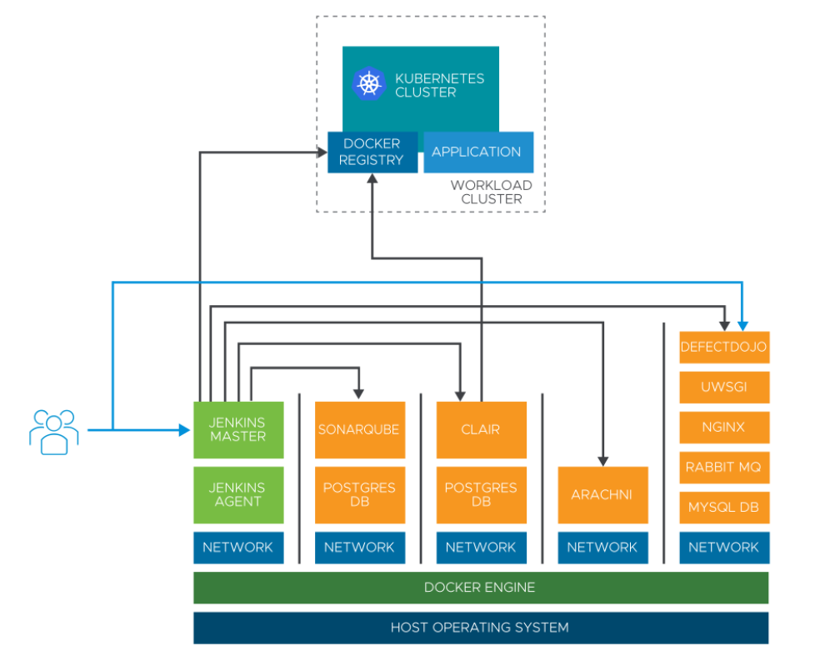
Security Testing Infrastructure (with the help of docker-compose)

Slide 18
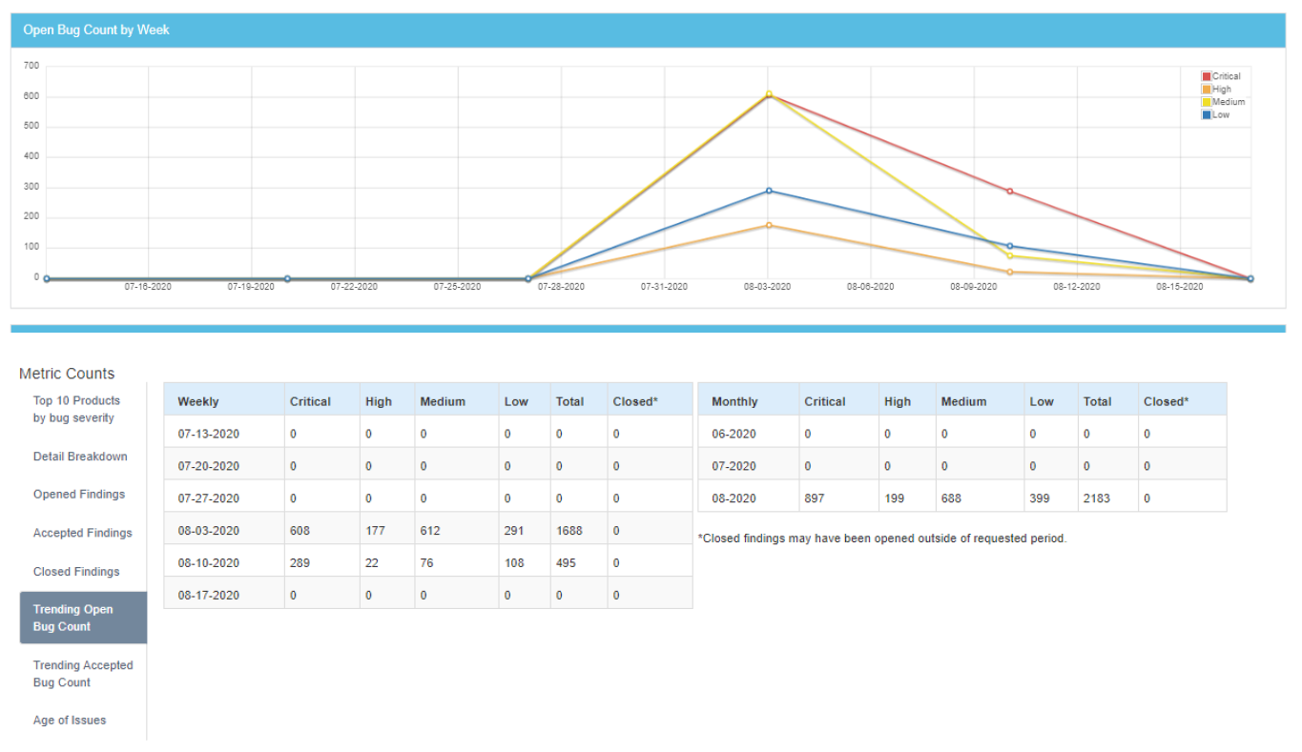
Central Reporting (with the help of DefectDojo)

Slide 19
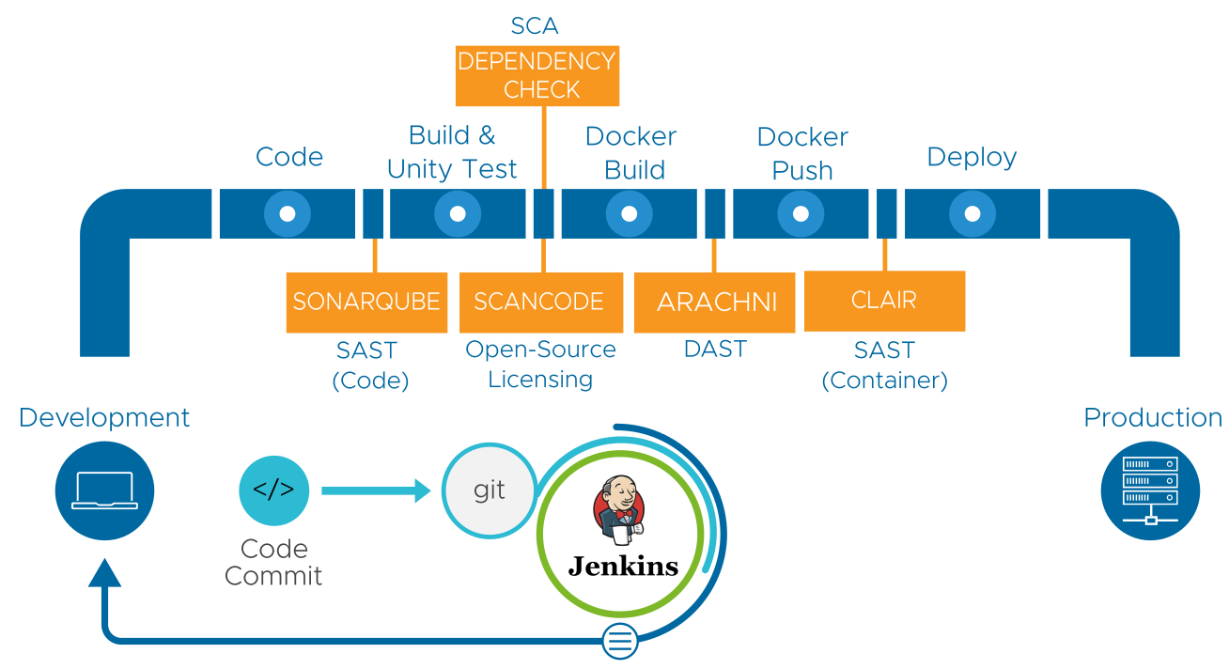
New secure delivery pipeline
Defect Dojo

Slide 20
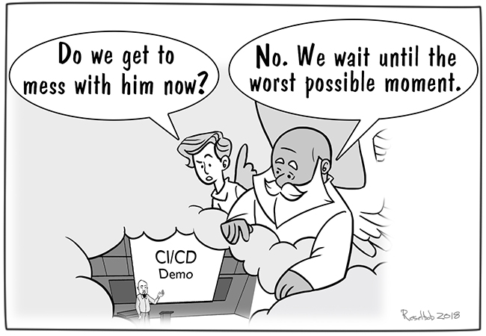
DEMO

Slide 21
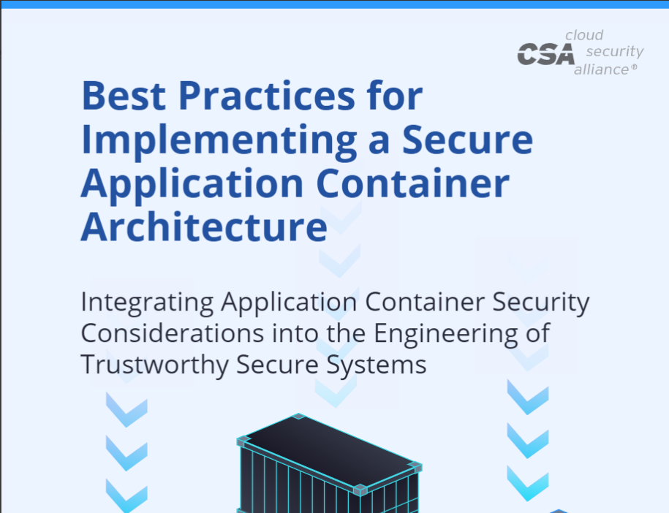
Give me structure
Implement complete SDL (Secure Development Lifecycle)
CSA: Best practices for Implementing a Secure Application Container Architecture https://cloudsecurityalliance.org/artifacts/best-practices-for-implementing-a-secure-application-container-architecture/
OWASP DevSecOps Guideline (+ SAMM model) https://owasp.org/www-project-devsecops-guideline/
Google: ‘devsecops reference architecture’ (example DoD Enterprise DevSecOps Reference Design https://dodcio.defense.gov/Portals/0/Documents/DoD%20Enterprise%20DevSecOps%20Reference%20Design%20v1.0_Public%20Release.pdf)

Slide 22
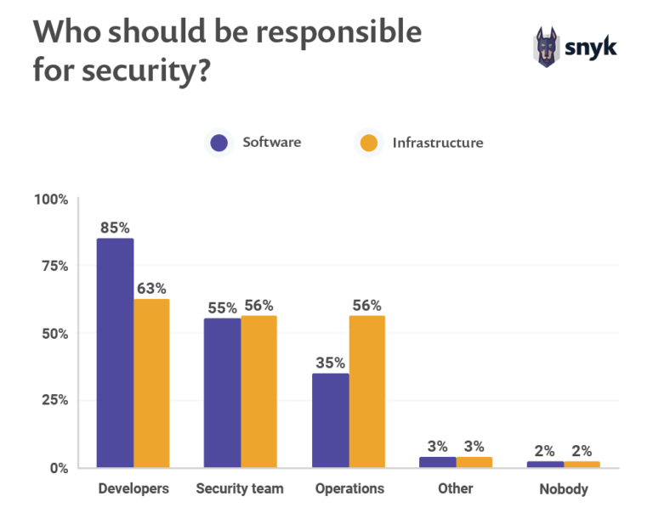
Source: https://snyk.io/open-source-security/

Slide 23
The End
Thank you.

