Slide 1

My name is Paul Horgan (@pauliehorgan)
I am a service delivery manager for an MSP in Cork
I do not work in Infosec fulltime. Yet.
I do love pulling things apart
I started looking into OSCP seriously in March. I bought 60 days of labtime.
Part of signing up to study OSCP is to sign an NDA. There is no material in the following slides that is not available on the public internet. Nothing that follows undermines or breaks that NDA. All opinions are my own.
I sat my exam in November 2020, I did not pass this time. These are the lessons learned.

Slide 2
What is the OSCP and what is PWK ?
OSCP (Offensive Security Certified Professional) is probably the most recognised (but not the only) pentest/red team IT Security certification.
PWK (Pentesting with Kali linux) is the course that you take before sitting the exam.
Why does everyone talk about this exam as a badge of honour ?
This exam is unique in IT. It is a 24 hour long proctored exam that is entirely practical. It is also open book.In order to pass it you must be able to demonstrate the ability to take exploit code and modify it, or otherwise take advantage of system security weaknesses to get access as the administrator user (or root). Given the 24 hour time, it is also an exercise in both time management and your ability to function potentially for a 24 hour stretch.

Slide 3
OK, so what do I need to know to begin this course ?
First off this course is expensive. 30 days of lab access and the materials costs $1000. 90 days will set you back $1349. All the options include an exam attempt (retake fee is currently $150)
This course will take time. The courseware (book and video) is lengthy. The book is over 800 pages, the video is 8 hours. Note that the video course will not cover everything in the book.
Will this course take me from Zero to Neo ?
No. This course expects that you are already familiar with Linux and its administration. It also presumes that you have relatively good knowledge of the basic tools of pentesting (Burpsuite, Metasploit , Impacket tools etc)
What are the labs ?
Part of your onboarding pack to the course is a VPN connection to Offensive Security’s lab environment. There are 3 networks (2 are hidden). There are a number of virtual machines, all to a greater or lesser extent vulnerable to attack. Some machines have dependencies hidden on other machines (recover a password from machine A that works on machine B)

Slide 4
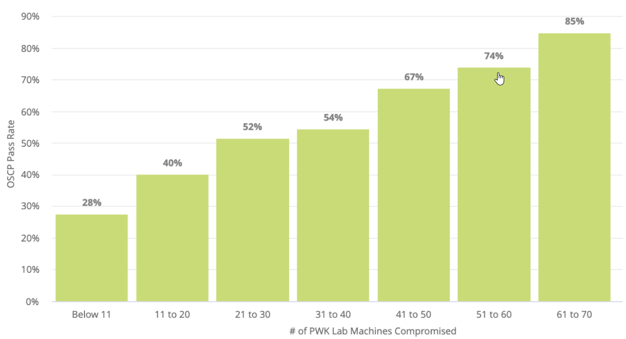
How can I maximise the money I’ve spent ?
This is probably the most important and pertinent question. The temptation is to go full on h4X0r and attack the lab machines, bathing in the glow of your own awesomeness. Don’t. Work through the text and the videos first. You can expect this to last at least 2 weeks. You will also need to spend significant time in the labs. Suddenly the 30 day option doesn’t look so practical.
Important note :
As you work through the text there are a number of exercises. Completing and documenting these are worth 5 bonus points on your exam. Recently (2020) the OSCP updated their text. One thing they did was to add 500 pages and a whole lot of exercises. In my opinion (and most of the people I’ve discussed this with) the amount of paperwork outweighs the benefit of the 5 bonus points. More on this later.

Slide 5
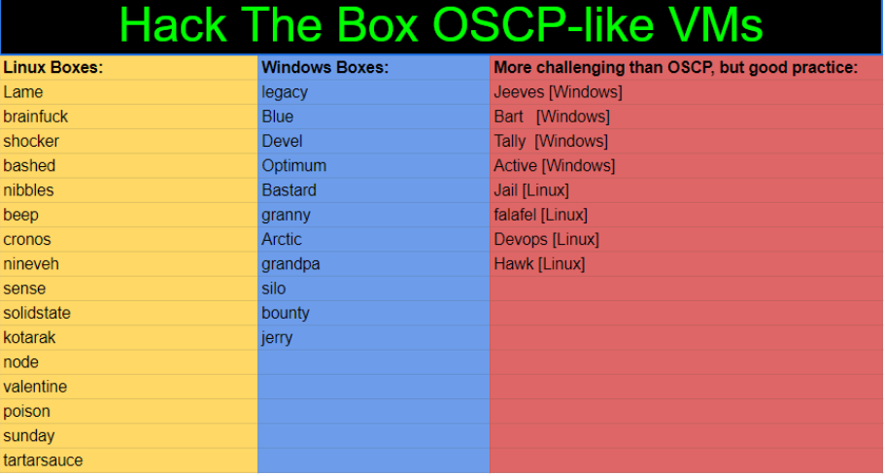
The Legend of TJ Null
One name keeps coming up when you research how best to pass the OSC. This is TJ Null. He has curated a list of OSCP like virtual machines across a number of platforms (Hack The Box, Vulnhub). There is something very important to say about this list. It is not enough to watch ippsec’s video walkthroughs of these machines.
This list is your golden ticket but only if you can root each of these machines and fully understand the how and why of each step you took to root them.

Slide 6
Your VM
Do not use a brand new image. Use an image that you have taken the time to use and get used to. Know where all your tools are installed. Know where your wordlists are. Now is not the time to be testing some new nmap automator that you haven’t used before. Now is the time to use what you know.
Once you have your image locked in, no more updates. The exam is designed to be passed using a basic toolset. Do not risk bricking your Kali instance the day before the exam.

Slide 7
The Exam :
As mentioned previously – the exam is 24 hours long. You must schedule the exam 30 days out. You will be offered a list of available dates and times. Pay close attention to your exam start time. Do not start a 24 hour exam at 1am. It sounds obvious, but it happens. Also plan to be in the one room for a significant amount of time.
The exam is open book. You can reference any written materials you like. You can google and youtube to your hearts content. If you desire you can have sites such as http://ippsec.rocks open. Use any opening to your advantage.
You will be proctored. The ideal scenario is to use a laptop with a built in webcam. Use the Windows version of the proctoring client. Launch your VM from whatever means you like (virtualbox, VMWare player).
The exam is online, so make sure that you have the most stable Internet connection available to you.

Slide 8
Buffer Overflow
Another legend of the OSCP is the buffer overflow. Yes - you are guaranteed to get at least one buffer overflow machine on the exam. Yes - it is worth 25 points. No - it is not always SLMAIL.
Do not go off and learn how to exploit SLMail and think that you are done. You are not. Learn the methodology. Learn how to find badchars manually. Learn how to find the jump points if Mona is not working.
To learn this effectively I used Tryhackme. They have a specific learning path just for buffer overflow. It is excellent.
This is potentially the easiest 25 points in the exam. It is the one machine where you know the methodology before you start. Do not waste the advantage.

Slide 9
The remaining machines :
Leaving aside the buffer overflow, you have a 10 point machine, 2 X 20 point machines and 1 other 25 point virtual machine. You need 70 points to pass.
Mathematically if you get the buffer overflow machine you need 45 points. There is no definite amount of machines you need to own to get the points. The fastest way is to get the buffer overflow, the 25 point machine and one of the 20 point machines.
There are 2 flags in each of the machines (the buffer overflow has only one). There is no official break down of the value of a low priv flag. Do not get a low priv on every machine and think that you are done.

Slide 10
Note taking :
Part of your exam is to submit a detailed report on what you did to own each machine. Failure to submit this report will constitute a fail on your exam. You have 24 hours for the exam and the next 24 hours to submit your report. It must be in a prescribed format and submitted correctly.
If you do not take detailed notes and submit a report containing all the steps you took to root a machine during the exam, you will fail.
If your notes are not detailed enough, you will fail. Reports regularly run to 60 – 80 pages.
As you work take notes. Take them digitally, take screenshots of every step you take and every command you run.
I also took notes with a pen.

Slide 11
Useful strategies :
Take breaks. Regularly.
Allocate time for each machine and stick to it. If after 2 hours you aren’t getting anywhere, move on. The machines have rabbit holes designed to trip you up.
Stay calm. Expect to get frustrated. Expect to feel lost.
Eat. Drink. Not monster or redbull. Water and fruit worked best for me. I stopped for dinner. I stopped for sleep.
24 hours is actually plenty of time to get to every machine. The pressure you feel is the pressure you put yourself under.
Do not deviate from your methodology, not for any reason. If you run nmap first and fuff after, then that’s what you do. Do not change it.

Slide 12
Useful resources :
Try hack me – This is very very good. Their learning path is so close to the OSCP that they had to rename it. Really. It costs $10 per month. Really worth it. Also a brilliant learning path for Buffer Overflow. https://tryhackme.com/
Virtual hacking labs – If you run out of lab time, these guys have an environment that almost mirrors it. This costs a little more at €233 for 3 months access. https://www.virtualhackinglabs.com/
Udemy : A tutor called Tib3rius has 2 excellent courses on Windows and Linux privilege escalation. Follow his twitter account : https://twitter.com/tibsec?lang=en for regular vouchers that reduce the cost of each course to $10
A note : There is a tutor called The Cyber Mentor who has some excellent starter videos on Ethical Hacking. While they are a little basic for the OSCP, anyone looking to get into the world of Pentest would do well to start by watching his videos. https://www.thecybermentor.com/
Youtube resources : Ippsec. The best resource I’ve found for machine walkthroughs. He also has a site : https://ippsec.rocks where there is a searchable index of his videos.
Twitter : The previously mentioned TJ Null : https://twitter.com/tj_null he keeps his list of OSCP like machines updated constantly.

