Slide 1
Introduction to Buffer Overflows
Ravi Vashatkar

Slide 2
> Whoami
Ravi Vashatkar Tenneti
MSc Cybersecurity | CEH | Former Endpoint Security Engineer | Electronic & Avionic Hobbyist

Slide 3
Contents
1) What are buffer overflows ?
2) Types of buffer overflow and methodologies.
3) Brief history and trends.
4) Common CPU registers and Assembly language.
5) Anatomy of memory.
6) Stack vs Heap memory.
7) Deep dive into stack based buffer overflow.
8) Developing stack buffer overflow exploits. (Demo)
- Fuzzing
- Determining offset of EIP
- Identifying Bad Characters
- Finding an appropriate module
- Generating a shellcode
- Post Exploitation activities
9) Ways to mitigate and/or Prevent buffer overflows

Slide 4
What is buffer overflow ?

Slide 5
What can go wrong when buffers overflow ?
Denial of Service (DoS)
Corruption of important information
Change in Program Flow
Arbitrary Code Execution
Privileges may elevate
Operational instabilities
Abnormal termination
Sometimes Nothing At All ..

Slide 6
Types of buffer overflows:
- Stack buffer overflow
- Heap buffer overflow (More complex)
- Integer overflows “are not buffer overflows”
Methods:
Data typed or pasted into text fields of the program’s graphical user interface.
Data sent to the program via a network.
Data provided in a file.
Data provided on the command line when invoking the program via a command line Interpreter.
- Data provided in environment variables.

Slide 7

Mehhh !!
YouTube has changed its view count limit to 9,223,372,036,854,775,807 because of this gentle man . . .
It was 2,147,483,647 before (Maximum value for 32 bit signed integer)
But showed -2147483648 when overflowed

Slide 8
Brief History & Trends
First identified in 1970’s
Morris worm in 1988.
Slammer worm in 2002 [CVE-2002-0649]
Internet Information Server (IIS) 4.0 and 5.0 ISAPI extension[CVE-2002-0071]
Heartbleed(OpenSSL (v1.0.1-1f) buffer Underflow bug [CVE-2014-0160])
Python’s os.symlink() method on Windows [CVE-2018-1000117]
Putty SSH client V 7.1 on Unix machines (RBO) [CVE-2019-9895]
IBM Watson IOT Message gateway vulnerability [CVE-2020-4207]
And many more… (Search for buffer overflow @ https://cve.mitre.org/ )

Slide 9
In many, many cases there is no check at all (due to laziness, guilelessness, an
“aggressive” development schedule or simply obliviousness of the programmer) – the data is just processed as is.

Slide 10
CPU Registers (X86 Architecture)
8 General purpose registers (Considering 32-bit processors)
EAX
EBX
ECX
EDX
ESI
EDI
ESP
EBP
6 Segment registers
CS
DS
SS
ES
FS
GS
Instruction pointer register
5 Control registers
EIP
CR0
CR1
CR2
CR3
CR4

Slide 11
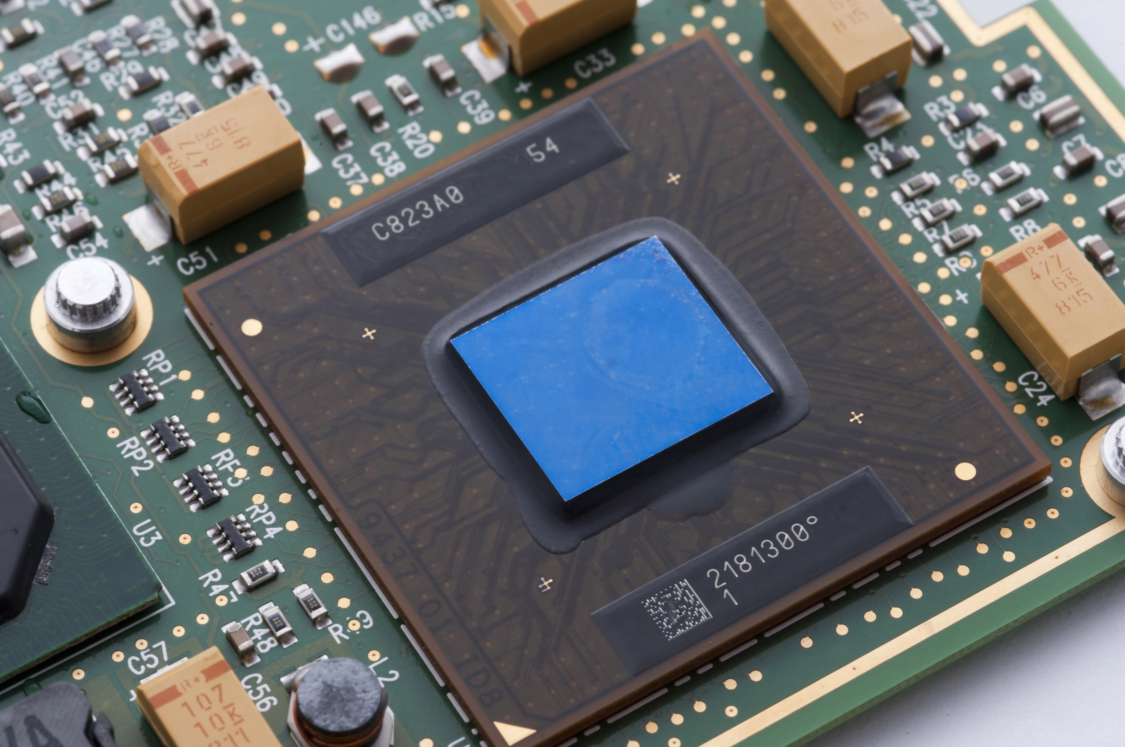
Assembly language & important instructions
Assembly Language:
Low-level programming language.
Used to communicate directly to the processor.
Depends on the processor family.
Has one-to-one correspondence with the byte/machine code.
Assembly
Machine Language
MOV EAX,EBX
XOR EAX,EAX
ADD EAX,0XFF
….
….
Assembler & Linker
0101100
1001010
1011101
Translation

Slide 12
Important Assembly Instructions
MOV <dest>, <src>
Move the value from <src> into <dest> → Used to set initial values
ADD <dest>, <src>
Add the value from <src> to <dest>
SUB <dest>, <src>
Subtract the value from <src> from <dest>
PUSH <target>
Push the value in <target> onto the stack, also decrements the stack pointer, ESP (remember
stack grows from high to low address)
POP <target>
Pops the value from the top of the stack, put it in <target> Also increments the stack pointer, ESP
JMP <address>
Jump to an instruction (like goto)
Change the EIP to <address>
CALL <address>
A function call.
Pushes the current EIP + 1 (next instruction) and the
EBP onto the stack, and jumps to <address>
NOP Dose noting, waits for some CPU cycles. .
Opcode: \x90

Slide 13
Anatomy of Memory
0xFFFF
High
Command line arguments and environment variables
Stack
For storing function calls, associated arguments and local variables
Unallocated space
Heap
Dynamic memory, shared by all modules and libraries of a process
Uninitialized data
AKA .bss segment, Global and static variables
Initialized data
AKA Data segment, Initialized Global & static variables
Low
0x0000
Text
AKA Code segment, Contains executable instructions, often read only

Slide 14
int abc = 1; ----> Initialized data: Read-Write Data
char *str; ----> BSS
const int i = 10; ----> Initialized data: Read-Only Data
main()
{
int ii, a=1, b=2, c; -----> Local Variables on Stack
char *ptr; -----> Local Variables on Stack
ptr = malloc(4); -----> Allocated Memory in Heap
c= a+b; -----> Text (Code)
}

Slide 15
Stack vs Heap
Linear data structure (LIFO data structure)
Mem is allocated in contiguous block
For local variables only
Size is pre decided by compiler
Variables cannot be resized
Will be automatically allocated by CPU based on requirement and will be freed on function exits.
Faster as its managed directly by CPU
Hierarchical data structure
Mem is allocated in random order
Allows to access variables globally
Size is decided at the run time
Variables can be resized
Larger in size without restrictions
Can be allocated using functions like malloc(), calloc() or realloc() and must be manually unallocated using free() in C
Slower as it uses pointers for access

Slide 16
C and C++ are susceptible to buffer overflows because they define strings as null-terminated arrays of characters, do not implicitly check bounds and provide standard library calls for strings that do not enforce bounds checking.

Slide 17
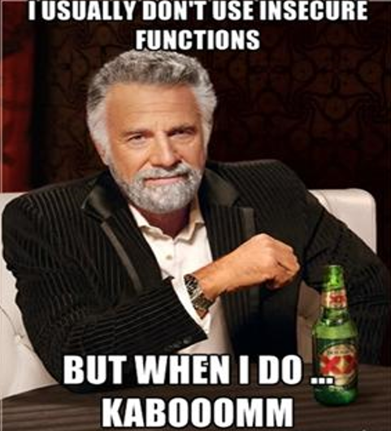

Slide 18
BOMOD Demo

Slide 19
0xFFFF
High
Kernel
Segmentation fault !!
Stack
\x56
Shell
Code
\x45
\x67
NOP
NOP
NOP
NOP
Unallocated space
Heap
KYUKTYN121v13vc3rhks1
dj5u6U6u6kuhutSDGSdb
GFDGTHM87TI79sgehdg
t87TI7TuiJKGK232hk1fwtd
34hkjh23hdlflhlshf4lwKTYiiasg52
t87TI7TuiJKGK232hk1234
Hkjh23hdlflhlshf4lwhsl4fjll
bsvkhgouySDGSGSGFDi
SDGSGSGFDGTHMKYUKi
TYN121v13vc3rhkdkhgjh
t87TI7TuiJKGK232hk1fwtd
34hkjh23hdlflhlshf4lwKTYii
ESP
Buffer
EBP
EIP [RET ADDR]
Uninitialized data
Initialized data
Low
0x0000
Text

Slide 20
Lets get our hands dirty by smashing the stack !
Vulnserver Demo

Slide 21
Steps involved in developing stack based buffer overflows
- Fuzzing
- Determining offset of EIP
- Identifying Bad Characters
- Finding an appropriate module
- Generating a shellcode
- Crafting our Payload
- Exploitation

Slide 22
pattern_create.rb and Pattern_offset.rb scripts by Metasploit.
/usr/share/metasploit-framework/tools/exploit/pattern_create.rb –l <lenght>
/usr/share/metasploit-framework/tools/exploit/pattern_offset.rb -l <length> -q <offset found in EIP {ASCII}>
Note: The same can be achieved using mona.py extension
Use !mona help for more options

Slide 23
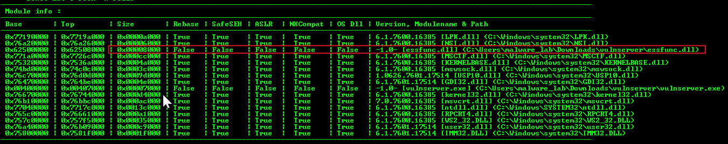
The below image was added just for referencing purpose as the practical demonstration
showed the actual details
Finding modules with bad/no protections using mona.py

Slide 24
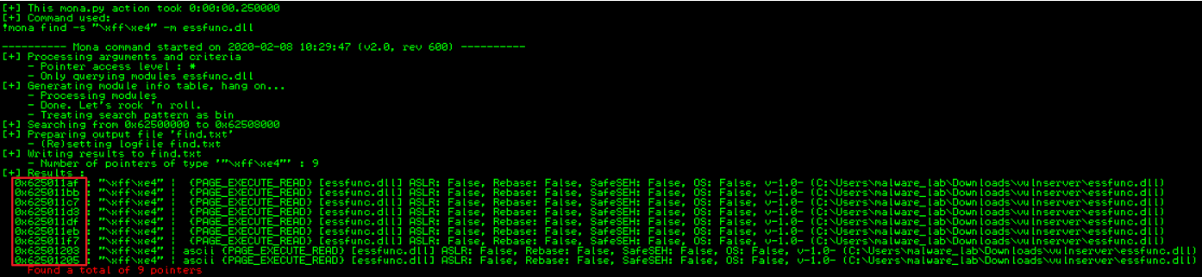
The below image was added just for referencing purpose as the practical demonstration
showed the actual details
Finding pointers for JMP ESP instruction using mona.py

Slide 25
Bad characters:
To name a few,
\x00 - String terminator (Null byte)
\x0a & \x0d (\r \n) – In the HTTP header fields
And could be more depending on the application we exploit.
Why should attacks be bothered about bad characters ?
The payloads would fail to run as expected if they have bad characters.
Bad characters in payloads would be misinterpreted.

Slide 26
How can we mitigate and/or prevent buffer overflows ?
By making stack pages non-executable [NX] bit offered by Intel processors] (DEP)
(May not always be advantages in preventing return to Libc attacks)
Use languages like Java that check array bounds.
Use secure libraries like those specified by C11 annex K, [gets_s, strcpy_s, strncpy_s ..etc]
Using Canaries [Stack cookies]
[Known pseudo random values inserted into stack pages to monitor buffer overflows ]
These are implemented in gcc by default
Knowing the value of Canaries would allow attackers to overcome this defence mechanism.
ASLR [Address Space Layout Randomization] (Linux kernel 2.6.x and above, Win 7 and above)
Raises the bar by randomizing the address of modules and makes it harder to implement Bos
- EMET & Windows Exploit Protection & EMET(deprecated) (Windows 10, version 1709 and above)

Slide 27
Attackers continuously develop new techniques to defeat ASLR defense. Bypass techniques include using ROP chain in non-ASLR modules (e.g., CVE 2013-1347), JIT/NOP spraying (e.g., CVE-2013-3346), as well as memory disclosure vulnerabilities and other techniques (e.g., CVE-2015-1685, CVE-2015-2449, CVE-2013-2556, CVE-2013-0640, CVE-2013-0634

Slide 28


Slide 29
References
SANS institute’s: Buffer Overflows for Dummies by Josef Nelißen
https://github.com/stephenbradshaw/vulnserver
https://resources.infosecinstitute.com/bypassing-seh-protection-a-real-life-example/#gref
https://www.fireeye.com/blog/threat-research/2019/10/shikata-ga-nai-encoder-still-going-strong.html
https://blog.morphisec.com/aslr-what-it-is-and-what-it-isnt/
http://msdn.microsoft.com/en-us/library/9a89h429(VS.80).aspx
https://docs.microsoft.com/en-us/windows/security/threat-protection/microsoft-defender-atp
/exploit-protection
- https://arxiv.org/abs/1807.03757

Slide 30
?

Slide 31
Thank you !

