Slide 1

Architecting for Security Resilience
Joel Oseiga Aleburu
11/05/2021

Slide 2

Content of this Talk
About the Speaker
Basic Definitions
Basic Principles for Secure Design
What is application threat modelling ?
Common Architectural Flaws
Questions

Slide 3
About the Speaker
Joel Oseiga Aleburu B.Sc. (Bowen) , M.Sc. (York)
Outsourced IT Security and Risk Architecture Lead - Smarttech247
Interests- Mathematics, Computer Science
Security Interests- Cyber Warfare, NSA, Critical Systems and Encryption
Other Stuff: Hiking, Small Planes and Fast Cars

Slide 4
Basic Definitions
Security → Risk management-> Enable the business process
Information Security Risk: Damage that a beach of, or attack on IT system could cause. Can be defined in Monetary terms or non-monetary terms.
Vulnerability: Weakness, flaw or error within a security system that can be leveraged by a threat in order to compromise an architecture.
Resilience: Ability to enable business acceleration by preparing for, responding to and recovering from cyber threats.
Notes:
Keypoint1: The ultimate goal of security and IT is to enable business processes. Security is not in the product, it is in the process.
Key point 2: Security Risk Management is the ongoing process of identifying these security risks and implementing plans to address them. Risk is determined by considering the likelihood that known threats will exploit vulnerabilities and the impact they have on a valuable asset.
Monetary terms which measures the effects of a cyber security breach on organizational assets or
Non-monetary terms which compromise reputational, strategic, legal, political or other types of risk.
Key point 3: The ultimate goal of cyber resiliency is to help an organization thrive in the face of adverse conditions.

Slide 5
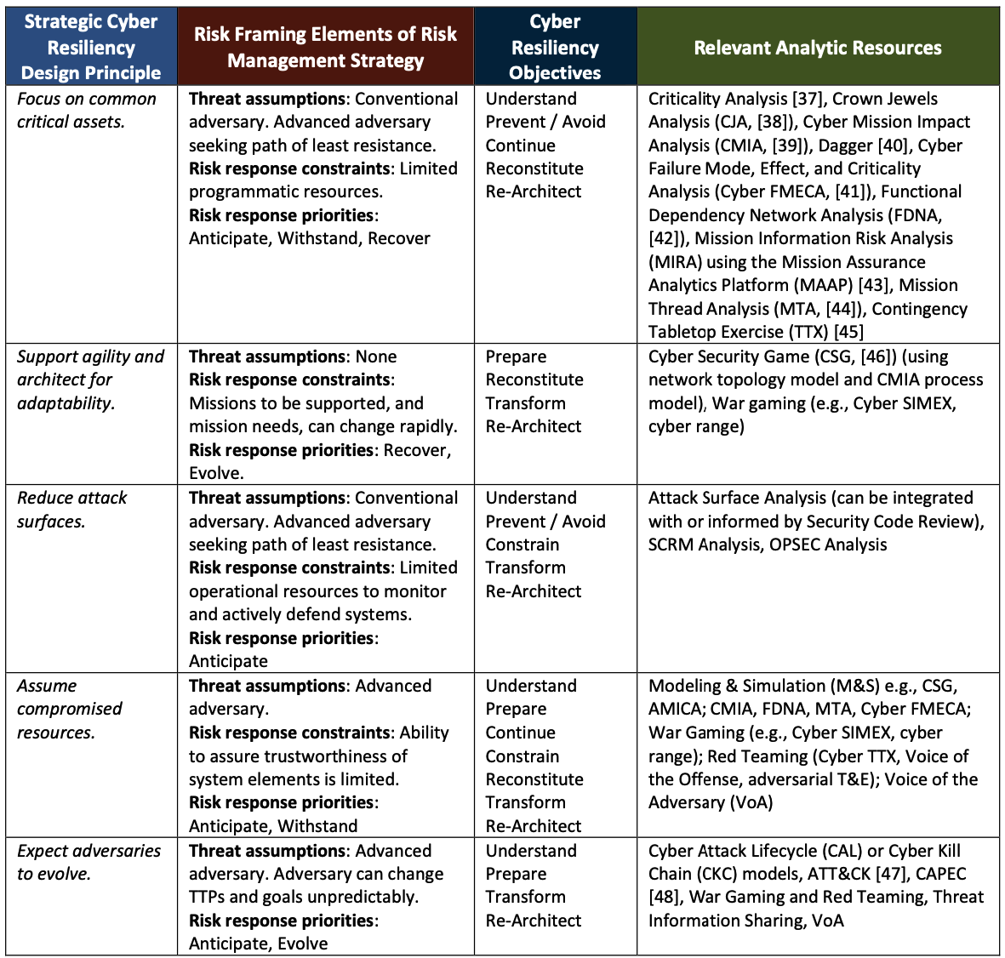
Strategic Resiliency Design Principles (MITRE)
Notes:
Mitre’s Security design principles.
Assets that are common to multiple missions or business functions are potentially high value targets for cyber attacks, either because those assets are critical or because their compromise increases the attackers’ options for lateral motion or persistence. Identify how the asset is used? What makes the asset critical?
Agility: In the context of cyber resiliency, agility is the property of a system or an infrastructure which can be reconfigured, in which resources can be reallocated and in which components can be reused so that cyber defenders can define, select and tailor cyber cources of action for a broad range of disruptions and malicious cyber activities.
Reduce attack surface: At a minimum, the term “attack surface” refers to “accessible areas where weaknesses or deficiencies in information systems (including the hardware, software, and firmware components) provide opportunities for adversaries to exploit vulnerabilities.” in other words, any hardware, software, connection, data exchange, service, removable media, etc. that might expose the system to potential threat access.
Assume compromised resources: This design principle implies the need for analysis of how the system architecture reduces the potential consequences of a successful compromise – in particular, the duration and degree of adversary-caused disruption, as well as the speed and extent of malware propagation .
Expect Adversaries to Evolve: Adversaries evolve in response to opportunities offered by new technologies or uses of technology, as well as to the knowledge they gain about defender TTPs. In (increasingly short) time, the tools developed by advanced adversaries become available to less sophisticated adversaries. Therefore, systems and missions need to be resilient in the face of unexpected attacks. This design principle therefore supports a risk management strategy which includes but goes beyond the common practice of searching for and seeking ways to remediate vulnerabilities (or classes of vulnerabilities); a system which has been hardened in the sense of remediating known vulnerabilities will remain exposed to evolving adversaries.

Slide 6
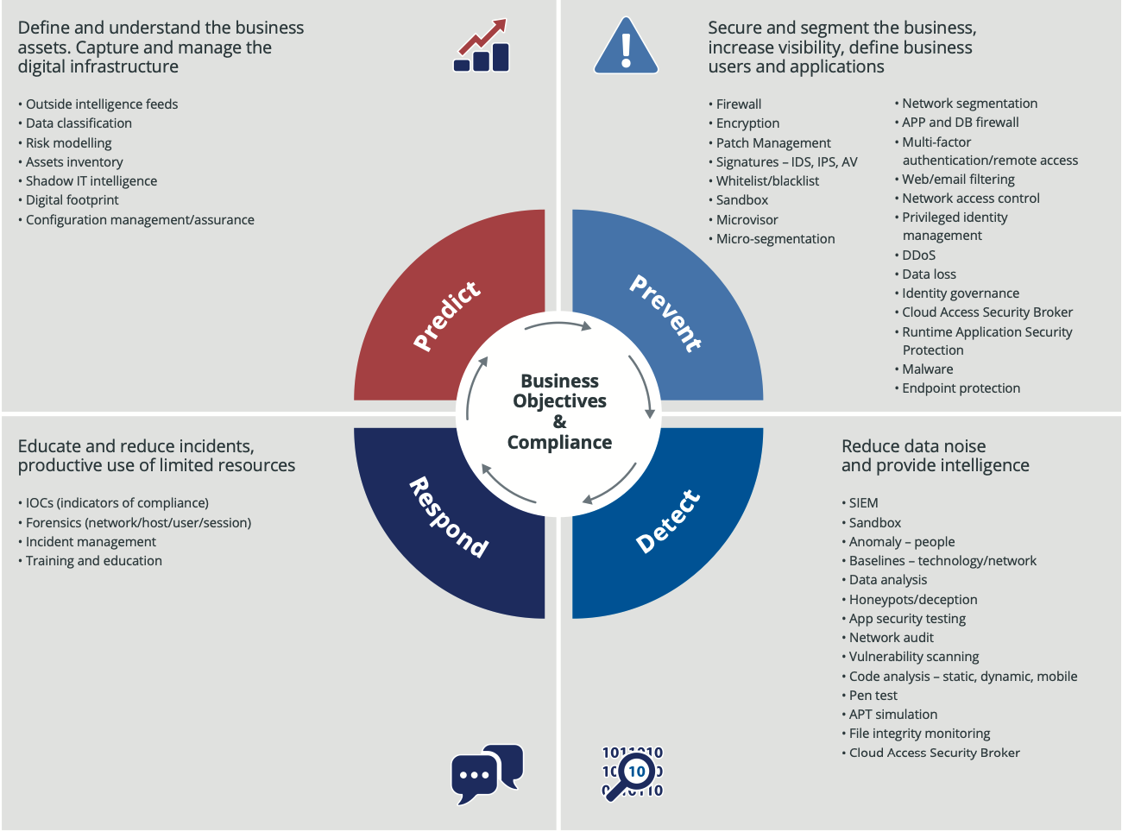
The Basics. i.e Cyber Resilience 101.
The overall goal is to align people, process and technology to build resilient cyber defense architecture in line with business objectives
Notes:
Five Steps towards a resilient cyber defence capability:
1. Establish a resilient cyber defence architecture in line with business objectives
2. Engage all relevant stakeholders to agree performance metrics and analytics
3. Review existing technology investments against resilient cyber defence capability to identify areas of little, low or over investment
4. Review existing security teams against the capability areas to understand where your skill sets need investment
5. Create processes that ensure information and intelligence sharing between all aspects of the model and regular governance and review points to drive continuous improvement
Reference: https://www.nttsecurity.com/docs/librariesprovider3/resources/uk_thought_leadership_innovation_resilient_cyber_uea_v2

Slide 7
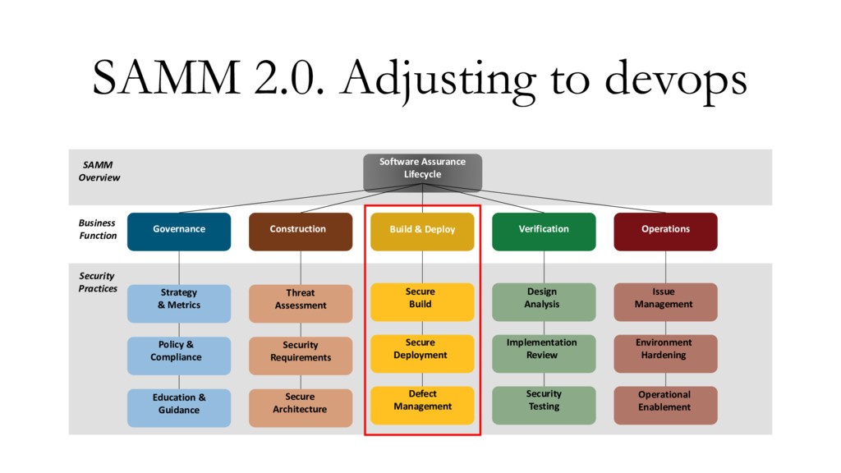
SDLC Work flow, OWASP SAMM 2

Slide 8
Threat Modelling Basics
Products do not stop cyber attacks, processes do
Threat modelling is a structured process through which IT pros can identify potential security threats and vulnerabilities, quantify the seriousness of each, and prioritize techniques to mitigate attack and protect IT resources.
Use Threat Modeling techniques :
STRIDE
PASTA
ATTACK Trees
OCTAVE, etc
Use STRIDE to step through diagram elements
Get specific about threat manifestation.
Attack trees are conceptual diagrams showing how an asset or target, might be attacked.

Slide 9
Looking for technical threats
Use Cases and user stories
- Features
-Different user roles
Architecture descriptions
- Where is your data stored?
- Where is it transferred and how?
Threat Actor
- Who can abuse your system and how

Slide 10
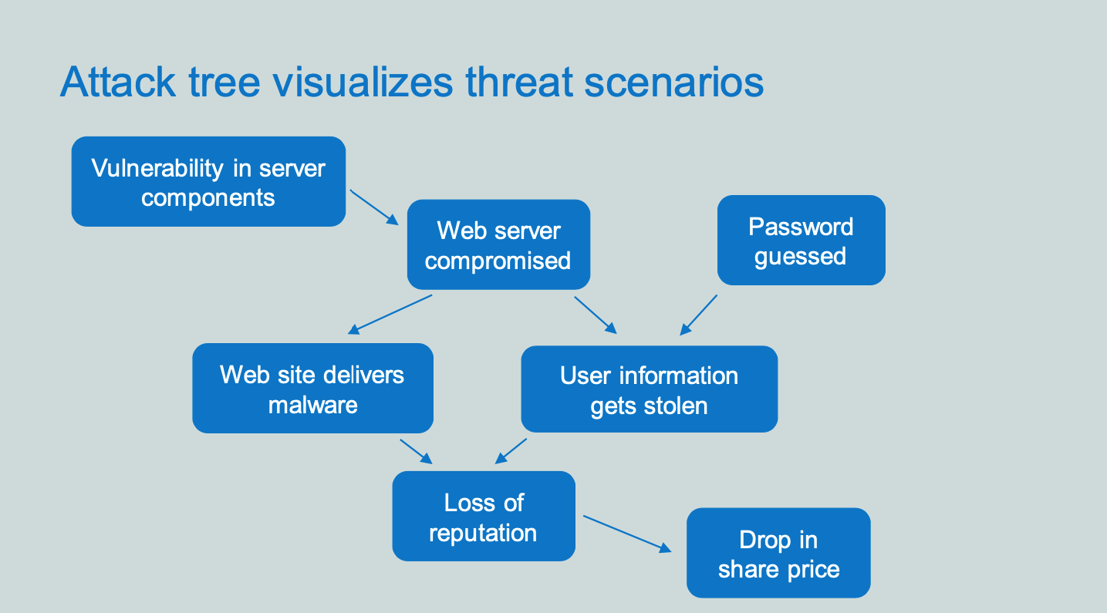

Slide 11
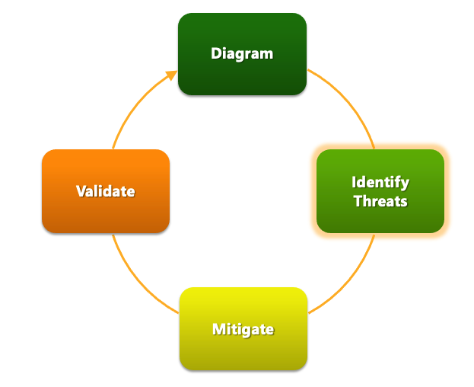
The Process: Identifying Threats
The four steps to make a threat model
Notes:
The 4 steps to make a threat model:
Source: Microsoft https://www.google.com/url?sa=t&rct=j&q=&esrc=s&source=web&cd=&cad=rja&uact=8&ved=2ahUKEwiY2vaBw8HwAhW1tXEKHZpyDrEQFjAKegQIBRAD&url=https%3A%2F%2Fdownload.microsoft.com%2Fdownload%2F9%2F3%2F5%2F935520EC-D9E2-413E-BEA7-0B865A79B18C%2FIntroduction_to_Threat_Modeling.ppsx&usg=AOvVaw2eemQo4VQDdBIyJSJ1a7f-

Slide 12
Identify Threats
Experts can brainstorm
Use STRIDE to step through the diagram elements
Get specific about threat manifestation
Threat Property we want
Spoofing | Authentication
Tampering | Integrity
Repudiation | Nonrepudiation
Information Disclosure | Confidentiality
Denial of Service | Availability
Elevation of Privilege | Authorization
Notes:
Self explanatory. The next slides go into more detail, with examples

Slide 13
Threat: Spoofing
Threat | Spoofing
Property | Authentication
Definition | Impersonating something or someone else
Example | Pretending to be any of, microsoft.com, or ntdll.dll
Notes:
Source: Microsoft.com

Slide 14
Threat: Tampering
Threat | Tampering
Property | Integrity
Definition | Modifying data or code
Example | Modifying a DLL on disk or DVD, or a packet as it traverses the LAN
Notes:
Source: Microsoft.com

Slide 15
Threat: Repudiation
Threat | Repudiation
Property | Non-Repudiation
Definition | Claiming to have not performed an action
Example | “I didn’t send that email,” “I didn’t modify that file,” “I certainly didn’t visit that Web site, dear!”
Notes:
Source: Microsoft.com

Slide 16
Threat: Information Disclosure
Threat | Information Disclosure
Property | Confidentiality
Definition | Exposing information to someone not authorized to see it
Example | Allowing someone to read the application source code; publishing a list of customers to a Web site
Notes:
Source: Microsoft.com

Slide 17
Threat: Denial of Service
Threat | Denial of Service
Property | Availability
Definition | Deny or degrade service to users
Example | Crashing application or a Web site, sending a packet and absorbing seconds of CPU time, or routing packets into a black hole
Notes:
Source: Microsoft.com

Slide 18
Threat: Elevation of Privilege
Threat | Elevation of Privilege (EoP)
Property | Authorization
Definition | Gain capabilities without proper authorization
Example | Allowing a remote Internet user to run commands is the classic example, but going from a “Limited User” to “Admin” is also EoP
Notes:
Source: Microsoft.com

Slide 19
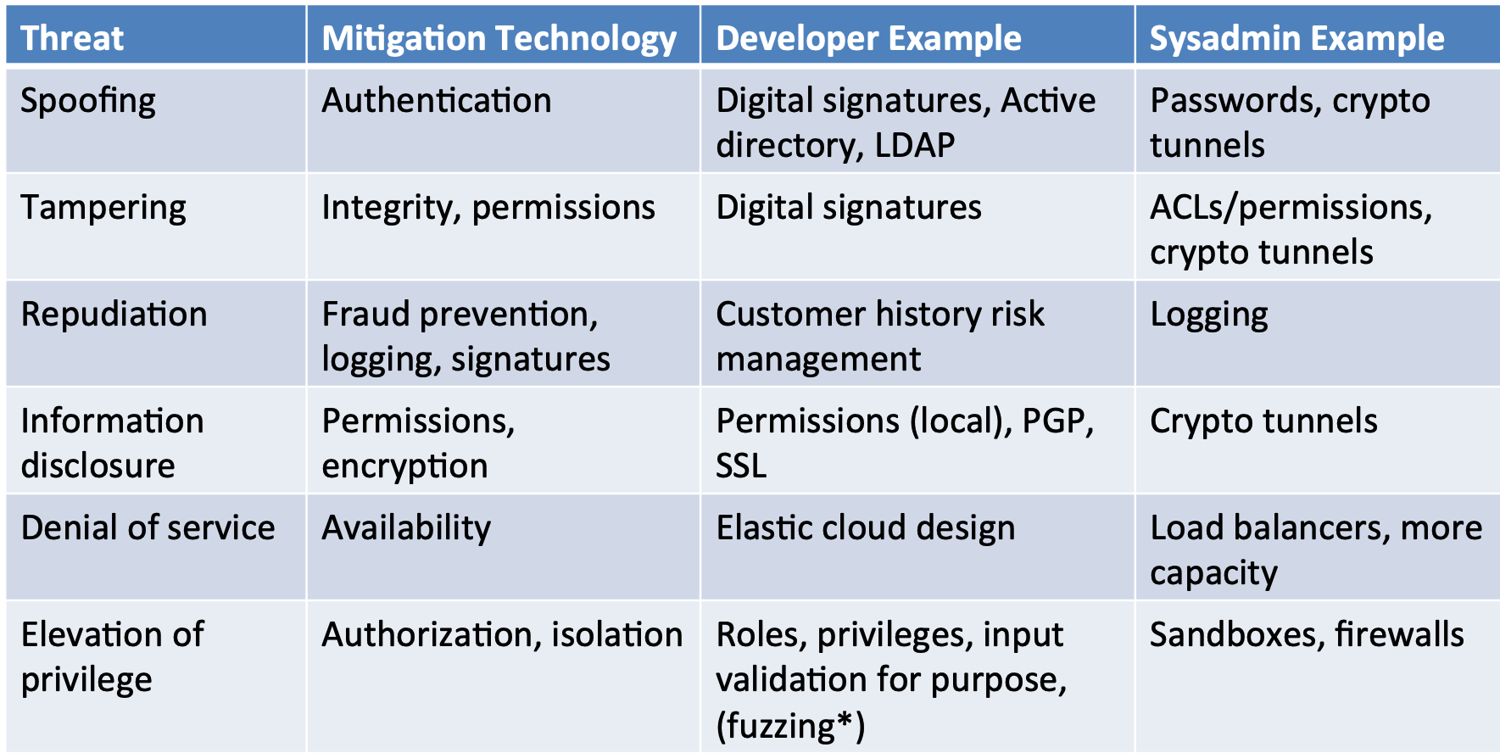
Some technical ways to address

Slide 20
Bugs vs Flaw
A design is a protocol between two things- It could be how a file is built or the methodology for logging.
Coding mistakes = bug
Design mistake = flaw
Flaws are harder, more expensive and labor intensive to fix.
Bugs can be detected and found by automated interactive analysis
Notes:
Even if your code contains thousands of bugs, automated tools- static, dynamic and interactive analysis alongside software composition analysis will help your devs find and fix them all.
A design flaw would be saying “I’m going to allow this application or microservice to accept any number of requests at any speed from any source. There will be no velocity checker, no identity and access control, no access management. That’s a design flaw. It’s not just screwing up a few lines of code.

Slide 21
Common Design Flaws
Missing authentication
Weak authentication
Missing/weak encryption
Missing authorization
Weak authorization
Leaking important data
Uncontrolled resources
Not validating input/data
Insufficient auditing
Insufficient session management
Notes:
Missing authentication:
Missing authentication or Authentication Bypass using an alternate path
Weak authentication:
Relying on Single Factor Authentication, Downgrade Authentication, No reauthentication, insufficient credential management.
Missing/weak encryption:
Insufficient cryptographic key management or use of custom weak encryption
Missing authorization:
Missing authorization or missing access controls
Weak authorization:
No context when authorizing, not revoting authorization
Leaking important data:
Insecure data storage or insecure data exposure
Uncontrolled resources:
Unmonitored execution and uncontrolled resource consumption

Slide 22

Avoiding flaws in design
Earn or give, but never assume trust
Use an authentication mechanism that cannot be bypassed or tampered with
Authorize after you authenticate
Strictly separate data and control instructions and never process control instructions received from untrusted sources
Define an approach that ensures all data are explicitly validated
Use cryptography correctly
Identify sensitive data and how they should be handled
Always consider the users
Understand how integrating external components changes your attack surface
Be flexible when considering future changes to objects and actors

Slide 23

Earn or give, but never assume
Make sure all data from an untrusted client are validated or even better still, validate everything (zero trust)
Assume data is compromised
Avoid authorization, access control, policy enforcement and use of sensitive data in client code

Slide 24
Use authenticated mechanism that can’t be bypassed
Prevent the user from changing identity without re-authentication, once authenticated
Consider the strength of the authentication a user has provided before taking action
Make use of Time outs
MFA actually works! Enforce it
Avoid shared resources e.g. IP and MAC addresses
Avoid predictable tokens
Notes:
Predictable session tokens: Server picks session token by incrementing a counter for each new session.
Attacker opens connection to server, gets session token.
Subtract 1 from session token: can hijack the last session opened to the server.

Slide 25
Authorize after authentication
Perform authorization as an explicit check
Re-use common infrastructure for conducting authorization checks
Authorization depends on a given set of privileges and on the context of the request
Failing to revoke authorization can result in authenticated users exercising out-of-date authorizations
Notes:
Authorization should be conducted as an explicit check, and as necessary even after an initial authentication has been completed. Authorization depends not only on the privileges associated with an authenticated user, but also on the context of the request. The time of the request and the location of the requesting user may both need to be taken into account
Just as a common infrastructure (e.g., system library or back end) should be responsible for authenticating users, so too should common infrastructure be re-used for conducting authorization checks.
Sometimes a user’s authorization for a system or service needs to be revoked, for example, when an employee leaves a company. If the authorization mechanism fails to allow for such revocation, the system is vulnerable to abuse by authenticated users exercising out-of-date authorizations.
For particularly sensitive operations, authorization may need to invoke authentication. Although authorization begins only after authentication has occurred, this requirement is not circular. Authentication is not binary — users may be required to present minimal (e.g. password) or more substantial (e.g. biometric or token-based) evidence of their identity, and authentication in most systems is not continuous — a user may authenticate, but walk away from the device or hand it to someone else. Hence authorization of a specially sensitive operation (for example, transferring a sum of money larger than a designated threshhold) may require a re-authentication or a higher level of authentication. Some policies require two people to authorize critical transactions (“two-person rule”). In such cases, it is important to assure that the two individuals are indeed distinct; authentication by password is insufficient for this purpose.

Slide 26
Strictly separate data and control instructions, and never process control instructions from untrusted sources
Utilize hardware capabilities to enforce separation of code and data
Know and use appropriate compiler/linker security flags
Expose methods or endpoints that consume structured types
Co-mingling data and control instructions in a single entity is bad
Beware of injection prone APIs (XSS, SQL injection, Shell injection)
Notes:
At lower levels, software platforms can utilize hardware capabilities to enforce separation of code and data. For example, memory access permissions can be used to mark memory that contains only data as non-executable and to mark memory where code is stored as executable, but immutable, at runtime.
When designing APIs (both general-purpose or public interfaces as well as those that are domain- or application-specific), avoid exposing methods or endpoints that consume strings in languages that embed both control and data. Prefer instead to expose, for example, methods or endpoints that consume structured types that impose strict segregation between data and control information.
Co-mingling data and control instructions in a single entity, especially a string, can lead to injection vulnerabilities. Lack of strict separation between data and code often leads to untrusted data controlling the execution flow of a software system. This is a general problem that manifests itself at several abstraction layers, from low-level machine instructions and hardware support to high-level virtual machine interpreters and application programming interfaces (APIs) that consume domain-specific language expressions.
Ensuring that appropriate validation or escaping is consistently applied in all code that interfaces with the query API is a difficult and error-prone process; implementing that functionality repeatedly increases the risk of injection vulnerabilities. Use or develop an API that mediates between application code and raw query-language based interfaces (e.g., SQL, LDAP) and exposes a safer API. Avoid code that constructs queries based on ad-hoc string concatenation of fixed query stanzas with potentially untrusted data.

Slide 27
Define an approach that ensures all data are explicitly validated
Ensure that comprehensive data validation actually takes place
Make security review of the validation scheme possible
Use centralized validation mechanisms and canonical data forms (avoid strings)
Avoid blacklisting, use whitelisting
Notes:
Design or use centralized validation mechanisms to ensure that all data entering a system (from the outside) or major component (from another component of the same system) are appropriately validated. For example:
It is desirable for web applications to utilize a mechanism (such as a request filter or interceptor facility provided by the underlying web application framework) to centrally intercept all incoming requests, and to apply basic input validation to all request parameters.
Use common libraries of validation primitives, such as predicates that recognize well-formed email addresses, URLs, and so forth. This ensures that all validation of different instances of the same type of data applies consistent validation semantics. Consistent use of common validation predicates can also increase the fidelity of static analysis. Validation should be based on a whitelisting approach, rather than blacklisting.

Slide 28
Use cryptography correctly
Use standard algorithms and libraries
Centralize and re-use
Design for crypto agility
Get help from real experts
DO NOT roll your own
Watch out for key management issues
Avoid non-random randomness
Notes:
Cryptography is one of the most important tools for building secure systems. Through the proper use of cryptography, one can ensure the confidentiality of data, protect data from unauthorized modification, and authenticate the source of data. Cryptography can also enable many other security goals as well.
Failure to centralize cryptography. Numerous situations have been observed in which different teams within an organization each implemented their own cryptographic routines. Cryptographic algorithms often don’t interact nicely. Best practices indicate getting it “right” once and reusing the component elsewhere.
Poor key management. When everything else is done correctly, the security of the cryptographic system still hinges on the protection of the cryptographic keys. Key management mistakes are common, and include hard-coding keys into software (often observed in embedded devices and application software), failure to allow for the revocation and/or rotation of keys, use of cryptographic keys that are weak (e.g., keys that are too short or that are predictable), and weak key distribution mechanisms.
Randomness that is not random. Confusion between statistical randomness and cryptographic randomness is common. Cryptographic operations require random numbers that have strong security properties. In addition to obtaining numbers with strong cryptographic randomness properties, care must be taken not to re-use the random numbers.

Slide 29
Identify sensitive data and how they should be handled
Know where your sensitive data are
Classify your data into categories
Consider data controls- File, memory, database protection
Plan for change over time
Confidentiality is not data protection
Watch out for trust boundaries
Notes:
Technical data sensitivity controls that a designer might consider include access control mechanisms (including file protection mechanisms, memory protection mechanisms, and database protection mechanisms), cryptography to preserve data confidentiality or integrity, and redundancy and backups to preserve data availability.
Not all data protection requirements are the same. For some data, confidentiality is critical. Examples include financial records and corporate intellectual property. For data on which business continuity or life depends (for example, medical data), availability is critical. In other cases, integrity is most important. Spoofing or substituting data to cause a system to misbehave intentionally are examples of failures to ensure data integrity. Do not conflate confidentiality alone with data protection.
Data sets do not exist only at rest, but in transit between components within a single system and between organizations. As data sets transit between systems, they may cross multiple trust boundaries. Identifying these boundaries and rectifying them with data protection policies is an essential design activity

Slide 30
Always consider the users
Think about: deployment configuration, use, update
Know that security is an emergent property of the system
Make things secure by default
Security is not a feature
Don’t impose too much security
Don’t assume users and care about security
Don’t let users make security decisions
Notes:
The security stance of a software system is inextricably linked to what its users do with it. It is therefore very important that all security-related mechanisms are designed in a manner that makes it easy to deploy, configure, use, and update the system securely. Remember, security is not a feature that can simply be added to a software system, but rather a property emerging from how the system was built and is operated.

Slide 31
Understand how integrating external components changes your attack surface
Test
Test your components for security
Include
Include external components and dependencies in review
Isolate
Isolate components
Keep
Keep an eye out for public security information about components
Be
Security risk can be inherited
Don’t trust
Don’t trust until you have applied and reviewed controls
Notes:
Tt is unlikely that you will develop a new system without using external pieces of software. In fact, when adding functionality to an existing system, developers often make use of existing components to provide some or all of that new functionality. In this context, external components refer to software “not written here”, such as:
Software procured as off-the-shelf components, platforms, and applications
Third-party open source or proprietary libraries.
Isolate external components as much as your required functionality permits; use containers, sandboxes, and drop privileges before entering uncontrolled code.
When possible, configure external components to enable only the functionality you intend to use.

Slide 32
Be flexible when considering future changes to objects and actors
Design for change
Consider security updates
Have a plan for “secret compromise” recovery
Notes:
Design for change: Software security must be designed for change, rather than being fragile, brittle, and static. During the design and development processes, the goal is to meet a set of functional and security requirements. However, software, the environments running software, and threats and attacks against software all change over time. Even when security is considered during design, or a framework being used was built correctly to permit runtime changes in a controlled and secure manner, designers still need to consider the security implications of future changes to objects and actors.
Design for secure updates. It is easier to upgrade small pieces of a system than huge blobs. Doing so ensures that the security implications of the upgrade are well understood and controlled. For example, a database engine upgrade may involve new access control defaults or rewrites of the controls such that previously tight permissions loosen, or create new default users that need to be disabled. If the update happens with the same change operation performed on the web server, the amount of change and adjustment to a dynamic, already-configured system may be overwhelming to track and assure
Design for changes to objects intended to be kept secret. History has shown us that secrets such as encryption keys and passwords get compromised. Keeping secrets safe is a hard problem, and one should be prepared to have secrets replaced at any time and at all levels of the system. This includes several aspects:
A secure way for users to change their own passwords, including disallowing the change until the old password has been successfully presented by the user.

Slide 33
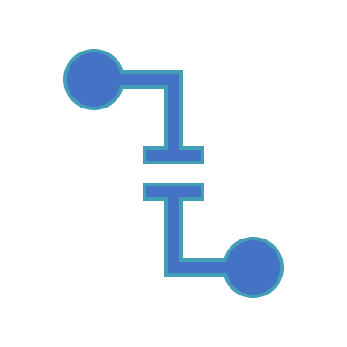
Conclusion
Threat model your work
Work with a security advisor from start to finish!
Products don’t stop cyberattacks, process does.
Learn more
Notes:
Source: Microsoft.com

Slide 34

Thank you very much
Any Questions?
Contact: joel@smarttech247.com

Slide 35
Threat Modeling Learning Resources
SDL Blog
All threat modeling posts
http://blogs.msdn.com/sdl/archive/tags/threat%20modeling/default.aspx
Books
The Security Development Lifecycle: SDL: A Process for Developing Demonstrably More Secure Software (Howard, Lipner, 2006) “Threat Modeling” chapter
http://www.microsoft.com/mspress/books/authors/auth8753.aspx
MSDN Magazine
Reinvigorate your Threat Modeling Process
http://msdn.microsoft.com/en-us/magazine/cc700352.aspx
Threat Modeling: Uncover Security Design Flaws Using The STRIDE Approach
http://msdn.microsoft.com/msdnmag/issues/06/11/ThreatModeling/default.aspx

Slide 36
References
https://www.cs.montana.edu/courses/csci476/topics/threat_modeling.pdf
https://cybersecurity.ieee.org/blog/2015/11/13/authorize-after-you-authenticate/
https://owasp.org/www-community/Application_Threat_Modeling
https://users.encs.concordia.ca/~clark/courses/1601-6150/scribe/L04c.pdf
https://owasp.org/www-pdf-archive//Slide_Deck_-_Threat_Modelling.pdf
https://www.slideshare.net/sapran/threat-modeling-101
https://www.nttsecurity.com/docs/librariesprovider3/resources/uk_thought_leadership_innovation_resilient_cyber_uea_v2
https://www.mitre.org/sites/default/files/publications/PR%2017-0103%20Cyber%20Resiliency%20Design%20Principles%20MTR17001.pdf

