Slide 1
Bitcoin in 2014
Concept
  Gold and Fiat Currencies
  Crypto Gold
Technology
  Mining
  Block Chain
Infrastructure
  Bitcoin Security
  Got Goxxed?
  Government Regulation

Slide 2
Concept
We Use Coins
  http://www.youtube.com/watch?v=Um63OQz3bjo

Slide 3

Historical Gold Standard
  In the 1800s US had a bimetallic (gold and silver) system of money
  True gold standard in 1900 (Gold Standard Act)
    Effectively ended in 1933 with outlawed private gold ownership in the middle of the Great Depression
  1946 Bretton Woods System
    35USD/ounce
    Fixed exchange rates
    Ended on August 15, 1971
  The gold standard has not been used in any major economy since that time

Slide 4
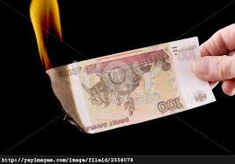
Fiat Currencies (So Far...)
Paper money systems started in 11th century China
  All Chinese fiat paper ended in inflation and currency disaster
  Only the Ming Dynasty survived an experiment with paper money
  By voluntarily ending it and returning to hard commodity money
In the West paper currencies date back to the 17th century
  “Paper money eventually returns to its intrinsic value – zero.” (Voltaire, 1694-1778)
  All previous Western fiat currencies failed, too

Slide 5
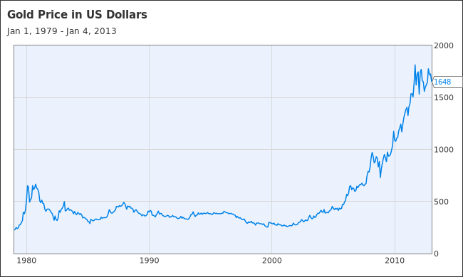
Gold (or Fiat^-1)

Slide 6
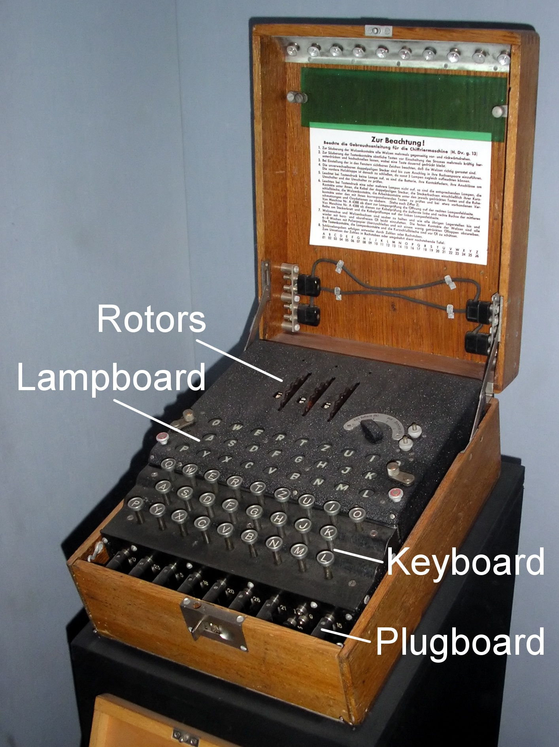
Crypto Gold
A new kind of money
  First decentralised electronic currency
  Peer-to-peer
  Miners provide “Central Bank” functionality
  Open Source – reference implementation

Slide 7
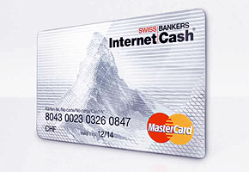
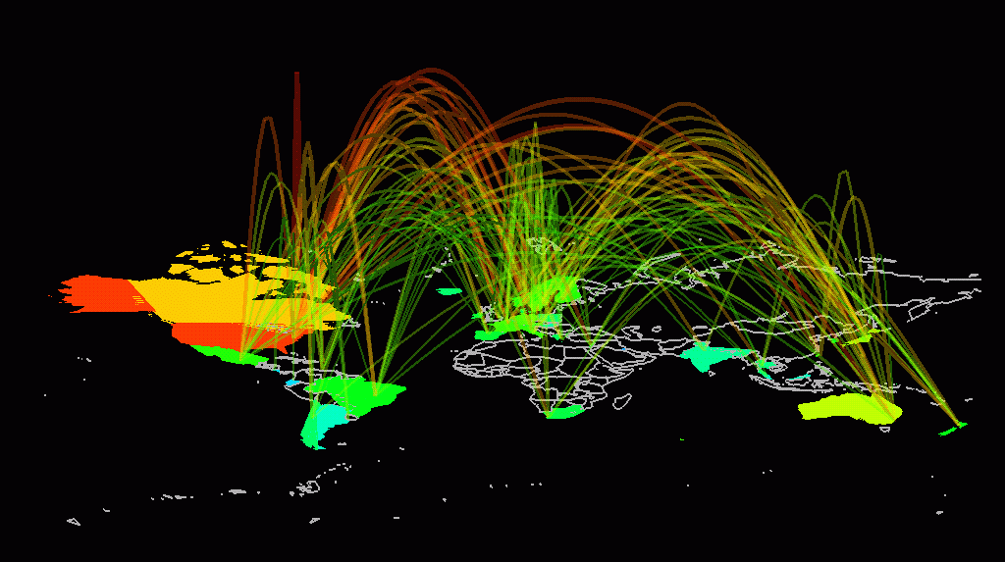
Money for the Internet
Bitcoin is more efficient than competing currencies
  Leverages Moore's Law
  Leverages Metcalf's Law
  “Pure” free market
  No National borders

Slide 8
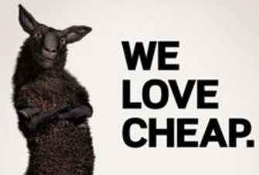
Its Cheap to Use!
Very small transaction cost
  Think email, not post office
  Think Skype, not phone company
  Think PCs (or smart phones), not bank mainframes

Slide 9
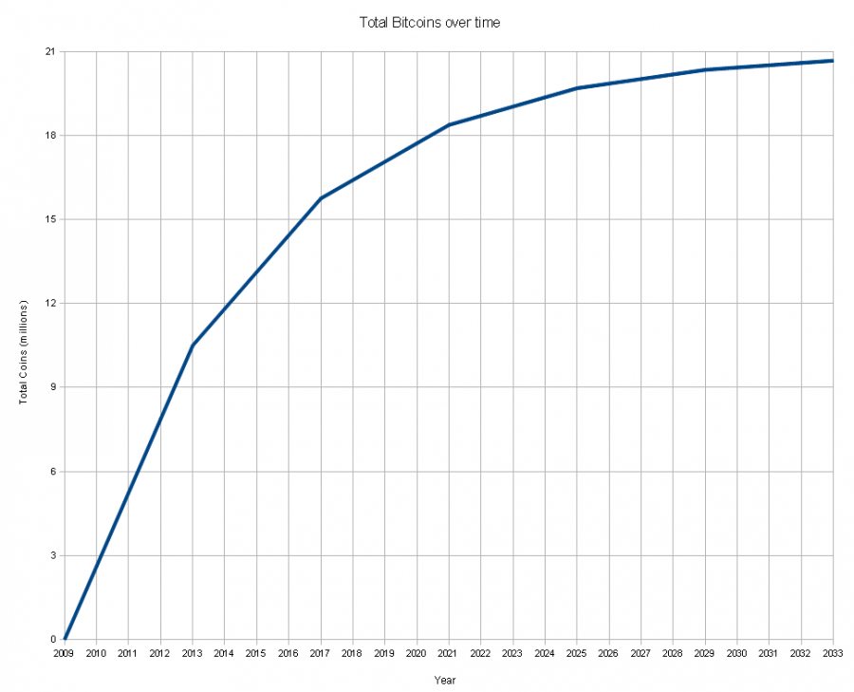
Bitcoin Inflation

Slide 10
Crypto Tech
What is Bitcoin Mining?
  http://www.youtube.com/watch?v=GmOzih6I1zs
How Bitcoin Works Under the Hood
  http://www.youtube.com/watch?v=Lx9zgZCMqXE
The Block Chain
  https://blockchain.info

Slide 11

Got Goxxed?
Mt Gox and “Transaction Malleability”:
  Transactions are signed
    However the signature does not currently cover all the data in a transaction that is hashed to create the transaction hash
    Therefore possible for a node on the network to change a transaction sent
  i.e. the hash can be invalidated (note: this just changes the hash)
  The output of the transaction remains the same
  The Bitcoins will still go to their intended recipient.
Mt. Gox was re-sending Bitcoins when it was reported to Mt. Gox that the orginal transactions had invalid hashes
  Transaction malleability was known for a number of years
  Non-Mt. Gox wallet implementations were already aware of this “feature” of the Bitcoin protocol
  (partially from https://en.bitcoin.it/wiki/Transaction_Malleability)

Slide 12
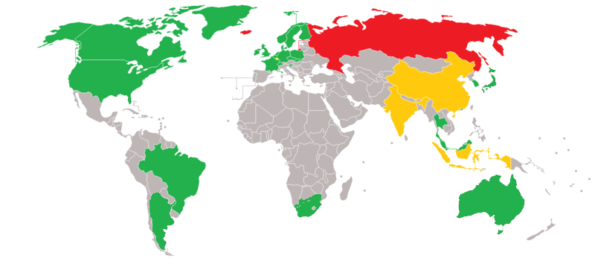
Government Regulation

