Slide 1

Is Bitcoin about to become a casualty of its own success?

Slide 2
Overview
Speaker & ITB Master’s
Bitcoin basics
Analysis Gap & Mining methods
Model development - Variables
New System &Findings
Effects on other Crypto-Currencies
Conclusion

Slide 3
Master’s InfoSec & Digital forensics
Fulltime Taught Masters – 12 months
Cryptography & Secure Data
Network security – SO / SNORT / metasploit
Digital Forensics – FTK / sleuth Kit
Cyber-crime Investigation – Wireshark / Maltego
BC/DR – Complete Plan
Biometrics – All – IRIS / Face /
Project 12 week –
26/13/9

Slide 4
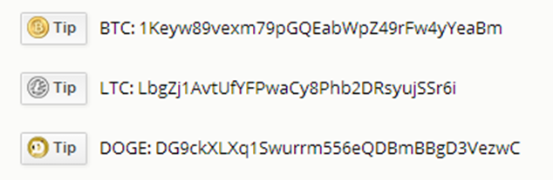
Virtual / Digital / Crypto-currencies
Bitcoin’s computational output world-wide is currently over 1,537,444 petaFlops per second (Watch, 2014)
Top 500 supercomputers computing power as of June 2014 = 273.8 PetaFlops per second (Top500, 2014)
Bitcoin is about 5600+ times more powerful. (Jul 14)

Slide 5
Crypto-currency Basics
Total Crypto-currency value $4.6 Billion
Bitcoin value at $4.3 Billion
Current Max Bitcoins 21million
Current Max Litecoins 84 Million
Crypto-currencies 472 as of august 2014
US dollars in circulation 1.29 Trillion & €959 euro
In god we trust – no Gold standard.
Bolivia / Ecuador Ban Bitcoins (May /July 2014)
Mostly covered by Money laundering legislation (exchanges targeted – ID all account holders)
Bitcoin ATM in Dublin March 2014

Slide 6
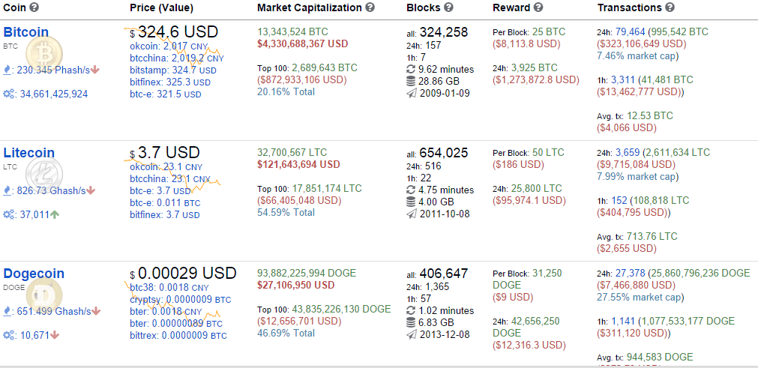
Bitcoin Basics

Slide 7
Bitcoin – Nakamoto 2008 / 2009 Genesis block
Proof of work (PoW) – solve a puzzle with some computational work that requires some effort in one direction but is very easy to verify. This effort adds an element of trust in the user as they are going to the effort of carrying out a specific task to have a transaction accepted. Bitcoin uses the SHA-256 hashing algorithm. Litecoin uses the Scrypt algorithm.
Nonce – in essence is a random number added to a block that gets incremented to achieve a specific hash output of the block
Block-chain – is a public ledger of all successful transactions shared to every node and a hash of the previous block
The block-chain output hash has to conform to a specific format comprising normally a specific number of leading Zero’s. The nonce is changed to allow the Hashing algorithm to achieve this specific Hash output.

Slide 8
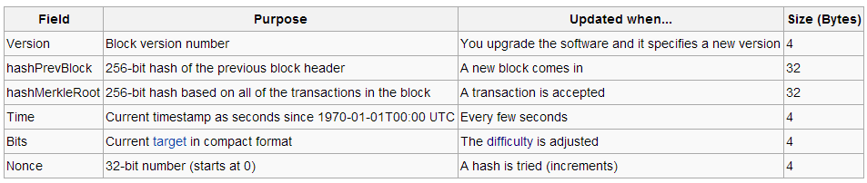
The Bitcoin header is 80 bytes - regardless of the number of the transactions HashMerkleRoot included in the header is a hash of the transactions.
The 1st transaction in “your” block will be to an address you set and hence the Merkle hash will be different for every node.
The difficulty level ensures a block output approx. every 10 minutes regardless of computing power used. (recalculated every 2016 blocks or about 14 days)
This is reflected in the number of leading ZERO bits in the hash output.
Bitcoin uses the SHA256 from
SHA256(SHA256(Block_Header)) (O'Dwyer & Malone, 2014). (16min)

Slide 9
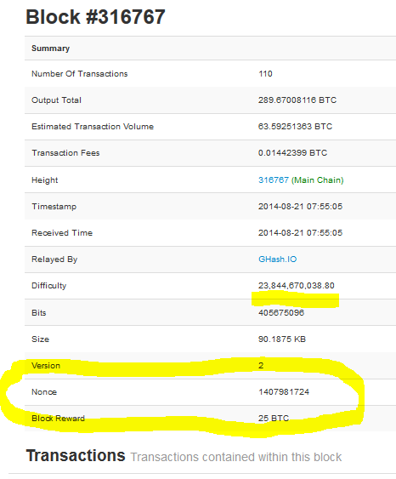

Slide 10
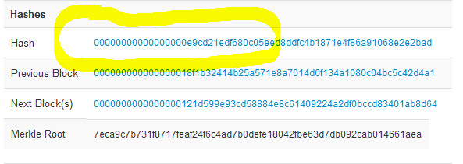
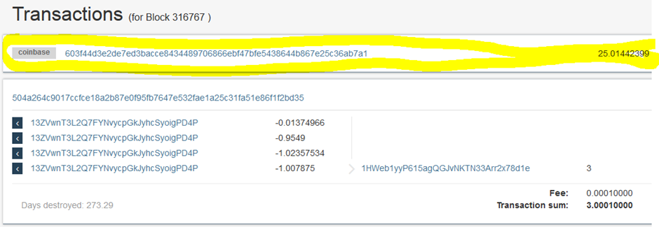

Slide 11
Gap / Mining
Work by Karl O’Dwyer & David Malone – ISSC 2014
0.1 – 10 MegaWatts – some concerns regarding ASIC’s
Power usage - Mining Equipment
PC – icore7 – 190watts = 66Mhashs/s
GPU – ATI 7970 – 214+ watts = 555-825 Mhashs/s
FPGA’s – ButterflyLabs – USB 80Watts = 832 Mhashs/s
ASIC’s – depending on the technology currently at 28 / 20nm (Haswell at 22nm) best device 0.45 watts per Ghash/s

Slide 12
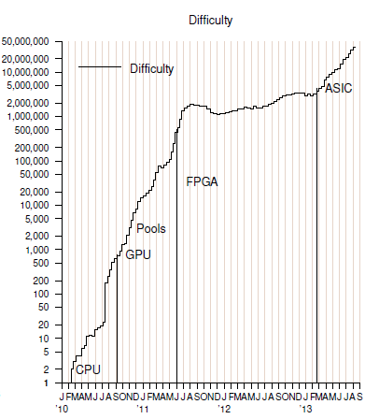
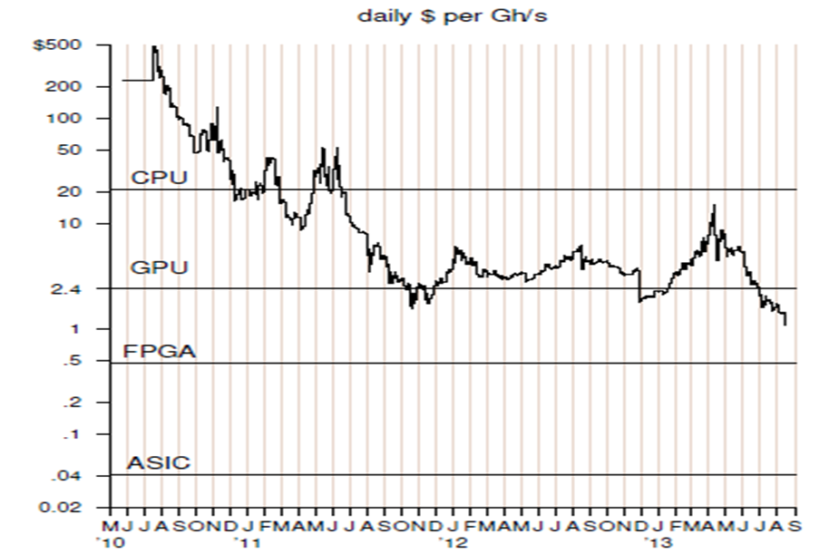
Difficulty now at 34,661,425,92

Slide 13
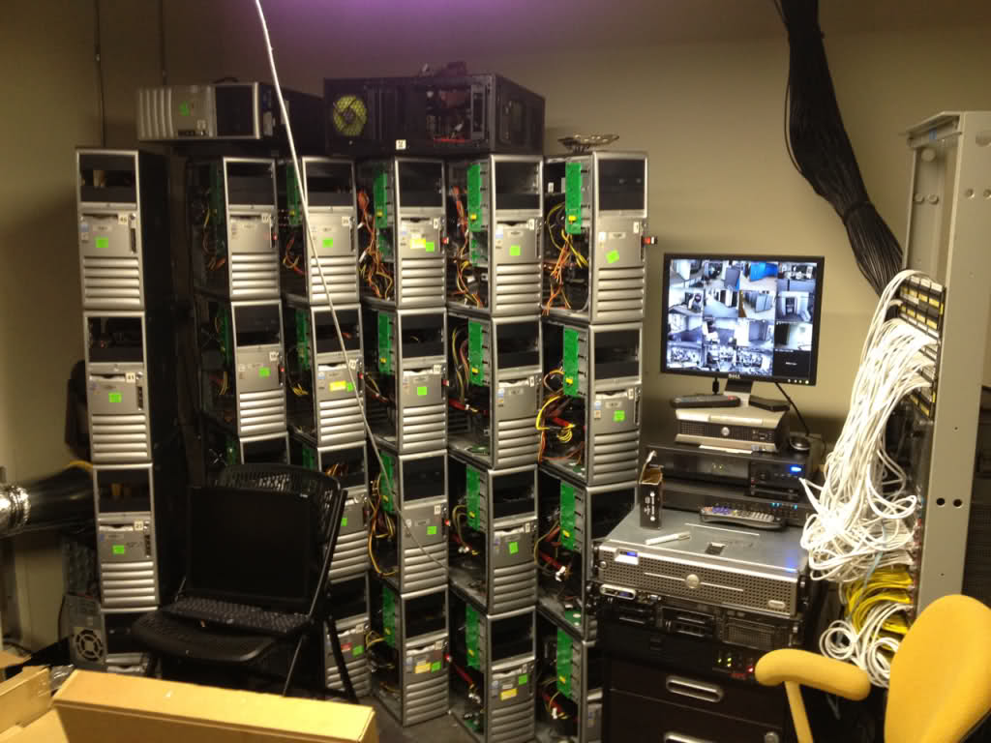
Mining Rig’s

Slide 14
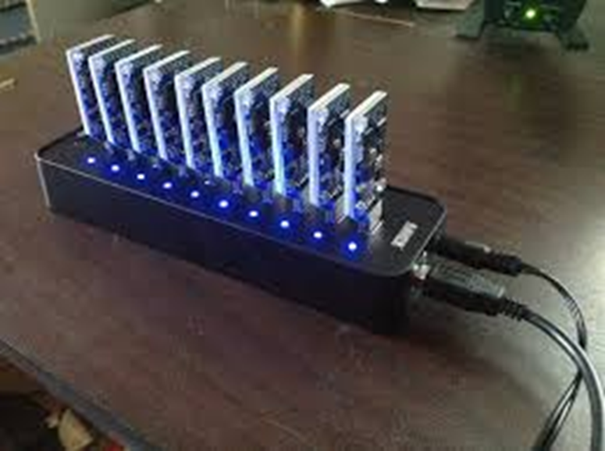
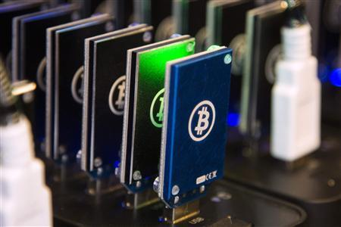

Slide 15
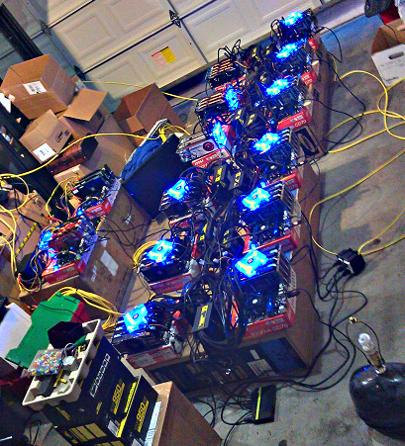

Slide 16
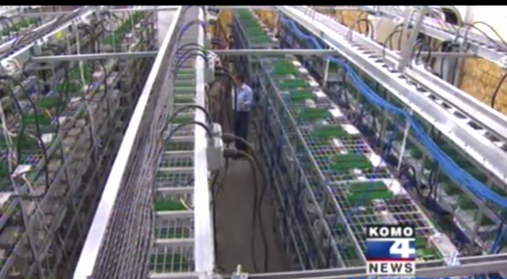
Producing $8 million

Slide 17
Model Development - Variables
This an approximate Model and the Key is in finding acceptable variable values.
Power Consumption - Energy cost (US EIA, 2014) (Eurostat, 2013), Industrial (9.71US+12.39EU) / 2 = 11US cents. (Miners worldwide best compromise)
Price of bitcoins – Today $325 ($1,300 ML BoA)
Hashing Growth – Researched and calculated
Watts per GH/s – Researched and calculated
Future changes - identified

Slide 18
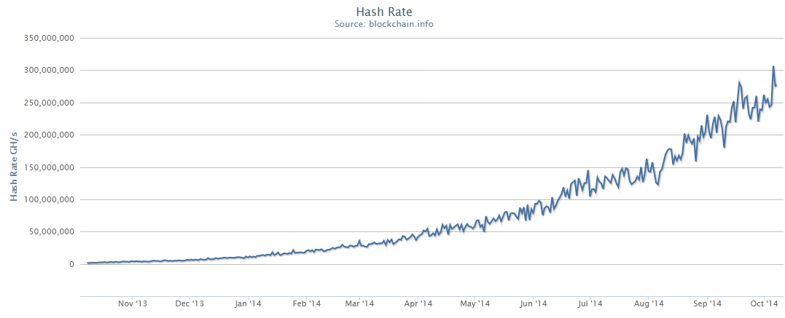
Hashing Growth – 48.8% month on Month

Slide 19
New System
Current available mining ASIC systems
average power consumption per GH/s of 0.85watts (9,055 / 10,700)
Device | Manufacturer | GH/s | Watts | Price
TerraMiner IV | CoinTerra | 2,000 | 1200 | 5,999
Neptune | KNC Miner | 3,000 | 2100 | 9,995
Zeus | HashCoins | 3500 | 3100 | 8,799
Sierra Batch 2 | HashFast | 1,200 | 780 | 7,080
CoinCraft Desk | Bitmine | 1,000 | 1875 | 7,099
 |  | 10,700 | 9,055 | 38,972

Slide 20
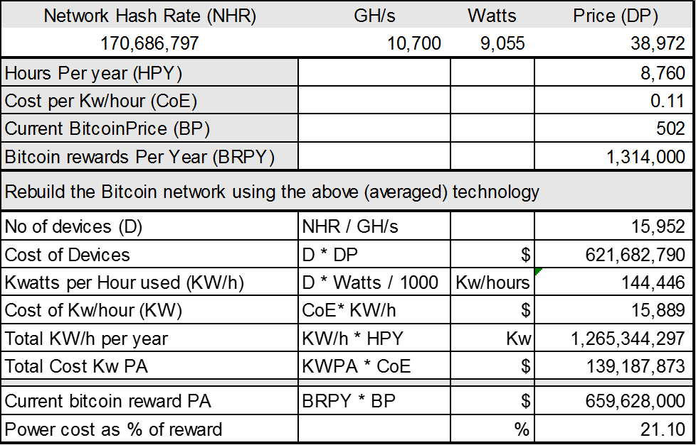
New system rebuilt using 5 devices above
The new Bitcoin network would consume 144 megawatts per hour.
Cost $621 million to build (without discounts)

Slide 21
Technology on the way
Next level of technology
This information allows us to calculate the average power consumption per GH/s of 0.57watts (5,600 / 9,800).

Slide 22
Findings

Slide 23
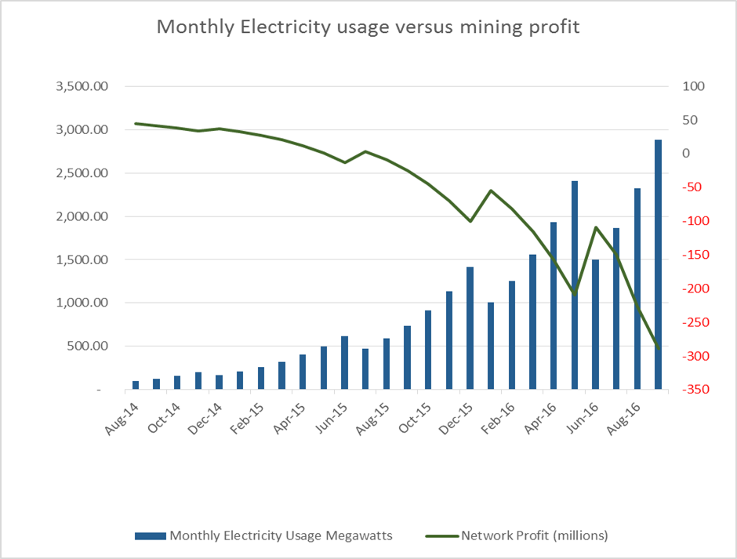

Slide 24
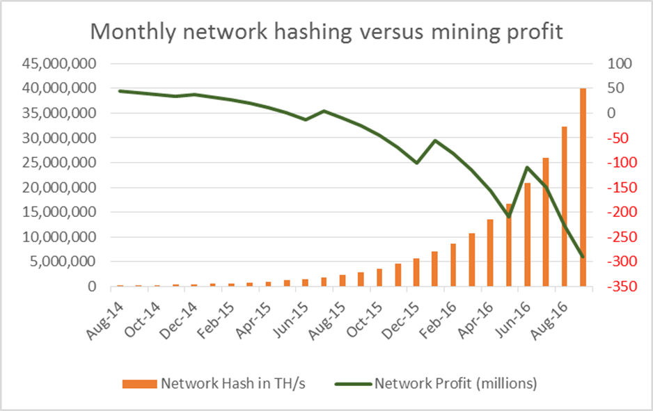

Slide 25
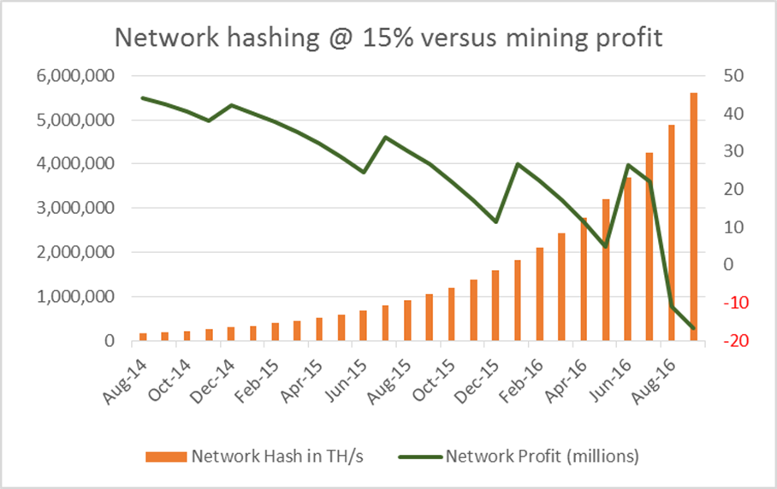

Slide 26
New mining entrant
If a person decided to mine Bitcoins using the best available system under the following conditions:
If the Growth remains constant at 15%
new rig was available from 1st of January 2015
energy cost 0.11 US cents per Kilowatt/hour
The rig purchased was SP1 Yukon 5.5 TH/ s – 3Kw - $ 3,920
Ran 24/7/365 for 1 year. (no down time)
The Bitcoins could be sold for $650 each
The percentage of hashing power was equal to the percentage of reward!!!!!!
Then the rig could earn $7,010 against costs of $6,771 – Profit ~= $249

Slide 28
Effects on other Crypto-Systems
This is a Mining Cost problem and any crypto currency relying on Mining for security will either change or die.
Security wise you cannot rely on people turning off their rigs – if they are turned on - 51% issue
Different algorithms change the timing.
Litecoin Network Hashing rate is about to rise considerably as and from Jan 15 – due to the availability of ASIC rigs. (25 LTC reward Oct15)

Slide 29
Conclusion
Rate of Hashing Growth (devices added to the network) could as soon as next year effect the Economic security of the Bitcoin mining process.
30th of Sept. – 263 TH/s = 224 Megawatts/per hour or $17.75 million average cost per hour. (850 W/Th/s)
If Price = $325 + cost =0.11 and growth = 48% then as of Nov 2014 network loss = 4 million
If Price = $750 + cost =0.08 and growth = 24.4% then as of Oct 2015 network loss = 10 million
Remember reward halves around July 2016

Slide 30
Let nature take its course (Do nothing) and the system will rebalance itself !!!!!
Increase the fee’s charged on transactions – one of the biggest advantages “almost free” would be killed off.
Change the algorithm and force the redevelopment of the ASIC chips – a very drastic measure that would be very difficult to implement.
Move to another Crypto-currency - Watch the pre-mined crypto-currencies Ripple / Stellar (Paypal / Stripe competitors) (Jeb McCaleb MtGox founder & Collison brothers)

Slide 31
Litecoin
Litecoin is about to be hit with a considerable amount of growth due to the 1st generation of ASIC mining rigs becoming available at the end of this year and the start of next year.
This could range from 2TH/s to 4 TH/s+ hashing power increase to current Litecoin hashing power 0.7 TH/s.

Slide 32
Questions ?

Slide 33
Thank You

