Slide 1
Lock picking

Slide 2

This talk will cover...
What is Lock picking & why does it matter?
Pin Tumbler Locks
Picking & Raking
Security Pins
Bypass
Prevention
Notes:
What is Lock picking & why does it matter?
Pin Tumbler Locks
The mechanism & what makes the lock vulnerable
Picking & Raking
Security Pins
Bypass

Slide 3
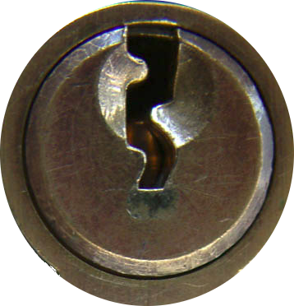
What is Lock picking?
Non-destructive form of entry
Manipulation
Fun!
*Only attack locks you have permission to attack!
Notes:
Non-destructive form of entry
Manipulation
Manipulation of lock components
Fun!
Locks are like puzzles.
Locksport
Need permission to pick!

Slide 4
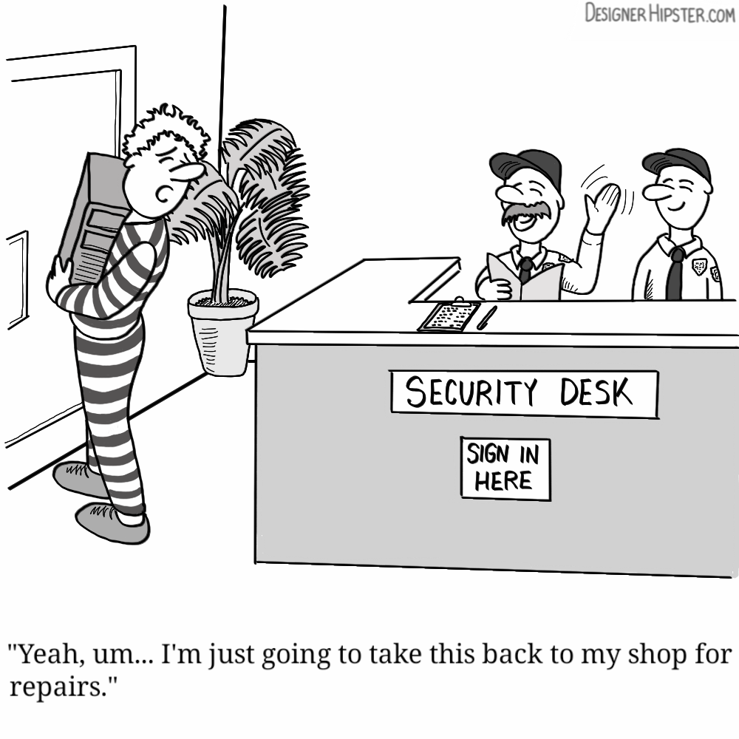
Why does it matter?
Physical Security
Notes:
Physical Security
No point having a state of the art IT security system when physical access is easy.
IT should consider physical security strongly, especially for the likes of sever rooms.

Slide 5
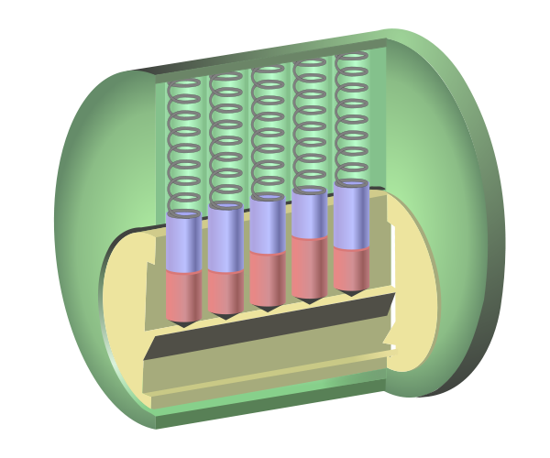
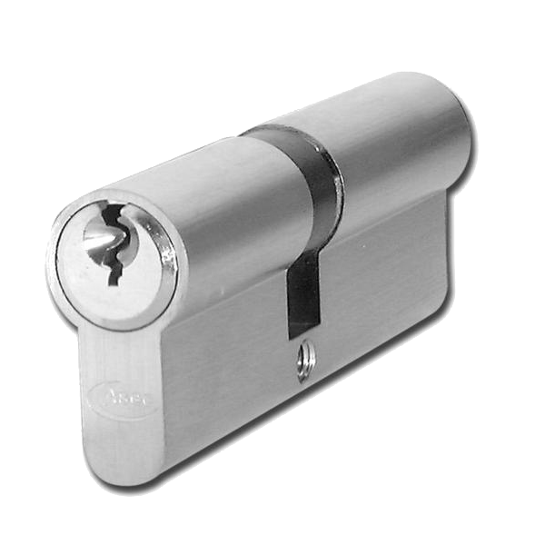
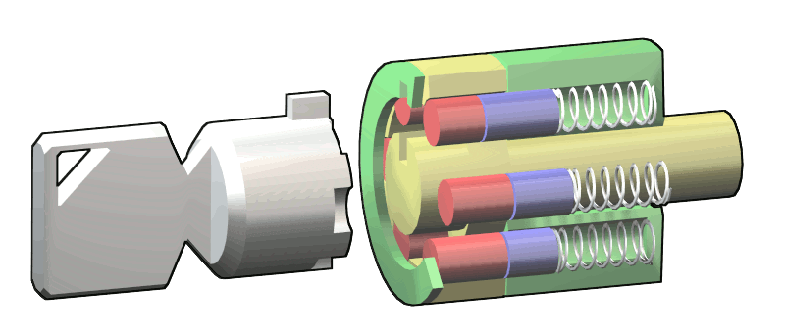
Pin Tumbler Lock
Found in...
- Cylinder Locks
- Tubular Pin Tumbler Locks
Notes:
Pin Tumbler
Very common lock
Found everywhere from your front door to padlocks
Very susceptible to attacks

Slide 6
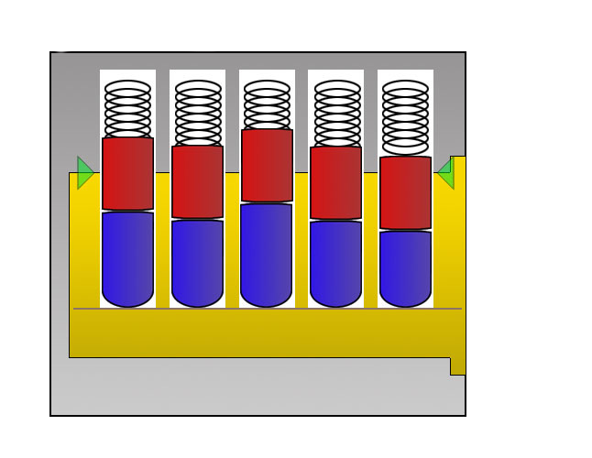
Pin Tumbler Lock
Components
Shell
Plug
Driver Pins
Key Pins
Shear Line
Notes:
Components in your average lock...
Shell
Plug
Pin stack – Pushed by springs
Driver pins
Key pins
Shear line
Keyway

Slide 7
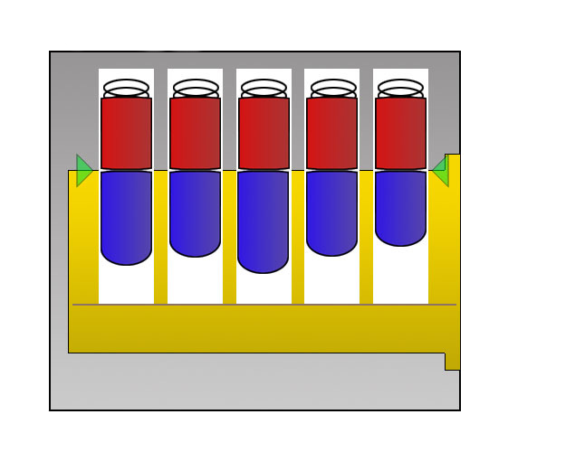
Pin Tumbler Lock
When the pin stack is split at the shear line, the plug may turn.
Notes:
In order for the plug to turn, the pin stack must be split at the shear line. Key pins remain in the plug while the driver pins stay in the shell.
When the plug turns, the lock can unlock/lock.

Slide 8
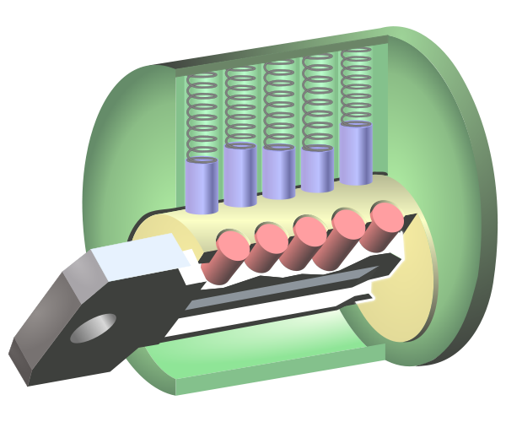
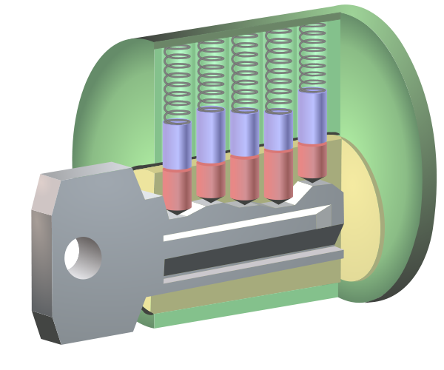
Pin Tumbler Lock
This state should only be reached then the correct key is inserted.
Notes:
The heights of the pin stacks can vary, therefore a correct key can be made for a lock which will allow it to open.
On paper, this design should work perfectly.
Questions on mechanism?

Slide 9

Pin Tumbler Lock
Imperfections in the lock can be exploited.
The Binding Effect
    - Caused by minute differences in pin diameter
    and/or pin chamber alignment.
    - When tension is applied to the lock, the
    only one pin will bind against the chamber.
    - This pin can then be set and the next largest
    pin will bind.
Notes:
But it doesn't...
Components in locks should be the exact same, but it is not possible to do this.
(Pins, pin chambers)
All pins should bind at the same time.
In reality, Only one will bind.
This is the binding effect.

Slide 10
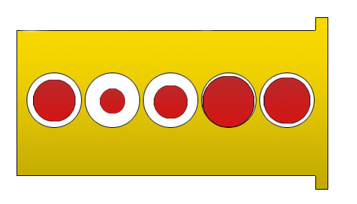
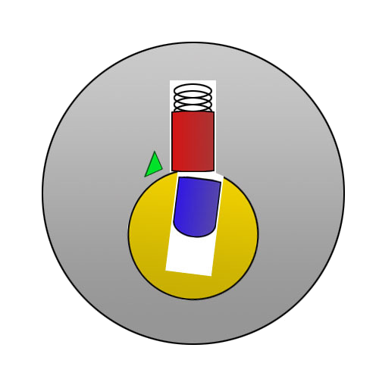
Pin Tumbler Lock
Exaggerated example of imperfect pins:
When a pin is set, the next binding pin will allow the plug to rotate just enough to hold the set pin in place.
Notes:
The order the pins bind is the “Binding Order”
The example order would be 21534
When a bind is set, it cannot return back to the normal position, due to the difference in size.

Slide 11
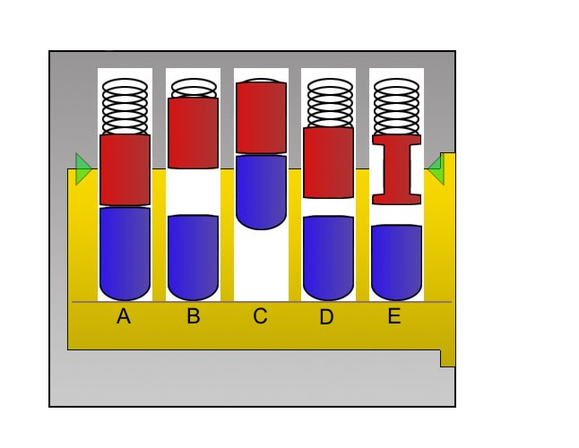
Pin Tumbler Lock
Pin States
A) Resting
B) Set
C) Over Set
D) Under Set
E) False Set
Notes:
Before we get into picking...
The states a pin can be in
Resting,
Set,
Overset – key pin in shell,
Underset – driver pin in plug,
False set – more later

Slide 12
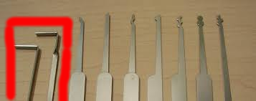
Picking & Raking
Tension is applied to the lock using a Tension (Torsion) Wrench. (Shown in red)
The binding pin is set using a Pick or a Rake.
Notes:
Use a tension wrench to apply tension.
When tension is applied, the binding pin can be found
This pin can then be set using a pick or a rake.

Slide 13
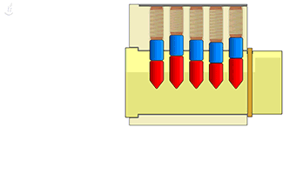
Picking
Steps:
  1. Find binding Pin
  2. Set it
  3. Repeat
  Speed Bump Method
  - Place the pick at the rear of the lock
  - Drag over the pins until a pin doesn't feel as
  responsive as the others. This is the Binding
  pin.
  - Set the pin and repeat.
Notes:
Set all bindings pins and the plug can turn.
The binding pin...
- All other pins will feel light and springy.
- The binding pin will feel heavier and not as responsive.
One method to find it is the Speed bump method.

Slide 14
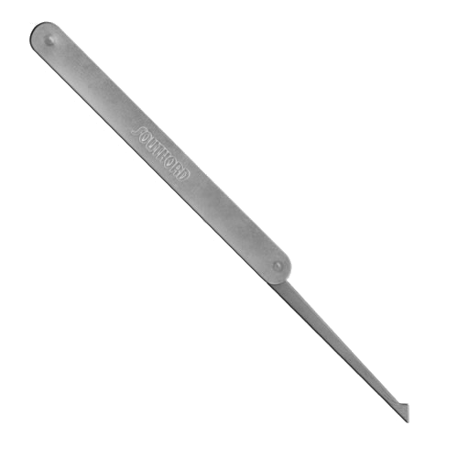
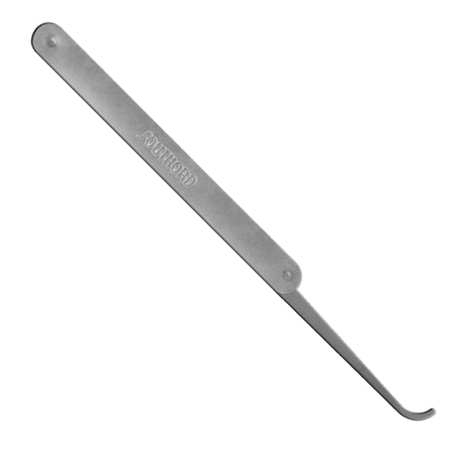
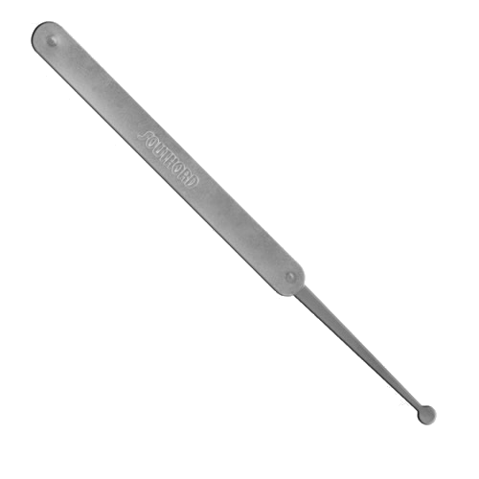
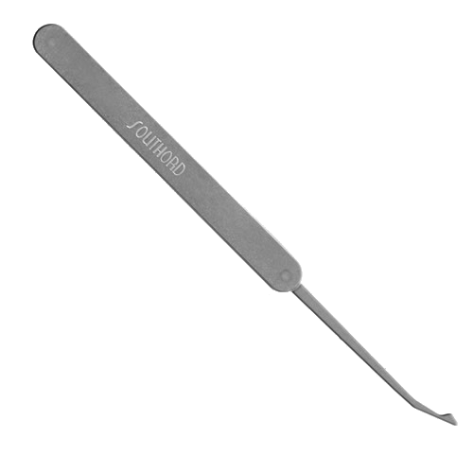
Picking
Common Pick Types
Half-Diamond
Hook
Single Ball
DeForest
Notes:
Common pick types...
All down to personal preference and which ever pick will work In the lock.

Slide 15
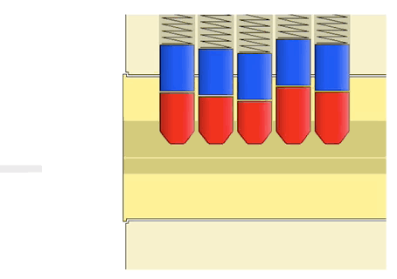
Raking
More aggressive than
picking.
Aim is to bounce the driver pins into the set position.
This is done by quickly running (or “raking”) a rake back and forth over the pins.
Notes:
More aggressive than picking
The idea is to pull a rake back and forth over the pins which should bounce the driver pins up and set them.
Works very well for some locks and speeds things up
However, It can damage the lock and will leave a greater forensic fingerprint.

Slide 16
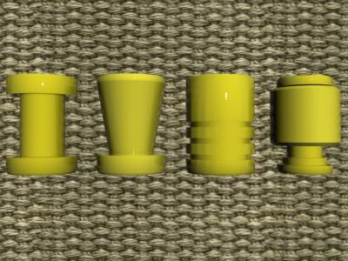
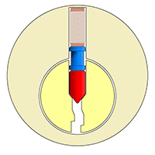
Security Pins
Security pins can be used in place of a regular driver pin, key pin, or both.
The aim is to have the pin get caught at the shear line, disrupting the picking attempt.
Many types; Mushroom, Serrated, Spool....
Notes:
Security pins were created to try prevent picking.
They don't prevent, but do frustrate the picking attempt.
The idea is to have these pins get caught on the shear line using a notch or serration.

Slide 17
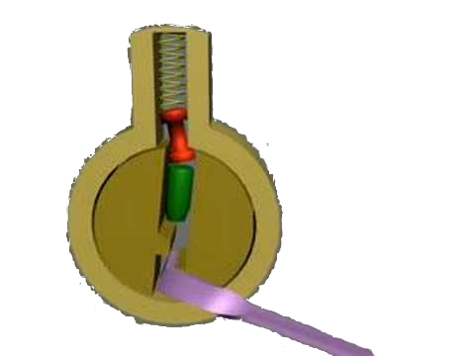
Security Pins
Spool Pin
    - Most common type of
    security pin.
    - Contains a long narrow center.
    - This pin will bind only when all other pins
    have been set. This creates a “False Set”.
Notes:
Spool Pin
- Most common type of
security pin. They're cheaper!
- Contains a long narrow center.
- This pin will bind only when all other pins have been set. This creates a “False Set”.

Slide 18
Security Pins
Spool Pin
    - They can still be beaten!
    - When a Spool Pin binds, it identifies itself.
    -When it is identified...
        >Apply pressure to the pin
        >Reduce the tension until the pin sets.
        >Reset any pins which have unset in the process.
Notes:
- When a Spool Pin binds, it identifies itself.
-When it is identified...
>Apply pressure to the pin
>Reduce the tension until the pin sets.
>Reset any pins which have unset in the process. Makes a big difference when multiple spool pins are present

Slide 19
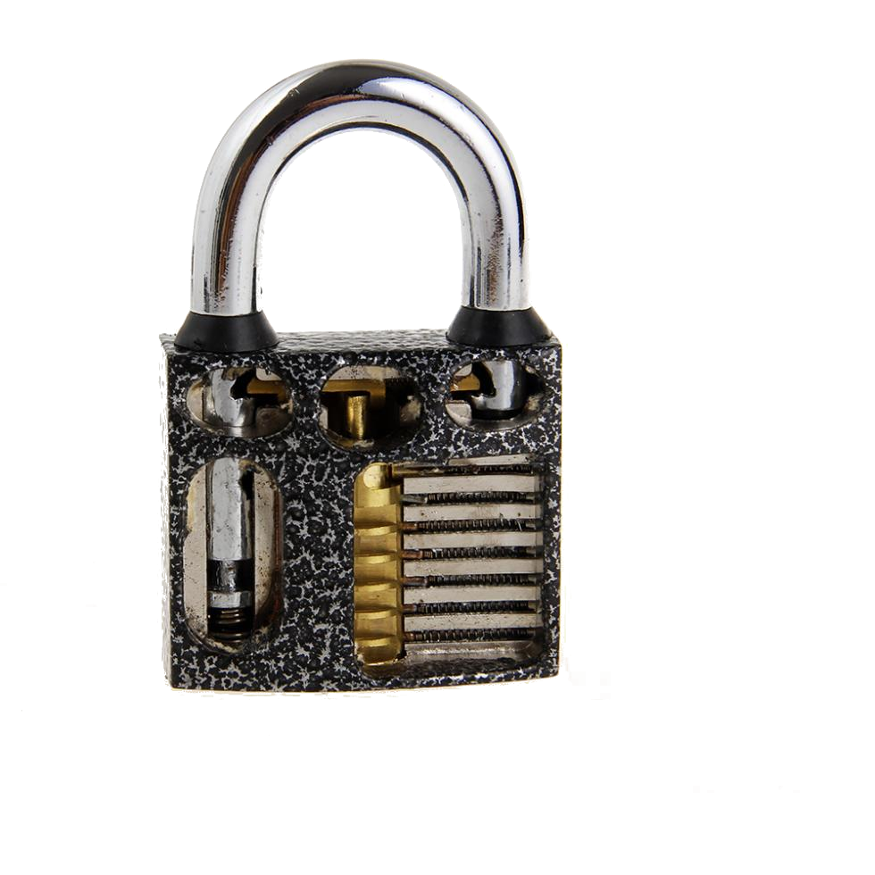
Bypass
Lock mechanisms on some padlocks can be bypassed altogether.
This is made possible
by lack of a “shield”
between the key way
and the actuator.
A tool is inserted through
the key way and used
to move the actuator,
opening the lock.
Notes:
Some padlocks don't need to be picked
Without a shield, the bolting mechanism of a padlock can be reached through the keyway.
The actuator in the mechanism can simply be moved and the lock will pop open.

Slide 20

Prevention
For high security locks, security pins are not enough.
A “Side-Bar” adds another obstacle to the picking process.
A shield in a padlock can prevent a bypass.
The shield is an object which simply divides the key way from the bolting mechanism.
Notes:
There's a variety of ways to prevent different types of attacks.
One generic method is the use of a side bar, which acts like a secondary mechanism which must be solved.
Can still be beaten!
A shield is a simple solution to bypass.
Usually not used due to cost.

Slide 21
Questions?

