Slide 1

From Flows to Sprays (Windowsx86)
Eoin Carroll
IT Security Engineer

Slide 2
1
2
3
4
5
Exploitation Classifications
Overflows
Sprays
Bypasses
EMET

Slide 3
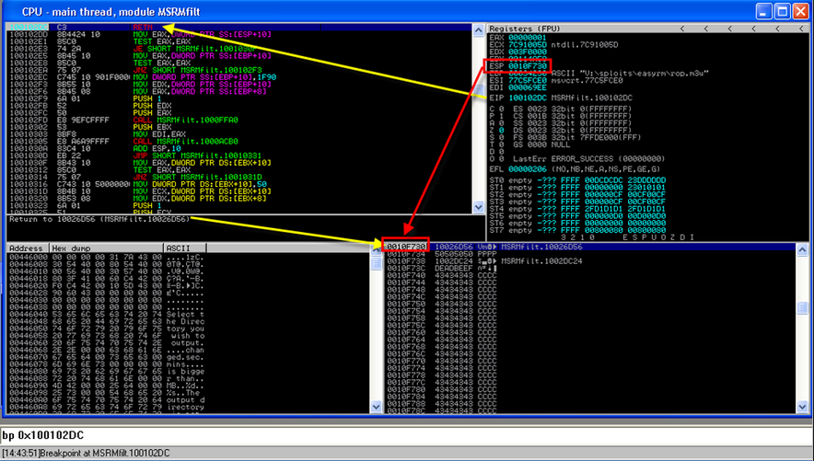
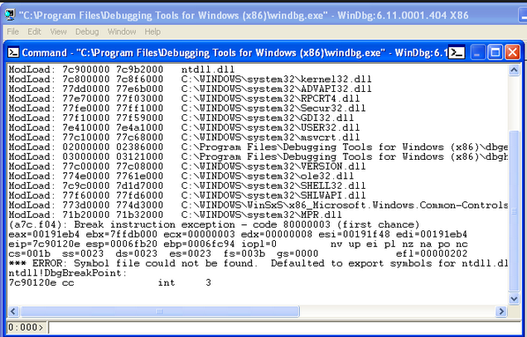
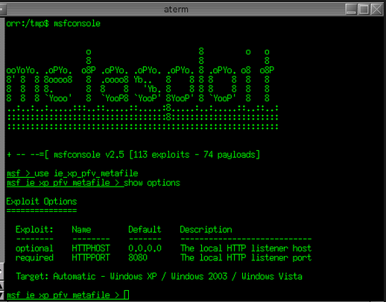
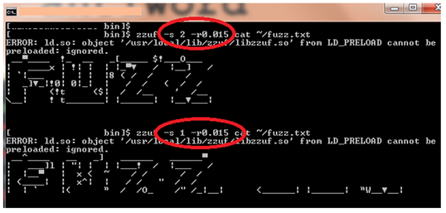
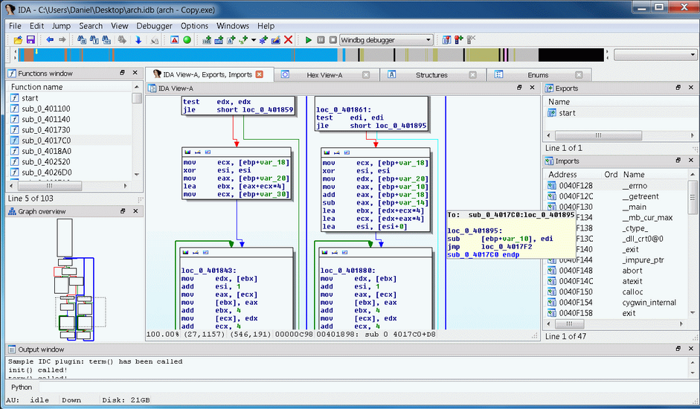
Arsenal

Slide 4

General Approach to Exploit Dev
Get ur Shellcode into memory and then redirect execution
Confirm the crash
Determine if buffer in memory
Determine offset
Every exploit is unique
Absolute addressing? JMP ESP or Call ESP etc…
DEP enabled? Need to use return-to-libc or Return Oriented Programming (ROP)
EIP

Slide 5
1
2
3
4
5
Exploitation Classifications
Overflows
Sprays
Bypasses
EMET

Slide 6
Exploitation Classifications
Overflows
Sprays
Use After Frees
Memory Leaks

Slide 7
1
2
3
4
5
Exploitation Classifications
Overflows
Sprays
Bypasses
EMET

Slide 8
Overflows
Buffer Overflow == Stack Overflow ?
SaveRetn
Buffer
Format String
Functions/ Pointers
SEH/Stack
Integer
OffbyOne
Object/
Vtable

Slide 9
Overflows
#include <string.h>
void do_something(char *Buffer)
{
char MyVar[128];
strcpy(MyVar,Buffer);
}
int main (int argc, char **argv)
{
do_something(argv[1]);
printf("Done\n");
}

Slide 10
Buffer Overflow
Stack Lowest Address
ESP
Space subtracted for variables
What is the stack? How is it generated?
Important AL Instructions and Registers
EBP – base pointer
ESP – stack pointer
EAX – general purpose register
PUSH EBP
POP EBP
Know the difference?
MOV EAX, [EBP]
MOV EAX, EBP
ESP
EBP stored for do_something
EBP
strcpy Stack Frame/Activation record
ESP
EIP stored for do_something
Function Prolog
PUSH EBP
MOV EBP, ESP
SUB ESP, XX
ESP
Param 2
ESP
Param 1
ESP
call strcpy
do_something stack data
Function Epilog
MOV ESP, EBP
POP EBP
RETN
do_something Stack Frame/Activation record
do_something A stack data
EBP

Slide 11
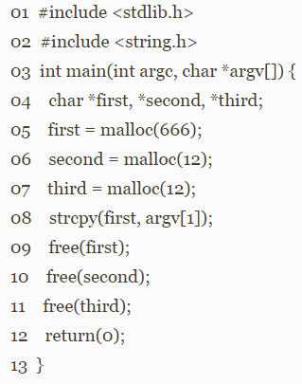
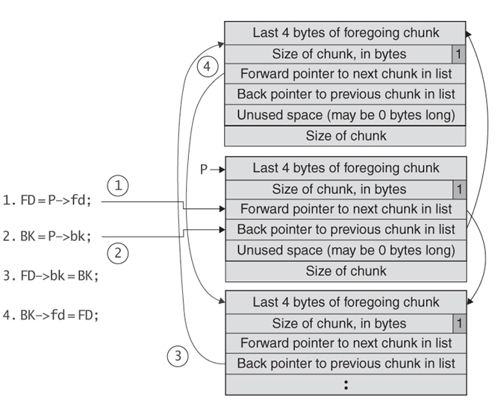
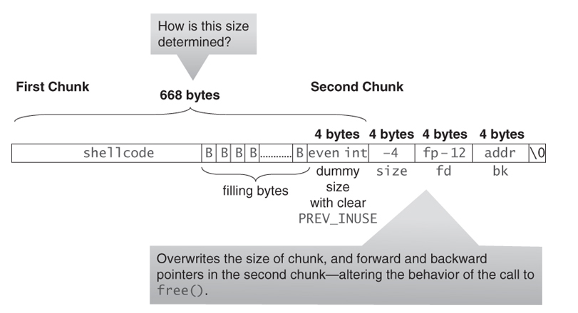
Heap Overflow
Secure Coding in C and C++ (2nd Edition)
Chapter 4. Dynamic Memory Management
by Robert C. Seacord

Slide 12
1
2
3
4
5
Exploitation Classifications
Overflows
Sprays
Bypasses
EMET

Slide 13
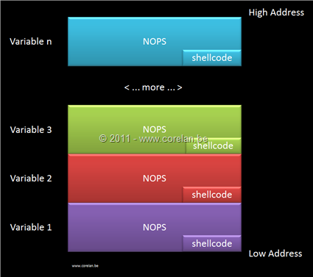
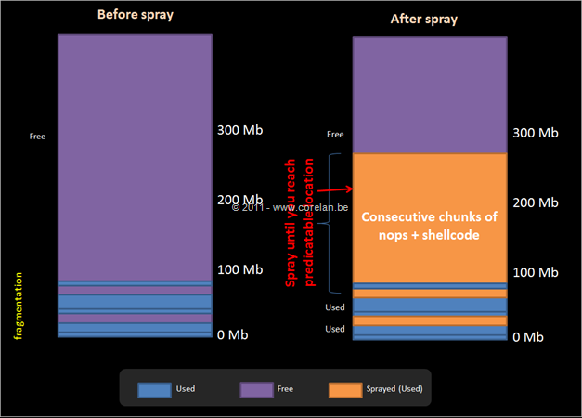
Heap Spray
Heap Spray == Heap Overflow?
Corelan Exploitation Tutorial Series
https://www.corelan.be/index.php/2011/12/31/exploit-writing-tutorial-part-11-heap-spraying-demystified/

Slide 14
1
2
3
4
5
Exploitation Classifications
Overflows
Sprays
Bypasses
EMET

Slide 15
Bypasses
Stack Cookies - /GS CF
SEH (SW DEP)- /safeSEH CF
DEP (HW) – NXCOMPAT CF
ASLR - /DYNAMICBASE CF
SEHOP (Structured Exception Handling Overwrite Protection) – system wide runtime
DEP + ASLR + SEHOP strong protection

Slide 16
1
2
3
4
5
Exploitation Classifications
Overflows
Sprays
Bypasses
EMET

Slide 17
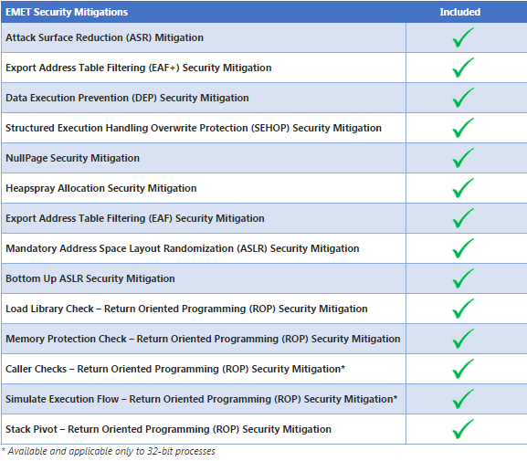
EMET
The Enhanced Mitigation Experience Toolkit ﴾EMET﴿ is a utility that helps prevent vulnerabilities in software from being successfully exploited.
It’s designed to help customers with their defense in depth strategies
against cyberattacks, by helping detect and block exploitation techniques that are commonly used to exploit memory
corruption vulnerabilities.

Slide 18
Some famous well know Exploits
Morris Worm Buffer Overflow
http://www.zdnet.com/article/the-morris-worm-internet-malware-turns-25/
Operation Aurora “UAF and Heap Spray”
http://www.thegreycorner.com/2010/01/heap-spray-exploit-tutorial-internet.html
Memory Corruption Attacks The (almost) Complete History
https://media.blackhat.com/bh-us-10/whitepapers/Meer/BlackHat-USA-2010-Meer-History-of-Memory-Corruption-Attacks-wp.pdf

Slide 19
Resources
Corelan Exploitation Tutorial Series https://www.corelan.be/index.php/articles/
The Grey Corner http://www.thegreycorner.com/
Fuzz Security http://fuzzysecurity.com/tutorials.html
Bypassing Browser Memory Protections
https://www.blackhat.com/presentations/bh-usa-08/Sotirov_Dowd/bh08-sotirov-dowd.pdf
Secure Coding in C and C++ (2nd Edition) Robert C. Seacord

Slide 20
Corelan Course Streams (3 days)
Boot Camp (60% Foundations & 40% Advanced) | Foundations | Advanced
The x86 environment | The x86 environment
Stack Buffer Overflows | Stack Buffer Overflows
Reliability++ & Reusability++ | Reliability++ & Reusability++
 | Unicode
 | Egg Hunters
 | Introduction to shellcoding
Metasploit framework Exploit Modules | Metasploit framework Exploit Modules
Limited Buffers
ASLR Bypass |  | ASLR Refresher
DEP/ROP |  | DEP Refresher
Heap Spraying |  | Heap Spraying
Browser Exploitation |  | Browser Exploitation

Slide 21
Thank You

