Slide 1

The Evolving state of HTTPS
Barry Pollard – January 2017

Slide 2
“We’d like to encourage all website owners to switch from HTTP to HTTPS to keep everyone safe on the web.”
Google
https://webmasters.googleblog.com/2014/08/https-as-ranking-signal.html

Slide 3

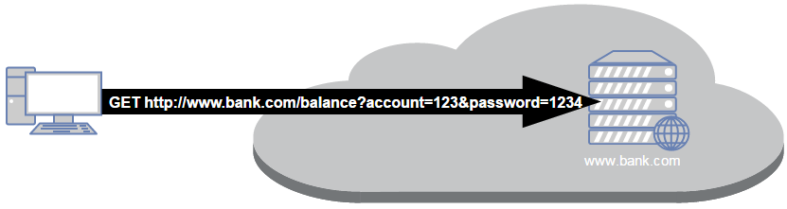

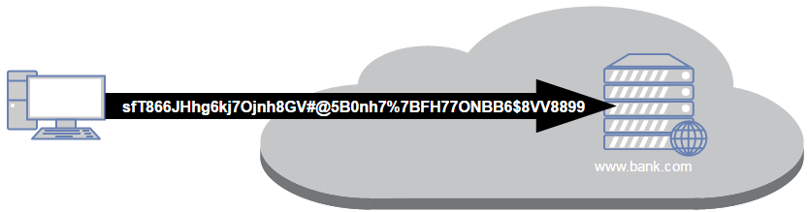
What is HTTPS?
An encrypted version of Hypertext Transfer Protocol (HTTP) – aka the green padlock
HTTP
HTTPS

Slide 4
Why do we need HTTPS?
HTTPS provides 3 key attributes to the transport layer:
Encryption – no one but the recipient can see what you send.
Integrity – no one can alter what you send en route.
Authentication – confidence in who you are talking to.

Slide 5

What does HTTPS not give you?
HTTPS provides encryption over the transport layer only
Does not indicate a safe site, just an encrypted connection.
Does not indicate website is safe from other, non-transport, security issues (e.g. XSS, CSRF, Virsus’s, Malware…etc.).
Does not say what happens AFTER data is transferred.

Slide 6
How does HTTPS encryption work?
HTTPS uses SSL/TLS to add security to the network layer (typically TCP) and encrypts rather than replaces HTTP.
HTTP + SSL/TLS = HTTPS
SSL/TLS uses public key asymmetric encryption to negotiate a secure symmetric encryption key.
Public Key is distributed by Digital Certificates provided by the website and signed by an approved Certificate Authority (CA).

Slide 7
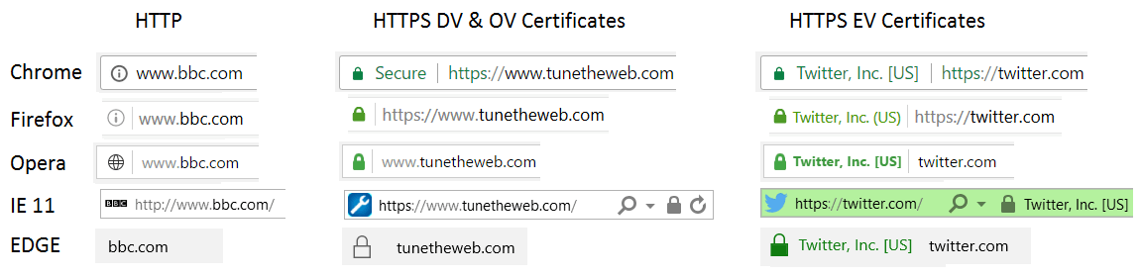
Types of Certificates
Domain Validation (DV)
Organisation Validation (OV)
Extended Validation (EV)
Arguments about whether EV adds any security. Google has stated intent to depreciate it.

Slide 8
Arguments used against HTTPS
HTTPS is too complicated.
…causes performance issues.
…is expensive.
…isn’t needed on my site as I don’t collect credit card details/only run a blog/only have internal sites.
Arguments no longer are valid!

Slide 9
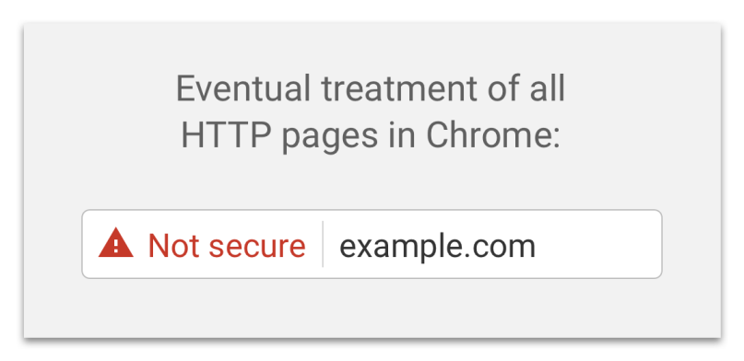
The web is moving to HTTPS
https://security.googleblog.com/2016/09/moving-towards-more-secure-web.html

Slide 10
HTTPS as a ranking signal for SEO
HTTPS is now a (small) ranking signal - https://webmasters.googleblog.com/2014/08/https-as-ranking-signal.html
Referrer data is also only provided from HTTPS sites to other HTTPS sites.
Note: HTTPS is a separate site so need to ensure redirect properly and set up separate Webmaster Tools/Search Console property, or can take a SEO hit when migrating.
Other SEO issues: update sitemaps, rel=canonical links and other links.

Slide 11
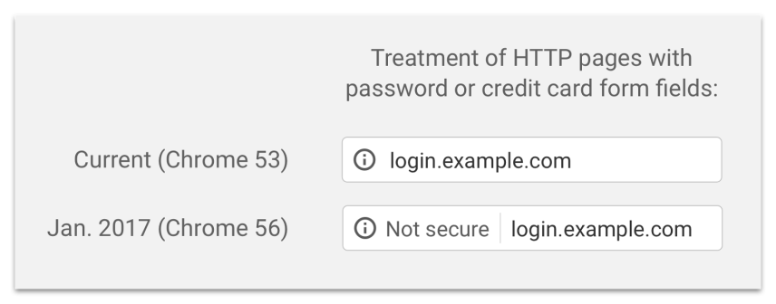

HTTP will get more warnings
Coming from this month (Jan 2017) for Chrome and Firefox:
HTTP pages that ask for login or credit card details will be shown as Not Secure in Address Bar and on the form.
Affects site with comment sections.
Affects intranet sites too!

Slide 12

Performance is no longer a problem
“TLS has exactly one performance problem: it is not used widely enough. Everything else can be optimized.”
Ilya Grigorik, Google - https://istlsfastyet.com/
HTTP/2 will only work with (strong) HTTPS.
https://www.tunetheweb.com/performance-test-360/
HTTPS can now be faster than HTTP – much faster!

Slide 13
Features are being restricted to HTTPS only
Geo-location – already restricted to HTTPS as of end of 2016
Device Motion and Orientation, Video, Microphones
Full Screen
Encrypted Media Extensions (EME) – DRM encrypted media
AppCache
Wordpress has similarly stated that some features (e.g. API Authentication) will only be available over HTTPS in future.
https://www.chromium.org/Home/chromium-security/marking-http-as-non-secure
https://blog.mozilla.org/security/2015/04/30/deprecating-non-secure-http/

Slide 14
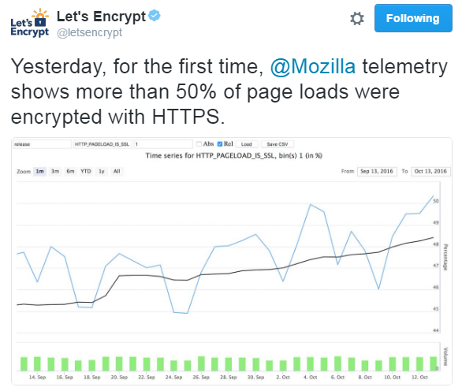
HTTPS usage will soon pass HTTP usage

Slide 15
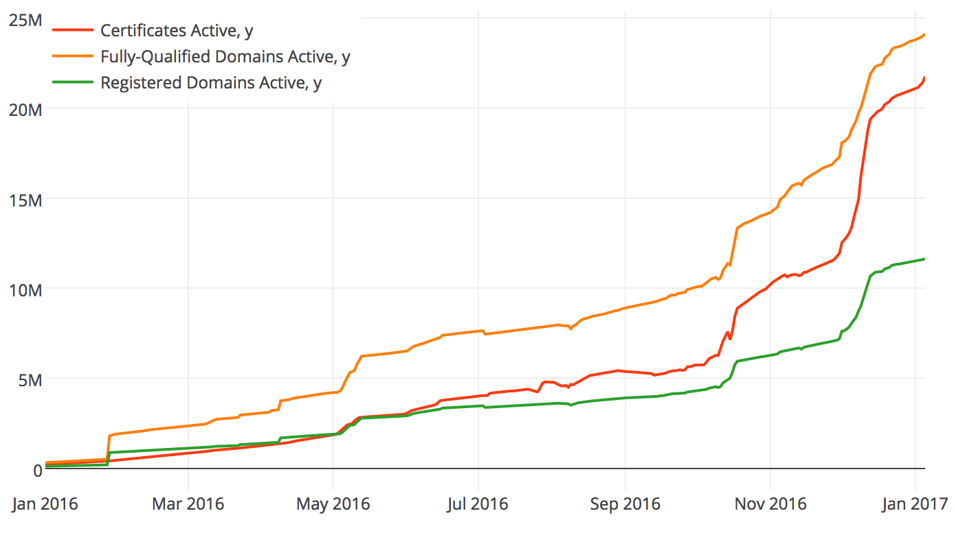
Let’s Encrypt
Free Certificates! Not the first CA to allow this but the easiest.
Public beta since Dec 2015
Ended beta April 2016
Automated
90 day maximum
Already 3rd largest CA

Slide 16
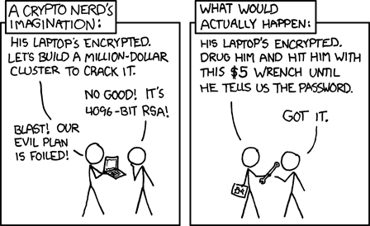
SSL/TLS security issues
Google
https://xkcd.com/538

Slide 17
SSL/TLS security issues
SHA1 Signatures (2015)
POODLE (2014)
Insecure Renegotiation (2009)
SLOTH (2016)
DROWN (2016)
Logjam (2015)
BEAST (2011)
DigiNotar breach (2011)
MD5 Signatures (2004)
CRIME (2012)
BREACH (2013)
SSLStrip (2009)
TIME (2013)
Insufficient key length
FREAK (2015)
Various CA certificate mis-issuances
Heartbleed (2014)
RC4 weaknesses (2013)
Lucky 13 (2013)
SMACK (2015)
SWEET32 (2016)
Superfish (2015)
https://www.feistyduck.com/ssl-tls-and-pki-history/

Slide 18
SSL/TLS history
SSLv2 - 1994
SSLv3 - 1995
TLSv1.0 - 1999
TLSv1.1 - 2006
TLSv1.2 – 2008 – Not widely supported until 2013
TLSv1.3 – 2017?
Recently there has been an increased move to Perfect Forward Secrecy Ciphers: https://youtu.be/YEBfamv-_do
Insecure since 1995
Insecure since 2014
Some insecurities – PCI DSS mandates no TLSv1.0 after June 2018

Slide 19
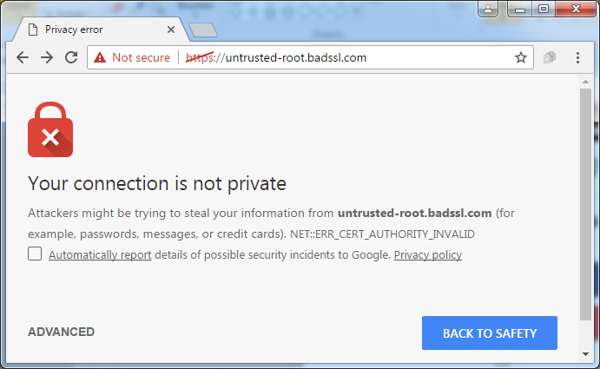
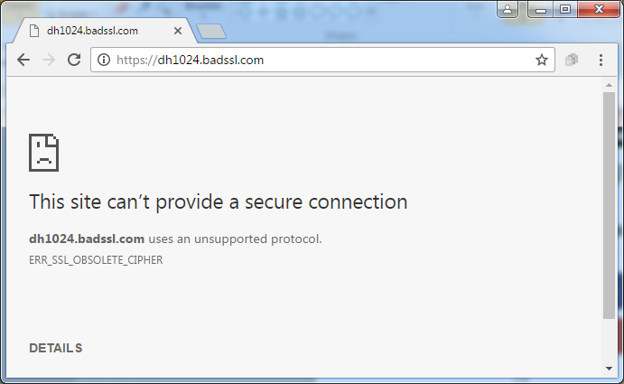

SSL/TLS security issues are important
Protecting your visitors
Keeping access to your site/app/APIs

Slide 20
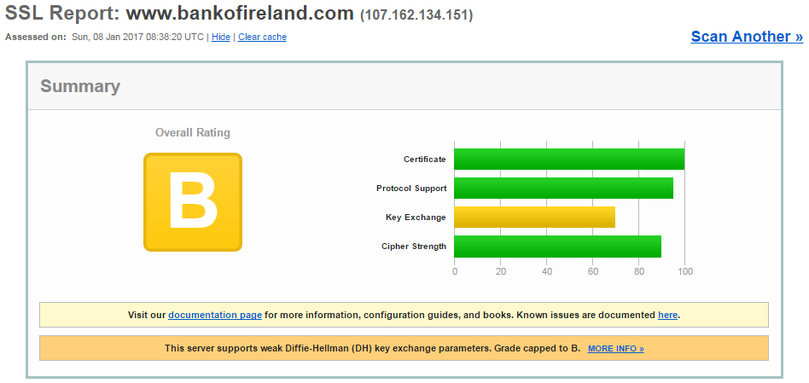
Check your HTTPS set up
Qualys SSL Labs is the de facto standard for testing website HTTPS setup: https://www.ssllabs.com/ssltest/
If website is not public facing then https://testssl.sh/ can be used.
Recommended config generator:
https://mozilla.github.io/server-side-tls/ssl-config-generator/

Slide 21
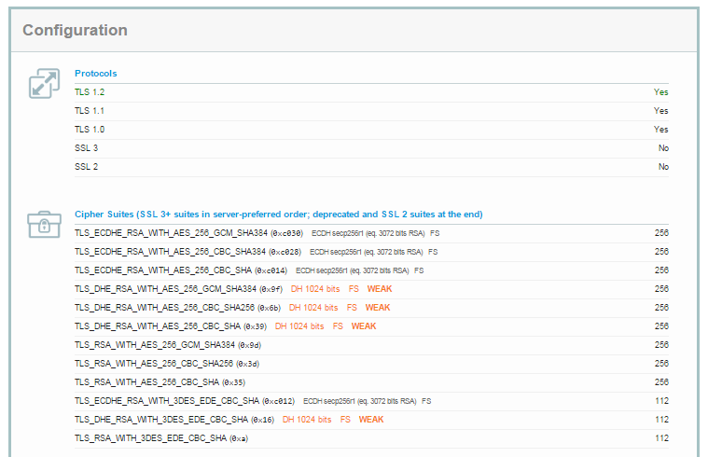
SSL Labs Protocol version and Ciphers

Slide 22
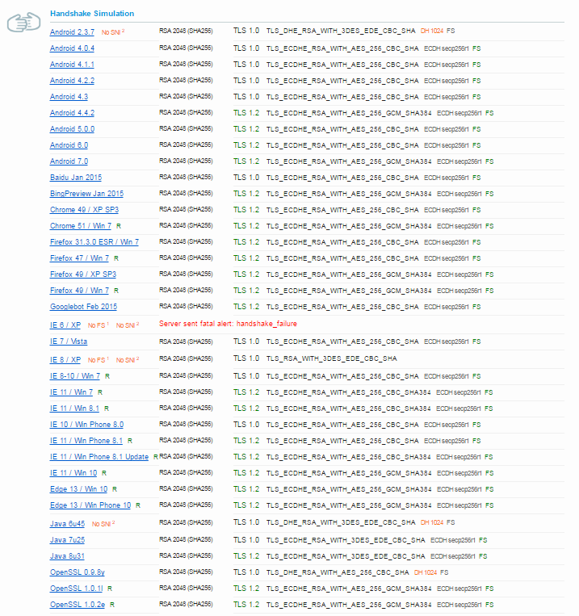
SSL Labs Handshake Simulation

Slide 23
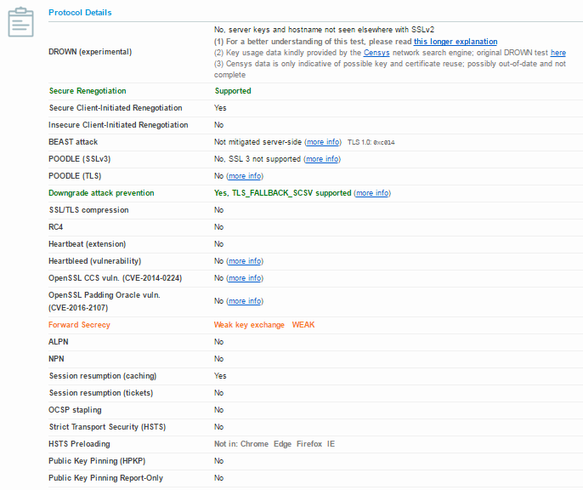
SSL Labs Protocol Details

Slide 24
Non SSL/TLS set up issues with HTTPS
Ensure no mixed content: https://www.whynopadlock.com/
Dual sites (HTTP for parts, HTTPS) are now an anti-pattern.
Redirect as default is still HTTP.
Do not turn off HTTP (port 80) – redirect instead.
Take care with SEO during migration (see previous).

Slide 25

Forcing HTTPS through HSTS
HTTP Strict Transport Security (HSTS) – is a HTTP header that forces your site to use HTTPS only.
“Adding support for HSTS is the single most important improvement you can make for the TLS security of your web sites.”
Required for an A+ grade on https://www.sslabs.com.
Can be preloaded into browsers.
WARNING – CAN BE VERY DANGEROUS!
More info: https://www.tunetheweb.com/blog/dangerous-web-security-features/

Slide 26
Reducing scope of CAs.
Any CA can issue a certificate for any site. Therefore a single point of failure in any of them makes the whole of HTTPS pointless (e.g. DigiNotar failure).
Mitigations:
HTTP Public Key Pinning (HPKP) – can be very, very dangerous!
Certificate Transparency (CT) – e.g. https://crt.sh/ and https://suricat.io/.
Certificate issuance (CAA).
DNS-based Authentication of Named Entities (DANE).

Slide 27

Thanks for Listening Questions?

Slide 28
Resources
Ivan Ristic is world renowned expert on SSL/TLS.
https://www.ssllabs.com/
https://www.feistyduck.com/books/bulletproof-ssl-and-tls/
https://www.feistyduck.com/ssl-tls-and-pki-history/
https://www.feistyduck.com/bulletproof-tls-newsletter/
Twitter: @ivanristic
Google Security Team
https://security.googleblog.com/
https://www.youtube.com/watch?v=cBhZ6S0PFCY HTTPS Everywhere presentation
Twitter: Ryan Sleevi (@sleevi_), Emily Schechter (@emschec), Emily Stark (@estark37), Adrienne Porter Felt (@__apf__), Ilya Grigorik (@igrigorik)
I blog at https://www.tunetheweb.com
Twitter: @tunetheweb

