Slide 1




Hak5 Essentials Field Kit
CorkSec March 7th 2017
Dylan Smyth
Nimbus Centre, Cork Institute of Technology

Slide 2
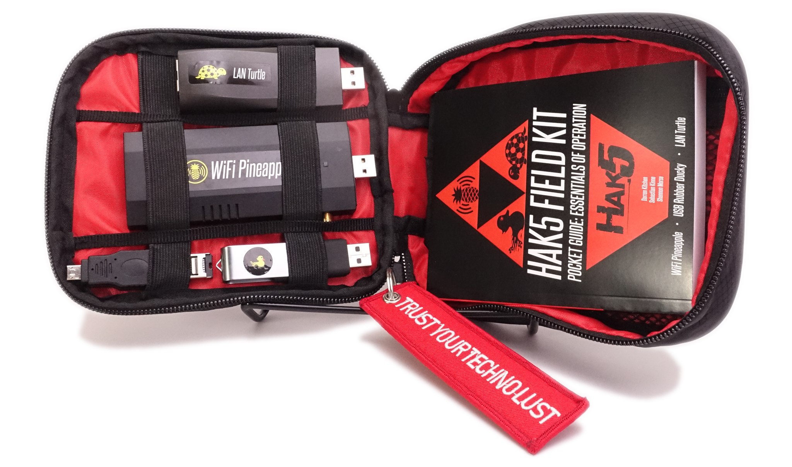
Hak5 Essentials Field Kit

Slide 3

Hak5 Essentials Field Kit
https://www.hak5.org

Slide 4
Hak5 Essentials Field Kit
LAN Turtle
Wifi Pineapple
USB Rubber Ducky

Slide 5

Hak5 Essentials Field Kit
LAN Turtle

Slide 6
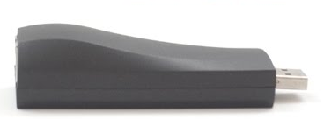
Hak5 Essentials Field Kit
LAN Turtle - Description
Embedded computer with Linux based OS
Housed in a generic USB-to-Ethernet

Slide 7
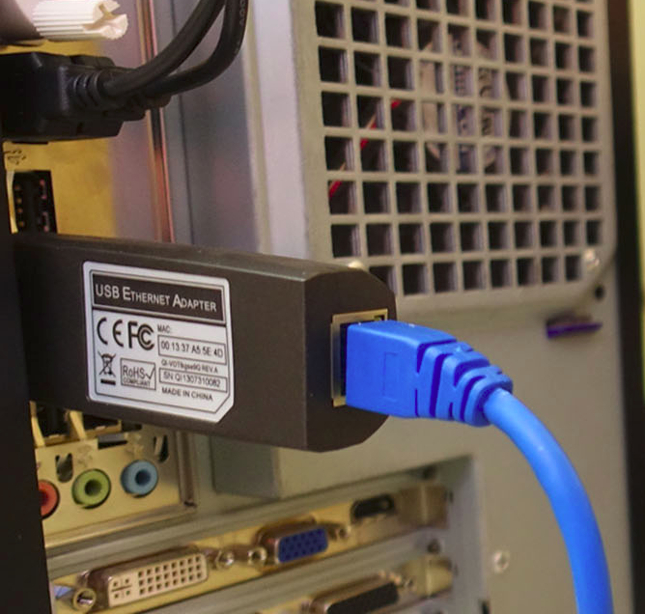
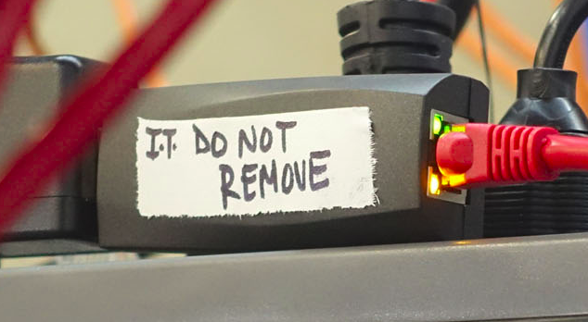
Hak5 Essentials Field Kit
LAN Turtle - Deployment
Just needs power and a network connection

Slide 8

Hak5 Essentials Field Kit
LAN Turtle - Deployment
Connect via SSH or have it connect back to you

Slide 9
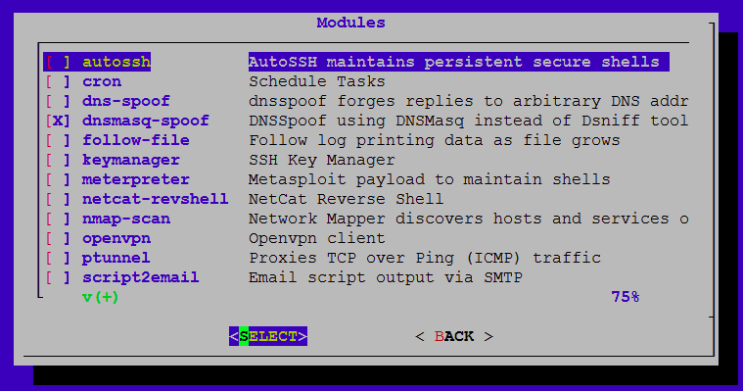
Hak5 Essentials Field Kit
LAN Turtle - Deployment
Run attacks against host or network

Slide 10
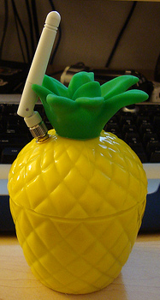
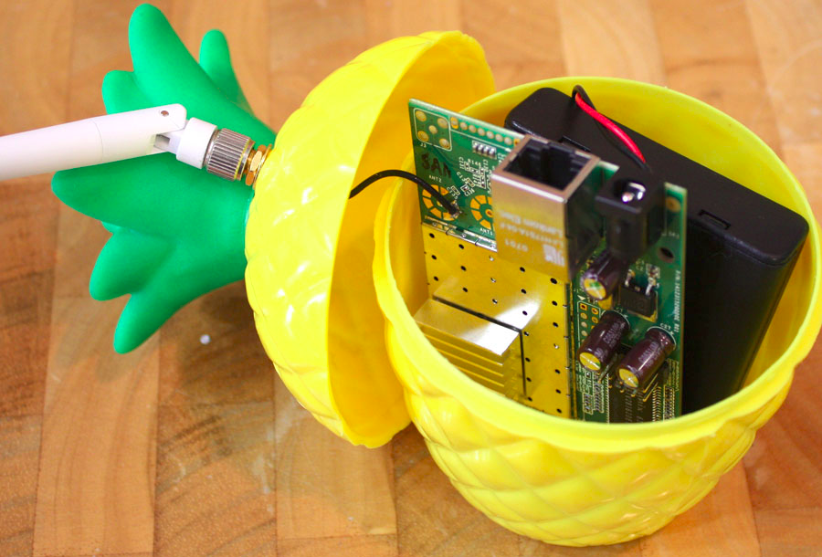
Hak5 Essentials Field Kit
Wifi Pineapple

Slide 11
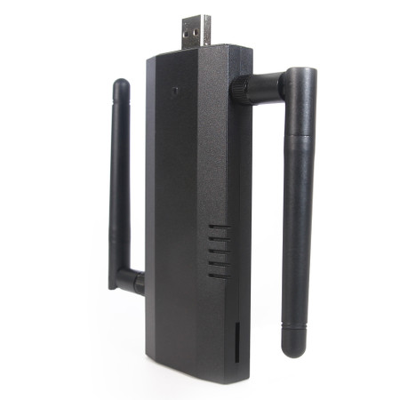
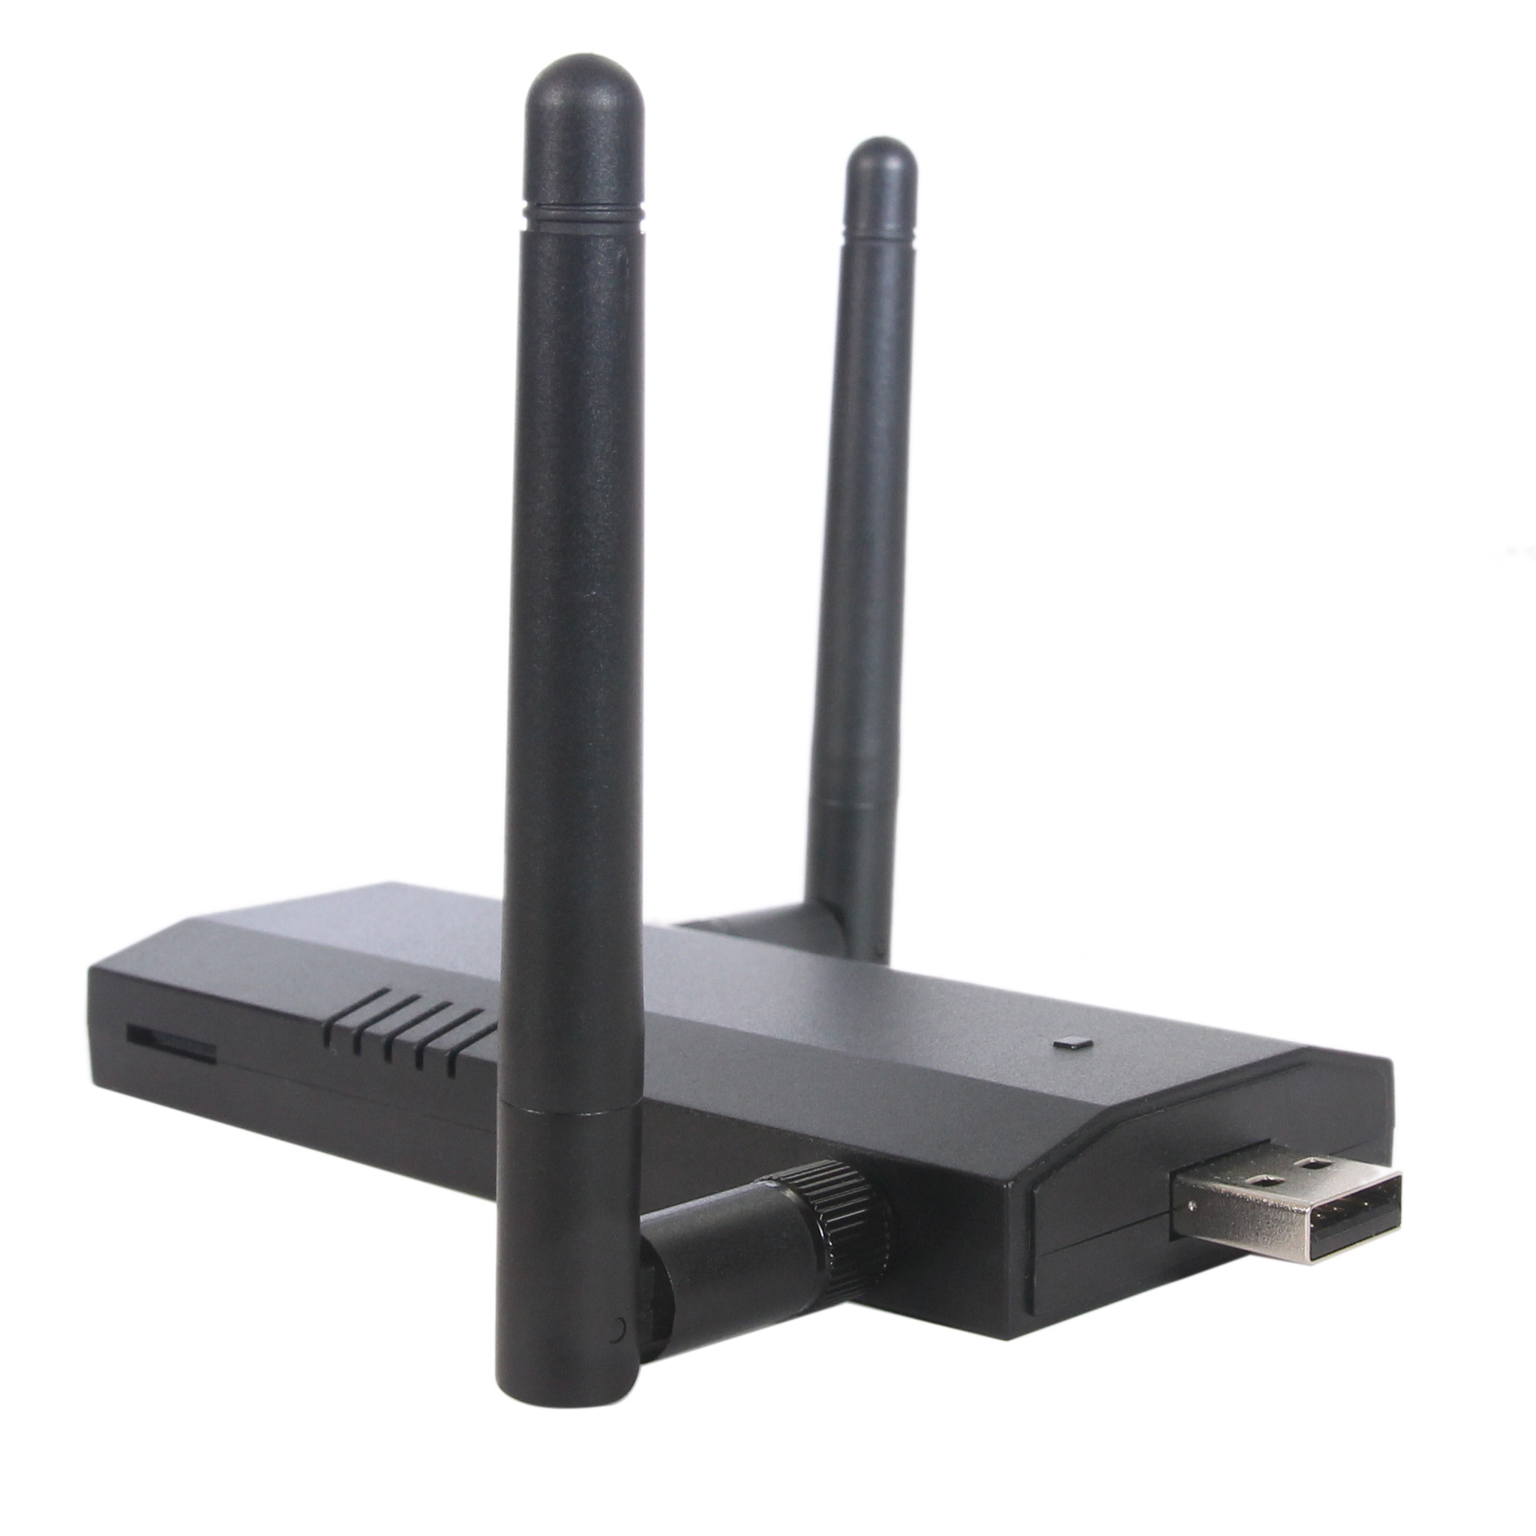
Hak5 Essentials Field Kit
Wifi Pineapple - Description
Wifi security auditing platform
Kit contains the Wifi Pineapple Nano

Slide 12
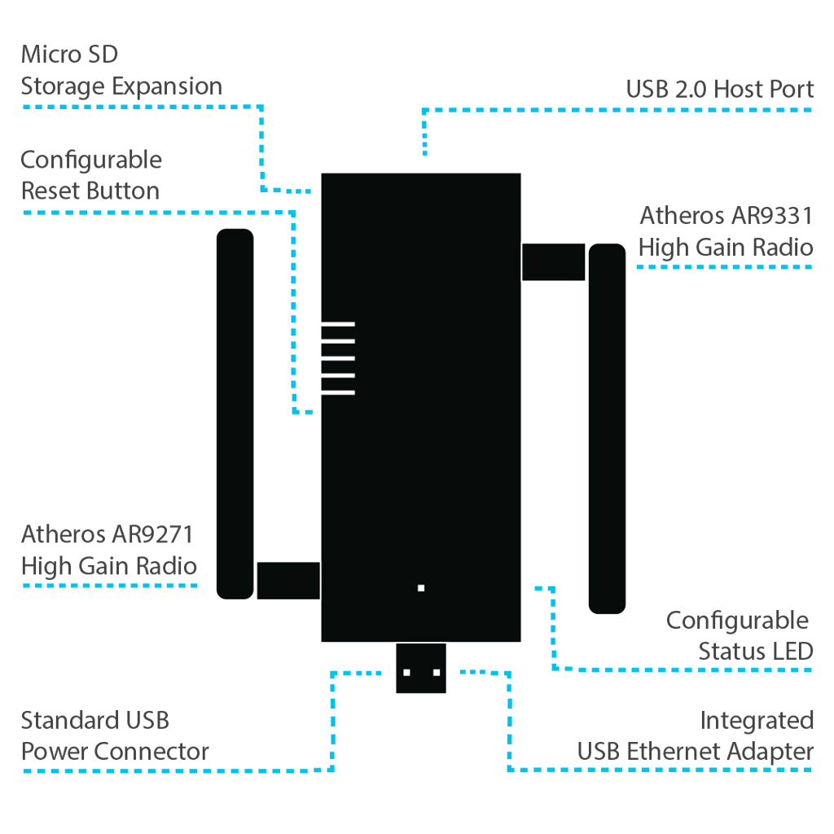
Hak5 Essentials Field Kit
Wifi Pineapple - Description

Slide 13
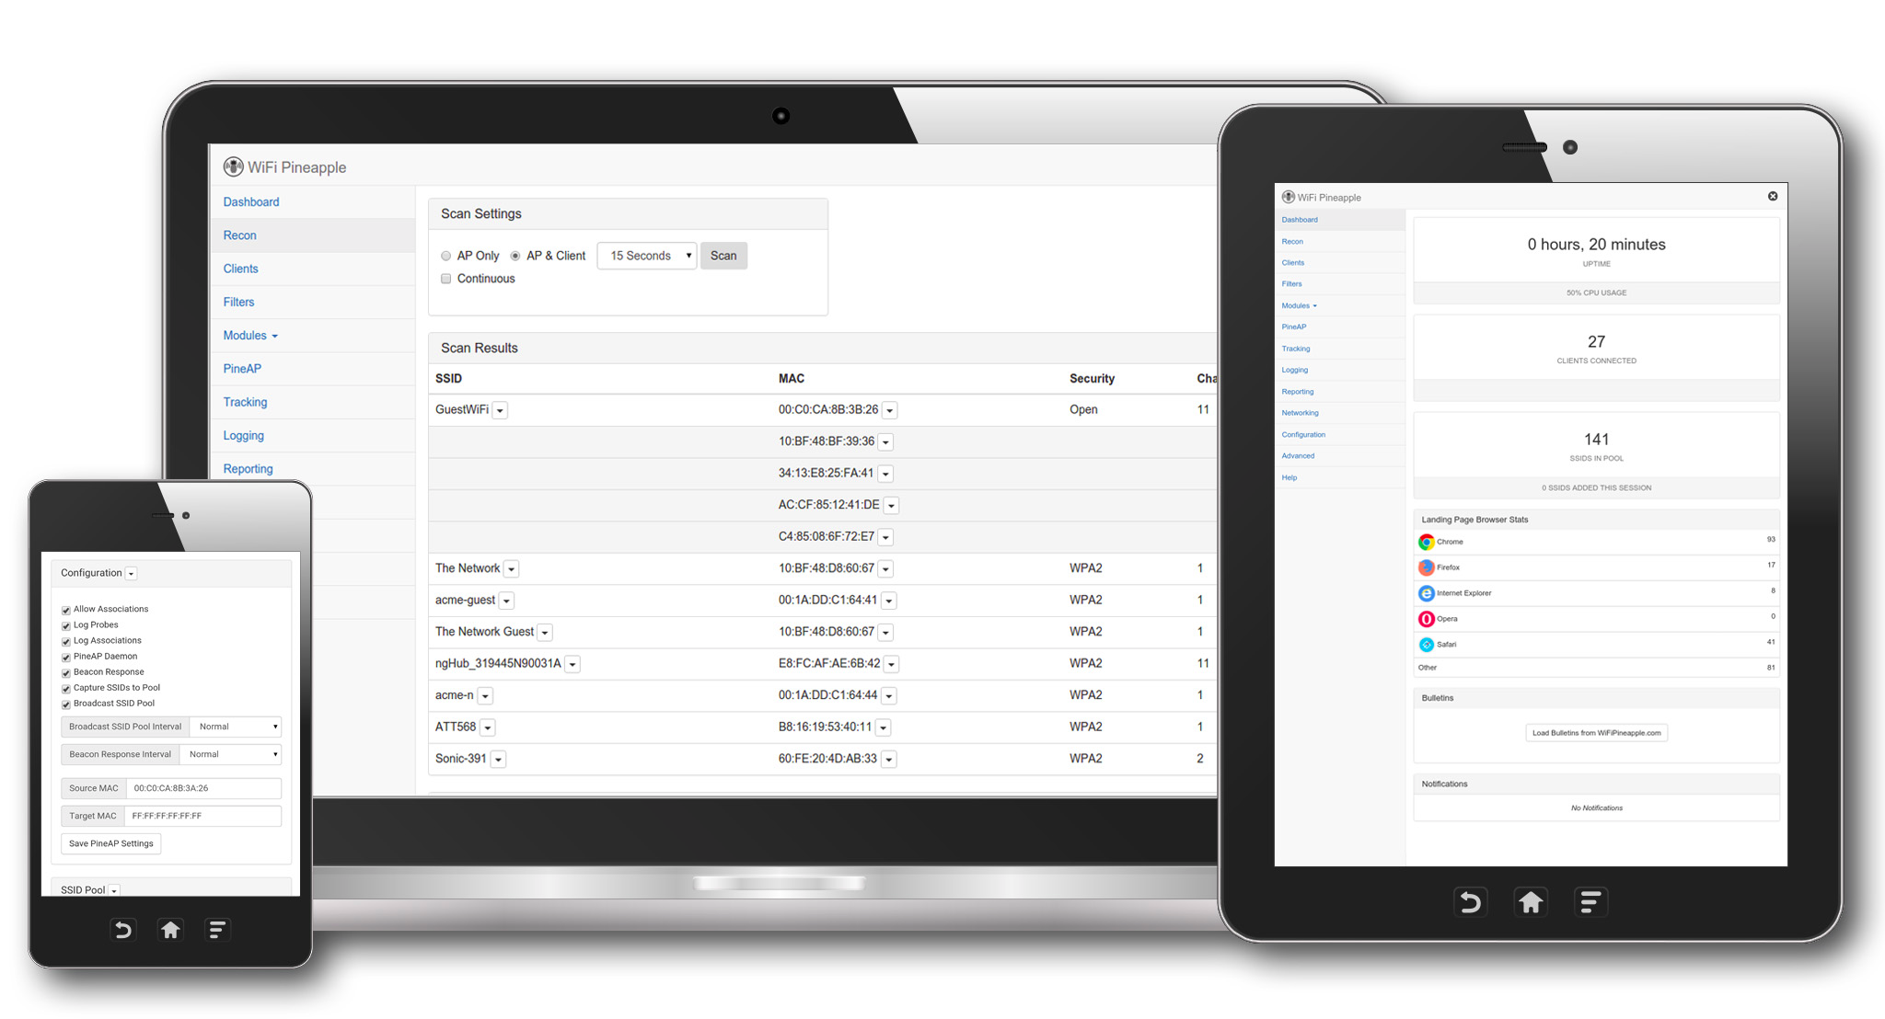
Hak5 Essentials Field Kit
Wifi Pineapple - Deployment
Can be used over SSH or via a web interface

Slide 14
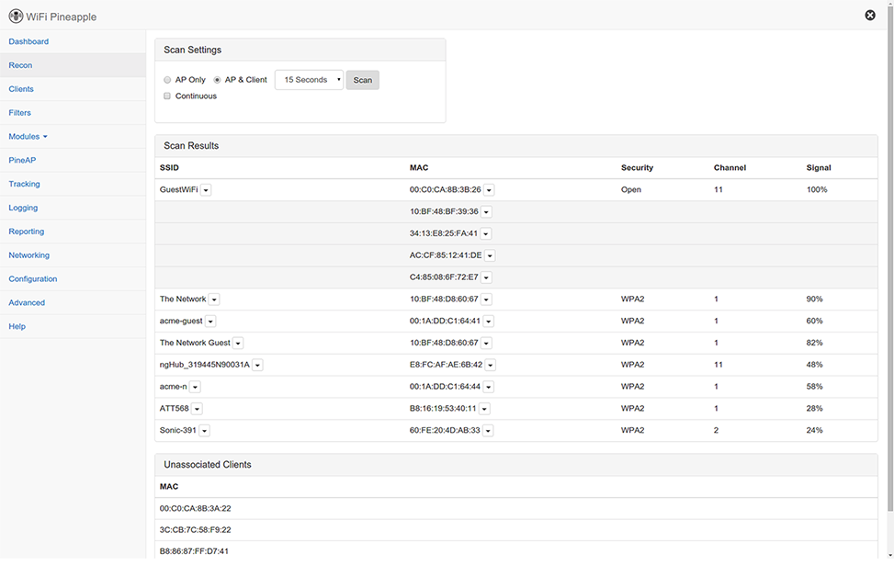
Hak5 Essentials Field Kit
Wifi Pineapple - Deployment
Scans and attacks can be run from the GUI

Slide 15
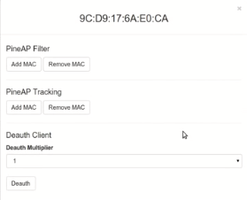
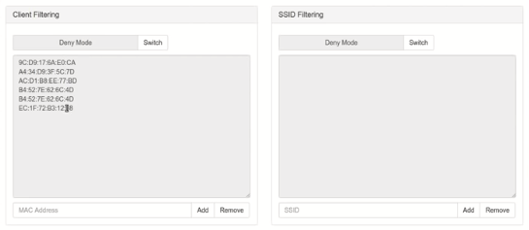
Hak5 Essentials Field Kit
Wifi Pineapple - Deployment
Filters can be set up

Slide 16
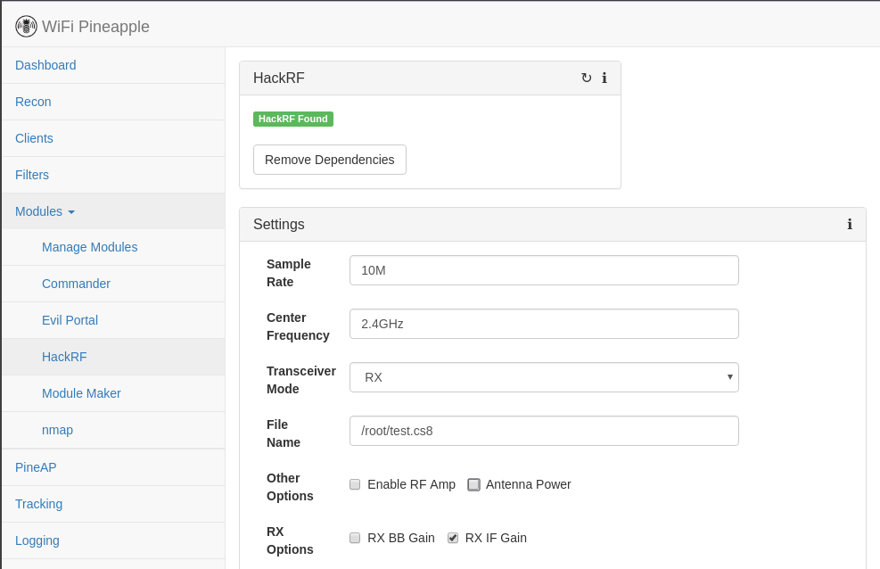
Hak5 Essentials Field Kit
Wifi Pineapple - Deployment
Tools are installed as modules

Slide 17
Hak5 Essentials Field Kit
Wifi Pineapple - Deployment
Most tools are useful for a MitM scenario

Slide 18
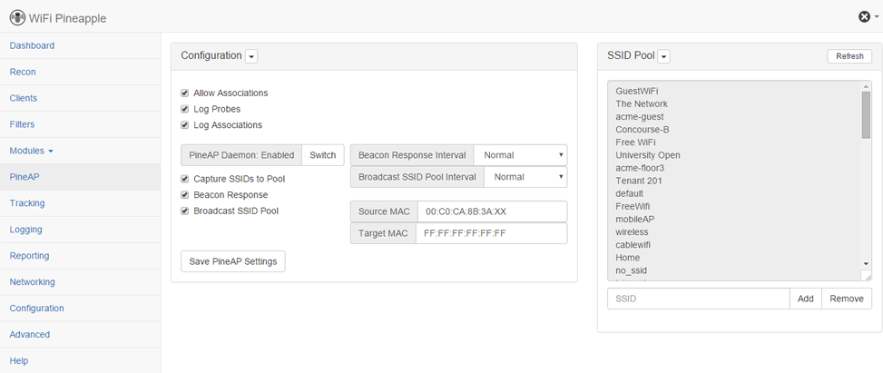
Hak5 Essentials Field Kit
Wifi Pineapple - PineAP
Tool for deploying rogue access points

Slide 19

Hak5 Essentials Field Kit
Wifi Pineapple - PineAP
Listens for and responds to beacon requests

Slide 20
Hak5 Essentials Field Kit
Wifi Pineapple - PineAP
Observed SSIDs get added to a broadcast pool

Slide 21

Hak5 Essentials Field Kit
USB Rubber Ducky

Slide 22
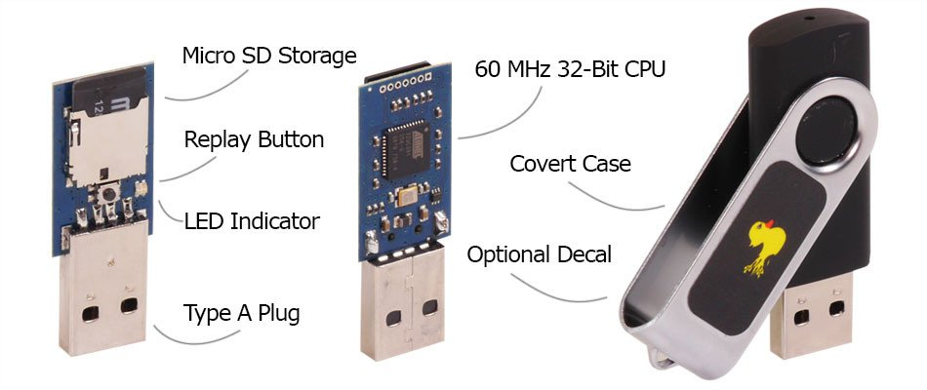
Hak5 Essentials Field Kit
USB Rubber Ducky - Description
Keystroke injection tool
Housed in a generic USB drive case

Slide 23

Hak5 Essentials Field Kit
USB Rubber Ducky - Deployment
Step 1) Insert into device (PC, Phone, etc.)
Step 2) Ducky types very very fast (>1000 w/m)
Step 3) Profit!

Slide 24
Hak5 Essentials Field Kit
USB Rubber Ducky - Firmware
Firmware options available:
  Duck firmware
  “Twin Duck”: allows storage on SD card
  “FAT Duck”: No keystroke injection, just storage

Slide 25
Hak5 Essentials Field Kit
USB Rubber Ducky - Payloads
Payloads are placed on the SD card
“Ducky Script” is used to write the payloads
Command | Use | Command | Use
REM | Comment | ALT key | Type alt + key
DEFAULT_DELAY x or DEFAULTDELAY x | Set default delay to x | CONTROL key or CTRL key | Type control + key
DELAY x | Wait x milliseconds | REPLAY x | Replay last command n times
STRING abc | Type keys “a”, “b”, and “c” | F1, F2, F3, DELETE, CAPSLOCKS, etc.
GUI or WINDOWS | Type windows key
SHIFT key | Type shift + key

Slide 26
Hak5 Essentials Field Kit
USB Rubber Ducky - Payloads
Open Notepad and type “Hello World”
DELAY 3000
GUI r
DELAY 50
STRING notepad.exe
ENTER
DELAY 100
STRING Hello World

Slide 27
Hak5 Essentials Field Kit
USB Rubber Ducky – Use Cases
Download and execute malware
Open reverse shell
Pull windows creds from memory (mimikatz)
Bruteforce
  Logins with a finite wordlist
  Android screen lock pin!
Automate non-malicious activity
…?

Slide 28
Hak5 Essentials Field Kit
USB Rubber Ducky – Caveats
Need information on target device before creating payload
Required physical access
Not intelligent (no conditional statements, etc.)

Slide 29

Hak5 Essentials Field Kit
USB Rubber Ducky – Demo!
“15 second Mr. Robot hack”
Extract windows credentials with Mimikatz and send to a web server.

Slide 30
Hak5 Essentials Field Kit
Questions?

