Slide 1
Ransomware and Databases
Markus Strauss

Slide 2
Contact details
Markus Strauss
markus.strauss@myself.com

Slide 3
When you find out that the programmers are using the sa username and password for the production connection string

Slide 4
Ransomware and Databases
Ransomware over the years
Traditional Ransomware approach
Ransomware reaches the database
A closer look

Slide 5
Ransomware over the years
WannaCry
Tesla Crypt
Cryptolocker
AIDS Virus
Reveton
Archievus
Cryptodefense
L0cky
1989
2006
2012
2013
2014
2015
2016
2017

Slide 6
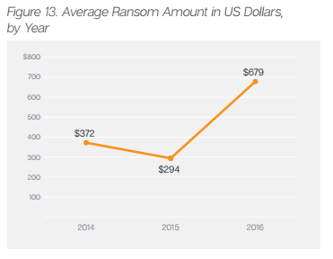
Ransomware over the years

Slide 7
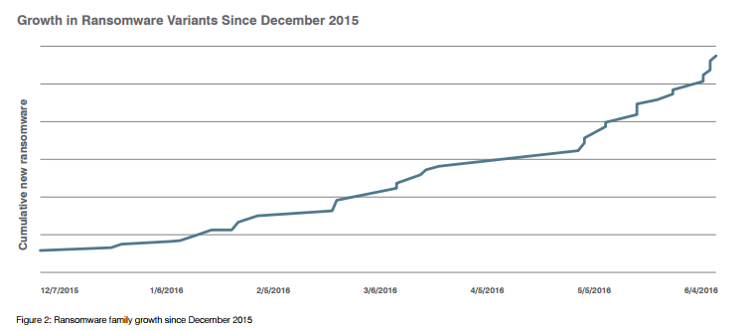
Ransomware over the years

Slide 8
Traditional Ransomware approach

Slide 9
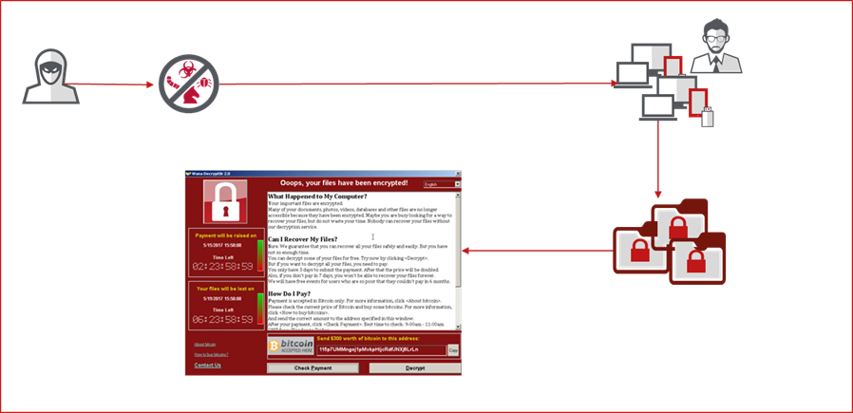
Traditional Ransomware approach

Slide 10
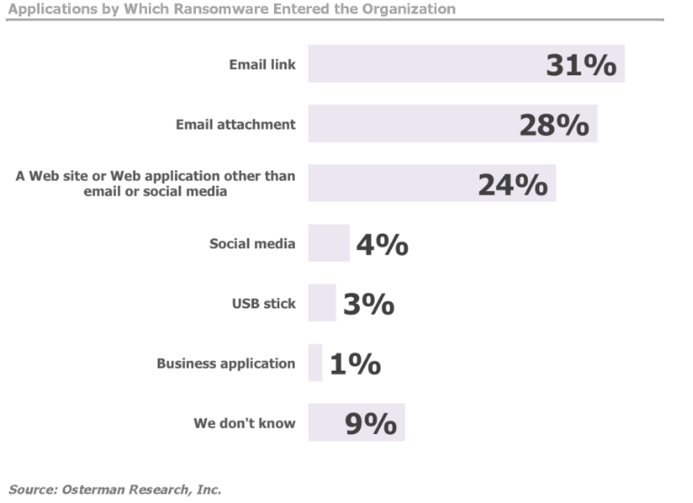

Slide 11
Ransomware reaches the Database
Introducing gradual encryption

Slide 12

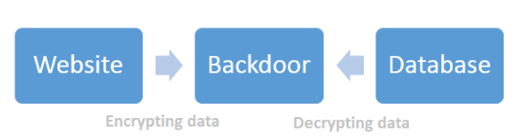
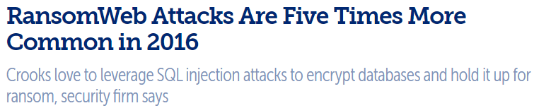

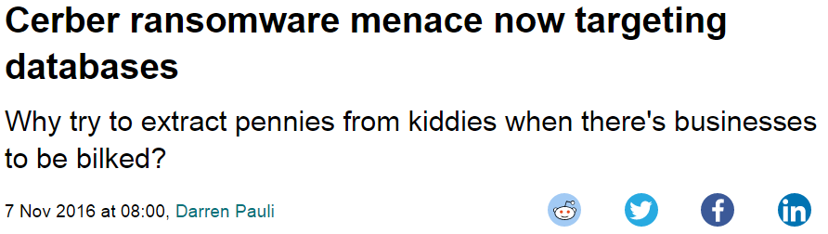
Starting in 2014

Slide 13
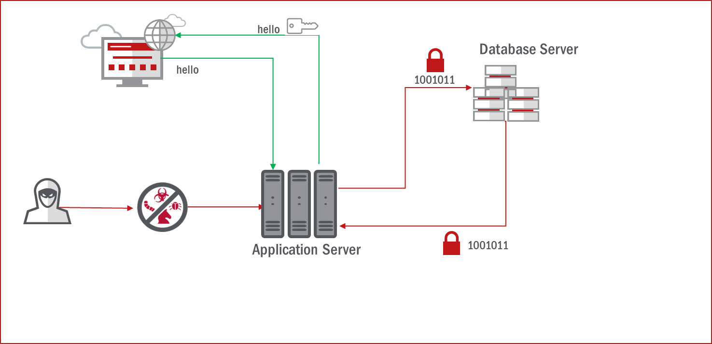
Ransomware reaches the database

Slide 14
A closer look
In the case of phpBB

Slide 15
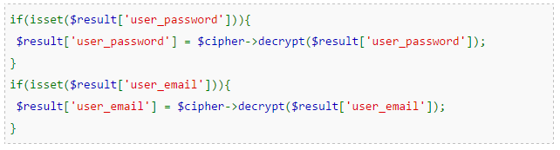
A closer Look
phpBB as RansomWeb vector
This is a changed function inside factory.php essentially ensuring
That the returned values for user_password and user_email are
decrypted

Slide 16
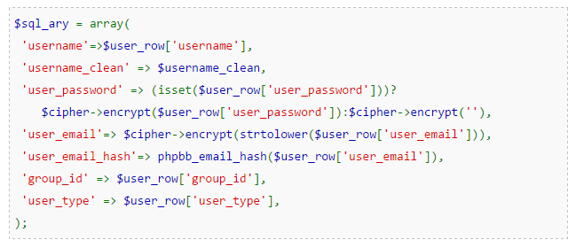
A closer Look
phpBB as RansomWeb vector
Now the attacker needs to ensure that every new user that’s added
Is encrypted. Here, functions_user.php has a changed user_add function.

Slide 17
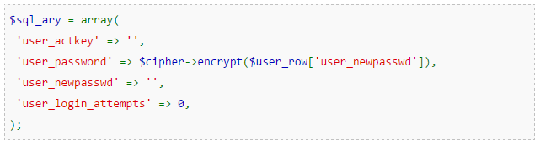
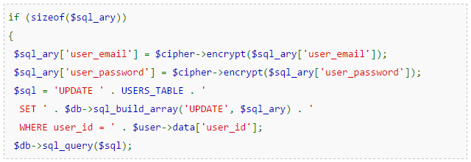
A closer Look
phpBB as RansomWeb vector
So far the attacker made sure that new users email and password get
Stored encrypted. With these changes in cp_activate & ucp_profile.php
the attacker now makes sure that the activation and any password
Changes in the User Profile are equally encrypted.

Slide 18
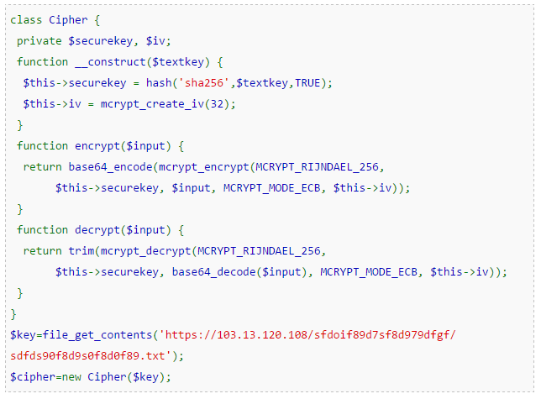
A closer Look
phpBB as RansomWeb vector
Now the attacker ensures that there is a valid key to decrypt data on the fly

Slide 19

Ransomware reaches the database
Username / password
Username / password

Slide 20
A closer Look
phpBB as RansomWeb vector
Imagine what happens when the attacker removes the key

Slide 21
A closer Look
phpBB as RansomWeb vector
…….

Slide 22
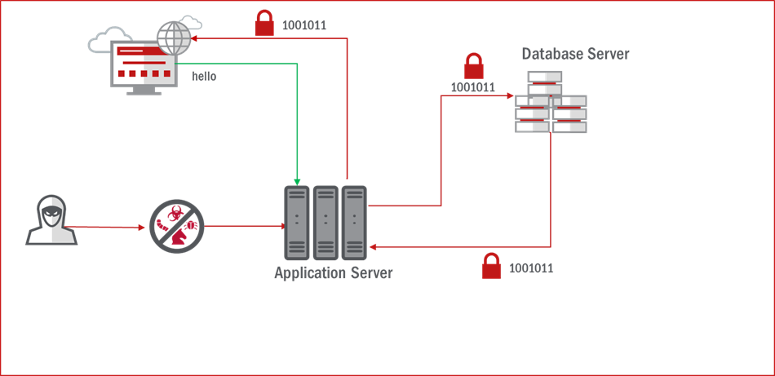
Ransomware reaches the database
Username / password

Slide 23
Keep it clean
Keep your application server up to date
Keep your applications patched
Have a File Integrity Monitoring solution on your Application Server
Use Native Auditing or a third party auditing
Use Intrusion prevention that helps preventing SQL injections
And if all that fails or you can’t update……

Slide 24
….Get the hell out of there

Slide 25
THANK YOU

