Slide 1
USB as an attack vector
Mark O’Sullivan

Slide 2
About Me
BSc in CIS and MSc in Cloud computing
11 years in EMC enterprise storage (Symmetrix/VMAX)
QE tester working on core features of Symmetrix OS
Systems integration engineer
Software developer (mainly C/C++/Python)
Developed disaster recovery solution to recover distributed file system for metadata
Developing Automation framework to simplify testing for both developers and QE
Unofficial lab support and Hardware engineer
I am not a “security expert” but am exploring more in the area

Slide 3
Topics
Why use USB as an attack vector
Types of USB attack that can be used
Commercial USB tools available for attacks
Defence
What next

Slide 4
Why use USB as an attack vector
USB is the most common port for peripheral connection (Universal!)
USB devices are hot swappable
Low security in OS by default to support all these device types
USB keys are shared and swapped with little consideration
Cross OS attacks possible
Air gapped systems have USB ports
Firmware updates are now pushed via USB
No security for data between device and bus it communicates on (IoT)
Notes:
Low security in OS by default to support all these device types
Whitelisting is possible, but still need to allow HIDs (unless you have PS/2 ports)
USB keys are shared and swapped with little consideration
Sure you are safe as long as we run AV scans on the
Wipe them from time to time, all will be grand
Cross OS attacks possible
Air gapped systems have USB ports
In lots of cases Industrial control systems running out of date windows.
Firmware updates are now pushed via USB
Even more systems with USB!

Slide 5
Why use USB as an attack vector (2)
Attack can be delivered in a non-technical method and cheaply
Interesting paper from 2016 IEEE Symposium on Security and Privacy (Elie Bursztein)
Out of 297 USB keys dropped on University of Illinois campus
48% were plugged in and at least one file opened
20% within 1 hour of drop
50% within 7 hours
24 hours before Reddit thread on weird amounts of USB keys on campus
98% of USB keys dropped were taken
One USB key plugged in within 6 minutes of being dropped!
Most users plug in drive for altruistic reasons to reunite it with its owner
Notes:
Some survey answers:
1. Trust my OS and security software to protect me
2. Macs don’t get viruses
3. Used univeristy comptuer (sacrificed computer)

Slide 6
Types of attacks with USB
Social engineering
Driver/firmware
Device spoofing
Juice Jacking
State/Corporate sponsored

Slide 7
Social engineering attack
Get/trick user to open on an infected file on USB key
Trick someone into entering personal/login details via HTML form contained on USB key
Low cost and very simple to create
Not very reliable
Not so covert

Slide 8
BAD USB - frimware attack
First described @ Black Hat conference by team from SRLabs
https://srlabs.de/wp-content/uploads/2014/07/SRLabs-BadUSB-BlackHat-v1.pdf
Targets a Phison PS2251-03 USB to flash microcontroller
http://www.phison.com/English/newProductView.asp?ID=235&SortID=60
Rewrite firmware to convert USB key into HID device
In theory it is possible to rewrite firmware to insert malware and still allow device function as USB key
Doing this requires a lot of low level knowledge but given time it is very possible
Firmware attacks are possible on a huge range of USB devices that allow firmware to be rewritten to embed malware in device
Talking about state/corporate levels of involvement here due to time/technical experience required for this type of attack

Slide 9
Device spoofing (HID)
USB is programmed to appear/act as keyboard
When plugged in USB devices starts sending automated keystrokes (~1,000 words per min)
Open reverse shell
HTTP get (MSF payload)
Powershell, WSCRIPT, Bash script execution
Brute force attacks on logins/pin numbers
Information gathering and reporting
You can add in storage space to deliver complicated payloads
In theory also possible to fake storage so user thinks everything is okay
Adding Wifi or GSM module to USB device would allow remote trigger
Also can be used for sending data out

Slide 10
Device spoofing (HID)
Rubber Ducky is off the shelf tool to perform keyboard injection attacks
Lots of payloads in the form of easy to understand ducky script
Roll your own with Teensy/Arduino
Some payloads available Social Engineer Toolkit (SET)
You can add various other components such as WIFI/GSM etc
Re-program USB key that uses a Phison PS2251-03 microcontroller
This method introduced the concept of ‘Bad USBs’ to a wider audience

Slide 11
Device spoofing (Ethernet)
USB device as Ethernet adapter to perform network hijack
OS auto loads USB as low-priority network device doing DHCP request even when locked
Most computers trust their local network!
Using Responder device can become gateway, DNS server WPAD server and lots more
https://github.com/lgandx/Responder
Various attacks available
Perform network reconnaissance
Capture credentials from locked machines
https://room362.com/post/2016/snagging-creds-from-locked-machines/
Man in the Middle
Lan Turtle & USB Armory commercially available tools for these attacks

Slide 12
Juice Jacking
Targets public USB charging stations
Takes advantage of the fact that USB port for charging also functions as data port
Once connected to compromised charger
Can drop payloads onto phone
Can extract data from phone

Slide 13
Government/Corporate level attacks
COTTONMOUTH from the NSA ANT list
A hardware implant for a USB keyboard to perform Man in the middle attacks
Allows data exfiltration via shortwave RF
Can deliver various payloads to target system
Supposedly added to intercepted keyboard shipments
Rewriting firmware on valid USB drives
Storing payloads in the USB drive firmware
Using zero day exploits to deliver payloads
Stuxnet is famous example using lnk vulnerability
Takes a lot of time and effort to achieve

Slide 14
Commercial tools available to investigate USB attacks
Rubber Ducky (EUR 40)
https://hakshop.com/products/usb-rubber-ducky-deluxe
Runs HID keyboard attacks
Payloads are written using easy to understand ducky script
Huge amount of payloads available in ducky script already to carry out
Reverse shell attacks
Inject binaries
Brute force smartphone pin codes
Expandable with SD memory to allow more payloads

Slide 15
Commercial tools available to investigate USB attacks
USB Armory (EUR 100)
https://inversepath.com/usbarmory
Flash drive sized ARM computer that supports secure boot and encryption
Opensource hardware
Supports USB device emulation (HID attacks, Ethernet attacks)
Can run Kali Linux
Supports host and standalone operation
Some interesting applications available include
Sandbox to investigate infected USB keys
Tor anonymizing middlebox
FIle encryption
Notes:
USB ArmoryNXP i.MX53 ARM® Cortex™-A8 800Mhz, 512MB DDR3 RAM
USB host powered (<500 mA) device with compact form factor (65 x 19 x 6 mm)
ARM® TrustZone®, secure boot + storage + RAM
microSD card slot
5-pin breakout header with GPIOs and UART
customizable LED, including secure mode detection
excellent native support (Android, Debian, Ubuntu, Arch Linux)
USB device emulation (CDC Ethernet, mass storage, HID, etc.)
Open Hardware & Software
https://github.com/inversepath/usbarmory/wiki/Applications

Slide 16
Commercial tools available to investigate USB attacks
Bash Bunny (EUR 100)
Flash drive sized ARM computer that supports different USB device emulation
Switch to allow different modes of running
2 switch positions will run custom payloads you have added
1 switch position is set to allow access to a Linux shell to run and manage payloads
Payloads are written in simple text file using Bunny script
Lots of payloads already available
Data exfiltration
Copying tools from bash bunny to target
Redirect and spoof DNS to bash bunny
Notes:
Bash Bunny:
Quad-core ARM Cortex A7
32 K L1/512 K L2 Cache
512 MB DDR3 Memory
8 GB SLC NAND Disk

Slide 17
Defence
Physical security is important and number one defence
Think about devices on the network in public spaces (TVs, computers on front desks etc)
Do IoT devices/external sensors need to have accessible USB ports
Educate users about dangers of plugging in unknown USB keys
Only use trusted USB devices
Can you trust free USB keys given out at conferences??
Blacklist/whitelist approved USB devices
Linux Kernel - https://www.kernel.org/doc/Documentation/usb/authorization.txt
Can use UDEV in Linux as well
Can be done with RegKeys or various endpoint security solutions in Windows
It is possible to spoof device IDs to get around this

Slide 18
Defence
Various group policies on Windows
Prevent run commands
Block powershell
Auto lock after x period of time
Can take hours to create and lead to systems being unusable
Lockdown system to prevent drivers from being installed
Does not block HID attack in most cases
Block external Ethernet ports
Monitor keystrokes to detect very fast keystroke rate
Have seen a few homebrew examples but nothing available commercially
Not sure if it works reliably but could mitgate attack
Detect and block multiple keyboards active on at once

Slide 19
Defence
Pour epoxy into all USB ports and go back to PS/2 ports
Even PS/2 ports can be attacked!
USB condom to prevent juice jacking
Simple connection that you put onto charging cable
Will prevent data pins from connecting to device, allowing only power through

Slide 20
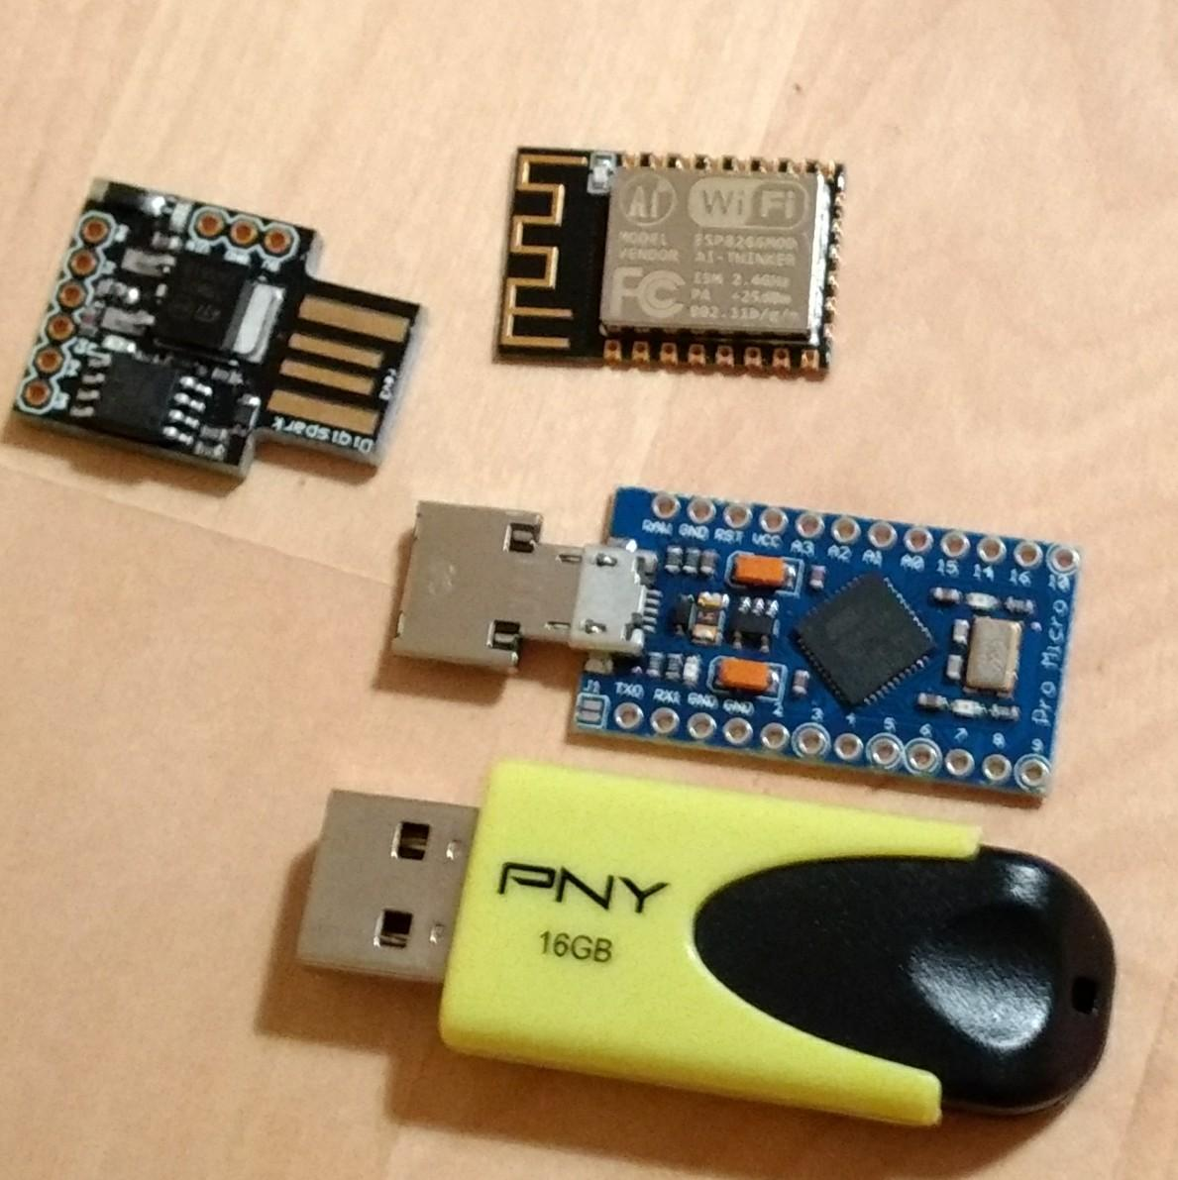
What next
Future talk (if this went well)
Explore more technical details of USB protocol and explore some attacks in detail
Possibly look at usbmon and wireshark captures of USB data
Roll your own very cheap USB HID attack device to gain understanding of USB and hardware hacking
Using Ardunio with the AVR chip atmega328p (EUR 5)
Add WiFI to control payload delivery remotely (EUR 6)

