Slide 1
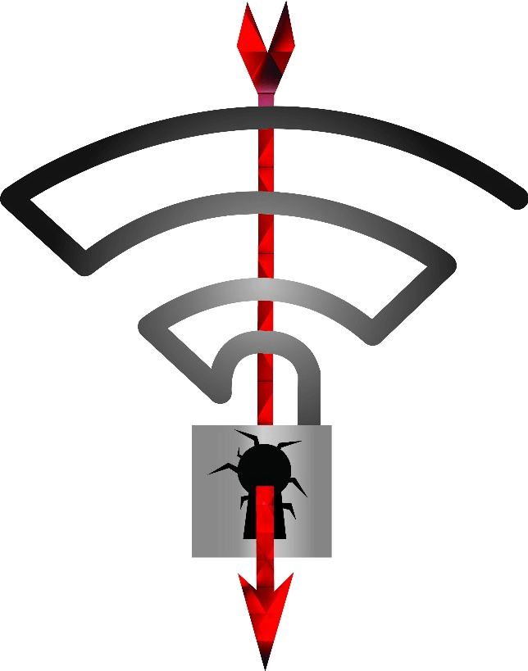
Key Reinstallation attACK
Keith Walsh

Slide 2
About me
BSc Computer Services Management
6 years at Eirteic
Senior Systems Engineer
Application support and customisation (LAMP)
Write and deliver Training
Not at all in security, but I do find it interesting
Might aim for security certification next year
Other hobbies include Arduino goodness and anything with a Land Rover badge
Notes:
PTK - Pairwise Transient Key
2

Slide 3
What is the KRACK Attack?
This is a Key Reinstallation attack, where the EAPOL 4 way handshake is abused.
This process is used by most Wi-Fi access points (those with WPA2 enabled).
The attacks purpose is to force reinstallation of the PTK causing counters to reset.
There are counters that are used to generate the encryption key stream and should be unique, but if you could reset them to an old value, then you could have multiple packets encrypted with the same key stream, which is not good.
Notes:
PTK - Pairwise Transient Key
3

Slide 4
Big scary disclaimer
I believe what is in this presentation is correct.
I am not a security expert, this was just an exploit that caught my attention.
I do like to take thing apart and see how they work, be that a mechanical thing or 1’s and 0’s in the air.

Slide 5
CCMP encryption overview – using AES-CTR
Plain text packet
Encrypted packet
XOR
Key stream
Key
AES
Counters
Packet Number
Flags
MAC ADDRESS
Notes:
CCMP- Counter Mode Cipher Block Chaining Message Authentication Code Protocol
AES-CTR – AES counter mode
5

Slide 6
With the Packet Number increasing each time, the key stream is always unique.
Encrypted Packet 1 = Keystream1 XOR Packet1
Encrypted Packet 2 = Keystream2 XOR Packet2
If you could reset the packet number, then the following would be correct:
Keystream1 = Keystream2
With both key streams identical, we can eliminate the encryption
Encrypted Packet 1 XOR Encrypted Packet 2 = Packet1 XOR Packet2
So we can see here, its rather important to never re-use the same key stream
Notes:
So the 2 packets are still xor’d together, but if you know one, you can get the other.
There are plenty packets that can be identified and guessed such as arp requests dhcp requests. They have knows sizes etc
6

Slide 7
WIFI handshake process
Before this process begins, the PSK is verified. During the 802.1x authentication stage a Pairwise Master Key is generated and installed on the client and the AP.
The PSK is not used for anything else from this stage onwards.

Slide 8
EAPOL 4-way handshake – Message 1
Device (supplicant)
AP (authenticator)
Nonce1
WPA: Nonce1 - hexdump(len=32): 07 7c 43 e4 fc 4c 00 52 ba ba ac 4f 39 66 72 59 36 11 67 df 14 66 a1 33 95 fc 3c 66 75 e4 59 87
Notes:
The AP (authenticator) generates a random number, number used once and sends this to the client
8

Slide 9
EAPOL 4-way handshake – Message 2
Device (supplicant)
AP (authenticator)
Nonce2
WPA: Nonce2 - hexdump(len=32): 83 06 ff 48 20 b8 f2 60 4a e4 b6 7c 30 9e 52 4b 5f 02 1d 05 62 9c 3b 58 72 50 32 b2 2f 63 9e 5f
At this stage the supplicant knows nonce1,nonce2 and PMK so it can now generate the PTK (Pairwise Transient Key )
Notes:
The client generates a random number, number used once and sends this to the client.
PMK = Pairwise Master Key
9

Slide 10
EAPOL 4-way handshake – Message 3
Device (supplicant)
AP (authenticator)
At this stage the authenticator knows nonce1,nonce2 and PMK so it can now generate the PTK (Pairwise Transient Key )
Confirm PTK, send GTK
Notes:
The authenticator can now generate the PMK and send back a confirmation
PMK = Pairwise Master Key
GTK= Group transient key -> used to send multicast messages
10

Slide 11
EAPOL 4-way handshake – Message 4
Device (supplicant)
AP (authenticator)
Confirm
Confirm PTK and GTK.
The handshake is complete, and the counters start counting.
Supplicant will start at zero
Authenticator will start at whatever number it was at
Notes:
The client generates a random number, number used once and sends this to the client.
PMK = Pairwise Master Key
11

Slide 12
So where is the vulnerability?
You can see that once message 3 is received by the supplicant, it starts using the key, with counters starting at zero.
If you blocked message 4 from reaching the AP, it would resend message 3 again
This would reset the counter on the supplicant, meaning the key in use now, was already used a moment ago.
So there are a number of packets which are using a re-used key

Slide 13
Device (supplicant)
AP (authenticator)
Message 1
Message 2
Message 3
X
Message 4
Packet A PN=1
Packet B PN=2
Message 3
Message 4
Packet C PN=1
Packet D PN=2
Notes:
This could be done with a rogue AP – same name and MAC as the real one, but on a different channel.
Force client to connect to you, forward the packets you want, block the ones you want blocked.
You can also then replay message 3
13

Slide 14
FT (fast transition) handover
A similar vulnerability exists where fast transition is used to roam between two AP’s
This attack is not as time restricted as the previous one, the replay can happen many thousands of packets later, in fact it remains valid until the PTK changes.
Notes:
The more data you can capture, the better chance you have of reading it
14

Slide 15
FT (fast transition) handover
Device
(supplicant)
AP
(authenticator)
Nonce2
Nonce1
Re associate request: Confirm PTK
Response
Packet A PN=1
Packet B PN=2
Replay confirm message
Response
Packet C PN=1
Packet D PN=2
Notes:
In the fast transition handover, a similar handshake takes place.
After the re associate request is sent, the PTK is reinstalled.
This can be captured and replayed at any time, until the PTK changes as there is nothing in the packet to prevent replay attacks.
This seems like an easy attack to perform as its just a replay, and I would expect business to be more vunerable to this, I know only 1 person with this setup at home.
15

Slide 16
FT handover test script
Mathy Vanhoef, who discovered the flaw, also released a script to test to allow you to check your infrastructure and see if its is vulnerable to this attack.
I cannot do a live demo now, as this requires two AP’s configured with handover
Conveniently, we just deployed a “proper” Wi-Fi network at the office last month, with handover… and I would like to know if the new gear is vulnerable to this attack.
…but it appears they also are not setup for fast transition
Notes:
16

Slide 17
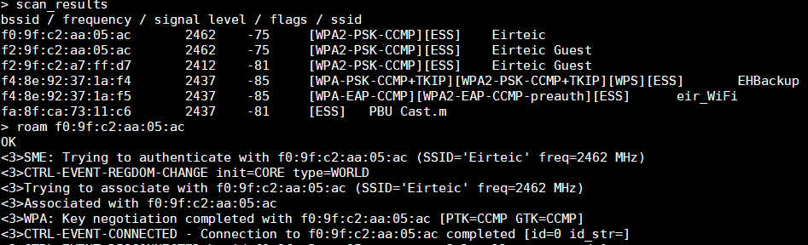
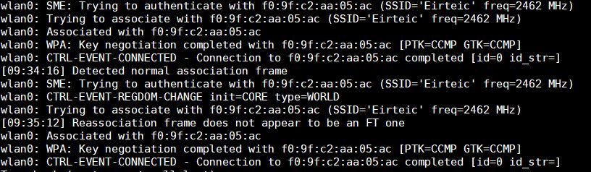
Shell session 2: ask kali to swap to the other AP
Association was not what the text script expected

Slide 18
Prevention / detection
Devices are being patched, so keep your devices up to date.
Many already released, OSX, IOS, Windows 10, OpenBSD just go get them.
HTTPS Traffic should still be secure, but incorrectly configured web servers can still be exploited ( see the official Krack Attack demo video)
Make user of wireless intrusion prevention systems to detect and alert when anomalies are found such as an access point with duplicate mac addresses are found
Use VLAN to encrypt traffic
Notes:
A bit tin foil hat maybe, but locating AP’s so there is poor signal outside the premises would reduce the effectiveness of the attach, as you need to be within range of the AP to perform the attack.
18

Slide 19
Possible Attack (in theory)
Establish a Channel MitM
You need two WiFi adapters capable of injection
Atheros AR9271 chip the best for 2.4GhZ
Did try Ralink 5370, but some glitches
Clone target AP on WiFi 1
Set MAC address the same as real AP
Copy Beacon frame and send on furthest channel away from real AP
You can set the mac address of client you are targeting as well to limit other connections
Setup cloned AP to respond to Probe requests from client
Notes:
Hat tip to Mark O'Sullivan for these next few slides
19

Slide 20
Possible Attack (in theory)
Set WiFi adapter to listen on channel of real AP
Listen for supplicant sending auth frame to real AP
(You could de-auth the client instead of waiting)
Once you see the client attempt a connection send a Channel Switch Announcement Frame, to send the client to the channel with the cloned AP
hostapd_cli allows you to send one with chan_switch if you want to see what it looks like
Forward frames between Supplicant and Real AP
Listen for EAPOL (4 way handshake)
Block sending of message 3 and replay message 3
Causes key re-installation
Notes:
20

Slide 21
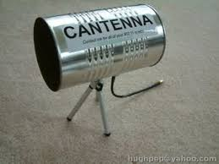
Possible Attack (in theory)
Complicated attack, but it is entirely possible (in theory)
Currently implementing it in scapy (Python), and have clone and bumping working almost
A lot of interest in the attack as can be seen in price increase in AR9271 chips - Alfa Network AWUS036NHA used ~15euro, price jumped to 30+ euro since attack made public
Distance is no real defence
Notes:
21

Slide 22
Further reading / References
https://www.krackattacks.com
This is the site of Mathy Vanhoef who discovered this flaw
http://etutorials.org/Networking/Wireless+lan+security/
Chapter 8 – key management, plenty good content there on the handshake
Pentester Academy TV
Excellent YouTube Channel, well worth a watch

