Slide 1
About Me
3rd year of IT Management
Doing my internship at Cylance
Started Malware Analysis early January

Slide 2
AVCrypt Ransomware
“In-dev” ransomware that deletes numerous windows services as well as AV software before encrypting files
Alias: Ransom:Win32/Pactelung.A
Discovered by @malwrhunterteam
Notes:
The file I’ll be going through is the AVCrypt ransomware, a seemingly in-dev piece of malware discovered by the MalwareHunterTeam. I’ll give a breakdown of how this sample operates and the process of making a YARA rule for it, to hopefully keep track of any further development of it.

Slide 3
File Information
SHA256 | a64dd2f21a42713131f555bea9d0a76918342d696ef6731608a9dbc57b79b32f
Classification | Ransomware
Alias | AVCrypt, Pactelung.A
Type | Win32 PE
Size | 2.91 MB
Timestamp | 2018-03-21
ITW Names | Av2018.exe, Av.exe, benedict richter.exe
Overview | Deletes Numerous AV software and windows services, encrypts files

Slide 4
In-dev Ransomware
Ransom note doesn’t contain any contact information – only “lol n”
Displays an alert before it starts
Numerous debug messages seen in IDA
No attempts at obfuscation
4 samples seen in the wild to date
Similar sounding ransomware recently hit a Japanese university
Notes:
The “ransom note” dropped by the sample isn’t really a ransom note, it only says “lol n” where as normally, with ransom notes you could expect links showing you how to buy bitcoin, an address to send the bitcoin to and a nice little explanation of how all your files are being held hostage.
When you execute the sample, it brings up a message box saying “Cont…” and you must click okay in order for it to keep executing.
Looking at the sample in IDA, a disassembler, you can see numerous debug messages which are a dead giveaway as to the intentions of the sample. Normally, a finished product would have little to no debug messages and would try to obfuscate anything that would hint towards its true functionality.
There have been 4 samples spotted on Virust Total to date, upon then initial discovery of the sample, a Japanese University was hit by a similar ransomware that deleted AV software, although it is unconfirmed if these samples were the same.

Slide 5
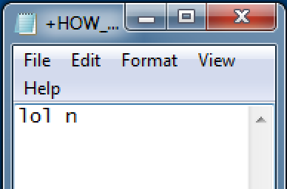
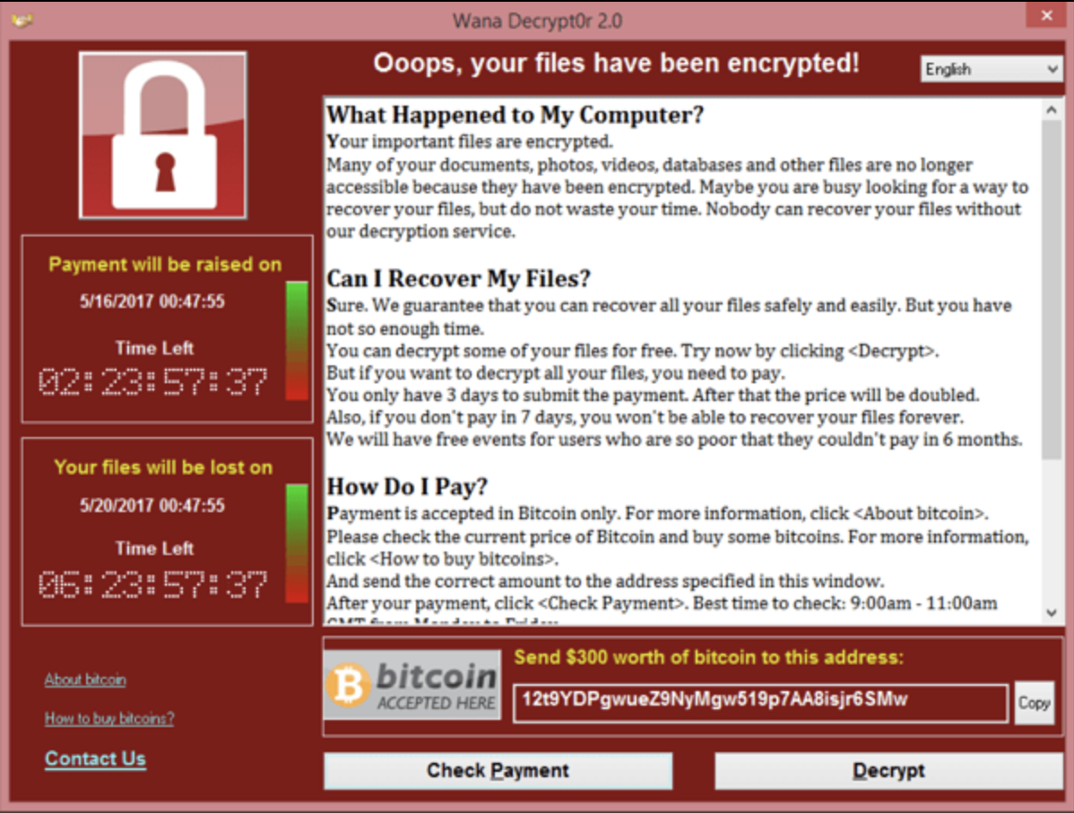
Ransom Note
AVCrypt
WannaCry
Notes:
Here’s the AVCrypt ransomnote compared to the ransomnote from wannacry, as you can see, wannacrys note has ecplanations of whats happened, how you can recover your files and also contains links to help the victim understand how to buy bitcoin. You even have a contact us link in case you encounter any issues, where as AVCrypts note just seems to contain useless filler text.

Slide 6
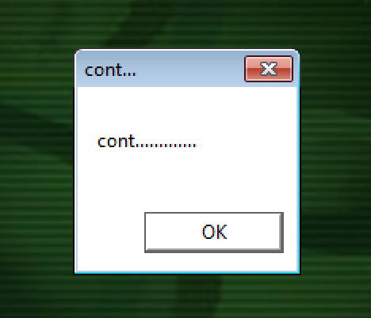
Alert
Notes:
Here is the alert that is displayed before the execution begins.

Slide 7
Flow of Execution
Deletes AV software relating to Malwarebytes and Emsisoft
Deletes numerous Windows services and services relating to Malwarebytes & Windows Defender
Disables other Windows features, leaving victim machines very vulnerable to further infection
Drops zip file containing tor.exe
Contacts C2 server bxp44w3qwwrmuupc[.]onion
Encrypts files & adds “+” to beginning of encrypted files
Notes:
The ransomware begins by deleting AV software, in particular, AV software from Malwarebytes and Emsisoft, once completed, it will deleted services related to Malwarebytes as well as windows services which will prevent windows from receiving updates and will also leave the victim machine vulnerable to further infection. It drops a zip file containing tor and its related dlls, these were all encrypted in order to evade patter matching techniques by AV companies.
Reaches out to the .onion c2 server shown above
It then begins to encrypt files on the system, adding a plus symbol to the beginning of each encrypted file.

Slide 8
Anti-Analysis Techniques
Tries to connect to www.Microsoft.com
Checks for presence of debugger
Notes:
When running this sample, I noticed it got caught in a loop trying to connect to www.Microsoft.com, and because I wasn’t connected to the internet, I couldn’t get past it, even fakenet wouldn’t work.
Fakenet being a tool used to aid malware analysis by simulating a network so that you can safely run samples that try and connect to remote hosts etc.
When running through it with Olly debugger, it would detect the presence of a debugger, which would then cause the process terminate itself

Slide 9
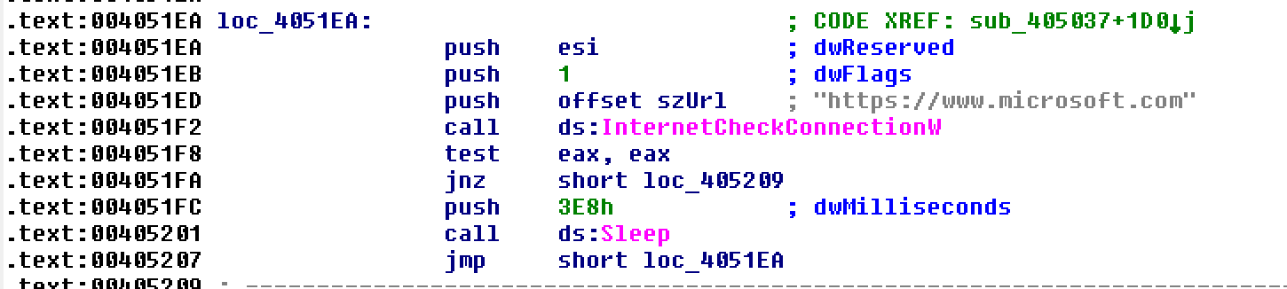
Microsoft loop
Need this to be jz
Notes:
This is the loop that constantly tries to connect to Microsoft, if the jnz is not taken, it will continue on to the jump at the bottom, which is the loop. I needed to change this jnz instruction to jz in order to get it to run. JNZ meaning jump if not zero, JZ meaning jump if zero. I was able to do this in a hex editor by following the offset highlighted in the bottom left.

Slide 10
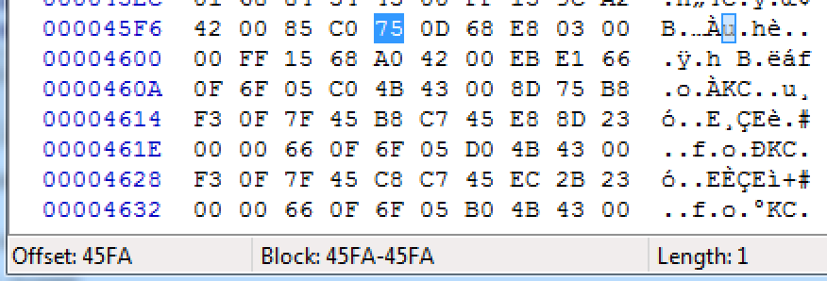
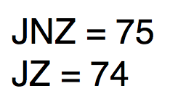
Microsoft loop
Notes:
In the hex editor, I jumped to the same offset, the 75 highlighted is the opcode for JNZ, to change the instruction all I had to to was change this to 74, the opcode for JZ and save the file.

Slide 11
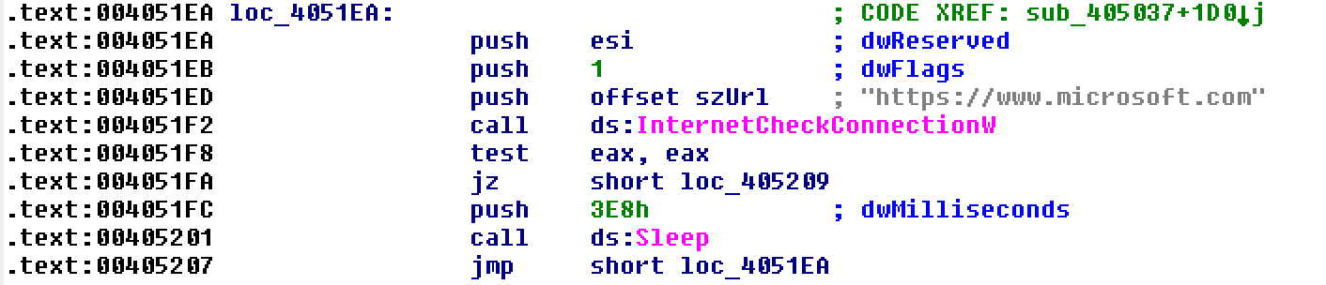
Microsoft loop
Notes:
This is the same loop in IDA after I changed the instruction, now the sample will only run if it CANT connect to Microsoft

Slide 12
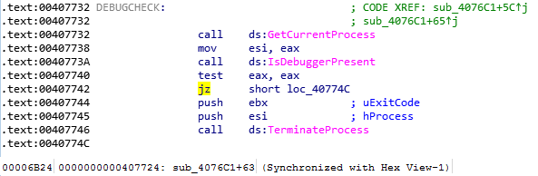
Check for debugger
Need this to be jnz
Notes:
Pretty much the exact same process for the debugger check, except this time I needed to change it to JNZ, notice again the offset highlighted

Slide 13
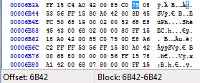
Check for debugger
Notes:
Here is changing the opcode again

Slide 14

Check for debugger
Notes:
And once again the edited check. Now the sample will only run if there is a debugger present.
Doing this changes the flow of execution of the malware, and therefore technically makes it a new strain of the malware, it was only run in an analysis environment and properly handled & disposed of when finished with.

Slide 15
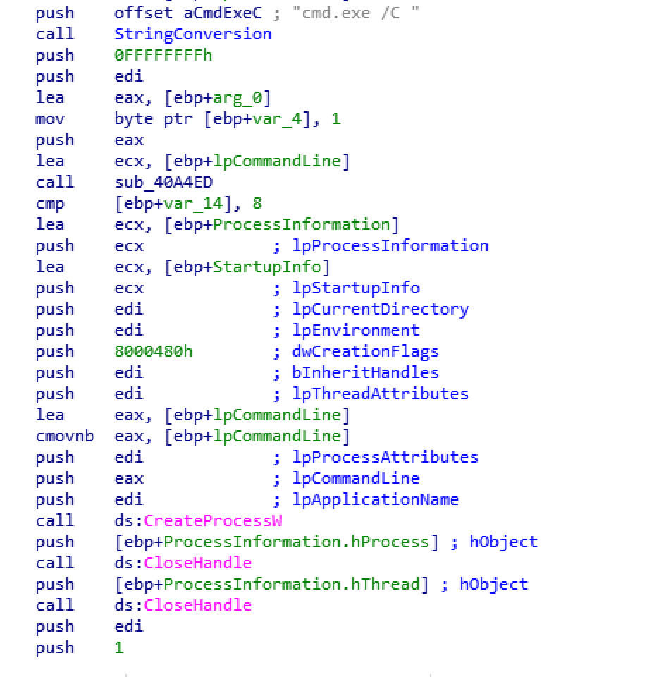
CreateCMD_exe
Notes:
I labeled this function CreateCMD_exe because its main function is to create the cmd.exe process, and we’ll be coming across it a few times so I just thought it would be worth making a point of.
At the top of the screenshot to the left you can see cmd.exe /C, further on down we see a call to CreateProcess, if we run this through a debugger and set a breakpoint at the call to create process, looking at the eax register we can see that the value being pushed onto the stack to be passed to the CreateProcess call is cmd.exe /C

Slide 16
AV Removal
Notes:
One of the first things the ransomware does is remove AV software, Malwarebytes in particular

Slide 17
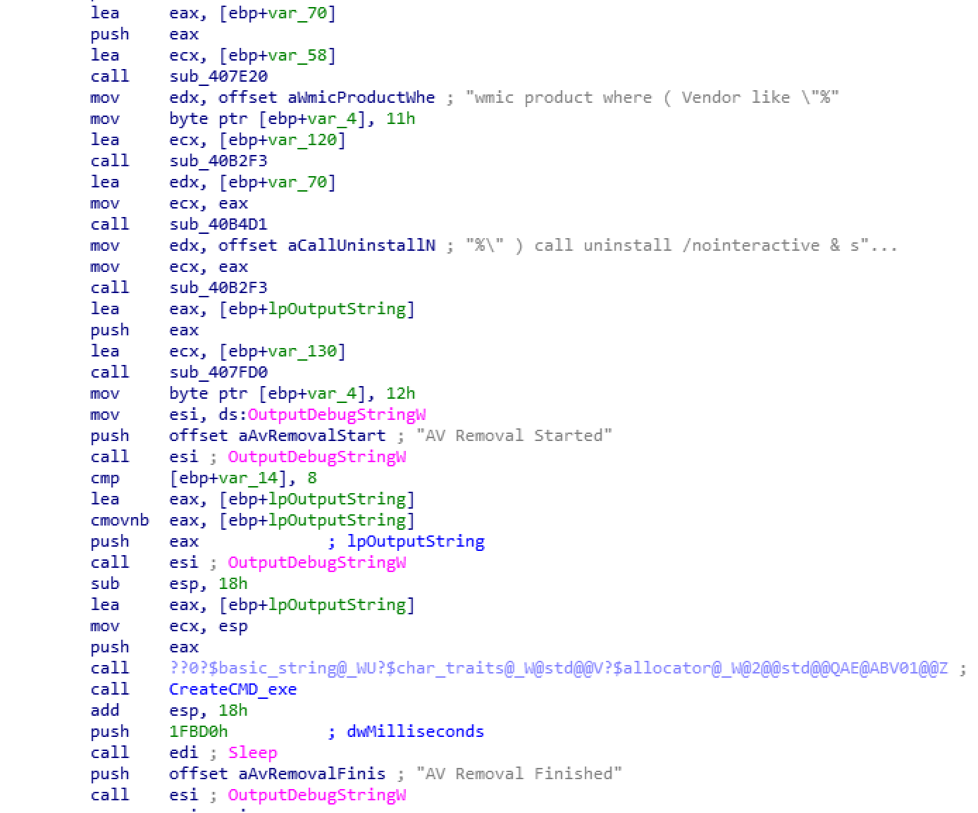
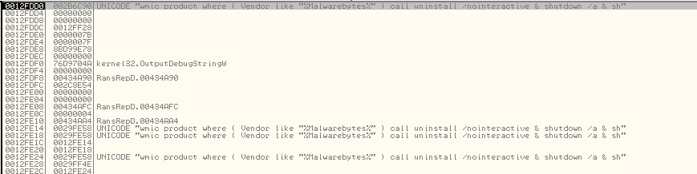
AV Removal
Notes:
Here we see two strings, these strings will be appended to one another and passed into createCMD_exe, which as we can see from the olly screenshot, gives a final result of a command line argument that uninstalls all Malwarebytes related software. Also, notice the debug string AV Removal Started, this is evidence towards this sample being in dev as in finished samples, you would rarely see much if any debug strings.

Slide 18
Service Removal
Notes:
Moving on from AV removal, the ransomware deletes windows services next

Slide 19
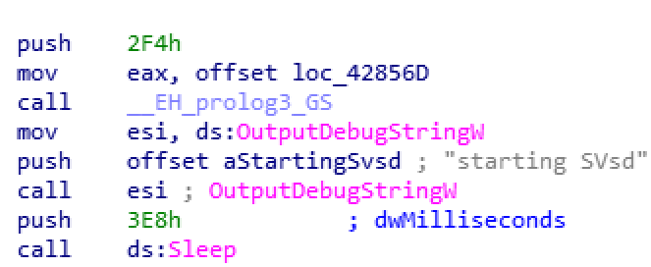
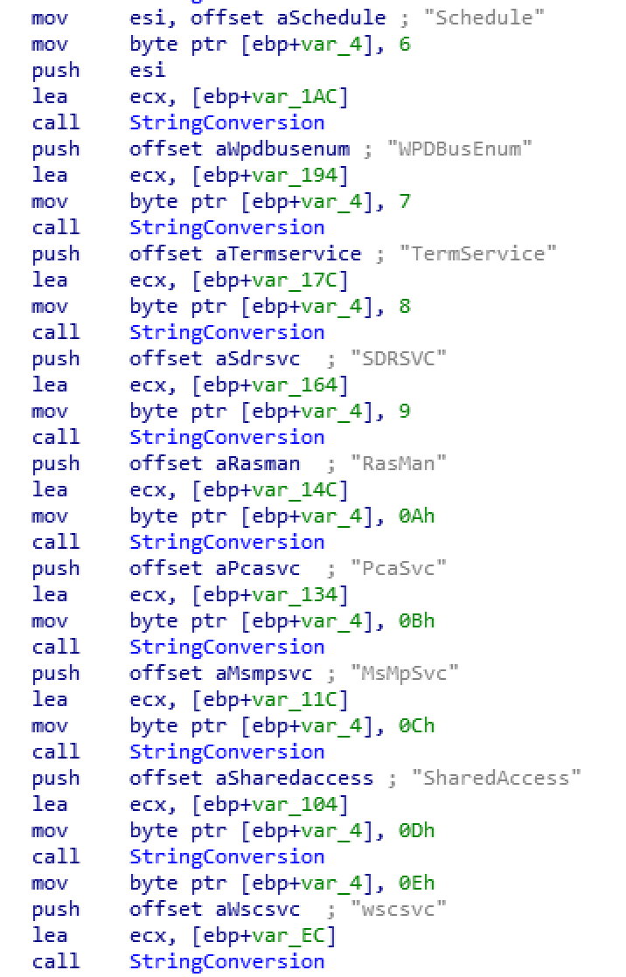
Start
Enumerate Services
Notes:
Here we can see the start of the service deletion routine, followed by a list of different windows services, there are more services in this list, I’ll cover them later. Also notice the debug string once again.

Slide 20
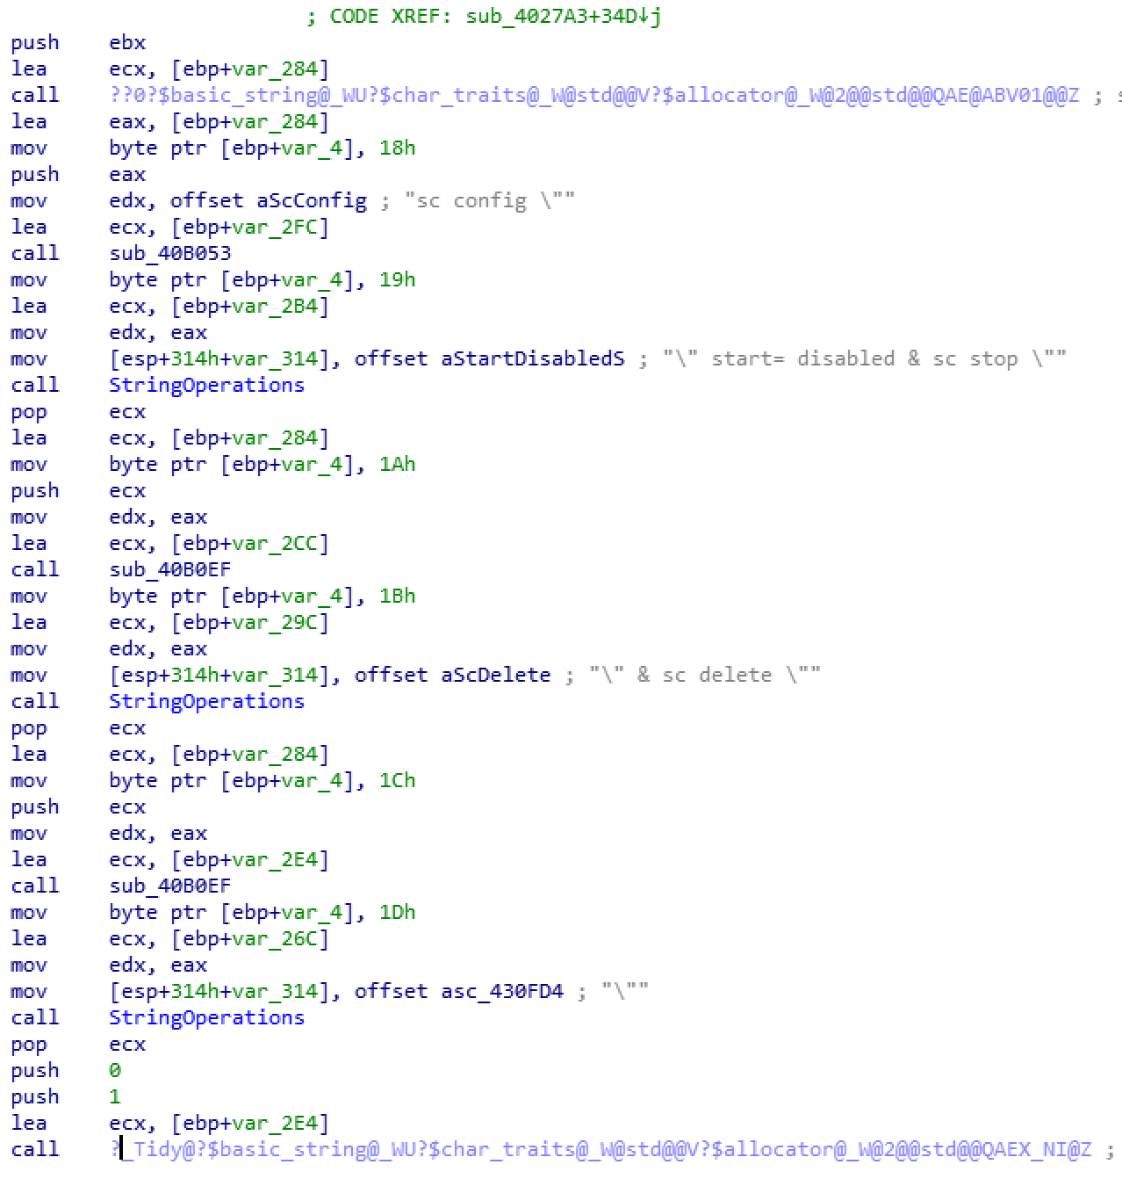
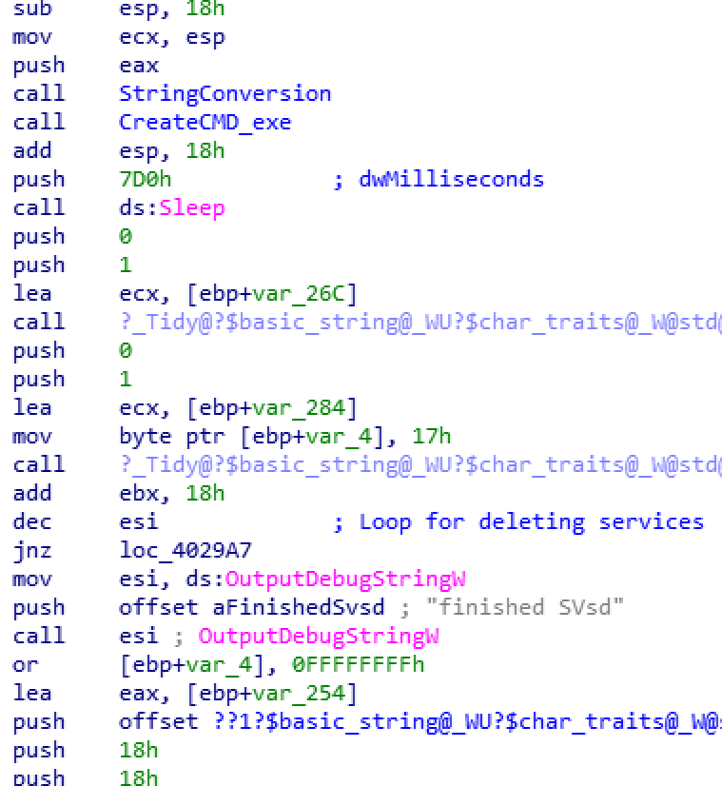
Build String
Delete & Loop
Notes:
Next part of the routine we can see its building the actual command to stop and delete the specified services, these strings are then passed onto the CreateCMD_exe function. Just above the first OutputDebugString call we can see that it decrements esi by one, if esi is 0, it will print finished SVsd, otherwise it will loop back up to where it began building the string and continue doing this until esi is equal to zero, which basically means until it has iterated through and deleted all specified services

Slide 21
Service Removal
Start
Enumerate Services
Build String
Loops until esi counter is depleted (when all specified services are deleted)
Delete & Loop
Notes:
Here is a cleaner layout of the service removal loop shown previously. So it starts, enumerates the services and then enters a loop which will delete each service, this will continues until esi is zero, which means the list has been fully gone through

Slide 22
List of Services Removed
MBAMService
MBAMSwissArmy
MBAMChameleon
MBAMWebProtection
MBAMFarflt
MBAMProtection
ESProtectionDriver
Schedule
WPDBusEnum
TermService
SDRSVC
RasMan
PcaSvc
MsMpSvc
SharedAccess
Wscsvc
Srservice
VSS
Swprv
WerSvc
MpsSvc
WinDefend
wuauserv
Notes:
This is the full list of services deleted by the ransomware, all the MBAM services are related to Malware bytes, the rest are windows services, it deletes these to evade detection and prevent windows from receiving updates. This will also leave the victim machine vulnerable to further infection.

Slide 23
Other Features Disabled
Windows Smart Screen
Check exe Signatures
Disable Realtime monitoring
Deletes Backup Catalog
Deletes volume snapshots
Notes:
SmartScreen is is a cloud-based anti-phishing and anti-malware component included in Microsoft products, It scans URLs against a whitelist and blacklist to prevent these type of attacks
CheckExeSignatures is used to run all downloads against a list of known bad signatures
Windows’s RealtimeMonitoring uses heuristics to identify malware based on suspicious and malicious activities
Deletes backup files to prevent system restoration
Disabling these features

Slide 24
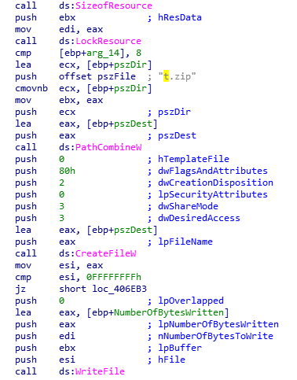
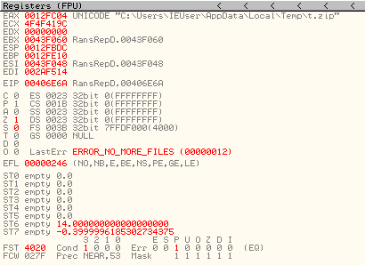
Drops t.zip
Notes:
Here we can see the t.zip file being created, the t.zip you can see above in IDA is appended to the rest of the file path using PathCombine, before being pushed onto the stack and called by CreateFile, which as you can see from the olly window, is located in the Temp folder

Slide 25
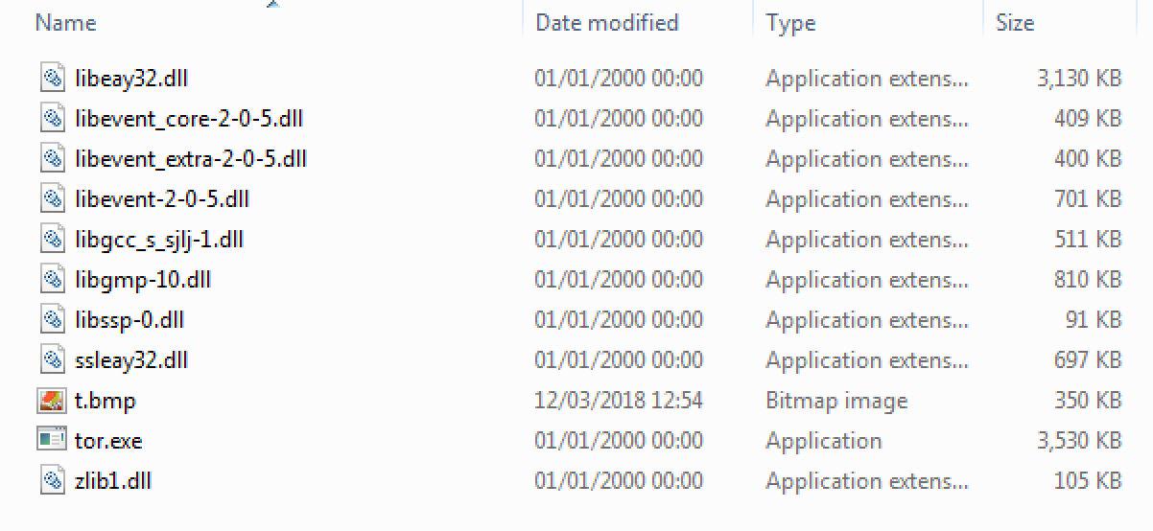
t.zip
Notes:
Here we see the contents of the zip file that was just created, it has tor.exe and dlls related to tor, it also has t.bmp, which is the image that would presumably be set as the background if this was a finished product. There were references to changing the background in the code, although they did not seem to be utilized in its current version. Tor.exe and its associated dlls were also all encrypted, presumably to avoid signature checking, the hashes of these files were as new as the ransomware itself on VT, meaning the authors most likely performed this encryption themselves.

Slide 26
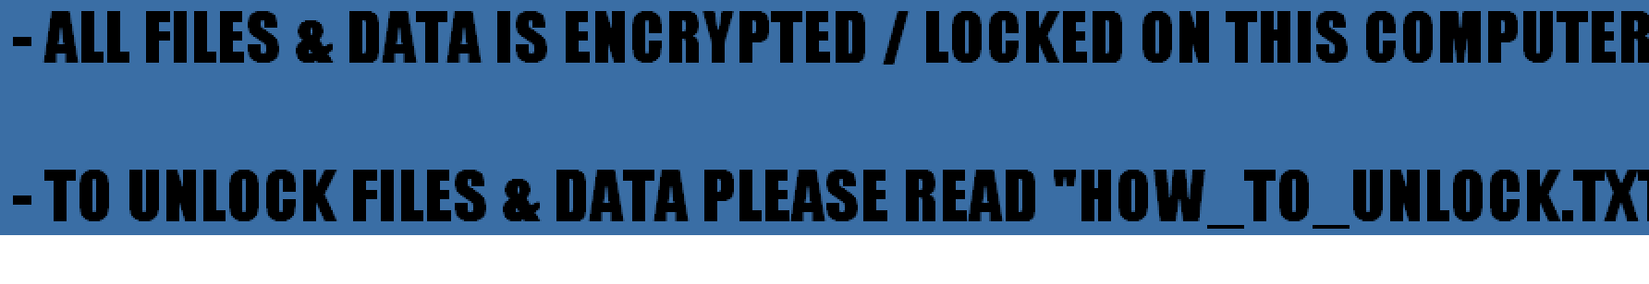
t.bmp
Notes:
This it the t.bmp image that would presumably be the background image in the finished product

Slide 27
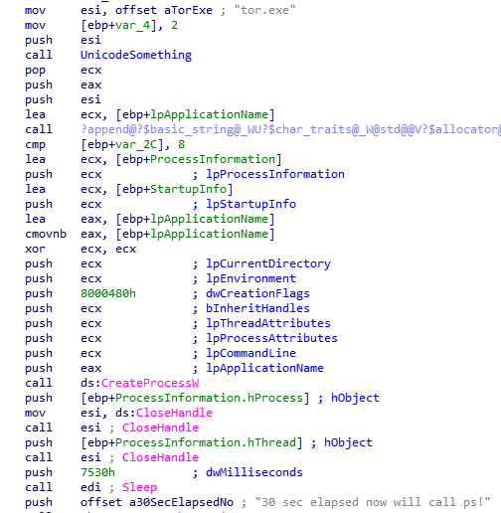
Creates Tor process
Notes:
Once dropped, the ransomware will then attempt to run the tor.exe process, tor is what it will use in order to connect back to its C2 server. After creating the process, it sleeps for 30 seconds before checking to ensure the process was successfully created and is running

Slide 28
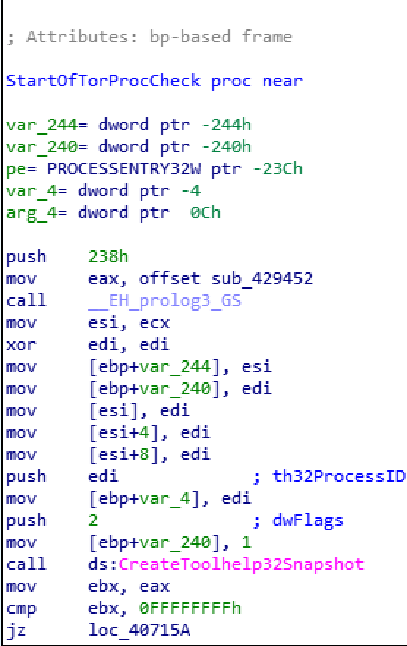
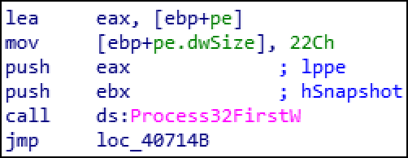
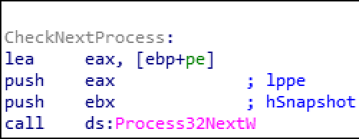
Checks for Tor process
Continues to search processes
Notes:
Here is a standard loop to check for the presence of a process. CreateToolhelp32Snapshot will create a snapshot of all running processes, Process32First will retrieve information about the first process in the snapshot before moving onto Process32Next which is, of course the next process in the snapshot, it will continue to loop through process32next until it has iterated through all processes and determined either the presence or absence of the tor process

Slide 29
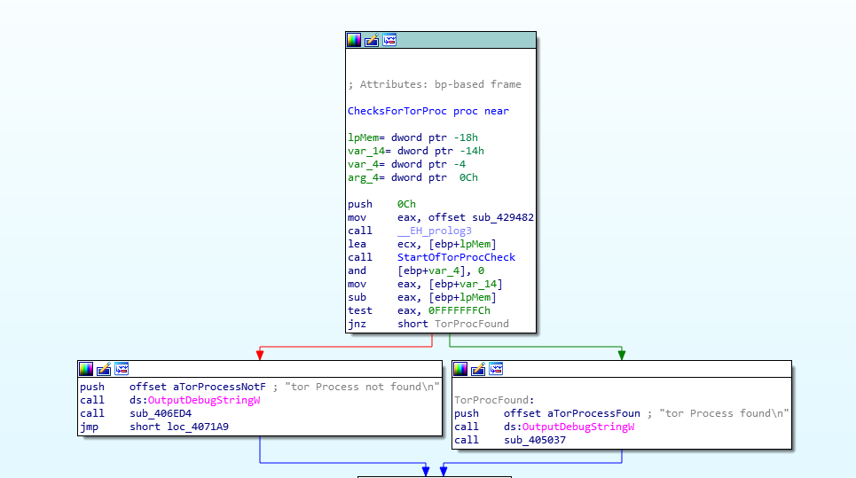
Tor Process Check Overview
Notes:
This is the basic layout of the Tor process check, everything shown in the last slide is contained within the call to StartOfTorProcCheck, it will return from that call and depending on whether tor was successfully run or not, it will take either path which will give an error or success message. These error and success messages yet another indicator that this is in development

Slide 30
Encryption
CryptAcquireContext
CryptCreateHash
CryptHashData
CryptDeriveKey
ReadFile
SetFilePointer
CryptEncrypt
WriteFile
+[filename].[extension]
Notes:
It uses CryptAcquireContextW to find out the Default Cryptographic Provider. AES_256
CryptCreateHash is used for creating an object for hashing. MD5
CryptHashData is used for hashing the Data. In debug strings it syas the key is derived from the users password but there is no evidence of this being utilized further pointing to the fact that this is most likely in dev
CryptDeriveKey is used for Deriving the Key.
ReadFile will read the file to be encrypted
SetFilePointer will set a pointer to the file that is to be encrypted
CryptEncrypt is then finally called to complete the Encryption Process.
And write file will add a + symbol to the beginning of all encrypted files, it will then jump back up to readfile and repeat the process.

Slide 31
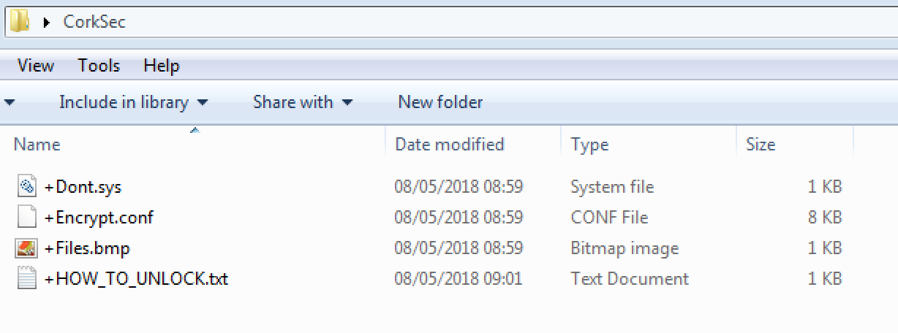
Encrypted Files
Notes:
Here’s what it looks like post-execution, you can see a +has been added to the beginning of the encrypted files, there was also a HOW_TO_UNLOCK.txt file which contains the ransomnote we saw earlier.

Slide 32
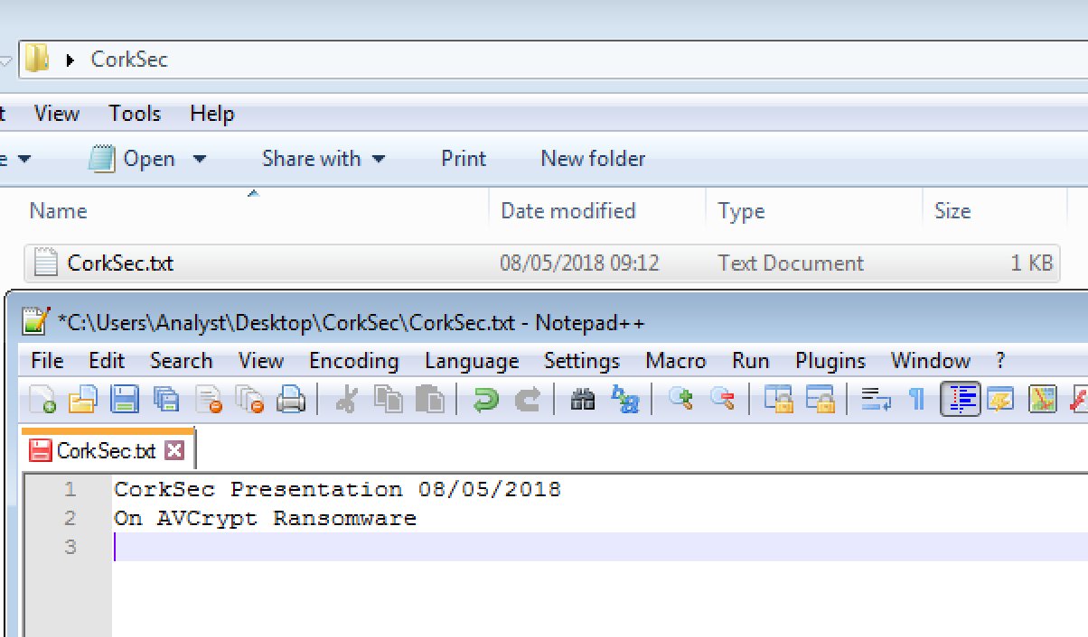
Encrypted Files
Notes:
Here another example to show the contents of a .txt before and after encryption, here we can see the contents of the file clearly

Slide 33
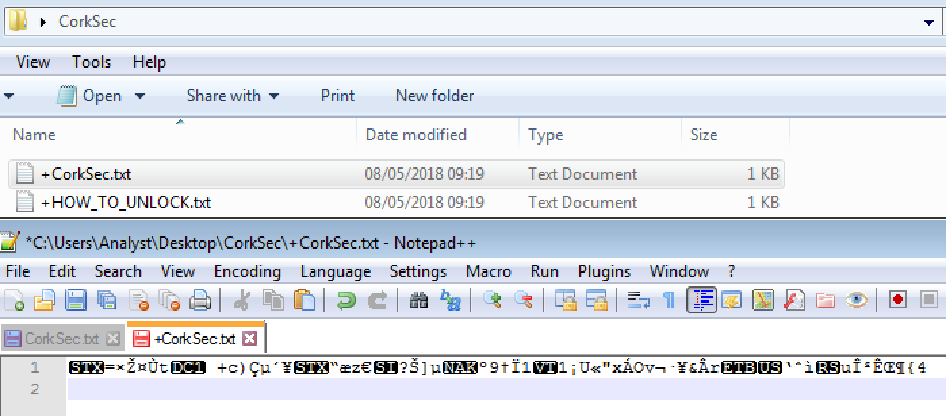
Encrypted Files
Notes:
And here is post-execution, where we can see the ransom note created, and the contents are unreadable.

Slide 34
Indicators Of Compromise (IOC’s)
Hashes:
SHA256: a64dd2f21a42713131f555bea9d0a76918342d696ef6731608a9dbc57b79b32f
SHA256: 58c7c883785ad27434ca8c9fc20b02885c9c24e884d7f6f1c0cc2908a3e111f2
SHA256: ecc12fb24c964d174a1bcbcd0b6ab5d698d342d4a79dee4d72c4033d01a88e33
SHA256: 4a133dab4be4fb71f933a0164979a2e57be5dd4c54bcada70df50c069bf98253
C2:
bxp44w3qwwrmuupc[.]onion
Files:
C:/Users/HOW_TO_UNLOCK.txt (seen in all other encrypted folders also)
C:/Users/bmp part.bmp
%TEMP%/t.zip
+ symbol added to beginning of most files
Mutex:
.$

Slide 35
File Types Encrypted
.exe
.sam
.dll
.sys
.vdx
.vxd
.com
.msi
.scr
.cpl
.bat
.cmd
.lnk
.url
.ini
.chm
.manifest
.inf
.trmp
.ttf
.png
.ico
.gif
.mp3
.wav
.avi
.theme
.evtx
.folder
.kdmp
.dmp
.wim
.cab
.mkv
.flv
35 Different file types encrypted
Notes:
These are the different file types the ransomware encrypts, a total of 35 different file types. This is a very low number of file types for ransomware, providing further evidence that this is in fact still an in dev sample, considering cerber ransomware encrypts several hundred different file types and locky encrypts about 200.
Another major flag that this is in dev is the fact that it doesn’t encrypt any zip files or docx files, which would be a huge target for finished ransomware.

Slide 36
YARA Rules
YARA is the name of a tool primarily used in malware research and detection.
It provides a rule-based approach to create descriptions of malware families
Based on textual or binary patterns.
Notes:
Moving on from the flow of execution, we’ll move onto rule creation used to detect new variants of this ransomware, we’ll use YARA rules for this.YARA rules are a good way to try and class different strains of malware. When writing YARA rules, you want the rule to be precise enough that it won’t trigger any false-positives, but also vague enough so that it will hit on variants of the original sample you used to create the rule

Slide 37
import "pe"
import "hash"
import "math"
rule Mal_Ransom_Win32_AVCrypt
{
meta:
description = "Detects W32 AVCrypt Ransomware"
date = "2018-04-04"
classification = "Malware"
subclass = "Ransom"
created_from_sha256 = "a64dd2f21a42713131f555bea9d0a76918342d696ef6731608a9dbc57b79b32f"
strings:
$f0 = "PShp.C" fullword ascii
$f1 = "not_a_socket" fullword ascii
$f2 = "taskkill" fullword ascii
$f3 = "ping -n 3 127.0.0.1 > nul" fullword ascii
$f4 = "bxp44w3qwwrmuupc.onion" fullword ascii
$f5 = "mach 2" fullword ascii
$f6 = "mach 1" fullword ascii
$f7= "AV Removal Started" fullword wide
$f8 = "AV Removal Finished" fullword wide
$f9 = "starting up LOL resrem_ 1" fullword wide
Notes:
This is the beginning of the rule, theres some meta data to describe what the rule detects, as well as the sha256 of the file that was used to create the rule.
Below are some text strings, these are strings that must be present in the sample in order for it to trigger the rule. The first few strings aren’t the most unique indicators, but they still will help identify the sample. The ping string is sometimes used in place of the sleep function in order to pause the flow of execution temporarily. However, all the strings after this are all very good indicators. The URL being the strongest, as this would be unique to the author of the malware, so the chances of it appearing in different samples is minimal. All the strings after this were all debug messages within the sample, meaning they are also much more likely to be unique to this specific sample

Slide 38
condition:
// Must be MZ file
uint16(0) == 0x5a4d and
// Must be less than
filesize < 3000KB and
// Must be x86
pe.machine == pe.MACHINE_I386 and
// Must have exactly 4 sections
pe.number_of_sections == 4 and
// ".text" section is the first section
pe.sections[0].name == ".text" and
// ".rdata" section is the second section
pe.sections[1].name == ".rdata" and
// ".data" section is the third section
pe.sections[2].name == ".data" and
// For loop which does an entropy Check on the .rsrc section of 7.5 or greater
for any i in (0..pe.number_of_sections - 1): (
math.entropy(pe.sections[i].raw_data_offset, pe.sections[i].raw_data_size) >= 7.5 and
pe.sections[i].name == ".rsrc" ) and
Notes:
Here are some other conditions relating to the structure of the file. The file must have an MZ header, basically meaning it must be an executable file. The file must be less than 3000 kilobytes, must run on x86 architecture. The file must have 4 sections, .text, .rdata, .data and .rsrc, in that order. And the .rsrc section must have an entropy of 7.5 or greater.

Slide 39
// PE Entry Point is in the first section
pe.sections[pe.section_index(pe.entry_point)].virtual_address==0x00001000 and
// Section Permissions
pe.sections[pe.section_index(".data")].characteristics&pe.SECTION_MEM_WRITE and
// Check for imports used to load the resource
pe.imports("WININET.dll", "InternetCheckConnectionW") and
pe.imports("WS2_32.dll", "socket") and
pe.imports("WS2_32.dll", "connect") and
pe.imports("WS2_32.dll", "send") and
// Must have Strings
9 of ($f*)
}
Notes:
The entry point of the file must be in the first section, and the .data section must have write permissions.
It must also have the imports listed. 9 of dollar f start basically means the file the rule is run against must contain 9 of the 10 strings specified earlier

Slide 40
VirusTotal: Retrohunt
Scan all files on VirusTotal against your YARA rule
Returns list of hashes that match the rule you made
Check classifications of these hashes to determine accuracy of your rule
Notes:
Using retrohunt on virus total we can run our rule on all files on VT and see how many matches we get. When the scan is finished, we are able to download a list of the hashes, we can search these hashes and check their classifications to determine the accuracy of our rule.

Slide 41
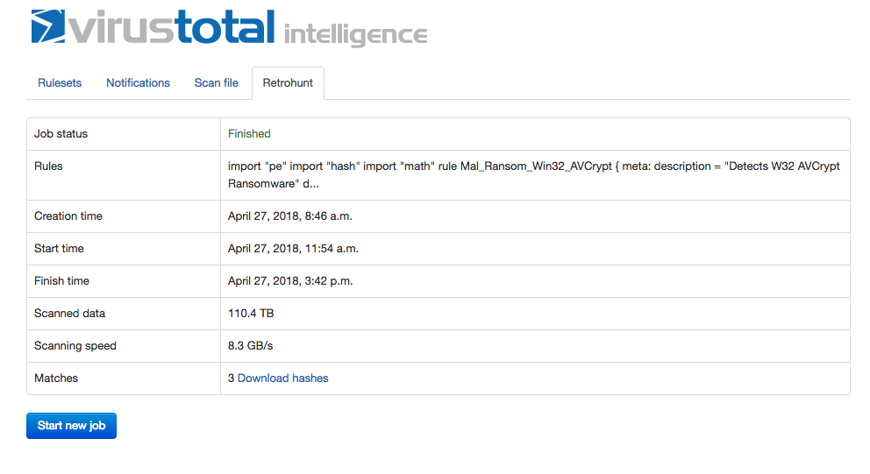
VirusTotal: Retrohunt
Notes:
Here are the results from our retro hunt, you can see the beginning of the rule in the rules row, we can also see that is scanned through 110 terabytes of data and hit on 3 different files.

Slide 42
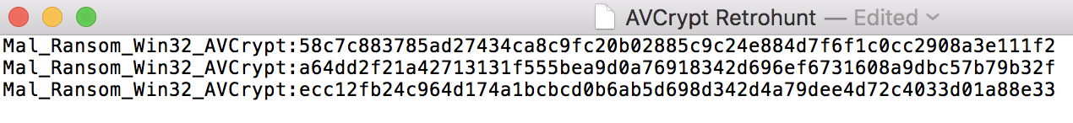
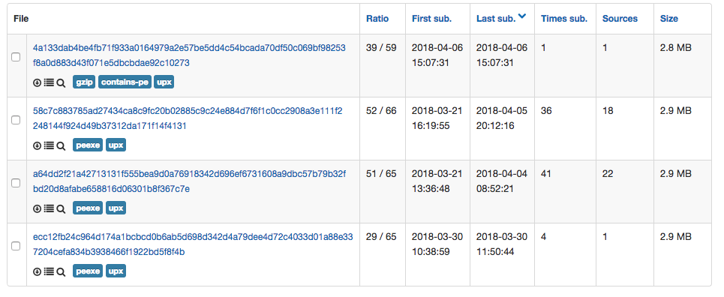
VirusTotal: Retrohunt
Notes:
Comparing the 3 SHAs we got from our retrohunt, we can see that they match 3 of the four files currently detected as AVCrypt on or Pactelung on virus total. It doesn’t hit on the top file because it is gzip compressed, which would obfuscate all the strings and hide the sections from the YARA rule. I’ve gotten no more hits on this rule since the 27th of April, I’ve also been checking virus total by just searching the classification to see if there have been any samples found that the rule didn’t hit on, but there has been none yet.

Slide 43
Questions?
Notes:
These are the different file types the ransomware encrypts, a total of 35 different file types

