Slide 1
6 Basic Questions
What
Who
Why
When
Where
How

Slide 2
LETS GEAR UP AND DISSECT A MALWARE
A Basic MALWARE ANALYSIS PRESENTATION

Slide 3
Who am I?
This one is known as “Dhina”
Gets a weird satisfaction when he breaks things and he gets to know how those things work
Cyber defense enthusiast, currently a software tester

Slide 4

What is a malware?
Any piece of code that is designed to penetrate or harm computers or to track user activity without consent.
Malicious + Software -> Malware
Otherwise known as payload
Viruses and worms (The Contagious bois)
Trojans and Rootkits (The Traitors)
Spyware and keyloggers (The Spies)
Adware(the little tortures)
Lockers and miners (The modern bad bois)
File-less malware (Injected bad bois or Memory residing a-holes)

Slide 5

What is malware analysis?
Malware analysis is the study or process of determining the functionality, origin and potential impact of a given malware sample
Why to do it?
What that bad boi can do
How to detect and stop the nasty little boi
How to measure and contain the bois damage.
Where to do it?
Dump the boi into an isolated environment which tricks him that he is all powerful – Basically setup a sand box and analyze

Slide 6
Basic analysis strategy
Find the boi
Stare at that boi (Static analysis)
Check out where, how and who the boi talks to(Network analysis)
Run the boi and watch (Dynamic or behavioural analysis)
Finger print the boi
Setup Sandbox
Stalk the boi (Internet search)
Stalk again with collected data (Internet search)

Slide 7
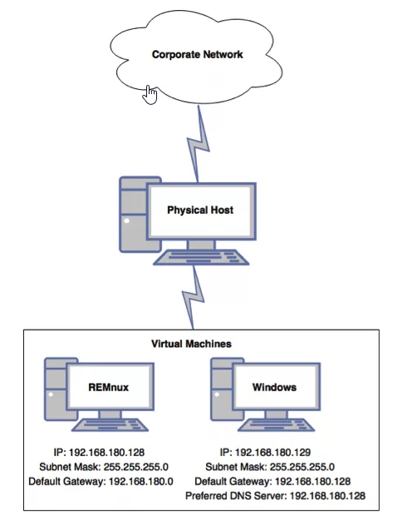
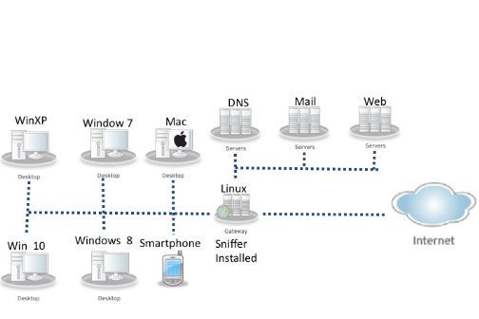
Setting up a sandbox
Simple lab setup
Complex or professional lab set up

Slide 8
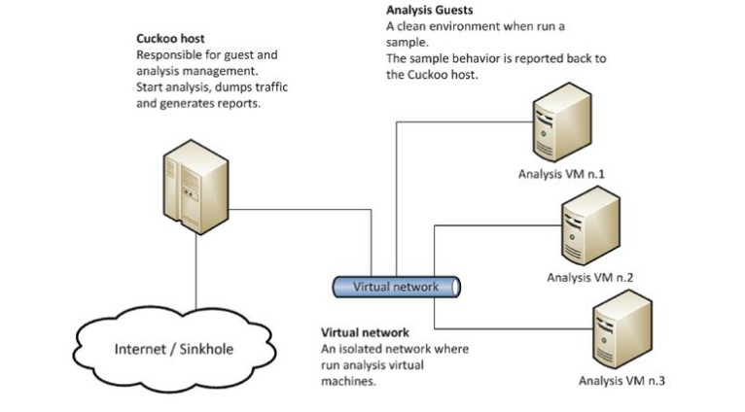
Cuckoos sandbox

Slide 9
Automated sandboxes
AMAaaS (Android files)
Any.run (Community Edition)
Binary Guard True Bare Metal
Intezer Analyze (Community Edition)
Comodo Valkyrie
Detux Sandbox (Linux binaries)
Joe Sandbox Cloud (Community Edition)
Malwr (down at the moment)
sandbox.pikker.ee
SecondWrite (free version)
Hybrid Analysis
ThreatTrack
ViCheck

Slide 10
How to make the boi feel all powerful?
Isolate the host from guest by disabling drag and drop, shared folders and bi-directional copy functionalities.
Set show hidden files and folders and unhide all the extensions of the file.
Disable notification by reducing the user access lever to minimum.
Disable Zone checking in internet explorer to allow communication of malware freely.
Disable Automatic updates and windows firewall
Disable Antivirus system (Windows defender Realtime protection).
Network isolation: Create a new network adapter in VMware and set it to host- only. Connect both windows and REMNUX to the newly created network and Provide static IP in IPV4 settings of windows machine and use the IP of REMNUX as Gateway and DNS.

Slide 11

The lazy persons option
Flare VM

Slide 12
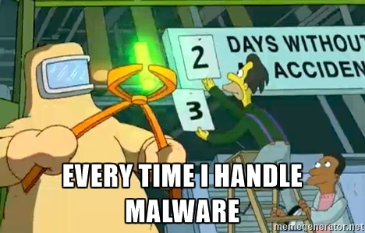
The commandments
Note down every step and every result from here on.
Confirm whether the network is isolated.
Hand pick the tools based on the preference and malware type
Take snapshot of VM.
Make multiple copies of the guest machine and save it in
Search and download malware only inside virtual machine
Unzip it only after network isolation

Slide 13
Picking up the malware and fingerprinting it
Find the repository of malware to analyse
https://www.megabeets.net/fantastic-malware-and-where-to-find-them/
My personal fav : MalekalDB
Hash the sample – useful for internet search

Slide 14
Internet search and static analysis
Use the hash in virus total and other automated sandbox to find the existing data on the malware then continue with static analysis.
Begin static analysis
Find whether the code is packed or obfuscated – CFF Explorer / PeID
If obfuscated->deobfuscate – CFF explorer
Do string search – Strings.exe
Use dependency walker to find the dlls used. – CFF Explorer/PeStudio
Analyse the code using disassembler or debugger -> Pretty advanced stuff though -> IDA pro, OllyDBG, WinDBG etc

Slide 15
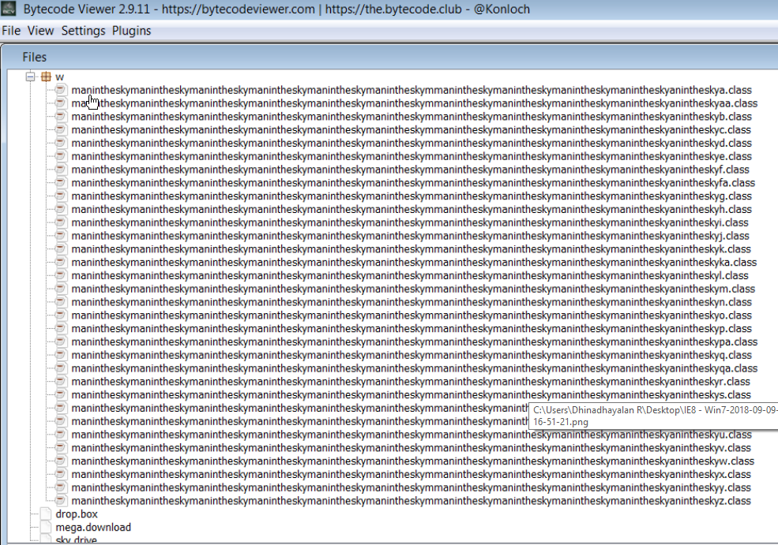
How to make the life tough for analyst

Slide 16
How to make the life tough for analyst 2
Anti VM code
Anti Debugger code
Disassemble to analyse this little pest

Slide 17
Dynamic analysis
Start the following software:
Regshot
Procmon
process explorer
Execute the malware
Use process explorer to view the current running processes and get real time memory data from the
Use procmon to capture the events and
Use regshot to capture the changes in the system by taking snapshots before and after execution

Slide 18
Network analysis and internet search again
Start fake DNS and nginx, fakemail.py, ircd.
Capture the packets using wire shark in REMNUX and use the PCAP for further analysis.
Lazyguys go to– Analyse using Packet total, Inetsim

Slide 19
Whats after this?
Restore the previous snap shot, begin reverse engineering the malware using IDA Pro, WinDBG, OllyDBG.
Start profiling using YARA.
If The machine crashed use the vmem file generated to do the memory analysis
Perform OSINT using Maltego to understand the network
This is the hardest part, when there is a anti debugging mechanism, where the analyst has to look into the assembly code and disassemble it.
Then plan the incidence response plan according to malware and update the signatures in IDS and IPS to prevent future attacks

Slide 20


